Slide 1
Course Management E222
Geoffrey C. Fox

Slide 2
Overall remarks
We will use Github for all artifacts – it’s better than Canvas – but non-software Homework and Grading reported on Canvas
Github will be open and collaborative
Proviso: Cloud technology in E222 will be taken to be Docker and Kubernetes.
Advanced courses have more complex technology but maybe Docker will end up as dominant commercially

Slide 3
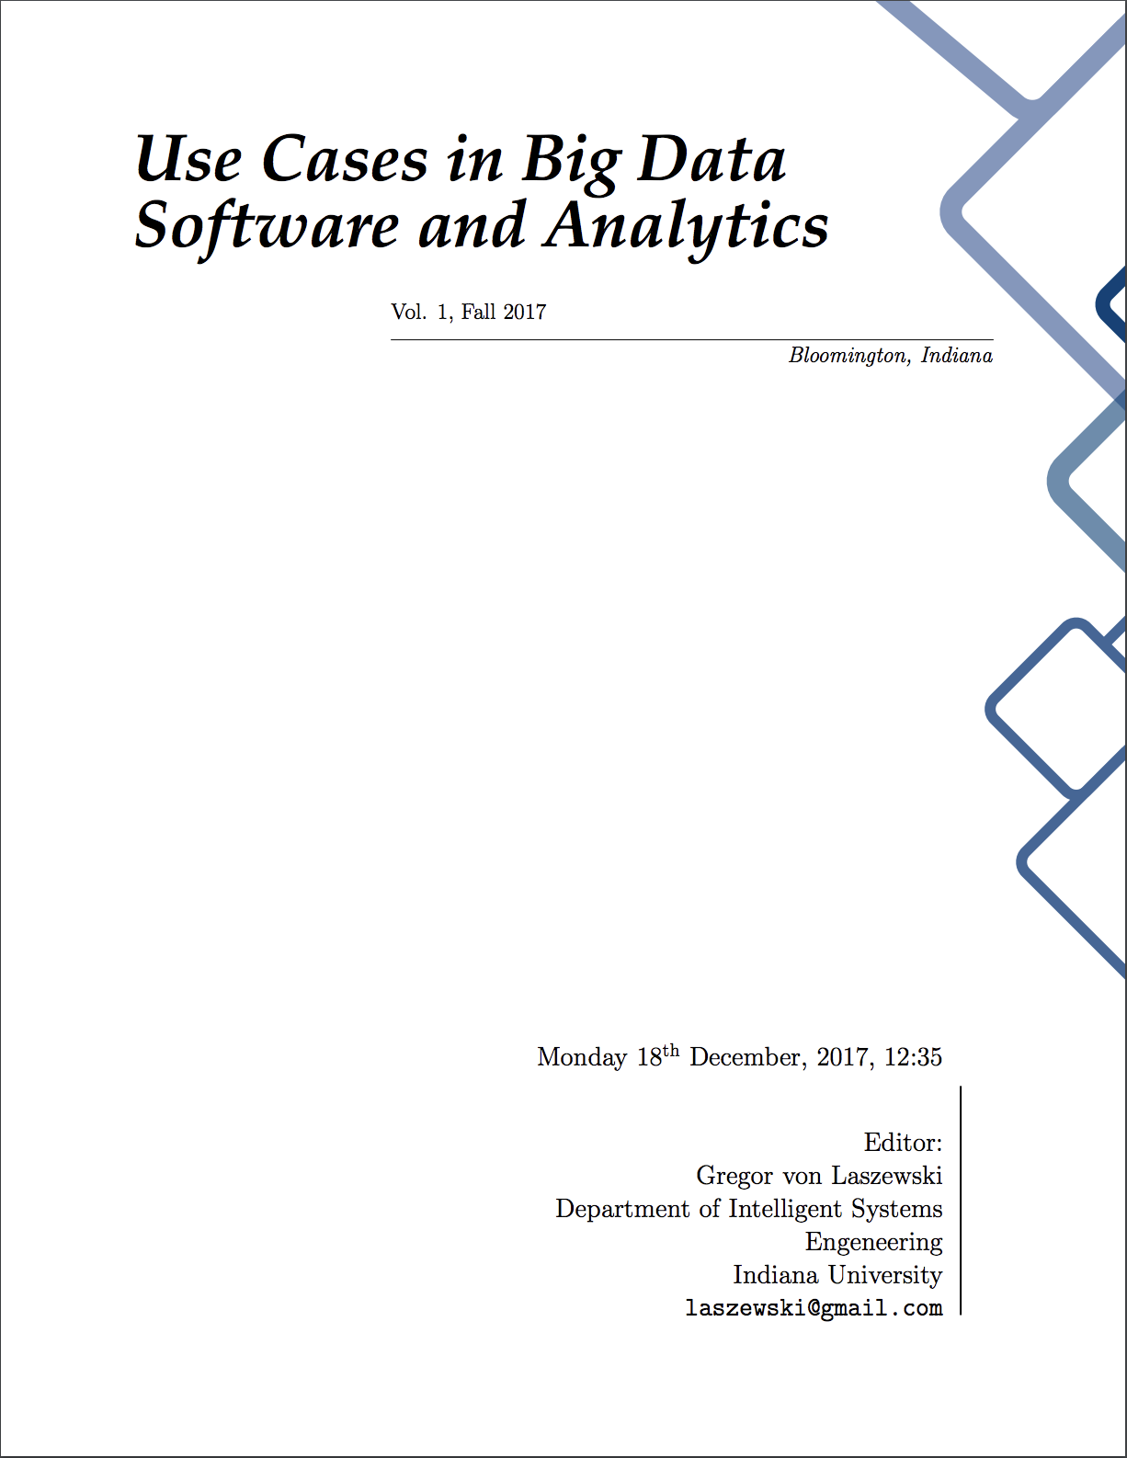
Class Material Dissemination
Handbook and volumes will be updated
1 Handbook + 6 Volumes with student contributions
The Handbook is the first one in a series of documents that are providing a comprehensive overview of Clouds, Big Data, and their technologies and applications. Material from these volumes are used selectively as part of this class.
You can view on
(Cell phone) / tablet / laptop / desktop
Handbook has currently more than 700 pages from which we have released ~500.

Slide 4
Additional Bibliography
Web
Book
Use clever google searches
Cloud Computing for Science and Engineering By Ian Foster and Dennis B. Gannon
https://mitpress.mit.edu/books/cloud-computing-science-and-engineering
Gartner
Access leading Industry analysis like hypecycles
We will tell you how to access

Slide 5
Links to the Reference Material
Handbook
Handbook of Clouds and Big Data, Gregor von Laszewski, Geoffrey C. Fox, and Judy Qiu, Fall 2017, https://tinyurl.com/cloudmesh/vonLaszewski-bigdata.pdf or https://tinyurl.com/vonLaszewski-handbook-pdf
Volumes:
Use Cases in Big Data Software and Analytics Vol. 1, Gregor von Laszewski, Fall 2017, https://tinyurl.com/cloudmesh/vonLaszewski-i523-v1.pdf
Use Cases in Big Data Software and Analytics Vol. 2, Gregor von Laszewski, Fall 2017, https://tinyurl.com/cloudmesh/vonLaszewski-i523-v2.pdf
Use Cases in Big Data Software and Analytics Vol. 3, Gregor von Laszewski, Fall 2017, https://tinyurl.com/cloudmesh/vonLaszewski-i523-v3.pdf
Additional Drafts – useful but not yet finalized:
Big Data Software Vol 1., Gregor von Laszewski, Spring 2017, https://github.com/cloudmesh/sp17-i524/blob/master/paper1/proceedings.pdf
Big Data Software Vol 2., Gregor von Laszewski, Spring 2017, https://github.com/cloudmesh/sp17-i524/blob/master/paper2/proceedings.pdf
Big Data Projects, Gregor von Laszewski, Spring 2017, https://github.com/cloudmesh/sp17-i524/blob/master/project/projects.pdf
Initially this talk at http://dsc.soic.indiana.edu/presentations/E222-Course-Management.pptx
Introduction to Cloud computing at http://dsc.soic.indiana.edu/presentations/E222-516-2018-CloudIntro.pptx

Slide 6
Contributors
Anyone can contribute
We invite you to contribute a chapter or improve an existing chapter
Get in contact with Gregor von Laszewski, laszewski@gmail.com
Handbook is hosted on git
https://github.com/cloudmesh/book/
Use the e222 branch for this class
We have a long list of contributors, that you can look up in the Handbook, or the volumes.
Note Github manages software, documentation and videos
Lectures are given conventionally but video recordings will be made available
All links in handbook

Slide 7
Conventions
Navigation
Extensive Table of Content
Index
Hyperlinks are embedded
Documents
Videos
Slides
Web Pages
Citations
Index
Boxes indicate
Notes
Warnings
Specific IU topics
Exercises are Marked
Do only the Exercises for your section
You are welcome to do others, but will not get credit for it. However your experience grows.
Some exercises take weeks not minutes
We recommend to not print as content will change. These are our lecture notes.

Slide 8
Topics covered
Handbook
Volumes
Class Management
Collaboration
Scientific Writing
Development Tools
Python
Cloud Technologies
Links to Theory Videos
Examples
Applications
Technologies
You are invited to contribute: spelling, grammar, chapter, section, drawings, images
See also the TODO list upfront, its not just for the TA’s

Slide 9
Syllabus E222
Sample Selected Topics
Outcomes
Introduction to REST: Theory and Practice - develop a REST service
Introduction to Clouds: Theory and Practice - create via a program virtual machines and start on them the REST service
Introduction to Kubernetes: Theory and Practice - create a container that runs a REST service
Introduction to Advanced AI: Integrate your AI engine into a REST service and run on a cloud and in Kubernetes
Introduction to Hadoop: Theory and Practice - Run Hadoop in a container; run hadoop on a futuresystems cluster
Edge Computing: Theory and Practice - Integrate Sensor data into Cloud Services via REST and MQTT
Return to Machine Learning: review E221 and move on
Do a project: Machine Learning on a cloud
Have an elementary understanding of issues involved in Cloud Computing as part of the intelligent systems effort.
Gain hands-on laboratory experience with several examples.
Apply knowledge of mathematics, science, and engineering
Understand research challenges and important issues with Software Defined Systems.
Have advanced skills in teamwork with peers.
Have theoretical and practical knowledge about REST, Clouds, Containers, Machine Learning and Edge Computing.

Slide 10
Parallel Tracks
Communication
Piazza
Write a paper
“Theory” i.e. Basic material
Learn about Cloud and Big Data, machine learning algorithms, applications as applied to Intelligent Systems Engineering
Programming
Python

Slide 11
MOST IMPORTANT POLICIES
Think
As a student you may be tempted to follow a tutorial or a guide.
We sometimes observe that students simply copy and paste and do not read the content. This could have disastrous consequences!!!
So our simple policy is: READ FIRST, THINK, THINK, DO ONCE or short R2D1
Backup
Before installing things on your computer backup

Slide 12
Policies
General
Self Reporting
Mind the University calendar
Piazza not CANVAS
Use class material and read it
HID = Homework Identifier, TA’s will assign this so you do not use the IU ID with us
Office hours with TA’s will be announced
Use a notebook.md as discussed in the handbook to self report weekly what you have done in bullet form
Plagiarism
We follow University procedures
See Handbook

Slide 13
Assignments
Will be announced
Focus on Containers
Learn Basics of Containers
Learn Containers in the Cloud
Learn AI
Integrate AI onto cloud services
All will be done while focusing on Containers
Assignments will be given and may take 1, 2, or 3 weeks to implement.
In contrast to E516, 616, this class final project will be much smaller in scope and details will be added to the Handbook

Slide 14
Grading
Proposed:
Comments
Assignments and exams will be 60%
Project will be 30%
Participation will be 10%
The Handbook may have still some different information, but it will be updated once we finalize.
This class will have no exams, but you are expected to deliver the assignments, projects in the highest possible quality.
There are assignment deliverables for midterm and final periods

Slide 15
Piazza vs. CANVAS
Superior Communication
Inferior Communication via CANVAS
Encourages students to collaborate
Allows students and instructors to work on single answer
Which than could be integrated in handbook
Encourages individual exchange between student and teacher
It has only messaging
Dependent on which browser you use, messages vanish before you send them
After Piazza is set up for your class, please read the chapter in the Handbook about it.

Slide 16
Making Piazza Work
Students participate: Students must collaboratively work on an answer to a question. Students must not post irrelevant follow ups to a question. If you notice your comment was irrelevant, please delete it. Students must search prior to asking a new question if the question has already been asked. Duplicated questions can be merged.
Instructors guide: The instructor guides the students in order to obtain an answer to a question. In some cases the instructor may be the only one knowing the answer in which case he tries to provide it.
Not using e-mail: Instructors will not and must not use e-mail to communicate with a student. All communication will be done via piazza. There, are only very few situations where e-mail is allowed, ask on piazza first if you should engage in e-mail conversations.

Slide 17
Good Messages on Piazza
Select: instructors
Select: Folder
Subject: HID000 – How do I install xyz
Body:
HID000: Firstname, Lastname
How can I install xyz on my computer that is a chromebook and has 1GB Main memory?
You likely will get a question as an answer and have to provide the answer in your answer section. The comment will help you:
Have you looked at the recommendation in the Handbook about recommended computers/resources.

Slide 18
Assignment Week 1
Post a bio on piazza in the bio folder
(once piazza is activated and you have registered in it)
A survey will be send out later
Please answer all questions

