Slide 1
Panel Session
The Challenges at the Interface of Life Sciences and Cyberinfrastructure and how should we tackle them?
Chris Johnson, Geoffrey Fox, Shantenu Jha, Judy Qiu

Slide 2
Life Sciences & Cyberinfrastructure
Enormous increase in scale of data generation, vast data diversity and complexity - Development, improvement and sustainability of 21st Century tools, databases, algorithms & cyberinfrastructure
Past: 1 PI (Lab/Institute/Consortium) = 1 Problem
Future: Knowledge ecologies and New metrics to assess scientists & outcomes (lab’s capabilities vs. ideas/impact)
Unprecedented opportunities for scientific discovery and solutions to major world problems

Slide 3
Some Statistics
10,000-fold improvement in sequencing vs. 16-fold improvement in computing over Moore Law
- 11% Reproducibility Rate (Amgen) and up to 85% Research Waste (Chalmers)
- 27 +/-9 % of Misidentified Cancer Lines and One of out 3 Proteins Unannotated (Unknown Function)

Slide 4
Opportunities and Challenges
New transformative ways of doing data-enabled/ data-intensive/ data-driven discovery in life sciences.
Identification of research issues/high potential projects to advance the impact of data-enabled life sciences on the pressing needs of the global society.
Challenges to development, improvement, sustainability, reproducibility and criteria to evaluation the success.
Education and Training for next generation data scientists

Slide 5
Largely Data for Life Sciences
How do we move data to computing
Does data have co-located compute resources (cloud?)
Do we want HDFS style data storage
Or is data in a storage system supporting wide area file system shared by nodes of cloud?
Or is data in a database (SciDB or SkyServer)?
Or is data in an object store like OpenStack Swift or S3?
Relative importance of large shared data centers versus instrumental or computer generated individually owned data?
How often is data read (presumably written once!)
  Which data is most important? Raw or processed to some level?
Is there a metadata challenge?
How important is data security and privacy?

Slide 6
Largely Computing for Life Sciences
Relative importance of data analysis and simulation
Do we want Clouds (cost effective and elastic) OR Supercomputers (low latency)?
What is the role of Campus Clusters/resources?
Do we want large cloud budgets in federal grants?
How important is fault tolerance/autonomic computing?
What are special Programming Model issues?
  Software as a Service such as “Blast on demand”
  Is R (cloud R, parallel R) critical
  What about Excel, Matlab
  Is MapReduce important?
  What about Pig Latin?
What about visualization?

Slide 7
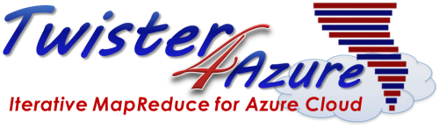

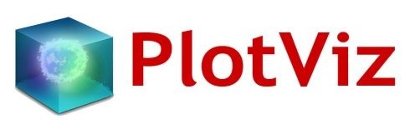






Analysis Tools for
Data Enabled Science
SALSA HPC Group
http://salsahpc.indiana.edu
School of Informatics and Computing
Indiana University

Slide 8
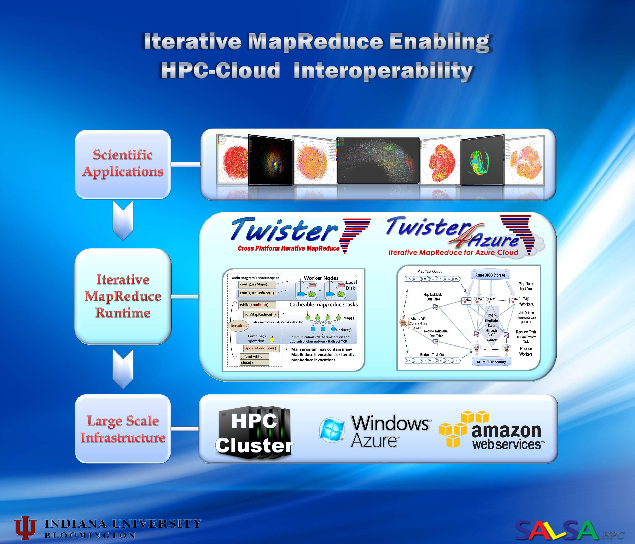

Slide 9
Outline
Iterative Mapreduce Programming Model
Interoperability of HPC and Cloud
Reproducibility of eScience

Slide 10


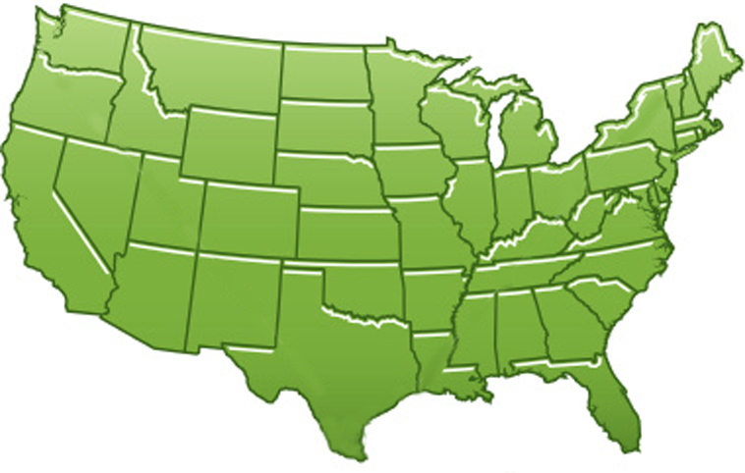















300+ Students learning about Twister & Hadoop
MapReduce technologies, supported by FutureGrid.
July 26-30, 2010 NCSA Summer School Workshop
http://salsahpc.indiana.edu/tutorial
Washington
University
University of
Minnesota
Michigan
State
Johns
Hopkins
Univ.Illinois
at Chicago
Iowa
Penn
State
IBM Almaden
Research Center
Notre
Dame
University of
California at
Los Angeles
Indiana
University
San Diego
Supercomputer
Center
University of
Texas at El Paso
University of
Arkansas
University
of Florida

Slide 11
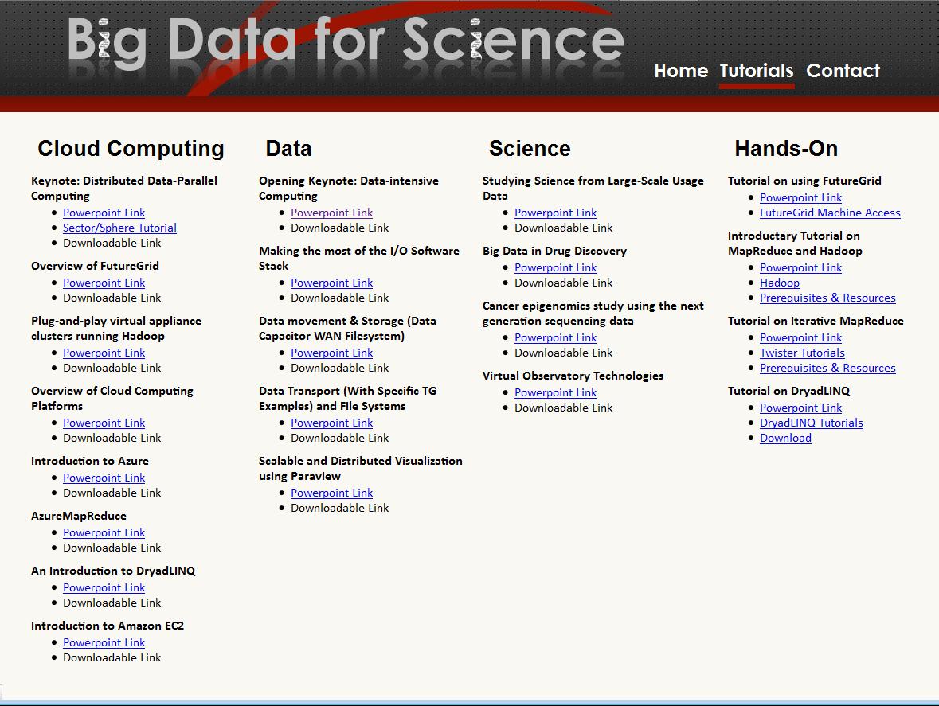

Slide 12
Intel’s Application Stack

Slide 13
(Iterative) MapReduce in Context
Support Scientific Simulations (Data Mining and Data Analysis)
Kernels, Genomics, Proteomics, Information Retrieval, Polar Science, Scientific Simulation Data Analysis and Management, Dissimilarity Computation, Clustering, Multidimensional Scaling, Generative Topological Mapping
Applications
Security, Provenance, Portal
Programming Model
Services and Workflow
High Level Language
Runtime
Cross Platform Iterative MapReduce (Collectives, Fault Tolerance, Scheduling)
Storage
Distributed File Systems
Object Store
Data Parallel File System
Linux HPC
Bare-system
Amazon Cloud
Windows Server HPC
Bare-system
Azure Cloud
Grid Appliance
Infrastructure
Virtualization
Virtualization
Hardware
CPU Nodes
GPU Nodes

Slide 14





Map Reduce
Programming Model
Moving Computation to Data
Scalable
Fault Tolerance
  Simple programming model
  Excellent fault tolerance
  Moving computations to data
  Works very well for data intensive pleasingly parallel applications
  Ideal for data intensive pleasingly parallel applications
Notes:
MapReduce provides a easy to use programming model together with very good fault tolerance and scalability for large scale applications. MapReduce model is proving to be Ideal for data intensive pleasingly parallel applications in commodity hardware and in clouds.

Slide 15
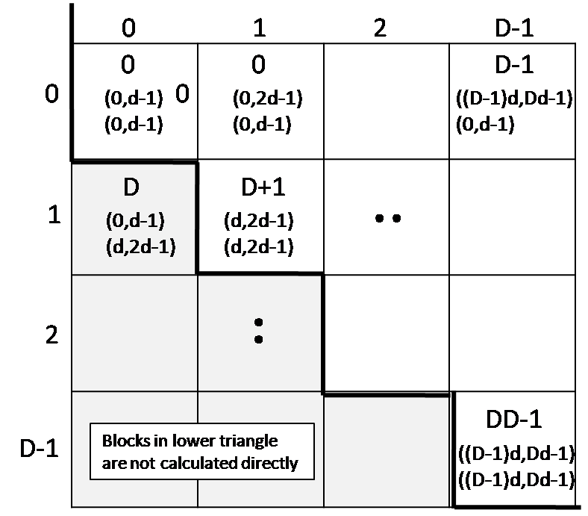
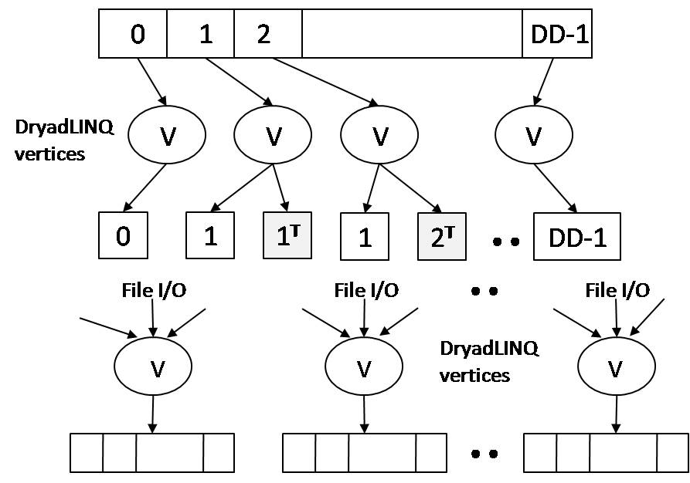
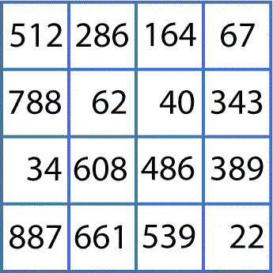
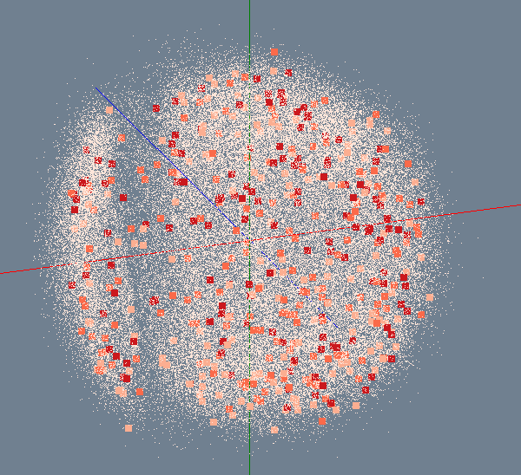

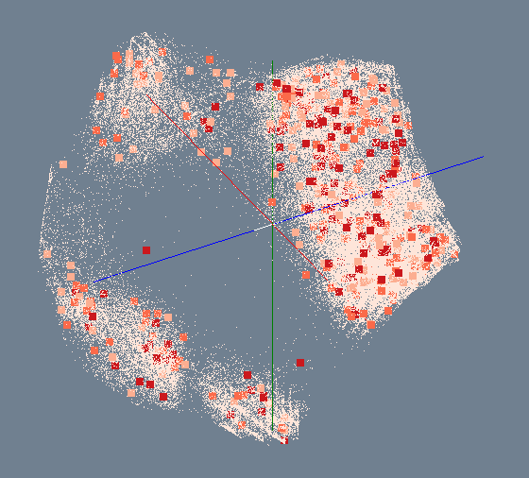

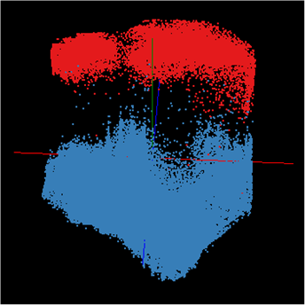
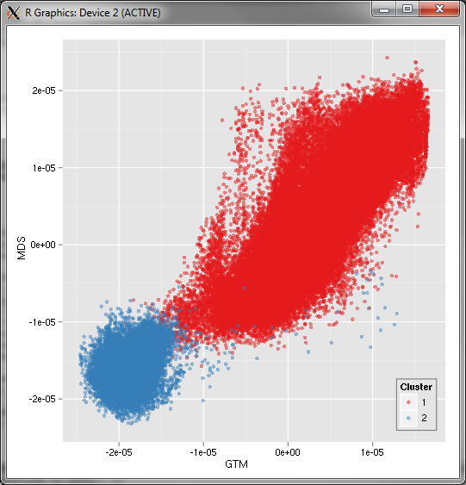
Bioinformatics Pipeline
Gene Sequences (N = 1 Million)
Pairwise Alignment & Distance Calculation
Distance Matrix
Select Reference
Reference Sequence Set (M = 100K)
Reference Coordinates
N - M Sequence Set (900K)
Interpolative MDS with Pairwise Distance Calculation
x, y, z
Multi-Dimensional Scaling (MDS)
O(N²)
N - M Coordinates
x, y, z
Visualization
3D Plot

Slide 16
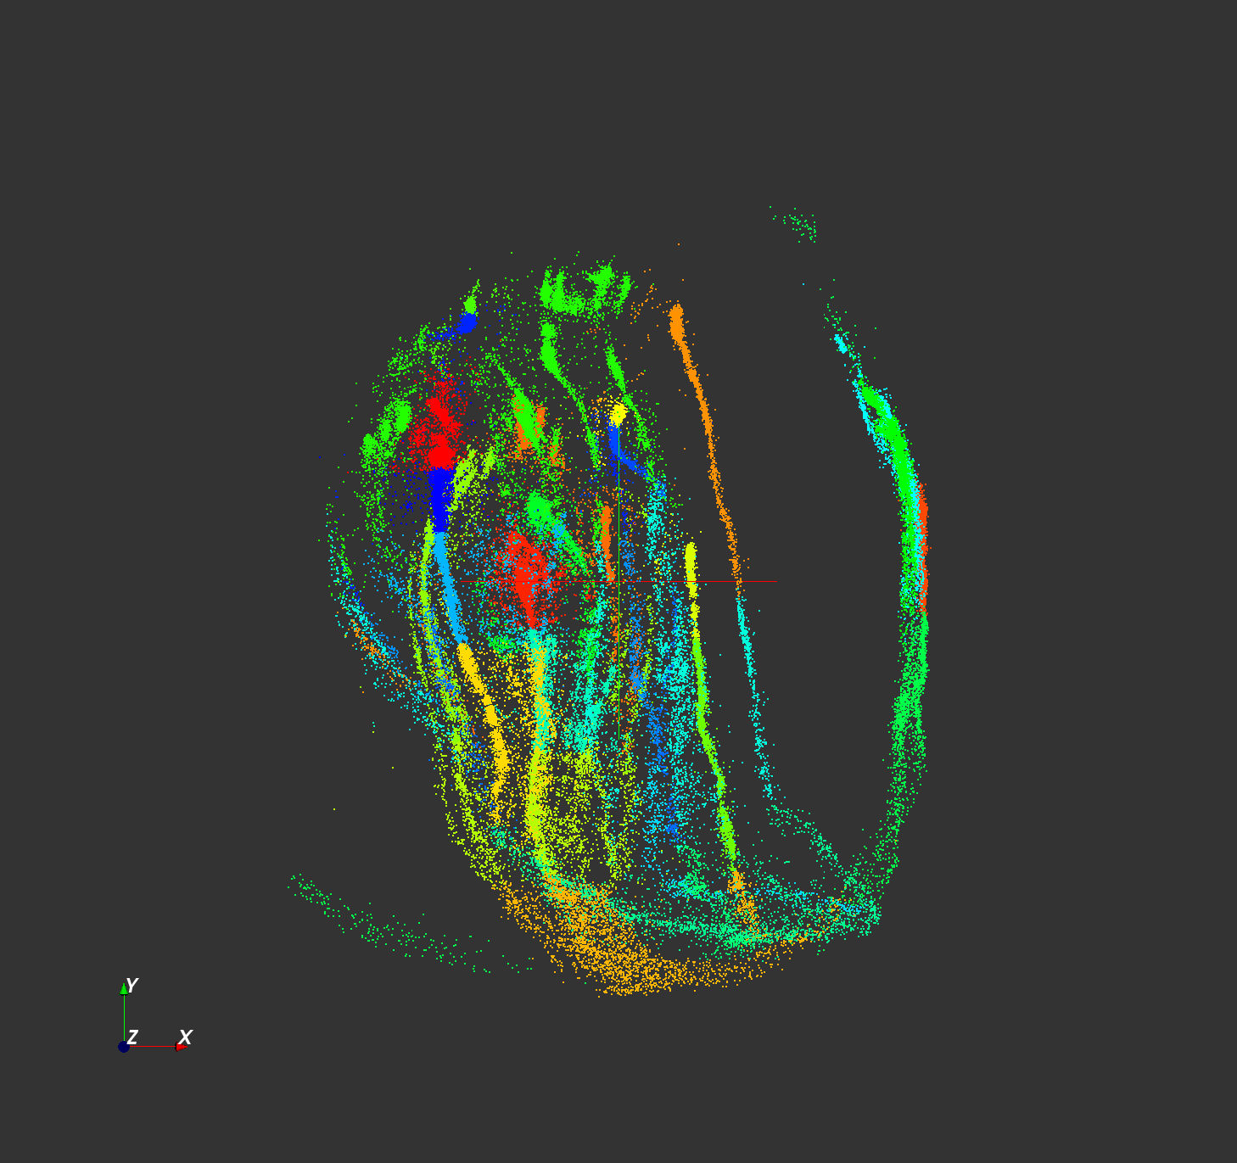
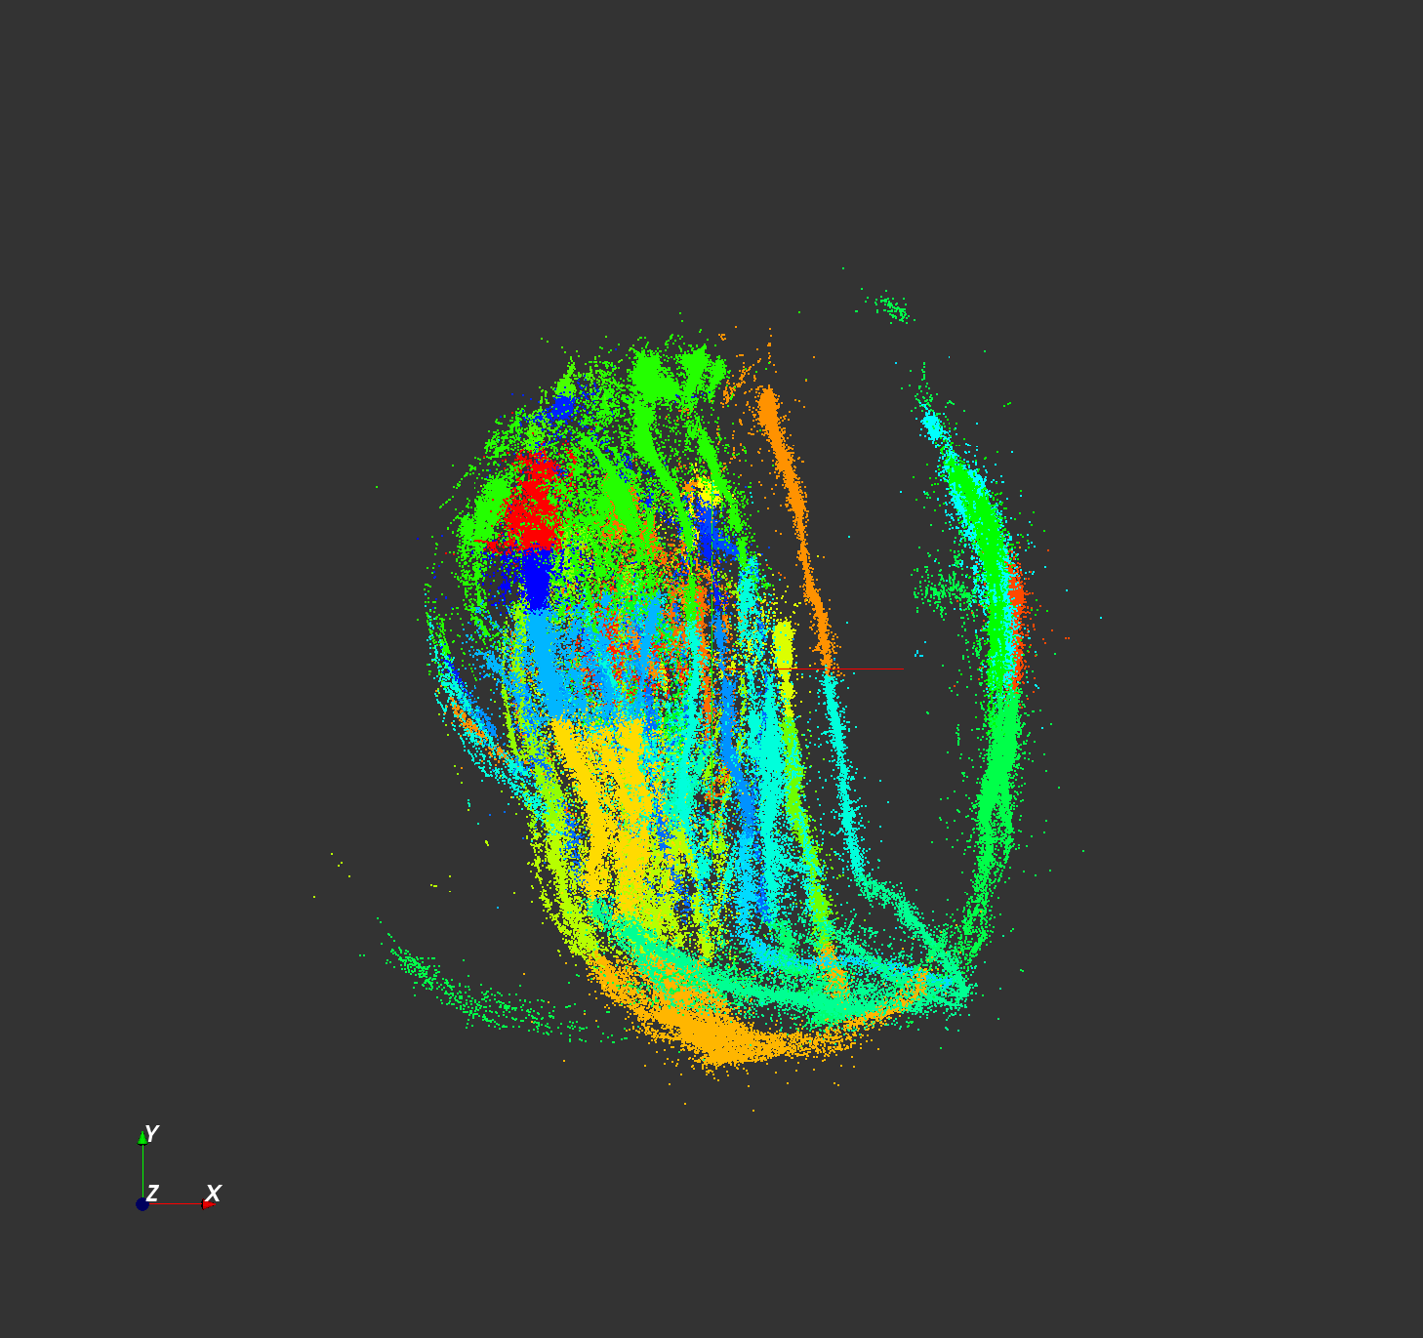

Million Sequence Challenge
  Input DataSize: 680k
  Sample Data Size: 100k
  Out-Sample Data Size: 580k
  Test Environment: PolarGrid with 100 nodes, 800 workers.
100k sample data
680k data

Slide 17

Building Virtual Clusters
Towards Reproducible eScience in the Cloud
Separation of concerns between two layers
Infrastructure Layer – interactions with the Cloud API
Software Layer – interactions with the running VM

Slide 18
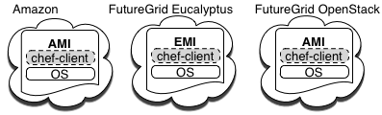

Design and Implementation
Equivalent machine images (MI) built in separate clouds
Common underpinning in separate clouds for software installations and configurations
Extend to Azure
Configuration management used for software automation

Slide 19
Running CloudBurst on Hadoop
Running CloudBurst on a 10 node Hadoop Cluster
knife hadoop launch cloudburst 9
echo ‘{"run list": "recipe[cloudburst]"}' > cloudburst.json
chef-client -j cloudburst.json
CloudBurst on a 10, 20, and 50 node Hadoop Cluster

Slide 20

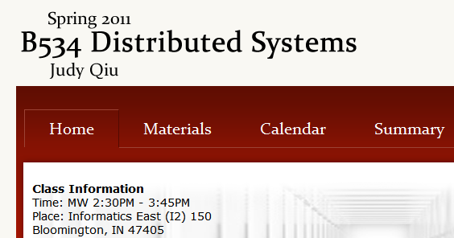
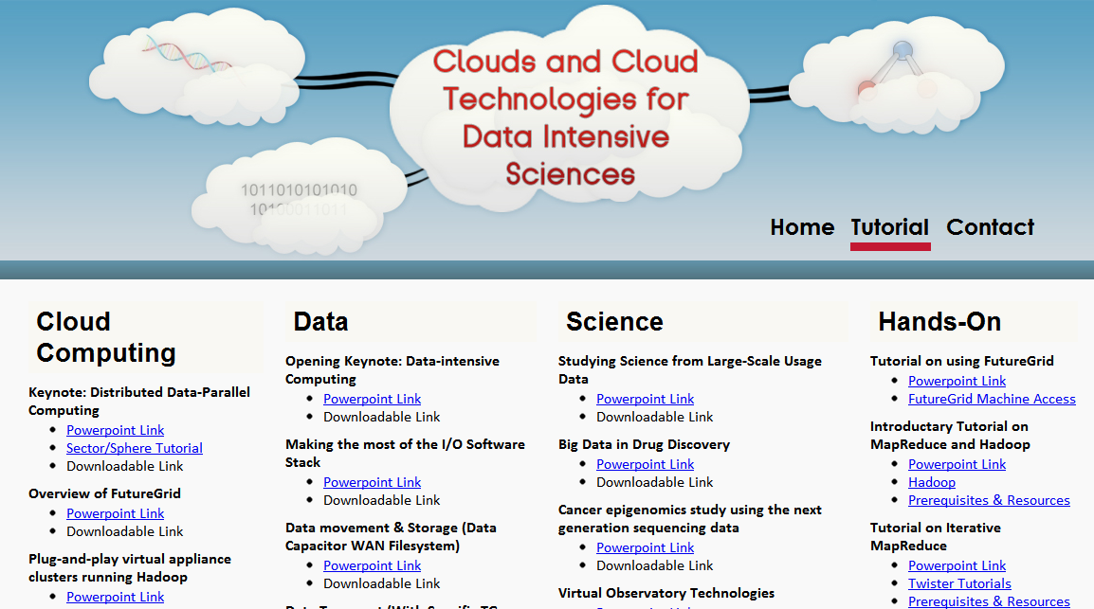
Education
We offer classes with hot new topic
Together with tutorials on the most popular cloud computing tools

Slide 21
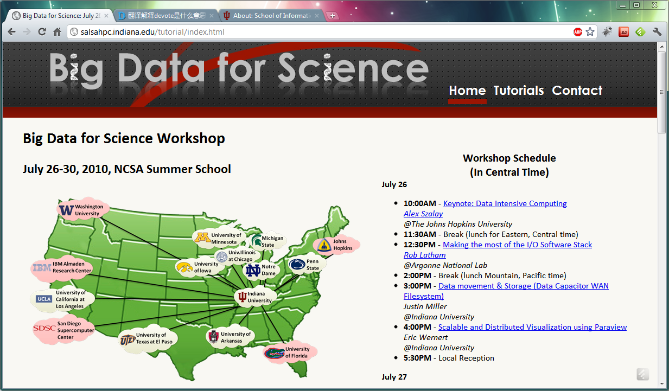
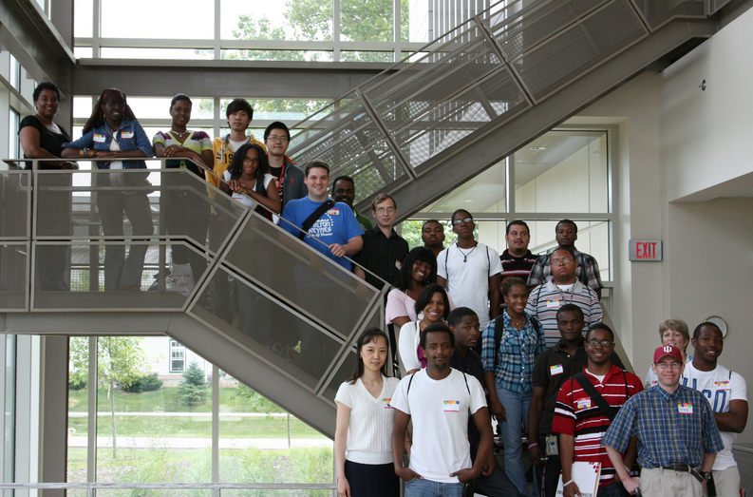

Broader Impact
Hosting workshops spreading our technology across the nation
Giving students unforgettable research experience

