Slide 1
E-DECIDER Earthquake Response Activities
Marlon Pierce, Jun Wang, Yu Ma, Xiaoming Gao

Slide 2
E-DECIDER Overview
This will be discussed in greater detail by project PI Margaret Glasscoe
Basic idea is to apply QuakeSim tools and datasets for time series and deformation analysis to problems in disaster planning and emergency response.
Forecasting → Fault Models → Simulated Earthquakes → HAZUS → GIS Layers + Interferograms

Slide 3
The 2010 Baja Earthquake
Mag 7.2 Earthquake on April 04, 2010
http://earthquake.usgs.gov/earthquakes/recenteqsww/Quakes/ci14607652.php

Slide 4
General Plan
The earthquake occurred on the well-known Laguna Salada fault that bisects the US-Mexican border.
Sparsely populated area
Fault model available from QuakeTables (from CGS catalogs).
UAVSAR interferograms measured after event.
We can simulate the fault with QuakeSim deformation tools.
Create PESH input files for HAZUS using OpenSHA.
Manually run HAZUS to see what happens.
Make GIS products

Slide 5
Study Region: El Centro, CA
Data is organized by census tracts in Hazus
No data across the Mexican border
Image shows Google Earth with overlay exported from HAZUS.

Slide 6
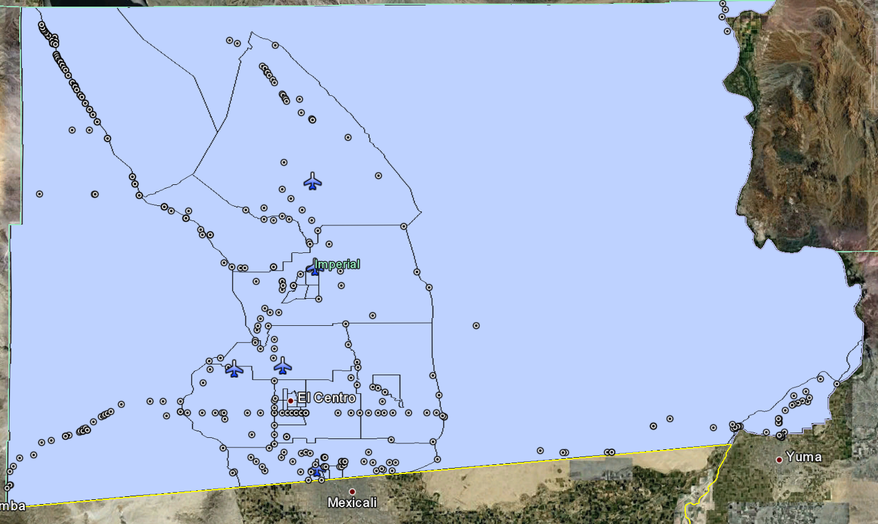
Data Export Example: Transportation
Highway bridges and airports

Slide 7
Critical Infrastructure
Hospitals, police stations, schools and fire stations.

Slide 8
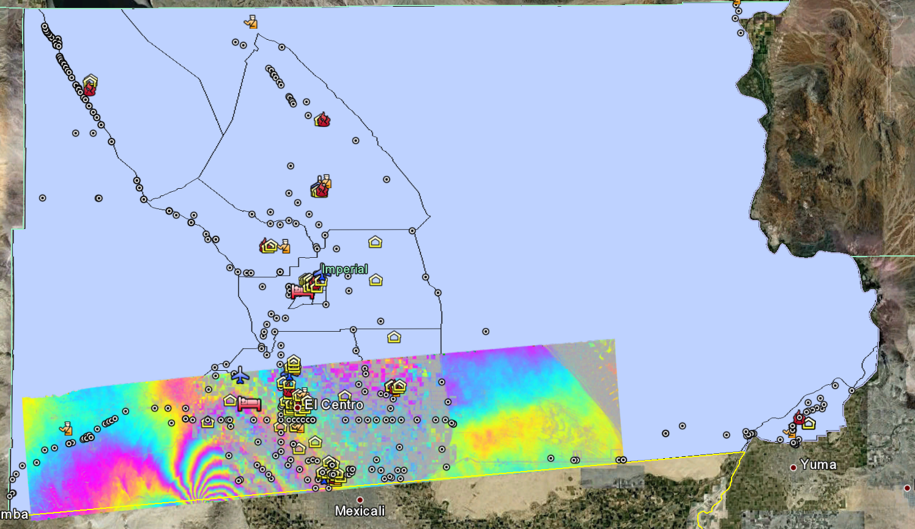
Exposure to Baja 7.2 Earthquakes UAVSAR Interferograms

Slide 9
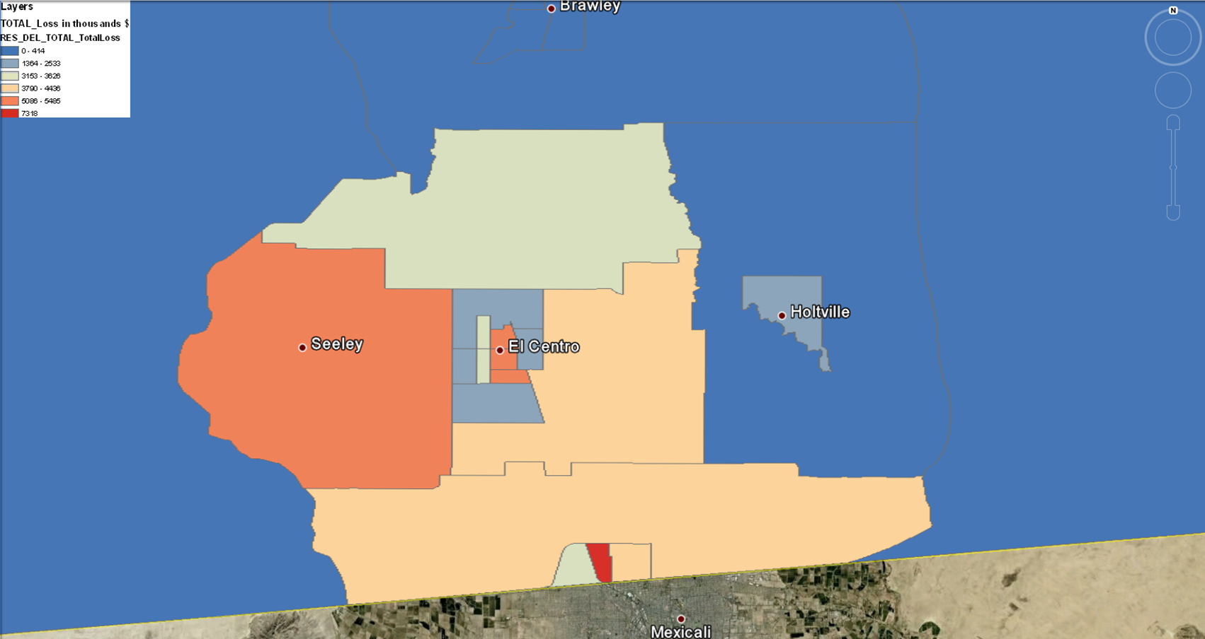
HAZUS Total Loss Estimation

Slide 10
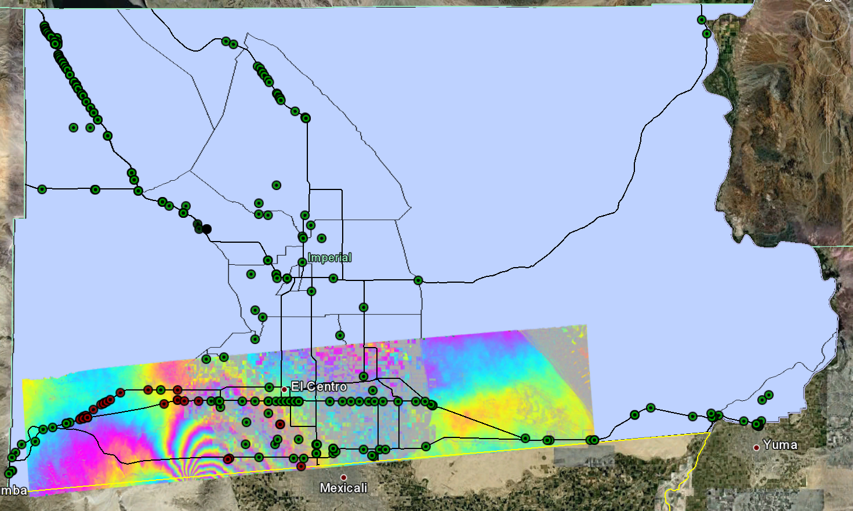
Highway Bridge Functionality
HAZUS-identified damaged bridges

Slide 11
Summary and Problems
HAZUS is a resource for obtaining critical infrastructure information.
Most detailed GIS information is not centralized in the US (local and state governments)
But it only applies to the US
Data has not been validated.
How damaged were those bridges?
Is the information in HAZUS even correct?
How realistic are the models?
HAZUS is a desktop tool, not a service.
Must be run interactively.
Not possible to do run all scenarios.
We can use UC Davis forecasting tools to guide us.
Next step is to produce a catalog of earthquake scenarios with QuakeSim and HAZUS
PESH input files, pre-calculated results

Slide 12
Tohoku Earthquake Response

Slide 13
Summary of Activities
E-DECIDER participated in disaster response through the International Charter
http://www.disasterscharter.org/home
“The International Charter aims at providing a unified system of space data acquisition and delivery to those affected by natural or man-made disasters through Authorized Users.”
IU produced “Level 0” data products for Fukushima Nuclear Power Plant (Ohkuma area) and Minamisoma (a city).
The task was to make side-by-side comparisons of before and after effects.
Also through QuakeSim, we assisted with GPS-based time series and deformation analysis.

Slide 17
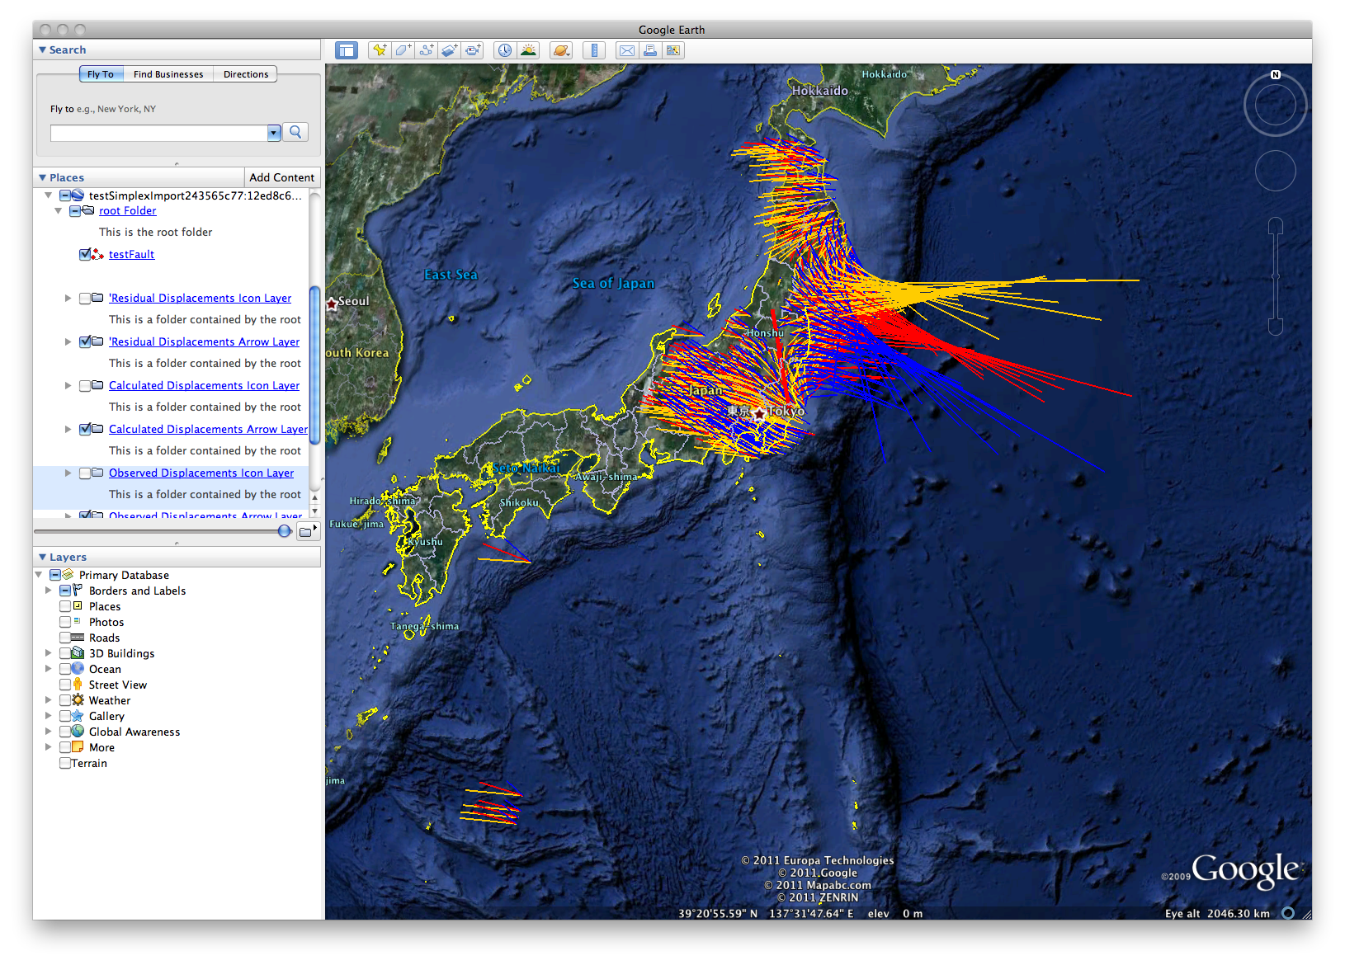
Observed (GPS) and modeled surface displacements using QuakeSim deformation tools. Simplex provides a geometric fault model from displacements.

Slide 18
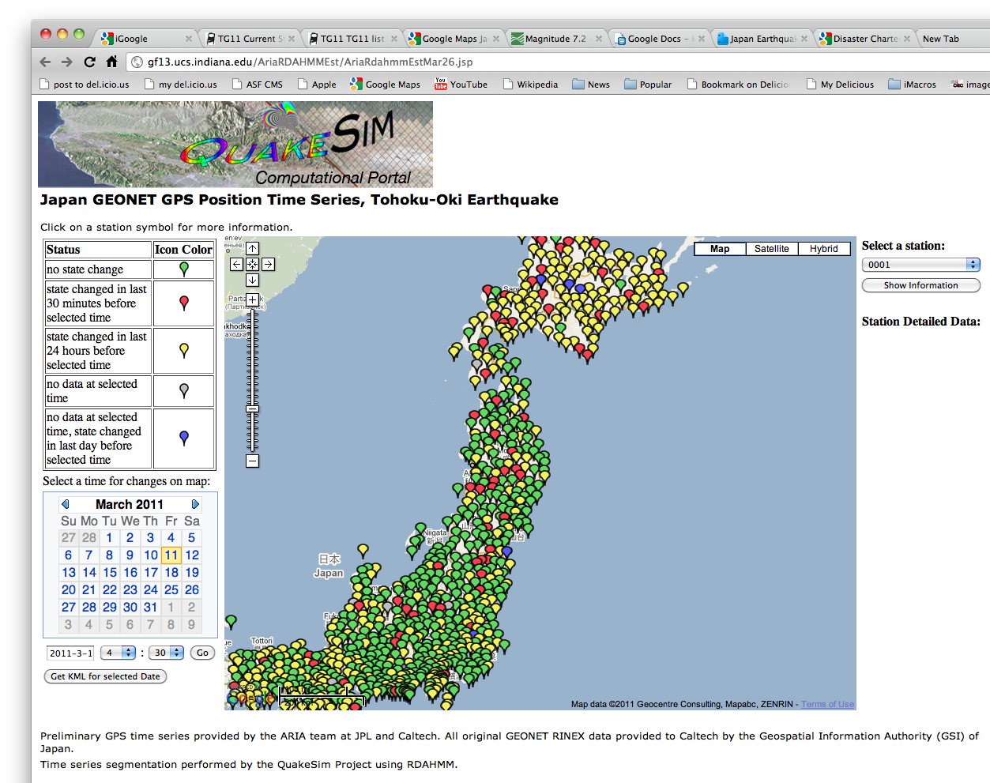
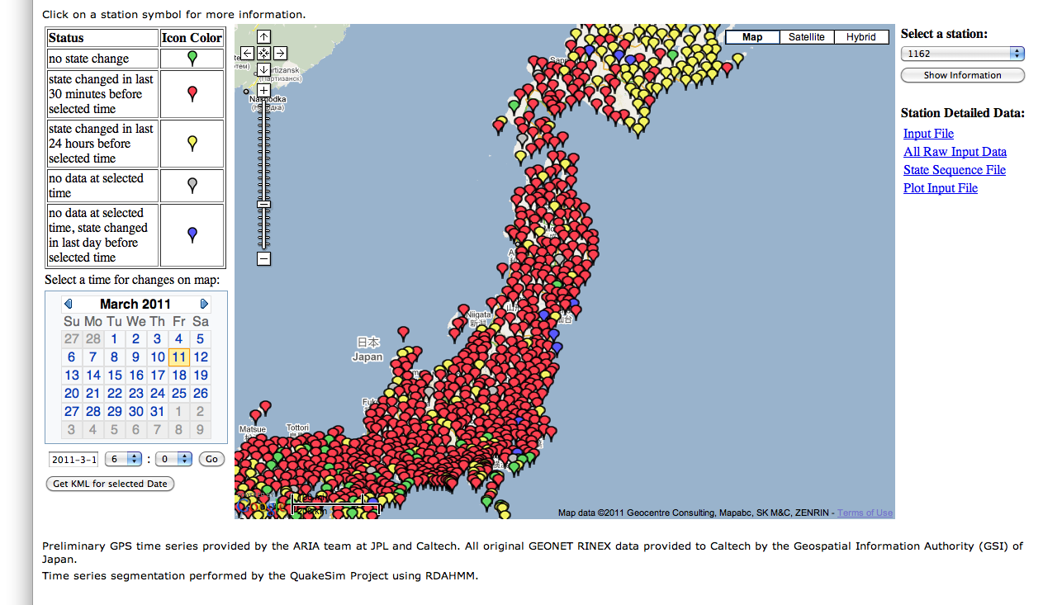
Time series analysis for GPS network before, during, and after the M9 earthquake. Robert Granat will discuss in more detail.

Slide 19
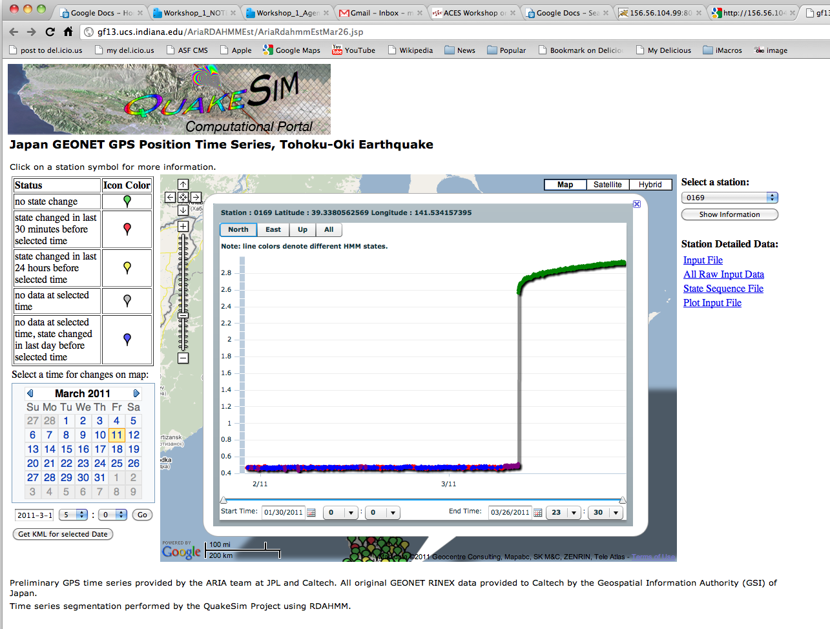
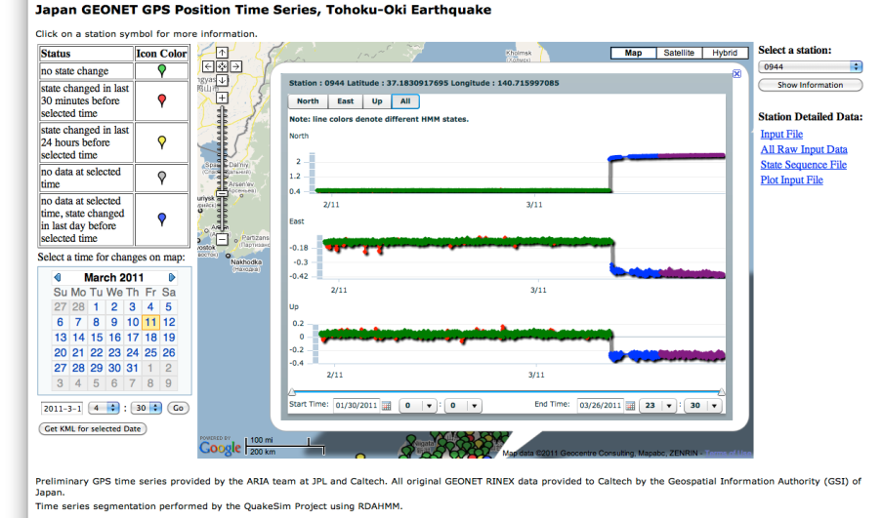

Slide 20
Correct Me if I’m Wrong
Global IT infrastructure to support emergency response is in a miserable state.
GIS information in the US tends to depend on local and state rather than federal government.
Need to integrate/federate these
In the US, disaster modeling is available through obsolete HAZUS system.
There is no international system for disaster modeling.
But disasters cross borders, as does charity
What good were the International Charter Level 0 data products?
Maybe useful in Haiti but not Japan.
How do we apply the scientific and mathematical tools of ACES to disasters?

