Slide 1
E-DECIDER Workshop: QuakeSim Tools and Products
Marlon Pierce
Indiana University

Slide 2
E-DECIDER and QuakeSim Tools
Inverse Methods and Data
Tools: Simplex
Inputs: GPS positions and velocities, InSAR and Optical Imagery
Forward Methods and Data
Tools: Disloc, GeoFEST, Virtual California
Outputs: Displacement maps, synthetic InSAR images, forecast maps
Fault
Models
(QuakeTables)

Slide 3
Connecting with Emergency Preparation and Response
Obvious connection point is generating HAZUS input files from fault models.
Can leverage OpenSHA open source tools
(But this takes some work….)
Examples
Generate HAZUS input files for all forecasted hotspots.
Integrate HAZUS file generation with automated QuakeSim tools.
With inverse methods and GPS and InSAR, provide better fault models for HAZUS tools

Slide 4
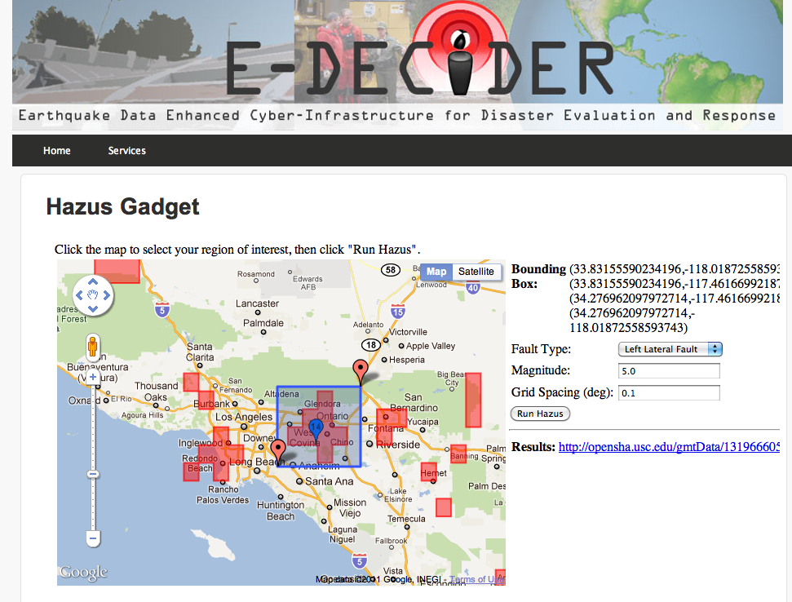
Example: HAZUS Gadgets
Can generate HAZUS input files.
Can generate HAZUS input files.

Slide 5
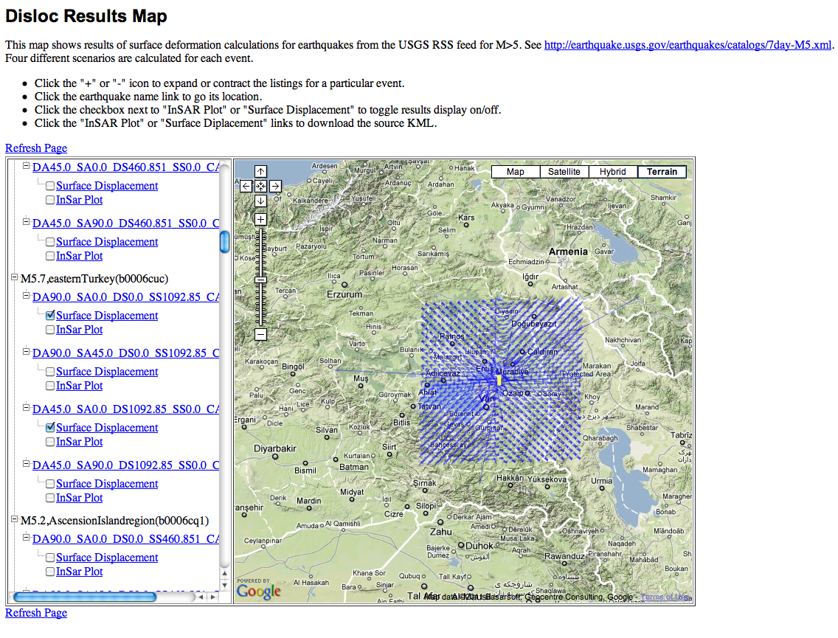
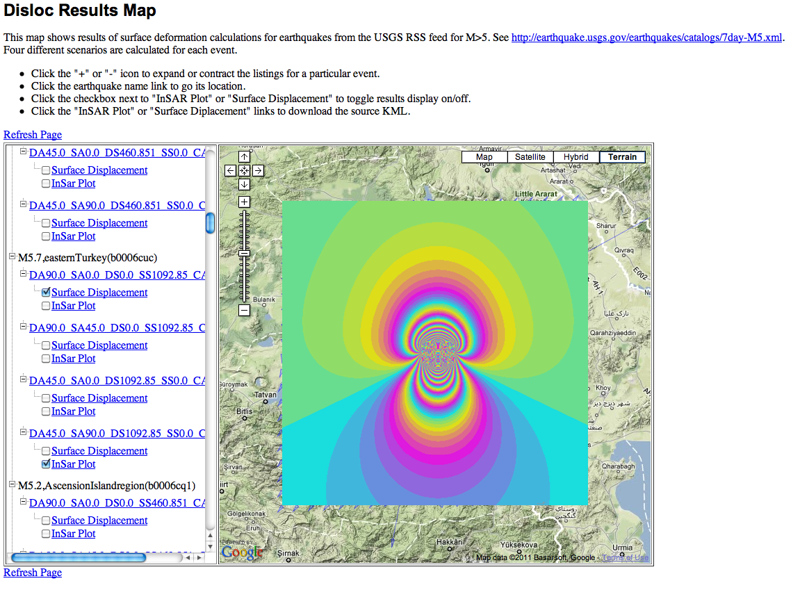
Example: RSS Disloc
Calculates surface displacements, synthetic InSAR from the USGS M>5 Earthquake RSS feed.
Can by integrated with OpenSHA HAZUS input generation tools.

Slide 6
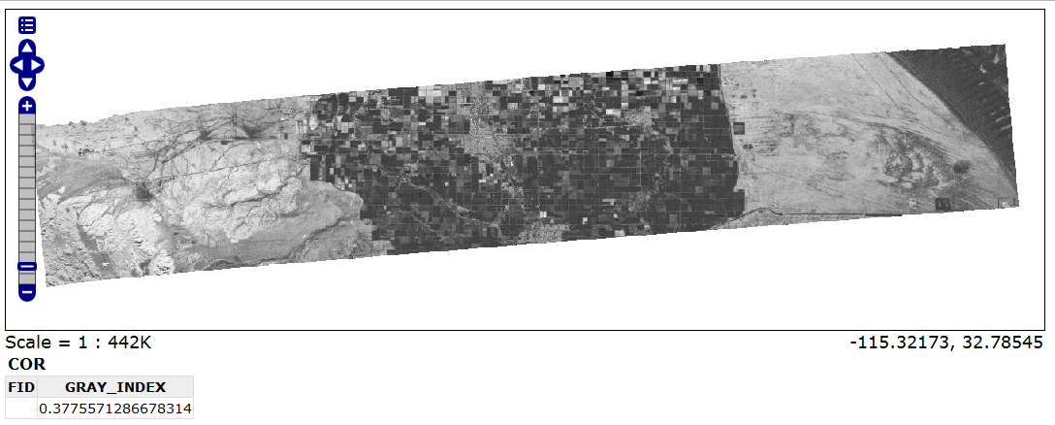
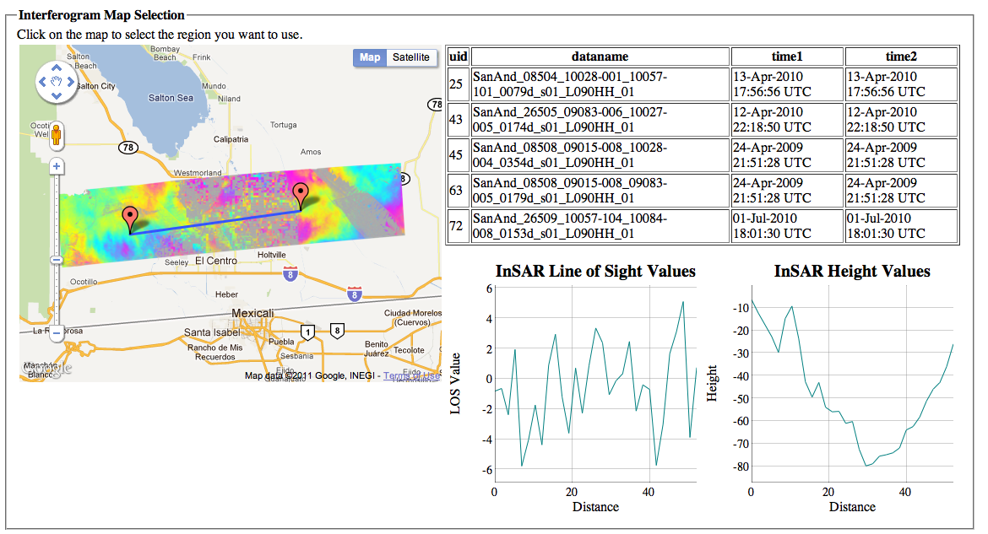
Example: GeoServer and InSAR
Interactive User Interfaces
Open Layers Output
KML Output

Slide 7
Fault Refinements with Simplex

Slide 8
How To Make It Happen
For end users
Types of Data Products
Delivery mechanisms
End clients
For data providers
Service architectures for interoperability
Open community development processes
GIS Standards

