Slide 1
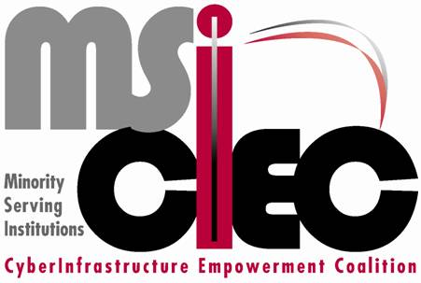
Engaging Minority-Serving Institutions (MSIs) in Cyberinfrastructure (CI) through CI Days
TeraGrid ’08
Las Vegas, NV
11 June 2008
Alex Ramirez, Hispanic Association of Colleges and Universities,
Geoffrey Fox, Indiana University,
Al Kuslikis, American Indian Higher Education Consortium,
Richard Alo, University of Houston-Downtown,
Karl Barnes, National Association for Equal Opportunity in Higher Education,
Diane Baxter, San Diego Supercomputer Center, and
Julie Foertsch, Leading Edge Evaluation & Consulting, LLC

Slide 2
Minority-Serving Institutions (MSIs)
Historically Black Colleges and Universities (HBCUs)
  Public & private, mostly 4 year institutions with some 2 year, established prior to 1964 to serve African Americans
  National Association of Colleges and Universities (NAFEO)
Tribal Colleges and Universities (TCUs)
  Tribally controlled, mostly 2 year institutions with some 4 year, often to serve geographically remote reservations
  American Indian Higher Education Consortium (AIHEC)
Hispanic-serving Institutions (HSIs)
  Public & private, evenly mixed 2 year & 4 year institutions, 25% Hispanic student enrollment
  Hispanic Association of Colleges and Universities (HACU)

Slide 3
Minority-serving Institutions (MSIs) provide an efficient strategy to reach the minority communities underrepresented in STEM
Represent <10% of all U.S. institutions of higher education, enroll a much higher proportion of students from their respective communities
  E.g., HSIs enroll about 50% of all Hispanic college students
HBCUs and HSIs produce 33% of African American and Hispanic STEM baccalaureates
Well represented in Top 50 baccalaureate institutions of Hispanic and African American STEM doctorates

Slide 4
Cyberinfrastructure & MSI-CIEC
“The comprehensive infrastructure needed to capitalize on dramatic advances in information technology has been termed cyberinfrastructure (CI). Cyberinfrastructure integrates hardware for computing, data and networks, digitally-enabled sensors, observatories and experimental facilities, and an interoperable suite of software and middleware services and tools. Investments in interdisciplinary teams and cyberinfrastructure professionals with expertise in algorithm development, system operations, and applications development are also essential to exploit the full power of cyberinfrastructure to create, disseminate, and preserve scientific data, information and knowledge [NSF OCI, Vision for 21st Century Discovery, p. 6].”

Slide 5
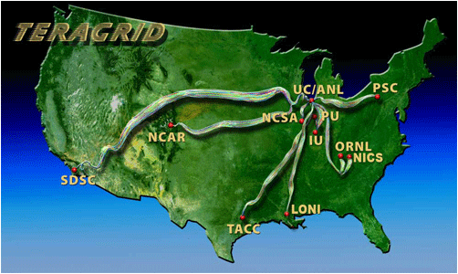
Cyberinfrastructure & MSI-CIEC
TeraGrid is an obvious example

Slide 6
Cyberinfrastructure & MSI-CIEC
CI intrinsically democratizes science with its focus on collaboration and sharing of resources
Expands who can participate in the new science and what they can do
Tremendous opportunity for MSIs
Not as add-ons but fully engaged

Slide 7
Cyberinfrastructure & MSI-CIEC
NSF OCI CI Vision
  “Broaden access to state-of-the-art computing resources, focusing especially on institutions with less capability and communities where computational science is an emerging activity, [ p. 7],”
  “To promote broad participation of underserved groups, communities and institutions, both as creators and users of CI [p. 39]”

Slide 8
Cyberinfrastructure & MSI-CIEC
MSI Cyberinfrastructure Empowerment Coalition
Vision:
  To advance science, technology, engineering and mathematics (STEM) and the participation of the nation’s underrepresented minorities in STEM, particularly e-science, and in the global STEM workforce through minority-serving institutions (MSIs) and the emerging cyberinfrastructure (CI).
Mission:
  To build and enhance the social and technological mechanisms for meaningful engagement of MSIs in cyberinfrastructure (CI).
The project develops the CI “middleware” resources to encourage, broker, enable and manage meaningful CI initiatives involving MSI collaborations for the use, support, deployment, development, and design of CI to enable the advancement of e-science research and education.

Slide 9
MSI-CIEC
Partners & co-Pis
AIHEC, Al Kuslikis NAFEO, Karl Barnes HACU, Alex Ramirez
University of Houston-Downtown, Richard Alo (PI)
Indiana University, Geoffrey Fox
San Diego Supercomputer Center, Diane Baxter
Evaluator: Julie Foertsch, Leading Edge Evaluation & Consulting, LLC
Advisory Board
Charles Catlett, TeraGrid Fran Berman, SDSC
Thomas Dunning, NCSA Jay Boisseau, TACC
Dan Reed, UNC, RENCI Mark Ellisman, UCSD, BIRN
Kelvin Droegemeier, Oklahoma, LEAD
Ian Foster, Chicago, Argonne, Open Science Grid
Malcolm Atkinson, NESC (UK National e-Science Center), ICEAGE (EU Grid Education)
Larry Smarr, CalIT2
Juan Meza, LBNL
Richard Tapia, Rice

Slide 10
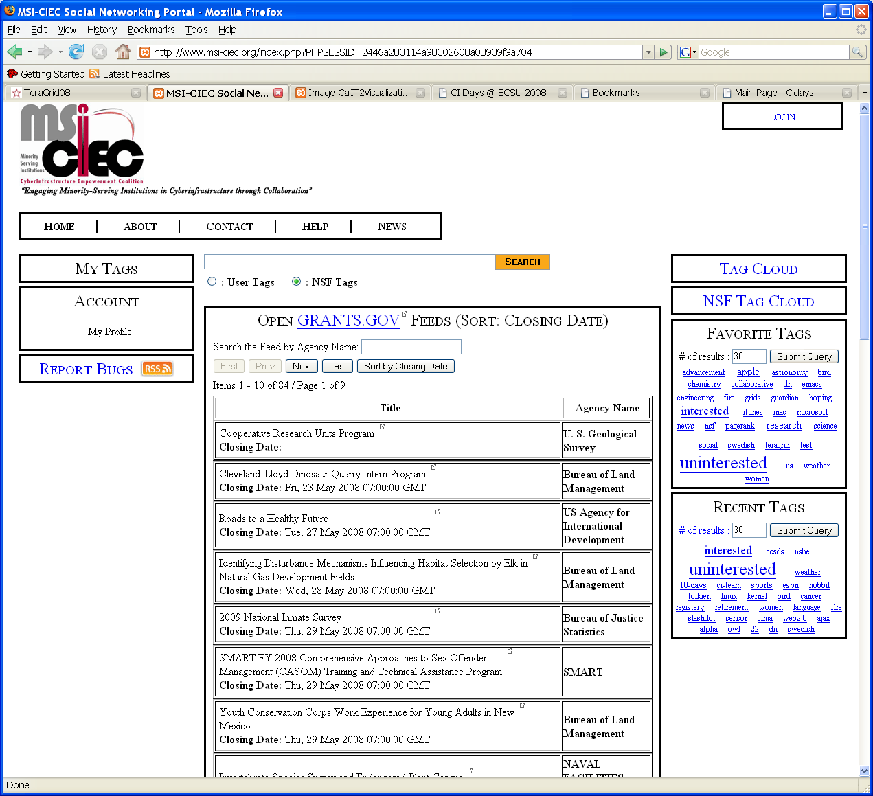
Social Networking Portal
WWW.MSI-CIEC.ORG

Slide 11
MSI-CIEC Campus Visits Cyberinfrastructure Days (CI Days)
CI Days coined by Jill Arnold, Internet 2, during TG Campus Partnership RAT
Helping campuses come to terms with CI not unique to MSIs
Critical for underfunded MSIs to do so when possible funding available
MSI-CIEC Campus Visit more involved
Evolved into CI Days virtual organization
(VO) with Russ Hobby, Internet2, lead

Slide 12
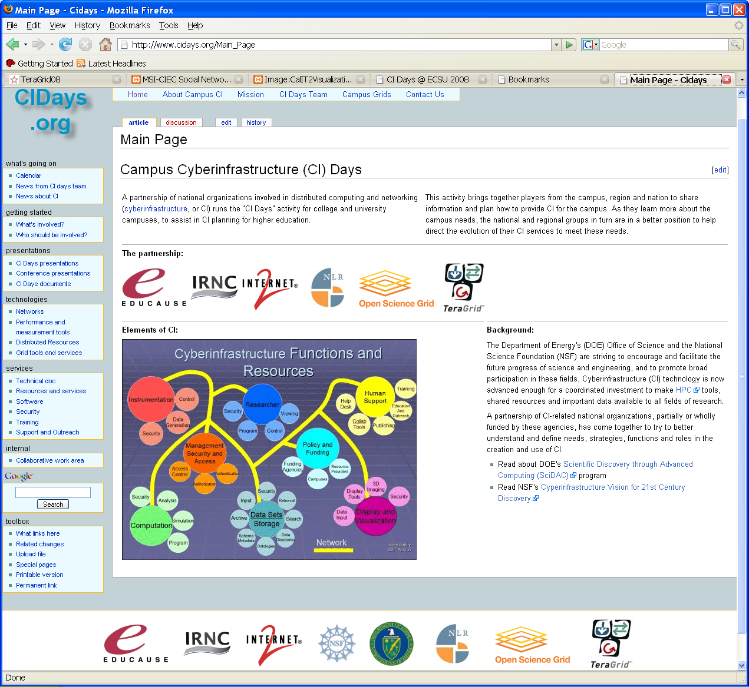

Cyberinfrastructure Days (CI Days)
Virtual Organization (VO) www.cidays.org

Slide 13
Cyberinfrastructure Days (CI Days) General Approach
  1 or 2 day event with a series of presentations by national organizations and local/regional entities
  Followed or intertwined with discussions
  Involving faculty, CIO & IT staff and Sponsored Research/Programs office
  Comprehend CI and relate to campus research and infrastructure
  Faculty may see relationship to their current or new possible research
  Initiate plans, preparations or realignments for campus to move forward on own, if they have the resources

Slide 14
MSI-CIEC Campus Visits
CI Days General Approach
MSIs
  Generally do not have the resources
  Primarily teaching institutions
    Particularly small or 2 year institutions
  May be skeptical that their institution could become engaged
MSI-CIEC works closely with the institution with the agenda, planning, arrangements and pre- and post-event activities
  Discussions with provosts, deans and others prior to event
  Works with CI Days VO and relevant regional entities (campus system, network provider, etc.)
  Arranges speakers, campus arranges local logistics
  Campus assessment and report
  Assists with follow-on activities

Slide 15
MSI-CIEC Campus Visits
CI Days General Approach
MSI-CIEC Campus Assessment
  Works closely with campus CIO
  Provides or engages needed expertise to review campus infrastructure
  Meets with campus
    CIO & IT staff
    President, provosts, deans and other administrators
    Key faculty
    Computing facilities
  Generates report for CIO, President, Provost and general campus review

Slide 16
CI Days General Regional Approach
CI Days involving a number of campuses
Obvious efficiencies for CI Days VO and other presenters
Inter-campuses exchange of info and ideas
Stimulate local campus and collaborative activities
Limited people from each campus, getting the “right” people from each campus, campus “ownership,” greater diversity of interests & needs

Slide 17
CI Days Case Study
Elizabeth City State University

Slide 18
CI Days Case Study
Elizabeth City State University
Planning of the event
  Worked with key faculty member, CIO & Office of Sponsored Programs
    key faculty member, original point of contact with prior involvement
    Office of Sponsored Programs very keyed into campus
    New CIO seeing CI Days good way to engage with campus
  Early discussions with Provost and deans
  Incorporated into existing campus event for faculty professional development
  Attempt to provide topic for everyone
  Scaffold local, regional and national

Slide 19
CI Days Case Study
Elizabeth City State University
Goals
  provide faculty, staff, and administrators in attendance with information about cyberinfrastructure developments in education and research,
  facilitate networking opportunities with national cyberinfrastructure organizations and experts, and
  provide breakout sessions for faculty within each of the university’s four colleges to brainstorm ways that cyberinfrastructure might be used in their classrooms and labs.

Slide 20
Explore Cyberinfrastructure and ECSU’s meaningful & strategic engagement

Slide 21
Welcome, Chancellor Gilchrist
ECSU Vision, CI & Strategic Opportunities, Provost Blackmon
Cyberinfrastructure Overview, Geoffrey Fox
Cyberinfrastructure Learning & Education, Bob Panoff
Cyberinfrastructure Enabled Science, Linda Hayden
Cyberinfrastructure Arts & Humanities, Joyce Rudinsky
National & State Partners:
Internet2, EDUCAUSE, TG,OSG, SURA, RENCI
NCREN, University of North Carolina System
Breakout Group Sessions Setting ECSU Strategic Directions
Group Reports
Next Steps
Closing

Slide 22
CI Days Case Study
Elizabeth City State University
Outcomes from breakout groups
  Even after long day faculty groups from all four schools clearly showed interest in potential of CI
  Some points seemed focused on more everyday campus IT
  Clearly focused on teaching and education with some interest in research
  Most spoke to the potential for collaboration with others in their fields for both education and research
  Most perceived need for increased bandwidth
  Some saw starting collaborations as the next step

Slide 23
CI Days Case Study
Elizabeth City State University
Evaluation Results
34% (31 out of 90) response rate
  may not necessarily be representative of the attitudes of the attendees, but they do provide a good sense of the general response to the event, the sessions that were particularly useful, and expectations on the part of attendees regarding future implementations of CI at the campus.
Wide range of academic disciplines
  including Music, Education, Psychology, Biology, Chemistry, and Computer Science
74% tenured faculty, 23% non-tenure track faculty, 10% administrators, 3% tech staff

Slide 24
CI Days Case Study
Elizabeth City State University
Evaluation Results

Slide 25
CI Days Case Study
Elizabeth City State University
Evaluation Results

Slide 26
CI Days Case Study
Elizabeth City State University
Evaluation Results

Slide 27
CI Days Case Study
Elizabeth City State University
Evaluation Results
“What do you see as the greatest obstacles to people in your department or college moving forward in exploring or developing the use of CI”
  most of the open ended responses indicated a lack of time and resources;
  as is generally true for most educational reforms.

Slide 28
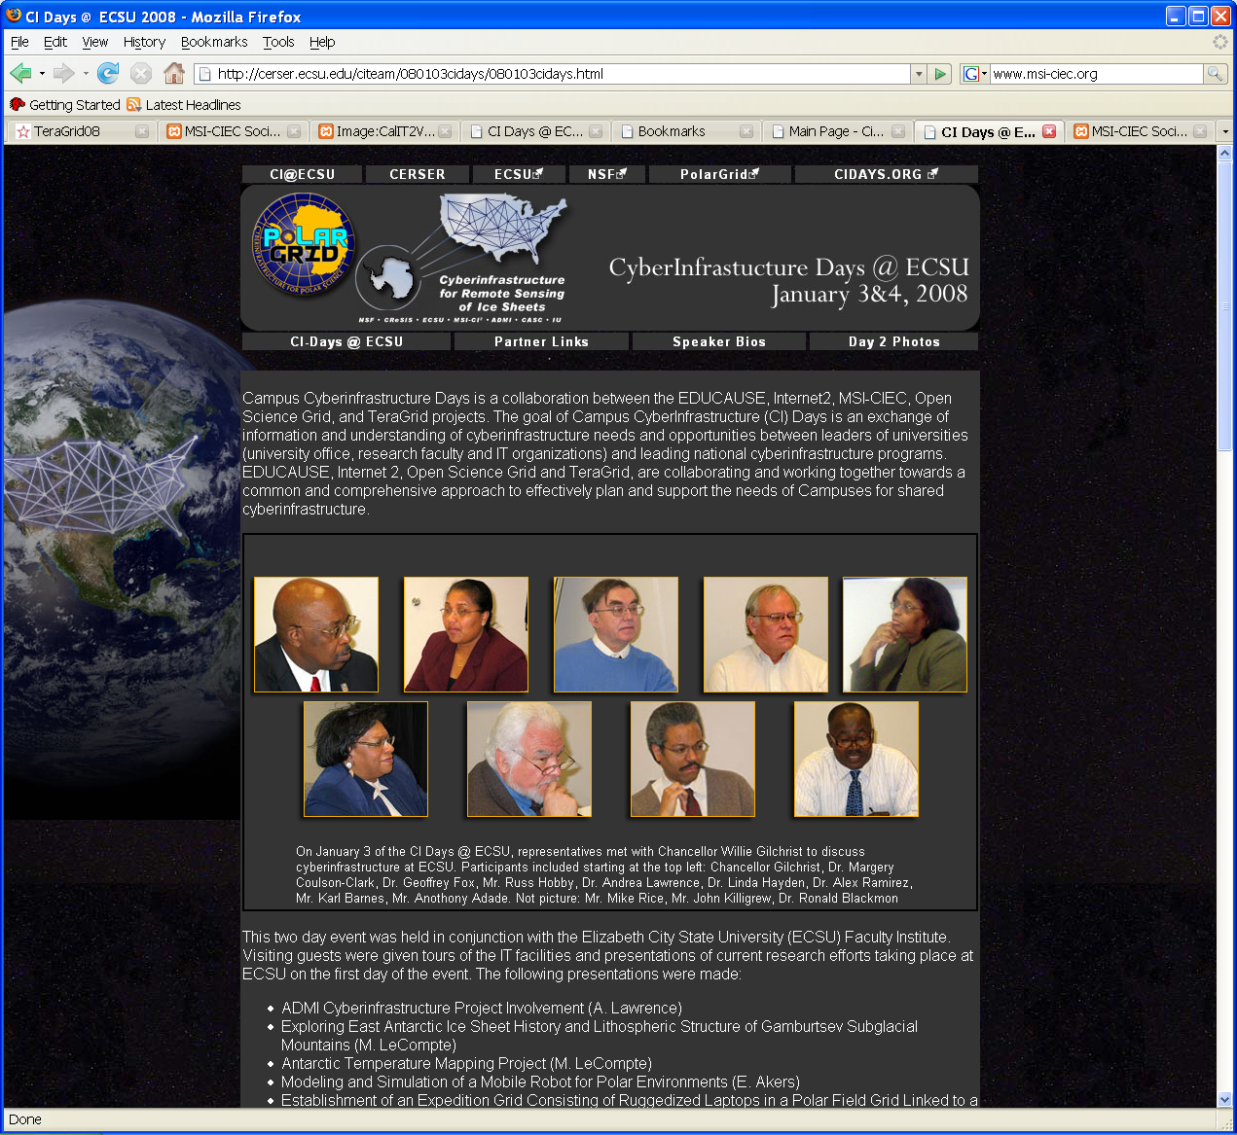
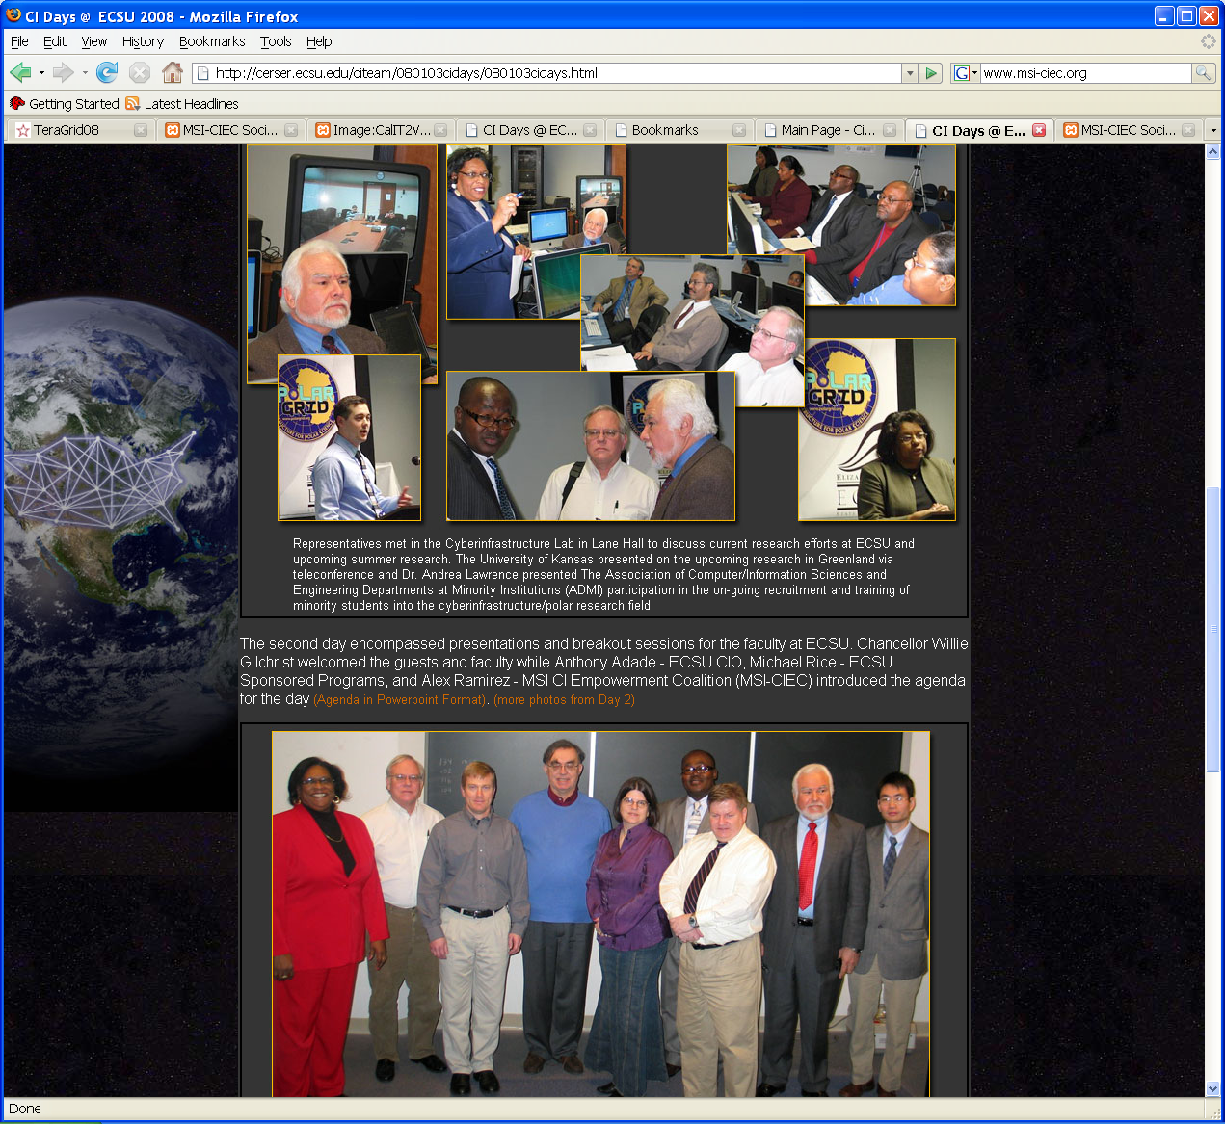
http://cerser.ecsu.edu/citeam/080103cidays/080103cidays.html

Slide 29


Slide 30
CI Days Case Study
New Mexico Statewide Regional

Slide 31
CI Days Case Study
New Mexico Statewide Regional
Nearly all institutions are an MSI, either one of the three Tribal Colleges or an HSI
About 30 college or university campuses
About 21 of which are 2 yr institutions
3 larger campuses
  University of New Mexico in Albuquerque
  New Mexico State University in Las Cruces
  New Mexico Institute of Mining and Technology (New Mexico Tech)

Slide 32
CI Days Case Study
New Mexico Statewide Regional
Interesting recent developments
New Mexico Computing Applications Center (NMACC)
  Encanto, SGI ranked 3rd on Top 500 for Nov ‘07
Navajo Tech (Navajo Technical College) Internet to the Hogan project and DineGrid

Slide 33
CI Days Case Study
New Mexico Statewide Regional
Planning of the event
New Mexico University primary contact
Worked with New Mexico Council for Higher Education Computing/Communication Service (CHECS)
Hosted by New Mexico Highlands University in Las Vegas, NM (the real Las Vegas)
Setting date problematic
Desire to occur in time to influence bi-annual state legislative session

Slide 34
CI Days Case Study
New Mexico Statewide Regional
Planning of the event
Two day event with discussions intertwined
Decision not to hold it at one of the “big” three was to increase participation from all campuses and give a more statewide focus
Hired professional facilitator particularly for strategic planning discussions and small group work
No campus assessments since regional

Slide 35
Explore Cyberinfrastructure
To think strategically how to engage CI for our education and research at the campus, state and national level
Particuarly the new exciting developments in NM

Slide 36
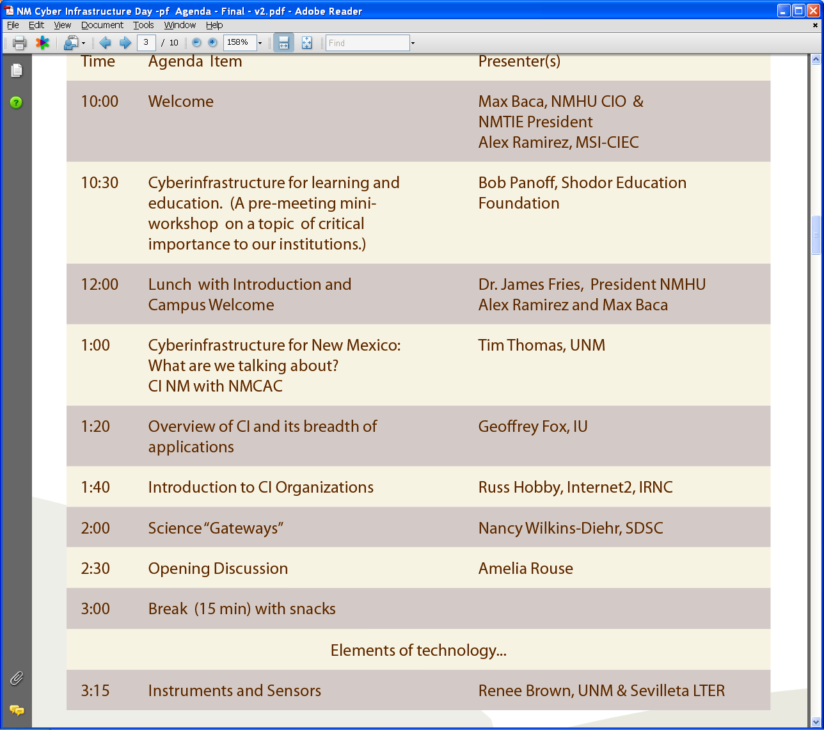
New Mexico Statewide Regional Agenda

Slide 37
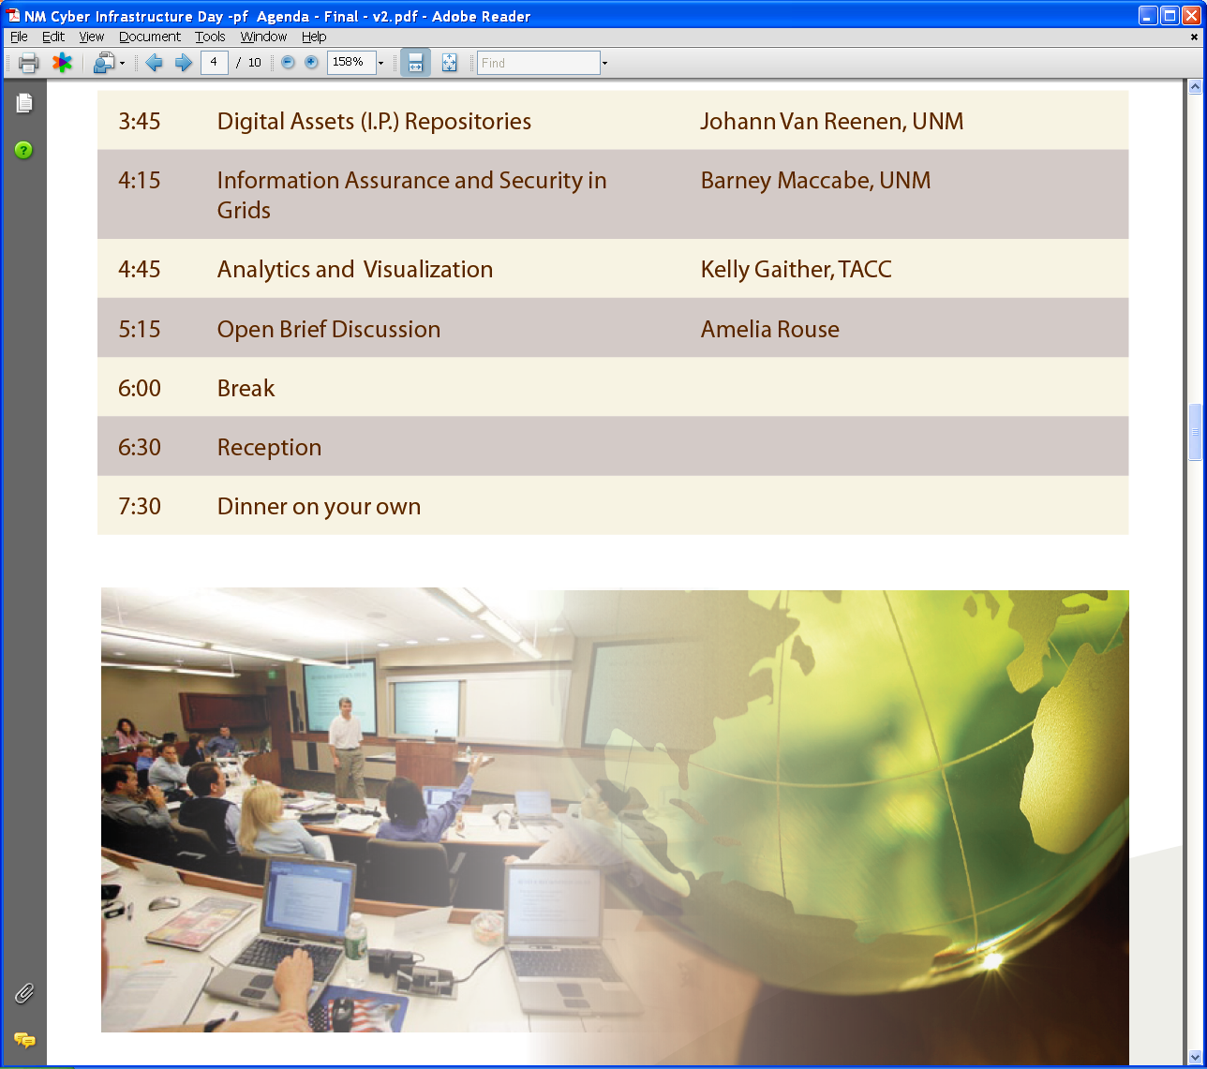
New Mexico Statewide Regional Agenda

Slide 38
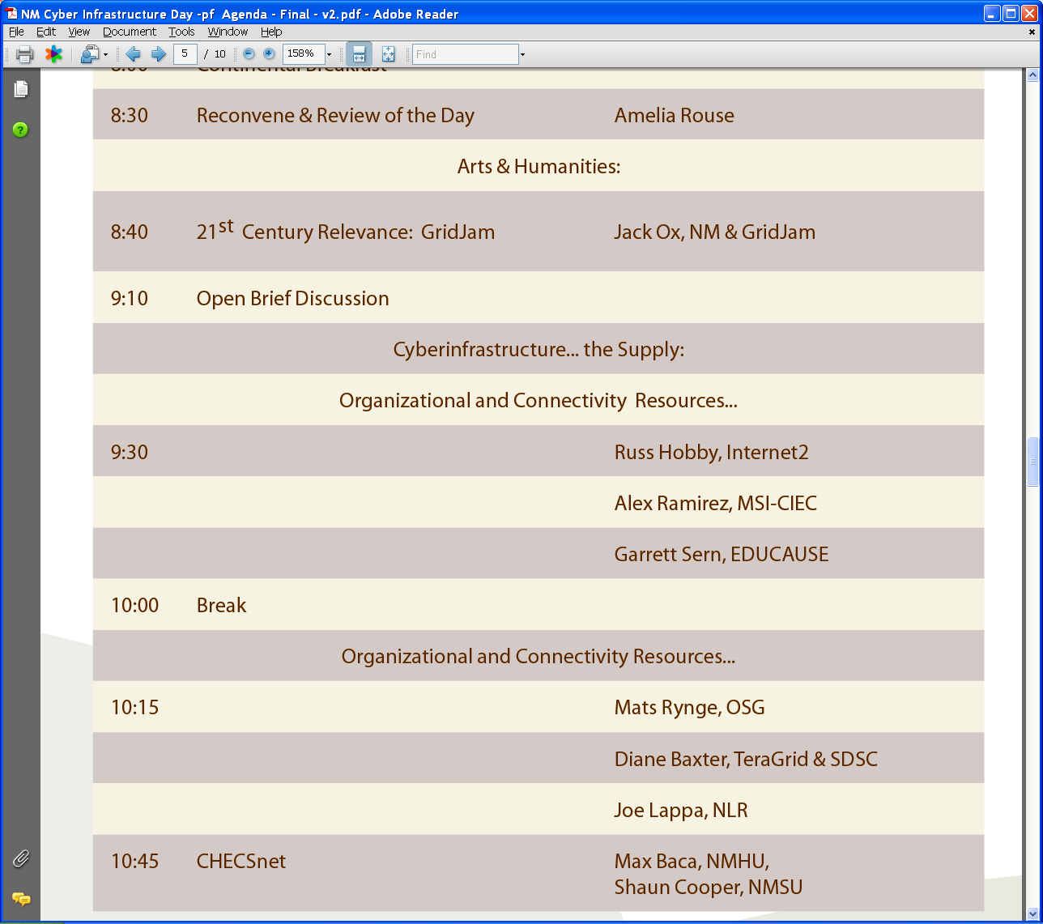
New Mexico Statewide Regional Agenda

Slide 39
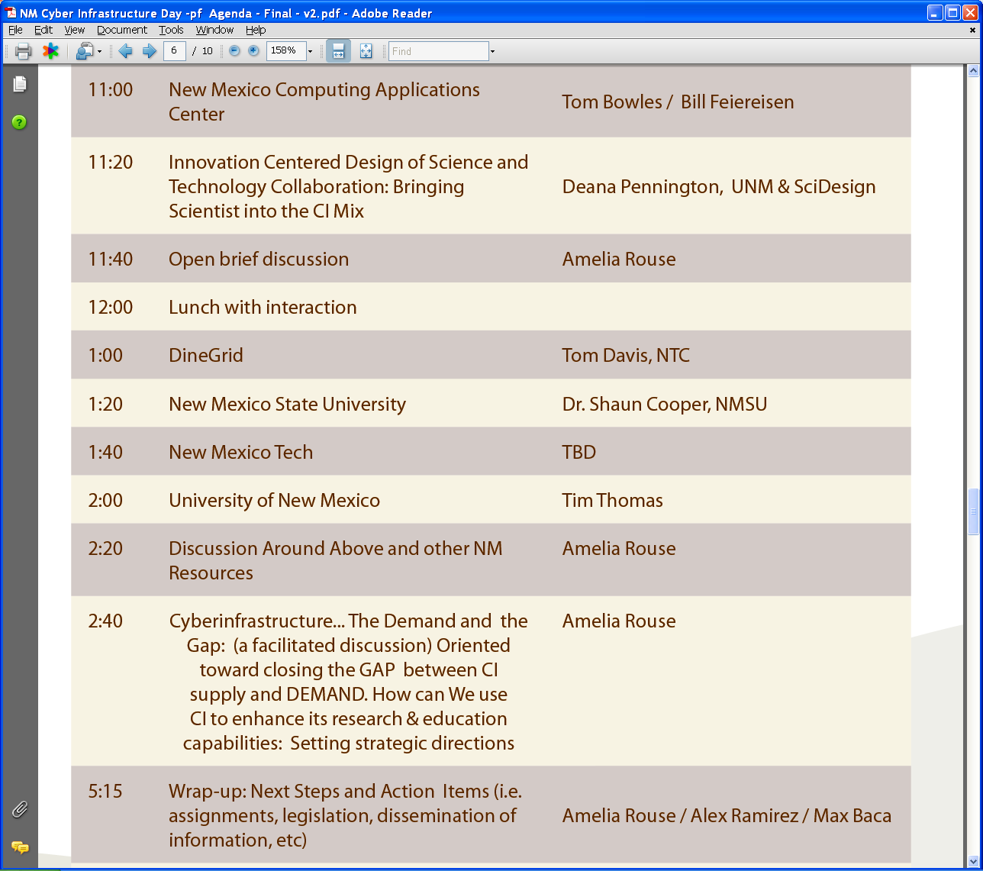
New Mexico Statewide Regional Agenda

Slide 40
CI Days Case Study
New Mexico Statewide Regional
Strategic Planning small group work goals
identify goals for CI at their home institutions or for New Mexico,
identify gaps between their goals and their current situation, especially obstacles to reaching their goals,
generate a list of the top assets needed to bridge the gaps, and
develop brief action plans to address the most critical perceived gap.

Slide 41
CI Days Case Study
New Mexico Statewide Regional
Selected outcomes from the small groups possible goals for CI in NM
Create Information Technology Extension Services
Explore cross-campus research opportunities
Increase partnering opportunities for small schools
Increase CI marketing efforts within universities and regionally
Virtualization of New Mexican assets (in-state collections and virtual repatriation of out-of-state collections) with a gateway for access.
Use CI for research, education, preservation of cultural information, and to enhance communities to allow for the persistence of value of place among New Mexicans.

Slide 42
CI Days Case Study
New Mexico Statewide Regional
Selected outcomes from the small groups possible goals for CI in NM
Connectivity: increase resources to realize the promise of what’s there (ie., Lambda Rail) and create what’s missing (first mile/last mile in NM)
Improved cooperation between NM government and local telecoms.
Make NM the model for cross-disciplinary collaboration with translational services in support of education, local communities, and research (with emphasis on problem-based research).

Slide 43
CI Days Case Study
New Mexico Statewide Regional
Selected outcomes from the small groups possible goals for CI in NM
Focus on people necessary for CI success: integrate CI into all levels of education to create necessary expertise; consider CI personnel needs in planning and funding for state-wide CI initiatives.
Use CI and technology to address issues of poverty, especially among tribal communities.
Blend research collaboration and teaching tools to make STEM more exciting for K-20 students.
Increase the technical knowledge (especially re: wireless communication) and understanding of the deployment of technology to aid tribal communities in reaching their goals.

Slide 44
CI Days Case Study
New Mexico Statewide Regional
Selected outcomes from the small groups possible gaps or obstacles
Marketing. People don’t know what’s going on in NM
Peoples’ attitudes. The tendency to join rather than initiate efforts/projects; a seeming lack of urgency
Broadband connectivity to specific sites (LTER, first/last mile); access to assets; and related communication issues regarding.
IT people are overworked/overtasked.
Lack of meaningful collaboration among researchers & faculty; between research & education
Lack of collaboration between state government and CI expert community.

Slide 45
CI Days Case Study
New Mexico Statewide Regional
Selected outcomes from the small groups possible gaps or obstacles
Gap between research and practice
Some legislators, members of the press, and others who need CI/IT education to be effective representatives, partners, and education advocates.
Regulatory and legislative jurisdictional issues work against collaboration, especially in tribal issues.
Communication between technologists and user communities
Gap between large and small educational organizations.

Slide 46
CI Days Case Study
New Mexico Statewide Regional
Selected outcomes from the small groups
Key assets
Support of Governor Richardson and NM US Senators
People (good ones)
Supercomputer
State and national collaborations (labs & universities)
Existing grids, HPC
Lambda rail
Supercomputer, high performance computing centers

Slide 47
CI Days Case Study
New Mexico Statewide Regional
Selected outcomes from the small groups
Key assets
Cultural institutions: museums, libraries, archives, tribal and other cultural and science centers
Expertise/information in communities and museums

Slide 48
CI Days Case Study
New Mexico Statewide Regional
Selected outcomes from the small groups
Brief action plan summaries
Create key collaborative project that demonstrates the value of CI (solve a NM problem: maybe water?)
Use assets to raise awareness, educate and market, especially regarding the overriding issues of need for connectivity and a recurring funding model
Develop examples of success stories and prototypes of the kinds of NM resources available through CI
Use “Prosperity Game” strategic planning methodology bringing together key sometimes opposing groups to develop workable strategic plans to build NM CI to address key state problems.

Slide 49
CI Days
Conclusions & Lessons Learned
The successful results of these two case studies clearly demonstrates that CI Days can be a useful method for engaging MSIs in CI
Increased interest in CI and HPC, particularly in NM, may lead to additional users or increased use of TeraGrid
  Currently 27 TG users from 11 MSIs, including UNM

Slide 50
CI Days
Conclusions & Lessons Learned
Lessons Learned
Individual campus events may be better able to attract faculty as opposed to IT staff and administrators
Having an added enticement or intense marketing may be necessary (door prizes)
Each event is unique to some degree and must be customized to fit the campus

Slide 51
CI Days
Conclusions & Lessons Learned
Lessons Learned
Added value to hiring a professional facilitator
Need for follow through planned from the beginning
  Time constraints for follow through activity may prove limiting factor to scalability of CI Days

Slide 52
CI Days
Conclusions & Lessons Learned
CI Education
Education was identified as a major interest in both CI Days
  This would be somewhat expected given MSIs major teaching emphasis
  Could prove a very interesting strategy for STEM pipeline by motivating middle and high school students to go to college and enter STEM

Slide 53
CI Days
Conclusions & Lessons Learned
CI Education has several dimensions
Training users or potential users of TeraGrid or other high end Grids such as the Open Science Grid, BIRN or GEON. There are several summer schools focusing on Grid technology training
K-12, Undergraduate or Graduate Grid web resources. There are of course a large number of these resources, including the National Science Digital Library, the collections of curricula material such as those at MIT or even CiteSeer or Google Scholar. For example China with the RealCourse project from Peking University is particularly advanced in the curricula area.

Slide 54
CI Days
Conclusions & Lessons Learned
CI Education has several dimensions
Involvement of students at various levels with research. REU activities are very popular and successful with undergraduates.
Support for students and faculty to attend conferences such as SC ’XY and at which research projects can be presented. ADMI, SC ‘XY, and MSI-CIEC have a strong emphasis on conference opportunities as a strategy for engaging faculty and students. While attending conferences has educational value and is an important adjunct to REU’s, they do not directly support the teaching mission of MSI’s.

Slide 55
CI Days
Conclusions & Lessons Learned
CI Education has several dimensions
Teaching Cyberinfrastructure at an undergraduate, graduate or even K-12 level. There are significant activities in computational science as illustrated by the work of Shodor foundation. The Open Grid Forum has a working group defining “Certificates of Grid expertise” building on the European Union ICEAGE activity led by Edinburgh University. This has a training focus and there is no clear consensus on how cyberinfrastructure or e-Science should be taught at universities. It is perhaps most often included in network or distributed system courses. This contrasts with computational science where several conferences, articles and projects have examined curriculum in detail.

Slide 56
CI Days
Conclusions & Lessons Learned
CI Education has several dimensions
Use of Web 2.0 technology like Second Life, Wiki’s, Blogs, Drupal, Flickr, YouTube in education (and research).
Use of collaboration technology like Polycom, WebEx and Access Grid to support real-time teaching
Use of Course management systems including the open source Sakai and commercial WebCT (now part of Blackboard suite)

Slide 57
CI Days
Conclusions & Lessons Learned
CI Education has several dimensions
Science Gateways with an emphasis on education. Here the NanoHub portal is a notable example but there is much more to be done both in education gateways for other domains and in defining best practices for needed technologies and approaches.
K-12, undergraduate or graduate grid resources going beyond traditional web sites and exploiting cyberinfrastructure with a focus on student involvement. QuarkNet is a well known example and there were several other projects such as the Biology Work Bench and ChickScope which do not appear to be as active as they had been.

Slide 58
CI Days
Conclusions & Lessons Learned
CI Education
There are interesting examples in the areas e) through j) but no clear best practice that CI Days can bring to MSI’s. This contrasts with the research use of cyberinfrastructure where there are disagreements in detail (e.g. should one use SOAP, WSRF or REST?) but broad agreement in principles and several good examples in many domains. We would recommend NSF funded activities aiming broadly at education and cyberinfrastructure and specifically at establishing best practice for dissemination to a broad community.

Slide 59
Acknowledgement
The authors wish to thank Mike Rice at the ECSU Office of Sponsored Programs and Anthony Adade, ESCU CIO, and Dr. Linda Hayden, ECSU, for their leadership with CI Days @ECSU, and Lou Sullo and Tim Thomas of UNM for their leadership with CI Days at NM. We also wish to thank all the presenters, especially, Dr. Bob Panoff, Shodor Foundation, and the organizational representatives to the CI Days VO, particularly Russ Hobby, Internet2. We also wish to thank the generous support of the NSF, grant award #0636352.

Slide 60
For inquiries contact
Alex Ramirez, Hispanic Association of Colleges and Universities
aramirez@hacu.net
Al Kuslikis, American Indian Higher Education Consortium
alkuslikis@aihec.org
Karl Barnes, National Association for Equal Opportunity in Higher Education
karl.barnes@gmail.com
Richard Alo, University of Houston-Downtown
ralo@uh.edu
Geoffrey Fox, Indiana University
gcf@indiana.edu
Diane Baxter, San Diego Supercomputer Center
dbaxter@sdsc.edu
Visit http://www.msi-ciec.org

