Slide 1

Eucalyptus on FutureGrid:
A case for Eucalyptus 3
Sharif Islam, Javier Diaz, Geoffrey Fox
Gregor von Laszewski
laszewski@gmail.com Indiana University

Slide 2
Abstract
In this talk we will be presenting an overview of Eucalyptus used by FutureGrid users. We will provide our experience of running Eucalyptus 2 over multiple years. We conducted performance experiments essential to our community motivating us to switch to Eucalyptus 3. Our experiments are based on running many virtual machines in parallel by the same user in order to coordinate large scale scientific calculations.
Gregor von Laszewski, laszewski@gmail.com

Slide 3
Bio
Gregor von Laszewski was exposed to parallel computers since 1982. Currently, he is the Assistant Director for Cloud Computing at the Community Grids Lab at Indiana University and the Software Architect of FutureGrid. He holds a PhD in Computer Science from Syracuse University. He worked in the past for GMD (Germany), NASA, and Argonne National Laboratory. His current interest are in Cloud Computing and works on "rain".

Slide 4
Statistics
FutureGrid in general
  920 users
  220 projects
FutureGrid Eucalyptus
  285 eucalyptus
  number of projects we do not track for eucalyptus
Images in Eucalyptus
  120 customized images
    (mostly ubuntu and centos images)
Gregor von Laszewski, laszewski@gmail.com

Slide 5
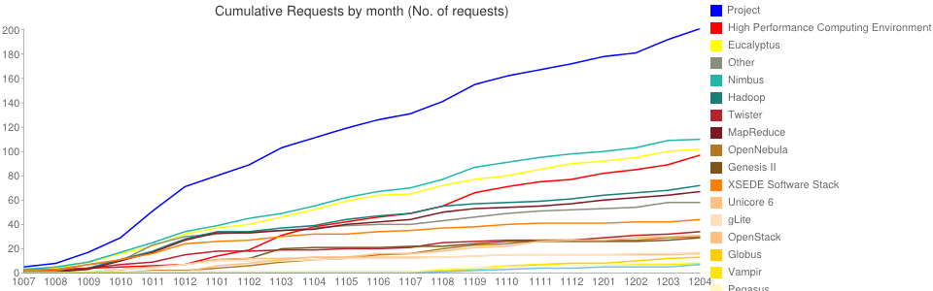
FutureGrid Project and
Technology Requests
Gregor von Laszewski, laszewski@gmail.com

Slide 6
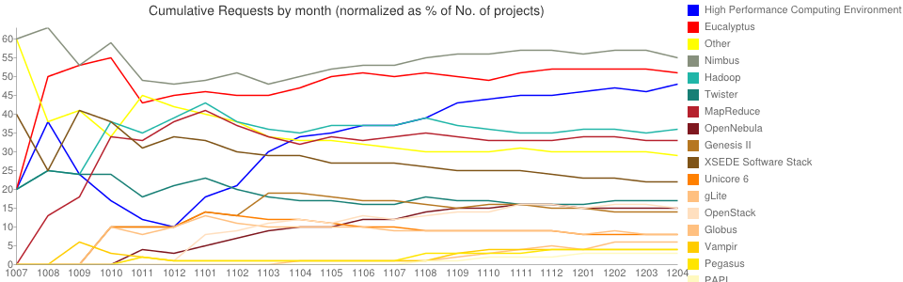
Normalized Project and Technology Requests in % of total projects
Gregor von Laszewski, laszewski@gmail.com

Slide 7
Projects ... using Eucalyptus
Generation of genetic sequencing (Indiana University)
Investigate data provenance via MapReduce (Indiana University)
Integrating heterogeneous sensor, data and computational resources deployed over a wide area (Indiana University)
Distributed systems Graduate Course (Indiana University)
Gregor von Laszewski, laszewski@gmail.com

Slide 8
Projects ... using Eucalyptus (cont.)
STAMPEDE: Synthesized Tools for Archiving, Monitoring Performance and Enhanced DEbugging (LBLN)
SAGA: Simple API for Grid Applications - Louisiana State University
Eucalyptus Usage Metrics Analysis (IU)
Virtual Cluster Generation for Clouds (IU)
Bare-metal and other Cloud Performance Comparison (IU)
Cloud Monitoring (SDSC/IU)

Slide 9
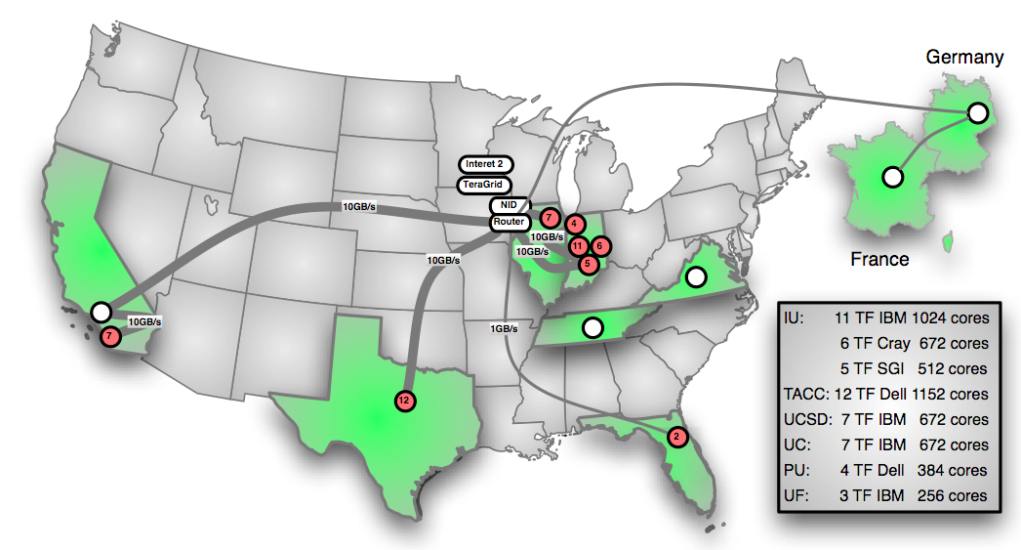
Selected Resources
Gregor von Laszewski, laszewski@gmail.com

Slide 10
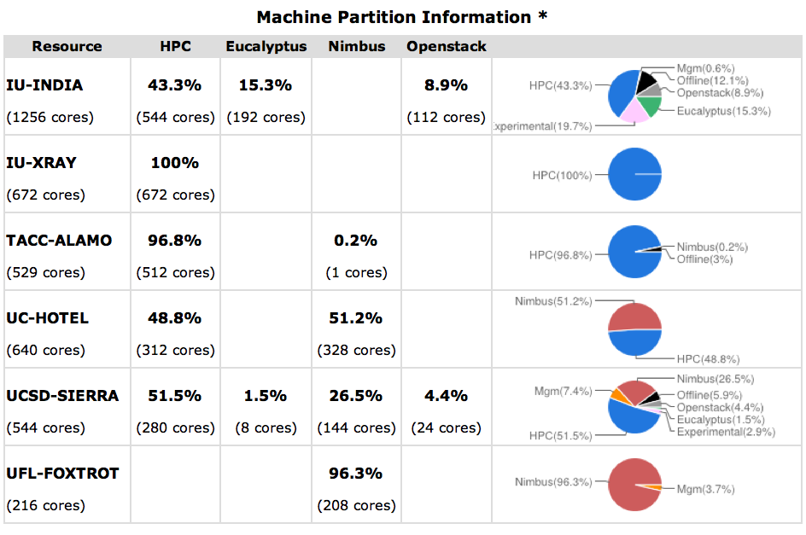
Services on FutureGrid Hardware

Slide 11
Rain (term coined by us)
Dynamic provisioning of
  HPC services
  Virtual machines
Image Management
  Image templates that run on HPC and clouds
  Include authentication and authorization to our user management
Resource Management
  Fabric Weaving and Cloud Shifting
Gregor von Laszewski, laszewski@gmail.com

Slide 12
How do we know something is wrong?
We run user level tests to identify issues
Tests and results are displayed in a dashboard
  (red/green) indicates broken and working tests
Tests are displayed in historical context to see if something is wrong
Gregor von Laszewski, laszewski@gmail.com

Slide 13
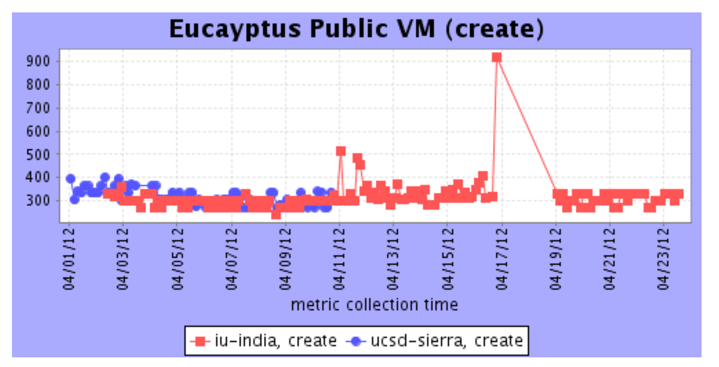
Tests:
Time for VM instantiations (create)
http://inca.futuregrid.org:8080/inca/jsp/report.jsp?startDate=040112&xml=cloudPerf.xml&submit=re-graph
results eucalyptus 2.0.3:
272s create
30s ping
30s ssh
0.44s destroy
Gregor von Laszewski, laszewski@gmail.com

Slide 14
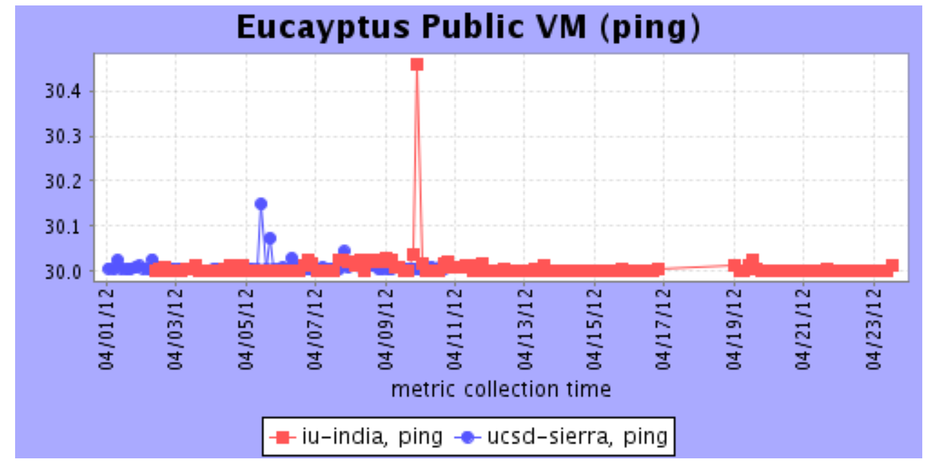
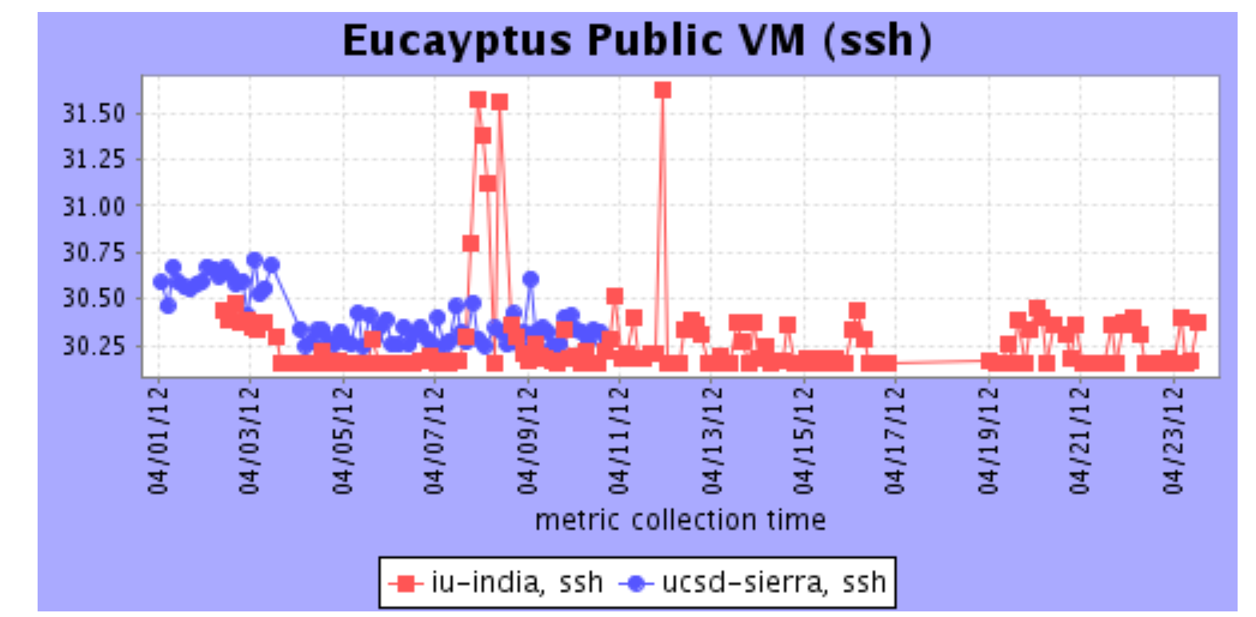
Tests: VM instantiations (ping, ssh)
Gregor von Laszewski, laszewski@gmail.com

Slide 15
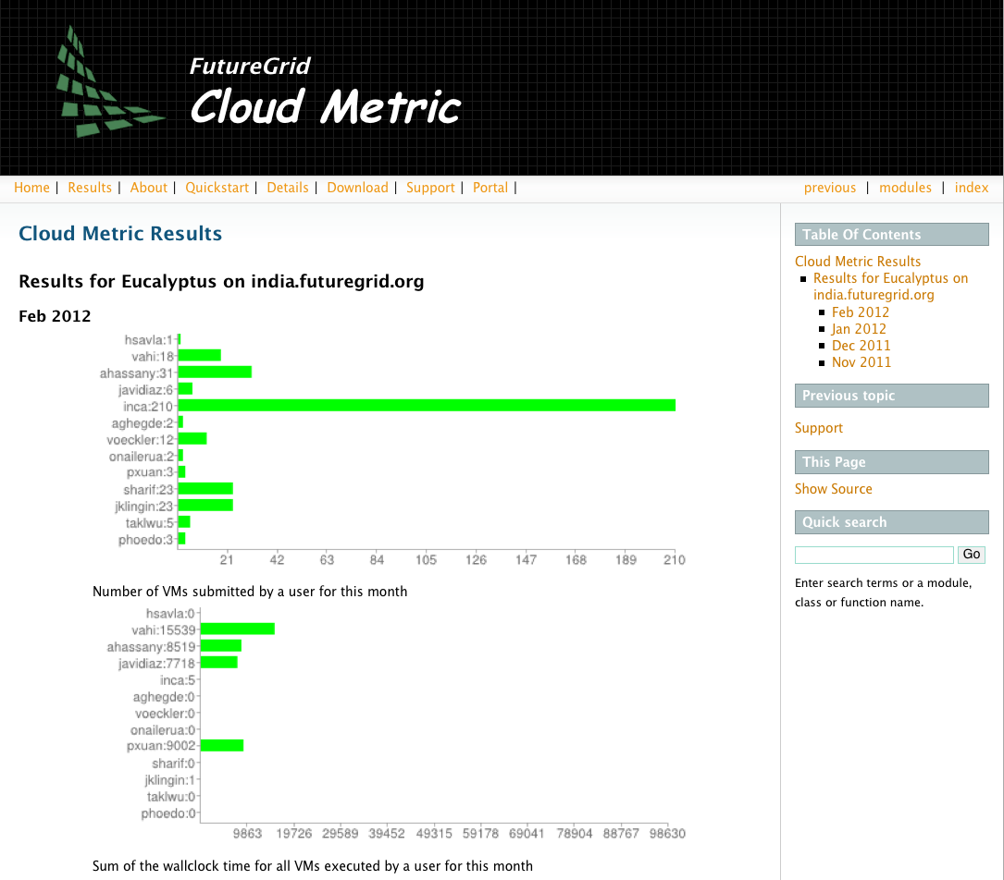
FutureGrid Cloud Metric Tool -
What is your user doing?
google:github futuregrid cloud metric
Gregor von Laszewski, laszewski@gmail.com

Slide 16
Improvements between Eucalyptus
2 and 3
Gregor von Laszewski, laszewski@gmail.com

Slide 17
Eucalyptus 2.0.3
Issues after OS upgrades
  Switch from MANAGED-NOVLAN mode from MANAGED mode solved some network problems leading to downtime after a reboot of our systems. An OS upgrade had some adverse effect.
  Fresh resinstalation of Xen was needed to solve network issues that occurred after an OS upgrade and Xen was updated.
Gregor von Laszewski, laszewski@gmail.com

Slide 18
Eucalyptus 2.0.3 (issues)
Problem with instances
  When multiple instances were launched some won't boot up properly.
  Instances will remain in pending status forever.
Error while communicating with Storage Controller.
  Often times euca-describe-volumes won't show the currently created volumes even though the volume appears in the folder.
After VmTypes were updated in the cluster configuration instances suddenly started to remain in pending status with 0.0.0.0.
  A full restart fixed the issue.

Slide 19
2.0.3 Issues (Cont. )
Memory/resource allocation issue:
  This is partly due to lack of compute nodes and how xen handles memory. Eucalyptus will send instances to boot to a particular node when it is overloaded. As a result, even though the node will be scheduled but will fail eventually to boot ("xend.err 'Error creating domain: Not enough free memory").
When DEBUG is on it is very hard to find relevant information in the log.
  We need DEBUG "on" to monitor system
Gregor von Laszewski, laszewski@gmail.com

Slide 20
Eucalyptus 3.0.1
We are excited about these changes:
Improved handling of multiple instances
  "Some instances were not able to access metadata services when multiple instances were launched at the same time."
  "When multiple instances were launched at the same time, some
  remained in a pending state indefinitely."
Launching instances after restart
  "A fatal parsing error was sometimes reported in the cloud logs when you attempted to launch an instance immediately after restarting the cloud processes."

Slide 21
cont.
Improved command line tools
  euca-get-console-output with the Xen hypervisor
User management
  "LDAP and Active Directory Integration."
  User management from command line tools
  "New and unique identity management allows group-based access control of the resources managed by Eucalyptus."
Fewer restarts
  Change of VM types (ram, disk) in the cluster configuration does not cause any connectivity issues and does not require a restart.

Slide 22
FutureGrid Software for Clouds
Create
  Virtual clusters on demand
  Hadoop clusters on demand
Compare
  Cloud and HPC performance
  Scalability studies of Cloud infrastructures
Configure
  Cloud Shifting and Fabric weaving
    Move resources between Cloud infrastructures
    Deploy Cloud infrastructure on demand

Slide 23
Scalability Tests
Study the scalability by instantiating as many virtual machines (VM) at the same time as possible (success if all the machines have ssh access)
Our results is the time that takes to have access to all the VMs
Performance of Eucalyptus 3
  Tests performed on Sierra
  We had 15 physical machines
Performance of Eucalyptus 2, OpenStack, OpenNebula and HPC
  Tests performed on India
  We had 111 physical machines for HPC
  We had up to 80 physical machines for Cloud

Slide 24
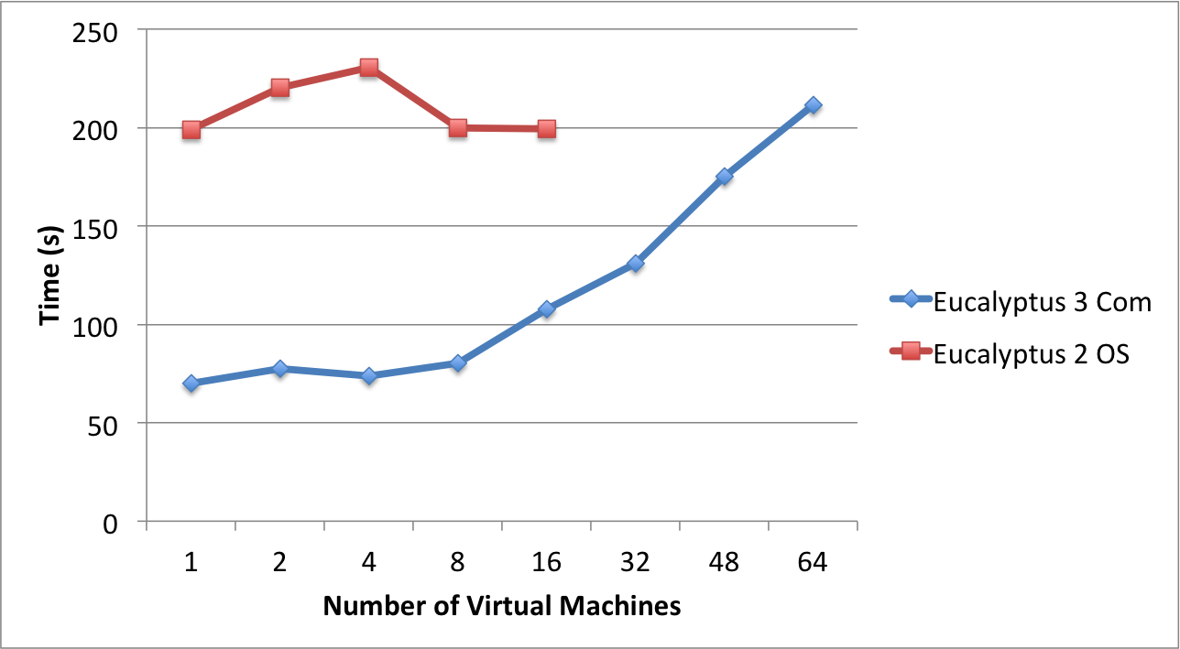
Results Eucalyptus 3 and 2
Com = Commercial
OS = Open Source
Gregor von Laszewski, laszewski@gmail.com

Slide 25
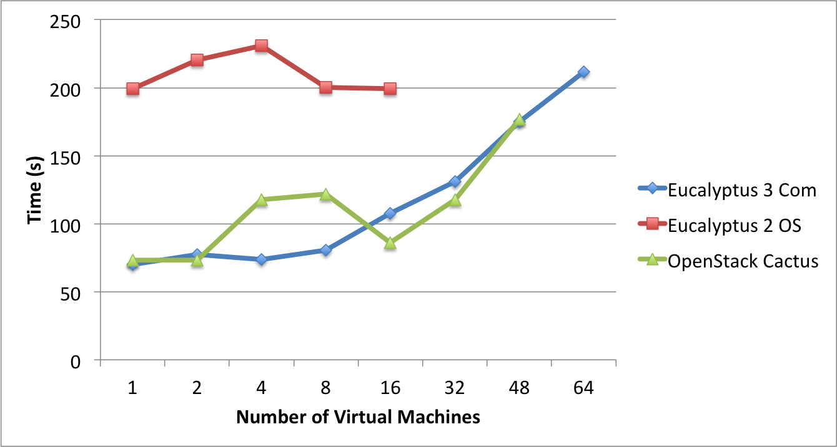
Results Eucalyptus 3, Eucalyptus 2 and OpenStack Cactus
Gregor von Laszewski, laszewski@gmail.com

Slide 26
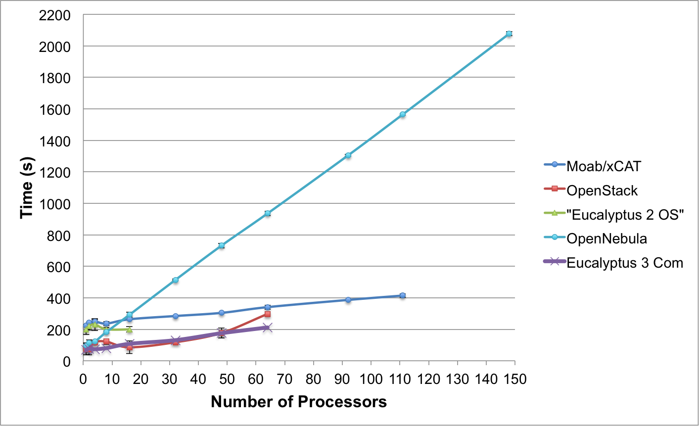
Results all tests
Gregor von Laszewski, laszewski@gmail.com

Slide 27
Scalability Test: Conclusions
The scalability and reliability has been significantly improved in Eucalyptus 3
The time to instantiate VMs has been reduced
Very few errors when instantiating more than 16 VMs at the same time
  VM does not get IP (Status: 0.0.0.0 0.0.0.0 pending)
The -m option of euca-run-instances works much better than in Eucalyptus 2 and OpenStack
  In the tests results the instances were created 10 at a time
  Additional tests with Eucalyptus 3 were performed instantiating all VMs with the same euca-run-instances command without problems
We will run larger tests once our machine becomes more empty

Slide 28
Next Steps
Discontinue use of Eucalyptus 2
Switch the users to Eucalyptus 3
Continue with our Projects
  Rain Infrastructure
  Measure usage
Apply for projects: https://portal.futuregrid.org
THANKS! To the Eucalyptus support team that makes all the difference for a deployed Eucalyptus environment and letting us use Eucalyptus 3.
Gregor von Laszewski, laszewski@gmail.com

