Slide 1
FutureGrid
Computing Testbed as a Service
Details
July 3 2013
Geoffrey Fox for FutureGrid Team
gcf@indiana.edu
http://www.infomall.org http://www.futuregrid.org
School of Informatics and Computing
Digital Science Center
Indiana University Bloomington

Slide 2
Topics Covered
Recap of Overview
Details of Hardware
More Example FutureGrid Projects
Details – XSEDE Testing and FutureGrid
Relation of FutureGrid to other Projects
FutureGrid Futures
Security in FutureGrid
Details of Image Generation on FutureGrid
Details of Monitoring on FutureGrid
Appliances available on FutureGrid

Slide 3
Recap Overview

Slide 4
FutureGrid Testbed as a Service
FutureGrid is part of XSEDE set up as a testbed with cloud focus
Operational since Summer 2010 (i.e. coming to end of third year of use)
The FutureGrid testbed provides to its users:
  Support of Computer Science and Computational Science research
  A flexible development and testing platform for middleware and application users looking at interoperability, functionality, performance or evaluation
  FutureGrid is user-customizable, accessed interactively and supports Grid, Cloud and HPC software with and without VM’s
  A rich education and teaching platform for classes
Offers OpenStack, Eucalyptus, Nimbus, OpenNebula, HPC (MPI) on same hardware moving to software defined systems; supports both classic HPC and Cloud storage

Slide 5

FutureGrid Operating Model
Rather than loading images onto VM’s, FutureGrid supports Cloud, Grid and Parallel computing environments by provisioning software as needed onto “bare-metal” or VM’s/Hypervisors using (changing) open source tools
  Image library for MPI, OpenMP, MapReduce (Hadoop, (Dryad), Twister), gLite, Unicore, Globus, Xen, ScaleMP (distributed Shared Memory), Nimbus, Eucalyptus, OpenNebula, KVM, Windows …..
  Either statically or dynamically
Growth comes from users depositing novel images in library
FutureGrid is quite small with ~4700 distributed cores and a dedicated network
Image1
Image2
…
ImageN
Choose
Load
Run

Slide 6
FutureGrid Partners
Indiana University (Architecture, core software, Support)
San Diego Supercomputer Center at University of California San Diego (INCA, Monitoring)
University of Chicago/Argonne National Labs (Nimbus)
University of Florida (ViNE, Education and Outreach)
University of Southern California Information Sciences (Pegasus to manage experiments)
University of Tennessee Knoxville (Benchmarking)
University of Texas at Austin/Texas Advanced Computing Center (Portal, XSEDE Integration)
University of Virginia (OGF, XSEDE Software stack)
Red institutions have FutureGrid hardware

Slide 7
FutureGrid offers
Computing Testbed as a Service
FutureGrid Uses
Testbed-aaS Tools
Provisioning
Image Management
IaaS Interoperability
NaaS, IaaS tools
Expt management
Dynamic IaaS NaaS
Devops
CS Research Use e.g. test new compiler or storage model
Class Usages e.g. run GPU & multicore
Applications
Software
(Application
Or Usage) SaaS
Cloud e.g. MapReduce
HPC e.g. PETSc, SAGA
Computer Science e.g. Compiler tools, Sensor nets, Monitors
FutureGrid RAIN uses Dynamic Provisioning and Image Management to provide custom environments that need to be created.
A Rain request may involves (1) creating,
(2) deploying, and
(3) provisioning
of one or more images in a set of machines on demand
Platform
PaaS
Infra
structure
IaaS
Software Defined Computing (virtual Clusters)
Hypervisor, Bare Metal
Operating System
Network
NaaS
Software Defined Networks
OpenFlow GENI

Slide 8
Selected List of Services Offered
FutureGrid
IaaS
Nimbus
Cloud PaaS
Hadoop
Iterative MapReduce
HDFS
Hbase
Swift Object Store
MPI
TestbedaaS
FG RAIN, CloudMesh
Portal
Inca
Eucalyptus
OpenStack
ViNE
HPCaaS
Ganglia
Devops (Chef, Puppet, Salt)
Experiment Management e.g. Pegasus
OpenMP
CUDA
GridaaS
Unicore
SAGA
Globus
Genesis II

Slide 9
Hardware(Systems) Details

Slide 10

FutureGrid: a Grid/Cloud/HPC Testbed
12TF Disk rich + GPU 512 cores
NID: Network Impairment Device
Private
Public
FG Network

Slide 11
Heterogeneous Systems Hardware
Name | System type | # CPUs | # Cores | TFLOPS | Total RAM (GB) | Secondary Storage (TB) | Site | Status
India | IBM iDataPlex | 256 | 1024 | 11 | 3072 | 512 | IU | Operational
Alamo | Dell PowerEdge | 192 | 768 | 8 | 1152 | 30 | TACC | Operational
Hotel | IBM iDataPlex | 168 | 672 | 7 | 2016 | 120 | UC | Operational
Sierra | IBM iDataPlex | 168 | 672 | 7 | 2688 | 96 | SDSC | Operational
Xray | Cray XT5m | 168 | 672 | 6 | 1344 | 180 | IU | Operational
Foxtrot | IBM iDataPlex | 64 | 256 | 2 | 768 | 24 | UF | Operational
Bravo | Large Disk & memory | 32 | 128 | 1.5 | 3072 (192GB per node) | 192 (12 TB per Server) | IU | Operational
Delta | Large Disk & memory With Tesla GPU’s | 32 CPU 32 GPU’s | 192 | 9 | 3072 (192GB per node) | 192 (12 TB per Server) | IU | Operational
Lima | SSD Test System | 16 | 128 | 1.3 | 512 | 3.8(SSD) 8(SATA) | SDSC | Operational
Echo | Large memory ScaleMP | 32 | 192 | 2 | 6144 | 192 | IU | Beta
TOTAL |  | 1128 + 32 GPU | 4704 +14336 GPU | 54.8 | 23840 | 1550

Slide 12
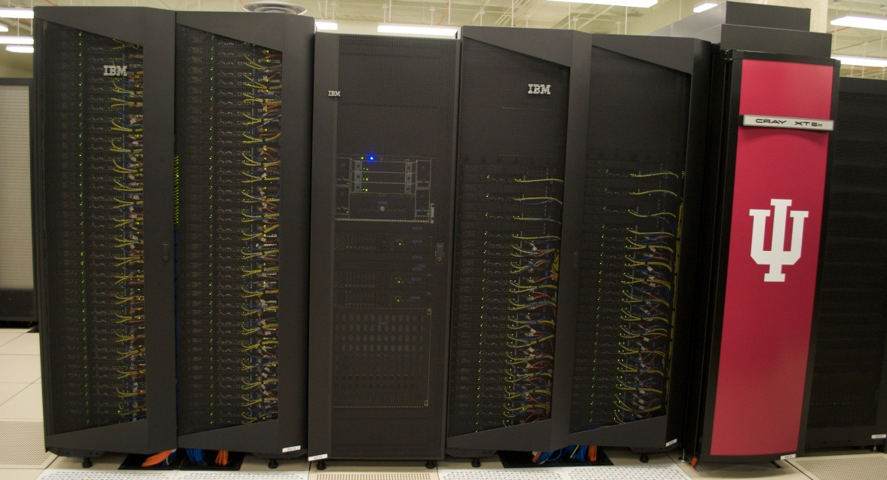
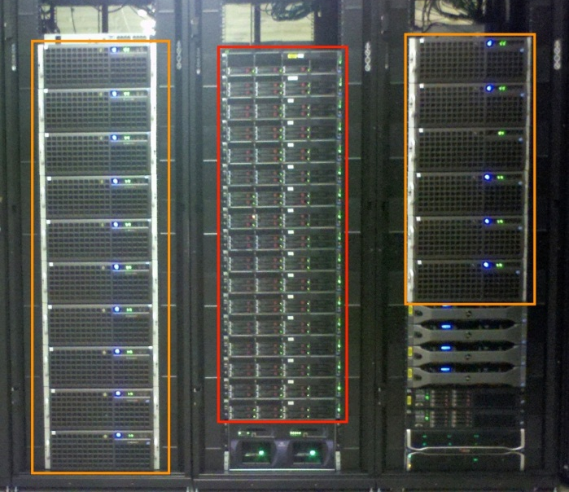
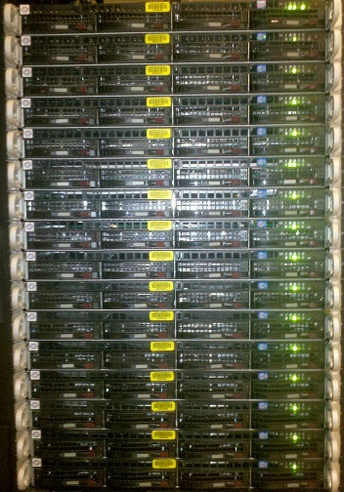
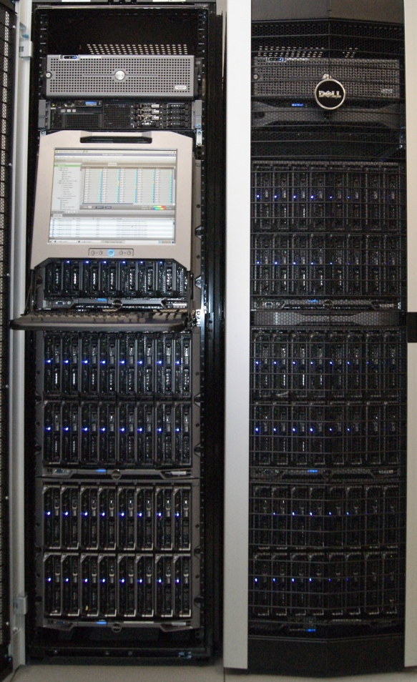
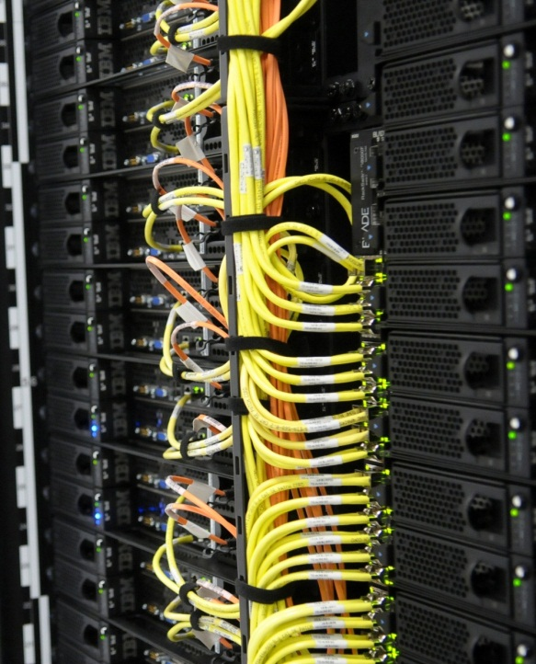
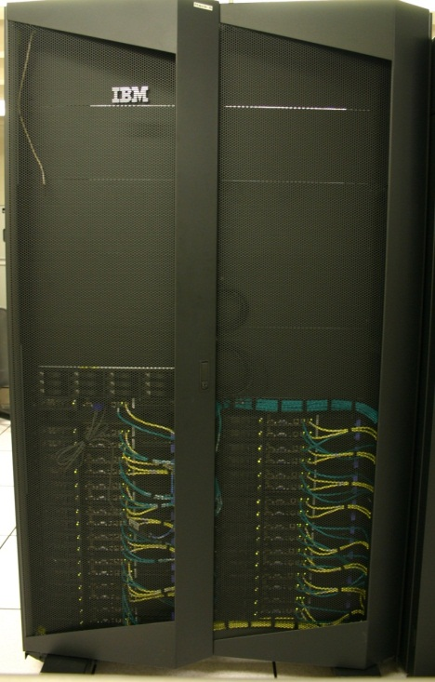
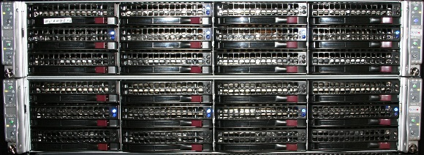
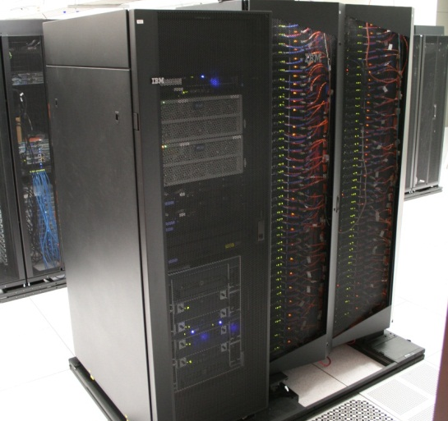
FutureGrid Distributed Computing TestbedaaS
Bravo Delta Echo (IU)
India (IBM) and Xray (Cray) (IU)
Lima (SDSC)
Hotel (Chicago)
Foxtrot (UF)
Sierra (SDSC)
Alamo (TACC)

Slide 13
Storage Hardware
System Type | Capacity (TB) | File System | Site | Status
Xanadu 360 | 180 | NFS | IU | New System
DDN 6620 | 120 | GPFS | UC | New System
SunFire x4170 | 96 | ZFS | SDSC | New System
Dell MD3000 | 30 | NFS | TACC | New System
IBM | 24 | NFS | UF | New System
Substantial back up storage at IU: Data Capacitor and HPSS
Support
Traditional Drupal Portal with usual functions
Traditional Ticket System
System Admin and User facing support (small)
Outreach group (small)
Strong Systems Admin Collaboration with Software group

Slide 14
More Example Projects

Slide 15
ATLAS T3 Computing in the Cloud
Running 0 to 600 ATLAS simulation jobs continuously since April 2012.
Number of running VMs responds dynamically to the workload management system (Panda).
Condor executes the jobs, Cloud Scheduler manages the VMs
Using cloud resources at FutureGrid, University of Victoria, and National Research Council of Canada

Slide 16
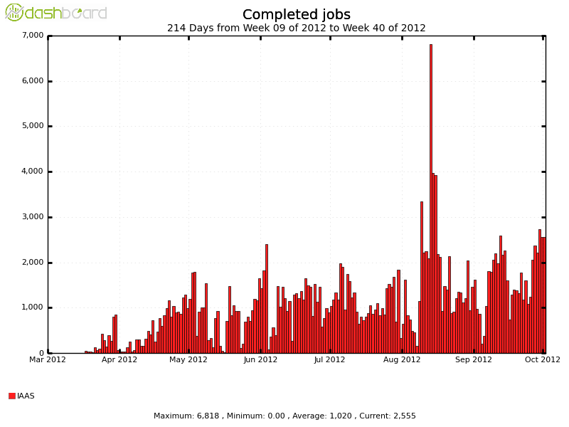
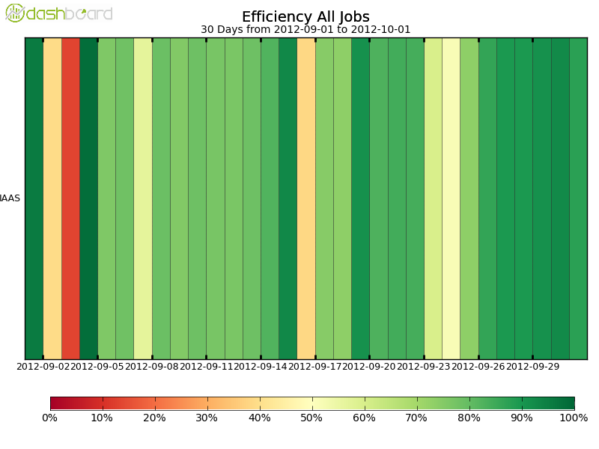
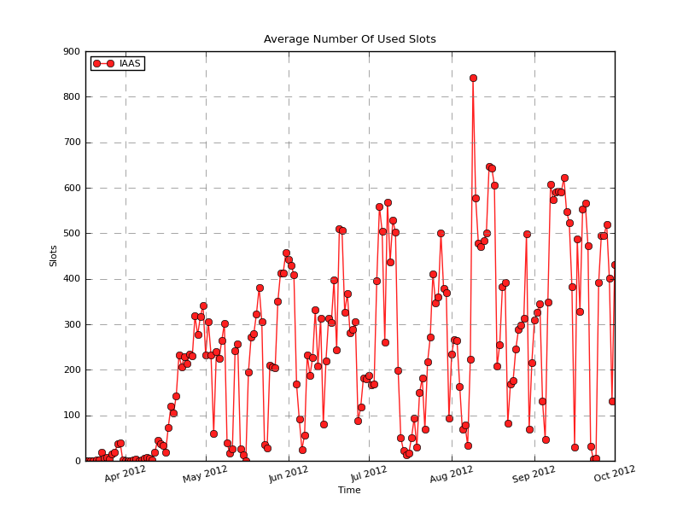
Completed jobs per day since march
CPU Efficiency in the last month
Number of simultaneously running jobs since march (1 per core)

Slide 17
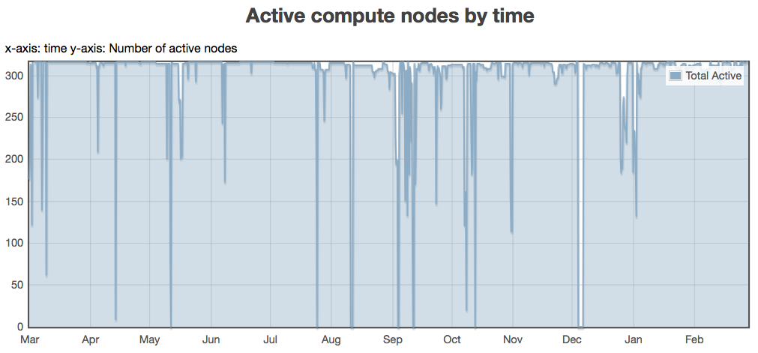
Improving IaaS Utilization
Challenge
  Utilization is the catch-22 of on-demand clouds
Solution
  Preemptible instances: increase utilization without sacrificing the ability to respond to on-demand requests
  Multiple contention management strategies
94%
78%
62%
47%
31%
16%
ANL Fusion cluster utilization 03/10 -03/11
Courtesy of Ray Bair, ANL
Paper:
Marshall P., K. Keahey, and T. Freeman,
“Improving Utilization of Infrastructure Clouds“, CCGrid’11
Notes:
Include utilization graph

Slide 18
Improving IaaS Utilization
Preemption Disabled
Average utilization: 36.36%
Maximum utilization: 43.75%
Preemption Enabled
Average utilization: 83.82%
Maximum utilization: 100%
Infrastructure Utilization (%)
Infrastructure Utilization (%)

Slide 19
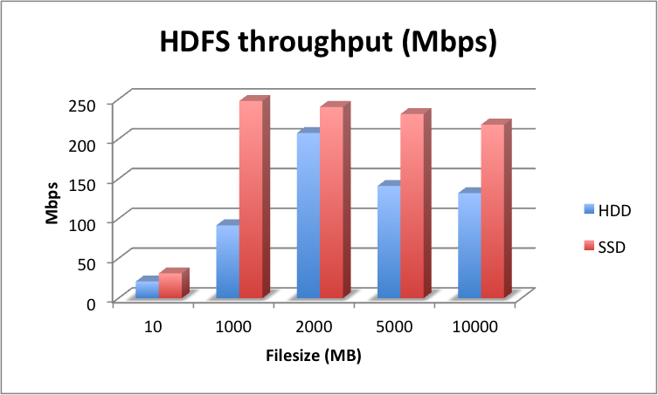
SSD experimentation using Lima
Lima @ UCSD
8 nodes, 128 cores
AMD Opteron 6212
64 GB DDR3
10GbE Mellanox ConnectX 3 EN
1 TB 7200 RPM Ent SATA Drive
480 GB SSD SATA Drive (Intel 520)
HDFS I/O throughput (Mbps) comparison for SSD and HDD using the TestDFSIO benchmark. For each file size, ten files were written to the disk.

Slide 20
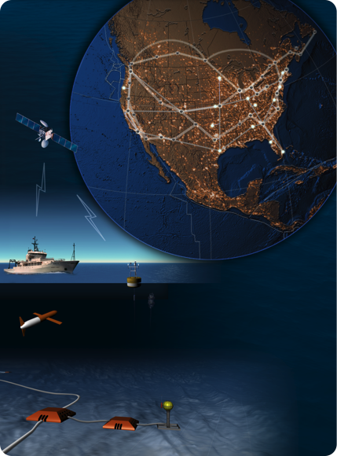

Ocean Observatory Initiative (OOI)
Towards Observatory Science
Sensor-driven processing
  Real-time event-based data stream processing capabilities
  Highly volatile need for data distribution and processing
  An “always-on” service
Nimbus team building platform services for integrated, repeatable support for on-demand science
  High-availability
  Auto-scaling
From regional Nimbus clouds to commercial clouds
Notes:
OOI is changing the nature of ocean scientists from an exploratory science -- where the scientists would go out to sea, gather artifacts and then examine them -- to an observatory science – where scientists gather data from sensors (ocean floor, floats, boats, buoys, satellite images, seismic stations, what have you…) – and reason about the ocean based on that data. These sensors recently became very cheap; this in conjunction with more reliable wireless networking enables the movement towards observatory science.
This means that rather than have relatively few very large data chunks, we are operating in an environment where we have a very large amount of relatively small data chunks or rather are constantly operating on data streams that can multiply and metamorphose very fast in real-time
There is no point in having all this up-to-the-minute information from data streams if you cannot process it. (A) Typically the need for processing varies based on the content of the data (e.g., hurricane detection creates the need for various prediction similations, algae bloom creates the needs for predictions, alerts to fisheries, beaches closing, etc.) -- the need for data distribution and analysis is highly volatile. (B) Services also need to be HA because when the hurricane is coming you can’t really say, “we are down for maintenance, tell the hurricane to come next week”
Nimbus Platform is helping OOI to provide autoscaling and HA services
Nimbus Infrastructure is configured on local clouds.

Slide 21
Details – XSEDE Testing and FutureGrid

Slide 22
Software Evaluation and Testing on FutureGrid
Technology Investigation Service (TIS) provides a capability to identify, track, and evaluate hardware and software technologies that could be used in XSEDE or any other cyberinfrastructure
XSEDE Software Development & Integration (SD&I) uses best software engineering practices to deliver high quality software thru XSEDE Operations to Service Providers, End Users, and Campuses.
XSEDE Operations Software Testing and Deployment (ST&D) performs acceptance testing of new XSEDE capabilities
Notes:
Three different testing teams associated with XSEDE. All have used FutureGrid resources in their software evaluations and are collaborating to come up with a common set of base images that can be shared amongst all testing efforts.

Slide 23


SD&I testing for XSEDE Campus Bridging for
EMS/GFFS
(aka SDIACT-101)
SD&I test plan
Full test pass involving…
XRay as only endpoint (putting heavy load on a single BES – Cray XT5m Linux/Torque/Moab)
India as only endpoint (testing on a IBM iDataplex Redhat 5/Torque/Moab)
Centurion (UVa) as only endpoint (testing against Genesis II BES)
Sierra setup fresh following CI installation guide (testing the correctness of the installation guide)
Sierra and India (testing load balancing to these endpoints)
GenesisII
Notes:
Example of single XSEDE testing effort that used three FG machines

Slide 24
XSEDE SD&I and Operations testing of xdusage (aka SDIACT-102)
Joint SD&I and Operations test plan
Full test pass involving…
FutureGrid Nimbus VM on Hotel (emulating TACC Lonestar)
Verne test node (emulating NICS Nautilus)
Giu1 test node (emulating PSC Blacklight)
xdusage gives researchers and their collaborators a command line way to view their allocation information in the XSEDE central database (XDCDB)
% xdusage -a -p TG-STA110005S
Project: TG-STA110005S/staff.teragrid
PI: Navarro, John-Paul
Allocation: 2012-09-14/2013-09-13
Total=300,000 Remaining=297,604 Usage=2,395.6 Jobs=21
PI Navarro, John-Paul portal=navarro usage=0 jobs=0
Notes:
Example of another testing effort where a Nimbus VM was used on Hotel.

Slide 25
Activities Related to FutureGrid

Slide 26
Essential and Different features of FutureGrid in Cloud area
Unlike many clouds such as Amazon and Azure, FutureGrid allows robust reproducible (in performance and functionality) research (you can request same node with and without VM)
  Open Transparent Technology Environment
FutureGrid is more than a Cloud; it is a general distributed Sandbox; a cloud grid HPC testbed
Supports 3 different IaaS environments (Nimbus, Eucalyptus, OpenStack) and projects involve 5 (also CloudStack, OpenNebula)
Supports research on cloud tools, cloud middleware and cloud-based systems
FutureGrid has itself developed middleware and interfaces to support FutureGrid’s mission e.g. Phantom (cloud user interface) Vine (virtual network) RAIN (deploy systems) and security/metric integration
FutureGrid has experience in running cloud systems

Slide 27
Related Projects
Grid5000 (Europe) and OpenCirrus with managed flexible environments are closest to FutureGrid and are collaborators
PlanetLab has a networking focus with less managed system
Several GENI related activities including network centric EmuLab, PRObE (Parallel Reconfigurable Observational Environment), ProtoGENI, ExoGENI, InstaGENI and GENICloud
BonFire (Europe) similar to Emulab
Recent EGI Federated Cloud with OpenStack and OpenNebula aimed at EU Grid/Cloud federation
Private Clouds: Red Cloud (XSEDE), Wispy (XSEDE), Open Science Data Cloud and the Open Cloud Consortium are typically aimed at computational science
Public Clouds such as AWS do not allow reproducible experiments and bare-metal/VM comparison; do not support experiments on low level cloud technology

Slide 28
Related Projects in Detail I
EGI Federated cloud (see https://wiki.egi.eu/wiki/Fedcloud-tf:UserCommunities and https://wiki.egi.eu/wiki/Fedcloud-tf:Testbed#Resource_Providers_inventory) with about 4910 documented cores according to the pages. Mostly OpenNebula and OpenStack
Grid5000 is a scientific instrument designed to support experiment-driven research in all areas of computer science related to parallel, large-scale, or distributed computing and networking. Experience from Grid5000 is a motivating factor for FG. However, the management of the various Cloud and PaaS frameworks is not addressed.
EmuLab provides the software and a hardware specification for a Network Testbed. Emulab is a long-running project and has through its integration into GENI and its deployment in a number of sites resulted in a number of tools that we will try to leverage. These tools have evolved from a network-centric view and allow users to emulate network environments to further users’ research goals. Additionally, some attempts have been made to run IaaS frameworks such as OpenStack and Eucalyptus on Emulab.

Slide 29
Related Projects in Detail II
PRObE (Parallel Reconfigurable Observational Environment) using EmuLab targets scalability experiments on the supercomputing level while providing a large-scale, low-level systems research facility. It consists of recycled super-computing servers from Los Alamos National Laboratory.
PlanetLab consists of a few hundred machines spread over the world, mainly designed to support wide-area networking and distributed systems research
ExoGENI links GENI to two advances in virtual infrastructure services outside of GENI: open cloud computing (OpenStack) and dynamic circuit fabrics. ExoGENI orchestrates a federation of independent cloud sites and circuit providers through their native IaaS interfaces and links them to other GENI tools and resources. ExoGENI uses OpenFlow to connect the sites and ORCA as a control software. Plugins for OpenStack and Eucalyptus for ORCA are available.
ProtoGENI is a prototype implementation and deployment of GENI largely based on Emulab software. ProtoGENI is the Control Framework for GENI Cluster C, the largest set of integrated projects in GENI.

Slide 30
Related Projects in Detail III
BonFire from the EU is developing a testbed for internet as a service environment. It provides offerings similar to Emulab: a software stack that simplifies experiment execution while allowing a broker to assist in test orchestration based on test specifications provided by users.
OpenCirrus is a cloud computing testbed for the research community that federates heterogeneous distributed data centers. It has partners from at least 6 sites. Although federation is one of the main research focuses, the testbed does not yet employ a generalized federated access to their resources according to discussions that took place at the last OpenCirrus Summit.
Amazon Web Services (AWS) provides the de facto standard for clouds. Recently, projects have integrated their software services with resources offered by Amazon, for example, to utilize cloud bursting in the case of resource starvation as part of batch queuing systems . Others (MIT) have automated and simplified the process of building, configuring, and managing clusters of virtual machines on Amazon’s EC2 cloud.

Slide 31
Related Projects in Detail IV
InstaGENI and GENICloud build two complementary elements for providing a federation architecture that takes its inspiration from the Web. Their goals are to make it easy, safe, and cheap for people to build small Clouds and run Cloud jobs at many different sites. For this purpose, GENICloud/TransCloud provides a common API across Cloud Systems and access Control without identity. InstaGENI provides an out-of-the-box small cloud. The main focus of this effort is to provide a federated cloud infrastructure
Cloud testbeds and deployments. In addition a number of testbeds exist providing access to a variety of cloud software. These testbeds include Red Cloud, Wimpy, the Open Science Data Cloud, and the Open Cloud Consortium resources.
XSEDE is a single virtual system that scientists can use to share computing resources, data, and expertise interactively. People around the world use these resources and services, including supercomputers, collections of data, and new tools. XSEDE is devoted to delivering a production-level facility to its user community. It is currently exploring clouds, but has not yet committed to them. XSEDE does not allow the provisioning of the software stack in the way FG allows.

Slide 32
Link FutureGrid and GENI
Identify how to use the ORCA federation framework to integrate FutureGrid (and more of XSEDE?) into ExoGENI
Allow FG(XSEDE) users to access the GENI resources and vice versa
Enable PaaS level services (such as a distributed Hbase or Hadoop) to be deployed across FG and GENI resources
Leverage the Image generation capabilities of FG and the bare metal deployment strategies of FG within the GENI context.
  Software defined networks plus cloud/bare metal dynamic provisioning gives software defined systems

Slide 33
Typical FutureGrid/GENI Project
Bringing computing to data is often unrealistic as repositories distinct from computing resource and/or data is distributed
So one can build and measure performance of virtual distributed data stores where software defined networks bring the computing to distributed data repositories.
Example applications already on FutureGrid include Network Science (analysis of Twitter data), “Deep Learning” (large scale clustering of social images), Earthquake and Polar Science, Sensor nets as seen in Smart Power Grids, Pathology images, and Genomics
Compare different data models HDFS, Hbase, Object Stores, Lustre, Databases

Slide 34
Details – FutureGrid Futures

Slide 35
Lessons learnt from FutureGrid
Unexpected major use from Computer Science and Middleware
Rapid evolution of Technology Eucalyptus → Nimbus → OpenStack
Open source IaaS maturing as in “Paypal To Drop VMware From 80,000 Servers and Replace It With OpenStack” (Forbes)
  “VMWare loses $2B in market cap”; eBay expects to switch broadly?
Need interactive not batch use; nearly all jobs short
Substantial TestbedaaS technology needed and FutureGrid developed (RAIN, CloudMesh, Operational model) some
Lessons more positive than DoE Magellan report (aimed as an early science cloud) but goals different
Still serious performance problems in clouds for networking and device (GPU) linkage; many activities outside FG addressing
  One can get good Infiniband performance on a peculiar OS + Mellanox drivers but not general yet
We identified characteristics of “optimal hardware”
Run system with integrated software (computer science) and systems administration team
Build Computer Testbed as a Service Community

Slide 36
Future Directions for FutureGrid
Poised to support more users as technology like OpenStack matures
  Please encourage new users and new challenges
More focus on academic Platform as a Service (PaaS) - high-level middleware (e.g. Hadoop, Hbase, MongoDB) – as IaaS gets easier to deploy
    Expect increased Big Data challenges
Improve Education and Training with model for MOOC laboratories
Finish CloudMesh (and integrate with Nimbus Phantom) to make FutureGrid as hub to jump to multiple different “production” clouds commercially, nationally and on campuses; allow cloud bursting
  Several collaborations developing
Build underlying software defined system model with integration with GENI and high performance virtualized devices (MIC, GPU)
Improved ubiquitous monitoring at PaaS IaaS and NaaS levels
Improve “Reproducible Experiment Management” environment
Expand and renew hardware via federation

Slide 37
FutureGrid is an onramp to other systems
FG supports Education & Training for all systems
User can do all work on FutureGrid OR
User can download Appliances on local machines (Virtual Box) OR
User soon can use CloudMesh to jump to chosen production system
CloudMesh is similar to OpenStack Horizon, but aimed at multiple federated systems.
  Built on RAIN and tools like libcloud, boto with protocol (EC2) or programmatic API (python)
  Uses general templated image that can be retargeted
  One-click template & image install on various IaaS & bare metal including Amazon, Azure, Eucalyptus, Openstack, OpenNebula, Nimbus, HPC
  Provisions the complete system needed by user and not just a single image; copes with resource limitations and deploys full range of software
  Integrates our VM metrics package (TAS collaboration) that links to XSEDE (VM's are different from traditional Linux in metrics supported and needed)

Slide 38
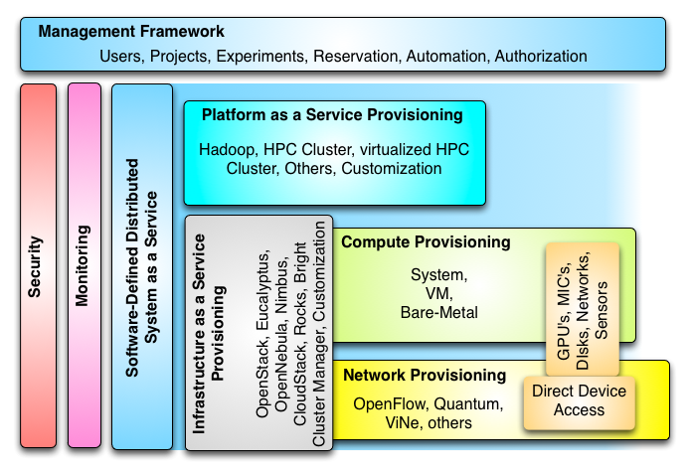
Proposed FutureGrid Architecture

Slide 39
Summary Differences between FutureGrid I (current) and FutureGrid II
Usage | FutureGrid I | FutureGrid II
Target environments | Grid, Cloud, and HPC | Cloud, Big-data, HPC, some Grids
Computer Science | Per-project experiments | Repeatable, reusable experiments
Education | Fixed Resource | Scalable use of Commercial to FutureGrid II to Appliance per-tool and audience type
Domain Science | Software develop/test | Software develop/test across resources using templated appliances
Cyberinfrastructure | FutureGrid I | FutureGrid II
Provisioning model | IaaS+PaaS+SaaS | CTaaS including NaaS+IaaS+PaaS+SaaS
Configuration | Static | Software-defined
Extensibility | Fixed size | Federation
User support | Help desk | Help Desk + Community based
Flexibility | Fixed resource types | Software-defined + federation
Deployed Software Service Model | Proprietary, Closed Source, Open Source | Open Source
IaaS Hosting Model | Private Distributed Cloud | Public and Private Distributed Cloud with multiple administrative domains

Slide 40
Details -- Security

Slide 41
Security issues in FutureGrid Operation
Security for TestBedaaS is a good research area (and Cybersecurity research supported on FutureGrid)!
Authentication and Authorization model
  This is different from those in use in XSEDE and changes in different releases of VM Management systems
  We need to largely isolate users from these changes for obvious reasons
  Non secure deployment defaults (in case of OpenStack)
  OpenStack Grizzly (just released) has reworked the role based access control mechanisms and introduced a better token format based on standard PKI (as used in AWS, Google, Azure)
  Custom: We integrate with our distributed LDAP between the FutureGrid portal and VM managers. LDAP server will soon synchronize via AMIE to XSEDE
Security of Dynamically Provisioned Images
  Templated image generation process automatically puts security restrictions into the image; This includes the removal of root access
  Images include service allowing designated users (project members) to log in
  Images vetted before allowing role-dependent bare metal deployment
  No SSH keys stored in images (just call to identity service) so only certified users can use

Slide 42
Some Security Aspects in FG
User Management
  Users are vetted twice
    (a) when they come to the portal all users are checked if they are technical people and potentially could benefit from a project
    (b) when a project is proposed the proposer is checked again.
    Surprisingly: so far vetting of most users is simple
  Many portals do not do (a)
    therefore they have many spammers and people not actually interested in the technology
    As we have wiki forum functionality in portal we need (a) so we can avoid vetting every change in the portal which is too time consuming

Slide 43
Image Management
Authentication and Authorization
  Significant changes in technologies within IaaS frameworks such as OpenStack
  OpenStack
    Evolving integration with enterprise system Authentication and Authorization frameworks such as LDAP
    Simplistic default setup scenarios without securing the connections
    Grizzly changes several things

Slide 44
Significant Grizzly changes
“A new token format based on standard PKI functionality provides major performance improvements and allows offline token authentication by clients without requiring additional Identity service calls. OpenStack Identity also delivers more organized management of multi-tenant environments with support for groups, impersonation, role-based access controls (RBAC), and greater capability to delegate administrative tasks.”

Slide 45
A new version comes out …
We need to redo security work and integration into our user management system.
Needs to be done carefully.
Should we federate accounts?
  Previously we have not federated accounts in OpenStack with the portal
  We are experimenting now with federation, e.g. users can use portal account to log into clouds, and use same keys they use for logging into HPC.

Slide 46
Federation with XSEDE
We can receive new user requests from XSEDE and create accounts for such users
How do we approach SSO?
  The Grid community has made this a major task
  However we are not just about XSEDE resources, what about EGI, GENI, …, Azure, Google, AWS
  Two models (a) VO’s with federated authentication and authorization (b) user-based federation while user manages multiple logins in various services through a key-ring with multiple keys

Slide 47
Details – Image Generation

Slide 48
Life Cycle of Images

Slide 49
Phase (a) & (b) from Lifecycle Management
  Creates images according to user’s specifications:
    OS type and version
    Architecture
    Software Packages
  Images are not aimed to any specific infrastructure
  Image stored in Repository
Notes:
This picture represent the workflow of the image generation. After the user introduce the requirements, the image generation service searches into the image repository to identify a base image to be cloned. A base image only contains the OS and minimum required software. If the image generation service finds such an image, it just needs to install the software required by the user and store de image.
In the case that it does not find a base image, it create such an image from scratch. This is done using the tools to bootstrap images provided by the different OSes, such as yum for CentOS and deboostrap for Ubuntu. To deal with different OSes and architectures, we use cloud technologies. Consequently, an image is created with all user specified packages inside a VM instantiated on-demand. Therefore, multiple users can create multiple images for different operating systems concurrently; obviously, this approach provides us with great flexibility, architecture independence, and high scalability. Currently, we use OpenNebula to support this process.
------------------
First, the image generation tool searches into the image repository to identify a base image to be cloned, and if there is no good candidate, the base image is created from scratch. Once we have a base image, the image generation tool installs the software required by the user.
One feature of our design is to either create images from scratch or by cloning already created base images we locate in our repository. In the first case, images are created using the tools to bootstrap images provided by the different OSes, such as yum for CentOS and deboostrap for Ubuntu. To deal with different OSes and architectures, we use cloud technologies. Consequently, an image is created with all user specified packages inside a VM instantiated on-demand. Therefore, multiple users can create multiple images for different operating systems concurrently; obviously, this approach provides us with great flexibility, architecture independence, and high scalability. Currently, we use OpenNebula to support this process.
We can speed-up the process of generating an image by not starting from scratch but by using an image already stored in the repository. We have tagged such candidate images in the repository as base images. Consequently, modifications include installation or update of the packages that the user requires. Our design can utilize either VMs or a physical machine to chroot into the image to conduct this step.

Slide 50
Performance of Dynamic Provisioning
4 Phases a) Design and create image (security vet) b) Store in repository as template with components c) Register Image to VM Manager (cached ahead of time) d) Instantiate (Provision) image
Phase d)
Phase a) b)
Phase a) b)

Slide 51
Time for Phase (a) & (b)

Slide 52
Time for Phase (c)

Slide 53
Time for Phase (d)

Slide 54
Why is bare metal slower
HPC bare metal is slower as time is dominated in last phase, including a bare metal boot
In clouds we do lots of things in memory and avoid bare metal boot by using an in memory boot.
We intend to repeat experiments in Grizzly and will have than more servers.

Slide 55
Details – Monitoring on FutureGrid
Monitoring and metrics are critical for a Testbed

Slide 56
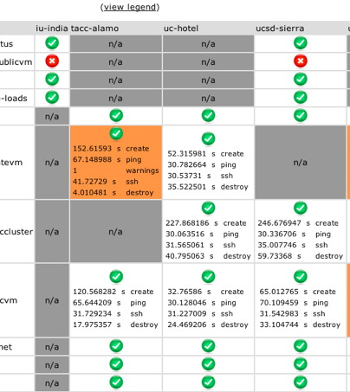
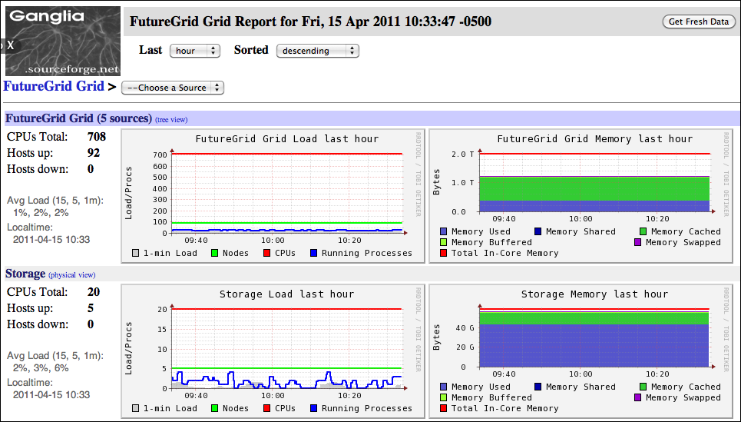
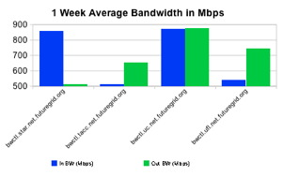
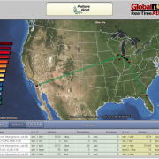
Inca
Software functionality and performance
Ganglia
Cluster monitoring
perfSONAR
Network monitoring - Iperf measurements
SNAPP
Network monitoring – SNMP measurements
Monitoring on FutureGrid
Important and even more needs to be done
Notes:
Listing of the monitoring tools currently deployed on FutureGrid

Slide 57
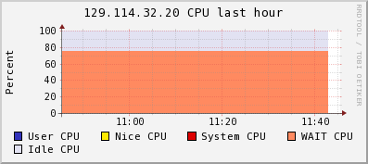
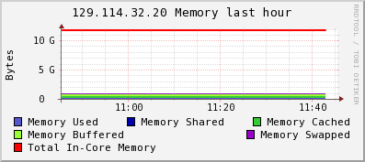
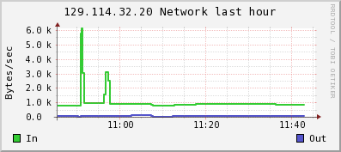
Transparency in Clouds helps users understand application performance
FutureGrid provides transparency of its infrastructure via monitoring and instrumentation tools
Example:
$ cloud-client.sh –conf conf/alamo.conf --status
Querying for ALL instances.
[*] - Workspace #3132. 129.114.32.112 [ vm-112.alamo.futuregrid.org ]
State: Running
Duration: 60 minutes.
Start time: Tue Feb 26 11:28:28 EST 2013
Shutdown time: Tue Feb 26 12:28:28 EST 2013
Termination time: Tue Feb 26 12:30:28 EST 2013
Details: VMM=129.114.32.76
*Handle: vm-311
Image: centos-5.5-x86_64.gz
Nimbus provides VMM information
Ganglia provides host load information

Slide 58
Messaging and Dashboard provided unified access to monitoring data
Messaging tool provides programmatic access to monitoring data
  Single format (JSON)
  Single distribution mechanism via AMQP protocol (RabbitMQ)
  Single archival system using CouchDB (a JSON object store)
Dashboard provides integrated presentation of monitoring data in user portal
Consumers
query/result
messages
Database
Common Representation Language
messages
Messaging Service
messages
Information Gatherer
Information Gatherer

Slide 59
Virtual Performance Measurement
Goal: User-level interface to hardware performance counters for applications running in VMs
Problems and solutions:
  VMMs may not expose hardware counters
    addressed in most recent kernels and VMMs
  Strict infrastructure deployment requirements
    exploration and documentation of minimum requirements
  Counter access may impose high virtualization overheads
    requires careful examination of trap-and-emulate infrastructure
    counters must be validated and interpreted against bare metal
  Virtualization overheads reflect in certain hardware event types; i.e. TLB and cache events
    on-going area for research and documentation

Slide 60
Virtual Timing
Various methods for timekeeping in virtual systems:
  real time clock, interrupt timers, time stamp counter, tickless timekeeping (no timer interrupts)
Various corrections needed for application performance timing; tickless is best
PAPI currently provides two basic timing routines:
  PAPI_get_real_usec for wallclock time
  PAPI_get_virt_usec for process virtual time
    affected by “steal time” when VM is descheduled on a busy system
PAPI has implemented steal time measurement (on KVM) to correct for time deviations on loaded VMMs

Slide 61
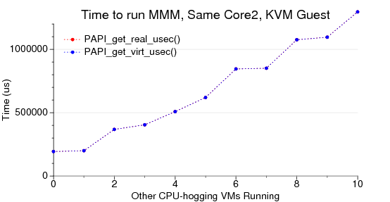
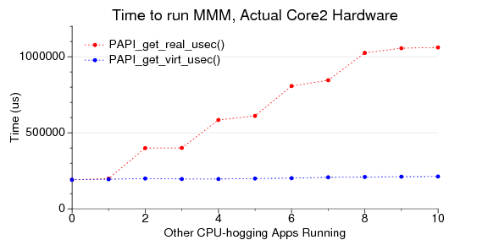
Effect of Steal Time on
Execution Time Measurement
real execution time of matrix-matrix multiply increases linearly per core as other apps are added
virtual execution time remains constant, as expected
both real and virtual execution times increase in lockstep
virtual guests are “stealing” time from each other, creating the need for a virtual-virtual time correction (Stealing when VM’s descheduled to allow others to run)

Slide 62
Details – FutureGrid Appliances

Slide 63
Education and Training Use of FutureGrid
28 Semester long classes: 563+ students
  Cloud Computing, Distributed Systems, Scientific Computing and Data Analytics
3 one week summer schools: 390+ students
  Big Data, Cloudy View of Computing (for HBCU’s), Science Clouds
7 one to three day workshop/tutorials: 238 students
Several Undergraduate research REU (outreach) projects
From 20 Institutions
Developing 2 MOOC’s (Google Course Builder) on Cloud Computing and use of FutureGrid supported by either FutureGrid or downloadable appliances (custom images)
  See http://iucloudsummerschool.appspot.com/preview and http://fgmoocs.appspot.com/preview
FutureGrid appliances support Condor/MPI/Hadoop/Iterative MapReduce virtual clusters

Slide 64
Educational appliances in FutureGrid
A flexible, extensible platform for hands-on, lab-oriented education on FutureGrid
Executable modules – virtual appliances
  Deployable on FutureGrid resources
  Deployable on other cloud platforms, as well as virtualized desktops
Community sharing – Web 2.0 portal, appliance image repositories
  An aggregation hub for executable modules and documentation

Slide 65
Grid appliances on FutureGrid
Virtual appliances
  Encapsulate software environment in image
    Virtual disk, virtual hardware configuration
The Grid appliance
  Encapsulates cluster software environments
    Condor, MPI, Hadoop
  Homogeneous images at each node
  Virtual Network forms a cluster
  Deploy within or across sites
Same environment on a variety of platforms
  FutureGrid clouds; student desktop; private cloud; Amazon EC2; …

Slide 66

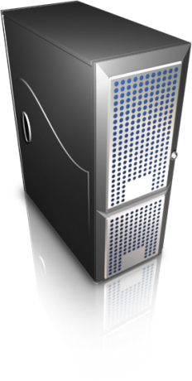
Grid appliance on FutureGrid
Users can deploy virtual private clusters
Hadoop
+
Virtual
Network
Group
VPN
A Hadoop worker
Another Hadoop worker
instantiate
Virtual
machine
copy
GroupVPN
Credentials
Repeat…
(from
Web site)
Virtual IP - DHCP
10.10.1.1
Virtual IP - DHCP
10.10.1.2

