Slide 1
FutureGrid and US Cyberinfrastructure Collaboration with EU
Symposium on transatlantic EU-U.S. cooperation in the field of large scale research infrastructures
1st October 2010 CNR, Rome, Italy
Geoffrey Fox
gcf@indiana.edu
http://www.infomall.org http://www.futuregrid.org
Director, Digital Science Center, Pervasive Technology Institute
Associate Dean for Research and Graduate Studies, School of Informatics and Computing
Indiana University Bloomington

Slide 2
US Cyberinfrastructure Context
There are a rich set of facilities
Production TeraGrid facilities with distributed and shared memory
Experimental “Track 2D” Awards
FutureGrid: Distributed Systems experiments cf. Grid5000
Keeneland: Powerful GPU Cluster
Gordon: Large (distributed) Shared memory system with SSD aimed at data analysis/visualization
Open Science Grid aimed at High Throughput computing and strong campus bridging

Slide 3
FutureGrid key Concepts I
FutureGrid is an international testbed modeled on Grid5000
Rather than loading images onto VM’s, FutureGrid supports Cloud, Grid and Parallel computing environments by dynamically provisioning software as needed onto “bare-metal” using Moab/xCAT
Image library for MPI, OpenMP, Hadoop, Dryad, gLite, Unicore, Globus, Xen, ScaleMP (distributed Shared Memory), Nimbus, Eucalyptus, OpenNebula, KVM, Windows …..
~5000 dedicated cores distributed across country
The FutureGrid testbed provides to its users:
A flexible development and testing platform for middleware and application users looking at interoperability, functionality and performance
Each use of FutureGrid is an experiment that is reproducible
A rich education and teaching platform for advanced cyberinfrastructure classes
Growth comes from users depositing novel images in library

Slide 4
FutureGrid key Concepts II
Support Computer Science and Computational Science
Industry and Academia
Europe and USA
Key early user oriented milestones:
June 2010 Initial users
November 2010-September 2011 Increasing number of users allocated by FutureGrid
October 2011 FutureGrid allocatable via TeraGrid process
3 classes using FutureGrid this fall
Apply now to use FutureGrid on web site www.futuregrid.org

Slide 5
FutureGrid Partners
Indiana University (Architecture, core software, Support)
Collaboration between research and infrastructure groups
Purdue University (HTC Hardware)
San Diego Supercomputer Center at University of California San Diego (INCA, Monitoring)
University of Chicago/Argonne National Labs (Nimbus)
University of Florida (ViNE, Education and Outreach)
University of Southern California Information Sciences (Pegasus to manage experiments)
University of Tennessee Knoxville (Benchmarking)
University of Texas at Austin/Texas Advanced Computing Center (Portal)
University of Virginia (OGF, Advisory Board and allocation)
Center for Information Services and GWT-TUD from Technische Universtität Dresden. (VAMPIR) EUROPE!
Red institutions have FutureGrid hardware

Slide 6
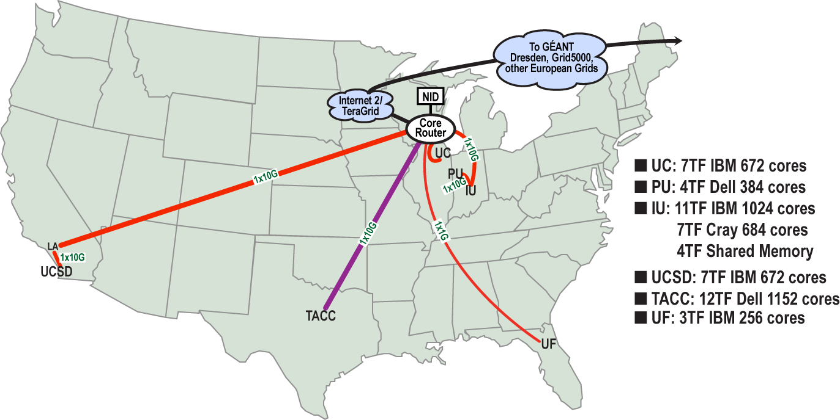
FutureGrid: a Grid/Cloud/HPC Testbed
Operational: IU Cray operational; IU , UCSD, UF & UC IBM iDataPlex operational
Network, NID operational
TACC Dell finished acceptance tests
INCA Node Operating Mode Statistics
NID: Network Impairment Device
Private Public
FG Network

Slide 7
Network & Internal Interconnects
FutureGrid has dedicated network (except to TACC) and a Spirent XGEM network fault and delay generator
Can isolate experiments on request; IU runs Network for NLR/Internet2
(Many) additional partner machines will run FutureGrid software and be supported (but allocated in specialized ways)
Machine | Name | Internal Network
IU Cray | xray | Cray 2D Torus SeaStar
IU iDataPlex | india | DDR IB, QLogic switch with Mellanox ConnectX adapters Blade Network Technologies & Force10 Ethernet switches
SDSC iDataPlex | sierra | DDR IB, Cisco switch with Mellanox ConnectX adapters Juniper Ethernet switches
UC iDataPlex | hotel | DDR IB, QLogic switch with Mellanox ConnectX adapters Blade Network Technologies & Juniper switches
UF iDataPlex | foxtrot | Gigabit Ethernet only (Blade Network Technologies; Force10 switches)
TACC Dell | alamo | QDR IB, Mellanox switches and adapters Dell Ethernet switches

Slide 8
Some Current FutureGrid early uses
Investigate metascheduling approaches on Cray and iDataPlex
Deploy Genesis II and Unicore end points on Cray and iDataPlex clusters
Develop new Nimbus cloud capabilities
Prototype applications (BLAST) across multiple FutureGrid clusters and Grid’5000
Compare Amazon, Azure with FutureGrid hardware running Linux, Linux on Xen or Windows for data intensive applications
Test ScaleMP software shared memory for genome assembly
Develop Genetic algorithms on Hadoop for optimization
Attach power monitoring equipment to iDataPlex nodes to study power use versus use characteristics
Cummins running CFD codes to study combustion strategies to maximize energy efficiency
Support evaluation needed by XD TIS and TAS services
Investigate performance of Kepler workflow engine
Study scalability of SAGA in difference latency scenarios
Test and evaluate new algorithms for phylogenetics/systematics research in CIPRES portal
Investigate performance overheads of clouds in parallel and distributed environments
Support tutorials and classes in cloud, grid and parallel computing (IU, Florida, LSU)
~12 active/finished users out of ~32 early user applicants

Slide 9
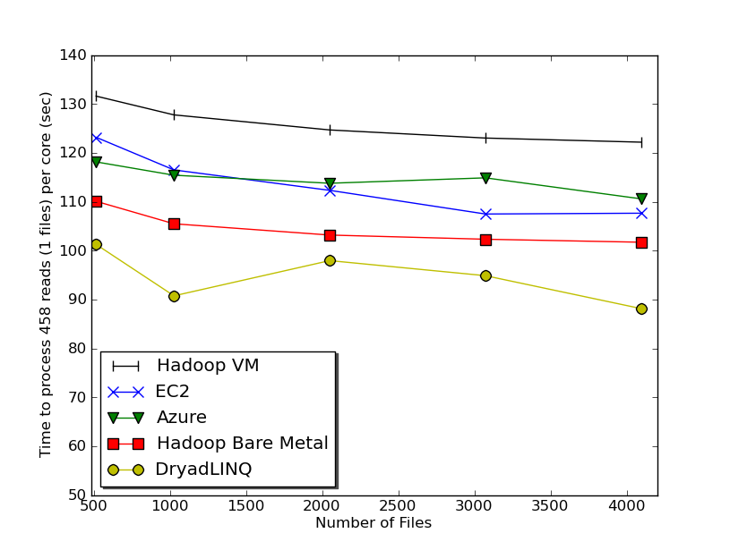
Typical Performance Study
Linux, Linux on VM, Windows, Azure, Amazon Bioinformatics

Slide 10
Education on FutureGrid
Build up tutorials on supported software
Support development of curricula requiring privileges and systems destruction capabilities that are hard to grant on conventional TeraGrid
Offer suite of appliances (customized VM based images) supporting online laboratories
Supporting ~200 students in Virtual Summer School on “Big Data” July 26-30 with set of certified images – first offering of FutureGrid 101 Class; TeraGrid ‘10 “Cloud technologies, data-intensive science and the TG”; CloudCom conference tutorials Nov 30-Dec 3 2010
Experimental class use fall semester at Indiana, Florida and LSU

Slide 11
Software Components
Portals including “Support” “use FutureGrid” “Outreach”
Monitoring – INCA, Power (GreenIT)
Experiment Manager: specify/workflow
Image Generation and Repository
Intercloud Networking ViNE
Virtual Clusters built with virtual networks
Performance library
Rain or Runtime Adaptable InsertioN Service: Schedule and Deploy images
Security (including use of isolated network), Authentication, Authorization,

Slide 12
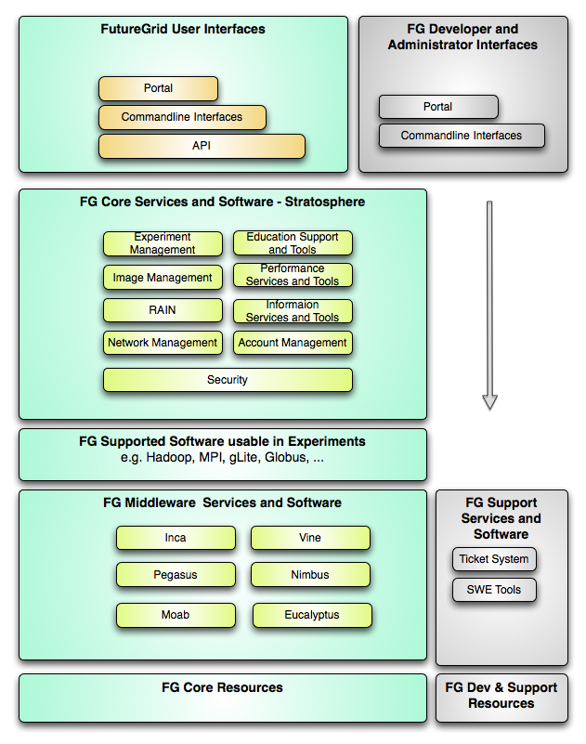
FutureGrid Layered Software Stack
User Supported Software usable in Experiments e.g. OpenNebula, Charm++, Other MPI, Bigtable

Slide 13
Dynamic Provisioning Experiment Logical View

Slide 14
Dynamic Provisioning Results
Time minutes
Number of nodes
Time elapsed between requesting a job and the jobs reported start time on the provisioned node. The numbers here are an average of 2 sets of experiments.

Slide 15
FutureGrid Viral Growth Model
Users apply for a project
Users improve/develop some software in project
This project leads to new images which are placed in FutureGrid repository
Project report and other web pages document use of new images
Images are used by other users
And so on ad infinitum ………

Slide 16
Interactions with Europe I
Software Collaboration: currently Amazon/Azure far ahead of academic computing platforms
Collaboration between Venus-C, FutureGrid and Magellan (DoE) on quantifying value of Clouds in Science
Have planning meeting at CloudCom 2010
Collaboration between NSF Keeneland facility and PRACE (?) on quantifying value of GPGPU’s in Science and developing programming models for Heterogeneous/GPGPU systems
Collaboration between NSF Gordon facility and others on quantifying infrastructure needed for data intensive computational science and engineering

Slide 17
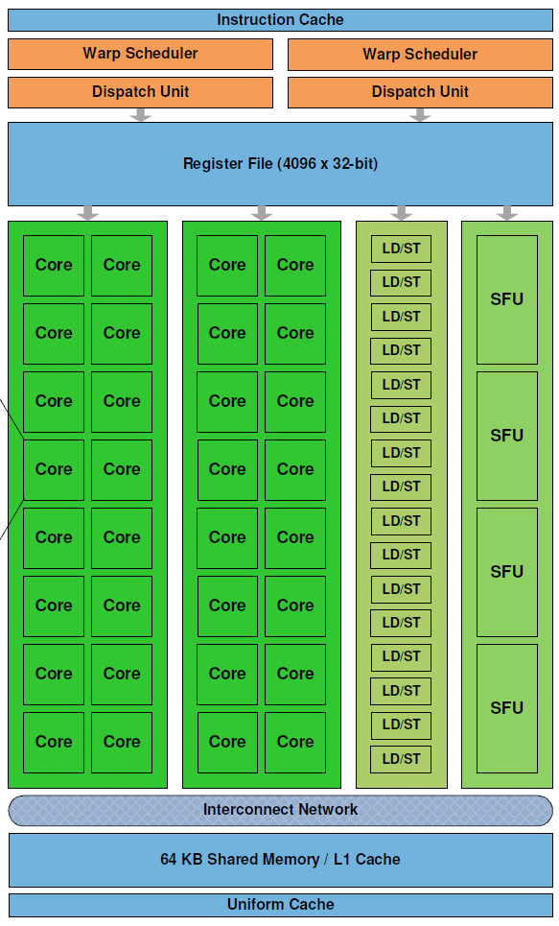
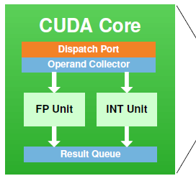
Keeneland – NSF-Funded Partnership to Enable Large-scale Computational Science on Heterogeneous Architectures
NSF Track 2D System of Innovative Design
Georgia Tech
UTK NICS
ORNL
UTK
Two GPU clusters
Initial delivery
Being built now; Expected availability is November 2010
Full scale – Spring 2012
NVIDIA, HP, Intel, Qlogic
Operations, user support
Education, Outreach, Training for scientists, students, industry
Software tools, application development
Exploit graphics processors to provide extreme performance and energy efficiency
Prof. Jeffrey S. Vetter
Prof. Richard Fujimoto
Prof. Karsten Schwan
Prof. Jack Dongarra
Dr. Thomas Schulthess
Prof. Sudha Yalamanchili
Jeremy Meredith
Dr. Philip Roth
Richard Glassbrook
Patricia Kovatch
Stephen McNally
Dr. Bruce Loftis
Jim Ferguson
James Rogers
Kathlyn Boudwin
Arlene Washington
Many others…
NVIDIA’s new Fermi GPU
http://keeneland.gatech.edu
http://ft.ornl.gov

Slide 18
Interactions with Europe II
Joint Summer Schools in areas of Computational and Data-enabled Science and Engineering – GPU’s, Petascale, Big Data, Clouds
Define “appliances” to support laboratories
Study link US Cyberinfrastructure to EGI starting with setting up an “EGI node” on FutureGrid
Build on work of GIN group in OGF
Suite of Interoperability experiments between Grids and Clouds – US Europe Asia South America
Studies of importance of GreenIT using Grid5000, FutureGrid and ?
Generalize to other distributed computing research

Slide 19
194 papers submitted to main track; 48 accepted; 4 days of tutorials including OpenNebula

