Slide 1
FutureGrid Overview
June 14 2012
Cloud and Autonomic Computing Center Spring 2012 Workshop
Cloud Computing: from Cybersecurity to Intercloud
University of Florida Gainesville
Geoffrey Fox
gcf@indiana.edu
http://www.infomall.org https://portal.futuregrid.org
Director, Digital Science Center, Pervasive Technology Institute
Associate Dean for Research and Graduate Studies, School of Informatics and Computing
Indiana University Bloomington

Slide 2
FutureGrid key Concepts I
FutureGrid is an international testbed modeled on Grid5000
Supporting international Computer Science and Computational Science research in cloud, grid and parallel computing (HPC)
  Industry and Academia
The FutureGrid testbed provides to its users:
  A flexible development and testing platform for middleware and application users looking at interoperability, functionality, performance or evaluation
  Each use of FutureGrid is an experiment that is reproducible
  A rich education and teaching platform for advanced cyberinfrastructure (computer science) classes

Slide 3
FutureGrid key Concepts II
FutureGrid has a complementary focus to both the Open Science Grid and the other parts of XSEDE (TeraGrid).
  FutureGrid is user-customizable, accessed interactively and supports Grid, Cloud and HPC software with and without virtualization.
  FutureGrid is an experimental platform where computer science applications can explore many facets of distributed systems
  and where domain sciences can explore various deployment scenarios and tuning parameters and in the future possibly migrate to the large-scale national Cyberinfrastructure.
  FutureGrid supports Interoperability Testbeds (see OGF)
Note much of current use Education, Computer Science Systems and Biology/Bioinformatics

Slide 4

FutureGrid key Concepts III
Rather than loading images onto VM’s, FutureGrid supports Cloud, Grid and Parallel computing environments by provisioning software as needed onto “bare-metal” using Moab/xCAT
  Image library for MPI, OpenMP, MapReduce (Hadoop, Dryad, Twister), gLite, Unicore, Globus, Xen, ScaleMP (distributed Shared Memory), Nimbus, Eucalyptus, OpenNebula, KVM, Windows …..
  Either statically or dynamically
Growth comes from users depositing novel images in library
FutureGrid has ~4000 (will grow to ~5000) distributed cores with a dedicated network and a Spirent XGEM network fault and delay generator
Image1
Image2
…
ImageN
Choose
Load
Run

Slide 5
FutureGrid Partners
Indiana University (Architecture, core software, Support)
Purdue University (HTC Hardware)
San Diego Supercomputer Center at University of California San Diego (INCA, Monitoring)
University of Chicago/Argonne National Labs (Nimbus)
University of Florida (ViNE, Education and Outreach)
University of Southern California Information Sciences (Pegasus to manage experiments)
University of Tennessee Knoxville (Benchmarking)
University of Texas at Austin/Texas Advanced Computing Center (Portal)
University of Virginia (OGF, Advisory Board and allocation)
Center for Information Services and GWT-TUD from Technische Universtität Dresden. (VAMPIR)
Red institutions have FutureGrid hardware

Slide 6

FutureGrid: a Grid/Cloud/HPC Testbed
NID: Network Impairment Device
Private
Public
FG Network

Slide 7
Compute Hardware
Name | System type | # CPUs | # Cores | TFLOPS | Total RAM (GB) | Secondary Storage (TB) | Site | Status
india | IBM iDataPlex | 256 | 1024 | 11 | 3072 | 339 + 16 | IU | Operational
alamo | Dell PowerEdge | 192 | 768 | 8 | 1152 | 30 | TACC | Operational
hotel | IBM iDataPlex | 168 | 672 | 7 | 2016 | 120 | UC | Operational
sierra | IBM iDataPlex | 168 | 672 | 7 | 2688 | 96 | SDSC | Operational
xray | Cray XT5m | 168 | 672 | 6 | 1344 | 339 | IU | Operational
foxtrot | IBM iDataPlex | 64 | 256 | 2 | 768 | 24 | UF | Operational
Bravo | Large Disk & memory | 32 | 128 | 1.5 | 3072 (192GB per node) | 144 (12 TB per Server) | IU | Operational
Delta | Large Disk & memory With Tesla GPU’s | 32 32 GPU’s | 192+ 14336 GPU | ? 6 | 1536 (192GB per node) | 96 (12 TB per Server) | IU | Operational
 |  |  | TOTAL Cores 4384

Slide 8
Storage Hardware
System Type | Capacity (TB) | File System | Site | Status
Xanadu 360 | 180 | NFS | IU | New System
DDN 6620 | 120 | GPFS | UC | New System
SunFire x4170 | 96 | ZFS | SDSC | New System
Dell MD3000 | 30 | NFS | TACC | New System
IBM | 24 | NFS | UF | New System
Substantial back up storage at IU: Data Capacitor and HPSS

Slide 9
Network Impairment Device
  Spirent XGEM Network Impairments Simulator for jitter, errors, delay, etc
  Full Bidirectional 10G w/64 byte packets
  up to 15 seconds introduced delay (in 16ns increments)
  0-100% introduced packet loss in .0001% increments
  Packet manipulation in first 2000 bytes
  up to 16k frame size
  TCL for scripting, HTML for manual configuration

Slide 10
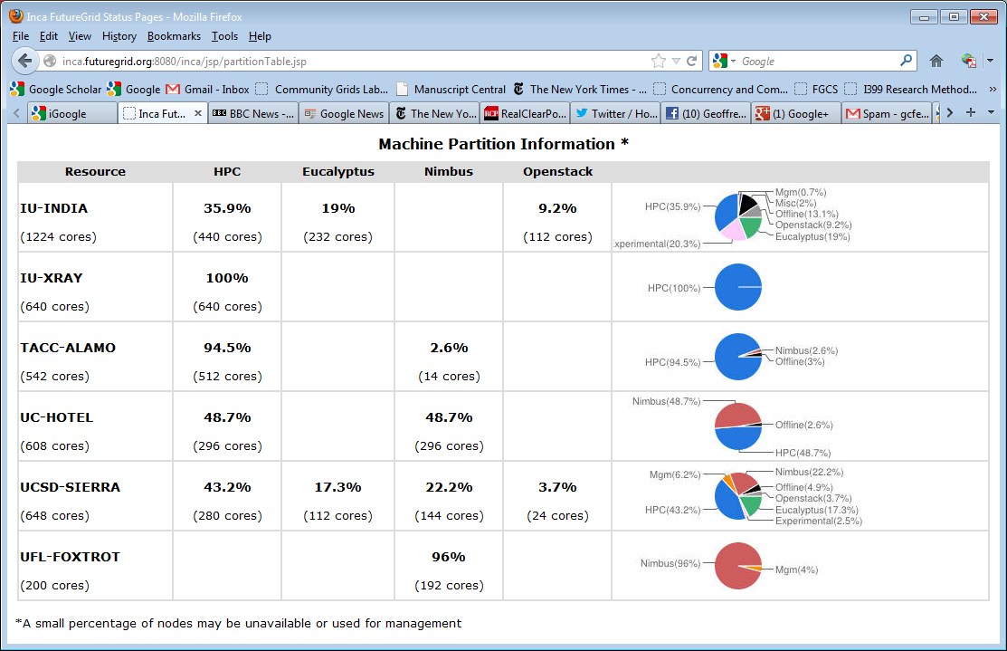
FutureGrid: Inca Monitoring

Slide 11
5 Use Types for FutureGrid
218 approved projects June 13 2012
  https://portal.futuregrid.org/projects
Training Education and Outreach (8%)
  Semester and short events; promising for small universities
Interoperability test-beds (3%)
  Grids and Clouds; Standards; from Open Grid Forum OGF
Domain Science applications (31%)
  Life science highlighted (18%), Non Life Science (13%)
Computer science (47%)
  Largest current category
Computer Systems Evaluation (27%)
  XSEDE (TIS, TAS), OSG, EGI
Clouds are meant to need less support than other models; FutureGrid needs more user support …….

Slide 12
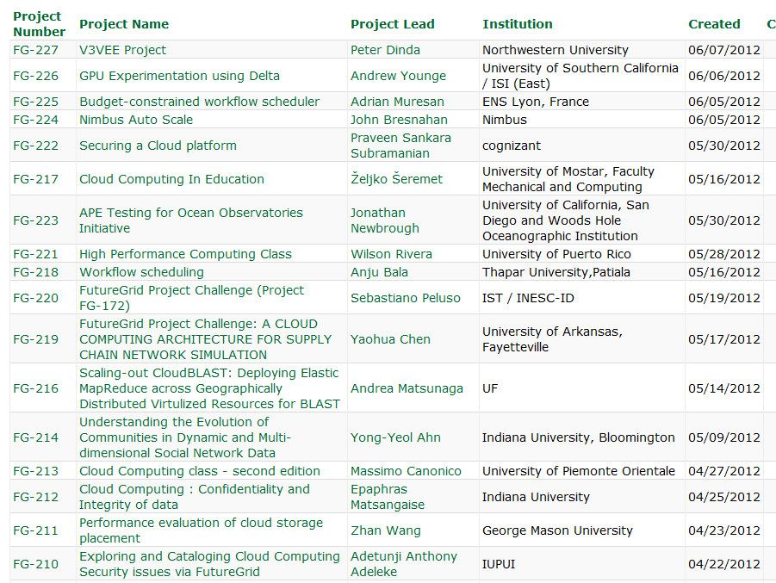
  https://portal.futuregrid.org/projects

Slide 13
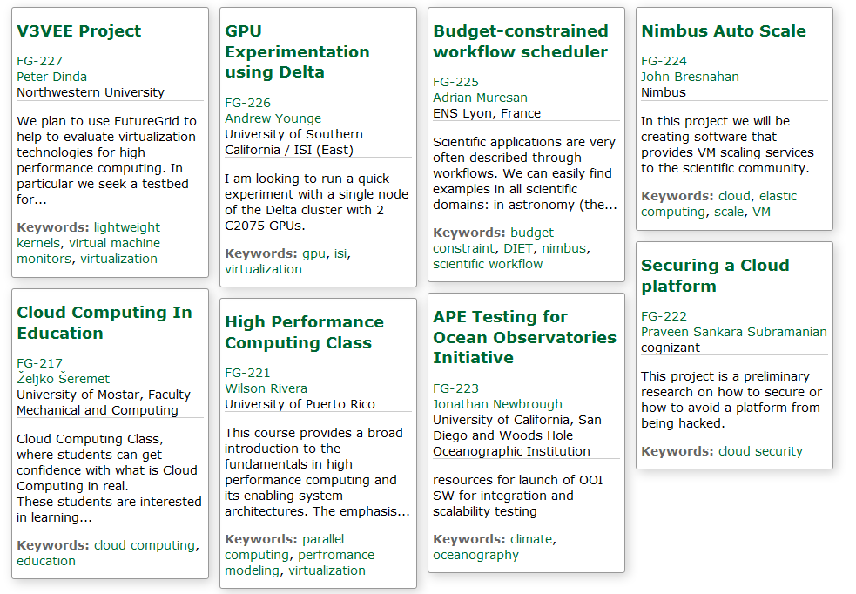
Recent Projects

Slide 14
Distribution of FutureGrid Technologies and Areas
220 Projects

Slide 15
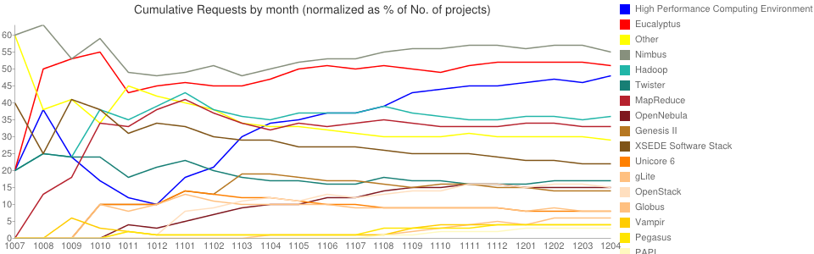
Environments Chosen Fractions v Time
High Performance Computing Environment: 103(47.2%)
Eucalyptus: 109(50%)
Nimbus: 118(54.1%)
Hadoop: 75(34.4%)
Twister: 34(15.6%)
MapReduce: 69(31.7%)
OpenNebula: 32(14.7%)
OpenStack: 36(16.5%)
Genesis II: 29(13.3%)
XSEDE Software Stack: 44(20.2%)
Unicore 6: 16(7.3%)
gLite: 17(7.8%)
Vampir: 10(4.6%)
Globus: 13(6%)
Pegasus: 10(4.6%)
PAPI: 8(3.7%)
CUDA(GPU Software)): 1(0.5%)

Slide 16
FutureGrid Tutorials
Cloud Provisioning Platforms
Using Nimbus on FutureGrid [novice]
Nimbus One-click Cluster Guide
Using OpenStack Nova on FutureGrid Using Eucalyptus on FutureGrid [novice]
Connecting private network VMs across Nimbus clusters using ViNe [novice]
Using the Grid Appliance to run FutureGrid Cloud Clients [novice]
Cloud Run-time Platforms
Running Hadoop as a batch job using MyHadoop [novice]
Running SalsaHadoop (one-click Hadoop) on HPC environment [beginner]
Running Twister on HPC environment
Running SalsaHadoop on Eucalyptus
Running FG-Twister on Eucalyptus
Running One-click Hadoop WordCount on Eucalyptus [beginner]
Running One-click Twister K-means on Eucalyptus
Image Management and Rain
Using Image Management and Rain [novice]
Storage
Using HPSS from FutureGrid [novice]
Educational Grid Virtual Appliances
Running a Grid Appliance on your desktop
Running a Grid Appliance on FutureGrid
Running an OpenStack virtual appliance on FutureGrid
Running Condor tasks on the Grid Appliance
Running MPI tasks on the Grid Appliance
Running Hadoop tasks on the Grid Appliance
Deploying virtual private Grid Appliance clusters using Nimbus
Building an educational appliance from Ubuntu 10.04
Customizing and registering Grid Appliance images using Eucalyptus
High Performance Computing
Basic High Performance Computing
Running Hadoop as a batch job using MyHadoop
Performance Analysis with Vampir
Instrumentation and tracing with VampirTrace
Experiment Management
Running interactive experiments [novice]
Running workflow experiments using Pegasus
Pegasus 4.0 on FutureGrid Walkthrough [novice]
Pegasus 4.0 on FutureGrid Tutorial [intermediary]
Pegasus 4.0 on FutureGrid Virtual Cluster [advanced]

Slide 17
Software Components
Portals including “Support” “use FutureGrid” “Outreach”
Monitoring – INCA, Power (GreenIT)
Experiment Manager: specify/workflow
Image Generation and Repository
Intercloud Networking ViNE
Virtual Clusters built with virtual networks
Performance library
Rain or Runtime Adaptable InsertioN Service for images
Security Authentication, Authorization,
Note Software integrated across institutions and between middleware and systems Management (Google docs, Jira, Mediawiki)
Note many software groups are also FG users
“Research”
Above and below
Nimbus OpenStack Eucalyptus

Slide 18
Motivation: Image Management and Rain on FutureGrid
Allow users to take control of installing the OS on a system on bare metal (without the administrator)
By providing users with the ability to create their own environments to run their projects (OS, packages, software)
Users can deploy their environments in both bare-metal and virtualized infrastructures
Security is obviously important
RAIN manages tools to dynamically provide custom HPC environment, Cloud environment, or virtual networks on-demand

Slide 19
Architecture

Slide 20
Create Image from Scratch
CentOS
Takes Up to 69%
Ubuntu
Takes Up to 83%
Notes:
Need to optimize the CentOS golden image, used by OpenNebula, because the booting process takes longer than the Ubuntu one
Orange section shows the time needed to create the images, which is the most time consuming part of the whole process
-Up to a 69% for CentOS and a 83% for Ubuntu is spent to create the base image

Slide 21
Create Image from Base Image
Reduces 55-67%
CentOS
Ubuntu
Reduces 62-80%
Notes:
We have reduced the time time to create an image in a … 55-67% and 62-80% respectively

Slide 22
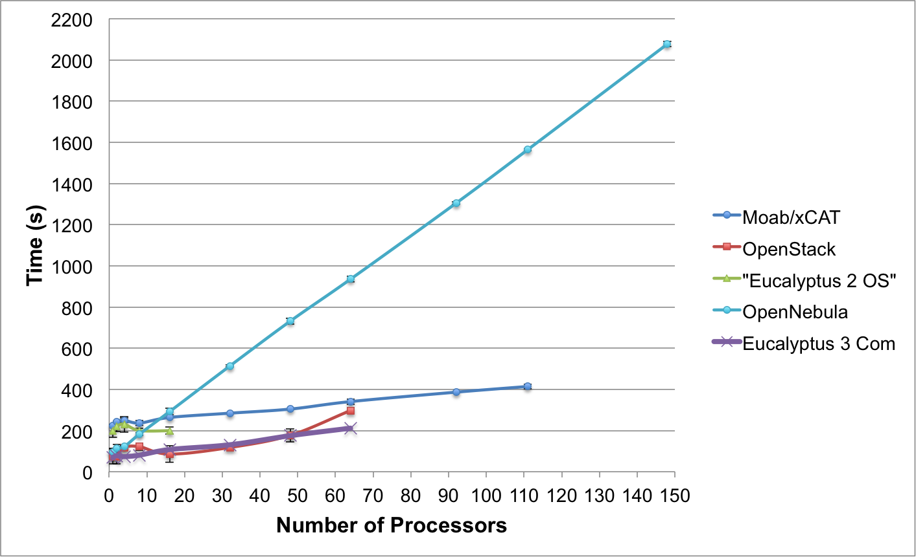
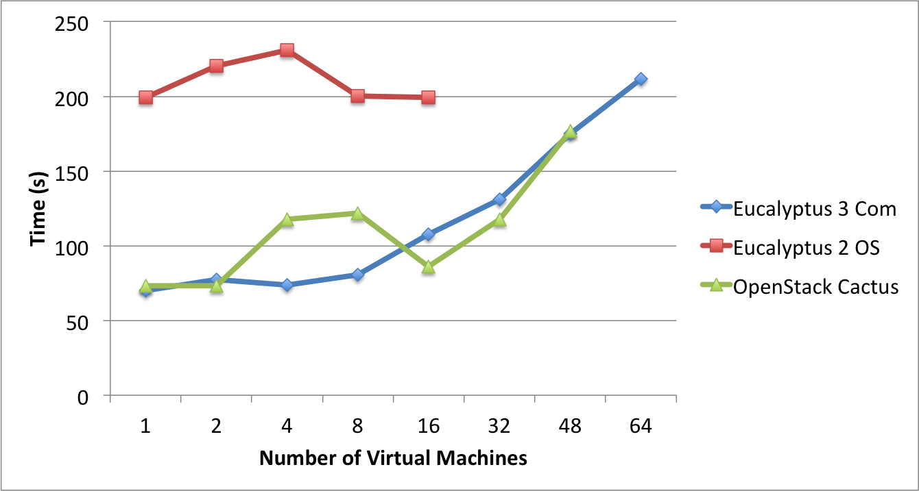
Templated Dynamic Provisioning
Abstract Specification of image mapped to various HPC and Cloud environments
OpenNebula
Parallel provisioning now supported
Moab/xCAT HPC – high as need reboot before use
Essex replaces Cactus
Current Eucalyptus 3 commercial while version 2 Open Source

Slide 23
What is FutureGrid?
The FutureGrid project mission is to enable experimental work that advances:
  Innovation and scientific understanding of distributed computing and parallel computing paradigms,
  The engineering science of middleware that enables these paradigms,
  The use and drivers of these paradigms by important applications, and,
  The education of a new generation of
  students and workforce on the use of
  these paradigms and their applications.
The implementation of mission includes
  Distributed flexible hardware
  with supported use
  Identified IaaS and PaaS “core” software
  with supported use
  Outreach
~4500 cores in 5 major
sites
FutureGrid Usage

Slide 24
Extras

Slide 25
What is FutureGrid?
The FutureGrid project mission is to enable experimental work that advances:
  Innovation and scientific understanding of distributed computing and parallel computing paradigms,
  The engineering science of middleware that enables these paradigms,
  The use and drivers of these paradigms by important applications, and,
  The education of a new generation of students and workforce on the use of these paradigms and their applications.
The implementation of mission includes
  Distributed flexible hardware with supported use
  Identified IaaS and PaaS “core” software with supported use
  Outreach
~4500 cores in 5 major sites

Slide 26
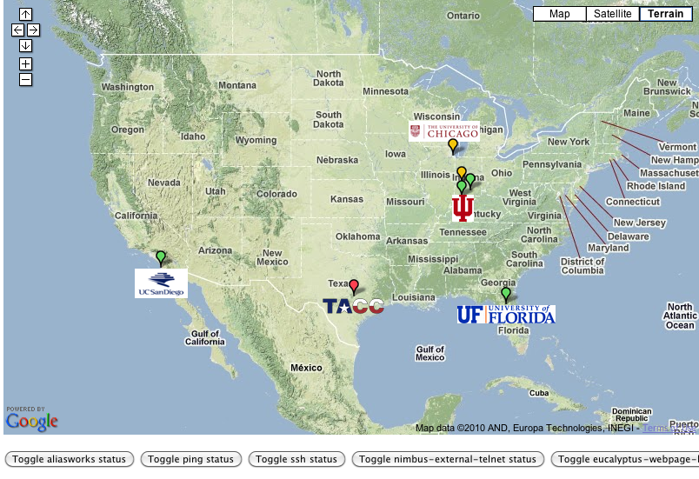
FutureGrid: Online Inca Summary

Slide 27


Slide 28
Technology Projects
ScaleMP for Gene Assembly, Indiana Pervasive Technology Institute (PTI) and Biology, Investigates distributed shared memory over 16 nodes for SOAPdenovo assembly of Daphnia genomes
XSEDE, Virginia, Uses FutureGrid resources as a testbed for XSEDE software development
EMI, European Middleware Initiative will deploy software on FutureGrid for training and use by international users
Bioinformatics and Clouds, University of Oregon installed a local cloud on the UO campus, and used FutureGrid to get a head start on creating and using VMs.

Slide 29
Computer Science Projects I
Data Transfer Throughput, Buffalo, End-to-end optimization of data transfer throughput over wide-area, high-speed networks
Elastic Computing, Colorado, Tools and technologies to create elastic computing environments using IaaS clouds that adjust to changes in demand automatically and transparently
Cloud-TM, Portugal, Cloud-Transactional Memory programming model
The VIEW Project, Wayne State, Investigates Nimbus and Eucalyptus as cloud platforms for elastic workflow scheduling and resource provisioning

Slide 30
Computer Science Projects II
Leveraging Network Flow Watermarking for Co-residency Detection in the Cloud, Oregon Looking at security risks in virtualization and ways of mitigating
Distributed MapReduce, Minnesota. Support data analytics with Hadoop with distributed real time data sources
Evaluation of MPI Collectives for HPC Applications on Distributed Virtualized Environments, Rutgers supporting virtualized simulations for WRF weather codes

Slide 31
Education projects
System Programming and Cloud Computing, Fresno State, Teaches system programming and cloud computing in different computing environments
REU: Cloud Computing, Arkansas, Offers hands-on experience with FutureGrid tools and technologies
Workshop: A Cloud View on Computing, Indiana School of Informatics and Computing (SOIC), Boot camp on MapReduce for faculty and graduate students from underserved ADMI institutions
Topics on Systems: Distributed Systems, Indiana SOIC, Covers core computer science distributed system curricula (for 60 students)

Slide 32
Interoperability Projects
SAGA, Louisiana State, Explores use of FutureGrid components for extensive portability and interoperability testing of Simple API for Grid Applications, and scale-up and scale-out experiments
XSEDE/OGF Unicore and Genesis Grid endpoints tests for new US and European grids

Slide 33
Bio Application Projects
Metagenomics Clustering, North Texas, Analyzes metagenomic data from samples collected from patients
Next Generation Sequencing in the Cloud, Indiana and Lilly, investigate clouds for next generation sequencing using MapReduce
Hadoop-GIS: Emory, High Performance Query System for Analytical Medical Imaging, Geographic Information System like interface to nearly a million derived markups and hundred million features per image.

Slide 34
Non-Bio Application Projects
Physics: Higgs boson, Virginia, Matrix Element calculations representing production and decay mechanisms for Higgs and background processes
Business Intelligence on MapReduce, Cal State - L.A., Market basket and customer analysis designed to execute MapReduce on Hadoop platform
CFD and Workload Management Experimentation Cummins – a major truck engine company testing new simulation approaches

Slide 35

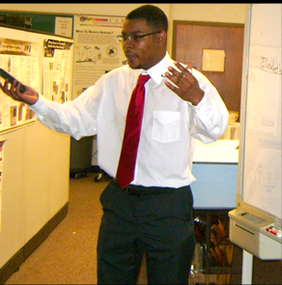
ADMI Cloudy View on
Computing Workshop June 2011
Concept and Delivery by
Jerome Mitchell:
Undergraduate ECSU,
Masters Kansas, PhD Indiana
Jerome took two courses from IU in this area Fall 2010 and Spring 2011 on FutureGrid
ADMI: Association of Computer and Information Science/Engineering Departments at Minority Institutions
Offered on FutureGrid
10 Faculty and Graduate Students from ADMI Universities
The workshop provided information from cloud programming models to case studies of scientific applications on FutureGrid.
At the conclusion of the workshop, the participants indicated that they would incorporate cloud computing into their courses and/or research.

Slide 36
Workshop Purpose
Introduce ADMI to the basics of the emerging Cloud Computing paradigm
  Learn how it came about
  Understand its enabling technologies
  Understand the computer systems constraints, tradeoffs, and techniques of setting up and using cloud
Teach ADMI how to implement algorithms in the Cloud
  Gain competence in cloud programming models for distributed processing of large datasets.
  Understand how different algorithms can be implemented and executed on cloud frameworks
  Evaluating the performance and identifying bottlenecks when mapping applications to the clouds

Slide 37

Typical FutureGrid Performance Study
Linux, Linux on VM, Windows, Azure, Amazon Bioinformatics

Slide 38
FutureGrid Viral Growth Model
Users apply for a project
Users improve/develop some software in project
This project leads to new images which are placed in FutureGrid repository
Project report and other web pages document use of new images
Images are used by other users
And so on ad infinitum ………
Please bring your nifty software up on FutureGrid!!

Slide 39
FutureGrid Software Architecture
Note on Authentication and Authorization
We have different environments and requirements from XSEDE
Non trivial to integrate/align security model with XSEDE

Slide 40
Detailed Software Architecture

Slide 41
Methodology
Software deployed on the FutureGrid India cluster
  Intel Xeon X5570 servers with 24GB of memory
  Single drive 500GB with 7200RPMm 3Gb/s
  Interconnection network of 1Gb Ethernet
Software Client is in India’s login node
Image Generation supported by OpenNebula
Image Repository supported by Cumulus (store images) and MongoDB (store metadata)
HPC supported by xCAT, Moab and Torque
Notes:
Image Generation supported by OpenNebula to allow us to create images for different OSes and architectures. This also provides scalability by simply adding more compute nodes to OpenNebula. So, when we create an image from SCRATCH, OpenNebula starts the appropriate VM and create the image inside.

Slide 42
Scalability of Image Generation I
Concurrent requests to create CentOS images from scratch
Increasing number of OpenNebula compute nodes to scale
Notes:
OpenNebula is used to provide scalability and independence from the OS. Each time that we receive an image creation request, we boot a VM with the appropriate OS and create the image in that VM.
Minimum walltime to create an image is around 6 minutes when we have a single request
In the worst scenario (one compute node and eight requests) the walltime is only 16 minutes
Performance degrades when we generate more than two images per compute node

Slide 43
Scalability of Image Generation II
Analyze how the time is spent within the image creation process
Only one OpenNebula compute node to better analyze the behavior of each step of the process
Concurrent requests to create CentOS and Ubuntu images
Image creation performed from scratch and reusing a base image from the repository

Slide 44
Scalability of Image Registration
Register the same CentOS image in different infrastructures:
  OpenStack (Cactus version configured with KVM hypervisor)
  Eucalyptus (2.03 version configured with XEN hypervisor)
  HPC (netboot image using xCAT and Moab)
To have minimal impact on other HPC services, only process one request at a time is allowed for HPC registration
Notes:
In HPC we only allow the deployment of one image at a time because if this fails it could compromise the stability of our HPC infrastructure

Slide 45
Register Images on Cloud
Eucalyptus
OpenStack
Notes:
Time needed to deploy an image in OpenStack is higher than in Eucalyptus
OpenStack we need to include certain software to allow OpenStack to contextualize the VM during the instantiation time
The process to upload the image to the OpenStack cloud takes longer than in Eucalyptus
OpenStack uncompress the image in the server side as part of this process, while Eucalyptus seem to maintain the compress version of the images
Occasionally OpenStack fails to upload some images when we perform several concurrent requests. These images get stuck in the untarring status and do not evolve to the available one. We suspect that it may be due to some problem with the messaging queue system of our OpenStack deployment, but we could not confirm that because the logs were not very helpful.

Slide 46
Register Image on HPC
Notes:
We observe that the overall process only takes about two minutes as no additional software is needed to be installed and everything is executed on the server.
The most time consuming parts are uncompress the image (orange part) and execute the xCAT packimage command
Creates a tar/cpio image that will be use to netboot bare-metal machines
The scalability of this service is limited because the packimage has to be executed in the machine where xCAT server is installed

