Slide 1
FutureGrid Overview
June 28 2012
HPC 2012 Cetraro, Italy
Geoffrey Fox
gcf@indiana.edu
http://www.infomall.org https://portal.futuregrid.org
Director, Digital Science Center, Pervasive Technology Institute
Associate Dean for Research and Graduate Studies, School of Informatics and Computing
Indiana University Bloomington

Slide 2
FutureGrid key Concepts I
FutureGrid is an international testbed modeled on Grid5000
  June 27 2012: 225 Projects, 920 users
Supporting international Computer Science and Computational Science research in cloud, grid and parallel computing (HPC)
  Industry and Academia
The FutureGrid testbed provides to its users:
  A flexible development and testing platform for middleware and application users looking at interoperability, functionality, performance or evaluation
  Each use of FutureGrid is an experiment that is reproducible
  A rich education and teaching platform for advanced cyberinfrastructure (computer science) classes

Slide 3
FutureGrid key Concepts II
Part of XSEDE but FutureGrid has a complementary focus to both the Open Science Grid and the other parts of XSEDE (TeraGrid).
  FutureGrid is user-customizable, accessed interactively and supports Grid, Cloud and HPC software with and without virtualization.
  FutureGrid is an experimental platform where computer science applications can explore many facets of distributed systems
  and where domain sciences can explore various deployment scenarios and tuning parameters and in the future possibly migrate to the large-scale national Cyberinfrastructure.
  FutureGrid supports Interoperability Testbeds (helping OGF)
Note much of current use Education, Computer Science Systems and Biology/Bioinformatics

Slide 4

FutureGrid key Concepts III
Rather than loading images onto VM’s, FutureGrid supports Cloud, Grid and Parallel computing environments by provisioning software as needed onto “bare-metal” using Moab/xCAT (need to generalize)
  Image library for MPI, OpenMP, MapReduce (Hadoop, (Dryad), Twister), gLite, Unicore, Globus, Xen, ScaleMP (distributed Shared Memory), Nimbus, Eucalyptus, OpenNebula, KVM, Windows …..
  Either statically or dynamically
Growth comes from users depositing novel images in library
FutureGrid has ~4400 distributed cores with a dedicated network and a Spirent XGEM network fault and delay generator
Image1
Image2
…
ImageN
Choose
Load
Run

Slide 5
FutureGrid Partners
Indiana University (Architecture, core software, Support)
San Diego Supercomputer Center at University of California San Diego (INCA, Monitoring)
University of Chicago/Argonne National Labs (Nimbus)
University of Florida (ViNE, Education and Outreach)
University of Southern California Information Sciences (Pegasus to manage experiments)
University of Tennessee Knoxville (Benchmarking)
University of Texas at Austin/Texas Advanced Computing Center (Portal)
University of Virginia (OGF, XSEDE Software stack)
Center for Information Services and GWT-TUD from Technische Universtität Dresden. (VAMPIR)
Red institutions have FutureGrid hardware

Slide 6

FutureGrid: a Grid/Cloud/HPC Testbed
10TF Disk rich + GPU 320 cores
NID: Network Impairment Device
Private
Public
FG Network

Slide 7
Compute Hardware
Name | System type | # CPUs | # Cores | TFLOPS | Total RAM (GB) | Secondary Storage (TB) | Site | Status
india | IBM iDataPlex | 256 | 1024 | 11 | 3072 | 180 | IU | Operational
alamo | Dell PowerEdge | 192 | 768 | 8 | 1152 | 30 | TACC | Operational
hotel | IBM iDataPlex | 168 | 672 | 7 | 2016 | 120 | UC | Operational
sierra | IBM iDataPlex | 168 | 672 | 7 | 2688 | 96 | SDSC | Operational
xray | Cray XT5m | 168 | 672 | 6 | 1344 | 180 | IU | Operational
foxtrot | IBM iDataPlex | 64 | 256 | 2 | 768 | 24 | UF | Operational
Bravo | Large Disk & memory | 32 | 128 | 1.5 | 3072 (192GB per node) | 192 (12 TB per Server) | IU | Operational
Delta | Large Disk & memory With Tesla GPU’s | 32 CPU 32 GPU’s | 192+ 14336 GPU | ? 9 | 1536 (192GB per node) | 192 (12 TB per Server) | IU | Operational
 |  |  | TOTAL Cores 4384

Slide 8
Storage Hardware
System Type | Capacity (TB) | File System | Site | Status
Xanadu 360 | 180 | NFS | IU | New System
DDN 6620 | 120 | GPFS | UC | New System
SunFire x4170 | 96 | ZFS | SDSC | New System
Dell MD3000 | 30 | NFS | TACC | New System
IBM | 24 | NFS | UF | New System
Substantial back up storage at IU: Data Capacitor and HPSS
Support
Traditional Drupal Portal with usual functions
Traditional Ticket System
System Admin and User facing support (small)
Outreach group (small)
Strong Systems Admin Collaboration with Software group

Slide 9
Network Impairment Device
  Spirent XGEM Network Impairments Simulator for jitter, errors, delay, etc
  Full Bidirectional 10G w/64 byte packets
  up to 15 seconds introduced delay (in 16ns increments)
  0-100% introduced packet loss in .0001% increments
  Packet manipulation in first 2000 bytes
  up to 16k frame size
  TCL for scripting, HTML for manual configuration

Slide 10
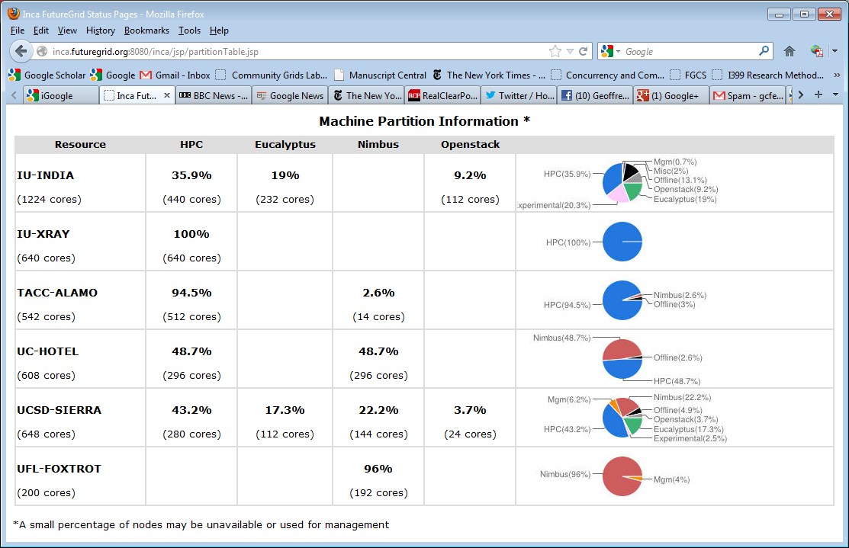
FutureGrid: Inca Monitoring

Slide 11
5 Use Types for FutureGrid
225 approved projects (~920 users) June 27 2012
  USA, China, India, Pakistan, lots of European countries
  Industry, Government, Academia
Training Education and Outreach (8%)
  Semester and short events; promising for small universities
Interoperability test-beds (3%)
  Grids and Clouds; Standards; from Open Grid Forum OGF
Domain Science applications (31%)
  Life science highlighted (18%), Non Life Science (13%)
Computer science (47%)
  Largest current category
Computer Systems Evaluation (27%)
  XSEDE (TIS, TAS), OSG, EGI
Clouds are meant to need less support than other models; FutureGrid needs more user support …….

Slide 12
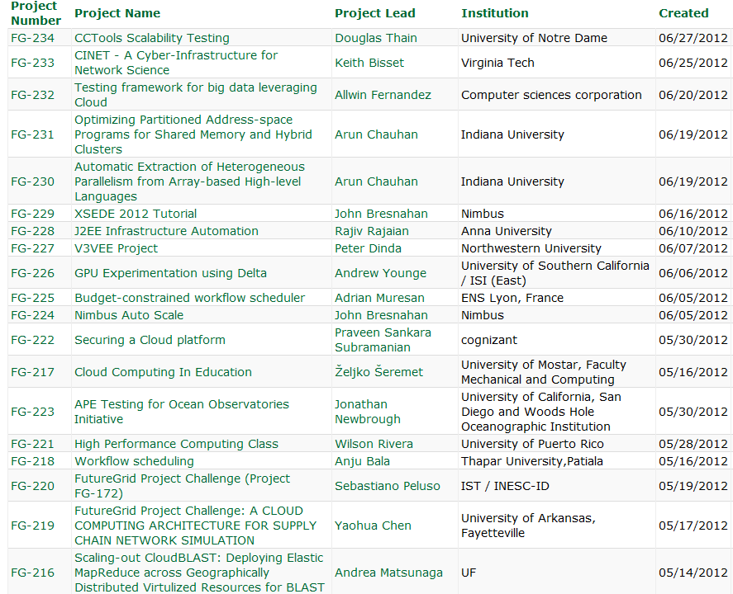
  https://portal.futuregrid.org/projects

Slide 13
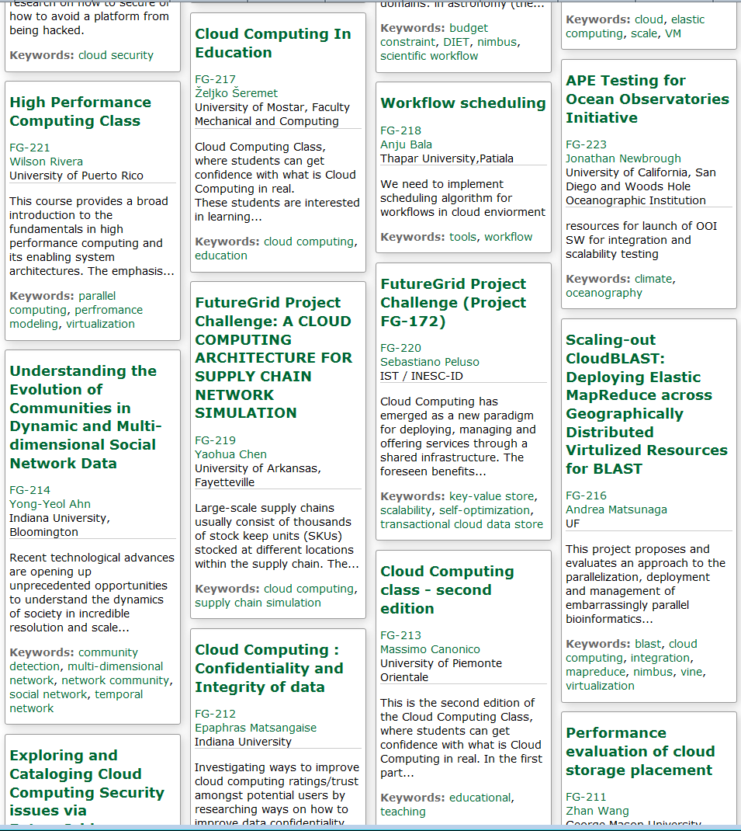
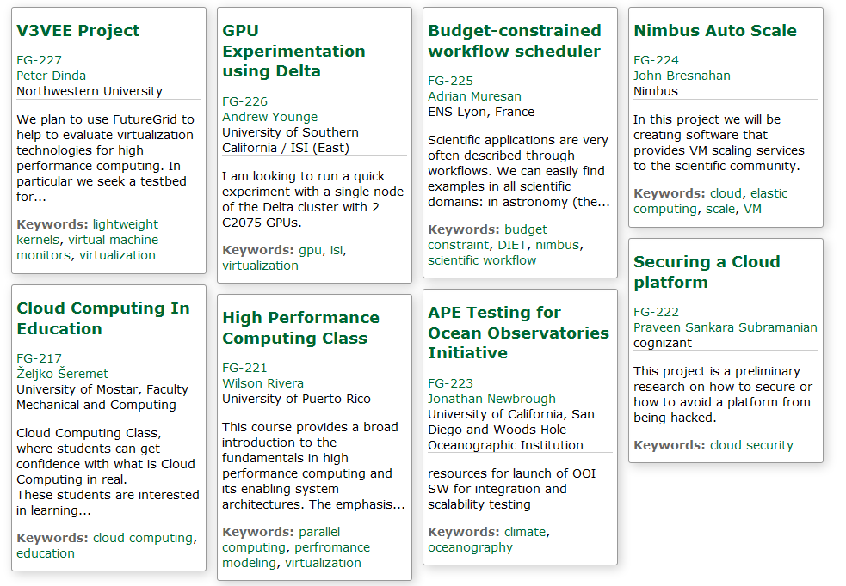
Recent Projects
Have Competitions
Last one just finished
Grand Prize
Trip to SC12
Next Competition
Beginning of August
For our Science Cloud Summer School

Slide 14
Distribution of FutureGrid Technologies and Areas
220 Projects

Slide 15
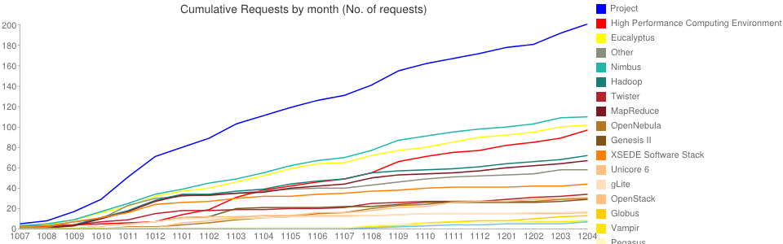
Environments Chosen Fractions v Time
High Performance Computing Environment: 103(47.2%)
Eucalyptus: 109(50%)
Nimbus: 118(54.1%)
Hadoop: 75(34.4%)
Twister: 34(15.6%)
MapReduce: 69(31.7%)
OpenNebula: 32(14.7%)
OpenStack: 36(16.5%)
Genesis II: 29(13.3%)
XSEDE Software Stack: 44(20.2%)
Unicore 6: 16(7.3%)
gLite: 17(7.8%)
Vampir: 10(4.6%)
Globus: 13(6%)
Pegasus: 10(4.6%)
PAPI: 8(3.7%)
CUDA(GPU Software)): 1(0.5%)
>920 Users
>220 Projects

Slide 16
ScaleMP vSMP Performance
Benchmark with HPCC, SPEC, & 3rd Party Apps
Compare vSMP Performance to Native
(Future) Compare vSMP to SGI Altix UV
FutureGrid will have 16 384GB memory (6GB total) ScaleMP nodes (now on “silly” 24GB India nodes)

Slide 17
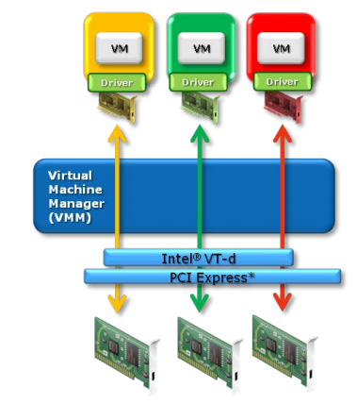
GPU’s in Cloud: Xen PCI Passthrough
Pass through the PCI-E GPU device to DomU
Use Nvidia Tesla CUDA programming model
Work at ISI East (USC)
Intel VT-d or AMD IOMMU extensions
Xen pci-back
FutureGrid “delta” has16 192GB memory nodes each with 2 GPU’s (Tesla C2075 - 6GB)
CUDA
CUDA
CUDA
GPU1
GPU2
GPU3

Slide 18
FutureGrid Tutorials
Cloud Provisioning Platforms
Using Nimbus on FutureGrid [novice]
Nimbus One-click Cluster Guide
Using OpenStack Nova on FutureGrid Using Eucalyptus on FutureGrid [novice]
Connecting private network VMs across Nimbus clusters using ViNe [novice]
Using the Grid Appliance to run FutureGrid Cloud Clients [novice]
Cloud Run-time Platforms
Running Hadoop as a batch job using MyHadoop [novice]
Running SalsaHadoop (one-click Hadoop) on HPC environment [beginner]
Running Twister on HPC environment
Running SalsaHadoop on Eucalyptus
Running FG-Twister on Eucalyptus
Running One-click Hadoop WordCount on Eucalyptus [beginner]
Running One-click Twister K-means on Eucalyptus
Image Management and Rain
Using Image Management and Rain [novice]
Storage
Using HPSS from FutureGrid [novice]
Educational Grid Virtual Appliances
Running a Grid Appliance on your desktop
Running a Grid Appliance on FutureGrid
Running an OpenStack virtual appliance on FutureGrid
Running Condor tasks on the Grid Appliance
Running MPI tasks on the Grid Appliance
Running Hadoop tasks on the Grid Appliance
Deploying virtual private Grid Appliance clusters using Nimbus
Building an educational appliance from Ubuntu 10.04
Customizing and registering Grid Appliance images using Eucalyptus
High Performance Computing
Basic High Performance Computing
Running Hadoop as a batch job using MyHadoop
Performance Analysis with Vampir
Instrumentation and tracing with VampirTrace
Experiment Management
Running interactive experiments [novice]
Running workflow experiments using Pegasus
Pegasus 4.0 on FutureGrid Walkthrough [novice]
Pegasus 4.0 on FutureGrid Tutorial [intermediary]
Pegasus 4.0 on FutureGrid Virtual Cluster [advanced]

Slide 19
aaS and Roles/Appliances
If you package a capability X as XaaS, it runs on a separate VM and you interact with messages
  SQLaaS offers databases via messages similar to old JDBC model
If you build a role or appliance with X, then X built into VM and you just need to add your own code and run
  Generalized worker role builds in I/O and scheduling
FG will take capabilities – MPI, MapReduce, Workflow .. – and offer as roles or aaS (or both)
Perhaps workflow has a controller aaS with graphical design tool while runtime packaged in a role?
Package parallelism as a virtual cluster

Slide 20

Selected List of Services Offered
FutureGrid
User
IaaS
Bare Metal
Nimbus
PaaS
Hadoop
Twister
Hive
Hbase
MPI
Others
FG RAIN
Portal
Inca
Eucalyptus
OpenStack
OpenNebula
ViNE
HPCC
Ganglia
Experiment Management
(Pegasus)
OpenMP
ScaleMP
CUDA
XSEDE Software
Grid
Globus
Unicore
SAGA
Genesis II

Slide 21
Software Components
Portals including “Support” “use FutureGrid” “Outreach”
Monitoring – INCA, Power (GreenIT)
Experiment Manager: specify/workflow
Image Generation and Repository
Intercloud Networking ViNE
Virtual Clusters built with virtual networks
Performance library
Rain or Runtime Adaptable InsertioN Service for images
Security Authentication, Authorization,
Note Software integrated across institutions and between middleware and systems Management (Google docs, Jira, Mediawiki)
Note many software groups are also FG users
“Research”
Above and below
Nimbus OpenStack Eucalyptus

Slide 22
RAINing on FutureGrid
http://futuregrid.org

Slide 23
Motivation: Image Management and RAIN on FutureGrid
Allow users to take control of installing the OS on a system on bare metal (without the administrator)
By providing users with the ability to create their own environments to run their projects (OS, packages, software)
Users can deploy their environments in both bare-metal and virtualized infrastructures
Security is obviously important
RAIN manages tools to dynamically provide custom HPC environment, Cloud environment, or virtual networks on-demand
Amazon, Azure, Bare Metal, Nimbus, Eucalyptus, OpenStack, OpenNebula Interoperability

Slide 24
RAIN Architecture
Templated Images target
Eucalyptus
Nimbus
OpenNebula
OpenStack
Amazon
Azure
OpenNebula used to implement Image Management

Slide 25
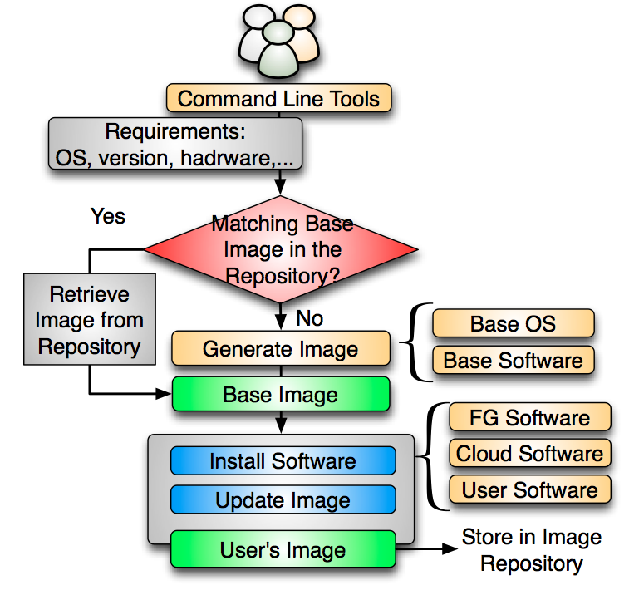
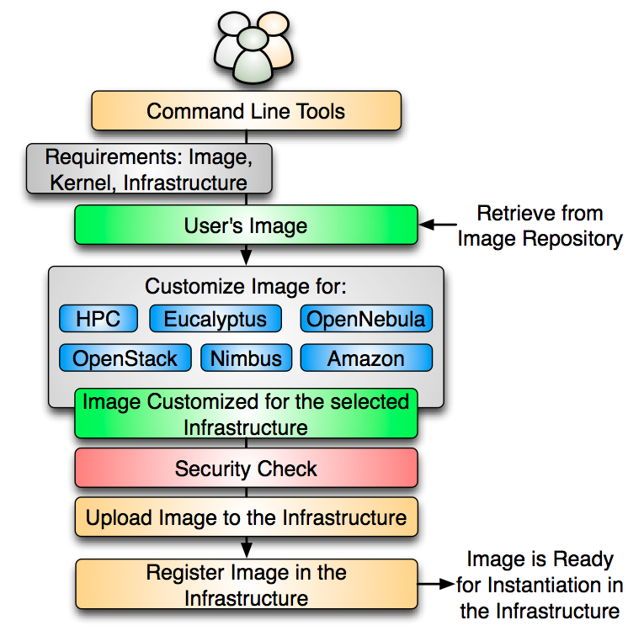
VM Image Management

Slide 26
Create Image from Scratch
CentOS
Takes Up to 69%
Ubuntu
Takes Up to 83%
Notes:
the figures use a stacked bar chart to depict the time spent in each phase of this process including . This (1) boot the VM, (2) generate the image and install user’s software, (3) compress the image, and (4) upload the image to the repository.
we observe the virtualization layer (blue section) introduces significant overhead in the process, which is higher in the case of centos. Next, the orange section represent the time to generate and install the user’s software. Here, generating the image from scratch is the most time consuming part. This is up to 69% for Centos and up to 83% in the case of Ubuntu.
For this reason, we considered to manage base images that can be used to save time during the image creation process.

Slide 27
Create Image from Base Image
Reduces 55-67%
CentOS
Ubuntu
Reduces 62-80%
Notes:
Here, we show the results of creating images using a base image stored in the image repository. So, first, we retrieve the base image and uncompress it, then we install the software required by the user and finally we compress the image and upload to the repository.
By using a base image, the time spent in the creation process is reduced dramatically. In particular, we have reduced the overall time of this process up to an 80% in the case of 1 ubuntu image.
There are two reasons: there is no need to create the base image every time, and we do not need to use the virtualization layer since the base image already has the desired OS and only needs to be upgraded with the software requested by the user.
-------------
This means that the time to create an image has been reduced from six minutes to less than two minutes for a single request. For the worst case, we reduced the time from 16 minutes to less than nine minutes, where we used one processors handling eight concurrent requests.

Slide 28
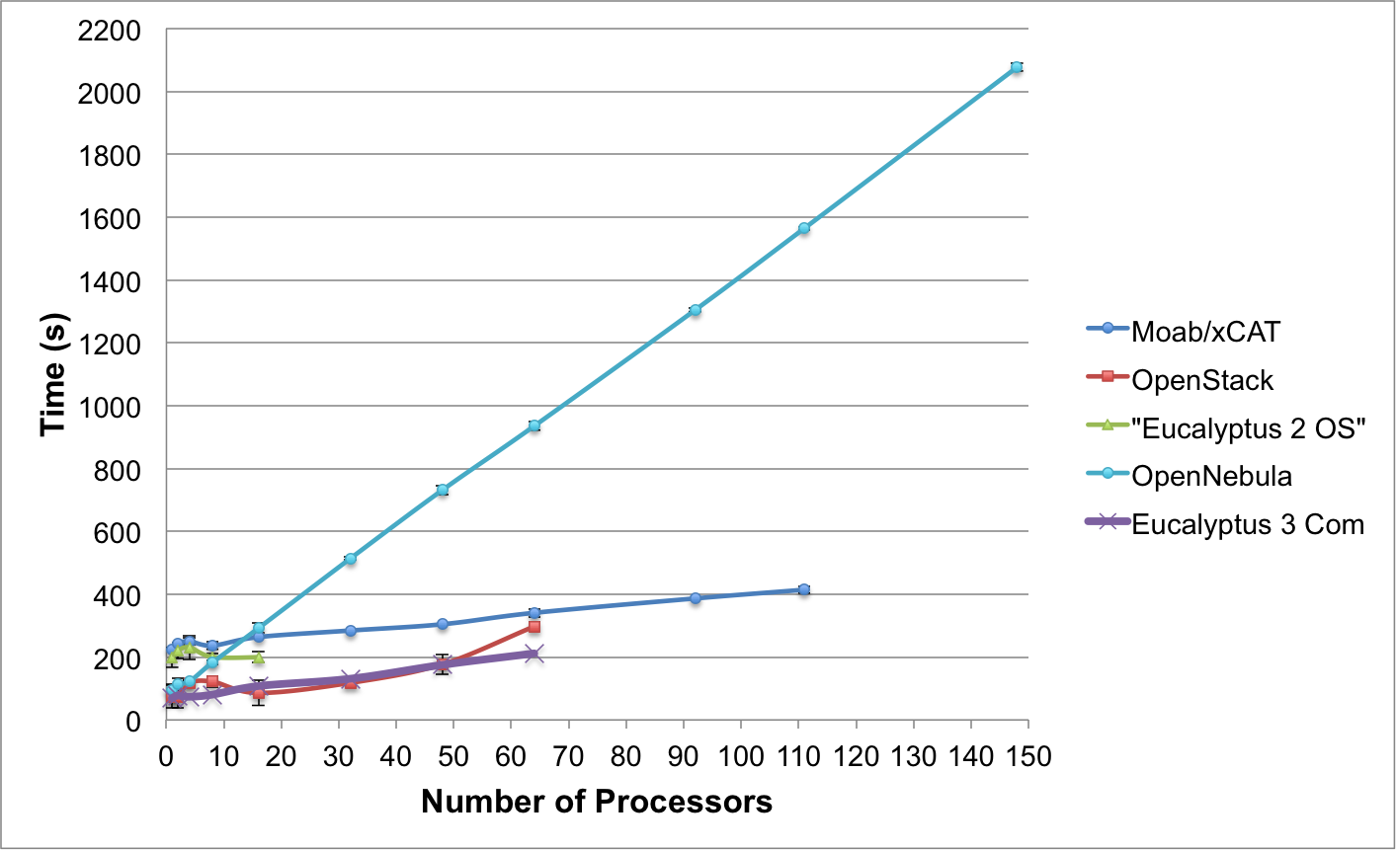
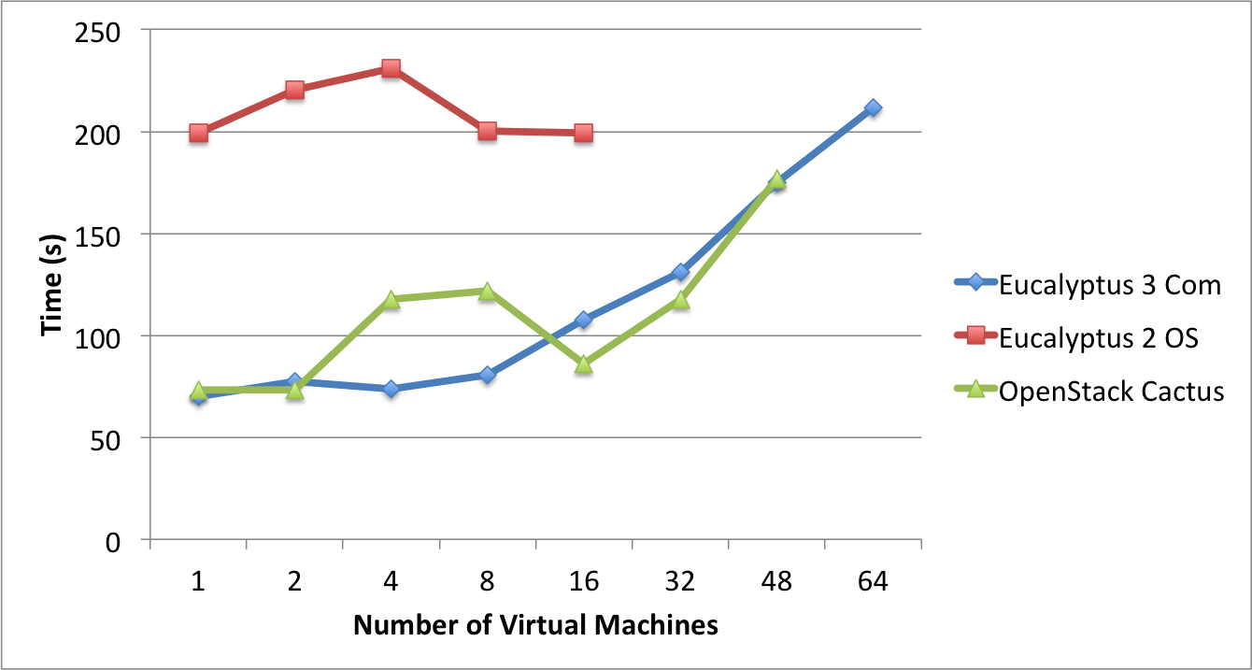
Templated(Abstract) Dynamic Provisioning
Abstract Specification of image mapped to various HPC and Cloud environments
OpenNebula
Parallel provisioning now supported
Moab/xCAT HPC – high as need reboot before use
Essex replaces Cactus
Current Eucalyptus 3 commercial while version 2 Open Source

Slide 29
Evaluate Cloud Environments: Interfaces
✓ | OpenStack (Cactus) | EC2 and S3, Rest Interface
✓✓ | OpenStack (Essex) | EC2 and S3, Rest Interface, OCCI
✓ | Eucalyptus (2.0) | EC2 and S3, Rest Interface
✓✓ | Eucalyptus (3.1) | EC2 and S3, Rest Interface, OCCI
✓ | Nimbus | EC2 and S3, Rest Interface
✓✓✓ | OpenNebula | Native XML/RPC, EC2 and S3, OCCI, Rest Interface

Slide 30
Hypervisor
✓✓✓ | OpenStack | KVM, XEN, VMware Vsphere, LXC, UML and MS HyperV
✓✓ | Eucalyptus | KVM and XEN. VMWare in the enterprise edition.
✓ | Nimbus | KVM and XEN
✓✓ | OpenNebula | KVM, XEN and VMWare

Slide 31
Networking
✓✓✓ | OpenStack | - Two modes: (a) Flat networking (b) VLAN networking -Creates Bridges automatically -Uses IP forwarding for public IP -VMs only have private IPs
✓✓✓ | Eucalyptus | - Four modes: (a) managed; (b) managed-noLAN; (c) system; and (d) static - In (a) & (b) bridges are created automatically - IP forwarding for public IP -VMs only have private IPs
✓✓ | Nimbus | - IP assigned using a DHCP server that can be configured in two ways. Bridges must exists in the compute nodes
✓✓✓ | OpenNebula | - Networks can be defined to support Ebtable, Open vSwitch and 802.1Q tagging -Bridges must exists in the compute nodes -IP are setup inside VM

Slide 32
Software Deployment
✓ | OpenStack | - Software is composed by component that can be placed in different machines. - Compute nodes need to install OpenStack software
✓ | Eucalyptus | - Software is composed by component that can be placed in different machines. - Compute nodes need to install Eucalyptus software
✓✓ | Nimbus | Software is installed in frontend and compute nodes
✓✓✓ | OpenNebula | Software is installed in frontend

Slide 33
DevOps Deployment
✓✓✓ | OpenStack | Chef, Crowbar, (Puppet), juju
✓ | Eucalyptus | Chef*, Puppet* (*according to vendor)
 | Nimbus | no
✓✓ | OpenNebula | Chef, Puppet

Slide 34
Storage (Image Transfer)
✓ | OpenStack | - Swift (http/s) - Unix filesystem (ssh)
✓ | Eucalyptus | Walrus (http/s)
✓ | Nimbus | Cumulus (http/https)
✓ | OpenNebula | Unix Filesystem (ssh, shared filesystem or LVM with CoW)

Slide 35
Authentication
✓✓✓ | OpenStack (Cactus) | X509 credentials, LDAP
✓✓ | OpenStack (Essex) | X509 credentials, (LDAP)
✓ | Eucalyptus 2.0 | X509 credentials
✓✓✓ | Eucalyptus 3.1 | X509 credentials, LDAP
✓✓ | Nimbus | X509 credentials, Grids
✓✓✓ | OpenNebula | X509 credential, ssh rsa keypair, password, LDAP

Slide 36
Typical Release Frequency
 | OpenStack | <4month
✓ | Eucalyptus | >4 month
 | Nimbus | <4 month
✓ | OpenNebula | >6 month

Slide 37
License
✓ ✓ | OpenStack | Open Source Apache
 | Eucalyptus 2.0 | Open Source ≠ Commercial (3.0)
✓ | Eucalyptus 3.1 | Open Source, (Commercial add ons)
✓ ✓ | Nimbus | Open Source Apache
✓ ✓ | OpenNebula | Open Source Apache

Slide 38
Reminder: What is FutureGrid?
The FutureGrid project mission is to enable experimental work that advances:
  Innovation and scientific understanding of distributed computing and parallel computing paradigms,
  The engineering science of middleware that enables these paradigms,
  The use and drivers of these paradigms by important applications, and,
  The education of a new generation of
  students and workforce on the use of
  these paradigms and their applications.
The implementation of mission includes
  Distributed flexible hardware
  with supported use
  Identified IaaS PaaS SaaS “core” software
  with supported use
  Outreach
~4400 cores in 5 major
sites
FutureGrid Usage

Slide 39
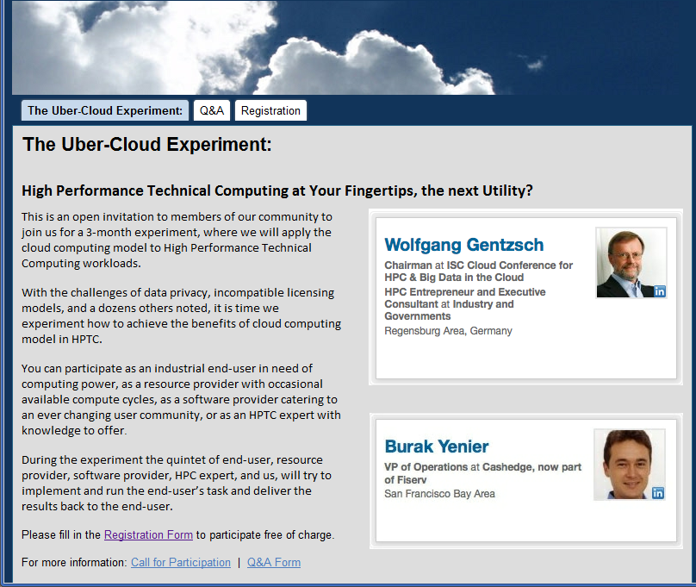
Next steps for you?
http://www.hpcexperiment.com/
FutureGrid is NOT Exascale (or even petascale) but still useful
Apply for an account on FutureGrid and conduct your project
  https://portal.futuregrid.org
Have your students/staff work with us on joint projects
Tell us what we need to do better
Tell us where we should go
Maybe work through http://www.hpcexperiment.com/
Science Cloud (Virtual) Summer School July 30-August 3 on FutureGrid

