Slide 1
Tutorial
Presented at TG2011
Geoffrey Fox, Gregor von Laszewski, Renato Figueiredo, Kate Keahey, Andrew Younge
Contact:
https://portal.futuregrid.org/help

Slide 2
Outline (8:30 am – 10:00 am)
Introduction (30 min)
  Overview of FG (15 min)
    Geoffrey Fox
  Overview of existing Services (15 min)
    Gregor von Laszewski
Getting an Account
  Gregor von Laszewski (5min)
Selected Services
  Nimbus on FG (20 min)
    Kate Keahey
  FG Dynamic Provisioning
  Tech. Preview (15 min)
    Gregor von Laszewski
  Appliances on FG (15 min)
    Renato Figueiredo.

Slide 3
Outline (cont.)
Break (10am-10:30am)
10.30-11 Selected Services
  Hpc (10 min)
  Hadoop (10 min)
  Eucalyptus (10 min)
    Andrew Younge

Slide 4
FutureGrid
Overview
TG 11
Salt Lake City
July 18 2011
Geoffrey Fox
gcf@indiana.edu
http://www.infomall.org https://portal.futuregrid.org
Director, Digital Science Center, Pervasive Technology Institute
Associate Dean for Research and Graduate Studies, School of Informatics and Computing
Indiana University Bloomington

Slide 5
FutureGrid key Concepts I
FutureGrid is an international testbed modeled on Grid5000
Supporting international Computer Science and Computational Science research in cloud, grid and parallel computing (HPC)
  Industry and Academia
The FutureGrid testbed provides to its users:
  A flexible development and testing platform for middleware and application users looking at interoperability, functionality, performance or evaluation
  Each use of FutureGrid is an experiment that is reproducible
  A rich education and teaching platform for advanced cyberinfrastructure (computer science) classes

Slide 6
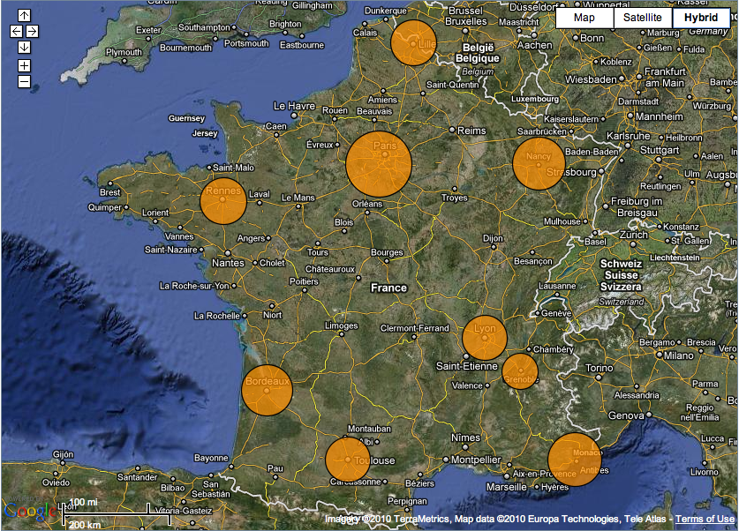
FutureGrid modeled on Grid’5000
Experimental testbed
  Configurable, controllable, monitorable
Established in 2003
10 sites
  9 in France
  Porto Allegre in Brazil
~5000+ cores

Slide 7
FutureGrid key Concepts II
FutureGrid has a complementary focus to both the Open Science Grid and the other parts of TeraGrid.
  FutureGrid is user-customizable, accessed interactively and supports Grid, Cloud and HPC software with and without virtualization.
  FutureGrid is an experimental platform where computer science applications can explore many facets of distributed systems
  and where domain sciences can explore various deployment scenarios and tuning parameters and in the future possibly migrate to the large-scale national Cyberinfrastructure.
  FutureGrid supports Interoperability Testbeds – OGF really needed!
Note much of current use Education, Computer Science Systems and Biology/Bioinformatics

Slide 8

FutureGrid key Concepts III
Rather than loading images onto VM’s, FutureGrid supports Cloud, Grid and Parallel computing environments by dynamically provisioning software as needed onto “bare-metal” using Moab/xCAT
  Image library for MPI, OpenMP, MapReduce (Hadoop, Dryad, Twister), gLite, Unicore, Globus, Xen, ScaleMP (distributed Shared Memory), Nimbus, Eucalyptus, OpenNebula, KVM, Windows …..
Growth comes from users depositing novel images in library
FutureGrid has ~4000 (will grow to ~5000) distributed cores with a dedicated network and a Spirent XGEM network fault and delay generator
Image1
Image2
…
ImageN
Choose
Load
Run

Slide 9
Dynamic Provisioning Results
Number of nodes
Time elapsed between requesting a job and the jobs reported start time on the provisioned node. The numbers here are an average of 2 sets of experiments.

Slide 10
FutureGrid Partners
Indiana University (Architecture, core software, Support)
Purdue University (HTC Hardware)
San Diego Supercomputer Center at University of California San Diego (INCA, Monitoring)
University of Chicago/Argonne National Labs (Nimbus)
University of Florida (ViNE, Education and Outreach)
University of Southern California Information Sciences (Pegasus to manage experiments)
University of Tennessee Knoxville (Benchmarking)
University of Texas at Austin/Texas Advanced Computing Center (Portal)
University of Virginia (OGF, Advisory Board and allocation)
Center for Information Services and GWT-TUD from Technische Universtität Dresden. (VAMPIR)
Red institutions have FutureGrid hardware

Slide 11

FutureGrid: a Grid/Cloud/HPC Testbed
NID: Network Impairment Device
Private
Public
FG Network

Slide 12
Compute Hardware
Name | System type | # CPUs | # Cores | TFLOPS | Total RAM (GB) | Secondary Storage (TB) | Site | Status
india | IBM iDataPlex | 256 | 1024 | 11 | 3072 | 339 + 16 | IU | Operational
alamo | Dell PowerEdge | 192 | 768 | 8 | 1152 | 30 | TACC | Operational
hotel | IBM iDataPlex | 168 | 672 | 7 | 2016 | 120 | UC | Operational
sierra | IBM iDataPlex | 168 | 672 | 7 | 2688 | 96 | SDSC | Operational
xray | Cray XT5m | 168 | 672 | 6 | 1344 | 339 | IU | Operational
foxtrot | IBM iDataPlex | 64 | 256 | 2 | 768 | 24 | UF | Operational
Bravo* | Large Disk & memory | 32 | 128 | 1.5 | 3072 (192GB per node) | 144 (12 TB per Server) | IU | Early user Aug. 1 general
Delta* | Large Disk & memory With Tesla GPU’s | 16 16 GPU’s | 96 | ? 3 | 1536 (192GB per node) | 96 (12 TB per Server) | IU | ~Sept 15
 |  |  | TOTAL Cores 4288
* Teasers for next machine

Slide 13
Storage Hardware
System Type | Capacity (TB) | File System | Site | Status
DDN 9550 (Data Capacitor) | 339 shared with IU + 16 TB dedicated | Lustre | IU | Existing System
DDN 6620 | 120 | GPFS | UC | New System
SunFire x4170 | 96 | ZFS | SDSC | New System
Dell MD3000 | 30 | NFS | TACC | New System
IBM | 24 | NFS | UF | New System

Slide 14
Network Impairment Device
  Spirent XGEM Network Impairments Simulator for jitter, errors, delay, etc
  Full Bidirectional 10G w/64 byte packets
  up to 15 seconds introduced delay (in 16ns increments)
  0-100% introduced packet loss in .0001% increments
  Packet manipulation in first 2000 bytes
  up to 16k frame size
  TCL for scripting, HTML for manual configuration

Slide 15
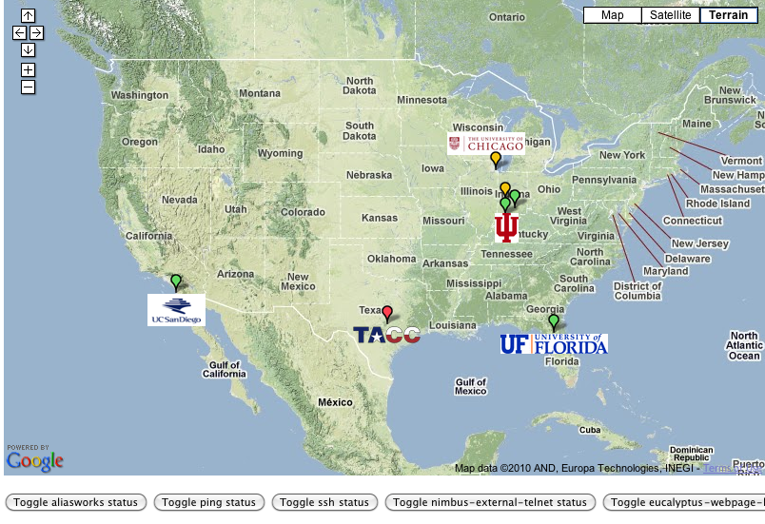
FutureGrid: Online Inca Summary

Slide 16
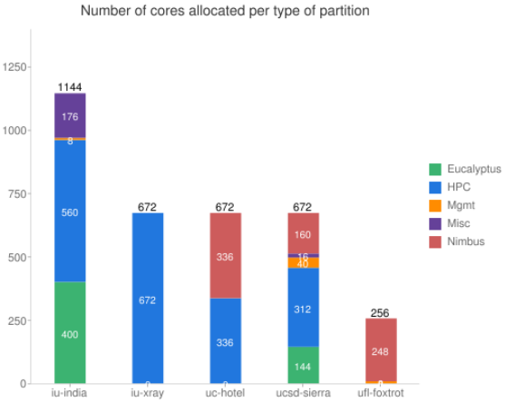
FutureGrid: Inca Monitoring

Slide 17
5 Use Types for FutureGrid
122 approved projects July 17 2011
  https://portal.futuregrid.org/projects
Training Education and Outreach (13)
  Semester and short events; promising for small universities
Interoperability test-beds (4)
  Grids and Clouds; Standards; from Open Grid Forum OGF
Domain Science applications (42)
  Life science highlighted (21)
Computer science (50)
  Largest current category
Computer Systems Evaluation (35)
  TeraGrid (TIS, TAS, XSEDE), OSG, EGI
Clouds are meant to need less support than other models; FutureGrid needs more user support …….

Slide 18
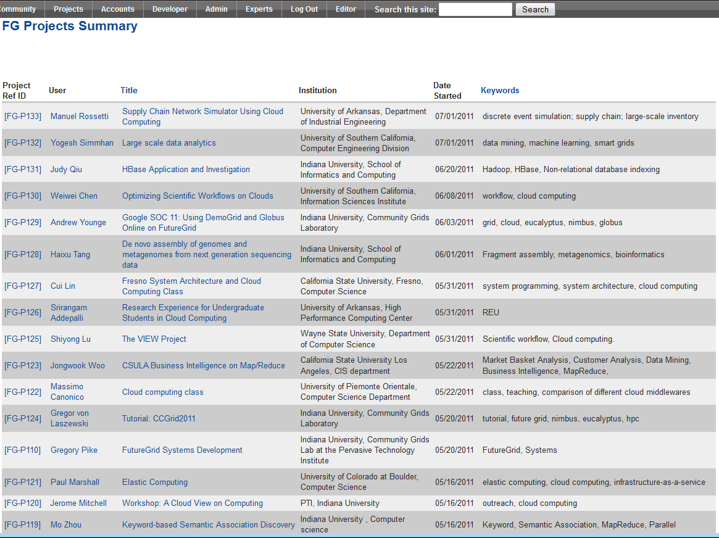
  https://portal.futuregrid.org/projects

Slide 19
Current Education projects
System Programming and Cloud Computing, Fresno State, Teaches system programming and cloud computing in different computing environments
REU: Cloud Computing, Arkansas, Offers hands-on experience with FutureGrid tools and technologies
Workshop: A Cloud View on Computing, Indiana School of Informatics and Computing (SOIC), Boot camp on MapReduce for faculty and graduate students from underserved ADMI institutions
Topics on Systems: Distributed Systems, Indiana SOIC, Covers core computer science distributed system curricula (for 60 students)

Slide 20
Current Interoperability Projects
SAGA, Louisiana State, Explores use of FutureGrid components for extensive portability and interoperability testing of Simple API for Grid Applications, and scale-up and scale-out experiments

Slide 21
Current Bio Application Projects
Metagenomics Clustering, North Texas, Analyzes metagenomic data from samples collected from patients
Genome Assembly, Indiana SOIC, De novo assembly of genomes and metagenomes from next generation sequencing data

Slide 22
Current Non-Bio Application Projects
Physics: Higgs boson, Virginia, Matrix Element calculations representing production and decay mechanisms for Higgs and background processes
Business Intelligence on MapReduce, Cal State - L.A., Market basket and customer analysis designed to execute MapReduce on Hadoop platform

Slide 23
Current Computer Science Projects
Data Transfer Throughput, Buffalo, End-to-end optimization of data transfer throughput over wide-area, high-speed networks
Elastic Computing, Colorado, Tools and technologies to create elastic computing environments using IaaS clouds that adjust to changes in demand automatically and transparently
The VIEW Project, Wayne State, Investigates Nimbus and Eucalyptus as cloud platforms for elastic workflow scheduling and resource provisioning

Slide 24
Current Technology Projects
ScaleMP for Gene Assembly, Indiana Pervasive Technology Institute (PTI) and Biology, Investigates distributed shared memory over 16 nodes for SOAPdenovo assembly of Daphnia genomes
XSEDE, Virginia, Uses FutureGrid resources as a testbed for XSEDE software development
Globus Online, Indiana PTI, Chicago, Investigates the feasibility of providing DemoGrid and its Globus services on FutureGrid IaaS clouds

Slide 25

Typical FutureGrid Performance Study
Linux, Linux on VM, Windows, Azure, Amazon Bioinformatics

Slide 26

OGF 2010 Demo from Rennes
SDSC
Rennes
Grid’5000 firewall
UF
Lille
UC
Sophia
ViNe provided the necessary inter-cloud connectivity to deploy CloudBLAST across 6 Nimbus sites, with a mix of public and private subnets.

Slide 27
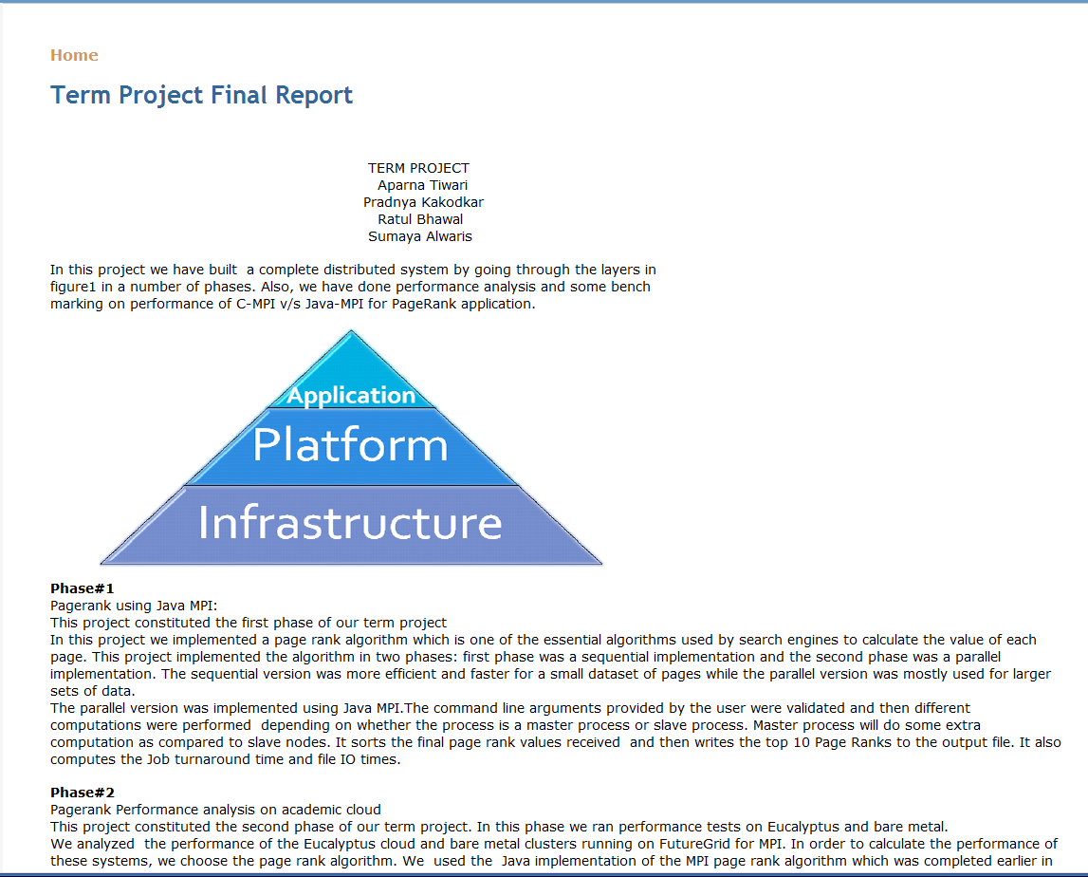
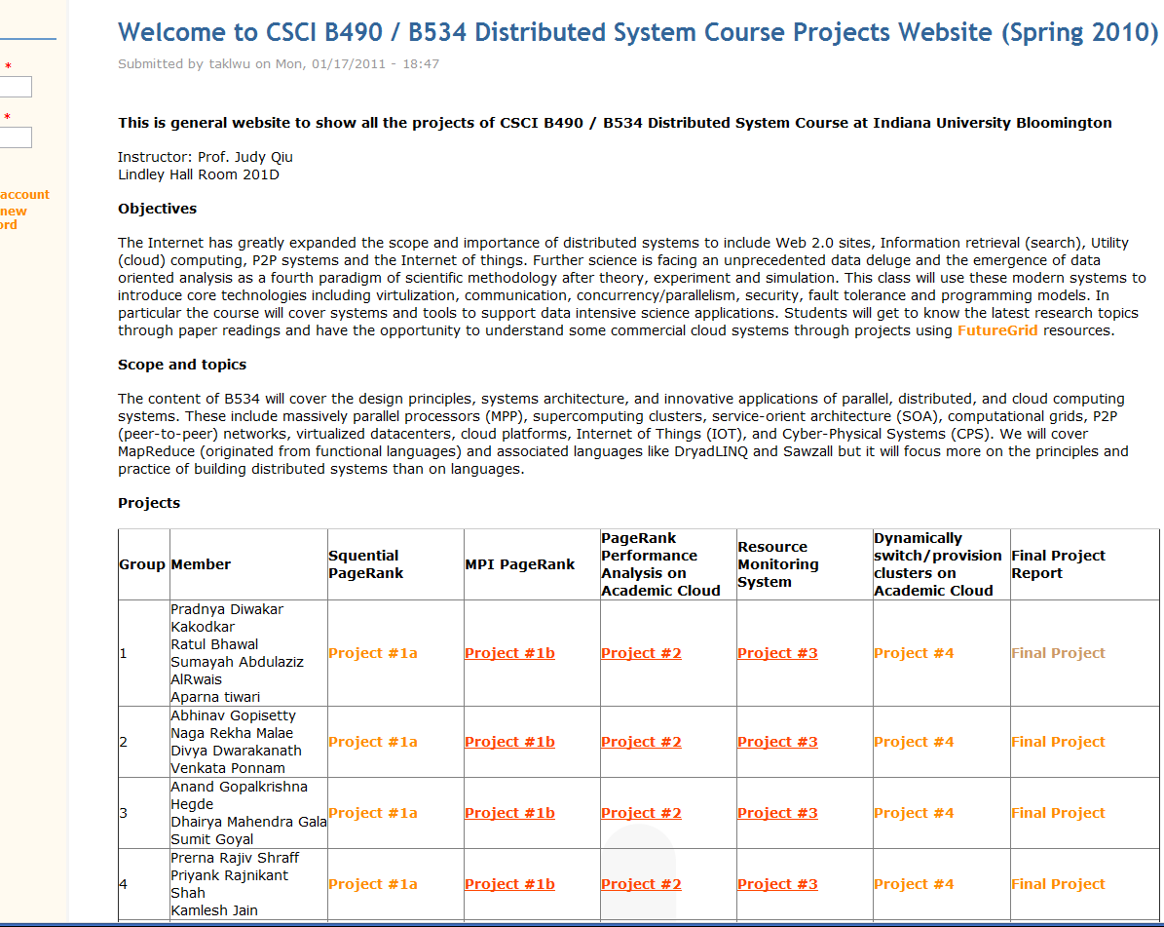
B534 Distributed Systems Class
17 3-4 person projects

Slide 28

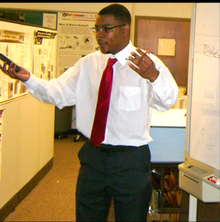
ADMI Cloudy View on
Computing Workshop June 2011
Concept and Delivery by
Jerome Mitchell:
Undergraduate ECSU,
Masters Kansas, PhD Indiana
Jerome took two courses from IU in this area Fall 2010 and Spring 2011 on FutureGrid
ADMI: Association of Computer and Information Science/Engineering Departments at Minority Institutions
Offered on FutureGrid
10 Faculty and Graduate Students from ADMI Universities
The workshop provided information from cloud programming models to case studies of scientific applications on FutureGrid.
At the conclusion of the workshop, the participants indicated that they would incorporate cloud computing into their courses and/or research.

Slide 29
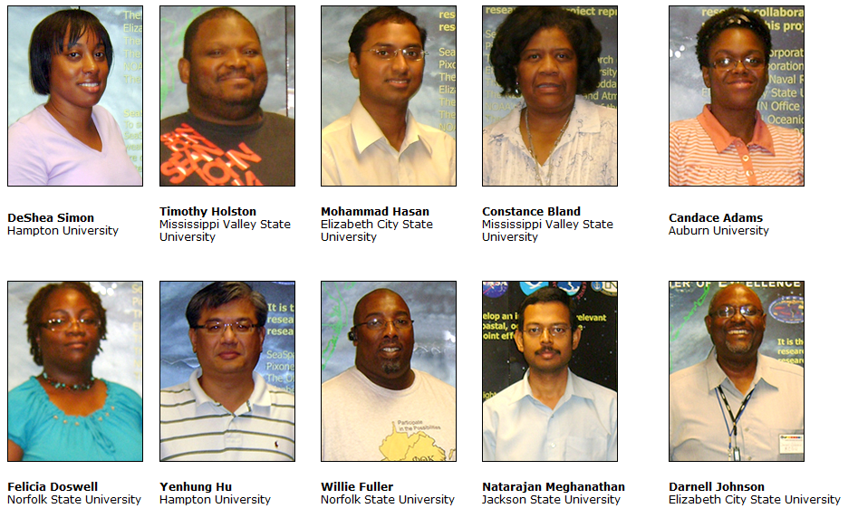
ADMI Cloudy View on Computing Workshop Participants

Slide 30
Workshop Purpose
Introduce ADMI to the basics of the emerging Cloud Computing paradigm
  Learn how it came about
  Understand its enabling technologies
  Understand the computer systems constraints, tradeoffs, and techniques of setting up and using cloud
Teach ADMI how to implement algorithms in the Cloud
  Gain competence in cloud programming models for distributed processing of large datasets.
  Understand how different algorithms can be implemented and executed on cloud frameworks
  Evaluating the performance and identifying bottlenecks when mapping applications to the clouds

Slide 31
FutureGrid Tutorials
Tutorial topic 3: Educational Virtual Appliances
Tutorial GA1: Introduction to the Grid Appliance
Tutorial GA2: Creating Grid Appliance Clusters
Tutorial GA3: Building an educational appliance from Ubuntu 10.04
Tutorial GA4: Deploying Grid Appliances using Nimbus
Tutorial GA5: Deploying Grid Appliances using Eucalyptus
Tutorial GA7: Customizing and registering Grid Appliance images using Eucalyptus
Tutorial MP1: MPI Virtual Clusters with the Grid Appliances and MPICH2
Tutorial topic 4: High Performance Computing
Tutorial VA1: Performance Analysis with Vampir
Tutorial VT1: Instrumentation and tracing with VampirTrace
Tutorial topic 1: Cloud Provisioning Platforms
Tutorial NM1: Using Nimbus on FutureGrid
Tutorial NM2: Nimbus One-click Cluster Guide
Tutorial GA6: Using the Grid Appliances to run FutureGrid Cloud Clients
Tutorial EU1: Using Eucalyptus on FutureGrid
Tutorial topic 2: Cloud Run-time Platforms
Tutorial HA1: Introduction to Hadoop using the Grid Appliance
Tutorial HA2: Running Hadoop on FG using Eucalyptus (.ppt)
Tutorial HA2: Running Hadoop on Eualyptus

Slide 32
FutureGrid Viral Growth Model
Users apply for a project
Users improve/develop some software in project
This project leads to new images which are placed in FutureGrid repository
Project report and other web pages document use of new images
Images are used by other users
And so on ad infinitum ………
Please bring your nifty software up on FutureGrid!!

Slide 33
Software Components
Portals including “Support” “use FutureGrid” “Outreach”
Monitoring – INCA, Power (GreenIT)
Experiment Manager: specify/workflow
Image Generation and Repository
Intercloud Networking ViNE
Virtual Clusters built with virtual networks
Performance library
Rain or Runtime Adaptable InsertioN Service for images
Security Authentication, Authorization,
Note Software integrated across institutions and between middleware and systems Management (Google docs, Jira, Mediawiki)
Note many software groups are also FG users
“Research”
Above and below
Nimbus OpenStack Eucalyptus

Slide 34
FutureGrid Software Architecture
Note on Authentication and Authorization
We have different environments and requirements from TeraGrid
Non trivial to integrate/align security model with TeraGrid

Slide 35
Detailed Software Architecture

Slide 36
Rain in FutureGrid

Slide 37
FG RAIN Command
Example ``rain'' a Hadoop environment defined by an user on a cluster.
  fg-hadoop -n 8 -app myHadoopApp.jar …
fg-rain –h hostfile –iaas nimbus –image img
fg-rain –h hostfile –paas hadoop …
fg-rain –h hostfile –paas dryad …
fg-rain –h hostfile –gaas gLite …
fg-rain –h hostfile –image img
  Authorization is required to use fg-rain without virtualization.

Slide 38
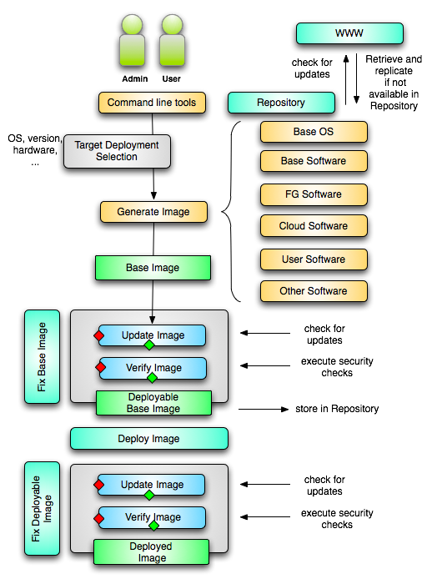
Image Creation
Creating deployable image
  User chooses one base mages
  User decides who can access the image; what additional software is on the image
  Image gets generated; updated; and verified
Image gets deployed
Deployed image gets continuously
  Updated; and verified
Note: Due to security requirement an image must be customized with authorization mechanism
  limit the number of images through the strategy of "cloning" them from a number of base images.
  users can build communities that encourage reuse of "their" images
  features of images are exposed through metadata to the community
  Administrators will use the same process to create the images that are vetted by them
  Customize images in CMS

Slide 39
Portal Plans

Slide 40
… next …
Overview of the FG
Software and Services

