Slide 1
FutureGrid BOF
Overview
TG 11
Salt Lake City
July 20 2011
Geoffrey Fox
gcf@indiana.edu
http://www.infomall.org https://portal.futuregrid.org
Director, Digital Science Center, Pervasive Technology Institute
Associate Dean for Research and Graduate Studies, School of Informatics and Computing
Indiana University Bloomington

Slide 2
FutureGrid key Concepts I
FutureGrid supports Computer Science and Computational Science research in cloud, grid and parallel computing (HPC)
The FutureGrid testbed provides to its users:
  An interactive development and testing platform for middleware and application users looking at interoperability, functionality, performance or evaluation with or without virtualization
  A rich education and teaching platform for advanced cyberinfrastructure (computer science) classes
FutureGrid has a complementary focus to both the Open Science Grid and the other parts of XSEDE.
Note that significant current use in Education, Computer Science Systems and Biology/Bioinformatics

Slide 3

FutureGrid key Concepts II
Rather than loading images onto VM’s, FutureGrid supports Cloud, Grid and Parallel computing environments by dynamically provisioning software as needed onto “bare-metal” using Moab/xCAT
  Image library for MPI, OpenMP, MapReduce (Hadoop, Dryad, Twister), gLite, Unicore, Xen, Genesis II, ScaleMP (distributed Shared Memory), Nimbus, Eucalyptus, OpenNebula, OpenStack, KVM, Windows …..
Growth comes from users depositing novel images in library
FutureGrid has ~4300 (will grow to ~5000) distributed cores with a dedicated network and a Spirent XGEM network fault and delay generator
Image1
Image2
…
ImageN
Choose
Load
Run

Slide 4
FutureGrid Partners
Indiana University (Architecture, core software, Support)
Purdue University (HTC Hardware)
San Diego Supercomputer Center at University of California San Diego (INCA, Monitoring)
University of Chicago/Argonne National Labs (Nimbus)
University of Florida (ViNE, Education and Outreach)
University of Southern California Information Sciences (Pegasus to manage experiments)
University of Tennessee Knoxville (Benchmarking)
University of Texas at Austin/Texas Advanced Computing Center (Portal)
University of Virginia (OGF, Advisory Board and allocation)
Center for Information Services and GWT-TUD from Technische Universtität Dresden. (VAMPIR)
Red institutions have FutureGrid hardware

Slide 5

FutureGrid: a Grid/Cloud/HPC Testbed
NID: Network Impairment Device
Private
Public
FG Network

Slide 6
Compute Hardware
Name | System type | # CPUs | # Cores | TFLOPS | Total RAM (GB) | Secondary Storage (TB) | Site | Status
india | IBM iDataPlex | 256 | 1024 | 11 | 3072 | 339 + 16 | IU | Operational
alamo | Dell PowerEdge | 192 | 768 | 8 | 1152 | 30 | TACC | Operational
hotel | IBM iDataPlex | 168 | 672 | 7 | 2016 | 120 | UC | Operational
sierra | IBM iDataPlex | 168 | 672 | 7 | 2688 | 96 | SDSC | Operational
xray | Cray XT5m | 168 | 672 | 6 | 1344 | 339 | IU | Operational
foxtrot | IBM iDataPlex | 64 | 256 | 2 | 768 | 24 | UF | Operational
Bravo* | Large Disk & memory | 32 | 128 | 1.5 | 3072 (192GB per node) | 144 (12 TB per Server) | IU | Early user Aug. 1 general
Delta* | Large Disk & memory With Tesla GPU’s | 16 16 GPU’s | 96 | ? 3 | 1536 (192GB per node) | 96 (12 TB per Server) | IU | ~Sept 15
Total |  | 1064 | 4288 | 45 | 16TB
* Teasers for next machine

Slide 7
Storage Hardware
System Type | Capacity (TB) | File System | Site | Status
DDN 9550 (Data Capacitor) | 339 shared with IU + 16 TB dedicated | Lustre | IU | Existing System
DDN 6620 | 120 | GPFS | UC | New System
SunFire x4170 | 96 | ZFS | SDSC | New System
Dell MD3000 | 30 | NFS | TACC | New System
IBM | 24 | NFS | UF | New System

Slide 8
Network Impairment Device
  Spirent XGEM Network Impairments Simulator for jitter, errors, delay, etc
  Full Bidirectional 10G w/64 byte packets
  up to 15 seconds introduced delay (in 16ns increments)
  0-100% introduced packet loss in .0001% increments
  Packet manipulation in first 2000 bytes
  up to 16k frame size
  TCL for scripting, HTML for manual configuration

Slide 9
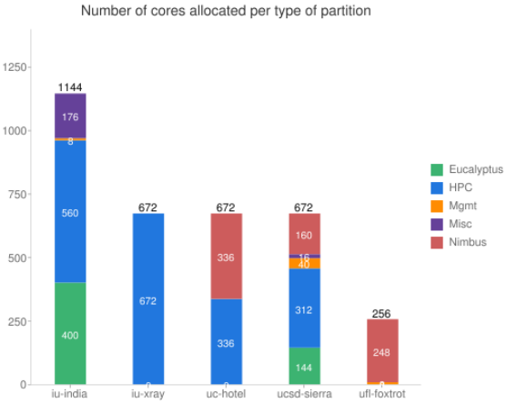
FutureGrid: Inca Monitoring

Slide 10
5 Use Types for FutureGrid
122 approved projects July 17 2011
  https://portal.futuregrid.org/projects
Training Education and Outreach (13)
  Semester and short events; promising for small universities
Interoperability test-beds (4)
  Grids and Clouds; Standards; from Open Grid Forum OGF
Domain Science applications (42)
  Life science highlighted (21)
Computer science (50)
  Largest current category
Computer Systems Evaluation (35)
  TeraGrid (TIS, TAS, XSEDE), OSG, EGI
Clouds are meant to need less support than other models; FutureGrid needs more user support …….

Slide 11
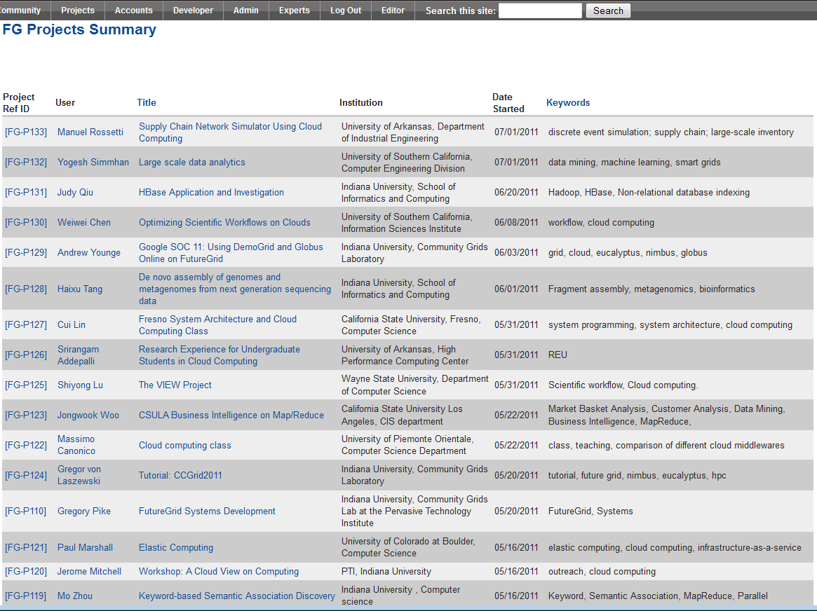
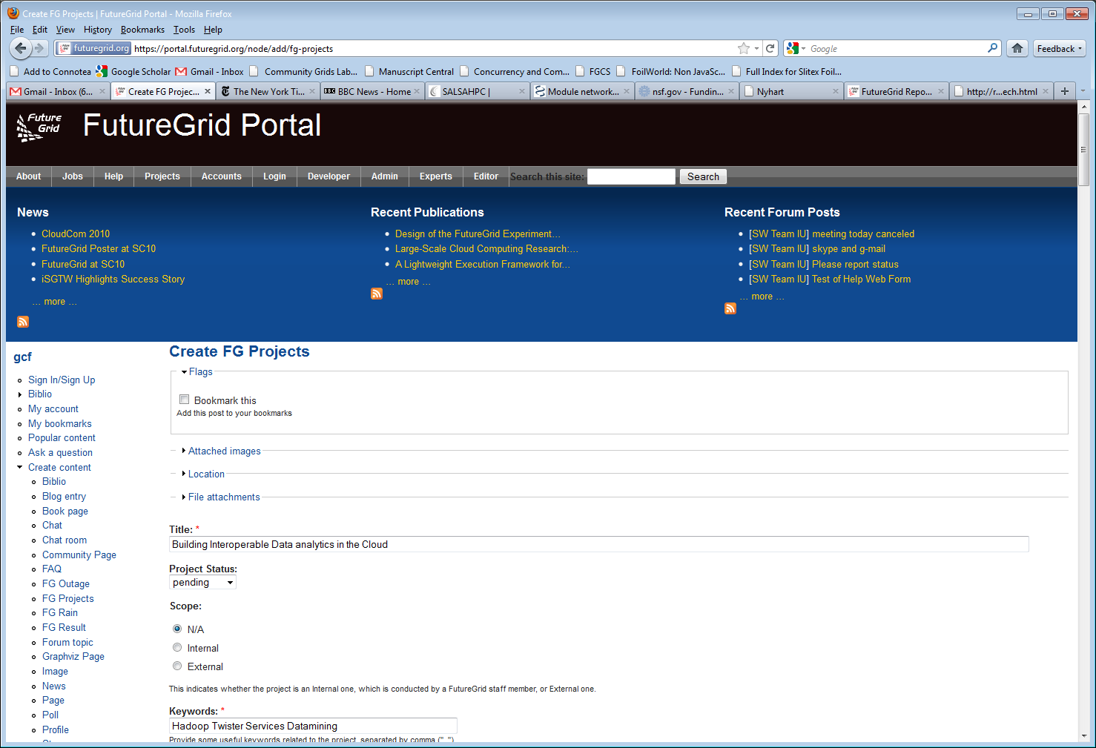
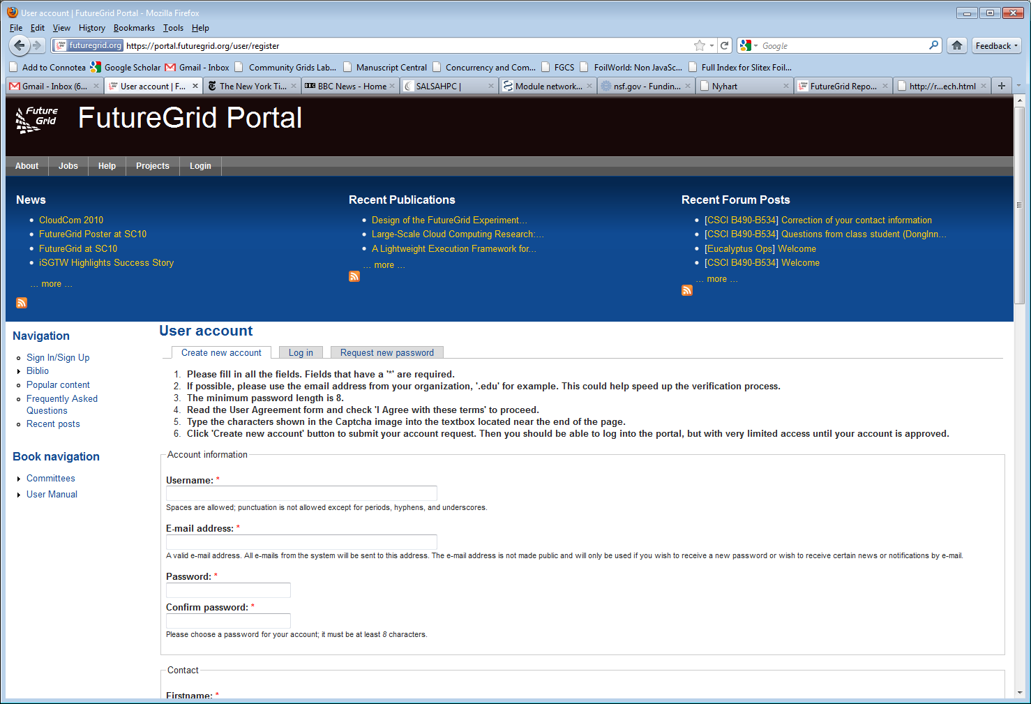
Create a Portal Account and apply for a Project

Slide 12
Selected Current Education projects
System Programming and Cloud Computing, Fresno State, Teaches system programming and cloud computing in different computing environments
REU: Cloud Computing, Arkansas, Offers hands-on experience with FutureGrid tools and technologies
Workshop: A Cloud View on Computing, Indiana School of Informatics and Computing (SOIC), Boot camp on MapReduce for faculty and graduate students from underserved ADMI institutions
Topics on Systems: Distributed Systems, Indiana SOIC, Covers core computer science distributed system curricula (for 60 students)

Slide 13
Selected Current Interoperability Projects
SAGA, Louisiana State, Explores use of FutureGrid components for extensive portability and interoperability testing of Simple API for Grid Applications, and scale-up and scale-out experiments
Unicore,Genesis, gLite, Virginia, OGF standard end points

Slide 14
Selected Current Bio Application Projects
Metagenomics Clustering, North Texas, Analyzes metagenomic data from samples collected from patients
Genome Assembly, Indiana SOIC, De novo assembly of genomes and metagenomes from next generation sequencing data

Slide 15
Selected Current Non-Bio Application Projects
Physics: Higgs boson, Virginia, Matrix Element calculations representing production and decay mechanisms for Higgs and background processes
Business Intelligence on MapReduce, Cal State - L.A., Market basket and customer analysis designed to execute MapReduce on Hadoop platform

Slide 16
Selected Current Computer Science Projects
Data Transfer Throughput, Buffalo, End-to-end optimization of data transfer throughput over wide-area, high-speed networks
Elastic Computing, Colorado, Tools and technologies to create elastic computing environments using IaaS clouds that adjust to changes in demand automatically and transparently
The VIEW Project, Wayne State, Investigates Nimbus and Eucalyptus as cloud platforms for elastic workflow scheduling and resource provisioning

Slide 17
Selected Current Technology Projects
ScaleMP for Gene Assembly, Indiana Pervasive Technology Institute (PTI) and Biology, Investigates distributed shared memory over 16 nodes for SOAPdenovo assembly of Daphnia genomes
XSEDE, Virginia, Uses FutureGrid resources as a testbed for XSEDE software development
Globus Online, Indiana PTI, Chicago, Investigates the feasibility of providing DemoGrid and its Globus services on FutureGrid IaaS clouds

Slide 18

Typical FutureGrid Performance Study
Linux, Linux on VM, Windows, Azure, Amazon Bioinformatics

Slide 19

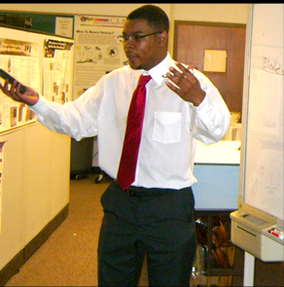
ADMI Cloudy View on
Computing Workshop June 2011
Concept and Delivery by
Jerome Mitchell:
Undergraduate ECSU,
Masters Kansas, PhD Indiana
Jerome took two courses from IU in this area Fall 2010 and Spring 2011 on FutureGrid
ADMI: Association of Computer and Information Science/Engineering Departments at Minority Institutions
Offered on FutureGrid
10 Faculty and Graduate Students from ADMI Universities
The workshop provided information from cloud programming models to case studies of scientific applications on FutureGrid.
At the conclusion of the workshop, the participants indicated that they would incorporate cloud computing into their courses and/or research.

Slide 20
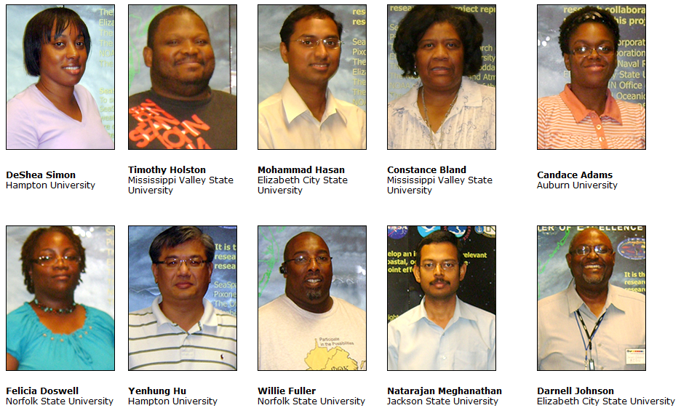
ADMI Cloudy View on Computing Workshop Participants

Slide 21
FutureGrid Viral Growth Model
Users apply for a project
Users improve/develop some software in project
This project leads to new images which are placed in FutureGrid repository
Project report and other web pages document use of new images
Images are used by other users
And so on ad infinitum ………
Please bring your nifty software up on FutureGrid!!

Slide 22
Software Components
Portals including “Support” “use FutureGrid” “Outreach”
Monitoring – INCA, Power (GreenIT)
Experiment Manager: specify/workflow
Image Generation and Repository
Intercloud Networking ViNE
Virtual Clusters built with virtual networks
Performance library
Rain or Runtime Adaptable InsertioN Service for images
Security Authentication, Authorization,
Note Software integrated across institutions and between middleware and systems Management (Google docs, Jira, Mediawiki)
Note many software groups are also FG users
“Research”
Above and below
Nimbus OpenStack Eucalyptus

