Slide 1
FutureGrid RAIN:
More than Dynamic Provisioning Across Virtual and Bare-metal Resources
Gregor von Laszewski¹
Javier Diaz², Fugang Wang¹, Koji Tanaka¹, Hyungro Lee¹, Geoffrey C. Fox¹
¹Indiana University, ²now Rutgers University

Slide 2
Acknowledgement
NSF Funding
Reuse of Slides
The FutureGrid project is funded by the National Science Foundation (NSF) and is led by Indiana University with University of Chicago, University of Florida, San Diego Supercomputing Center, Texas Advanced Computing Center, University of Virginia, University of Tennessee, University of Southern California, Dresden, Purdue University, and Grid 5000 as partner sites.
If you reuse the slides you must properly site this slide deck and its associated publications.
Please contact Gregor von Laszewski
  laszewski@gmail.com

Slide 3
Outline
Introduction
  FutureGrid
  Dynamic Provisioning
Rain
  Usecases
    OS, Hadoop, vCluster
  Design
  Performance
Autonomous Rain
  Design & Metrics
  Usecase
    Resource Shifting
Other Activities
  Teefaa
  Cloud Mesh
Conclusion

Slide 4
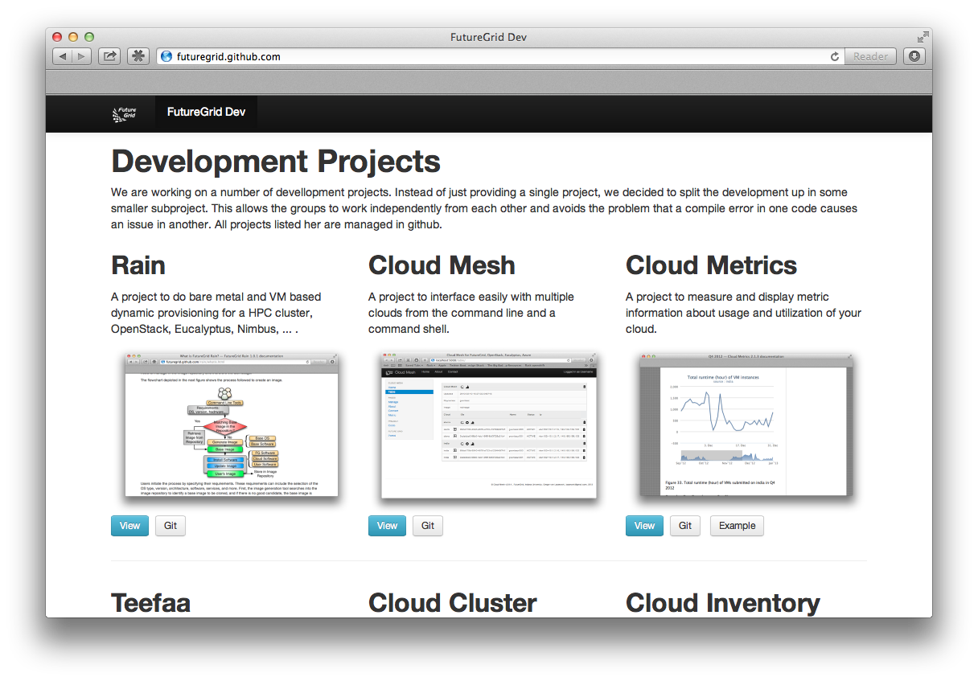
futuregrid.github.com
http://futuregrid.github.com/rain

Slide 5
Introduction

Slide 6
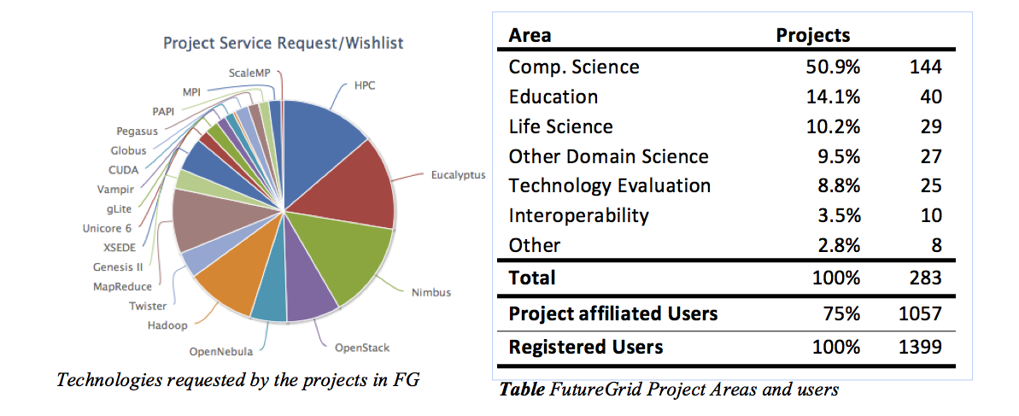
FutureGrid
International customizable testbed for Cloud, HPC, and Grid Computing
    Mar 2012: more than 280 Projects, and 1000 users
      >80% from the US
    4 major use types:
      Computer Science, Education, Evaluation, Domain Science
Other Life Science
Computer Science
Computer Science

Slide 7
Hardware & Support
Computing
  Distributed set of clusters at
    IU, UC, SDSC, UFL
  Diverse specifications
    See portal
Networking
  WAN 10GB/s
  Many Clusters Infiniband
  Network fault generator
Storage
  Sites maintain their own shared file server
  Has ben upgraded on one machine to 4TB per server due to user request
Support
  Portal
  Ticket System
  Integrated Systems and Software Team

Slide 8

FutureGrid: a Grid/Cloud/HPC Testbed
12TF Disk rich + GPU 512 cores
NID: Network Impairment Device
Private
Public
FG Network

Slide 9
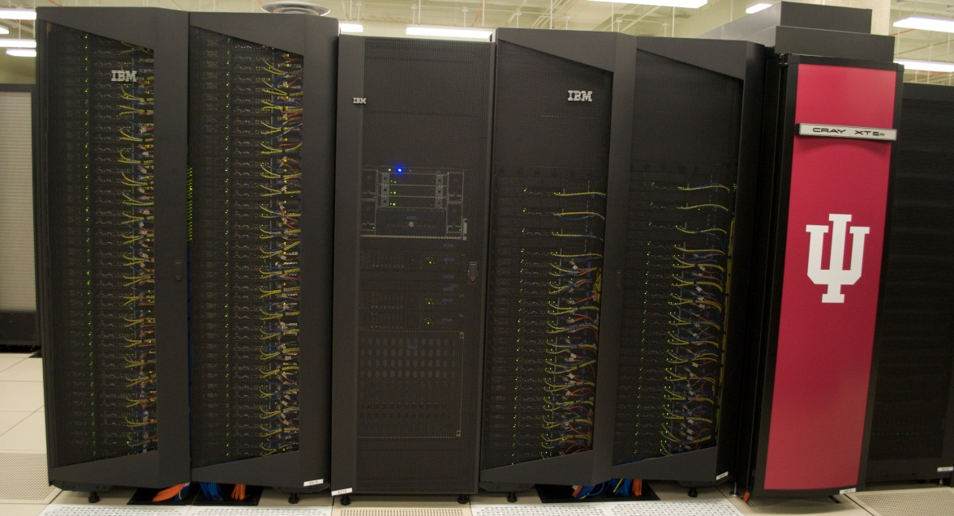
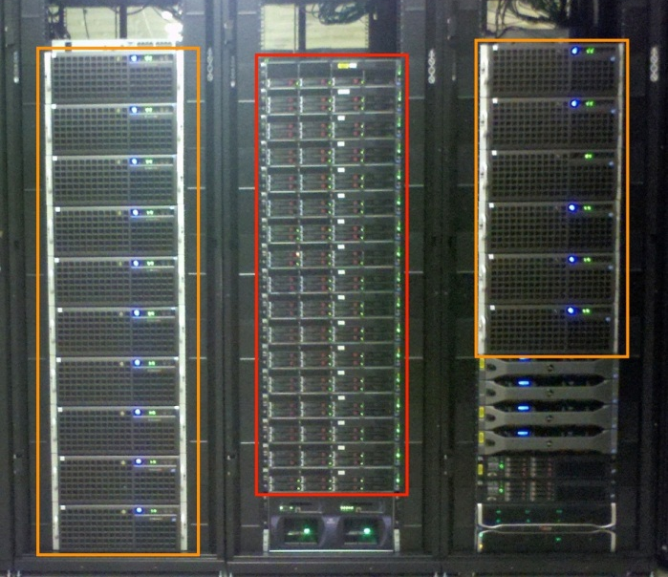
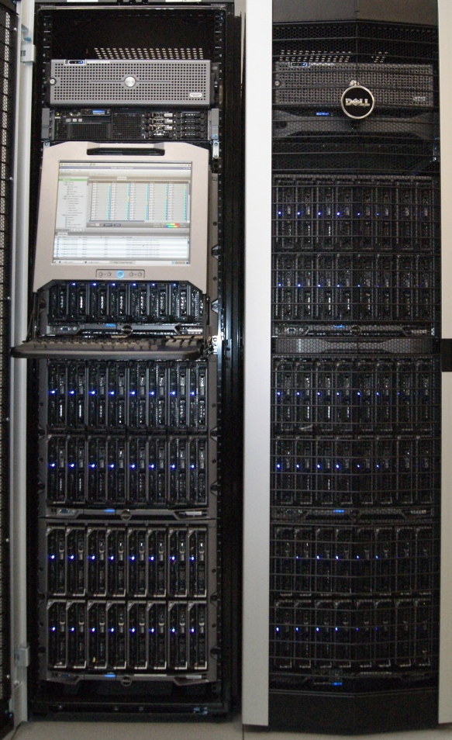
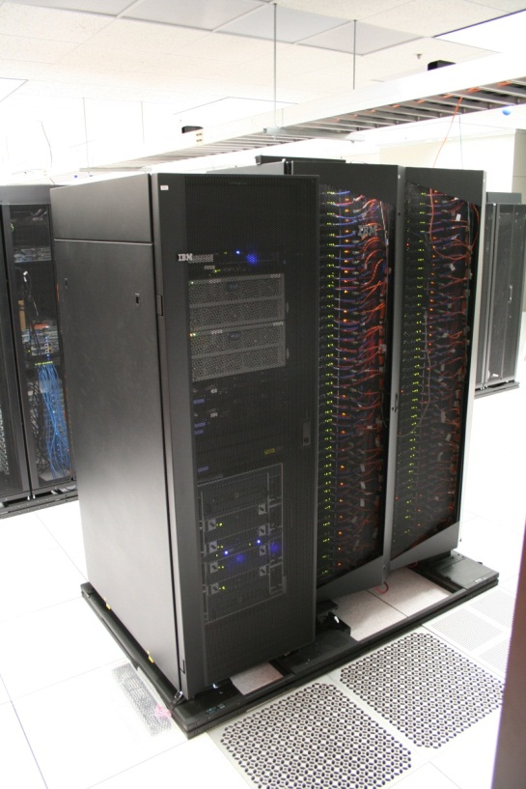

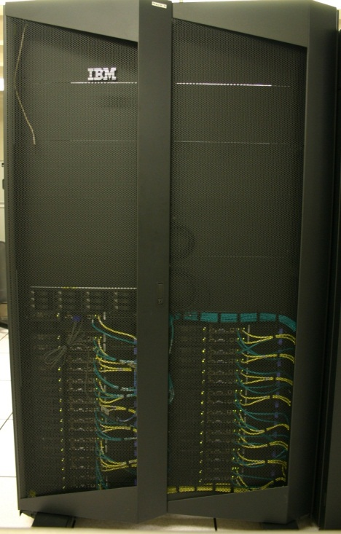
FutureGrid Distributed Testbed-aaS
Bravo Delta (IU)
India (IBM) and Xray (Cray) (IU)
Hotel (Chicago)
Foxtrot (UF)
Sierra (SDSC)
Alamo (TACC)

Slide 10
Compute Hardware
Name | System type | # CPUs | # Cores | TFLOPS | Total RAM (GB) | Secondary Storage (TB) | Site | Status
India | IBM iDataPlex | 256 | 1024 | 11 | 3072 | 512 | IU | Operational
Alamo | Dell PowerEdge | 192 | 768 | 8 | 1152 | 30 | TACC | Operational
Hotel | IBM iDataPlex | 168 | 672 | 7 | 2016 | 120 | UC | Operational
Sierra | IBM iDataPlex | 168 | 672 | 7 | 2688 | 96 | SDSC | Operational
Xray | Cray XT5m | 168 | 672 | 6 | 1344 | 180 | IU | Operational
Foxtrot | IBM iDataPlex | 64 | 256 | 2 | 768 | 24 | UF | Operational
Bravo | Large Disk & memory | 32 | 128 | 1.5 | 3072 (192GB per node) | 192 (12 TB per Server) | IU | Operational
Delta | Large Disk & memory With Tesla GPU’s | 32 CPU 32 GPU’s | 192+ 14336 GPU | 9 ? | 1536 (192GB per node) | 192 (12 TB per Server) | IU | Operational
Echo (Scale MP) | Large Disk & memory | 32 | 192 | 2 | 6144 | 192 | IU | Testing
TOTAL |  | 1112 + 32 GPU | 4576 +14336 GPU | 53.5 | 21792 | 1538

Slide 11
Simplified Software Architecture

Slide 12
Selected List of Services Offered
FutureGrid
IaaS
Nimbus
Cloud PaaS
Hadoop
Twister
HDFS
Swift Object Store
MPI
TestbedaaS
FG RAIN
Portal
Inca
Eucalyptus
OpenStack
ViNE
HPCaaS
Ganglia
Devops
Exper. Manag./Pegasus
OpenMP
CUDA
GridaaS
Unicore
SAGA
Globus
Genesis II

Slide 13
Services Offered
 | India | Sierra | Hotel | Foxtrot | Alamo | Xray | Bravo | Delta | Echo
myHadoop | ✔ | ✔ |  |  | ✔
Nimbus |  | ✔ | ✔ | ✔ | ✔
OpenStack | ✔ | ✔ |  |  | ✔ |  |  | ✔
Eucalyptus | ✔ | 
ViNe¹ | ☑ | ✔ | ☑ | ✔ | ☑
Genesis II | ✔ | ✔ |  |  | ✔ | ✔
Unicore | ✔ | ✔ |  |  |  | ✔
MPI | ✔ | ✔ | ✔ | ✔ | ✔ | ✔ | ✔
OpenMP |  |  |  |  |  | ✔
ScaleMP |  |  |  |  |  |  |  |  | ✔
Ganglia | ✔ | ✔ | ✔ | ✔ | ✔
Pegasus³ | ☑ | ☑ | ☑ | ☑ | ☑
Inca | ✔ | ✔ | ✔ | ✔ | ✔ | ✔
Portal² | ☒ | ☒ | ☒ | ☒ | ☒ | ☒
PAPI |  |  |  |  |  | ✔
Globus |  |  |  |  | ✔
ViNe can be installed on the
other resources via Nimbus ☑
Access to the resource is requested through the portal ☒
Pegasus available via Nimbus and Eucalyptus images
.. deprecated

Slide 14
What to do when the users flavor of the day changes?
Single Service HPC
Multi Service Data Center
There is possibly no flavor of the day
  limited flavor of the week/month selection
Reconfigure the machine based on individual user requests
  Administrator driven
  Time consuming
  Requests are difficult to prioritize
  New services could provide operational challenge
Move the resources to services that need them
  Host multiple services in parallel
  Adjust resource assignment to services that need it
  Automatize the assignment process
  Allow (certain) provisioning to be conducted by users

Slide 15
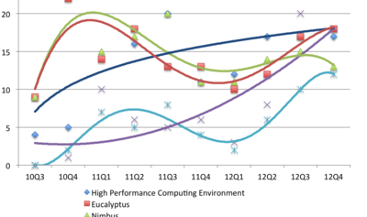
Technology Requests per Quarter
OpenStack
Eucalyptus
HPC
Nimbus
(c) It is not permissible to publish the above graph in a paper or report without co-authorship and prior notification of Gregor von Lazewski. Please contact laszewski@gmail.com

Slide 16
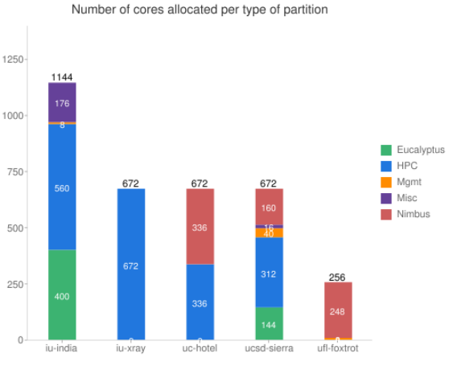
Dynamic Service Allocation
Based on Utilization

Slide 17
Preview of Rain Functionality
http://futuregrid.org

Slide 18
RAIN
Templates
&
Services
Virtual Cluster
Virtual Machine
Haddop
OS Image
Resources
Other

Slide 19
Rain Goals
Deployment. Deploy custom services onto Resources including IaaS, PaaS, Queuing System aaS, Database aaS,Application/Software aaS, Address bare metal provisioning
Runtime. Adjustment services on demand for resource assignment between Iaas, PaaS, A/SaaS
Interface. Simple interfaces following Gregor’s CAU-Principle: equivalence between
Command line, API and User interface

Slide 20
Motivating Use Cases
Give me a virtual cluster with 30 nodes based on Xen
Give me 15 KVM nodes each in Chicago and Texas linked to Azure
Give me a Eucalyptus environment with 10 nodes
Give 32 MPI nodes running on first Linux and then Windows
Give me a Hadoop environment with 160 nodes
Give me a 1000 BLAST instances
Run my application on Hadoop, Dryad, Amazon and Azure … and compare the performance
http://futuregrid.org

Slide 21
Vision
  fg-rain –h hostfile –iaas openstack –image img
  fg-rain –h hostfile –paas hadoop …
  fg-rain –h hostfile –paas azure …
  fg-rain –h hostfile –gaas genesisII …
  fg-rain –h hostfile –image img
Command
Shell
API
User Portal/
User Interface
Gregor’s CAU principle
http://futuregrid.org

Slide 22
…
this is more than
Dynamic Provisioning of the OS
We will focus here mostly on the dynamic provisioning part of RAIN

Slide 23
Classical Dynamic Provisioning
Dynamically partition a set of resources
Dynamically allocate resources to users
Dynamically define the environment that a resource is going to use
Dynamically assign them based on user request
Deallocate the resources so they can be dynamically allocated again

Slide 24
Use Cases of Dynamic Provisioning
Static provisioning:
  Resources in a cluster may be statically reassigned based on the anticipated user requirements, part of an HPC or cloud service. It is still dynamic, but control is with the administrator. (Note some call this also dynamic provisioning.)
Automatic Dynamic provisioning:
  Replace the administrator with intelligent scheduler.
Queue-based dynamic provisioning:
  provisioning of images is time consuming, group jobs using a similar environment and reuse the image. User just sees queue.
Deployment:
  dynamic provisioning features are provided by a combination of using XCAT and Moab
http://futuregrid.org

Slide 25
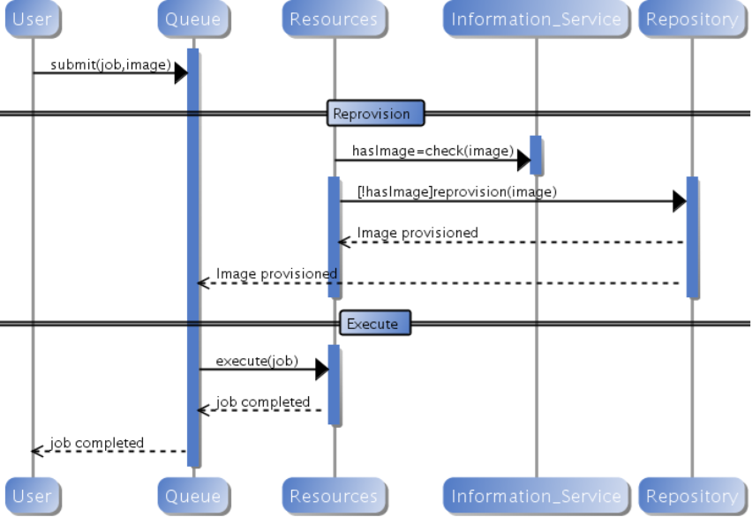
Generic Provisioning
http://futuregrid.org

Slide 26
RAIN can help!
for those that need an acronym:
RAIN = Runtime Adaptable INsertion Framework

Slide 27
Terminology
Image Management provides the low level software (create, customize, store, share and deploy images) needed to achieve Dynamic Provisioning and Rain
Dynamic Provisioning is in charge of providing machines with the requested OS
RAIN is our highest level component that uses Dynamic Provisioning and Image Management to provide custom environments that may have to be created. Therefore, a Rain request may involve the
(1) creating, (2) deploying, and (3) provisioning
of one or more images in a set of machines on demand

Slide 28

RAIN Architecture
CAU Framework
CAU Framework
Image Management
Autonomous Runtime Services
Dynamic provisioning Abstraction
Portal
Command Shell
API
User Portal
AAA
Image Management
Autonomous Runtime Services
Image Generation
Image Repository
Information
Image Deployment
Prediction
External Servicee DevOps, Security Tools
Dynamic Provisioning and Resource Abstraction
Bare Metal Provisioners
Resources
local
Teefaa
IaaS
VMs
Moab&XCAT
Kadeploy
Cluster
Servers
OpenStack BM
Network
GENI/Openflow
Switches

Slide 29
Image Management
Major Services
Goal
Image Repository
Image Generator
Image Deployment
Dynamic provisioning
External Services
Create and maintain platforms in custom images that can be retrieved, deployed, and provisioned on demand
Use case:
  fg-image-generate –o ubuntu –v maverick -s openmpi-bin,gcc,fftw2,emacs\
  –n ubuntu-mpi-dev –label mylabel
  fg-image-deploy –x india.futuregrid.org –label mylabel
  fg-rain –provision -n 32 ubuntu-mpi-dev

Slide 30
Life Cycle of Images

Slide 31
Image Metadata
User Metadata
Field Name | Description
imgId | Image’s unique identifier
owner | owner
os | Operating system
description | Description of the image
tag | Image’s keywords
vmType | Virtual machine type
imgType | Aim of the image
permission | Access permission
imgStatus | Status of the image
createdDate | Upload date
lastAccess | Last time the image was accessed
accessCount | # times the image has been accessed
size | Size of the image
Field Name | Description
userId | User’s unique identifier
fsCap | Disk max usage (quota)
fsUsed | Disk space used
lastLogin | Last time user used the framework
status | Active, pending, disable
role | Admin, User
ownedimg | # of owned images
Attributes for quota management
Notes:
These tables collects the metadata associated with images and users. This includes information about properties of the images, the access permission by users and the usage.
--------
Access permissions allow the image owner to determine who has access to the image. The simplest types of sharing include private to owner, shared with the public or shared with a set of people defined by a group/project. Usage information is available as part of the metadata to allow information about usage to be recorded. This includes how many times an image was accessed and by whom.

Slide 32
Image Generation
  Creates images according to user’s specifications:
    OS type and version
    Architecture
    Software Packages
  Software installation may be aided by DevOps tool
  Images are not aimed to any specific infrastructure
  Image stored in Repository or returned to user
Notes:
This picture represent the workflow of the image generation. After the user introduce the requirements, the image generation service searches into the image repository to identify a base image to be cloned. A base image only contains the OS and minimum required software. If the image generation service finds such an image, it just needs to install the software required by the user and store de image.
In the case that it does not find a base image, it create such an image from scratch. This is done using the tools to bootstrap images provided by the different OSes, such as yum for CentOS and deboostrap for Ubuntu. To deal with different OSes and architectures, we use cloud technologies. Consequently, an image is created with all user specified packages inside a VM instantiated on-demand. Therefore, multiple users can create multiple images for different operating systems concurrently; obviously, this approach provides us with great flexibility, architecture independence, and high scalability. Currently, we use OpenNebula to support this process.
------------------
First, the image generation tool searches into the image repository to identify a base image to be cloned, and if there is no good candidate, the base image is created from scratch. Once we have a base image, the image generation tool installs the software required by the user.
One feature of our design is to either create images from scratch or by cloning already created base images we locate in our repository. In the first case, images are created using the tools to bootstrap images provided by the different OSes, such as yum for CentOS and deboostrap for Ubuntu. To deal with different OSes and architectures, we use cloud technologies. Consequently, an image is created with all user specified packages inside a VM instantiated on-demand. Therefore, multiple users can create multiple images for different operating systems concurrently; obviously, this approach provides us with great flexibility, architecture independence, and high scalability. Currently, we use OpenNebula to support this process.
We can speed-up the process of generating an image by not starting from scratch but by using an image already stored in the repository. We have tagged such candidate images in the repository as base images. Consequently, modifications include installation or update of the packages that the user requires. Our design can utilize either VMs or a physical machine to chroot into the image to conduct this step.

Slide 33
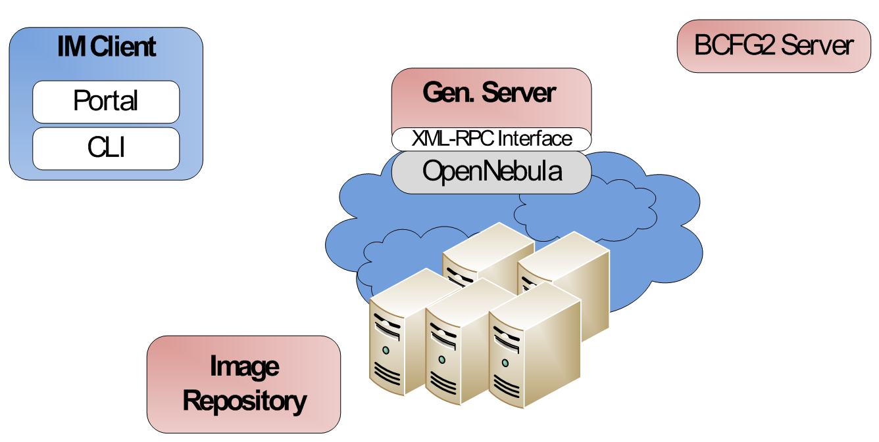
Generate an Image
fg-generate -o centos -v 5 -a x86_64
–s python26,wget (returns id)
Generate img
Deploy VM
And
Gen. Img
1
2
3
Store in the Repo
or
Return it to user

Slide 34
Generate an Image
fg-generate –u $USER -o centos -v 5 -a x86_64
–s python26, wget
Client output:
Image generator client...
Please insert the password for the user $USER
Password:
Selected Architecture: x86_64
Connecting server: i120:56791
Your image request is in the queue to be processed
------wait here if too many request are being processed------
Your image request is being processed
Generating the image
------wait here until finished------
Your image has be uploaded in the repository with ID=915678426632408832461797
The image and the manifest generated are packaged in a tgz file.
Please be aware that this FutureGrid image does not have kernel and fstab. Thus, it is not built for any deployment type. To deploy the new image, use the IMDeploy command.
Generate img
Deploy VM
And
Gen. Img
1
2
3
Store in the Repo
or
Return it to user

Slide 35
Image Repository Examples
Query the image repository
  fg-repo –u $USER –q “* where os=centos_5”
Upload an Image
  fg-repo –u $USER–p imagefile.tgz “os=centos & vmtype=kvm & description=my image”
Authentication OK
2 items found
imgId=215369546596144595085417, os=centos_5, arch=x86_64, owner=$USER, description=None, tag=$USER2699012769, vmType=none, imgType=machine, permission=private, status=available
imgId=68725515834828774883357, os=centos_5, arch=x86_64, owner=$USER, description=None, tag=$USER1786816389, vmType=none, imgType=machine, permission=private, status=available
Checking quota and Generating an ImgId
Authentication OK
Uploading image. You may be asked for ssh/passphrase password
Imagefile.tgz 100% 53 0.1KB/s 00:00
Registering the image
The image has been uploaded and registered with id 211913675261934066702430

Slide 36
Image Repository Examples
Add User
  fg-repo –u $USER --useradd userId
Image Usage
  fg-repo –u $USER –histimg
Authentication OK
User created successfully.
Remember that you still need to activate this user (see setuserstatus command)
Authentication OK
imgId=191563243441508818679593, createdDate(UTC)=2011-10-13 21:43:30, lastAccess(UTC)=2011-10-24 17:37:45, accessCount=16,
imgId=111462205747829171557134, createdDate(UTC)=2011-10-14 20:36:40, lastAccess(UTC)=2011-10-21 13:48:04, accessCount=4,
imgId=21870735808909675281040, createdDate(UTC)=2011-10-07 20:36:33, lastAccess(UTC)=2011-10-07 20:36:33, accessCount=0,

Slide 37
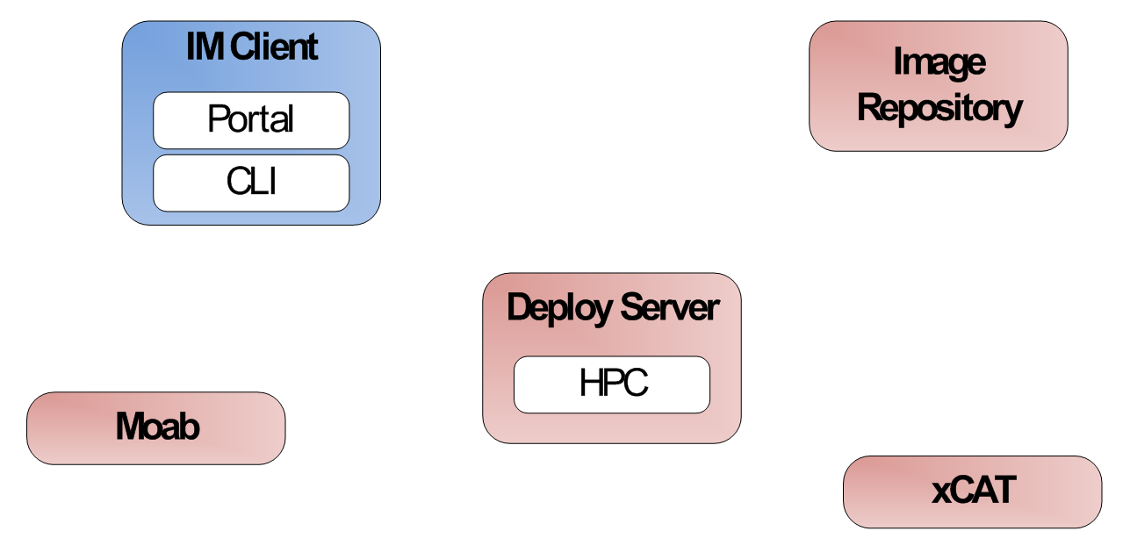

Register an Image for HPC
fg-register -r 2131235123 -x india
Register img from Repo
Get img from Repo
1
2
Register img in Moab and recycle sched
5
Customize img
6
3
Return info about the img
Register img in xCAT (cp files/modify tables)
4

Slide 38
Register an Image for HPC
fg-register -u $USER -r 2131235123 -x india
Client output:
Starting image deployer...
Please insert the password for the user $USER
Password:
Connecting to xCAT server
------wait here if an image is being registered-----
Authentication OK
Customizing and registering image on xCAT
------wait here until finished-----
Connecting to Moab server
Your image has been registered in xCAT as centosjavi960524558.
Please allow a few minutes for xCAT to register the image before attempting to use it.
To boot an machine using your image: qsub -l os=<imagename>
To check the status of the job you can use checkjob and showq commands
Register img from Repo
Get img from Repo
1
2
Register img in Moab and recycle sched
5
Customize img
6
3
Return info about the img
Register img in xCAT (cp files/modify tables)
4

Slide 39
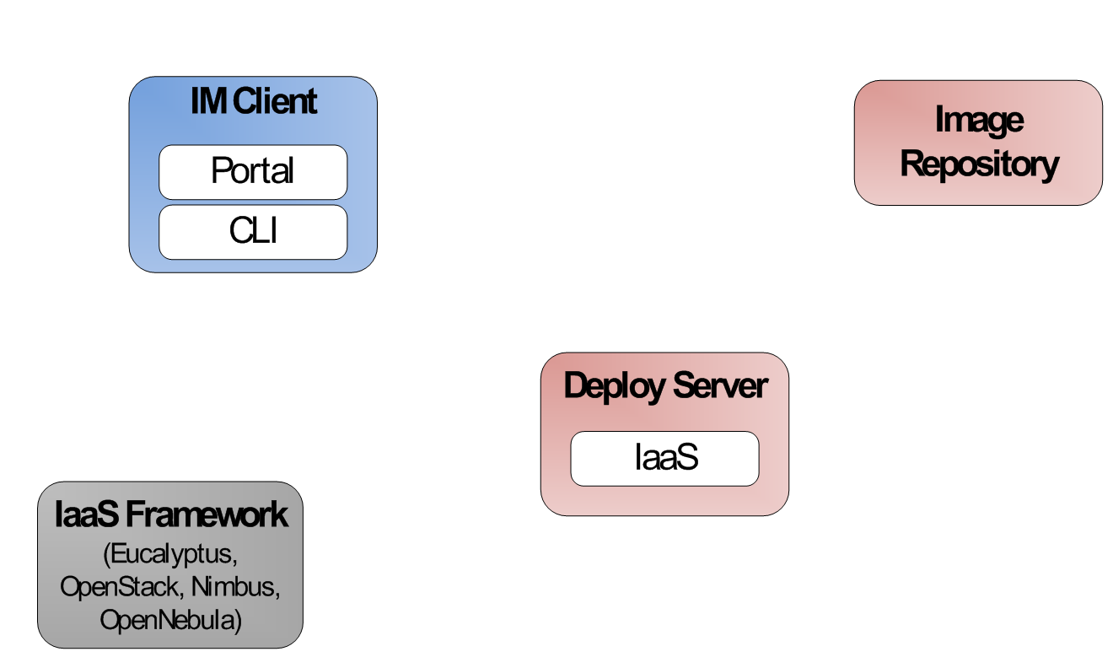

Register an Image stored in the Repository into OpenStack
fg-register -r 2131235123 -s india
Deploy img from Repo
Get img from Repo
1
2
Upload the img to the Cloud
Customize img
5
4
Return img to client
3

Slide 40
Register an Image stored in the Repository into OpenStack
fg-register -u $USER -r 2131235123 -s india -v ~/novarc
Client output:
Starting image registration...
Please insert the password for the user $USER
Password:
Authentication OK
------wait here until finished-----
Retrieving image. You may be asked for ssh/passphrase password
centos5$USER 2250444196.img 100% 1496MB 65.0MB/s 00:23
euca-bundle-image ….
euca-upload-image …
euca-register …
IMAGE emi-437C1239
Your image has been registered on OpenStack with the id emi-437C1239
To launch a VM you can use euca-run-instances -k keyfile -n <#instances> id
Remember to load you Eucalyptus environment before you run the instance (source eucarc)
More information is provided in More information is provided in https://portal.futuregrid.org/tutorials/oss and in https://portal.futuregrid.org/tutorials/eucalyptus
Deploy img from Repo
Get img from Repo
1
2
Upload the img to the Cloud
Customize img
5
4
Return img to client
3

Slide 41
List of Registered Images for xCAT/Moab
fg-register –u $USER -l –x india
List deployed Images
1
Return Images both know about
4
Tell me what images you know
Tell me what images you know
3
2

Slide 42
List of Registered Images for xCAT/Moab
fg-register –u $USER -l –x india
List deployed Images
Client output:
Starting image deployer...
Please insert the password for the user $USER
Password:
Connecting to xCAT server
Authentication OK
Connecting to Moab server
The list of available images on xCAT/Moab is:
centos$USER960524558
centosfuwang1549296807
You can get more details by querying the image repository using IRClient.py -q command and the query string: "* where tag=imagename".
NOTE: To query the repository you need to remove the OS from the image name (centos,ubuntu,debian,rhel...). The real name starts with the username.
1
Return Images both know about
4
Tell me what images you know
Tell me what images you know
3
2

Slide 43
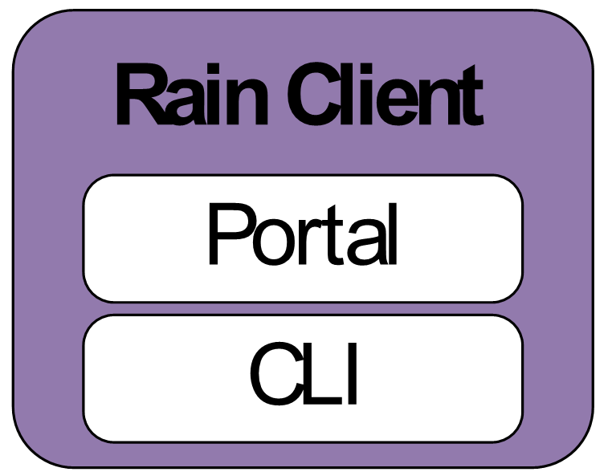
Rain an Image and execute a task (baremetal)
fg-rain -r 123123123 -x india -j testjob.sh -m 2
Run job in my image stored in the repo
7
qsub, monitor status, completion status and indiacate output files
1
Register img
2
Register img from Repo
Get img from Repo
3
4
Register img in Moab and recycle sched
7
Customize img
8
5
Return info about the img
Register img in xCAT (cp files/modify tables)
6

Slide 44
Teefaa Provisioning
Remove dependency on xcat/Moab
Provision a clone of a virtual machine or a baremetal machine on some other baremetal machine
Create a cloud image from a virtual machine or a baremetal machine

Slide 45
Rain an Image and execute a task (baremetal)
fg-rain -u $USER -r 123123123 -x india -j testjob.sh -m 2
Client output:
Starting rain...
Please insert the password for the user $USER
Password:
----- Deploy the image. Same logs as before ---
Job id is: 200941
Wait until the job finishes
State: Idle
State: Idle
State: Running
State: Running
State: Completed
Completion Code: 0 Time: Fri Oct 28 15:05:02
The Standard output is in the file: salida.txt
The Error output is in the file: jobscript.e200941
Run job in my image stored in the repo
7
qsub, monitor status, completion status and indiacate output files
1
Register img
2
Register img from Repo
Get img from Repo
3
4
Register img in Moab and recycle sched
7
Customize img
8
5
Return info about the img
Register img in xCAT (cp files/modify tables)
6

Slide 46
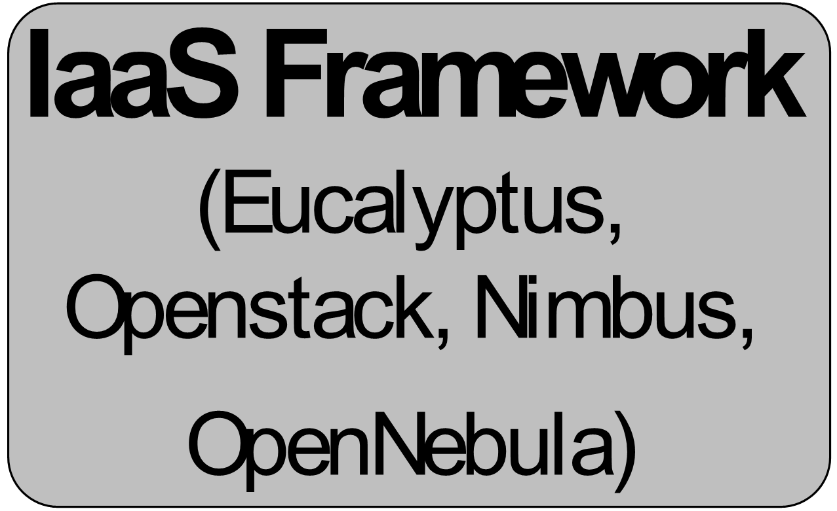
Rain a Hadoop environment in Interactive mode
fg-rain -i ami-00000017 -s india -v ~/OSessex-india/novarc --hadoop --inputdir ~/inputdir1/ --outputdir ~/outputdir/ -m 3 -I
Start VM
2
VMs Running
3
Install/Configure Hadoop
1
4
Deploy Hadoop Environment
Login User in Hadoop Master
5

Slide 47
Rain a Hadoop environment in Interactive mode
fg-rain -u $USER -i ami-00000017 -s india -v ~/OSessex-india/novarc --hadoop --inputdir ~/inputdir1/ --outputdir ~/outputdir/ -m 3 -I
Client output:
Starting Rain...
Please insert the password for the user $USER
Password:
Verify that the requested image is in available status or wait until it is available
Creating temportal sshkey pair for EC2
Save private sshkey into a file
Launching image
Waiting for running state in all the VMs
i-00000772:pending
i-00000773:pending
i-00000774:pending
-------------------------
i-00000772:running
i-00000773:running
i-00000774:running
-------------------------
Number of instances booted 3
Waiting to have access to Instance i-00000772 associated with address server-1906
Waiting to have access to Instance i-00000773 associated with address server-1907
Waiting to have access to Instance i-00000774 associated with address server-1908
All VMs are accessible: True
Creating temporal sshkey files
Copying temporal private and public ssh-key files to VMs
Configuring ssh in VM and mounting home directory (assumes that sshfs and ldap is installed)
Copying temporal private and public ssh-key files to VMs
Configuring ssh in VM and mounting home directory (assumes that sshfs and ldap is installed)
Copying temporal private and public ssh-key files to VMs
Configuring ssh in VM and mounting home directory (assumes that sshfs and ldap is installed)
Setting up Hadoop environment in the $USER home directory
Configure Hadoop cluster in the $USER home directory
Starting Hadoop cluster in the $USER home directory
Formatting HDFS
12/07/10 17:15:49 INFO namenode.NameNode: STARTUP_MSG:
/************************************************************
STARTUP_MSG: Starting NameNode
STARTUP_MSG: host = 10.1.2.157/10.1.2.157
STARTUP_MSG: args = [-format]
STARTUP_MSG: version = 1.0.2
STARTUP_MSG: build = https://svn.apache.org/repos/asf/hadoop/common/branches/branch-1.0.2 -r 1304954; compiled by 'hortonfo' on Sat Mar 24 23:58:21 UTC 2012
************************************************************/
12/07/10 17:15:50 INFO util.GSet: VM type = 64-bit
12/07/10 17:15:50 INFO util.GSet: 2% max memory = 19.33375 MB
12/07/10 17:15:50 INFO util.GSet: capacity = 2^21 = 2097152 entries
12/07/10 17:15:50 INFO util.GSet: recommended=2097152, actual=2097152
12/07/10 17:15:50 INFO namenode.FSNamesystem: fsOwner=$USER
12/07/10 17:15:50 INFO namenode.FSNamesystem: supergroup=supergroup
12/07/10 17:15:50 INFO namenode.FSNamesystem: isPermissionEnabled=true
12/07/10 17:15:50 INFO namenode.FSNamesystem: dfs.block.invalidate.limit=100
12/07/10 17:15:50 INFO namenode.FSNamesystem: isAccessTokenEnabled=false accessKeyUpdateInterval=0 min(s), accessTokenLifetime=0 min(s)
12/07/10 17:15:50 INFO namenode.NameNode: Caching file names occuring more than 10 times
been successfully formatted.
12/07/10 17:15:50 INFO namenode.NameNode: SHUTDOWN_MSG:
/************************************************************
SHUTDOWN_MSG: Shutting down NameNode at 10.1.2.157/10.1.2.157
************************************************************/
Starting the cluster
starting namenode, logging to /N/u/$USER/hadoopjob764175511/hadoop-1.0.2/libexec/../logs/hadoop-$USER-namenode-10.1.2.157.out
server-1908: starting datanode, logging to /N/u/$USER/hadoopjob764175511/hadoop-1.0.2/libexec/../logs/hadoop-$USER-datanode-10.1.2.160.out
server-1907: starting datanode, logging to /N/u/$USER/hadoopjob764175511/hadoop-1.0.2/libexec/../logs/hadoop-jdiaz-datanode-10.1.2.159.out
server-1906: Warning: Permanently added 'server-1906,10.1.2.157' (RSA) to the list of known hosts.
server-1906: starting secondarynamenode, logging to /N/u/jdiaz/hadoopjob764175511/hadoop-1.0.2/libexec/../logs/hadoop-jdiaz-secondarynamenode-10.1.2.157.out
Waiting in the safemode
Safe mode is OFF
Starting MapReduce daemons
starting jobtracker, logging to /N/u/jdiaz/hadoopjob764175511/hadoop-1.0.2/libexec/../logs/hadoop-jdiaz-jobtracker-10.1.2.157.out
server-1908: starting tasktracker, logging to /N/u/jdiaz/hadoopjob764175511/hadoop-1.0.2/libexec/../logs/hadoop-jdiaz-tasktracker-10.1.2.160.out
server-1907: starting tasktracker, logging to /N/u/jdiaz/hadoopjob764175511/hadoop-1.0.2/libexec/../logs/hadoop-jdiaz-tasktracker-10.1.2.159.out
Running Job
You are going to be logged as root, but you can change to your user by executing su - <username>
List of machines are in /root/machines and /N/u/<username>/machines. Your real home is in /tmp/N/u/<username>
Hadoop is in the home directory of your user.
[root@10 ~]#
If we exit from VM:
Stopping Hadoop Cluster
stopping jobtracker
server-1907: stopping tasktracker
server-1908: stopping tasktracker
stopping namenode
server-1908: stopping datanode
server-1907: stopping datanode
server-1906: stopping secondarynamenode
Job Done
Start VM
2
VMs Running
3
Install/Configure Hadoop
1
4
Deploy Hadoop Environment
Login User in Hadoop Master
5
https://portal.futuregrid.org

Slide 48
Rain a Hadoop environment and execute Word count 1/2
As example we use the word count application to count the words of several books
Create script with the hadoop command (hadoopword.sh)
Download books in txt
Uncompress books
hadoop jar $HADOOP_CONF_DIR/../hadoop-examples*.jar wordcount inputdir1 outputdir
$ wget i120/test-image/books-example.tgz
$ mkdir ~/inputdir1
$ tar xvfz books-example.tgz –C ~/inputdir1

Slide 49
Rain a Hadoop environment and execute Word count 2/2
Execute rain
Once the job is done
The output is in the file part-r-00000
$ fg-rain -u jdiaz -i ami-00000017 -s india -v ~/OSessex-india/novarc –j ~/hadoopword.sh --hadoop --inputdir ~/inputdir1/ --outputdir ~/outputdir/ -m 3
$ ls ~/outputdir/outputdir/
_logs part-r-00000 _SUCCESS

Slide 50
Note
The virtual cluster example does not work due to some experimentation we do with OpenStack

Slide 51
Rain a Virtual Cluster
fg-cluter run -i ami-00000017 -n 3 -t m1.medium -a mycluster
Start VM
2
VMs Running
3
Install/Configure SLURM
1
4
Login User in Frontend
Deploy Virtual Cluster
5

Slide 52
Autonomous Runtime Services

Slide 53
Autonomous Runtime Services
Orchestrates resource re-allocation among different infrastructures
Command Line interface to ease the access to this service
Exclusive access to the service to prevent conflicts
Keep status information about the resources assigned to each infrastructure as well as the historical to be able to make predictions about the future needs
Scheduler that can dynamically re-allocate resources and support manually planning future re-allocations

Slide 54
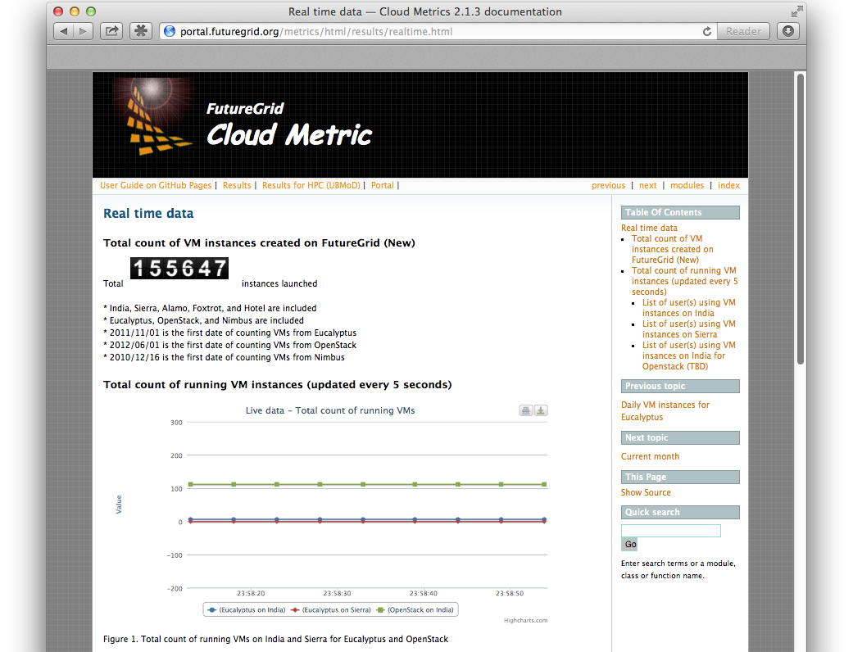

Slide 55
Use Case: Move Resources
Autonomous Runtime Services
2
1

Slide 56
Cloud Mesh
Simplify access across clouds.
Some aspects similar to OpenStack Horizon, but for multiple clouds
While using RAIN it will be able to do
  one-click template & image install on various IaaS & baremetal
  templated workflow management involving VMs and bare metal

Slide 57
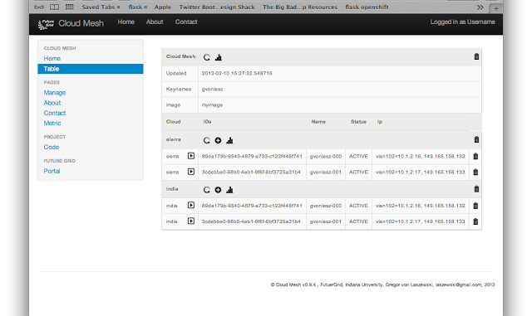
Cloud Mesh GUI

Slide 58
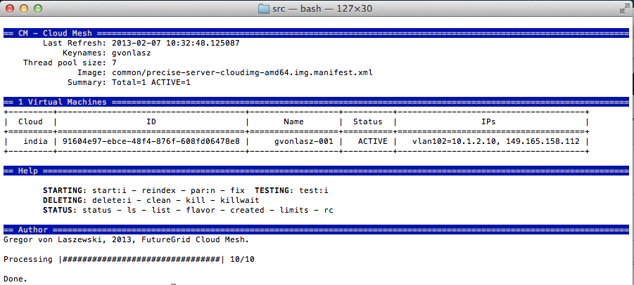
Different view (Comandline GUI)

Slide 59
Some Numbers… (I)

Slide 60
Some Numbers… (II)

Slide 61
Summary

Slide 62
Summary
RAIN
  Provision IaaS, PaaS, bare-metal
  Working towards Autonomous services
Bare Metal Provisioning
  Users can customize bare metal images
  We provide base images that can be extended
  We have developed an environment allowing multiple users to do this at the same time
Moab & XCAT
  Moab supports OS dynamic provisioning
    Term dynamic provisioning is often ambiguous
  Significant changes of XCAT
  We are replacing Moab and XCAT with SLURM, OpenStack and teefaa

