Slide 1
FutureGrid Quick Summary
July 18 2013
Geoffrey Fox for FutureGrid Team
gcf@indiana.edu
http://www.infomall.org http://www.futuregrid.org
School of Informatics and Computing
Digital Science Center
Indiana University Bloomington

Slide 2
Summary
FutureGrid has a set of MOOC's that cover core capabilities and various advanced capabilities and tools.
In core capabilities we have an introduction to FutureGrid and a presentation that gives more detail. These presentations are divided into separate lessons.
Then we offer MOOC's on core capabilities: setting up a portal account and project; using non virtualized HPC nodes.
Then we have two approaches to virtual machines: using OpenStack Grizzly release and using the Eucalyptus system.
The advanced topics currently cover IP-over-P2P (IPOP) technology but more topics will be added.

Slide 3
FutureGrid Testbed as a Service
FutureGrid is part of XSEDE set up as a testbed with cloud focus
Operational since Summer 2010 (i.e. coming to end of third year of use)
The FutureGrid testbed provides to its users:
Support of Computer Science and Computational Science research
A flexible development and testing platform for middleware and application users looking at interoperability, functionality, performance or evaluation
FutureGrid is user-customizable, accessed interactively and supports Grid, Cloud and HPC software with and without VM’s
A rich education and teaching platform for classes
Offers OpenStack, Eucalyptus, Nimbus, OpenNebula, HPC (MPI) on same hardware moving to software defined systems; supports both classic HPC and Cloud storage

Slide 4
5 Use Types for FutureGrid TestbedaaS
318 approved projects (1860 users) July 3 2013
USA(77%), Puerto Rico(2.9%), Indonesia(2.4%), Italy(2.2%)- last 3 as students in class, India, China, United Kingdom …
Industry, Government, Academia
Computer science and Middleware (51.2%)
Core CS and Cyberinfrastructure
Interoperability (3.1%)
for Grids and Clouds such as Open Grid Forum OGF Standards
New Domain Science applications (22.4%)
Life science highlighted (11.2%), Non Life Science (11.2%)
Training Education and Outreach (14.4%)
Semester and short events; focus on outreach to HBCU
Computer Systems Evaluation (8.8%)
XSEDE (TIS, TAS), OSG, EGI; Campuses

Slide 5
Selected List of Services Offered
FutureGrid
IaaS
Nimbus
Cloud PaaS
Hadoop
Iterative MapReduce
HDFS
Hbase
Swift Object Store
MPI
TestbedaaS
FG RAIN, CloudMesh
Portal
Inca
Eucalyptus
OpenStack
ViNE
HPCaaS
Ganglia
Devops (Chef, Puppet, Salt)
Experiment Management e.g. Pegasus
OpenMP
CUDA
GridaaS
Unicore
SAGA
Globus
Genesis II

Slide 6
Heterogeneous Systems Hardware
Name | System type | # CPUs | # Cores | TFLOPS | Total RAM (GB) | Secondary Storage (TB) | Site | Status
India | IBM iDataPlex | 256 | 1024 | 11 | 3072 | 512 | IU | Operational
Alamo | Dell PowerEdge | 192 | 768 | 8 | 1152 | 30 | TACC | Operational
Hotel | IBM iDataPlex | 168 | 672 | 7 | 2016 | 120 | UC | Operational
Sierra | IBM iDataPlex | 168 | 672 | 7 | 2688 | 96 | SDSC | Operational
Xray | Cray XT5m | 168 | 672 | 6 | 1344 | 180 | IU | Operational
Foxtrot | IBM iDataPlex | 64 | 256 | 2 | 768 | 24 | UF | Operational
Bravo | Large Disk & memory | 32 | 128 | 1.5 | 3072 (192GB per node) | 192 (12 TB per Server) | IU | Operational
Delta | Large Disk & memory With Tesla GPU’s | 32 CPU 32 GPU’s | 192 | 9 | 3072 (192GB per node) | 192 (12 TB per Server) | IU | Operational
Lima | SSD Test System | 16 | 128 | 1.3 | 512 | 3.8(SSD) 8(SATA) | SDSC | Operational
Echo | Large memory ScaleMP | 32 | 192 | 2 | 6144 | 192 | IU | Beta
TOTAL |  | 1128 + 32 GPU | 4704 +14336 GPU | 54.8 | 23840 | 1550

Slide 7
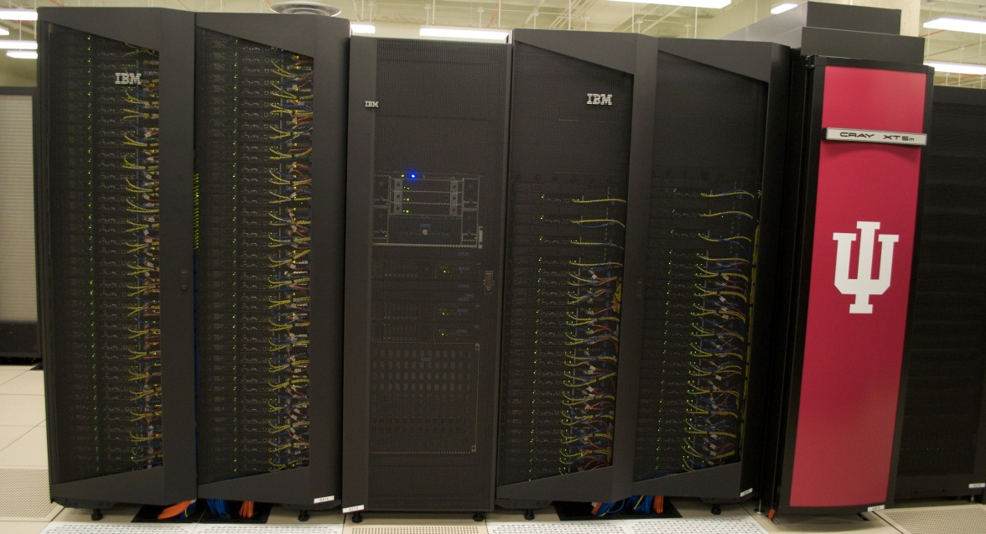
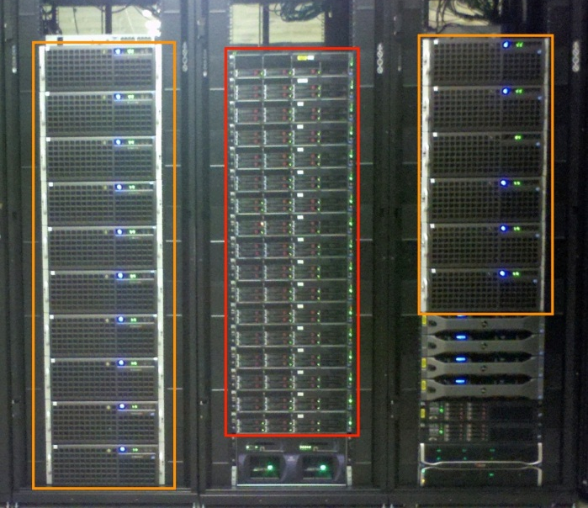
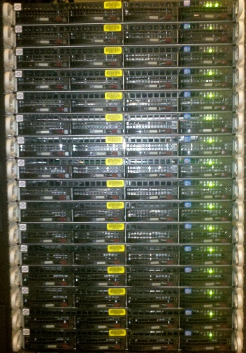
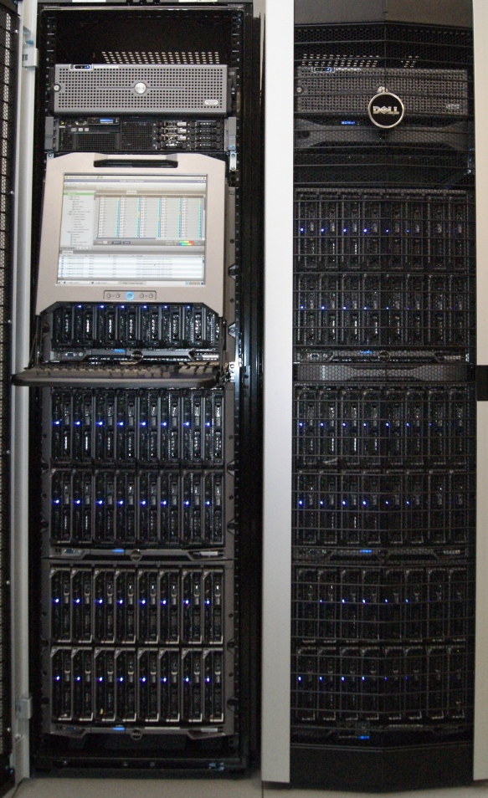
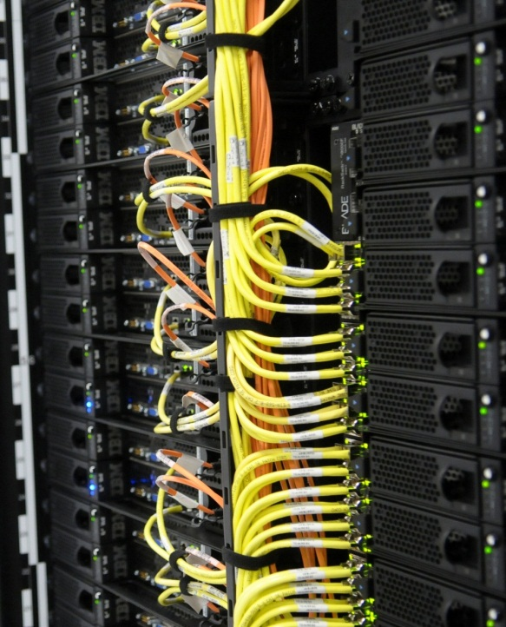
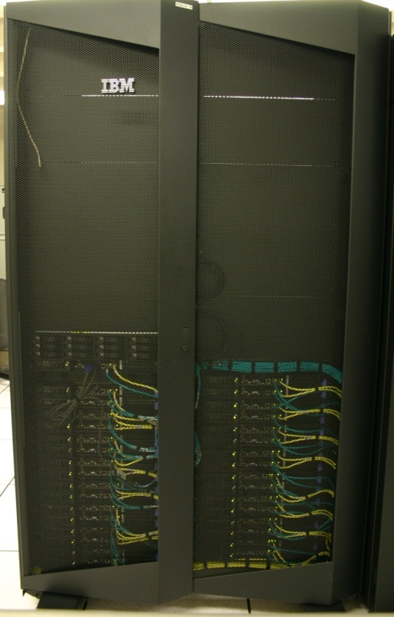
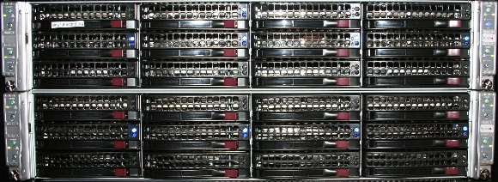
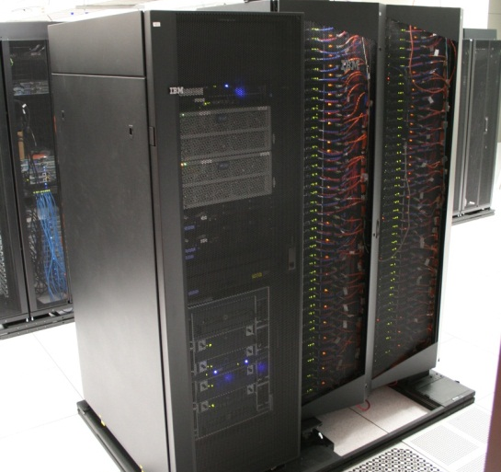
FutureGrid Distributed Computing TestbedaaS
Bravo Delta Echo (IU)
India (IBM) and Xray (Cray) (IU)
Lima (SDSC)
Hotel (Chicago)
Foxtrot (UF)
Sierra (SDSC)
Alamo (TACC)

