Slide 1
Overview of Existing Services
Gregor von Laszewski
laszewski@gmail.com
(15 min)

Slide 2
Categories
PaaS: Platform as a Service
  Delivery of a computing platform and solution stack
IaaS: Infrastructure as a Service
  Deliver a compute infrastructure as a service
Grid:
  Deliver services to support the creation of virtual organizations contributing resources
HPCC: High Performance Computing Cluster
  Traditional high performance computing cluster environment
Other Services
  Other services useful for the users as part of the FG service offerings

Slide 3

Selected List of Services Offered
FutureGrid
User
IaaS
Nimbus
PaaS
Hadoop
(Twister)
(Sphere/Sector)
MPI
Others
Portal
Inca
Eucalyptus
ViNE
(OpenStack)
(OpenNebula)
HPCC
Ganglia
(Exper. Manag./(Pegasus
(Rain)
OpenMP
ScaleMP
(XD Stack)
Grid
(Globus)
Unicore
SAGA
Genesis II
(will be added in future)

Slide 4
Services Offered
 | India | Sierra | Hotel | Foxtrot | Alamo | Xray | Bravo
myHadoop | ✔ | ✔ |  |  | ✔
Nimbus |  | ✔ | ✔ | ✔ | ✔
Eucalyptus | ✔ | ✔
ViNe¹ | ☑ | ✔ | ☑ | ✔ | ☑
Genesis II | ✔ | ✔ |  |  | ✔ | ✔
Unicore | ✔ | ✔ |  |  |  | ✔
MPI | ✔ | ✔ | ✔ | ✔ | ✔ | ✔ | ✔
OpenMP |  |  |  |  |  | ✔
ScaleMP | ✔
Ganglia | ✔ |  | ✔
Pegasus³ | ☑ | ☑ | ☑ | ☑ | ☑
Inca | ✔ | ✔ | ✔ | ✔ | ✔ | ✔
Portal² | ☒ | ☒ | ☒ | ☒ | ☒ | ☒
PAPI |  |  |  |  |  | ✔
Vampir
ViNe can be installed on the
other resources via Nimbus ☑
Access to the resource is requested through the portal ☒
Pegasus available via Nimbus and Eucalyptus images

Slide 5
Which Services should we install?
We look at statistics on what users request
We look at interesting projects as part of the project description
We look for projects which we intend to integrate with: e.g. XD TAS, XD XSEDE
We leverage experience from the community

Slide 6
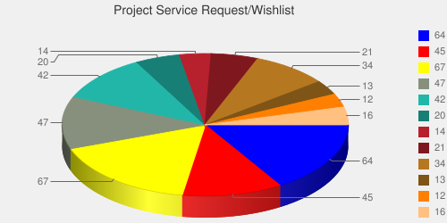
User demand influences service deployment
Based on User input we focused on
  Nimbus (53%)
  Eucalyptus (51%)
  Hadoop (37%)
  HPC (36%)
Eucalyptus: 64(50.8%)
High Performance Computing Environment: 45(35.7%)
Nimbus: 67(53.2%)
Hadoop: 47(37.3%)
MapReduce: 42(33.3%)
Twister: 20(15.9%)
OpenNebula: 14(11.1%)
Genesis II: 21(16.7%)
Common TeraGrid Software Stack: 34(27%)
Unicore 6: 13(10.3%)
gLite: 12(9.5%)
OpenStack: 16(12.7%)
* Note: We will improve the way we gather statistics in order to avoid inaccuracy during the information gathering at project and user registration time.

Slide 7
Software Architecture

Slide 8
Software Architecture

Slide 9
Next we present selected Services
☒
☒
☒
☒
☒
☒
☒
☒
☒
☒
☒

Slide 10
Getting Access to FutureGrid
Gregor von Laszewski

Slide 11
Portal Account,
Projects, and System Accounts
The main entry point to get access to the systems and services is the FutureGrid Portal.
We distinguish the portal account from system and service accounts.
  You may have multiple system accounts and may have to apply for them separately, e.g. Eucalyptus, Nimbus
  Why several accounts:
    Some services may not be important for you, so you will not need an account for all of them.
      In future we may change this and have only one application step for all system services.
    Some services may not be easily integratable in a general authentication framework

Slide 12
Get access
Project Lead
Project Member
Create a portal account
Create a project
Add project members
Create a portal account
Ask your project lead to add you to the project
Once the project you participate in is approved
Apply for an HPC & Nimbus account
  You will need an ssh key
Apply for a Eucalyptus Account

Slide 13
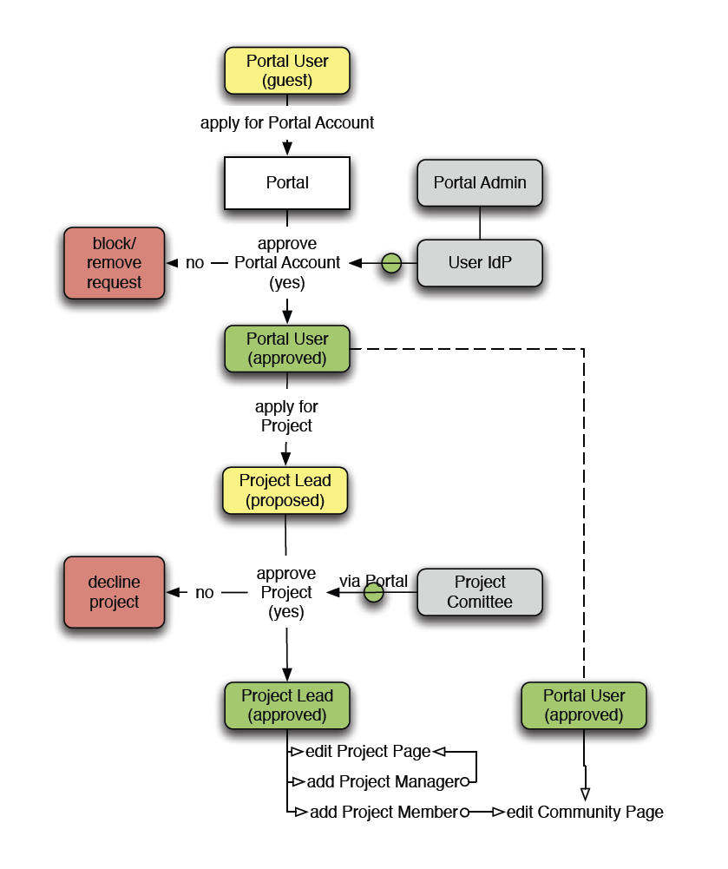
The Process: A new Project
(1) get a portal account
  portal account is approved
(2) propose a project
  project is approved
(3) ask your partners for their portal account names and add them to your projects as members
  No further approval needed
(4) if you need an additional person being able to add members designate him as project manager (currently there can only be one).
  No further approval needed
You are in charge who is added or not!
  Similar model as in Web 2.0 Cloud services, e.g. sourceforge
(1)
(2)
(4)
(3)

Slide 14
The Process: Join A Project
(1) get a portal account
  portal account is approved
Skip steps (2) – (4)
(2u) Communicate with your project lead which project to join and give him your portal account name
Next step done by project lead
  (3) The project lead will add you to the project
You are responsible to make sure the project lead adds you!
  Similar model as in Web 2.0 Cloud services, e.g. sourceforge
(1)
(2u)
(3)

Slide 15
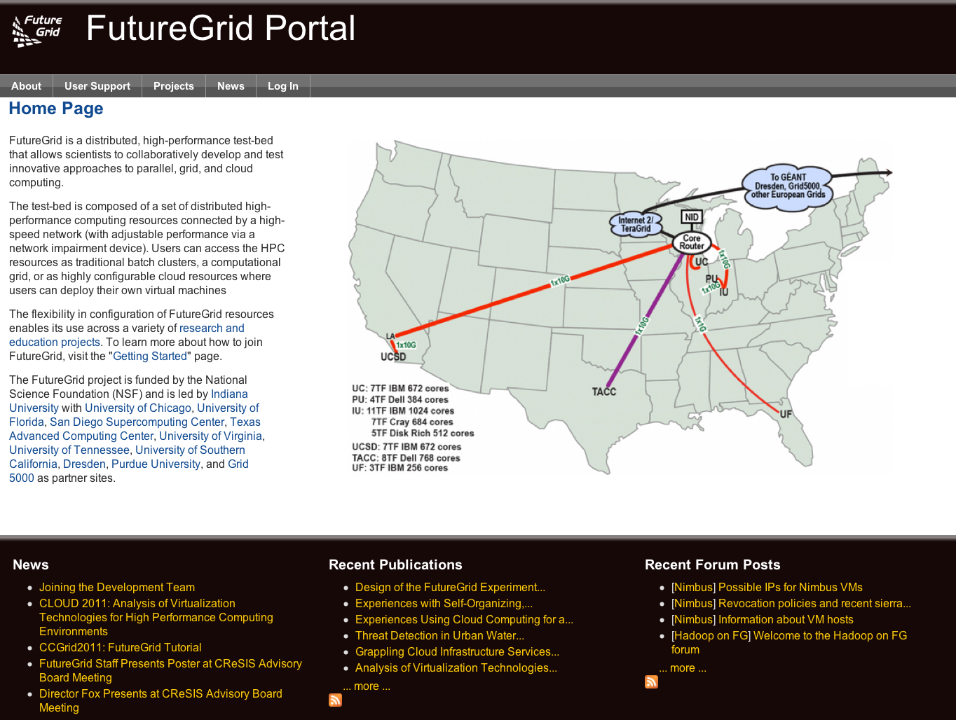
Apply for a Portal Account

Slide 16
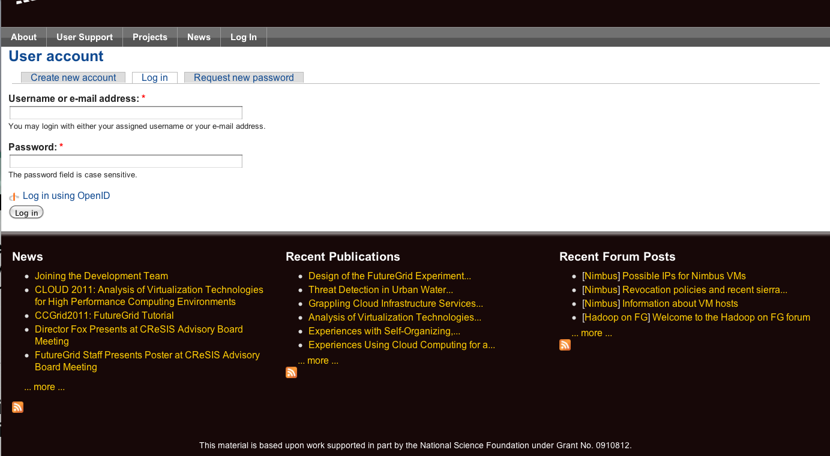
Apply for a Portal Account

Slide 17
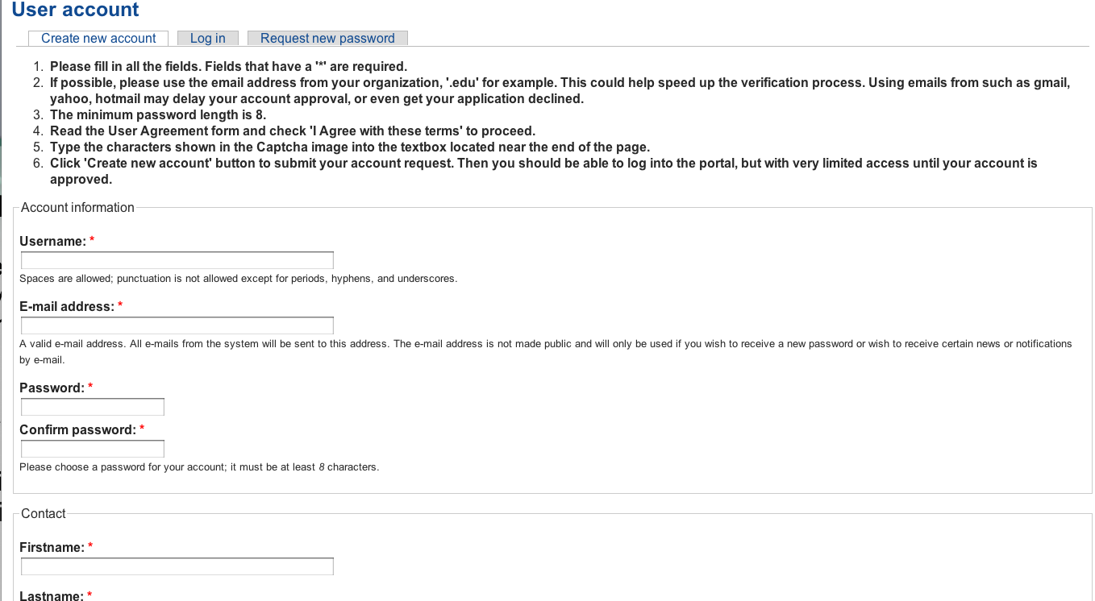
Apply for a Portal Account
Please Fill Out.
Use proper capitalization
Use e-mail from your organization
(yahoo,gmail, hotmail, … emails may result in rejection of your account request)
Chose a strong password

Slide 18
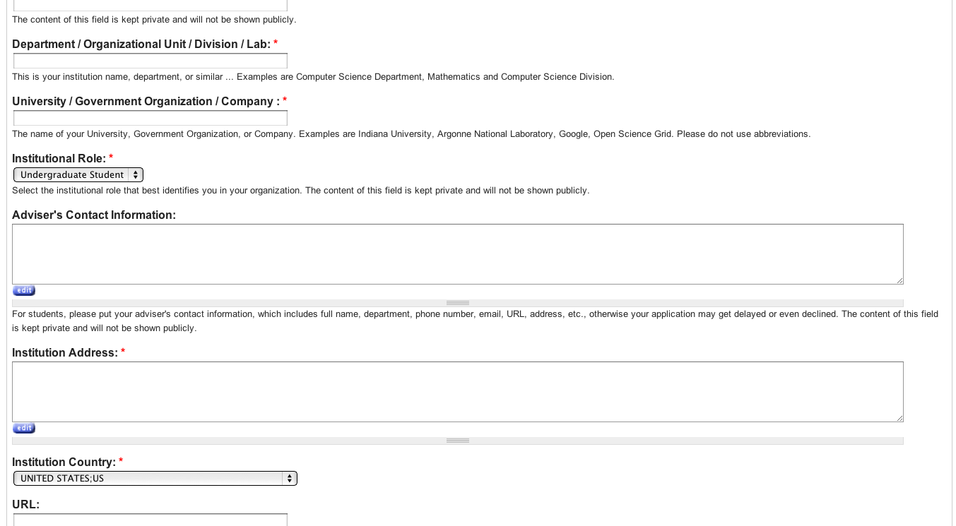
Apply for a Portal Account
Please Fill Out.
Use proper department and university
Specify advisor or supervisors contact
Use the postal address, use proper capitalization

Slide 19
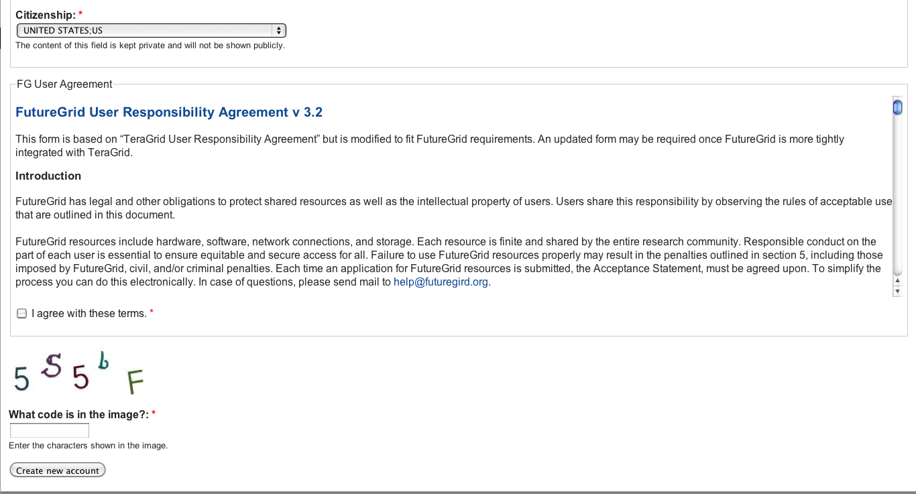
Apply for a Portal Account
Please Fill Out.
Report your citizenship
READ THE RESPONSIBILITY AGREEMENT
AGREE IF YOU DO. IF NOT CONTACT FG.
You may not be able to use it.

Slide 20
Wait
Wait till you get notified that you have a portal account.
Now you have a portal account (cont.)

Slide 21
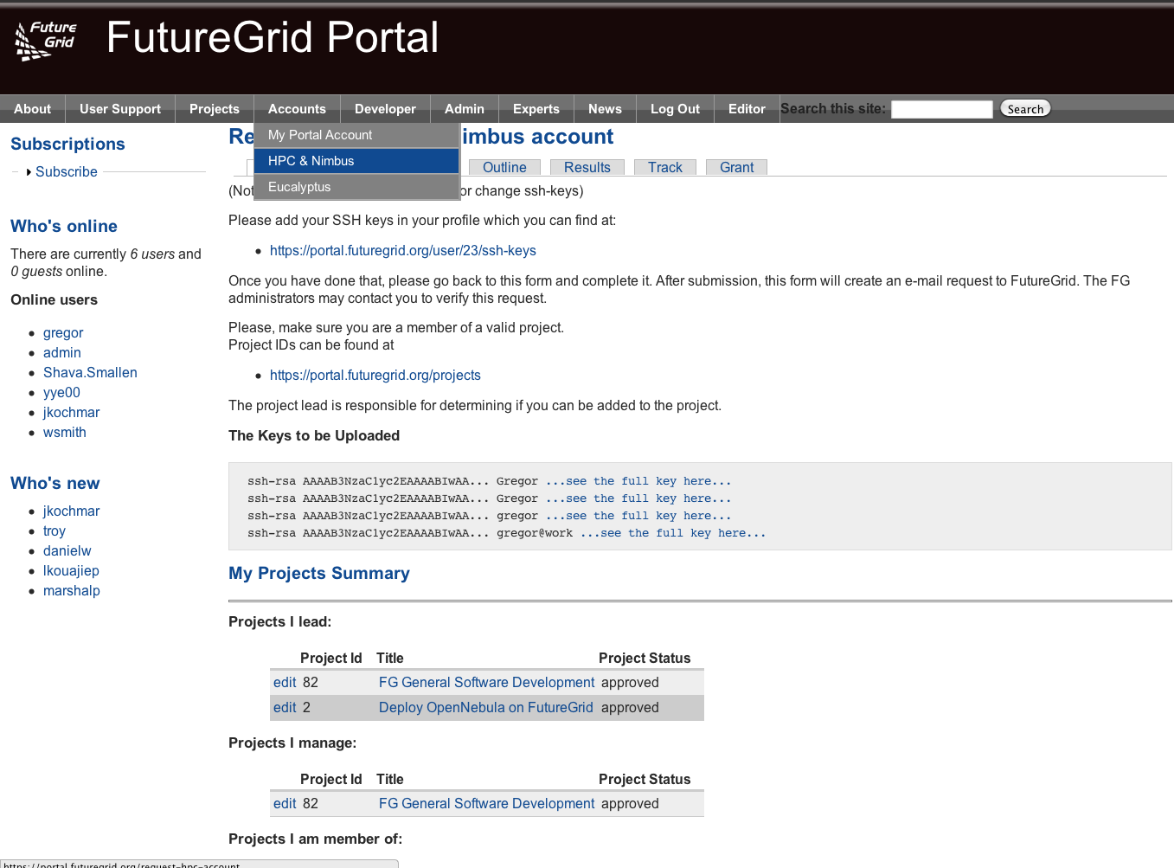
Apply for an HPC and Nimbus account
Login into the portal
Simple go to
  Accounts->
  HPC&Nimbus
(1) add you ssh keys
(3) make sure you are in a
valid project
(2) wait for up to 3 business days
  No accounts will be granted on
  Weekends
  Friday 5pm EST – Monday 9 am EST

Slide 22
Generating an SSH key pair
  For Mac or Linux users
    ssh-keygen –t rsa –C yourname@hostname
    Copy the contents of ~/.ssh/id_rsa.pub to the web form
  For Windows users, this is more difficult
    Download putty.exe and puttygen.exe
    Puttygen is used to generate an SSH key pair
      Run puttygen and click “Generate”
    The public portion of your key is in the box labeled “SSH key for pasting into OpenSSH authorized_keys file”
http://futuregrid.org
Notes:
-c comment

Slide 23
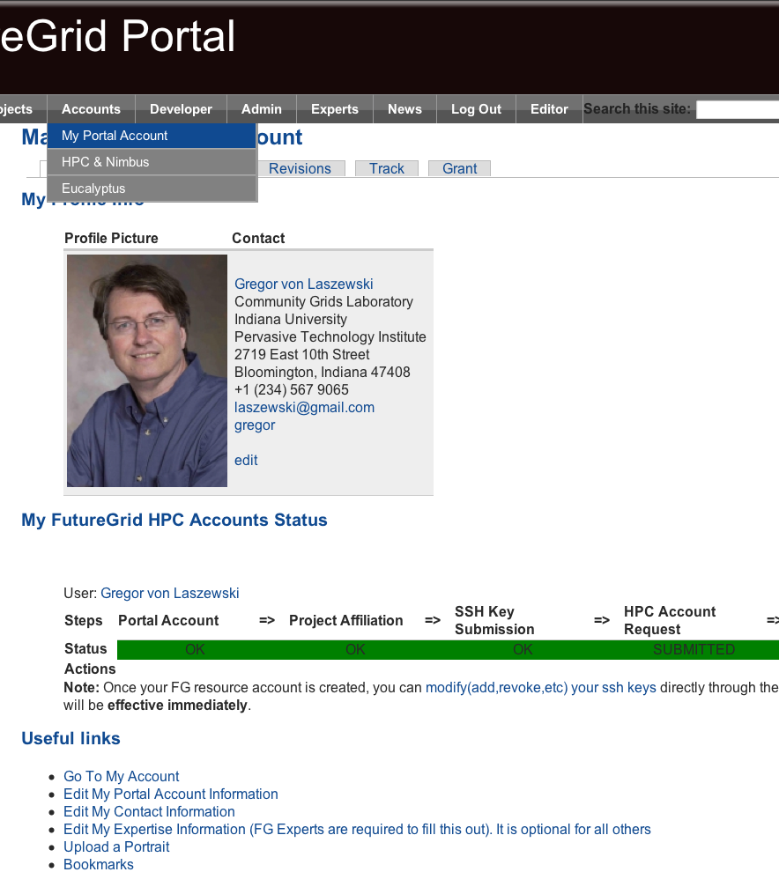
Check your Account Status
Goto:
  Accounts-My Portal Account
Check if the account status bar is green
  Errors will indicate an issue or a task that requires waiting
Since you are already here:
  Upload a portrait
  Check if you have other things that need updating
  Add ssh keys if needed

Slide 24
Eucalyptus Account Creation
  YOU MUST BE IN A VALID FG PROJECT OR YOUR REQUEST GETS DENIED
  Use the Eucalyptus Web Interfaces at
  https://eucalyptus.india.futuregrid.org:8443/
  On the Login page click on Apply for account.
  On the next page that pops up fill out ALL the Mandatory AND optional fields of the form.
  Once complete click on signup and the Eucalyptus administrator will be notified of the account request.
  You will get an email once the account has been approved.
  Click on the link provided in the email to confirm and complete the account creation process
http://futuregrid.org

Slide 25
Portal
Gregor von Laszewski
http://futuregrid.org

Slide 26
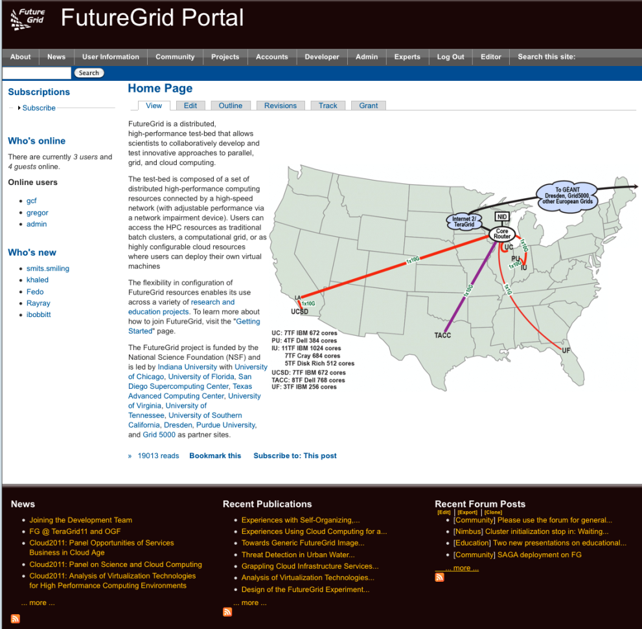
FG Portal
Coordination of Projects and users
  Project management
    Membership
    Results
  User Management
    Contact Information
    Keys, OpenID
Coordination of Information
  Manuals, tutorials, FAQ, Help
  Status
    Resources, outages, usage, …
Coordination of the Community
  Information exchange: Forum, comments, community pages
  Feedback: rating, polls
Focus on support of additional FG processes through the Portal

Slide 27
Portal Subsystem
http://futuregrid.org

Slide 28
Information Services
  What is happening on the system?
    System administrator
    User
    Project Management & Funding agency
  Remember FG is not just an HPC queue!
    Which software is used?
    Which images are used?
    Which FG services are used (Nimbus, Eucalyptus, …?)
    Is the performance we expect reached?
    What happens on the network
http://futuregrid.org

Slide 29
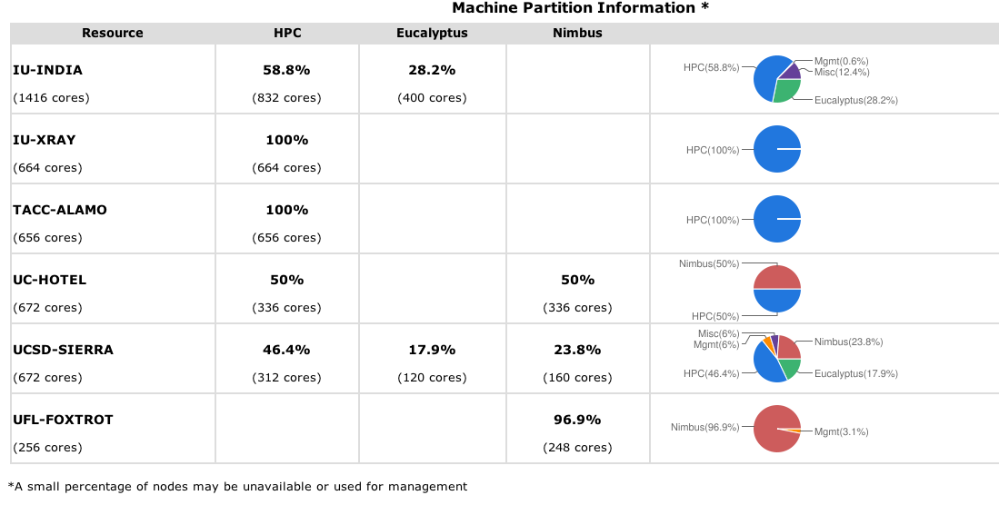
Simple Overview
http://futuregrid.org

Slide 30
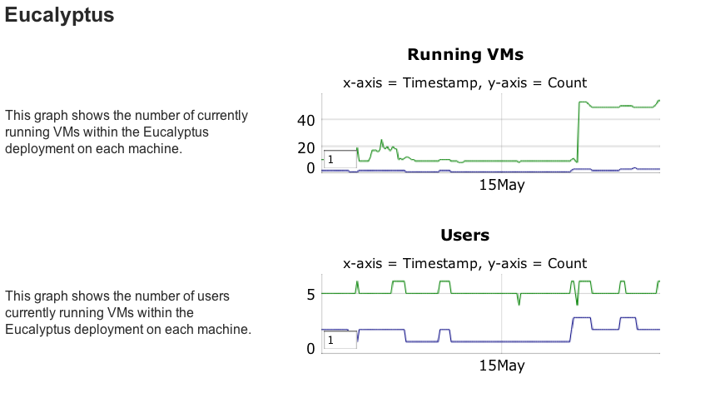

Slide 31
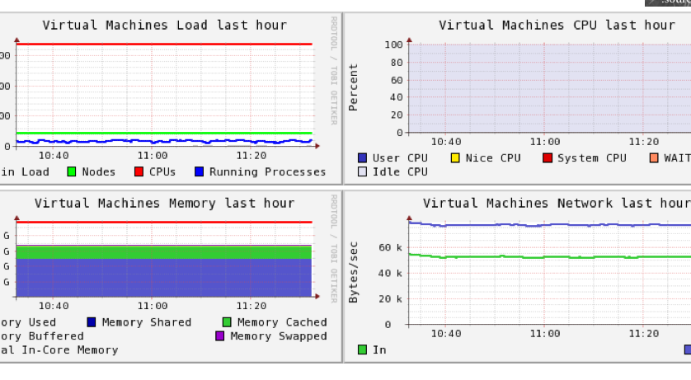
Ganglia
On India

Slide 32
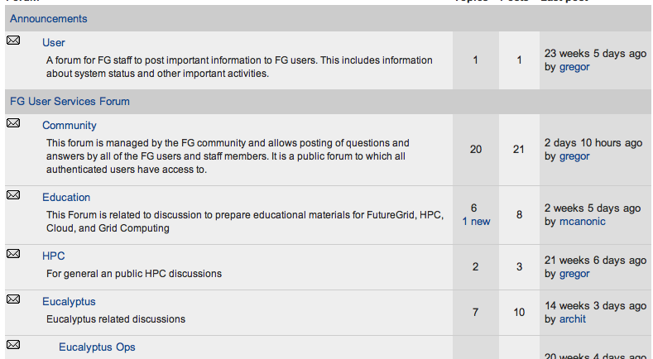
Forums

Slide 33
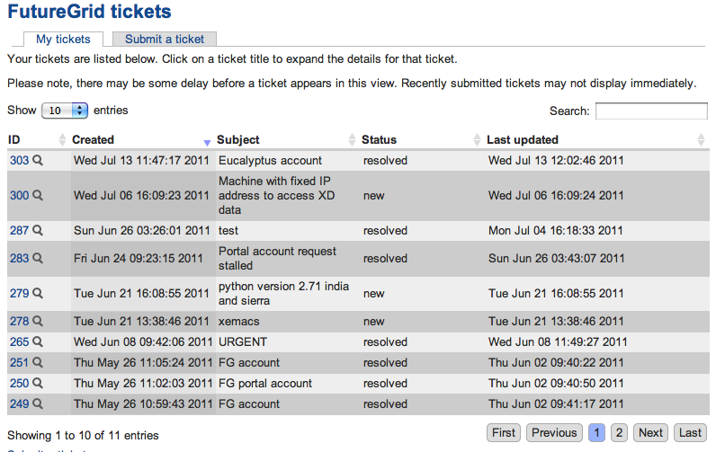
My Ticket System

Slide 34
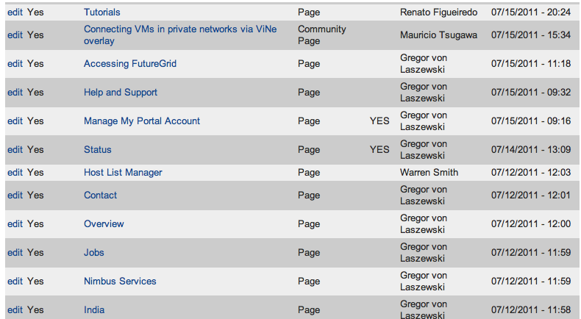
My Ticket Queue

Slide 35
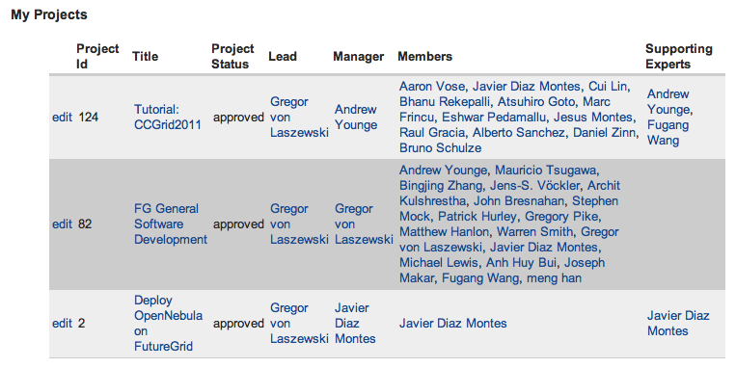
My Projects

Slide 36
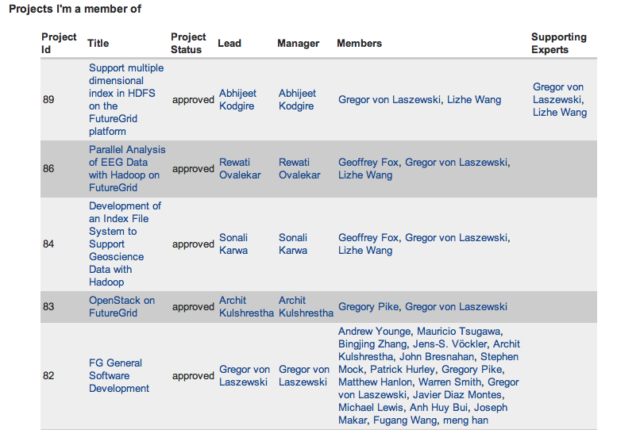
Projects I am Member of

Slide 37
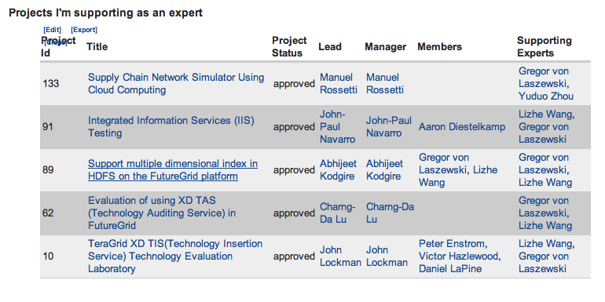
Projects I Support

Slide 38
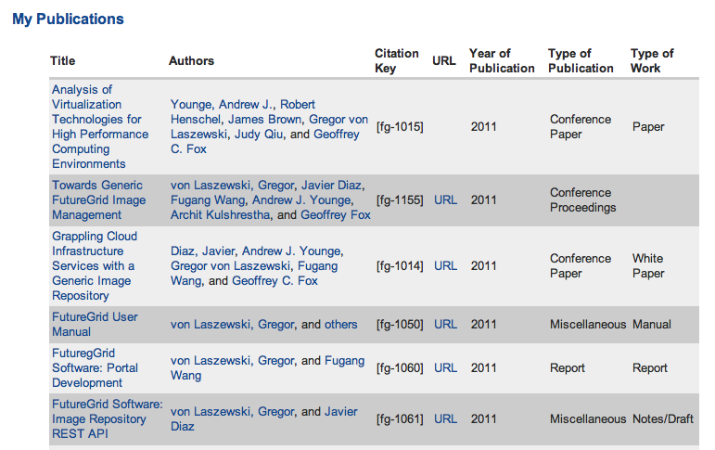
My References

Slide 39
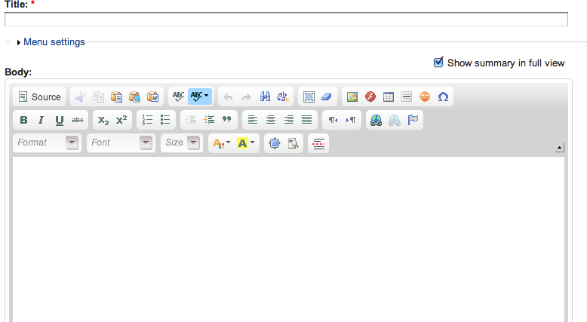
My Community Wiki

Slide 40
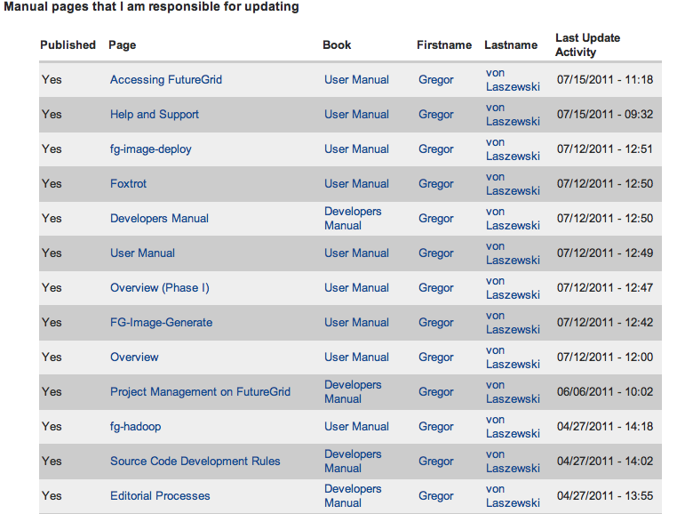
Pages I Manage

Slide 41
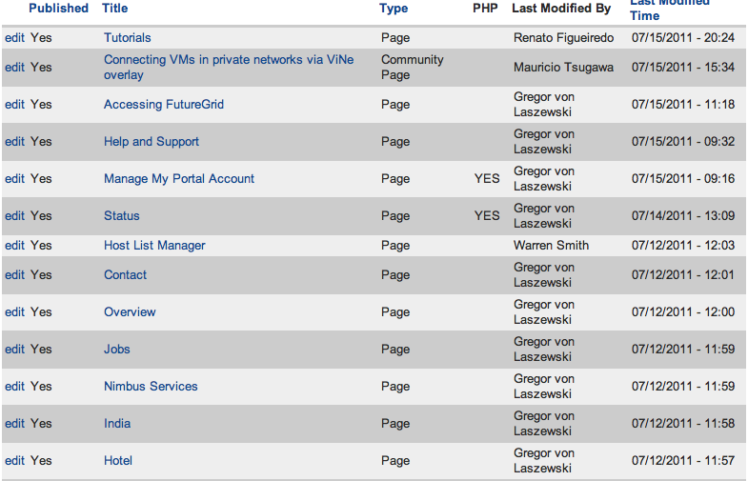
Pages to be Reviewed
(Editor view)

Slide 42
Dynamic Provisioning & RAIN on FutureGrid
Technology Preview
Gregor von Laszewski
http://futuregrid.org

Slide 43
Classical Dynamic Provisioning
Technology Preview
  Dynamically
    partition a set of resources
    allocate the resources to users
    define the environment that the resource use
    assign them based on user request
  Deallocate the resources so they can be dynamically allocated again
http://futuregrid.org

Slide 44
Use Cases of Dynamic Provisioning
Technology Preview
  Static provisioning:
    Resources in a cluster may be statically reassigned based on the anticipated user requirements, part of an HPC or cloud service. It is still dynamic, but control is with the administrator. (Note some call this also dynamic provisioning.)
  Automatic Dynamic provisioning:
    Replace the administrator with intelligent scheduler.
  Queue-based dynamic provisioning:
    provisioning of images is time consuming, group jobs using a similar environment and reuse the image. User just sees queue.
  Deployment:
    dynamic provisioning features are provided by a combination of using XCAT and Moab
http://futuregrid.org

Slide 45
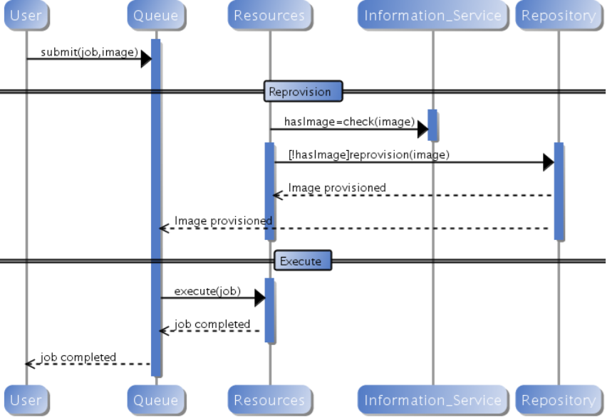
Generic Reprovisioning
Technology Preview
http://futuregrid.org

Slide 46
Dynamic Provisioning Examples
Technology Preview
  Give me a virtual cluster with 30 nodes based on Xen
  Give me 15 KVM nodes each in Chicago and Texas linked to Azure and Grid5000
  Give me a Eucalyptus environment with 10 nodes
  Give 32 MPI nodes running on first Linux and then Windows
  Give me a Hadoop environment with 160 nodes
  Give me a 1000 BLAST instances linked to Grid5000
  Run my application on Hadoop, Dryad, Amazon and Azure … and compare the performance
http://futuregrid.org

Slide 47
From Dynamic Provisioning to “RAIN”
Technology Preview
  In FG dynamic provisioning goes beyond the services offered by common scheduling tools that provide such features.
    Dynamic provisioning in FutureGrid means more than just providing an image
    adapts the image at runtime and provides besides IaaS, PaaS, also SaaS
    We call this “raining” an environment
  Rain = Runtime Adaptable INsertion Configurator
    Users want to ``rain'' an HPC, a Cloud environment, or a virtual network onto our resources with little effort.
    Command line tools supporting this task.
    Integrated into Portal
  Example ``rain'' a Hadoop environment defined by a user on a cluster.
    fg-hadoop -n 8 -app myHadoopApp.jar …
    Users and administrators do not have to set up the Hadoop environment as it is being done for them
http://futuregrid.org

Slide 48
FG RAIN Commands
Technology Preview
  fg-rain –h hostfile –iaas nimbus –image img
  fg-rain –h hostfile –paas hadoop …
  fg-rain –h hostfile –paas dryad …
  fg-rain –h hostfile –gaas gLite …
  fg-rain –h hostfile –image img
  fg-rain –virtual-cluster -16 nodes -2 core
  Additional Authorization is required to use fg-rain without virtualization.
http://futuregrid.org

Slide 49
Rain in FutureGrid
Technology Preview
http://futuregrid.org

Slide 50
Image Generation and Management on FutureGrid
Gregor von Laszewski
http://futuregrid.org

Slide 51
Motivation
  The goal is to create and maintain platforms in custom FG VMs that can be retrieved, deployed, and provisioned on demand.
  A unified Image Management system to create and maintain VM and bare-metal images.
  Integrate images through a repository to instantiate services on demand with RAIN.
  Essentially enables the rapid development and deployment of Platform services on FutureGrid infrastructure.
http://futuregrid.org
http://futuregrid.org

Slide 52
What happens internally?
Technology Preview
Generate a Centos image with several packages
  fg-image-generate –o centos –v 5.6 –a x86_64 –s emacs, openmpi –u javi
  > returns image: centosjavi3058834494.tgz
Deploy the image for HPC (xCAT)
  ./fg-image-register -x im1r –m india -s india -t /N/scratch/ -i centosjavi3058834494.tgz -u jdiaz
Submit a job with that image
  qsub -l os=centosjavi3058834494 testjob.sh

Slide 53
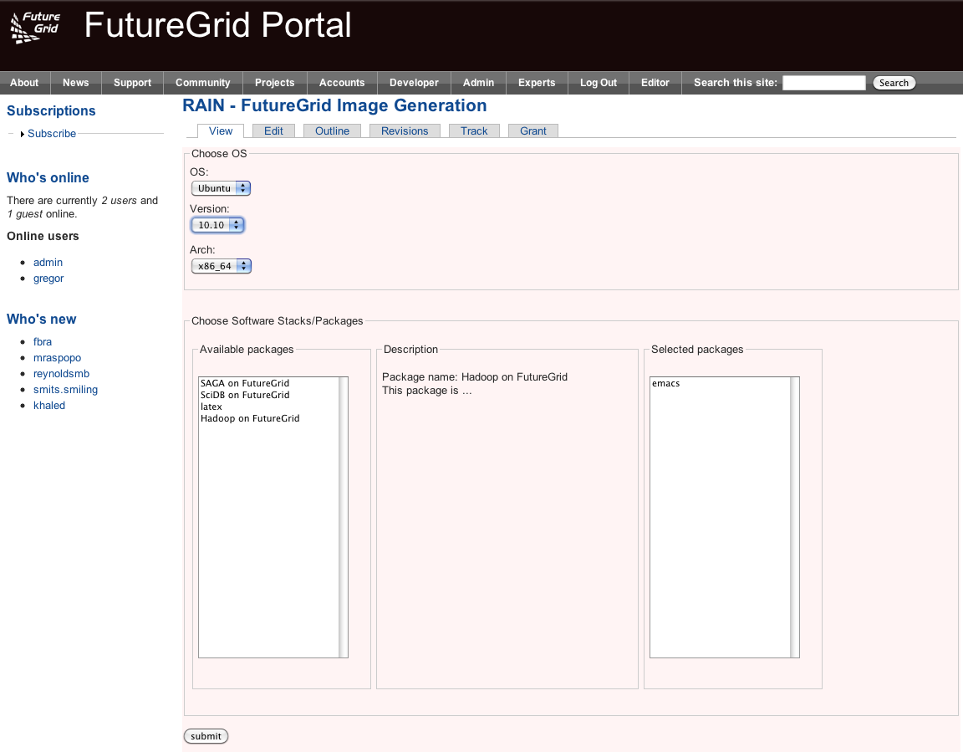

Slide 54
Image Generation
  Users who want to create a new FG image specify the following:
    OS type
    OS version
    Architecture
    Kernel
    Software Packages
  Image is generated, then deployed to specified target.
  Deployed image gets continuously scanned, verified, and updated.
  Images are now available for use on the target deployed system.
http://futuregrid.org

Slide 55
Deployment View
http://futuregrid.org
http://futuregrid.org

Slide 56
Implementation
Image Generator
  alpha available for authorized users
  Allows generation of Debian & Ubuntu, YUM for RHEL5, CentOS, & Fedora images.
  Simple CLI
  Later incorporate a web service to support the FG Portal.
  Deployment to Eucalyptus & Bare metal now, Nimbus and others later.
  Image Management
    Currently operating an experimental BCFG2 server.
    Image Generator auto-creates new user groups for software stacks.
    Supporting RedHat and Ubuntu repo mirrors.
    Scalability experiments of BCFG2 to be tested, but previous work shows scalability to thousands of VMs without problems
http://futuregrid.org
http://futuregrid.org
Notes:
(Yahoo!)

Slide 57
Interfacing with OGF
Deployments
  Genesis II
  Unicore
  Globus
  SAGA
Some thoughts
  How can FG get OCCI from a community effort?
  Is FG useful for OGF community?
  What other features are desired for OGF community?

Slide 58
Current Efforts
Interoperability
Domain Sciences – Applications
Computer Science
Computer system testing and evaluation

Slide 59
Grid interoperability testing
Requirements
Usecases
Provide a persistent set of standards-compliant implementations of grid services that clients can test against
Provide a place where grid application developers can experiment with different standard grid middleware stacks without needing to become experts in installation and configuration
Job management (OGSA-BES/JSDL, HPC-Basic Profile, HPC File Staging Extensions, JSDL Parameter Sweep, JSDL SPMD, PSDL Posix)
Resource Name-space Service (RNS), Byte-IO
Interoperability tests/demonstrations between different middleware stacks
Development of client application tools (e.g., SAGA) that require configured, operational backends
Develop new grid applications and test the suitability of different implementations in terms of both functional and non-functional characteristics

Slide 60
Implementation
Deployment
UNICORE 6
  OGSA-BES, JSDL (Posix, SPMD)
  HPC Basic Profile, HPC File Staging
Genesis II
  OGSA-BES, JSDL (Posix, SPMD, parameter sweep)
  HPC Basic Profile, HPC File Staging
  RNS, ByteIO
EGEE/g-lite
SMOA
  OGSA-BES, JSDL (Posix, SPMD)
  HPC Basic Profile
UNICORE 6
  Xray
  Sierra
  India
Genesis II
  Xray
  Sierra
  India
  Eucalyptus (India, Sierra)

Slide 61
Domain Sciences
Requirements
Usecases
Provide a place where grid application developers can experiment with different standard grid middleware stacks without needing to become experts in installation and configuration
Develop new grid applications and test the suitability of different implementations in terms of both functional and non-functional characteristics

Slide 62
Applications
Global Sensitivity Analysis in Non-premixed Counterflow Flames
A 3D Parallel Adaptive Mesh Renement Method for Fluid Structure Interaction: A Computational Tool for the Analysis of a Bio-Inspired Autonomous Underwater Vehicle
Design space exploration with the M5 simulator
Ecotype Simulation of Microbial Metagenomes
Genetic Analysis of Metapopulation Processes in the Silene-Microbotryum Host-Pathogen System
Hunting the Higgs with Matrix Element Methods
Identification of eukaryotic genes derived from mitochondria using evolutionary analysis
Identifying key genetic interactions in Type II diabetes
Using Molecular Simulations to Calculate Free Energy

Slide 63
Test-bed
Use as an experimental facility
Cloud bursting work
  Eucalyptus
  Amazon
Replicated files & directories
Automatic application configuration and deployment

Slide 64
Grid Test-bed
Requirements
Usecases
Systems of sufficient scale to test realistically
Sufficient bandwidth to stress communication layer
Non-production environment so production users not impacted when a component fails under test
Multiple sites, with high latency and bandwidth
Cloud interface without bandwidth or CPU charges
XSEDE testing
  XSEDE architecture is based on same standards, same mechanisms used here will be used for XSEDE testing
Quality attribute testing, particularly under load and at extremes.
  Load (e.g., job rate, number of jobs i/o rate)
  Performance
  Availability
New application execution
  Resources to entice
New platforms (e.g., Cray, Cloud)

Slide 65
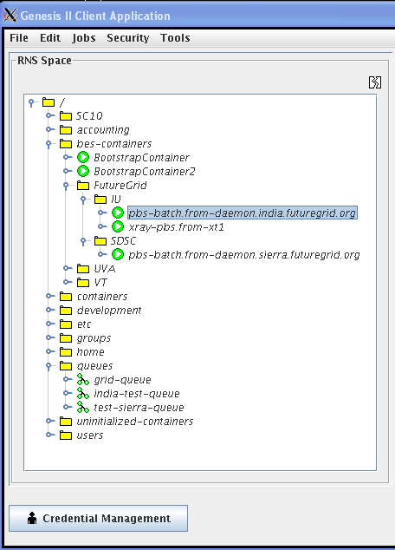
Extend XCG onto FutureGrid
(XCG- Cross Campus Grid)
Design
Image
Genesis II containers on head nodes of compute resources
Test queues that send the containers jobs
Test scripts that generate thousands of jobs, jobs with significant I/O demands
Logging tools to capture errors and root cause
Custom OGSA-BES container that understands EC2 cloud interface, and “cloud-bursts”

Slide 66
Virtual Appliances
Renato Figueiredo
University of Florida

Slide 67
Overview
Traditional ways of delivering hands-on training and education in parallel/distributed computing have non-trivial dependences on the environment
    Difficult to replicate same environment on different resources (e.g. HPC clusters, desktops)
    Difficult to cope with changes in the environment (e.g. software upgrades)
Virtualization technologies remove key software dependences through a layer of indirection

Slide 68
Overview
FutureGrid enables new approaches to education and training and opportunities to engage in outreach
  Cloud, virtualization and dynamic provisioning – environment can adapt to the user, rather than expect user to adapt to the environment
Leverage unique capabilities of the infrastructure:
  Reduce barriers to entry and engage new users
  Use of encapsulated environments (“appliances”) as a primary delivery mechanism of education/training modules – promoting reuse, replication, and sharing
  Hands-on tutorials on introductory, intermediate, and advanced topics

Slide 69
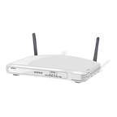

What is an appliance?
Hardware/software appliances
  TV receiver + computer + hard disk + Linux + user interface
  Computer + network interfaces + FreeBSD + user interface

Slide 70
What is a virtual appliance?
An appliance that packages software and configuration needed for a particular purpose into a virtual machine “image”
The virtual appliance has no hardware – just software and configuration
The image is a (big) file
It can be instantiated on hardware

Slide 71
Educational virtual appliances
A flexible, extensible platform for hands-on, lab-oriented education on FutureGrid
Support clustering of resources
  Virtual machines + social/virtual networking to create sandboxed modules
    Virtual “Grid” appliances: self-contained, pre-packaged execution environments
    Group VPNs: simple management of virtual clusters by students and educators

Slide 72


Virtual appliance clusters
Same image, different VPNs
Hadoop
+
Virtual
Network
Group
VPN
A Hadoop worker
Another Hadoop worker
instantiate
Virtual
machine
copy
GroupVPN
Credentials
Repeat…
Virtual IP - DHCP
10.10.1.1
Virtual IP - DHCP
10.10.1.2

Slide 73
Tutorials - examples
http://portal.futuregrid.org/tutorials
Introduction to FG IaaS Cloud resources
  Nimbus and Eucalyptus
  Within minutes, deploy a virtual machine on FG resources and log into it interactively
  Using OpenStack – nested virtualization, a sandbox IaaS environment within Nimbus
Introduction to FG HPC resources
  Job scheduling, Torque, MPI
Introduction to Map/Reduce frameworks
  Using virtual machines with Hadoop, Twister
  Deploying on physical machines/HPC (MyHadoop)

Slide 74
Virtual appliance – tutorials
Deploying a single appliance
  Nimbus, Eucalyptus, or user’s own desktop
    VMware, Virtualbox
  Automatically connects to a shared “playground” resource pool with other appliances
  Can execute Condor, MPI, and Hadoop tasks
Deploying private virtual clusters
  Separate IP address space – e.g. for a class, or student group
Customizing appliances for your own activity

Slide 75
Virtual appliance 101
cloud-client.sh --conf alamo.conf --run --name grid-appliance-2.04.29.gz --hours 24
ssh root@129.114.x.y
su griduser
cd ~/examples/montepi
gcc montepi.c -o montepi -lm -m32
condor_submit submit_montepi_vanilla
condor_status, condor_q

Slide 76
Where to go from here?
You can download Grid appliances and run on your own resources
You can create private virtual clusters and manage groups of users
You can customize appliances with other middleware, create images, and share with other users
More tutorials available at FutureGrid.org
Contact me at renato@acis.ufl.edu for more information about appliances

Slide 77
Cloud Computing with Nimbus on FutureGrid
TeraGrid’11 tutorial, Salt Late City, UT
Kate Keahey
keahey@mcs.anl.gov
Argonne National Laboratory
Computation Institute, University of Chicago

Slide 78



Nimbus Components
High-quality, extensible, customizable,
open source implementation
Nimbus Platform
Enable users to use IaaS clouds
Context Broker
Cloudinit.d
Elastic Scaling Tools
Gateway
Enable providers to build IaaS clouds
Nimbus Infrastructure
Workspace Service
Cumulus
Enable developers to extend,
experiment and customize

Slide 79
Nimbus Infrastructure

Slide 80

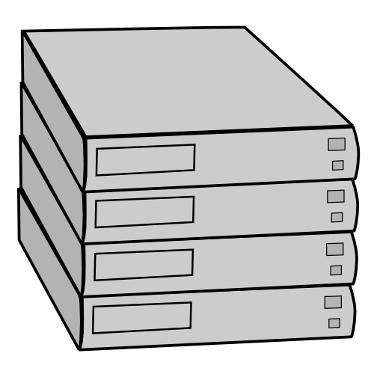
IaaS: How it Works
Pool
node
Pool
node
Pool
node
Nimbus
Pool
node
Pool
node
Pool
node
Pool
node
Pool
node
Pool
node
Pool
node
Pool
node
Pool
node

Slide 81
IaaS: How it Works
Nimbus publishes
information about each VM
Pool
node
Pool
node
Pool
node
Nimbus
Pool
node
Pool
node
Pool
node
Users can find out
information about their
VM (e.g. what IP
the VM was bound to)
Pool
node
Pool
node
Pool
node
Pool
node
Pool
node
Pool
node
Users can interact directly with their VM in the same way the would with a physical machine.

Slide 82
Nimbus on FutureGrid
Hotel (University of Chicago) -- Xen
41 nodes, 328 cores
Foxtrot (University of Florida) -- Xen
26 nodes, 208 cores
Sierra (SDSC) -- Xen
18 nodes, 144 cores
Alamo (TACC) -- KVM
15 nodes, 120 cores

Slide 83
FutureGrid: Getting Started
To get a FutureGrid account:
  Sign up for portal account: https://portal.futuregrid.org/user/register
  Once approved, apply for HPC account: https://portal.futuregrid.org/request-hpc-account
  Your Nimbus credentials will be in your home directory
Follow the tutorial at: https://portal.futuregrid.org/tutorials/nimbus
or Nimbus quickstart at http://www.nimbusproject.org/docs/2.7/clouds/cloudquickstart.html

Slide 84
FutureGrid: VM Images
[bresnaha@login1 nimbus-cloud-client-018]$ ./bin/cloud-client.sh –conf\
~/.nimbus/hotel.conf –list
----
[Image] 'base-cluster-cc12.gz' Read only
Modified: Jan 13 2011 @ 14:17 Size: 535592810 bytes (~510 MB)
[Image] 'centos-5.5-x64.gz' Read only
Modified: Jan 13 2011 @ 14:17 Size: 253383115 bytes (~241 MB)
[Image] 'debian-lenny.gz' Read only
Modified: Jan 13 2011 @ 14:19 Size: 1132582530 bytes (~1080 MB)
[Image] 'debian-tutorial.gz' Read only
Modified: Nov 23 2010 @ 20:43 Size: 299347090 bytes (~285 MB)
[Image] 'grid-appliance-jaunty-amd64.gz' Read only
Modified: Jan 13 2011 @ 14:20 Size: 440428997 bytes (~420 MB)
[Image] 'grid-appliance-jaunty-hadoop-amd64.gz' Read only
Modified: Jan 13 2011 @ 14:21 Size: 507862950 bytes (~484 MB)
[Image] 'grid-appliance-mpi-jaunty-amd64.gz' Read only
Modified: Feb 18 2011 @ 13:32 Size: 428580708 bytes (~408 MB)
[Image] 'hello-cloud' Read only
Modified: Jan 13 2011 @ 14:15 Size: 576716800 bytes (~550 MB)

Slide 85
Nimbus Infrastructure: a Highly-Configurable IaaS Architecture
Workspace Interfaces
Cumulus interfaces
EC2 SOAP
EC2 Query
WSRF
S3
Workspace API
Cumulus API
Workspace Service Implementation
Cumulus Service Implementation
Workspace RM options
Default
Default+backfill/spot
Workspace pilot
Workspace Control Protocol
Cumulus Storage API
Workspace Control
Cumulus Implementation options
Virtualization
(libvirt)
Image Mngm
Network
Ctx
ssh
…
POSIX
Xen
KVM
LANtorrent
HDFS

Slide 86
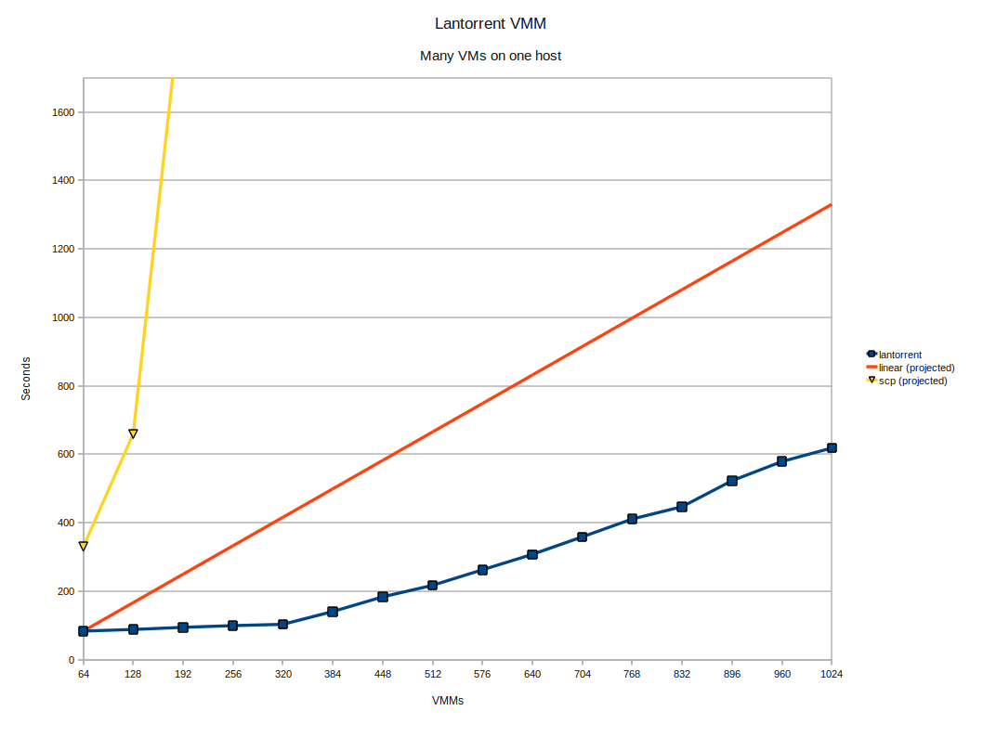
LANTorrent: Fast Image Deployment
Challenge: make image deployment faster
Moving images is the main component of VM deployment
LANTorrent: the BitTorrent principle on a LAN
Streaming
Minimizes congestion at the switch
Detecting and eliminating duplicate transfers
Bottom line: a thousand VMs in 10 minutes on Magellan
Nimbus release 2.6, see www.scienceclouds.org/blog
Preliminary data using the Magellan resource
At Argonne National Laboratory

Slide 87
Nimbus Platform

Slide 88
Nimbus Platform: Working with Hybrid Clouds
Creating Common Context
Allow users to build turnkey dynamic virtual clusters
Nimbus Elastic Provisioning
interoperability
automatic scaling
HA provisioning
policies
private clouds
(e.g., FNAL)
community clouds
(e.g., FutureGrid)
public clouds
(e.g., EC2)

Slide 89
Cloudinit.d
Repeatable deployment of sets of VMs
Coordinates launches via attributes
Works with multiple IaaS providers
User-defined launch tests (assertions)
Test-based monitoring
Policy-driven repair of a launch
Currently in RC2
Come to our talk at TG’11
Web
Server
NFS
Server
Web
Server
Postgress
Database
Web
Server
Run-level 1
Run-level 2

Slide 90
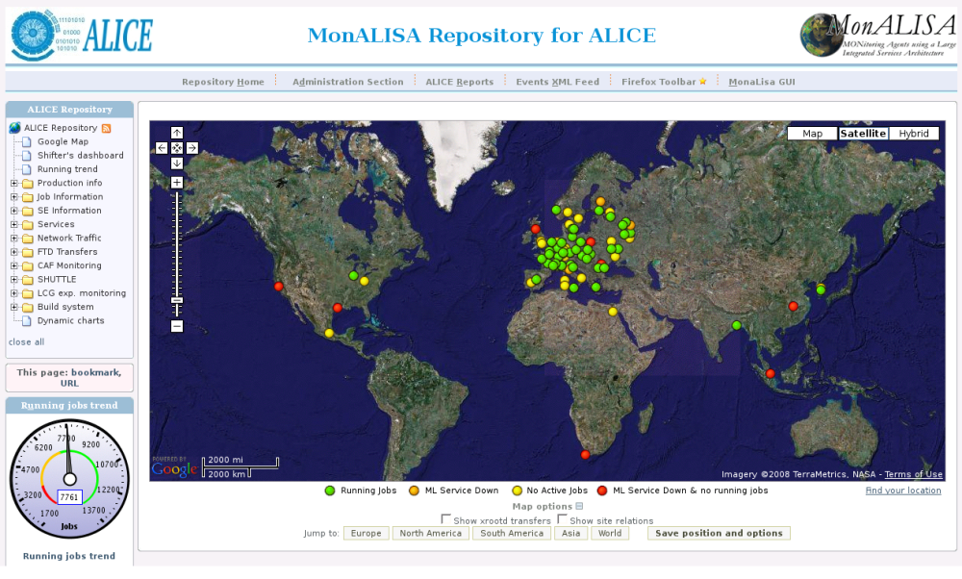
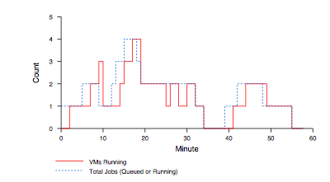
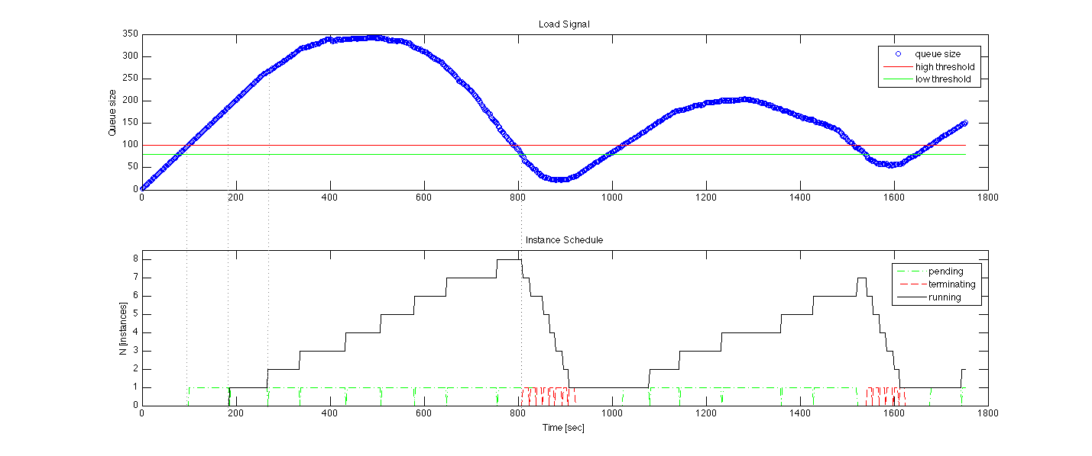
Elastic Scaling Tools:
Towards “Bottomless Resources”
Early efforts:
  2008: The ALICE proof-of-concept
  2009: ElasticSite prototype
  2009: OOI pilot
Challenge: a generic HA Service Model
  React to sensor information
  Queue: the workload sensor
  Scale to demand
  Across different cloud providers
  Use contextualization to integrate machines into the network
  Customizable
  Routinely 100s of nodes on EC2
Coming out later this year
Paper: “Elastic Site”, CCGrid 2010

Slide 91
FutureGrid Case Studies

Slide 92

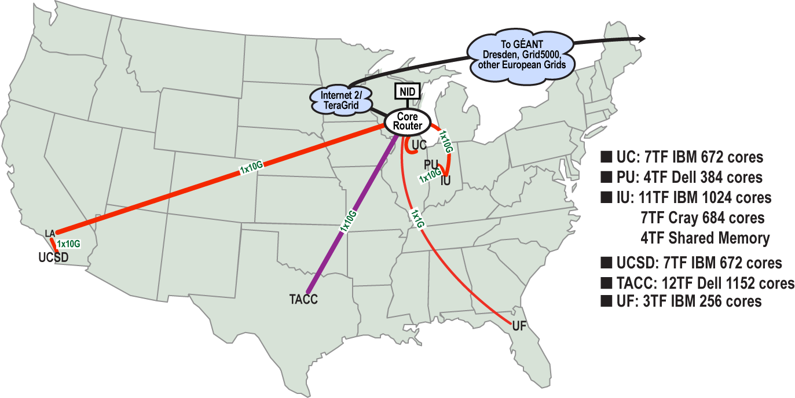
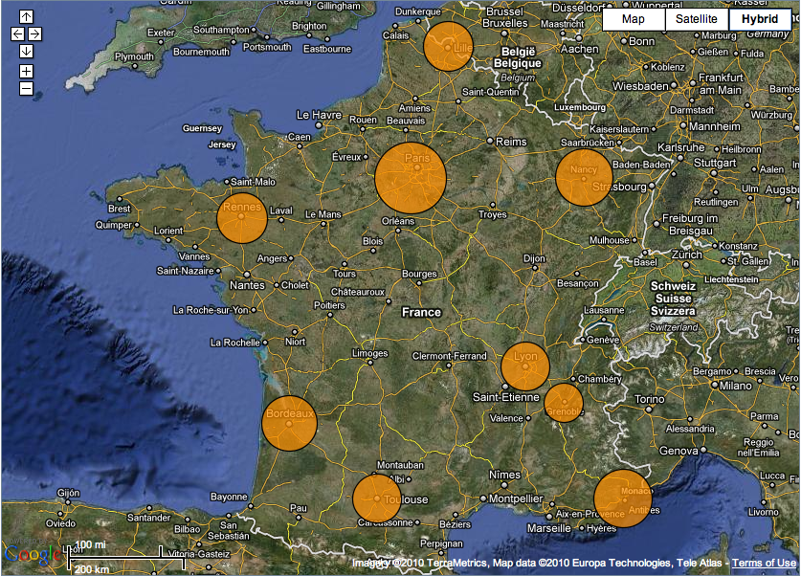

Sky Computing
Work by Pierre Riteau et al,
University of Rennes 1
Sky Computing = a Federation of Clouds
Approach:
  Combine resources obtained in multiple Nimbus clouds in FutureGrid and Grid’ 5000
  Combine Context Broker, ViNe, fast image deployment
  Deployed a virtual cluster of over 1000 cores on Grid5000 and FutureGrid – largest ever of this type
Grid’5000 Large Scale Deployment Challenge award
Demonstrated at OGF 29 06/10
TeraGrid ’10 poster
  More at: www.isgtw.org/?pid=1002832
  “Sky Computing”
  IEEE Internet Computing, September 2009

Slide 93
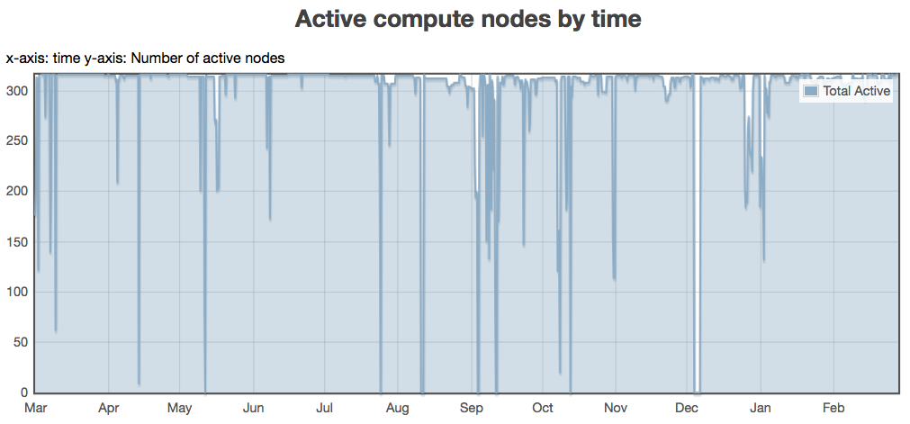
Backfill: Lower the Cost of Your Cloud
1 March 2010 through 28 February 2011
Challenge: utilization, catch-22 of on-demand computing
Solution: new instances
  Backfill
Bottom line: up to 100% utilization
Who decides what backfill VMs run?
Spot pricing
Open Source community contribution
Preparing for running of production workloads on FG @ U Chicago
Nimbus release 2.7
Paper @ CCGrid 2011
94%
78%
62%
47%
31%
16%

Slide 94

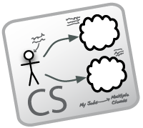


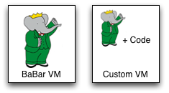
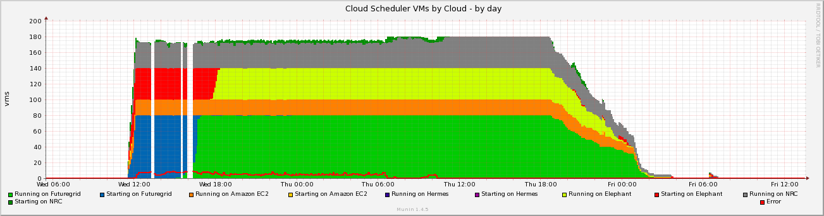
Work by the UVIC team
Canadian Efforts
BarBar Experiment at SLAC in Stanford, CA
Using clouds to simulating electron-positron collisions in their detector
Exploring virtualization as a vehicle for data preservation
Approach:
  Appliance preparation and management
  Distributed Nimbus clouds
  Cloud Scheduler
Running production BaBar workloads

Slide 95
The Nimbus Team
Project lead: Kate Keahey, ANL&UC
Committers:
  Tim Freeman - University of Chicago
  Ian Gable - University of Victoria
  David LaBissoniere - University of Chicago
  John Bresnahan - Argonne National Laboratory
  Patrick Armstrong - University of Victoria
  Pierre Riteau - University of Rennes 1, IRISA
Github Contributors:
  Tim Freeman, David LaBissoniere, John Bresnahan, Pierre Riteau, Alex Clemesha, Paulo Gomez, Patrick Armstrong, Matt Vliet, Ian Gable, Paul Marshall, Adam Bishop
And many others
  See http://www.nimbusproject.org/about/people/

Slide 96
Parting Thoughts
Many challenges left in exploring infrastructure clouds
FutureGrid offers an instrument that allows you to explore them:
  Multiple distributed clouds
  The opportunity to experiment with cloud software
  Paradigm exploration for domain sciences
Nimbus provides tools to explore them
Come and work with us on FutureGrid!

Slide 97
www.nimbusproject.com
Let’s make cloud computing for science happen.

Slide 98
Using HPC Systems on FutureGrid
Andrew J. Younge
Gregory G. Pike
Indiana University
http://futuregrid.org

Slide 99
A brief overview
  FutureGrid is a testbed
    Varied resources with varied capabilities
    Support for grid, cloud, HPC
    Continually evolving
    Sometimes breaks in strange and unusual ways
  FutureGrid as an experiment
    We’re learning as well
    Adapting the environment to meet user needs
http://futuregrid.org

Slide 100
Getting Started
  Getting an account
  Logging in
  Setting up your environment
  Writing a job script
  Looking at the job queue
  Why won’t my job run?
  Getting your job to run sooner
    http://portal.futuregrid.org/manual
    http://portal.futuregrid.org/tutorials
http://futuregrid.org

Slide 101
Getting an account
  Upload your ssh key to the portal, if you have not done that when you created the portal account
    Account -> Portal Account
      edit the ssh key
      or
        Include the public portion of your SSH key!
        use a passphrase when generating the key!!!!!
  Submit your ssh key through the portal
    Account -> HPC
  This process may take up to 3 days.
    If it’s been longer than a week, send email
    We do not do any account management over weekends!
http://futuregrid.org

Slide 102
Generating an SSH key pair
  For Mac or Linux users
    ssh-keygen –t rsa
    Copy ~/.ssh/id_rsa.pub to the web form
  For Windows users, this is more difficult
    Download putty.exe and puttygen.exe
    Puttygen is used to generate an SSH key pair
      Run puttygen and click “Generate”
    The public portion of your key is in the box labeled “SSH key for pasting into OpenSSH authorized_keys file”
http://futuregrid.org
Notes:
-c comment

Slide 103
Logging in
  You must be logging in from a machine that has your SSH key
  Use the following command (on Linux/OSX):
    ssh username@india.futuregrid.org
  Substitute your FutureGrid account for username
http://futuregrid.org

Slide 104
Now you are logged in.
What is next?

Slide 105
Setting up your environment
  Modules is used to manage your $PATH and other environment variables
  A few common module commands
    module avail – lists all available modules
    module list – lists all loaded modules
    module load – adds a module to your environment
    module unload – removes a module from your environment
    module clear –removes all modules from your environment
http://futuregrid.org

Slide 106
Writing a job script
  A job script has PBS directives followed by the commands to run your job
#!/bin/bash
#PBS -N testjob
#PBS -l nodes=1:ppn=8
#PBS –q batch
#PBS –M username@example.com
##PBS –o testjob.out
#PBS -j oe
#
sleep 60
hostname
echo $PBS_NODEFILE
cat $PBS_NODEFILE
sleep 60
http://futuregrid.org

Slide 107
Writing a job script
  Use the qsub command to submit your job
    qsub testjob.pbs
  Use the qstat command to check your job
  > qsub testjob.pbs
  25265.i136
  > qstat
  Job id Name User Time Use S Queue
  ---------- ------------ ----- -------- - ------
  25264.i136 sub27988.sub inca 00:00:00 C batch
  25265.i136 testjob gpike 0 R batch
http://futuregrid.org

Slide 108
Looking at the job queue
  Both qstat and showq can be used to show what’s running on the system
  The showq command gives nicer output
  The pbsnodes command will list all nodes and details about each node
  The checknode command will give extensive details about a particular node
  Run module load moab to add commands to path
http://futuregrid.org

Slide 109
Why won’t my job run?
  Two common reasons:
    The cluster is full and your job is waiting for other jobs to finish
    You asked for something that doesn’t exist
      More CPUs or nodes than exist
    The job manager is optimistic!
      If you ask for more resources than we have, the job manager will sometimes hold your job until we buy more hardware
http://futuregrid.org

Slide 110
Why won’t my job run?
  Use the checkjob command to see why your job will not run
  > checkjob 319285
  job 319285
  Name: testjob
  State: Idle
  Creds: user:gpike group:users class:batch qos:od
  WallTime: 00:00:00 of 4:00:00
  SubmitTime: Wed Dec 1 20:01:42
  (Time Queued Total: 00:03:47 Eligible: 00:03:26)
  Total Requested Tasks: 320
  Req[0] TaskCount: 320 Partition: ALL
  Partition List: ALL,s82,SHARED,msm
  Flags: RESTARTABLE
  Attr: checkpoint
  StartPriority: 3
  NOTE: job cannot run (insufficient available procs: 312 available)
http://futuregrid.org

Slide 111
Why won’t my job run?
  If you submitted a job that cannot run, use qdel to delete the job, fix your script, and resubmit the job
    qdel 319285
  If you think your job should run, leave it in the queue and send email
  It’s also possible that maintenance is coming up soon
http://futuregrid.org

Slide 112
Making your job run sooner
  In general, specify the minimal set of resources you need
    Use minimum number of nodes
    Use the job queue with the shortest max walltime
      qstat –Q –f
    Specify the minimum amount of time you need for the job
      qsub –l walltime=hh:mm:ss
http://futuregrid.org

Slide 113
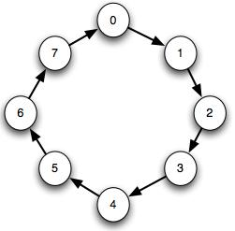
Example with MPI
Run through a simple example of an MPI job
  Ring algorithm passes messages along to each process as a chain or string
  Use Intel compiler and mpi to compile & run
  Hands on experience with PBS scripts

Slide 114
#PBS -N hello-mvapich-intel
#PBS -l nodes=4:ppn=8
#PBS -l walltime=00:02:00
#PBS -k oe
#PBS -j oe
EXE=$HOME/mpiring/mpiring
echo "Started on `/bin/hostname`"
echo
echo "PATH is [$PATH]"
echo
echo "Nodes chosen are:"
cat $PBS_NODEFILE
echo
module load intel intelmpi
mpdboot -n 4 -f $PBS_NODEFILE -v --remcons
mpiexec -n 32 $EXE
mpdallexit

Slide 115
Lets Run
> cp /share/project/mpiexample/mpiring.tar.gz .
> tar xfz mpiring.tar.gz
> cd mpiring
> module load intel intelmpi moab
Intel compiler suite version 11.1/072 loaded
Intel MPI version 4.0.0.028 loaded
moab version 5.4.0 loaded
> mpicc -o mpiring ./mpiring.c
> qsub mpiring.pbs
100506.i136
> cat ~/hello-mvapich-intel.o100506
...

Slide 116
Eucalyptus on FutureGrid
Andrew J. Younge
Indiana University
http://futuregrid.org

Slide 117
Before you can use Eucalyptus
  Please make sure you have a portal account
    https://portal.futuregrid.org
  Please make sure you are part of a valid FG project
    You can either create a new one or
    You can join an existing one with permission of the Lead
  Do not apply for an account before you have joined the project, your Eucalyptus account request will not be granted!

Slide 118

Eucalyptus
  Elastic Utility Computing Architecture Linking Your Programs To Useful Systems
    Eucalyptus is an open-source software platform that implements IaaS-style cloud computing using the existing Linux-based infrastructure
    IaaS Cloud Services providing atomic allocation for
      Set of VMs
      Set of Storage resources
      Networking
http://futuregrid.org

Slide 119
Open Source Eucalyptus
  Eucalyptus Features
      Amazon AWS Interface Compatibility
      Web-based interface for cloud configuration and credential management.
      Flexible Clustering and Availability Zones.
      Network Management, Security Groups, Traffic Isolation
        Elastic IPs, Group based firewalls etc.
      Cloud Semantics and Self-Service Capability
        Image registration and image attribute manipulation
      Bucket-Based Storage Abstraction (S3-Compatible)
      Block-Based Storage Abstraction (EBS-Compatible)
      Xen and KVM Hypervisor Support
Source: http://www.eucalyptus.com
http://futuregrid.org

Slide 120
Eucalyptus Testbed
  Eucalyptus is available to FutureGrid Users on the India and Sierra clusters.
  Users can make use of a maximum of 50 nodes on India. Each node supports up to 8 small VMs. Different Availability zones provide VMs with different compute and memory capacities.
AVAILABILITYZONE india 149.165.146.135
AVAILABILITYZONE |- vm types free / max cpu ram disk
AVAILABILITYZONE |- m1.small 0400 / 0400 1 512 5
AVAILABILITYZONE |- c1.medium 0400 / 0400 1 1024 7
AVAILABILITYZONE |- m1.large 0200 / 0200 2 6000 10
AVAILABILITYZONE |- m1.xlarge 0100 / 0100 2 12000 10
AVAILABILITYZONE |- c1.xlarge 0050 / 0050 8 20000 10
http://futuregrid.org

Slide 121
Eucalyptus Account Creation
  Use the Eucalyptus Web Interfaces at
  https://eucalyptus.india.futuregrid.org:8443/
  On the Login page click on Apply for account.
  On the next page that pops up fill out ALL the Mandatory AND optional fields of the form.
  Once complete click on signup and the Eucalyptus administrator will be notified of the account request.
  You will get an email once the account has been approved.
  Click on the link provided in the email to confirm and complete the account creation process.
http://futuregrid.org

Slide 122
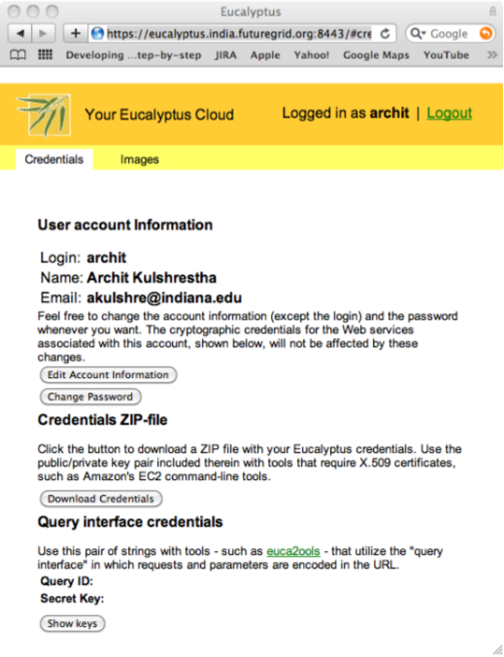

Obtaining Credentials
  Download your credentials as a zip file from the web interface for use with euca2ools.
  Save this file and extract it for local use or copy it to India/Sierra.
  On the command prompt change to the euca2-{username}-x509 folder which was just created.
    cd euca2-username-x509
  Source the eucarc file using the command source eucarc.
    source ./eucarc
http://futuregrid.org

Slide 123
Install/Load Euca2ools
  Euca2ools are the command line clients used to interact with Eucalyptus.
  If using your own platform Install euca2ools bundle from http://open.eucalyptus.com/downloads
    Instructions for various Linux platforms are available on the download page.
  On FutureGrid log on to India/Sierra and load the Euca2ools module.
  $ module load euca2ools
  euca2ools version 1.2 loaded
http://futuregrid.org

Slide 124
Euca2ools
  Testing your setup
    Use euca-describe-availability-zones to test the setup.
  List the existing images using euca-describe-images
  euca-describe-availability-zones
  AVAILABILITYZONE india 149.165.146.135
  $ euca-describe-images
  IMAGE emi-0B951139 centos53/centos.5-3.x86-64.img.manifest.xml admin available public x86_64 machine
  IMAGE emi-409D0D73 rhel55/rhel55.img.manifest.xml admin available public x86_64 machine
  …
http://futuregrid.org

Slide 125
Key management
  Create a keypair and add the public key to eucalyptus.
  Fix the permissions on the generated private key.
  $ euca-add-keypair userkey > userkey.pem
  $ chmod 0600 userkey.pem
  $ euca-describe-keypairs
  KEYPAIR userkey 0d:d8:7c:2c:bd:85:af:7e:ad:8d:09:b8:ff:b0:54:d5:8c:66:86:5d
http://futuregrid.org

Slide 126
Image Deployment
  Now we are ready to start a VM using one of the pre-existing images.
  We need the emi-id of the image that we wish to start. This was listed in the output of euca-describe-images command that we saw earlier.
    We use the euca-run-instances command to start the VM.
  $ euca-run-instances -k userkey -n 1 emi-0B951139 -t c1.medium
  RESERVATION r-4E730969 archit archit-default
  INSTANCE i-4FC40839 emi-0B951139 0.0.0.0 0.0.0.0 pending userkey 2010-07-20T20:35:47.015Z eki-78EF12D2 eri-5BB61255
http://futuregrid.org

Slide 127
Monitoring
  euca-describe-instances shows the status of the VMs.
  $ euca-describe-instances
  RESERVATION r-4E730969 archit default
  INSTANCE i-4FC40839 emi-0B951139 149.165.146.153 10.0.2.194 pending userkey 0 m1.small 2010-07-20T20:35:47.015Z india eki-78EF12D2 eri-5BB61255
  Shortly after…
  $ euca-describe-instances
  RESERVATION r-4E730969 archit default
  INSTANCE i-4FC40839 emi-0B951139 149.165.146.153 10.0.2.194 running userkey 0 m1.small 2010-07-20T20:35:47.015Z india eki-78EF12D2 eri-5BB61255
http://futuregrid.org

Slide 128
VM Access
  First we must create rules to allow access to the VM over ssh.
  euca-authorize -P tcp -p 22 -s 0.0.0.0/0 default
  The ssh private key that was generated earlier can now be used to login to the VM.
  ssh -i userkey.pem root@149.165.146.153
http://futuregrid.org

Slide 129
Image Deployment (1/3)
  We will use the example Fedora 10 image to test uploading images.
    Download the gzipped tar ball
  Uncompress and Untar the archive
  wget http://open.eucalyptus.com/sites/all/modules/pubdlcnt/pubdlcnt.php?file=http://www.eucalyptussoftware.com/downloads/eucalyptus-images/euca-fedora-10-x86_64.tar.gz&amp;nid=1210
  tar zxf euca-fedora-10-x86_64.tar.gz
http://futuregrid.org

Slide 130
Image Deployment (2/3)
  Next we bundle the image with a kernel and a ramdisk using the euca-bundle-image command.
    We will use the xen kernel already registered.
      euca-describe-images returns the kernel and ramdisk IDs that we need.
  $ euca-bundle-image -i euca-fedora-10-x86_64/fedora.10.x86-64.img --kernel eki-78EF12D2 --ramdisk eri-5BB61255
  Use the generated manifest file to upload the image to Walrus
  $ euca-upload-bundle -b fedora-image-bucket -m /tmp/fedora.10.x86-64.img.manifest.xml
http://futuregrid.org

Slide 131
Image Deployment (3/3)
  Register the image with Eucalyptus
  euca-register fedora-image-bucket/fedora.10.x86-64.img.manifest.xml
  This returns the image ID which can also be seen using euca-describe-images
  $ euca-describe-images
  IMAGE emi-FFC3154F fedora-image-bucket/fedora.10.x86-64.img.manifest.xml archit available public x86_64 machine eri-5BB61255 eki-78EF12D2
  IMAGE emi-0B951139 centos53/centos.5-3.x86-64.img.manifest.xml admin available public x86_64 machine ...
http://futuregrid.org

Slide 132
What is next?
https://portal.futuregrid.org/help
Questions about SW design:
laszewski@gmail.com

