Slide 1
Managing Appliance Launches in Infrastructure Clouds
John Bresnahan and Kate Keahey
keahey@mcs.anl.gov
Argonne National Laboratory
Computation Institute, University of Chicago

Slide 2
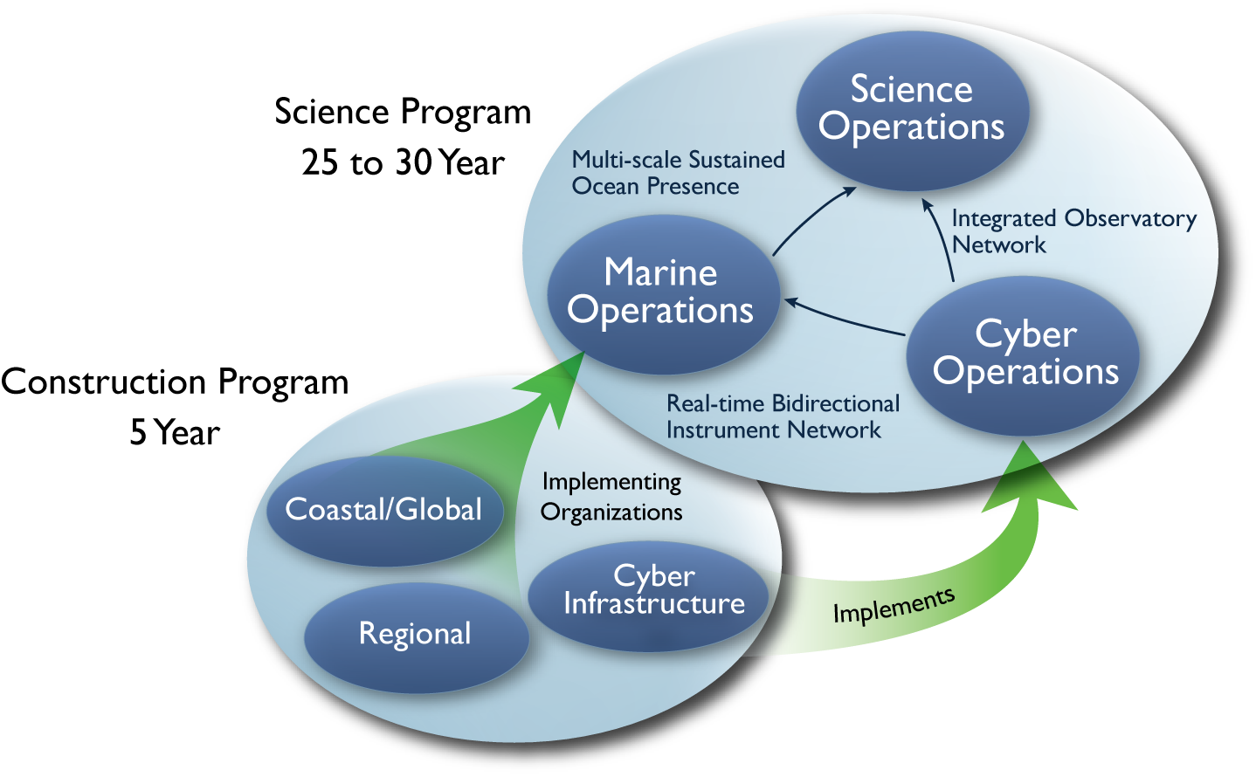
Observatory Science
Sensors
Processing
Reaction
Scaling Processing
On-demand expansion of computing
Highly Available (HA) services that provision resources on many clouds based on need
Significant OOI CI infrastructure in data and sensor management based on this model
How do we deploy that infrastructure and keep it running?

Slide 3
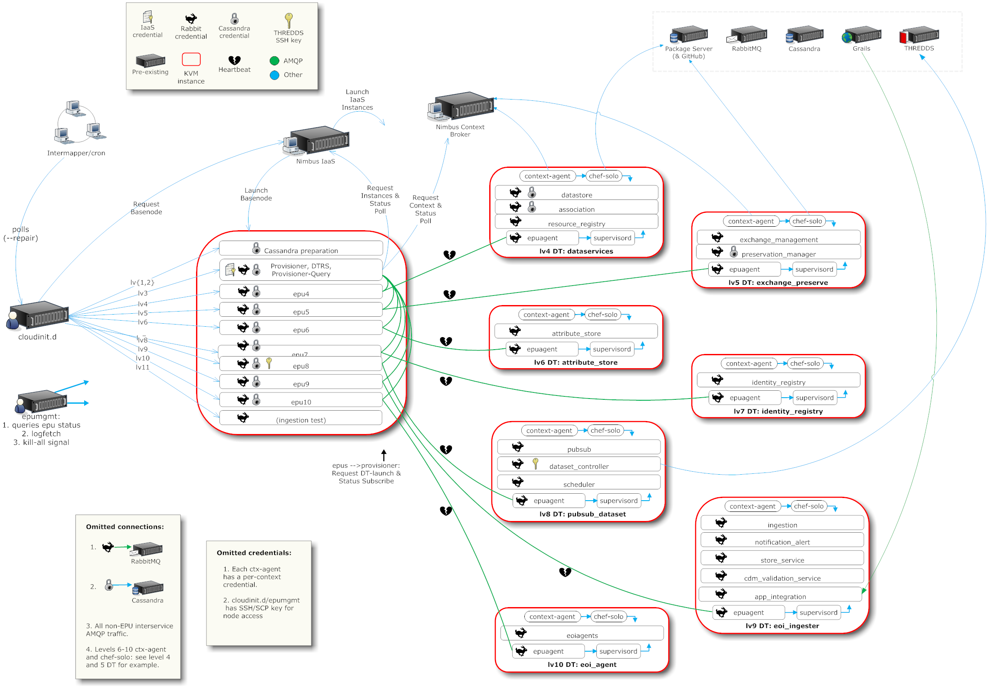
A Simplified Deployment Scenario

Slide 4
Collaborative Scenario
Tim
EC2

Slide 5
Collaborative Scenario
Jamie
Tim
OOI private cloud
EC2

Slide 6
Collaborative Scenario
David
Jamie
Tim
FutureGrid
OOI private cloud
EC2

Slide 7
Cloudinit.d Goals: Repeatable Launches
Launch plan
database
Web Server
Web Server
Web Server
Write a launch plan once, deploy many times

Slide 8
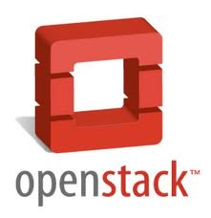
Cloudinit.d Goals: Multi-Cloud
Launch plan
database
Web Server
Web Server
Web Server
Deploy on cloud and non-cloud resources from many providers

Slide 9
Cloudinit.d Goals: Handling Dependencies
Launch plan
Run-level 1
database
Run-level 2
Web Server
Web Server
Web Server
Coordination of interdependent launches

Slide 10
Cloudinit.d Goals: Launch Tests
Launch plan
Run-level 1
database
Run-level 2
Web Server
Web Server
Web Server
User-defined launch tests

Slide 11
Cloudinit.d Goals: Monitoring and Repair
Launch plan
Run-level 1
database
Run-level 2
Web Server
Web Server
Web Server
Test-based monitoring and repair

Slide 12
Cloudinit.d Goals: Monitoring and Repair
Launch plan
Run-level 1
database
Run-level 2
Web Server
Web Server
Web Server
Test-based monitoring and repair

Slide 13
Cloudinit.d Goals: Easy to Use
Two roles:
Launch plan developers and users
Launch plan end-users/operators
Lightweight
Copy launch plan and “one click” action
Launch plan/application developers:
Minimal software assumptions (ssh)
“Stem cell” deployment approach
Incremental launch plan development

Slide 14
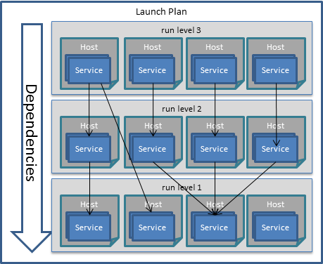
Overview
Services
Run Levels
Collections of services without dependencies on each other
Launch Plan
An ordered set of run levels

Slide 15
Cloudinit.d Services
Services:
well-defined task
confined to a single host machine
Example: HTTP server
Hosting :
Existing host
New automatically launched host (VM)
Many services can run on a single host/VM
[svc-alamoHTTP]
iaas_key: XXXXXX
iaas_secret: XXXX
iaas_host: alamo.futuregrid.org
iaas_port: 8443
iaas: Nimbus
image: ubunut10.10
ssh_username: ubuntu
localsshkeypath: ~/.ssh/fg.pem
readypgm: http-test.py
bootpgm: http-boot.sh
[svc-staticHostHTTP]
ssh_username: root
localsshkeypath: ~/.ssh/st.pem
readypgm: http-test.py
bootpgm: http-boot.sh

Slide 16
Configuring and Testing Services
Configuration via locally run scripts
Any language so long as your host can run it
Chef, yum, puppet
Injected in and run via ssh as needed
Start agent (bootpgm)
Configuration at setup
Test agent (readpgm)
Checks “health and happiness” of the service
E.g., for HTTP server: connect to localhost:80, download a known web page, check content
Termination agent (terminatepgm)
Gracefully take down a service, e.g. release resources

Slide 17
Dependency Handling
Represented as a set of key/value pairs
Input dependencies
Deps section of service definition
Output dependencies
Json document
Securely copied from the service back to cloudinit.d
Example: HTTP server
Run-level 1
database
Run-level 2
Web Server
[deps]
db_username: ${db.username}
db_password: ${db.password}
db_hostname: ${db.hostname}
{“db_username“: “timf“,
“db_password”: “SKJmsjkdf43jsjde”,
“db_hostname”: ec2xxx.amazon.com}

Slide 18
Run Levels
database
Collection of services with no dependencies on each other, e.g. database and NSF server
Launched at the same time
Depend on services from previous run level
Examples of dependencies: security tokens, contact information (hostname, port)
Considered complete when all services have successfully started

Slide 19
Launch
Ordered set of run levels
A launch plan describes a complete application
Defining a launch plan
Define all services
Arrange into run-levels
[runlevels]
level1: db_nfs.conf
level2: http.conf

Slide 20
Deployment Steps
Validate launch plan
All IaaS requests are made to optimize launch
ssh connection retries for first run-level
startpgm + dependencies are copied to services in first run-level
startpgm is run
Returns a document with key/value pairs that describe attributes of the newly configured service
When all services the first run-level pass test we proceed to the next run-level

Slide 21
Cloudinit.d Status
Nimbus Platform RC1 released
Available from www.nimbusproject.org
Let us know what you think!
Extensively used in OOI
Extended for use in FutureGrid to support experimental framework
Integrated with Nimbus Platform tools

Slide 22
Related Work
AWS CloudFormation
Configuration management systems: chef, puppet
Context Broker and Wrangler
Claudia

Slide 23
Conclusions
Large-scale resource management in the cloud is a complex task
New challenges:
Development of launch plans: scripts, services, and run-level definitions
Providing easy-to-use, repeatable launches
Interoperability between cloud providers
Give it a whirl!

