Slide 1
FutureGrid related presentations at TG and OGF
Sun. 17th: Introduction to FutireGrid (OGF)
Mon. 18th: Introducing to FutureGrid (TG)
Tue. 19th
  Educational Virtual Clusters for On-demand MPI/Hadoop/Condor in FutureGrid
  MapReduce Applications and Environments
  Managing Appliance Launches in Infrastructure Clouds
  BoF: Applications and Environments, Map Reduce
    July 19th, 5:30-7pm, Brighton
Wed. 20th
  BoF: TG'11: FutureGrid: What an Experimental Infrastructure can do for you
    July 20th, 5:30-7pm, Brighton

Slide 2


Towards Generic
FutureGrid Image Management
Gregor von Laszewski, Javier Diaz,
Fugang Wang, Andrew J. Younge,
Archit Kulshrestha, and Geoffrey Fox
laszewski@gmail.com
Community Grids Lab
Pervasive Technology Institute
Indiana University

Slide 3
Motivation
FutureGrid is an experimental cloud and grid testbed
We support HPC, Grid, and Cloud frameworks and services
  Much interest by the community is in the offered frameworks and services are based on virtualization technologies or make use of them
Image management becomes a key issue
Generic catalog and repository of images that will be able to interact with other FG subsystems and potentially with other infrastructures
Create and maintain platforms within custom FG images that can be retrieved, deployed and provisioned on demand

Slide 4
Related Work
Existing efforts to provide image repositories as part of IaaS/PaaS cloud frameworks
  Nimbus, Eucalyptus, OpenStack, OpenNebula, AbiCloud, Amazon Web Services, Windows Azure…
In general they provide their own local image repository specifically designed to interact with that particular framework
Our work differs as we strive towards providing an integrated service that overarches images suitable for bare metal and cloud IaaS frameworks installed on FG
  Enables storing and organizing of images from multiple cloud efforts in the same repository
  Allows storing the pedigree on how the images were created

Slide 5
Design
The FG image management processes are supported by a number of tightly-coupled services essential within FG
The major services are
  Image repository
  Image generator
  Image verifier
  Image deployment
  Experiment management framework

Slide 6
Image Repository
Integrated service that enables storing and organizing images from multiple cloud efforts in the same repository
Images are augmented with metadata to describe their properties like the software stack installed or the OS
Access to the images can be restricted to single users, groups of users or system administrators

Slide 7
Image Repository (II)
Maintains data related with the usage to assist performance monitoring and accounting
Quota management to avoid space restrictions
Pedigree to recreate image on demand
Repository’s interfaces: API's, a command line, an interactive shell, and a REST service
Other cloud frameworks could integrate with this image repository by accessing it through an standard API
Ability of generating images on-demand based on generic image generation descriptions

Slide 8
FG Image Repository (III)

Slide 9
Image Generation
Service to create specialized images for users on demand
Take in user requirements to format a new image that, once vetted and stored, can be deployed on FG hardware
User specifies image type, arch, software, hypervisor, IaaS…
Interact with the Image Repository to store new images and deploy on various infrastructures

Slide 10
Image Verification
Images will be verified to guarantee some minimum security requirements
Only if the image passes predefined tests, it is marked as deployable
Verification takes place several times on an image
  Time of generation
  Before and after the deployment
  Once a time threshold is reached
  Periodically

Slide 11
Image Deployment
Images need to be deployed on various IaaS frameworks supported within FG
We explore on-demand transforming workflows to derive images running on different IaaS frameworks
We explore time-to-live function that is coupled with our distributed image cache service and actively reduce the storage of outdated, obsolete, and rarely used images
  Popular images will be cached in the distributed storage to guarantee fast access (not be recreated with the workflow each time)

Slide 12
Image Deployment (II)

Slide 13
Experiment Management
Allows user to define, initiate, and control a repeatable set of events designed to exercise some particular functionality, either in isolation or in aggregate
Experiments may vary in complexity:
  Basic experiments, such as utilizing a particular pre-installed service and allowing a researcher debug an application interactively
  More sophisticated experiments, such as instantiating a particular environment and running a pre-specified set of tasks on the environment

Slide 14
Experiment Management (II)
This experiment-centric approach will allow the creation of a collection of reusable software images and experimental data
Researchers will be able to quickly select an appropriate pre-configured environment and use it in their specific scenario

Slide 15
Additional Services Integrated in Image Management

Slide 16
Authentication and Authorization
Images provisioned in FG will be integrated with FG general policies of account and project management
Deal with a change in user’s privileges by integrating certificate revocations and validation of valid accounts by default
Consider project based restrictions and allow user to create selective polices for authorization based on project participation
  Single users who create images for themselves
  Group of users who share the image amongst themselves
  System administrators who maintain the images for the standard FG resource deployments such as HPC

Slide 17
Accounting
Keep track of Image usage
  Who uses the image, when and from where
  Number of machines where the image has been deployed
It can be used to optimize space and improve performance
  Useless images are removed and need to be generated each time
  Popular images are cached for faster access

Slide 18
Image Management
Example

Slide 19
Example
Technology Preview
Generate a Centos image with several packages
  fg-image-generate –o centos –v 5.6 –a x86_64 –s emacs, openmpi –u javi
  > returns image: centosjavi3058834494.tgz
Deploy the image for HPC (xCAT)
  ./fg-image-register -x im1r –m india -s india -t /N/scratch/ -i centosjavi3058834494.tgz -u jdiaz
Submit a job with that image
  qsub -l os=centosjavi3058834494 testjob.sh

Slide 20
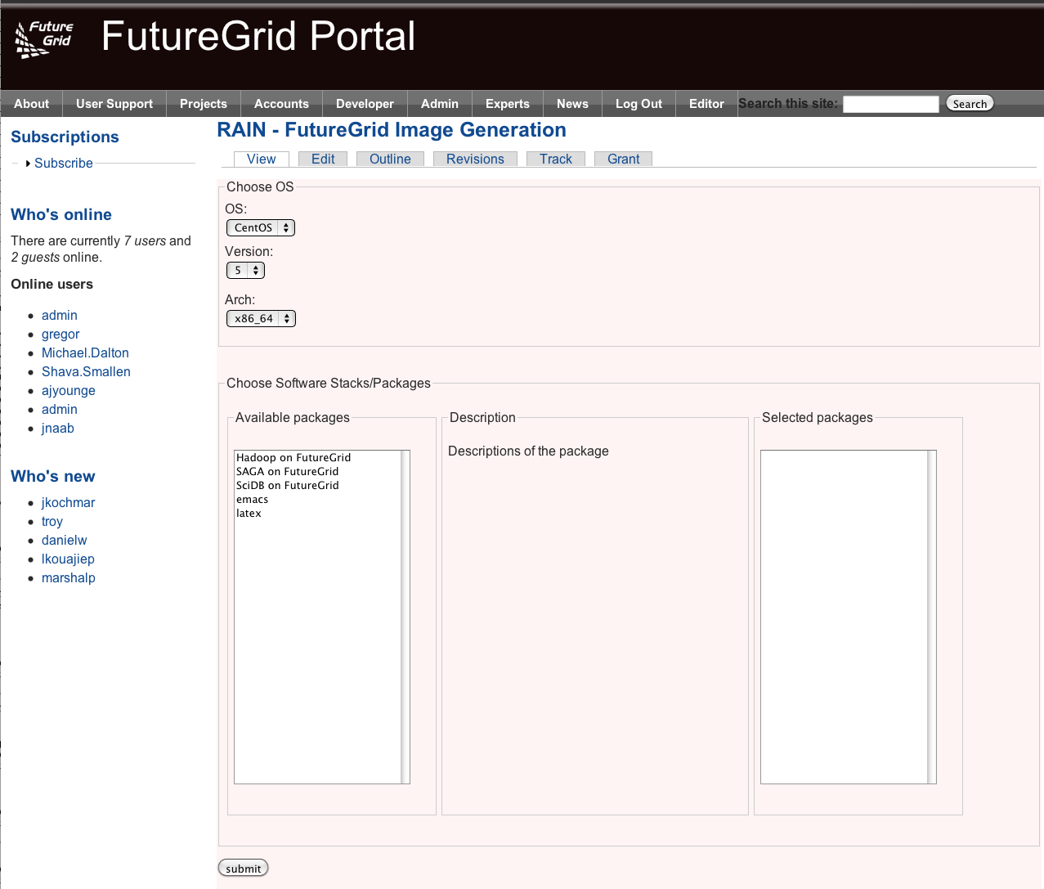
Image Generation with the Portal
Technology Preview

Slide 21
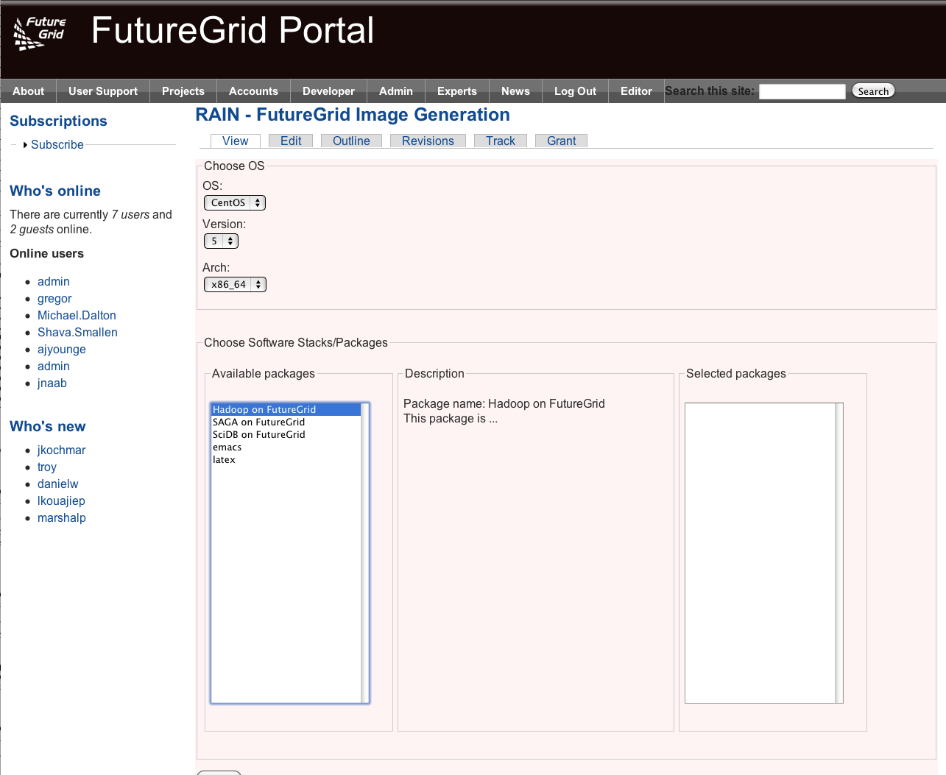
Image Generation with the Portal
Technology Preview

Slide 22
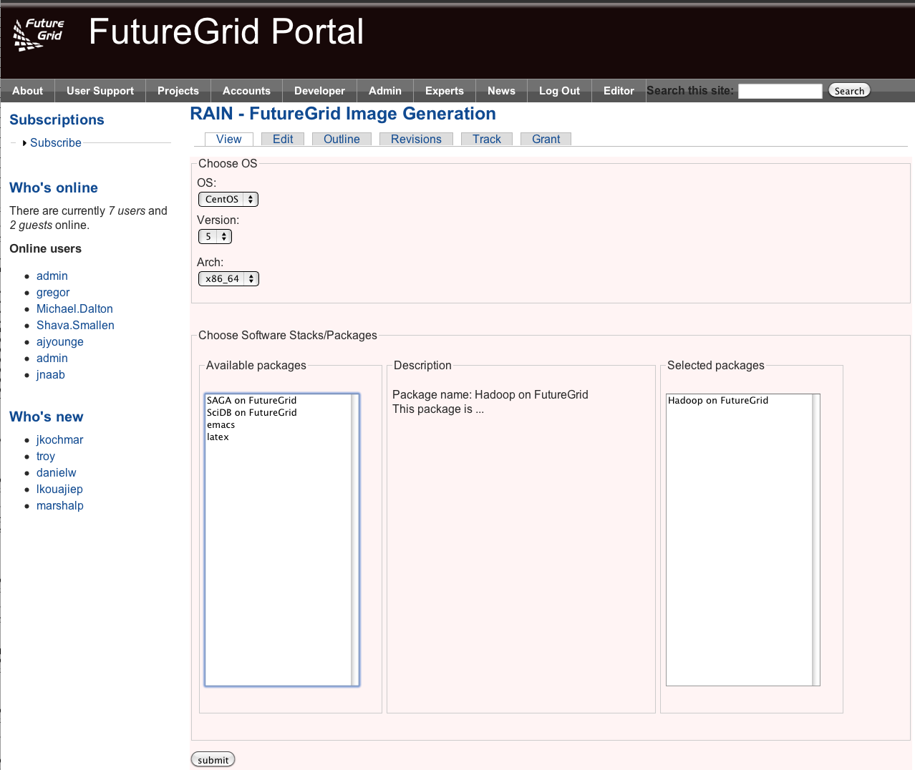
Image Generation with the Portal
Technology Preview

Slide 23
Current Status
Image Repository
  Get, put, remove and list images
  Access control to images (public or private)
  Manage users and quotas
Image Generation
  Centos and Ubuntu Images
  Users can request software from the default packages repositories (yum and apt)
Image Deployment
  Deploy images for HPC (xCAT/Moab)
  Deployed images can be requested through Moab (-l os=)

Slide 24
What is next?
Image Repository
  REST API/Web interface (together with UIC)
  Connect it with the Image Generation and Deploy
  Create group of users to control images access
  Extend the Repository to store Experiments
Image Generation
  Extend to other OS and version
  Include custom OS repositories to install our own tools
  Create EC2 interface to deploy VMs where the images are generated
  Explore tools like Chef to deploy and configure software in the images
  Rest API/Web interface
Image Deployment
  Generalize our strategy by avoiding the use of xCAT
  Rest API/Web interface
  Deploy images for different cloud platforms
  Deploy complex appliances

Slide 25
Conclusion
Design of the generic image repository and image management tools that will be used in FutureGrid
As key feature, it provides a unique and common interface to manage any kind of image for any kind of cloud infrastructure
Flexible design to be easily integrated not only with FutureGrid but also with other frameworks
Aids users with the image management and interoperability issues between different Cloud deployments

Slide 26
Thank for your attention!
Contact info:
Gregor Laszewski: laszewski@gmail.com
Javier Diaz: javidiaz@indiana.edu
https://portal.futuregrid.org

