Slide 1
FutureGrid Dynamic Provisioning Experiments including Hadoop
Fugang Wang, Archit Kulshrestha, Gregory G. Pike, Gregor von Laszewski, Geoffrey C. Fox

Slide 2
Hadoop at FG
FG will provide a hadoop environment to users
Currently in development and test phase
Environment installed and configured on NFS mounted space.
Users can request a virtual hadoop cluster with a specified number of nodes and cores, to execute a hadoop application.
FG provides tools to dynamically configure the virtual cluster.
FG software will generate a job for the hadoop application and submit it through the Torque queuing system.
Activities are logged and the output is dependent on the hadoop app itself.
Currently relying on Torque for job status monitoring.
CLI: fg-hadoop -[n|nodes] nodesNumber -[c|coresPerNode] coresPerNode -[i|jobname] jobName -[e|cmd] hadoopAppCmd(quoted) -[v|verbose]

Slide 3
Hadoop at FG – cont’d
SWG hadoop application is used to test the current setup
See next slide for the app introduction. (Thanks Judy Qiu and the SALSA group for providing this)
A sample run: fg-hadoop -v -n 4 -c 4 -i swg300_4Nodes4Cores -cmd "~/swg-hadoop.jar ~/AluY_300.txt 300 50 swgResult1 ~/swgTiming300_4Nodes4Cores.txt“
Sample result: # #seq #blockS Ttime input dataDistTime output 300 21 47.773 /N/u/fuwang/AluY_300.txt 974 swgResult1
Future improvement plans for this activity
The hadoop environment is preinstalled and configured on FG resources; or user could customize an image that has the environment included.
A persistent Hadoop filesystem instead of dynamically setting up and tearing down one.
With the proposed FG Experiment Management, it will be more convenient for users to monitor the job execution and retrieve the result.
The CLI could be augmented too when Experiment Management is ready. Users will also be able to access this functionality through FG Web portal.

Slide 4
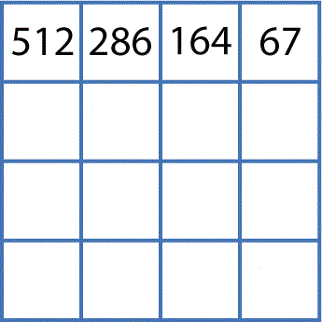
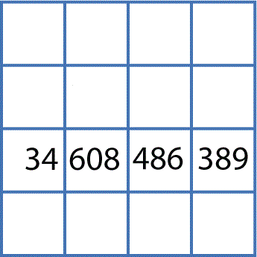
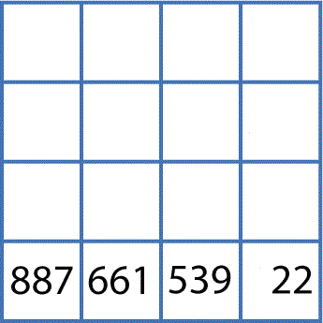
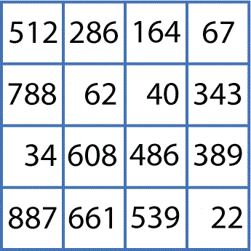
DNA/Protein Sequence Alignment Using Hadoop *
Smith Waterman - Gotoh pairwise
Performs local alignment of either DNA or Protein sequences
User Program
Split Data
..
..
1
FASTA
FASTA
FASTA
Partition the input FASTA file
Map ( )
SWG
Map () SWG
2
Map ( )
SWG
Pairwise align sequences in each input file
..
..
3
Partial distance score matrix
Reduce ( )
4
Combine partial matrices to form a full matrix
* Slide Courtesy of Stephen TAK-LON WU and the SALSA group at IU

Slide 5
Dynamic Provisioning on Future Grid

Slide 6
Dynamic Provisioning at FG
FutureGrid will allow for dynamic provisioning at multiple levels.
Core software and services will be dynamically provisioned on bare hardware
Services such as Eucalyptus and Nimbus will allow provisioning of VMs on nodes deployed as Eucalyptus or Nimbus nodes.
Will be used to supporting HPC activities and also Cloud activities.
Greater power and control – Build your own cluster with custom kernels, Network drivers, new paradigms of computing

Slide 7
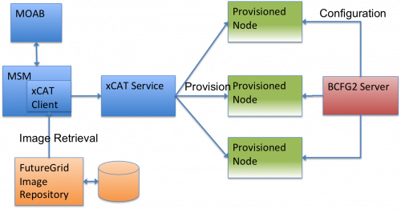
Dynamic Provisioning Experiment Logical View

Slide 8
Dynamic Provisioning Performance
Experiments show very good scalability
The experiment run this: msub –l os=statelessrhel5 testjob.sh
Time taken to provision a node is an average of 3 minutes and 45 seconds in the experiment.
As the number of provisioned nodes requested grows from 2 to 32, fluctuation in time taken to provision nodes is less than 10%.
When provisioning 32 nodes, the time to provision the nodes is quite uniform with a standard deviation of 14 seconds.

Slide 9
Dynamic Provisioning Results
Time elapsed between requesting a job and the jobs reported start time on the provisioned node. The numbers here are an average of 2 sets of experiments.

Slide 10
Provisioning times for nodes in a 32 node request
The nodes took an average of 3 minutes and 45 seconds to switch from the stateful to stateless image with a standard deviation of 14 seconds.

Slide 11
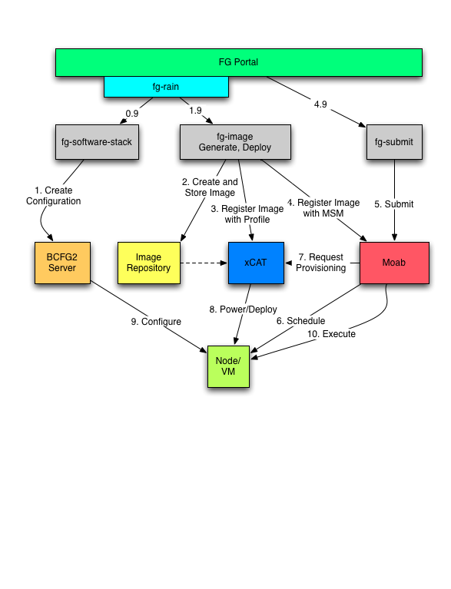
Phase III Process View

Slide 12
Credits
NSF
This work was supported in part by the National Science Foundation (NSF) under Grant No. 0910812 to Indiana University for "FutureGrid: An Experimental, High-Performance Grid Test-bed."
IU Research Technologies Team
IU Salsa Team

