Slide 1
FutureGrid Services I
FutureGrid Tutorial at PPAM 2011
Torun Poland
September 11 2011
Geoffrey Fox
Gregor von Laszewski
Andrew Grimshaw
Renato Figueiredo
Kate Keahey

Slide 2
Contents
This Slide Set
Overview of Services
Nimbus
OpenStack
Appliances
Dynamic Provisioning
Image Generation
Interoperability Activities
Getting an Account
Portal
Second Slide Set
HPC
Mapreduce
Eucalyptus

Slide 3
Overview of Existing Services

Slide 4
Categories
PaaS: Platform as a Service
  Delivery of a computing platform and solution stack
IaaS: Infrastructure as a Service
  Deliver a compute infrastructure as a service
Grid:
  Deliver services to support the creation of virtual organizations contributing resources
HPCC: High Performance Computing Cluster
  Traditional high performance computing cluster environment
Other Services
  Other services useful for the users as part of the FG service offerings

Slide 5

Selected List of Services Offered
FutureGrid
User
IaaS
Nimbus
PaaS
Hadoop
(Twister)
(Sphere/Sector)
MPI
Others
Portal
Inca
Eucalyptus
ViNE
(OpenStack)
(OpenNebula)
HPCC
Ganglia
(Exper. Manag./(Pegasus
(Rain)
OpenMP
ScaleMP
(XD Stack)
Grid
(Globus)
Unicore
SAGA
Genesis II
(will be added in future)

Slide 6
Services Offered
 | India | Sierra | Hotel | Foxtrot | Alamo | Xray | Bravo
myHadoop | ✔ | ✔ |  |  | ✔
Nimbus |  | ✔ | ✔ | ✔ | ✔
Eucalyptus | ✔ | ✔
ViNe¹ | ☑ | ✔ | ☑ | ✔ | ☑
Genesis II | ✔ | ✔ |  |  | ✔ | ✔
Unicore | ✔ | ✔ |  |  |  | ✔
MPI | ✔ | ✔ | ✔ | ✔ | ✔ | ✔ | ✔
OpenMP |  |  |  |  |  | ✔
ScaleMP | ✔
Ganglia | ✔ |  | ✔
Pegasus³ | ☑ | ☑ | ☑ | ☑ | ☑
Inca | ✔ | ✔ | ✔ | ✔ | ✔ | ✔
Portal² | ☒ | ☒ | ☒ | ☒ | ☒ | ☒
PAPI |  |  |  |  |  | ✔
Vampir
ViNe can be installed on the
other resources via Nimbus ☑
Access to the resource is requested through the portal ☒
Pegasus available via Nimbus and Eucalyptus images

Slide 7
Which Services should we install?
We look at statistics on what users request
We look at interesting projects as part of the project description
We look for projects which we intend to integrate with: e.g. XD TAS, XD XSEDE
We leverage experience from the community

Slide 8
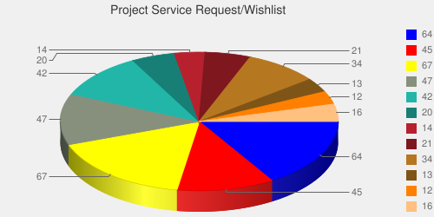
User demand influences service deployment
Based on User input we focused on
  Nimbus (53%)
  Eucalyptus (51%)
  Hadoop (37%)
  HPC (36%)
Eucalyptus: 64(50.8%)
High Performance Computing Environment: 45(35.7%)
Nimbus: 67(53.2%)
Hadoop: 47(37.3%)
MapReduce: 42(33.3%)
Twister: 20(15.9%)
OpenNebula: 14(11.1%)
Genesis II: 21(16.7%)
Common TeraGrid Software Stack: 34(27%)
Unicore 6: 13(10.3%)
gLite: 12(9.5%)
OpenStack: 16(12.7%)
* Note: We will improve the way we gather statistics in order to avoid inaccuracy during the information gathering at project and user registration time.

Slide 9
Software Architecture

Slide 10
Software Architecture

Slide 11
Next we present selected Services
☒
☒
☒
☒
☒
☒
☒
☒
☒
☒
☒

Slide 12
Cloud Computing with Nimbus on FutureGrid
TeraGrid’11 tutorial, Salt Late City, UT
Kate Keahey
keahey@mcs.anl.gov
Argonne National Laboratory
Computation Institute, University of Chicago

Slide 13
Nimbus Infrastructure

Slide 14
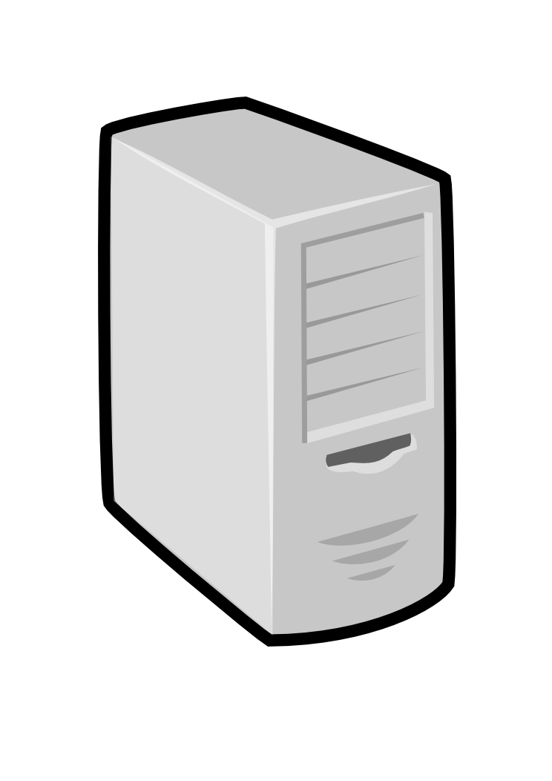
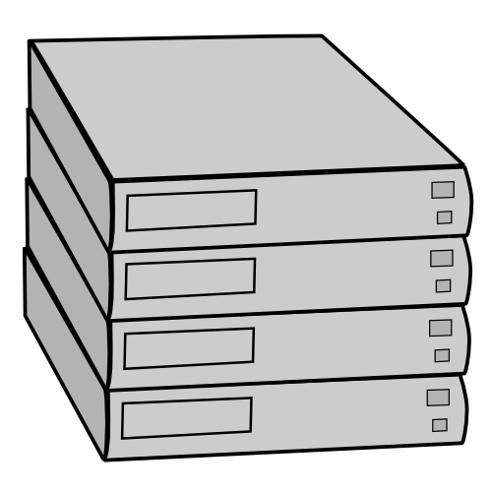

IaaS: How it Works
Pool
node
Pool
node
Pool
node
Nimbus
Pool
node
Pool
node
Pool
node
Pool
node
Pool
node
Pool
node
Pool
node
Pool
node
Pool
node
Notes:
A “story” – user comes to a Nimbus cloud, wants to deploy 3 VMs, etc.

Slide 15
IaaS: How it Works
Nimbus publishes
information about each VM
Pool
node
Pool
node
Pool
node
Nimbus
Pool
node
Pool
node
Pool
node
Users can find out
information about their
VM (e.g. what IP
the VM was bound to)
Pool
node
Pool
node
Pool
node
Pool
node
Pool
node
Pool
node
Users can interact directly with their VM in the same way the would with a physical machine.
Notes:
Continuation of a story…

Slide 16
Nimbus on FutureGrid
Hotel (University of Chicago) -- Xen
41 nodes, 328 cores
Foxtrot (University of Florida) -- Xen
26 nodes, 208 cores
Sierra (SDSC) -- Xen
18 nodes, 144 cores
Alamo (TACC) -- KVM
15 nodes, 120 cores
Notes:
Nimbus clouds on FG

Slide 17
FutureGrid: Getting Started
To get a FutureGrid account:
  Sign up for portal account: https://portal.futuregrid.org/user/register
  Once approved, apply for HPC account: https://portal.futuregrid.org/request-hpc-account
  Your Nimbus credentials will be in your home directory
Follow the tutorial at: https://portal.futuregrid.org/tutorials/nimbus
or Nimbus quickstart at http://www.nimbusproject.org/docs/2.7/clouds/cloudquickstart.html

Slide 18
FutureGrid: VM Images
[bresnaha@login1 nimbus-cloud-client-018]$ ./bin/cloud-client.sh –conf\
~/.nimbus/hotel.conf –list
----
[Image] 'base-cluster-cc12.gz' Read only
Modified: Jan 13 2011 @ 14:17 Size: 535592810 bytes (~510 MB)
[Image] 'centos-5.5-x64.gz' Read only
Modified: Jan 13 2011 @ 14:17 Size: 253383115 bytes (~241 MB)
[Image] 'debian-lenny.gz' Read only
Modified: Jan 13 2011 @ 14:19 Size: 1132582530 bytes (~1080 MB)
[Image] 'debian-tutorial.gz' Read only
Modified: Nov 23 2010 @ 20:43 Size: 299347090 bytes (~285 MB)
[Image] 'grid-appliance-jaunty-amd64.gz' Read only
Modified: Jan 13 2011 @ 14:20 Size: 440428997 bytes (~420 MB)
[Image] 'grid-appliance-jaunty-hadoop-amd64.gz' Read only
Modified: Jan 13 2011 @ 14:21 Size: 507862950 bytes (~484 MB)
[Image] 'grid-appliance-mpi-jaunty-amd64.gz' Read only
Modified: Feb 18 2011 @ 13:32 Size: 428580708 bytes (~408 MB)
[Image] 'hello-cloud' Read only
Modified: Jan 13 2011 @ 14:15 Size: 576716800 bytes (~550 MB)
Notes:
Those are images which are already configured and ready to go on FG – you don’t have to configure an image you can use one of these and modify it further – and afterwards save that modified image via the Nimbus client – save command.

Slide 19
Nimbus Infrastructure: a Highly-Configurable IaaS Architecture
Workspace Interfaces
Cumulus interfaces
EC2 SOAP
EC2 Query
WSRF
S3
Workspace API
Cumulus API
Workspace Service Implementation
Cumulus Service Implementation
Workspace RM options
Default
Default+backfill/spot
Workspace pilot
Workspace Control Protocol
Cumulus Storage API
Workspace Control
Cumulus Implementation options
Virtualization
(libvirt)
Image Mngm
Network
Ctx
ssh
…
POSIX
Xen
KVM
LANtorrent
HDFS
Notes:
A picture of the architecture – things to emphasize is that it is highly configurable and easy to extend – e.g. last summer we got a community contribution of the backfil/spot scheduler.
I typically just discuss workspace layers and then say that Cumulus is organized in a similar way. From top, by layer:
Interfaces – right now three types supported we’d love to support OCCI
And it would be easy to do because we have this workspace API layer that makes it easy to “add on” other interfaces
The RM layer – default is the workspace scheduler (we implemented it), spot pricing adds spot pricing functionality, workspace pilot enables worspace service to work with a batch scheduler such as SGE or Torque. But you can configure workspace service with any of these schedulers – or write your own.
Workspace Control Protocol allows any scheduler to interact with workspace control program that carries out its commands on the “worker nodes”
The workspace control program is itself configurable – you can have different virtualization flavors, different ways of distributing images to nodes, networking options, etc. – there are many plugins

Slide 20
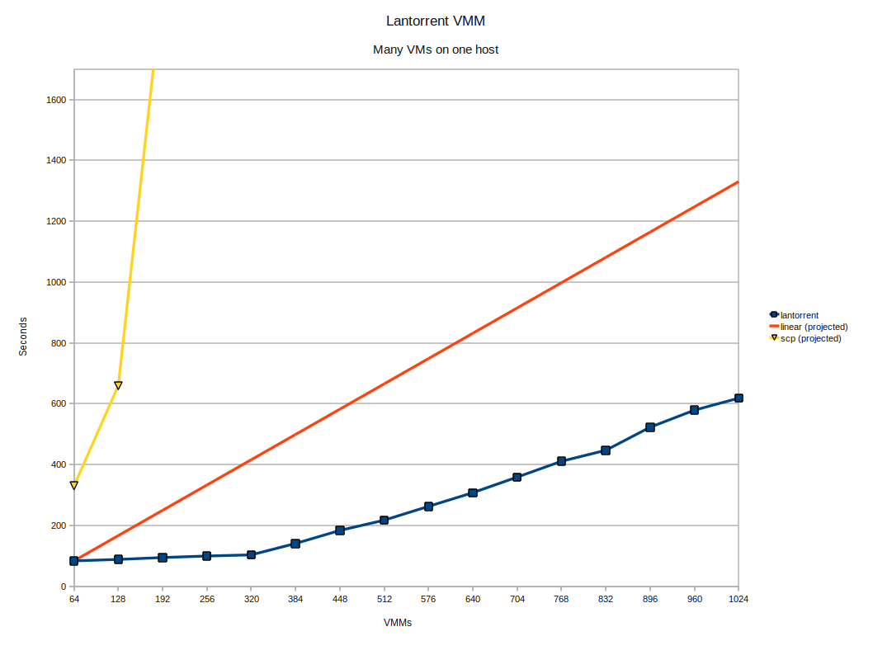
LANTorrent: Fast Image Deployment
Challenge: make image deployment faster
Moving images is the main component of VM deployment
LANTorrent: the BitTorrent principle on a LAN
Streaming
Minimizes congestion at the switch
Detecting and eliminating duplicate transfers
Bottom line: a thousand VMs in 10 minutes on Magellan
Nimbus release 2.6, see www.scienceclouds.org/blog
Preliminary data using the Magellan resource
At Argonne National Laboratory
Notes:
The deployment of many identical virtual machine images represents a very common pattern in scientific use of clouds. It occurs when researchers deploy a virtual cluster, augment an existing cluster by adding more worker nodes, or enlarge a set of platforms for a volunteer computing application.
LANTorrent leverages this pattern to optimize image distribution within your cloud. Built on the ideas underlying BitTorrent, LANTorrent uses streaming to propagate the VM image file to hundreds or thousands of nodes. Unlike copying, streaming does not wait for the file to fully arrive at its destination before forwarding it on – by the time the end of the file reaches the first node, its beginning may have been forwarded to many other nodes. The only limiting factor to how many streams we can have “in flight” at any given time is the capacity of the LAN switch. And this is where the “LAN” part of LANTorrent comes in – it tries to optimize the number of transfers in order to saturate the switch without causing contention. In addition to that, LANTorrent detects all same-image transfers taking place within a time bucket – even if they are part of different requests – and includes them in existing streams. As shown on the enclosed graph, on the ANL’s Magellan cloud we were able to deliver a thousand 1.2 GB VM images within 10 minutes. Moreover, the graph also shows that LANTorrent can scale better than linear (the red line in the graph) thanks to multiple transfer detection.

Slide 21
Nimbus Platform

Slide 22
Nimbus Platform: Working with Hybrid Clouds
Creating Common Context
Allow users to build turnkey dynamic virtual clusters
Nimbus Elastic Provisioning
interoperability
automatic scaling
HA provisioning
policies
private clouds
(e.g., FNAL)
community clouds
(e.g., FutureGrid)
public clouds
(e.g., EC2)
Notes:
Nowadays users want to use hybrid clouds – run on their own resources, maybe use some community cloud resources (such as FutureGrid) and then go to commercial clouds. And what they provision from those clouds has to work together and potentially also fit in with an existing environment. Nimbus Platform provides tools in this space in two layers:
The Nimbus Platform tools allow them to build highly scalable HA tools that go to *different* clouds (so far tested with Nimbus, Euca, OpenStack, and EC2 – FG clouds plus EC2 -- but extensible to other clouds via libcloud)
Once the VMs are provisioned on all those clouds we also allow them to create a common context between them – e.g make them into virtual clusters or add them to existing context.

Slide 23

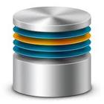



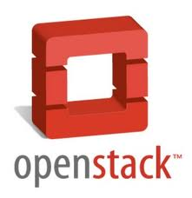



Cloudinit.d
Launch plan
Run-level 1
database
Run-level 2
Web Server
Web Server
Web Server
…and test-based monitoring and repair
Paper at TeraGrid’11
Notes:
5 points about cloudinit.d (supported by the animation on the slide):
Write a launchplan once, repeat many times. This helps with many things: (1) allows FG users to easily deploy complex sets of interdependent VMs on many different FG clouds. *Repeatable* deployment of sets of Vms is particularly important from the perspective of experiment support: it allows you to recreate the same conditions in which the experiment was enacted previously.
Works with multiple IaaS providers. A very important feature, ensures that it works with many infrastructure cloud interfaces. Compatibility across interfaces is achieved via the libcloud library. In particular, we test with the IaaS cloud formats supported in FG, specifically Nimbus, Eucalyptus and Openstack (on experimental basis) and additionally with EC2 – so that users can experiment with cloudbursting from community clouds (FG) to commercial clouds EC2.
Coordinates launches via attribute: sometimes the launch of one VM (e.g., a web server in this example) depends on the launch of another VM (e.g., a database of an NSF server). Cloudinit.d (like init.d from which its name derives) has the notion of runlevels – if a VM has dependencies all the VMs that it depends on are started in prior runlevels, i.e. run-level 1 has no dependencies, run-level 2 has only dependencies on level 1, etc.
User-defined launch tests (assertions): the user can define assumptions about the system in the form of tests that get executed when the VMs are booted. This allows users to monitor and reason about a launch.
- Test-based monitoring and policy-driven repair of a launch: cloudinit.d supports also the notion of tests (assertions) that can be evaluated after deployment. If such evaluation happens and some assertions about the system are not fulfilled the system has a capability for policy-driven repair (e.g., try to restart the VM 3 times before notifying the operator). If a VM is restarted all the downstream dependencies are restarted also.

Slide 24
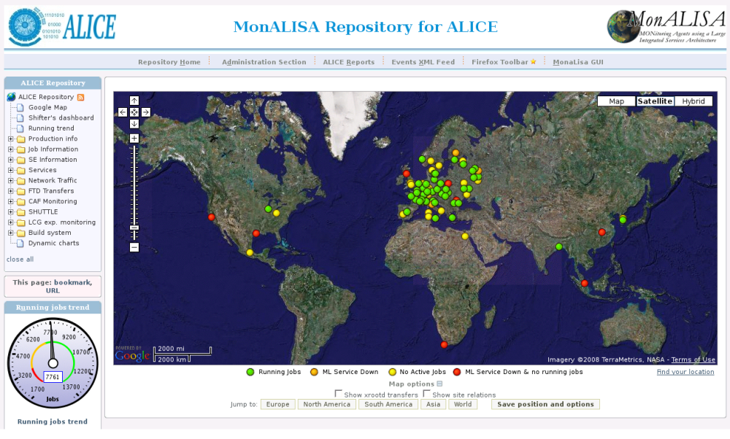
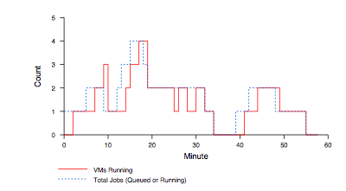
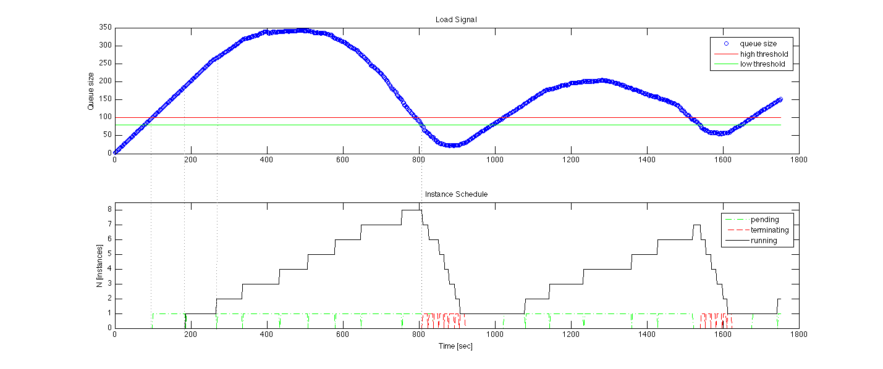
Elastic Scaling Tools:
Towards “Bottomless Resources”
Early efforts:
  2008: The ALICE proof-of-concept
  2009: ElasticSite prototype
  2009: OOI pilot
Challenge: a generic HA Service Model
  React to sensor information
  Queue: the workload sensor
  Scale to demand
  Across different cloud providers
  Use contextualization to integrate machines into the network
  Customizable
  Routinely 100s of nodes on EC2
Coming out later this year
Paper: “Elastic Site”, CCGrid 2010
Notes:
We are also working on the release of infrastructure that will support elastic and HA services.
This effort has a long history on the Nimbus team. In 2008, in collaboration with the CernVM project we produced a proof-of-concept of support for elastic provisioning for the ALICE experiment (one of the 4 LHC experiments). ALICE uses a scheduler called AliEn to submit jobs to a globally distributed resource pool supporting ALICE computations. The scientists asked us if we could elastically add resources to this pool when the AliEn queues get long and terminate those resources again when the “rush hour” terminates. We did just that and on the picture you see the output of the ALICE MonaLisa monitoring service which shows resources dynamically deployed on a Nimbus cloud in Chicago.
We repeated a similar experiment in 2009 but this time extending the Torque scheduler and published a paper about it in CCGrid 2010.
In 2009 also we repeated a similar experiment again using an AMQP queue representing the workload of the Ocean Observatory Initiative (OOI), a $400M NSF investment into the future of ocean sciences, building infrastructure to support them for the next 20-30 years.
However, all those were experiments – proof-of-concept, prototype, pilot… For the last two years we have been working with the OOI project on building a production infrastructure providing this functionality (I lead the development of the Common Execution Infrastructure CEI within OOI). The service (alpha to come out this year) applies sensor information (queue length, load, number of connections, etc.) to policies and scales to demand by provisioning resources on demand. It is highly customizable to include different sensor mixes, new sensors, different policies or even custom policy engines. It routinely scales to 100s of EC2 nodes.

Slide 25
FutureGrid Case Studies
Notes:
The next three slides illustrate ways in which FG can be used.

Slide 26

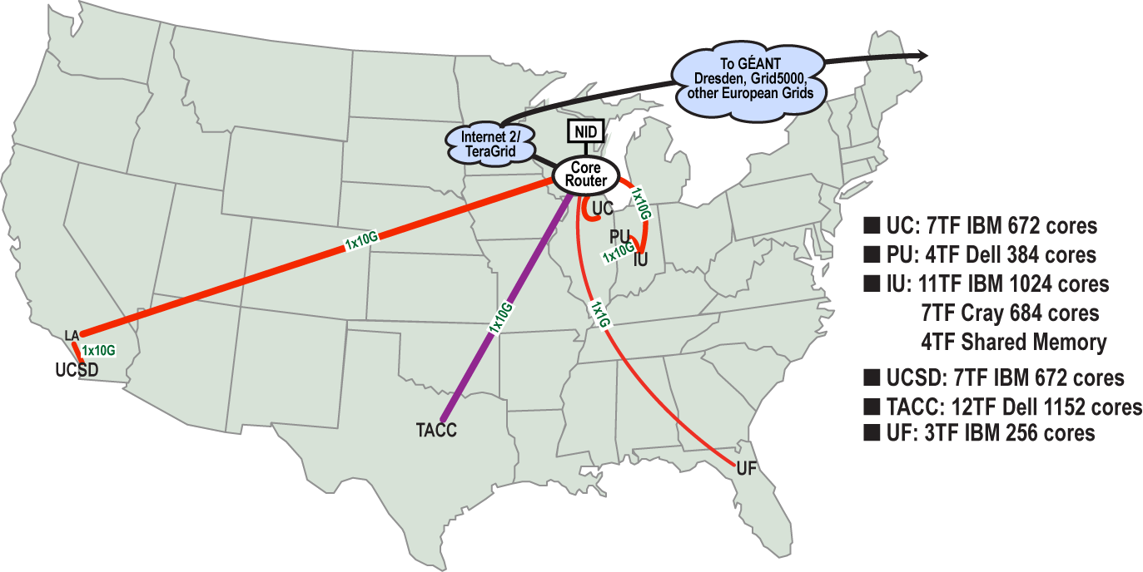
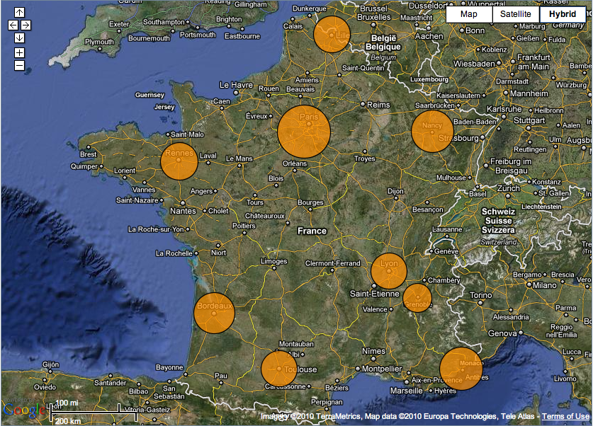

Sky Computing
Work by Pierre Riteau et al,
University of Rennes 1
Sky Computing = a Federation of Clouds
Approach:
  Combine resources obtained in multiple Nimbus clouds in FutureGrid and Grid’ 5000
  Combine Context Broker, ViNe, fast image deployment
  Deployed a virtual cluster of over 1000 cores on Grid5000 and FutureGrid – largest ever of this type
Grid’5000 Large Scale Deployment Challenge award
Demonstrated at OGF 29 06/10
TeraGrid ’10 poster
  More at: www.isgtw.org/?pid=1002832
  “Sky Computing”
  IEEE Internet Computing, September 2009
Notes:
An area that attracted a lot of attention lately is how to do computing on several different clouds – it is important to implement escalation from private to community to public clouds but also as a risk-mitigation strategy: one privider might go out of buisness, raise prices, become unreliable, etc.
What do you have when you work with many clouds – a sky of clouds! We had a paper on this with Jose Fortes in IEEE Internet computing defining the challenges and proposing the model.
A student from U of Rennes (our Grid5K collaborators), Pierre Riteau, wanted to experiment with multiple gegraphically distributed clouds. He combined resources from 6 clouds: 3 in FG and 3 in G5K which is a french experimental testbed similar to FG. He used Nimbus context broker for contextualization and ViNE for creating network overlays between the resources. He ended up creating a virtual cluster of over 1000 cores, the largest of this type (distributed) at that time and ran bioinformatics applications over it. He won awards and had articles about him published but most of all he managed to experiment with his project which was in optimizing VM deployment.
This is a good example of an experiment that can be carried out over the distributed clouds supported on FG; for widely distributed experiments we can arrange partnership with Grid’5000.

Slide 27
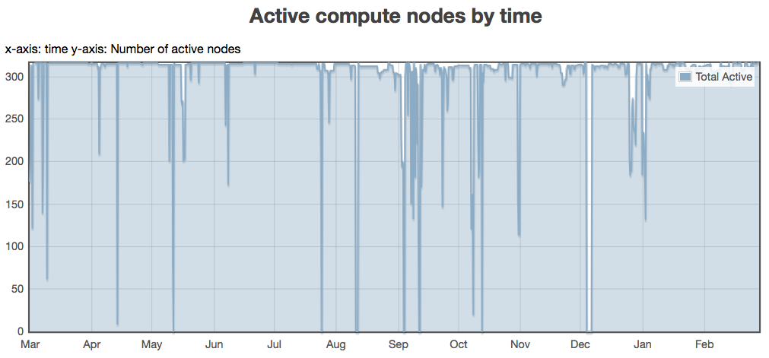
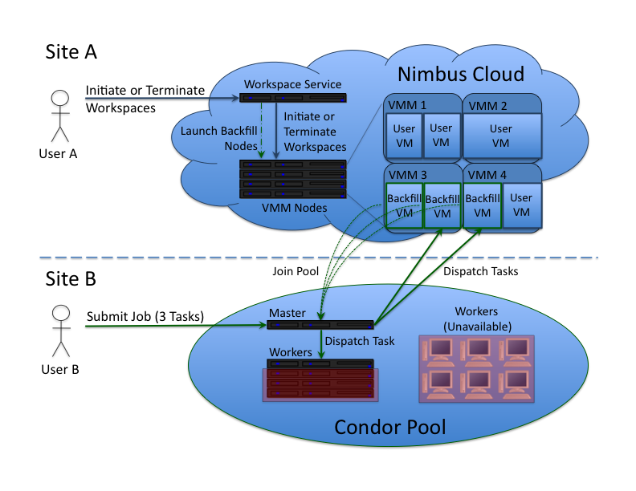
Backfill: Lower the Cost of Your Cloud
1 March 2010 through 28 February 2011
Challenge: utilization, catch-22 of on-demand computing
Solution: new instances
  Backfill
Bottom line: up to 100% utilization
Who decides what backfill VMs run?
Spot pricing
Open Source community contribution
Preparing for running of production workloads on FG @ U Chicago
Nimbus release 2.7
Paper @ CCGrid 2011
94%
78%
62%
47%
31%
16%
Notes:
Cloud computing users think on-demand availability is the best thing since sliced bread: it enables elastic computing, outsourcing for applications requiring urgent or interactive response, and reduces wait times in batch queues. But if you are a cloud provider you might not think so… In order to ensure on-demand availability you need to overprovision: keep a lot of nodes idle so that they can be used to service an on-demand request, which could come at any time. This means low utilization. The only way to improve it is to keep fewer nodes idle. But this means rejecting more requests – at which point you’re not really on-demand… a catch-22.
Low utilization is particularly hard to swallow in the scientific community where utilization rates are high – why configure a cloud if the good old batch scheduler will amortize your resource so much better? The gray graph represents the utilization of the Fusion cluster at Argonne – nearly 100%!
This problem gave us an idea. What if we deployed a VM on every idle cloud node and joined it to something that is used to operating in an environment where resources are coming and going, something that makes use of screensaver time on people’s desktops, something like SETI@home or a Condor pool? We went to work and extended Nimbus so that an administrator can configure a “backfill VM” that gets deployed on cloud nodes by default. When an on-demand request comes in, enough backfill VMs get terminated to service the request; when the on-demand request finishes, the backfill VMs get deployed again. Amazon’s spot pricing solution is very similar but in addition to providing backfill VMs they also allow users to “bid” on VMs in an auction – so we implemented both backfill and spot pricing.
For the user, this solution means that they can now choose from two types of instances: on-demand instances — what you get from a typical EC2-style cloud — and opportunistic instances – a pre-configured VM joining a volunteer computing pool. To find out what this means for the provider, Paul Marshall ran some experiments with backfill VMs configured to join a Condor pool and came up with the graphs on the right: a purely on-demand cloud is cold – add backfill VMs and the system heats up… you can get 100% utilization! More details in Paul’s CCGrid paper.
Nimbus is the only open source IaaS implementation that provides those features.

Slide 28

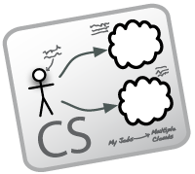


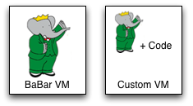
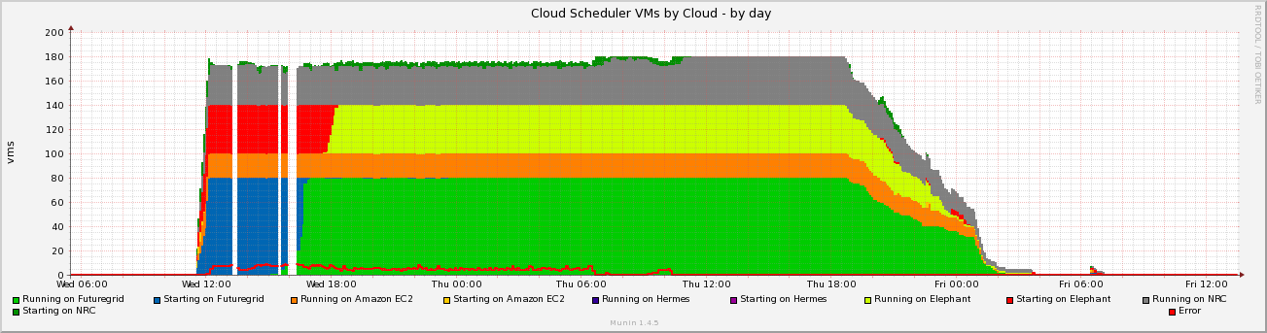
Work by the UVIC team
Canadian Efforts
BarBar Experiment at SLAC in Stanford, CA
Using clouds to simulating electron-positron collisions in their detector
Exploring virtualization as a vehicle for data preservation
Approach:
  Appliance preparation and management
  Distributed Nimbus clouds
  Cloud Scheduler
Running production BaBar workloads
Notes:
The name BaBar actually derives from the B/B-bar subatomic particles produced at SLAC during electron-positron collisions. These experiments help us achieve a better understanding of the relationship between matter and anti-matter and ultimately answer questions about the nature of the universe. This groundbreaking research is moving forward at a brisk pace: the BaBar scientists have petabytes of data, a plethora of insight, and a recent Nobel prize to show for it.
Sifting through petabytes of data requires petaflops of computation. And here the BaBar scientists faced what is a common problem in science — the software required to process the data is complex: hard to maintain, impossible to rewrite. To illustrate: we are talking about roughly 9 million lines of C++ and Fortran code developed by hundreds of scientists spread across 75 institutions in 10 different countries… Such software requires significant effort to port to new platforms and operating systems. This, in practice, limits the scientists’ access to resources since it takes a lot of effort to port the code to e.g., a new grid site. And this is also where cloud computing comes in.
The UVIC team’s idea was to put BaBar software on virtual machine (VM) images that could be run on any Infrastructure-as-a-Service (IaaS) cloud. They configured a base image which could be customized to support specific BaBar applications – this smoothed the way for the scientists to try cloud computing because it took the time-consuming configuration step out of the equation.
Running BaBar in the clouds was so successful that the demand soon outstripped the capabilities of the Nimbus cloud at UVIC (named “Elephant” ;-) . For this reason, the UVIC team decided to provision additional cloud resources from other clouds and this is where FutureGrid comes in along with a few other commercial and academic cycles.
But another problem then arose: how can you present resources provisioned over distributed clouds to the users in a uniform fashion? Rather than sending people from cloud to cloud shopping for cycles, the UVIC team automated the process. They did so via an infrastructure called the Cloud Scheduler – a combination of cloud provisioning and the Condor scheduler typically used to submit BaBar jobs. Cloud Scheduler works roughly like this: a user submits a job to a Condor queue (as always) and the Cloud Scheduler monitors the queue. Then, if there are jobs in the queue Cloud Scheduler stands up VMs on the various available clouds and makes them available to the Condor installation; if there are no jobs in the queue, the VMs are terminated. With the aid of this infrastructure, BaBar computations have been happily churning away on the distributed clouds demonstrating how the provisioning issues in a distributed environments can be effectively overcome.
The BaBar system has been running in production for over a year now and constitutes a proof of concept to the community that computation in the cloud can be successfully extended from private to community (such as FutureGrid) to eventually commercial clouds.

Slide 29
The Nimbus Team
Project lead: Kate Keahey, ANL&UC
Committers:
  Tim Freeman - University of Chicago
  Ian Gable - University of Victoria
  David LaBissoniere - University of Chicago
  John Bresnahan - Argonne National Laboratory
  Patrick Armstrong - University of Victoria
  Pierre Riteau - University of Rennes 1, IRISA
Github Contributors:
  Tim Freeman, David LaBissoniere, John Bresnahan, Pierre Riteau, Alex Clemesha, Paulo Gomez, Patrick Armstrong, Matt Vliet, Ian Gable, Paul Marshall, Adam Bishop
And many others
  See http://www.nimbusproject.org/about/people/
Notes:
In the background is an “impact graph” from github which is our repository – each ribbon represents one person contributing to code – you can see 10+ contributors overall with onely 3 people working on Nimbus at UC – others are the open source community driving the Nimbus development.

Slide 30
Parting Thoughts
Many challenges left in exploring infrastructure clouds
FutureGrid offers an instrument that allows you to explore them:
  Multiple distributed clouds
  The opportunity to experiment with cloud software
  Paradigm exploration for domain sciences
Nimbus provides tools to explore them
Come and work with us on FutureGrid!

Slide 31

www.nimbusproject.com
Let’s make cloud computing for science happen.

Slide 32
OpenStack
Why OpenStack?
  Users want to avoid being locked into a single solution.
  Has large backing by many industrial partners with contributing efforts (more than 60 companies)
  Is open source
  Provides flexibility in deployment

Slide 33
What is OpenStack?
Originated at NASA to provide a compute cloud infrastructure
Contains currently three subprojects
  OpenStack Compute (VM & Networks)
  OpenStack Image Service (Image Management)
  OpenStack Object Store (Storage)
Supports multiple hypervisors
  Xen, KVM, ESXi, Hyper-V

Slide 34
OpenStack Plans on FG
Currently we are installing OpenStack on FG and have test instances running
It will be available to the general users before the end of the year.
Also expect to have a professional version of Eucalyptus
Currently Nimbus best supported VM manager on FutureGrid

Slide 35
Virtual Appliances on FutureGrid
Renato Figueiredo (University of Florida)
renato@acis.ufl.edu

Slide 36
Overview
Traditional ways of delivering hands-on training and education in parallel/distributed computing have non-trivial dependences on the environment
    Difficult to replicate same environment on different resources (e.g. HPC clusters, desktops)
    Difficult to cope with changes in the environment (e.g. software upgrades)
Virtualization technologies remove key software dependences through a layer of indirection
Notes:
The key point to be made in this and the next slide is that FutureGrid provides a platform that allows self-contained executable education modules to be created, packages, shared and deployed without software dependences on the hosting environment

Slide 37
Overview
FutureGrid enables new approaches to education and training and opportunities to engage in outreach
  Cloud, virtualization and dynamic provisioning – environment can adapt to the user, rather than expect user to adapt to the environment
  Availability of plentiful resources to run appliances, the ability for users to create and share appliances, and the variety of VM management systems,
Leverage unique capabilities of the infrastructure:
  Reduce barriers to entry and engage new users
  Use of encapsulated environments (“appliances”) as a primary delivery mechanism of education/training modules – promoting reuse, replication, and sharing
  Hands-on tutorials on introductory, intermediate, and advanced topics

Slide 38
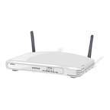

What is an appliance?
Hardware/software appliances
  TV receiver + computer + hard disk + Linux + user interface
  Computer + network interfaces + FreeBSD + user interface
Notes:
To introduce the idea of what is an appliance, an analogy that can be made is a TiVo “cable box” or a wireless routers – these build upon a general-purpose O/S such as Linux or BSD, and integrate hardware and software that specialize it to a particular function. Users are then able to use these appliances without having to worry about the internals of their configuration.

Slide 39
What is a virtual appliance?
An appliance that packages software and configuration needed for a particular purpose into a virtual machine “image”
The virtual appliance has no hardware – just software and configuration
The image is a (big) file
It can be instantiated on hardware
Notes:
A virtual appliance has an analogous goal – to provide users with a self-contained environment that is configured, tested, and integrated to provide a particular function. Virtualization technology enables them to be packaged conveniently in an image format that can be deployed on a variety of resources – the only dependence that need to be met is the availability of a compatible virtual machine monitor in the resource. Once instantiated, an appliance is isolated from other appliances - resource consolidation.

Slide 40
Educational virtual appliances
A flexible, extensible platform for hands-on, lab-oriented education on FutureGrid
Support clustering of resources
  Virtual machines + social/virtual networking to create sandboxed modules
    Virtual “Grid” appliances: self-contained, pre-packaged execution environments
    Group VPNs: simple management of virtual clusters by students and educators
Notes:
Virtual appliances have several applications (e.g. plug-and-play firewalls, databases, web servers, etc). In the context of grid/hpc/cloud, appliances can be developed with the specific goal of creating a realistic, reproducible execution environment for hands-on activities. However, for most cases, a single appliance is not sufficient, and you need a cluster – so it’s necessary to network the appliances together. In FutureGrid, we use virtual networks for that, and the virtual networks can be created and managed by users using a group abstraction – resources from users belonging to the group “join” a private VPN of appliances and participate in the virtual cluster.

Slide 41

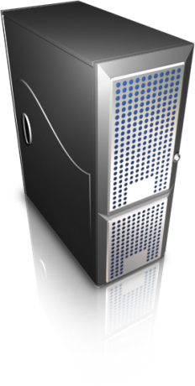
Virtual appliance clusters
Same image, different VPNs
Hadoop
+
Virtual
Network
Group
VPN
A Hadoop worker
Another Hadoop worker
instantiate
Virtual
machine
copy
GroupVPN
Credentials
Repeat…
Virtual IP - DHCP
10.10.1.1
Virtual IP - DHCP
10.10.1.2
Notes:
This slide animates the process of creating a virtual cluster, e.g. running Hadoop.
First step is to create an image, which has all the software/middleware needed to run Hadoop (e.g. Linux, Java, Hadoop jar files) as well as the middleware used for configuration of a Hadoop system (e.g. a system to discover which nodes are in the cluster, scripts to setup a data node and name node, etc).
In addition to the baseline image (which is the same for any userusing the Hadoop appliance), some per-cluster configuration is added to each instance – e.g. by attaching a virtual CD-ROM/floppy image to the virtual appliance when it boots. This configuration is needed to allow the appliances to join a given groupVPN cluster.
Once the image is deployed on target resources – e.g. FutureGrid, other cloud providers, a private cloud – they auto-configure to join the configured GroupVPN – as if they were connected to the same LAN.
FutureGrid users can build upon appliance and groupVPN technologies to reuse existing appliances for key middleware stacks (e.g. Condor, MPI, Hadoop), as well as create and share their own.

Slide 42
Tutorials - examples
http://portal.futuregrid.org/tutorials
Introduction to FG IaaS Cloud resources
  Nimbus and Eucalyptus
  Within minutes, deploy a virtual machine on FG resources and log into it interactively
  Using OpenStack – nested virtualization, a sandbox IaaS environment within Nimbus
Introduction to FG HPC resources
  Job scheduling, Torque, MPI
Introduction to Map/Reduce frameworks
  Using virtual machines with Hadoop, Twister
  Deploying on physical machines/HPC (MyHadoop)

Slide 43
Virtual appliance – tutorials
Deploying a single appliance
  Nimbus, Eucalyptus, or user’s own desktop
    VMware, Virtualbox
  Automatically connects to a shared “playground” resource pool with other appliances
  Can execute Condor, MPI, and Hadoop tasks
Deploying private virtual clusters
  Separate IP address space – e.g. for a class, or student group
Customizing appliances for your own activity
Notes:
This overviews what specific tutorials are out there if the people in your tutorial would like to give them a try on FutureGrid.

Slide 44
Virtual appliance 101
cloud-client.sh --conf alamo.conf --run --name grid-appliance-2.04.29.gz --hours 24
ssh root@129.114.x.y
su griduser
cd ~/examples/montepi
gcc montepi.c -o montepi -lm -m32
condor_submit submit_montepi_vanilla
condor_status, condor_q
Notes:
This is to highlight that from a user’s perspective, once you have a FG account, it takes only a few steps to get an appliance running, e.g. through Nimbus. The single command in the first bullet gets it running. The second command logs you into it, once it’s up and running. The following commands compile and submit 100 jobs to a small ‘playground’ condor pool running at UF.

Slide 45
Dynamic Provisioning & RAIN on FutureGrid
Technology Preview
Gregor von Laszewski
http://futuregrid.org

Slide 46
Classical Dynamic Provisioning
Technology Preview
  Dynamically
    partition a set of resources
    allocate the resources to users
    define the environment that the resource use
    assign them based on user request
  Deallocate the resources so they can be dynamically allocated again
http://futuregrid.org

Slide 47
Use Cases of Dynamic Provisioning
Technology Preview
  Static provisioning:
    Resources in a cluster may be statically reassigned based on the anticipated user requirements, part of an HPC or cloud service. It is still dynamic, but control is with the administrator. (Note some call this also dynamic provisioning.)
  Automatic Dynamic provisioning:
    Replace the administrator with intelligent scheduler.
  Queue-based dynamic provisioning:
    provisioning of images is time consuming, group jobs using a similar environment and reuse the image. User just sees queue.
  Deployment:
    dynamic provisioning features are provided by a combination of using XCAT and Moab
http://futuregrid.org

Slide 48
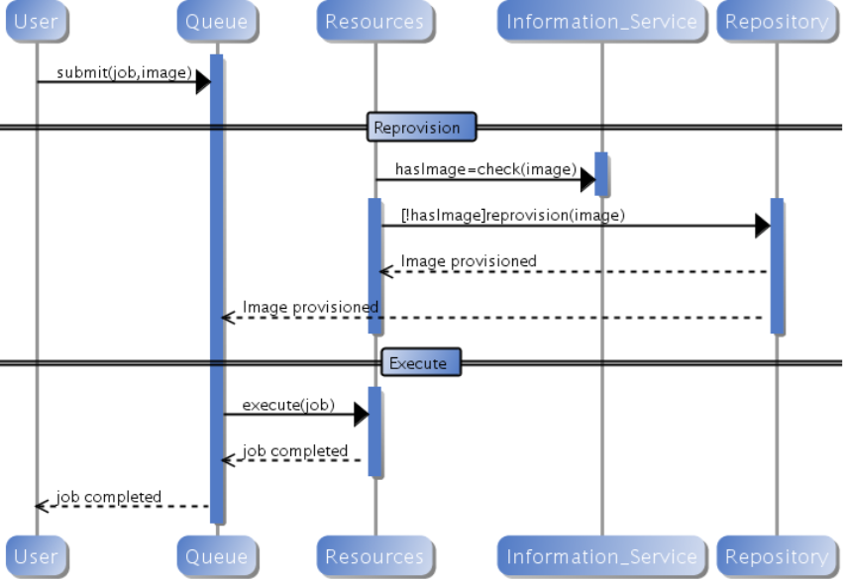
Generic Reprovisioning
Technology Preview
http://futuregrid.org

Slide 49
Dynamic Provisioning Examples
Technology Preview
  Give me a virtual cluster with 30 nodes based on Xen
  Give me 15 KVM nodes each in Chicago and Texas linked to Azure and Grid5000
  Give me a Eucalyptus environment with 10 nodes
  Give 32 MPI nodes running on first Linux and then Windows
  Give me a Hadoop environment with 160 nodes
  Give me a 1000 BLAST instances linked to Grid5000
  Run my application on Hadoop, Dryad, Amazon and Azure … and compare the performance
http://futuregrid.org

Slide 50
From Dynamic Provisioning to “RAIN”
Technology Preview
  In FG dynamic provisioning goes beyond the services offered by common scheduling tools that provide such features.
    Dynamic provisioning in FutureGrid means more than just providing an image
    adapts the image at runtime and provides besides IaaS, both PaaS and SaaS
    We call this “raining” an environment
  Rain = Runtime Adaptable INsertion Configurator
    Users want to ``rain'' an HPC, a Cloud environment, or a virtual network onto our resources with little effort.
    Command line tools supporting this task.
    Integrated into Portal
  Example ``rain'' a Hadoop environment defined by a user on a cluster.
    fg-hadoop -n 8 -app myHadoopApp.jar …
    Users and administrators do not have to set up the Hadoop environment as it is being done for them
http://futuregrid.org

Slide 51
FG RAIN Commands
Technology Preview
  fg-rain –h hostfile –iaas nimbus –image img
  fg-rain –h hostfile –paas hadoop …
  fg-rain –h hostfile –paas dryad …
  fg-rain –h hostfile –gaas gLite …
  fg-rain –h hostfile –image img
  fg-rain –virtual-cluster -16 nodes -2 core
  Additional Authorization is required to use fg-rain without virtualization.
http://futuregrid.org

Slide 52
Rain in FutureGrid
Technology Preview
http://futuregrid.org

Slide 53
Image Generation and Management on FutureGrid
Javier Diaz
Gregor von Laszewski
http://futuregrid.org

Slide 54
FG Image Repository I
Service to query, store, and update images through a unique and common interface
  Can distinguish image types for different purposes (IaaS, HPC…)
Maintains data related with the usage to assist performance monitoring and accounting
Special features
  Users can request images that fulfill their requirements. If there is not such image in the repository, it can be generated
  Store basic images and the description of how to generate new ones

Slide 55
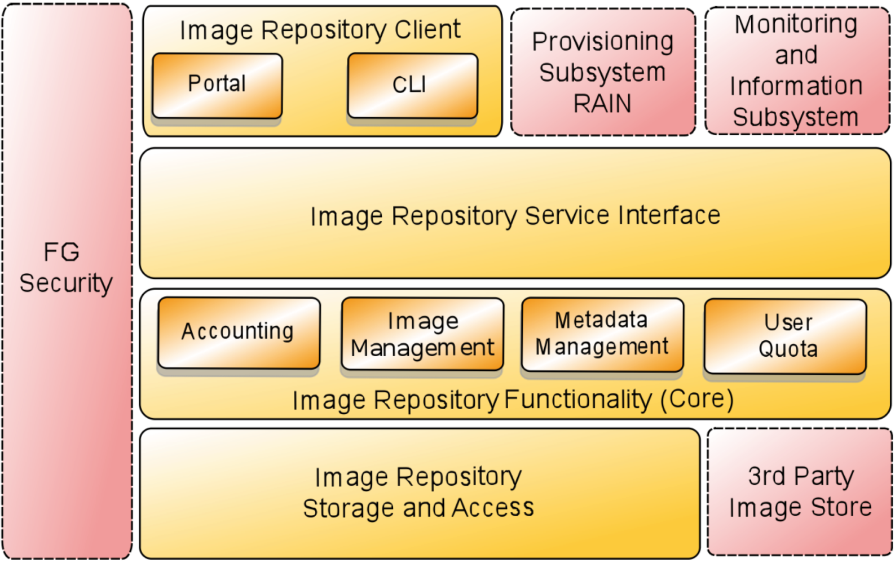
FG Image Repository II

Slide 56
Management Motivation
  The goal is to create and maintain platforms in custom FG VMs that can be retrieved, deployed, and provisioned on demand.
  A unified Image Management system to create and maintain VM and bare-metal images.
  Integrate images through a repository to instantiate services on demand with RAIN.
  Essentially enables the rapid development and deployment of Platform services on FutureGrid infrastructure.
http://futuregrid.org
http://futuregrid.org

Slide 57
What happens internally?
Technology Preview
Generate a Centos image with several packages
  fg-image-generate –o centos –v 5.6 –a x86_64 –s emacs, openmpi –u javi
  > returns image: centosjavi3058834494.tgz
Deploy the image for HPC (xCAT)
  ./fg-image-register -x im1r –m india -s india -t /N/scratch/ -i centosjavi3058834494.tgz -u jdiaz
Submit a job with that image
  qsub -l os=centosjavi3058834494 testjob.sh

Slide 58
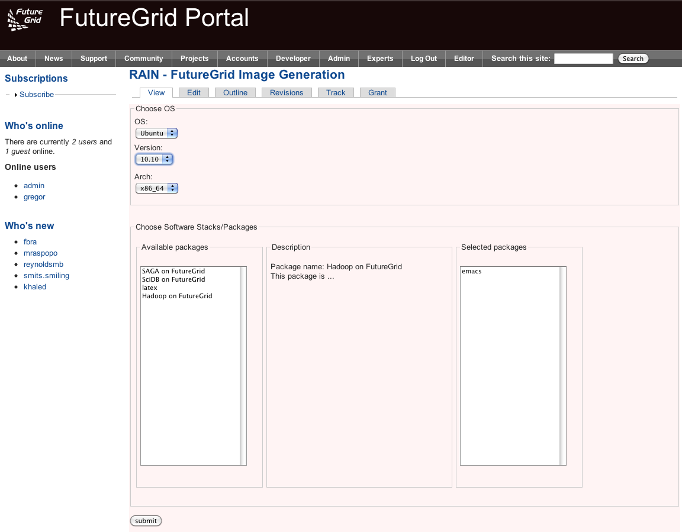

Slide 59
Image Generation
  Users who want to create a new FG image specify the following:
    OS type
    OS version
    Architecture
    Kernel
    Software Packages
  Image is generated, then deployed to specified target.
  Deployed image gets continuously scanned, verified, and updated.
  Images are now available for use on the target deployed system.
http://futuregrid.org

Slide 60
Deployment View
http://futuregrid.org
http://futuregrid.org

Slide 61
Implementation
Image Generator
  alpha available for authorized users
  Allows generation of Debian & Ubuntu, YUM for RHEL5, CentOS, & Fedora images.
  Simple CLI
  Later incorporate a web service to support the FG Portal.
  Deployment to Eucalyptus & Bare metal now, Nimbus and others later.
  Image Management
    Currently operating with an experimental BCFG2 server.
    Image Generator auto-creates new user groups for software stacks.
    Supporting RedHat and Ubuntu repo mirrors.
    Scalability experiments of BCFG2 to be tested, but previous work shows scalability to thousands of VMs without problems
http://futuregrid.org
Notes:
(Yahoo!)

Slide 62
Interoperability
Andrew Grimshaw

Slide 63
Interfacing with OGF
Deployments
  Genesis II
  Unicore
  Globus
  SAGA
Some thoughts
  How can FG get OCCI from a community effort?
  Is FG useful for OGF community?
  What other features are desired for OGF community?

Slide 64
Current Efforts
Interoperability
Domain Sciences – Applications
Computer Science
Computer system testing and evaluation

Slide 65
Grid interoperability testing
Requirements
Usecases
Provide a persistent set of standards-compliant implementations of grid services that clients can test against
Provide a place where grid application developers can experiment with different standard grid middleware stacks without needing to become experts in installation and configuration
Job management (OGSA-BES/JSDL, HPC-Basic Profile, HPC File Staging Extensions, JSDL Parameter Sweep, JSDL SPMD, PSDL Posix)
Resource Name-space Service (RNS), Byte-IO
Interoperability tests/demonstrations between different middleware stacks
Development of client application tools (e.g., SAGA) that require configured, operational backends
Develop new grid applications and test the suitability of different implementations in terms of both functional and non-functional characteristics

Slide 66
Implementation
Deployment
UNICORE 6
  OGSA-BES, JSDL (Posix, SPMD)
  HPC Basic Profile, HPC File Staging
Genesis II
  OGSA-BES, JSDL (Posix, SPMD, parameter sweep)
  HPC Basic Profile, HPC File Staging
  RNS, ByteIO
EGEE/g-lite
SMOA
  OGSA-BES, JSDL (Posix, SPMD)
  HPC Basic Profile
UNICORE 6
  Xray
  Sierra
  India
Genesis II
  Xray
  Sierra
  India
  Eucalyptus (India, Sierra)

Slide 67
Domain Sciences
Requirements
Usecases
Provide a place where grid application developers can experiment with different standard grid middleware stacks without needing to become experts in installation and configuration
Develop new grid applications and test the suitability of different implementations in terms of both functional and non-functional characteristics

Slide 68
Applications
Global Sensitivity Analysis in Non-premixed Counterflow Flames
A 3D Parallel Adaptive Mesh Renement Method for Fluid Structure Interaction: A Computational Tool for the Analysis of a Bio-Inspired Autonomous Underwater Vehicle
Design space exploration with the M5 simulator
Ecotype Simulation of Microbial Metagenomes
Genetic Analysis of Metapopulation Processes in the Silene-Microbotryum Host-Pathogen System
Hunting the Higgs with Matrix Element Methods
Identification of eukaryotic genes derived from mitochondria using evolutionary analysis
Identifying key genetic interactions in Type II diabetes
Using Molecular Simulations to Calculate Free Energy

Slide 69
Test-bed
Use as an experimental facility
Cloud bursting work
  Eucalyptus
  Amazon
Replicated files & directories
Automatic application configuration and deployment

Slide 70
Grid Test-bed
Requirements
Usecases
Systems of sufficient scale to test realistically
Sufficient bandwidth to stress communication layer
Non-production environment so production users not impacted when a component fails under test
Multiple sites, with high latency and bandwidth
Cloud interface without bandwidth or CPU charges
XSEDE testing
  XSEDE architecture is based on same standards, same mechanisms used here will be used for XSEDE testing
Quality attribute testing, particularly under load and at extremes.
  Load (e.g., job rate, number of jobs i/o rate)
  Performance
  Availability
New application execution
  Resources to entice
New platforms (e.g., Cray, Cloud)

Slide 71
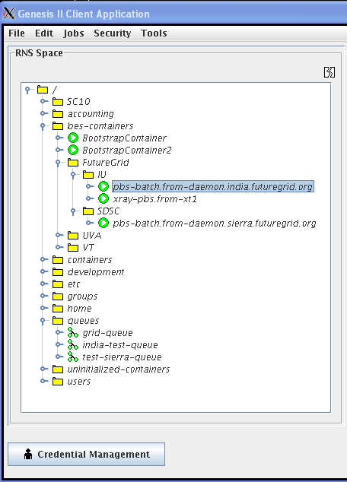
Extend XCG onto FutureGrid
(XCG- Cross Campus Grid)
Design
Image
Genesis II containers on head nodes of compute resources
Test queues that send the containers jobs
Test scripts that generate thousands of jobs, jobs with significant I/O demands
Logging tools to capture errors and root cause
Custom OGSA-BES container that understands EC2 cloud interface, and “cloud-bursts”

Slide 72
Getting Access to FutureGrid
Gregor von Laszewski

Slide 73
Portal Account,
Projects, and System Accounts
The main entry point to get access to the systems and services is the FutureGrid Portal.
We distinguish the portal account from system and service accounts.
  You may have multiple system accounts and may have to apply for them separately, e.g. Eucalyptus, Nimbus
  Why several accounts:
    Some services may not be important for you, so you will not need an account for all of them.
      In future we may change this and have only one application step for all system services.
    Some services may not be easily integratable in a general authentication framework

Slide 74
Get access
Project Lead
Project Member
Create a portal account
Create a project
Add project members
Create a portal account
Ask your project lead to add you to the project
Once the project you participate in is approved
Apply for an HPC & Nimbus account
  You will need an ssh key
Apply for a Eucalyptus Account

Slide 75
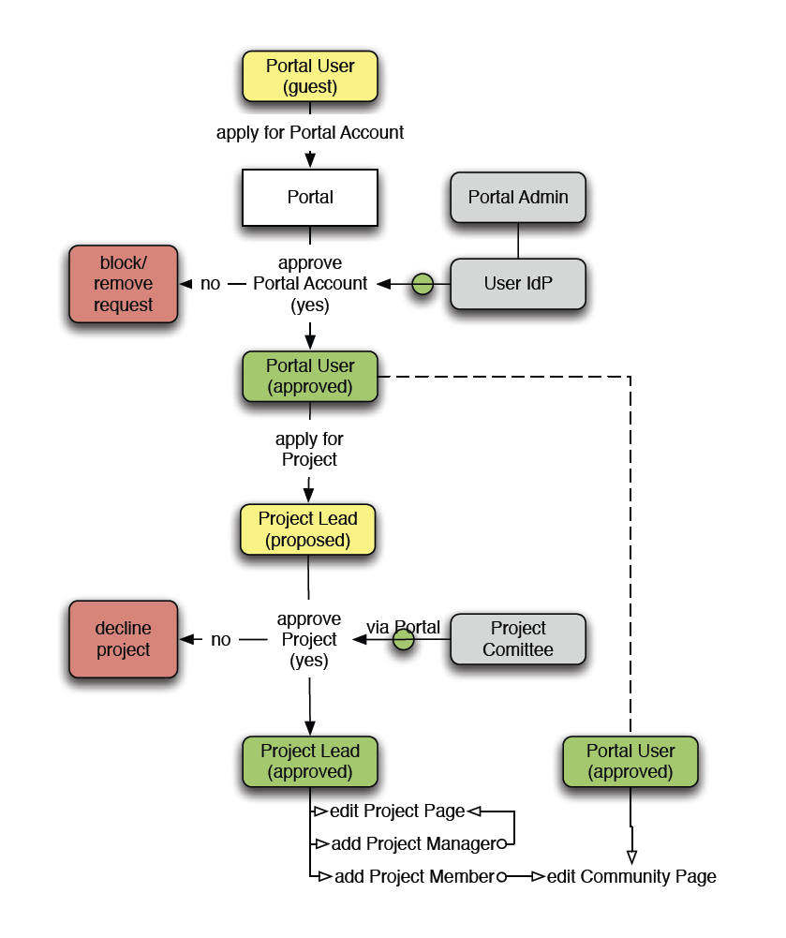
The Process: A new Project
(1) get a portal account
  portal account is approved
(2) propose a project
  project is approved
(3) ask your partners for their portal account names and add them to your projects as members
  No further approval needed
(4) if you need an additional person being able to add members designate him as project manager (currently there can only be one).
  No further approval needed
You are in charge who is added or not!
  Similar model as in Web 2.0 Cloud services, e.g. sourceforge
(1)
(2)
(4)
(3)

Slide 76
The Process: Join A Project
(1) get a portal account
  portal account is approved
Skip steps (2) – (4)
(2u) Communicate with your project lead which project to join and give him your portal account name
Next step done by project lead
  (3) The project lead will add you to the project
You are responsible to make sure the project lead adds you!
  Similar model as in Web 2.0 Cloud services, e.g. sourceforge
(1)
(2u)
(3)

Slide 77
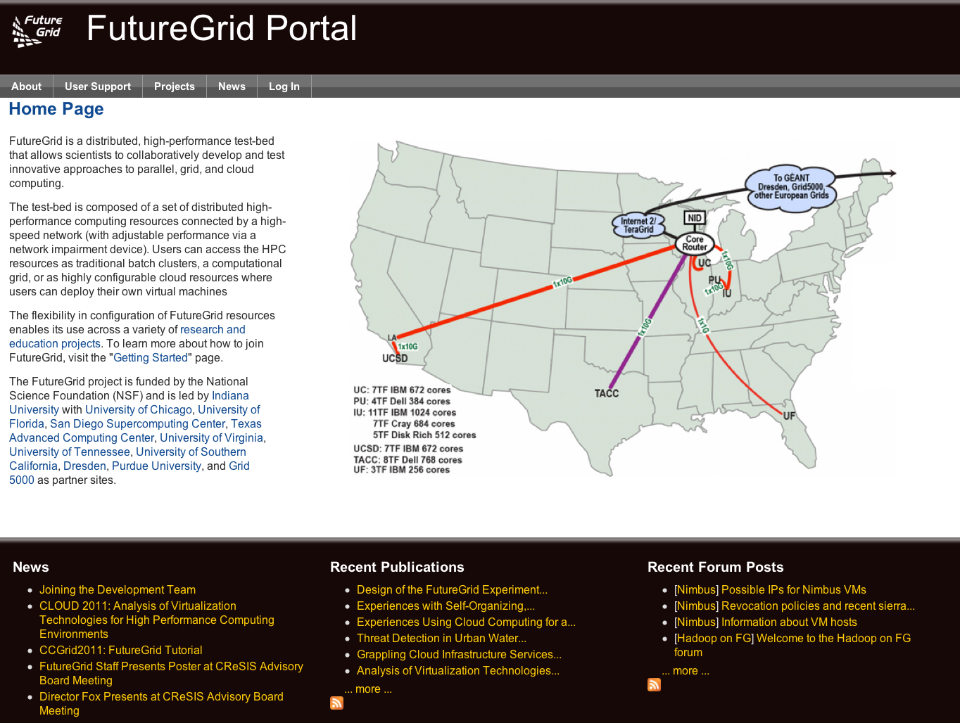
Apply for a Portal Account

Slide 78
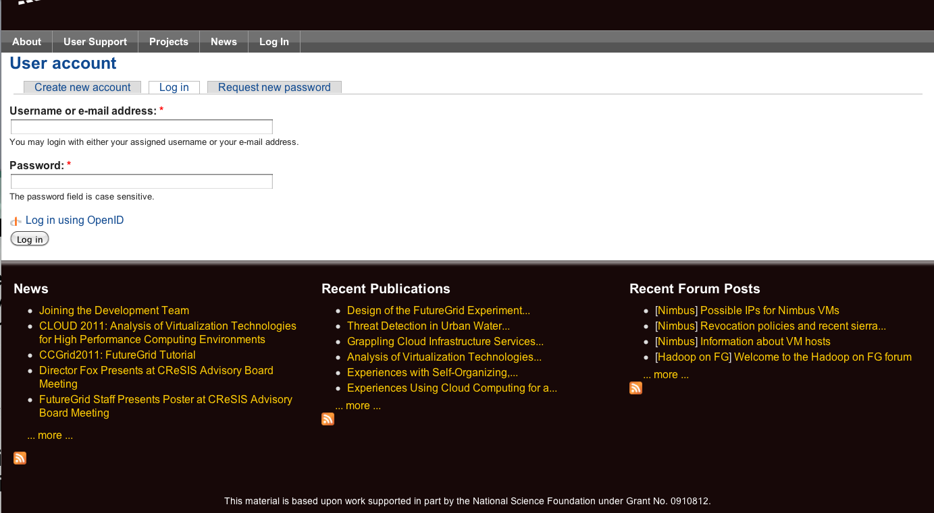
Apply for a Portal Account

Slide 79
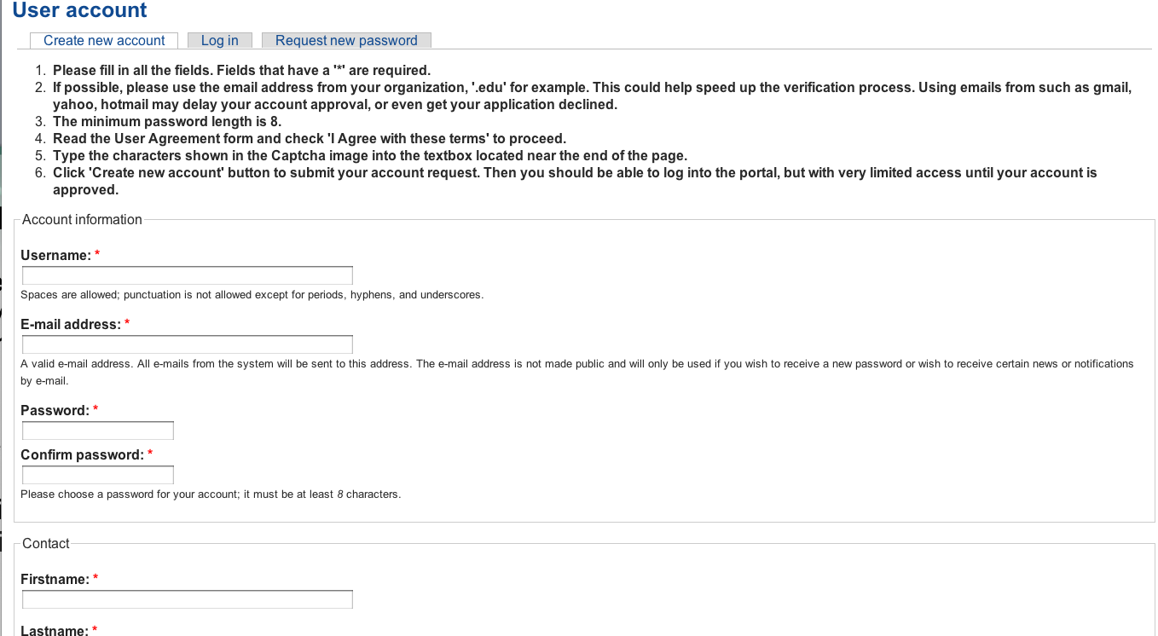
Apply for a Portal Account
Please Fill Out.
Use proper capitalization
Use e-mail from your organization
(yahoo,gmail, hotmail, … emails may result in rejection of your account request)
Chose a strong password

Slide 80
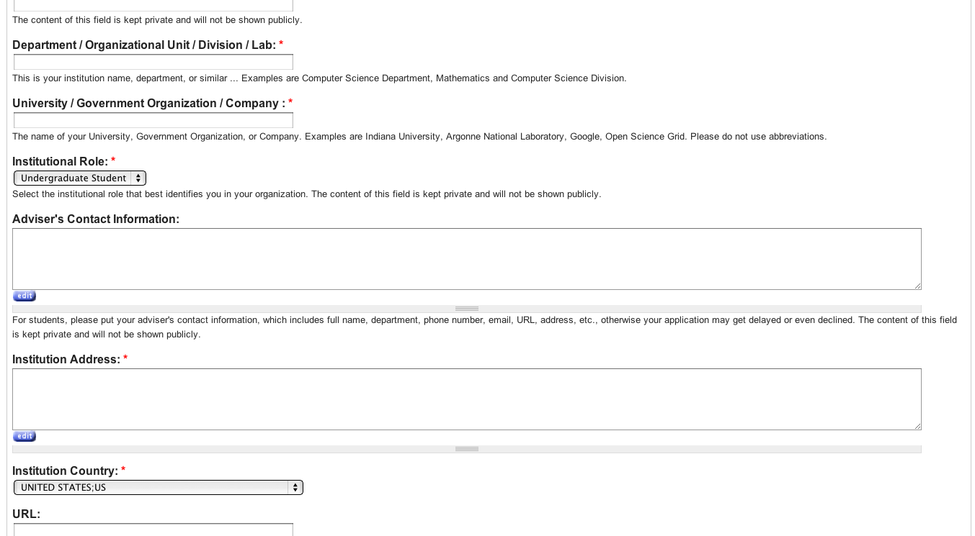
Apply for a Portal Account
Please Fill Out.
Use proper department and university
Specify advisor or supervisors contact
Use the postal address, use proper capitalization

Slide 81
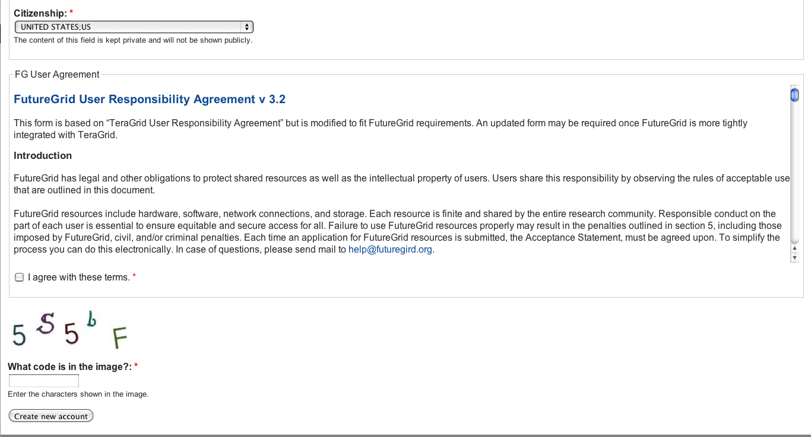
Apply for a Portal Account
Please Fill Out.
Report your citizenship
READ THE RESPONSIBILITY AGREEMENT
AGREE IF YOU DO. IF NOT CONTACT FG.
You may not be able to use it.

Slide 82
Wait
Wait till you get notified that you have a portal account.
Now you have a portal account (cont.)

Slide 83
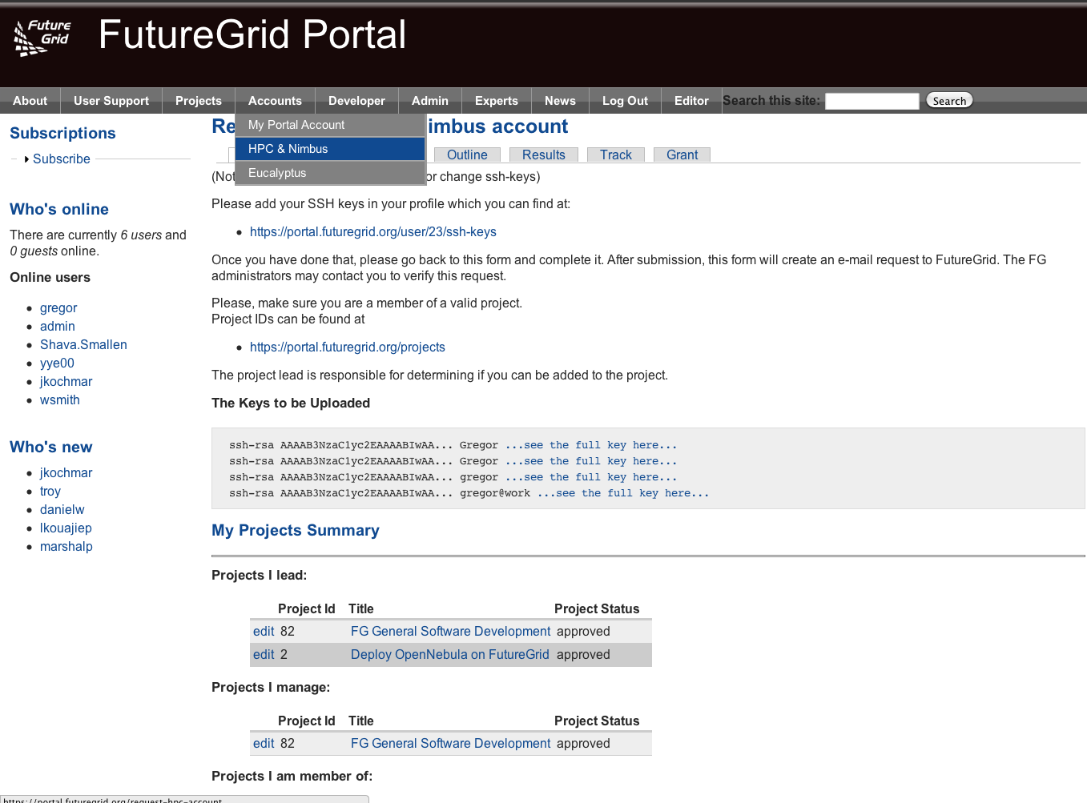
Apply for an HPC and Nimbus account
Login into the portal
Simple go to
  Accounts->
  HPC&Nimbus
(1) add you ssh keys
(3) make sure you are in a
valid project
(2) wait for up to 3 business days
  No accounts will be granted on
  Weekends
  Friday 5pm EST – Monday 9 am EST

Slide 84
Generating an SSH key pair
  For Mac or Linux users
    ssh-keygen –t rsa –C yourname@hostname
    Copy the contents of ~/.ssh/id_rsa.pub to the web form
  For Windows users, this is more difficult
    Download putty.exe and puttygen.exe
    Puttygen is used to generate an SSH key pair
      Run puttygen and click “Generate”
    The public portion of your key is in the box labeled “SSH key for pasting into OpenSSH authorized_keys file”
http://futuregrid.org
Notes:
-c comment

Slide 85
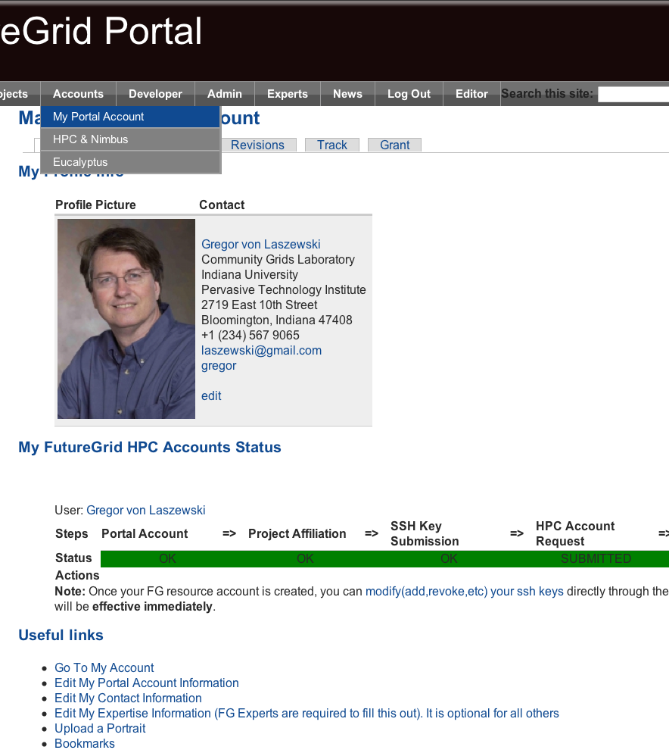
Check your Account Status
Goto:
  Accounts-My Portal Account
Check if the account status bar is green
  Errors will indicate an issue or a task that requires waiting
Since you are already here:
  Upload a portrait
  Check if you have other things that need updating
  Add ssh keys if needed

Slide 86
Eucalyptus Account Creation
  YOU MUST BE IN A VALID FG PROJECT OR YOUR REQUEST GETS DENIED
  Use the Eucalyptus Web Interfaces at
  https://eucalyptus.india.futuregrid.org:8443/
  On the Login page click on Apply for account.
  On the next page that pops up fill out ALL the Mandatory AND optional fields of the form.
  Once complete click on signup and the Eucalyptus administrator will be notified of the account request.
  You will get an email once the account has been approved.
  Click on the link provided in the email to confirm and complete the account creation process
http://futuregrid.org

Slide 87
Portal
Gregor von Laszewski
http://futuregrid.org

Slide 88
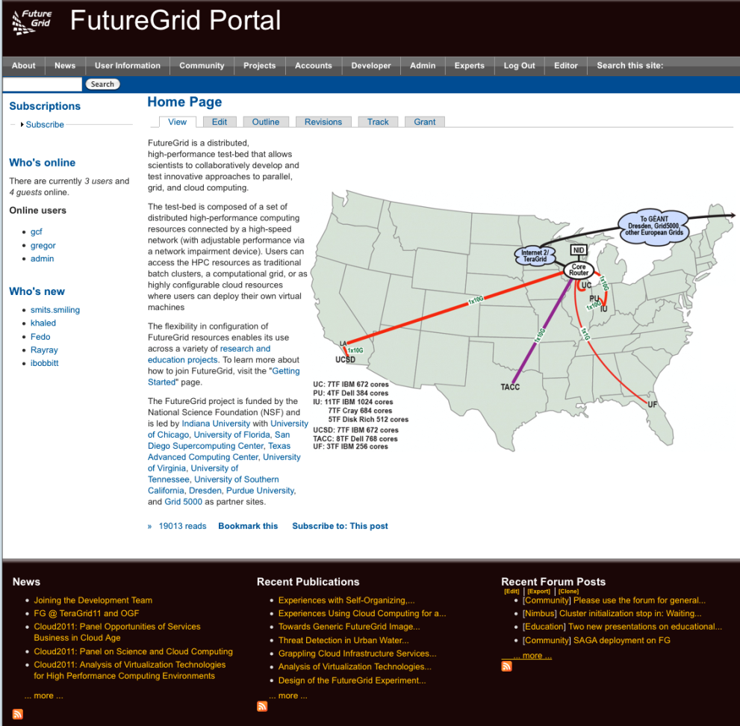
FG Portal
Coordination of Projects and users
  Project management
    Membership
    Results
  User Management
    Contact Information
    Keys, OpenID
Coordination of Information
  Manuals, tutorials, FAQ, Help
  Status
    Resources, outages, usage, …
Coordination of the Community
  Information exchange: Forum, comments, community pages
  Feedback: rating, polls
Focus on support of additional FG processes through the Portal

Slide 89
Portal Subsystem
http://futuregrid.org

Slide 90
Information Services
  What is happening on the system?
    System administrator
    User
    Project Management & Funding agency
  Remember FG is not just an HPC queue!
    Which software is used?
    Which images are used?
    Which FG services are used (Nimbus, Eucalyptus, …?)
    Is the performance we expect reached?
    What happens on the network
http://futuregrid.org

Slide 91
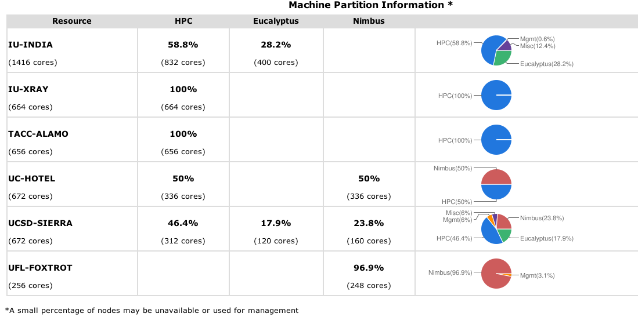
Simple Overview
http://futuregrid.org

Slide 92
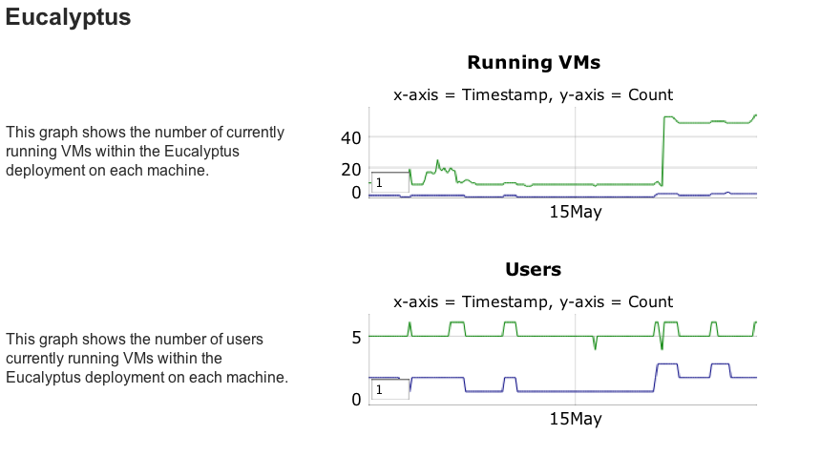

Slide 93
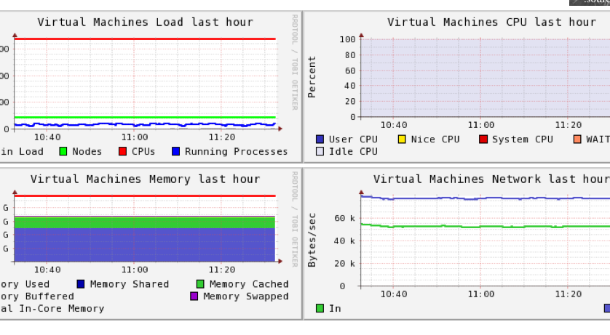
Ganglia
On India

Slide 94
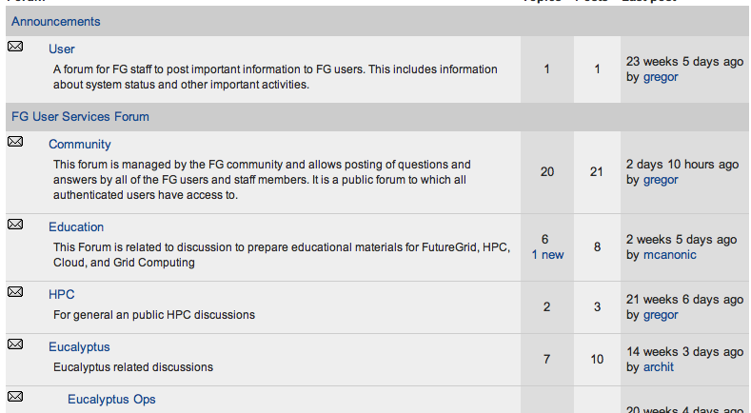
Forums

Slide 95
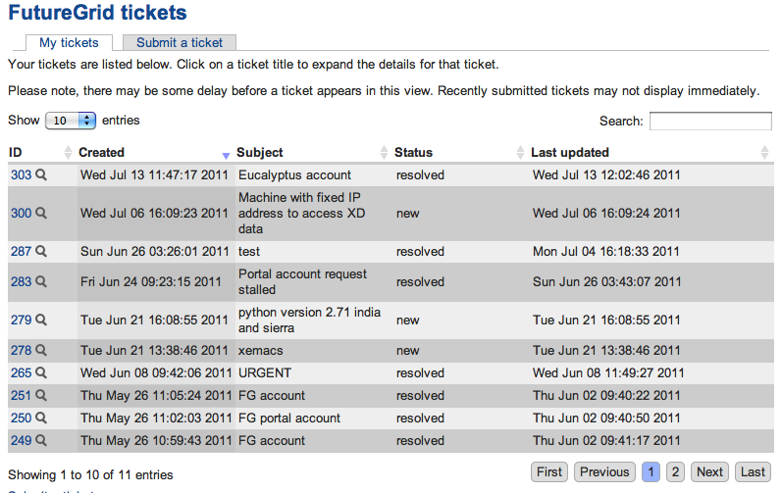
My Ticket System

Slide 96
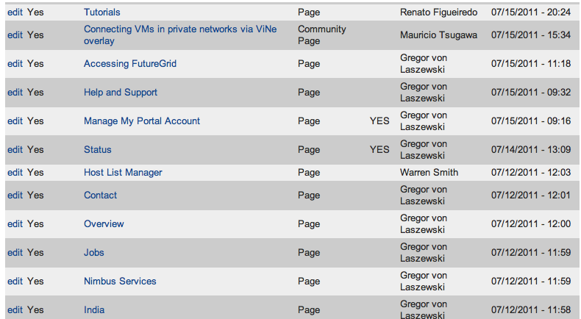
My Ticket Queue

Slide 97
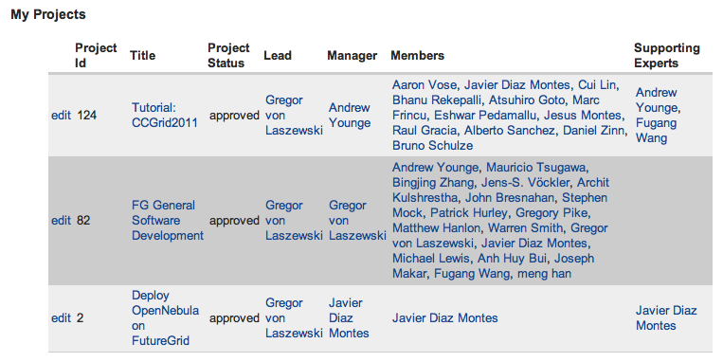
My Projects

Slide 98
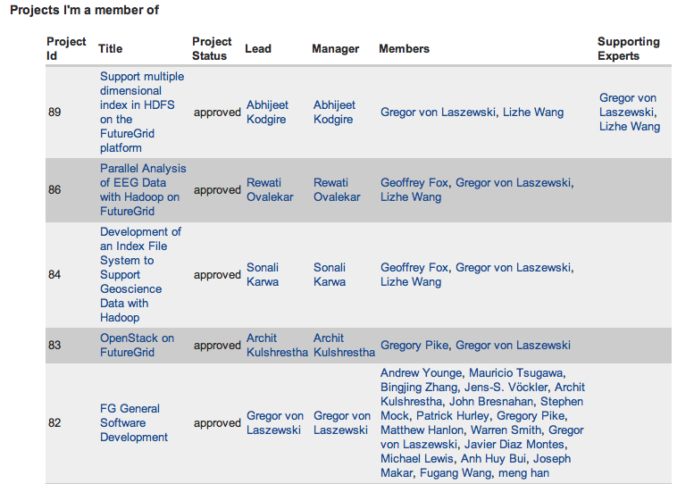
Projects I am Member of

Slide 99
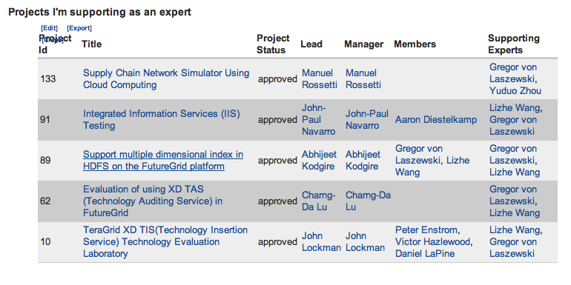
Projects I Support

Slide 100
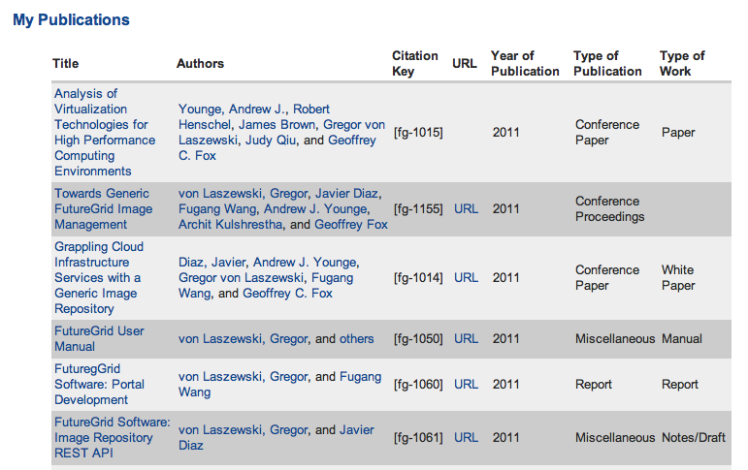
My References

Slide 101
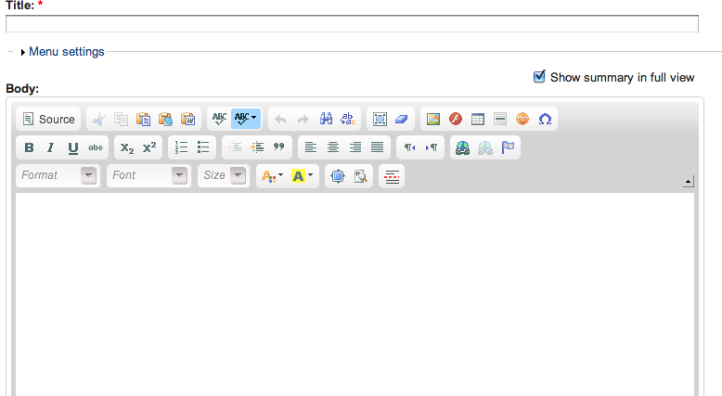
My Community Wiki

Slide 102
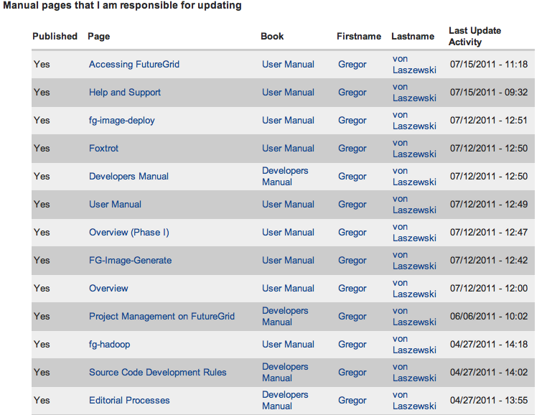
Pages I Manage

Slide 103
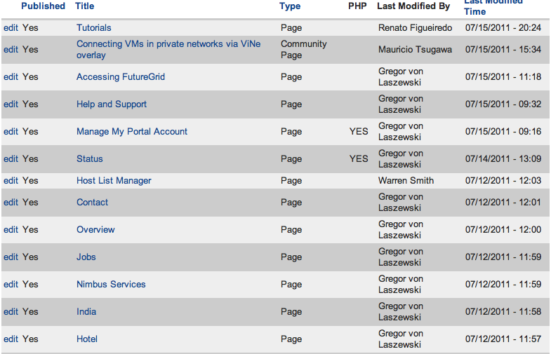
Pages to be Reviewed
(Editor view)

