Slide 1
Clouds will win!
FutureGrid Tutorial at PPAM 2011
Torun Poland
September 11 2011
Geoffrey Fox
gcf@indiana.edu
http://www.infomall.org http://www.futuregrid.org
Director, Digital Science Center, Pervasive Technology Institute
Associate Dean for Research and Graduate Studies, School of Informatics and Computing
Indiana University Bloomington

Slide 2
Important Trends
Data Deluge in all fields of science
Multicore implies parallel computing important again
  Performance from extra cores – not extra clock speed
  GPU enhanced systems can give big power boost
Clouds – new commercially supported data center model replacing compute grids (and your general purpose computer center)
Light weight clients: Sensors, Smartphones and tablets accessing and supported by backend services in cloud
Commercial efforts moving much faster than academia in both innovation and deployment

Slide 3
Big Data in Many Domains
According to one estimate, we created 150 exabytes (billion gigabytes) of data in 2005. In 2010, we created 1,200 exabytes
Enterprise Storage sold in 2010 was 15 Exabytes; BUT total storage sold (including flash memory etc.) was 1500 Exabytes
Size of the web ~ 3 billion web pages: MapReduce at Google was on average processing 20PB per day in January 2008
During 2009, American drone aircraft flying over Iraq and Afghanistan sent back around 24 years’ worth of video footage
  http://www.economist.com/node/15579717
  New models being deployed in 2010 will produce ten times as many data streams as their predecessors, and those in 2011 will produce 30 times as many
~108 million sequence records in GenBank in 2009, doubling in every 18 months
~20 million purchases at Wal-Mart a day
90 million Tweets a day
Astronomy, Particle Physics, Medical Records …
Most scientific task shows CPU:IO ratio of 10000:1 – Dr. Jim Gray
The Fourth Paradigm: Data-Intensive Scientific Discovery
Large Hadron Collider at CERN; 100 Petabytes to find Higgs Boson
Notes:
For each category, give examples, e.g. Astronomy solon 20 TB night,
http://www.datacenterknowledge.com/archives/2009/12/22/the-data-crunching-powerhouse-behind-avatar/

Slide 4
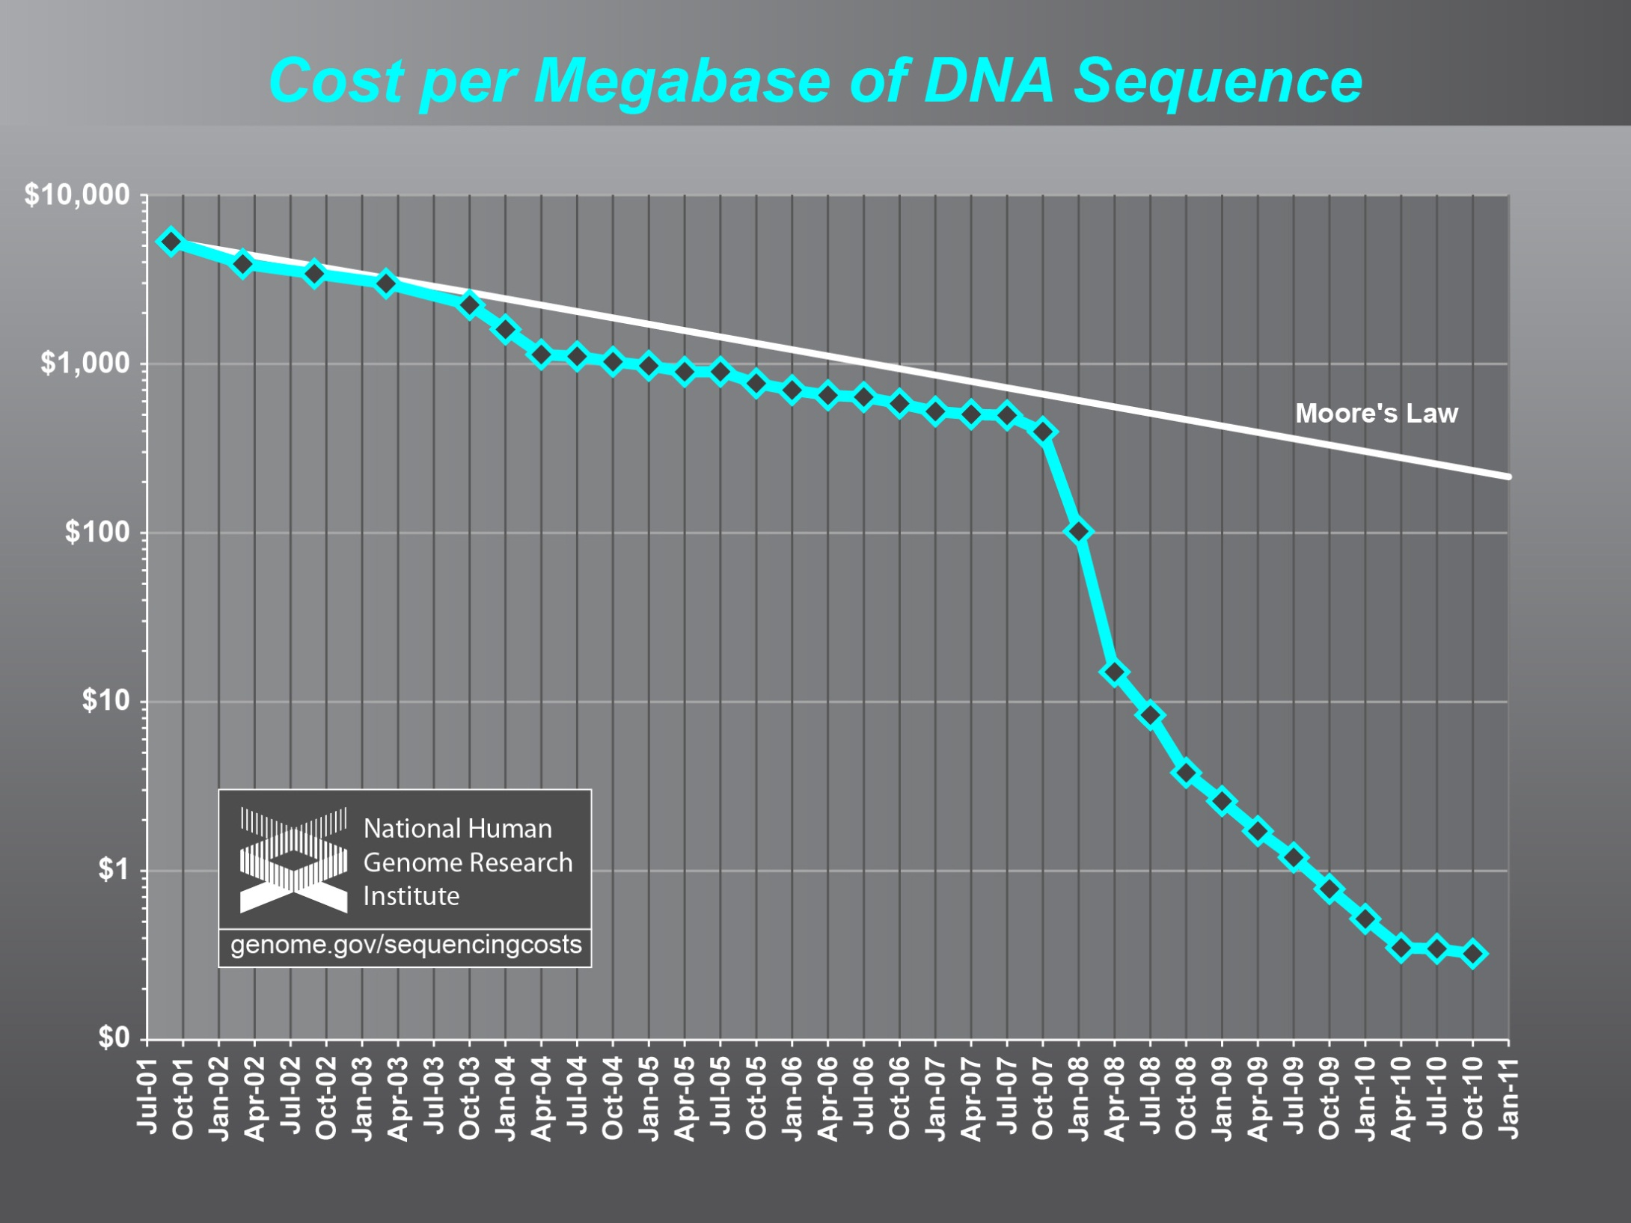

Slide 5
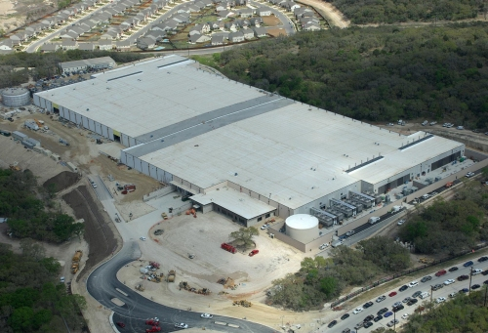
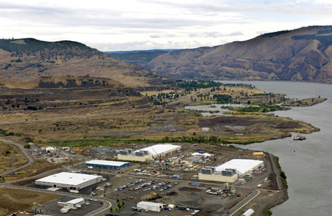
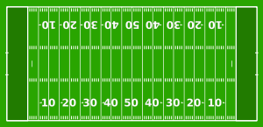
Data Centers Clouds &
Economies of Scale I
Range in size from “edge” facilities to megascale.
Economies of scale
  Approximate costs for a small size center (1K servers) and a larger, 50K server center.
2 Google warehouses of computers on the banks of the Columbia River, in The Dalles, Oregon
Such centers use 20MW-200MW
(Future) each with 150 watts per CPU
Save money from large size, positioning with cheap power and access with Internet
Technology | Cost in small-sized Data Center | Cost in Large Data Center | Ratio
Network | $95 per Mbps/ month | $13 per Mbps/ month | 7.1
Storage | $2.20 per GB/ month | $0.40 per GB/ month | 5.7
Administration | ~140 servers/ Administrator | >1000 Servers/ Administrator | 7.1
Each data center is
11.5 times
the size of a football field

Slide 6
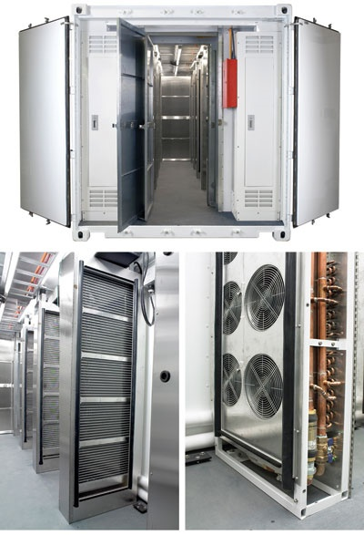
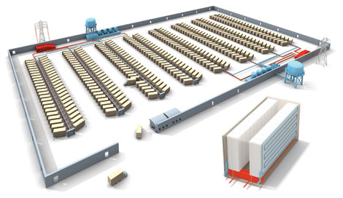
Data Centers, Clouds
& Economies of Scale II
Builds giant data centers with 100,000’s of computers;
~ 200-1000 to a shipping container with Internet access
“Microsoft will cram between 150 and 220 shipping containers filled with data center gear into a new 500,000 square foot Chicago facility. This move marks the most significant, public use of the shipping container systems popularized by the likes of Sun Microsystems and Rackable Systems to date.”

Slide 7
















X as a Service
SaaS: Software as a Service imply software capabilities
(programs) have a service (messaging) interface
  Applying systematically reduces system complexity to being linear in number of components
  Access via messaging rather than by installing in /usr/bin
IaaS: Infrastructure as a Service or HaaS: Hardware as a Service – get your computer time with a credit card and with a Web interface
PaaS: Platform as a Service is IaaS plus core software capabilities on which you build SaaS
Cyberinfrastructure is “Research as a Service”
Other Services
Clients

Slide 8


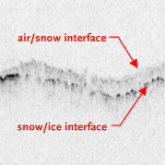

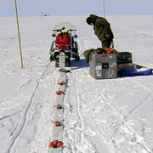

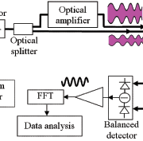

Sensors as a Service
Cell phones are important sensor
Sensors as a Service
Sensor Processing as a Service (MapReduce)

Slide 9
Clouds and Jobs
Clouds are a major industry thrust with a growing fraction of IT expenditure that IDC estimates will grow to $44.2 billion direct investment in 2013 while 15% of IT investment in 2011 will be related to cloud systems with a 30% growth in public sector.
Gartner also rates cloud computing high on list of critical emerging technologies with for example “Cloud Computing” and “Cloud Web Platforms” rated as transformational (their highest rating for impact) in the next 2-5 years.
Correspondingly there is and will continue to be major opportunities for new jobs in cloud computing with a recent European study estimating there will be 2.4 million new cloud computing jobs in Europe alone by 2015.
Cloud computing is an attractive for projects focusing on workforce development. Note that the recently signed “America Competes Act” calls out the importance of economic development in broader impact of NSF projects

Slide 10
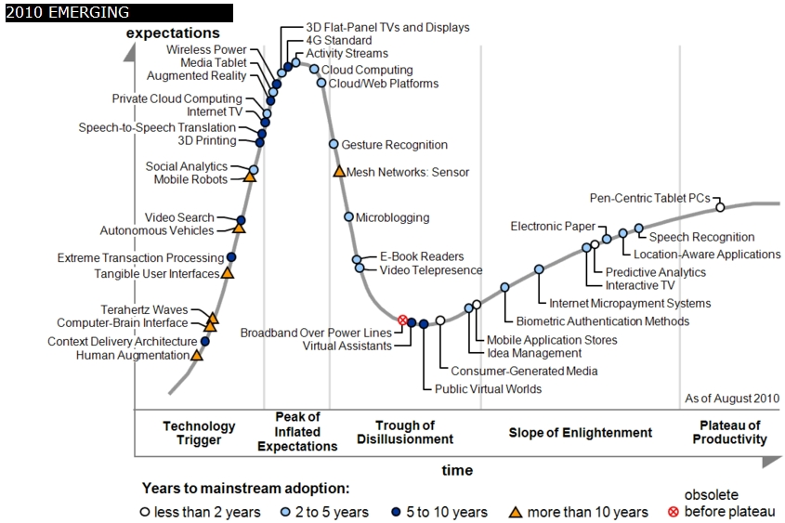
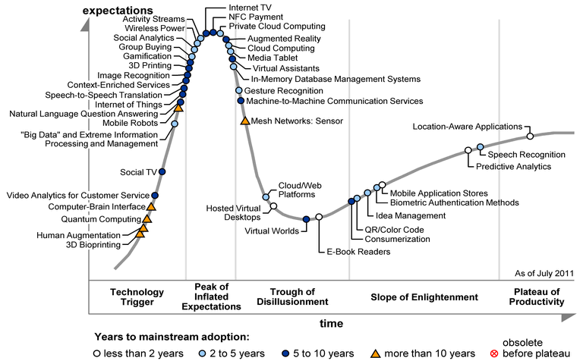
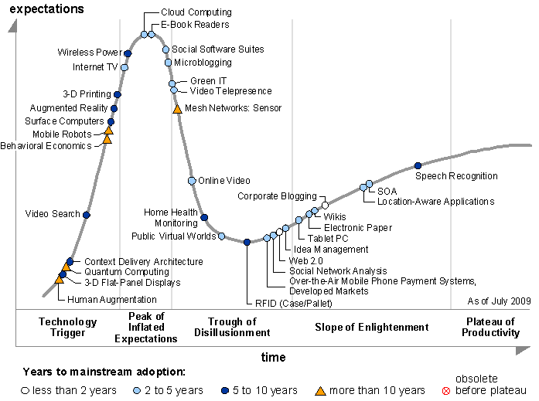
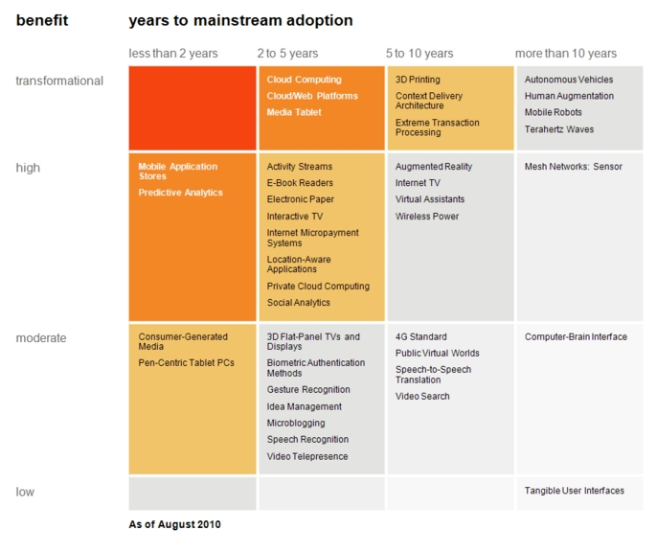
Transformational
High
Moderate
Low
Gartner 2009 Hype Curve
Clouds, Web2.0
Service Oriented Architectures
Cloud Computing
Cloud Web Platforms
Media Tablet

Slide 11
Philosophy of Clouds and Grids
Clouds are (by definition) commercially supported approach to large scale computing
  So we should expect Clouds to replace Compute Grids
  Current Grid technology involves “non-commercial” software solutions which are hard to evolve/sustain
Public Clouds are broadly accessible resources like Amazon and Microsoft Azure – powerful but not easy to optimize and perhaps data trust/privacy issues
Private Clouds run similar software and mechanisms but on “your own computers”
Services still are correct architecture with either REST (Web 2.0) or Web Services
Clusters still critical concept

Slide 12
Grids MPI and Clouds
Grids are useful for managing distributed systems
  Pioneered service model for Science
  Developed importance of Workflow
  Performance issues – communication latency – intrinsic to distributed systems
  Can never run large differential equation based simulations or datamining
Clouds can execute any job class that was good for Grids plus
  More attractive due to platform plus elastic on-demand model
  MapReduce easier to use than MPI for appropriate parallel jobs
  Currently have performance limitations due to poor affinity (locality) for compute-compute (MPI) and Compute-data
  These limitations are not “inevitable” and should gradually improve as in July 13 2010 Amazon Cluster announcement
  Will probably never be best for most sophisticated parallel differential equation based simulations
Classic Supercomputers (MPI Engines) run communication demanding differential equation based simulations
  MapReduce and Clouds replaces MPI for other problems
  Much more data processed today by MapReduce than MPI (Industry Informational Retrieval ~50 Petabytes per day)

Slide 13
Fault Tolerance and MapReduce
MPI does “maps” followed by “communication” including “reduce” but does this iteratively
There must (for most communication patterns of interest) be a strict synchronization at end of each communication phase
  Thus if a process fails then everything grinds to a halt
In MapReduce, all Map processes and all reduce processes are independent and stateless and read and write to disks
  As 1 or 2 (reduce+map) iterations, no difficult synchronization issues
Thus failures can easily be recovered by rerunning process without other jobs hanging around waiting
Re-examine MPI fault tolerance in light of MapReduce
  Twister will interpolate between MPI and MapReduce

Slide 14
Authentication and Authorization: Provide single sign in to both FutureGrid and Commercial Clouds linked by workflow
Workflow: Support workflows that link job components between FutureGrid and Commercial Clouds. Trident from Microsoft Research is initial candidate
Data Transport: Transport data between job components on FutureGrid and Commercial Clouds respecting custom storage patterns
Program Library: Store Images and other Program material (basic FutureGrid facility)
Blob: Basic storage concept similar to Azure Blob or Amazon S3
DPFS Data Parallel File System: Support of file systems like Google (MapReduce), HDFS (Hadoop) or Cosmos (dryad) with compute-data affinity optimized for data processing
Table: Support of Table Data structures modeled on Apache Hbase/CouchDB or Amazon SimpleDB/Azure Table. There is “Big” and “Little” tables – generally NOSQL
SQL: Relational Database
Queues: Publish Subscribe based queuing system
Worker Role: This concept is implicitly used in both Amazon and TeraGrid but was first introduced as a high level construct by Azure
MapReduce: Support MapReduce Programming model including Hadoop on Linux, Dryad on Windows HPCS and Twister on Windows and Linux
Software as a Service: This concept is shared between Clouds and Grids and can be supported without special attention
Web Role: This is used in Azure to describe important link to user and can be supported in FutureGrid with a Portal framework
Components of a Scientific Computing Platform

Slide 15
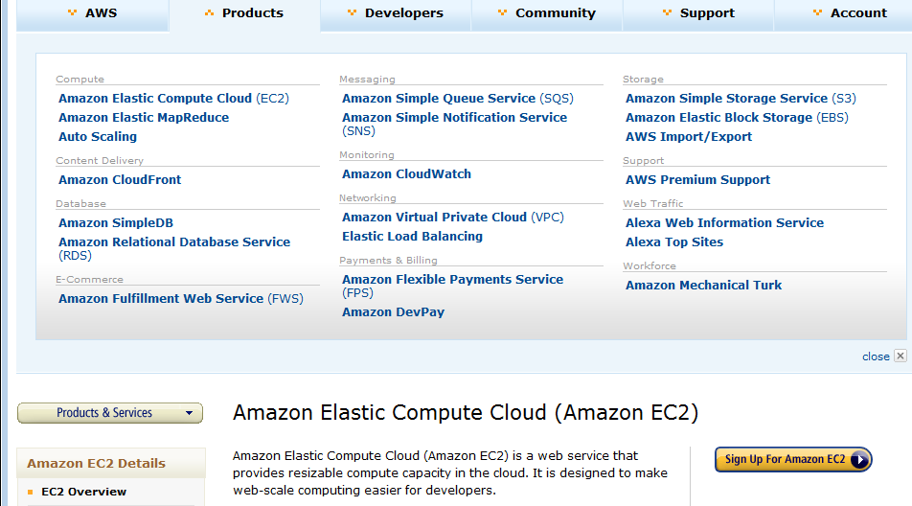
Amazon offers a lot!

Slide 16
Traditional File System?
S
Data
C
C
C
C
S
C
C
C
C
Archive
Data
S
C
C
C
C
Data
C
C
C
C
S
Data
Compute Cluster
Storage Nodes
Typically a shared file system (Lustre, NFS …) used to support high performance computing
Big advantages in flexible computing on shared data but doesn’t “bring computing to data”

Slide 17
Data Parallel File System?
Block1
Replicate each block
File1
Block2
……
Breakup
BlockN
C
C
C
C
Data
Data
Data
Data
C
C
C
C
Data
Data
Data
Data
C
C
C
C
Data
Data
Data
Data
C
C
C
C
Data
Data
Data
Data
Block1
File1
Block2
……
Breakup
Replicate each block
BlockN
No archival storage and computing brought to data

Slide 18
Important Platform Capability
MapReduce
Data Partitions
Map(Key, Value)
A hash function maps the results of the map tasks to reduce tasks
Reduce(Key, List<Value>)
Reduce Outputs
Implementations (Hadoop – Java; Dryad – Windows) support:
  Splitting of data
  Passing the output of map functions to reduce functions
  Sorting the inputs to the reduce function based on the intermediate keys
  Quality of service

