Slide 1

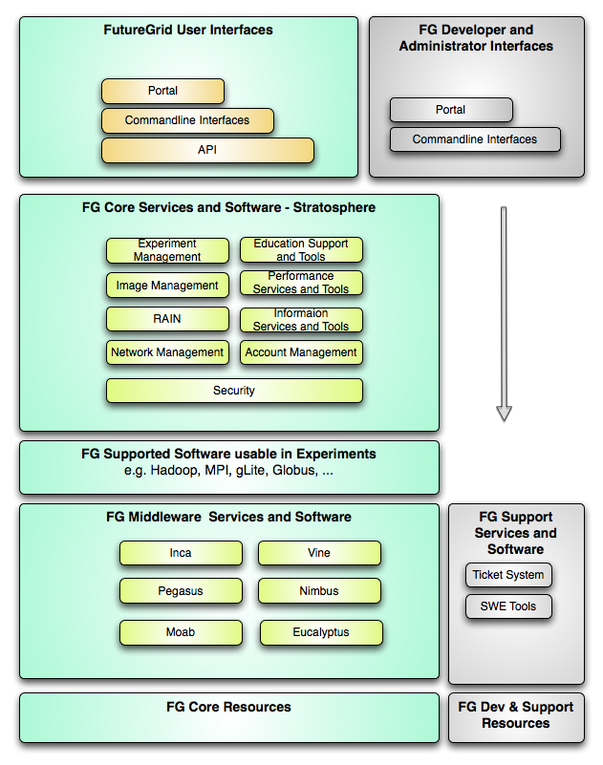
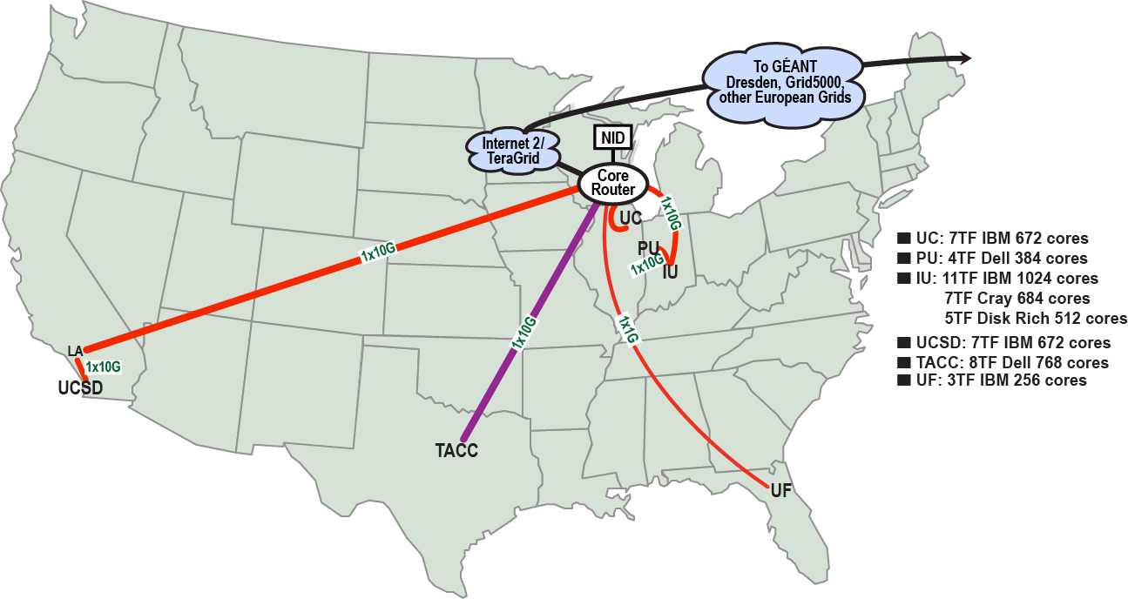
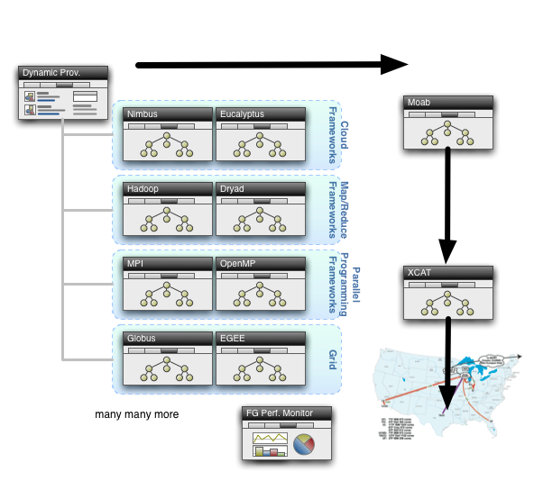

FutureGrid: An Experimental Grid Cloud and HPC Test-Bed
PI: Geoffrey Fox*, CoPIs: Kate Keahey⁺, Warren Smith⁻, Jose Fortes#, Andrew Grimshaw$, Software Lead: Gregor von Laszewski*
*Indiana University, ⁺University of Chicago, ⁻Texas Applied Computing Center, #University of Florida, $University of Virginia,
San Diego Supercomputer Center, Information Sciences Institute, Purdue University, University of Tennessee, Technical University Dresden
About FutureGrid
FutureGrid Projects
FutureGrid Software
FG’s mission is to enable experimental work that advances innovation and scientific understanding of distributed computing and parallel computing paradigms
The engineering science of middleware that enables these paradigms
The use and drivers of these paradigms by important applications
The education of a new generation of students and workforce on the use of these paradigms and their applications
FutureGrid has currently over 100 Projects with a very different mix from TeraGrid as
Significant education use
Over half projects are Computer Science
Most popular domain is Life Science
Projects tend to be small in terms of CPU use.
Register for a portal account at https://portal.futuregrid.org/login and then
Apply for your own project at https://portal.futuregrid.org/node/add/fg-projects
Architecture
FutureGrid has ~4000 (will grow to ~5000) distributed cores with a dedicated network and a Spirent XGEM network fault and delay generator
Implementing
Operational Model
Rather than loading images onto VM’s, FutureGrid dynamically provisioning software as needed onto “bare-metal” using Moab/xCAT
Aiming at Image library including MPI, OpenMP, Hadoop, Dryad, gLite, Unicore, Globus, Xen, ScaleMP (distributed Shared Memory), Nimbus, Eucalyptus, OpenNebula, KVM, Windows …..
Growth comes from users depositing novel images in library
Sponsored by:
Notes:
IU, UC, TACC, UF, SDSC, ISI, UV, PU, Tennessee

