Slide 1
Recipes for Success with Big Data using FutureGrid Cloudmesh
SDSC Exhibit Booth
New Orleans Convention Center
November 19 2014
Geoffrey Fox, Gregor von Laszewski
gcf@indiana.edu
http://www.infomall.org
School of Informatics and Computing
Digital Science Center
Indiana University Bloomington

Slide 2
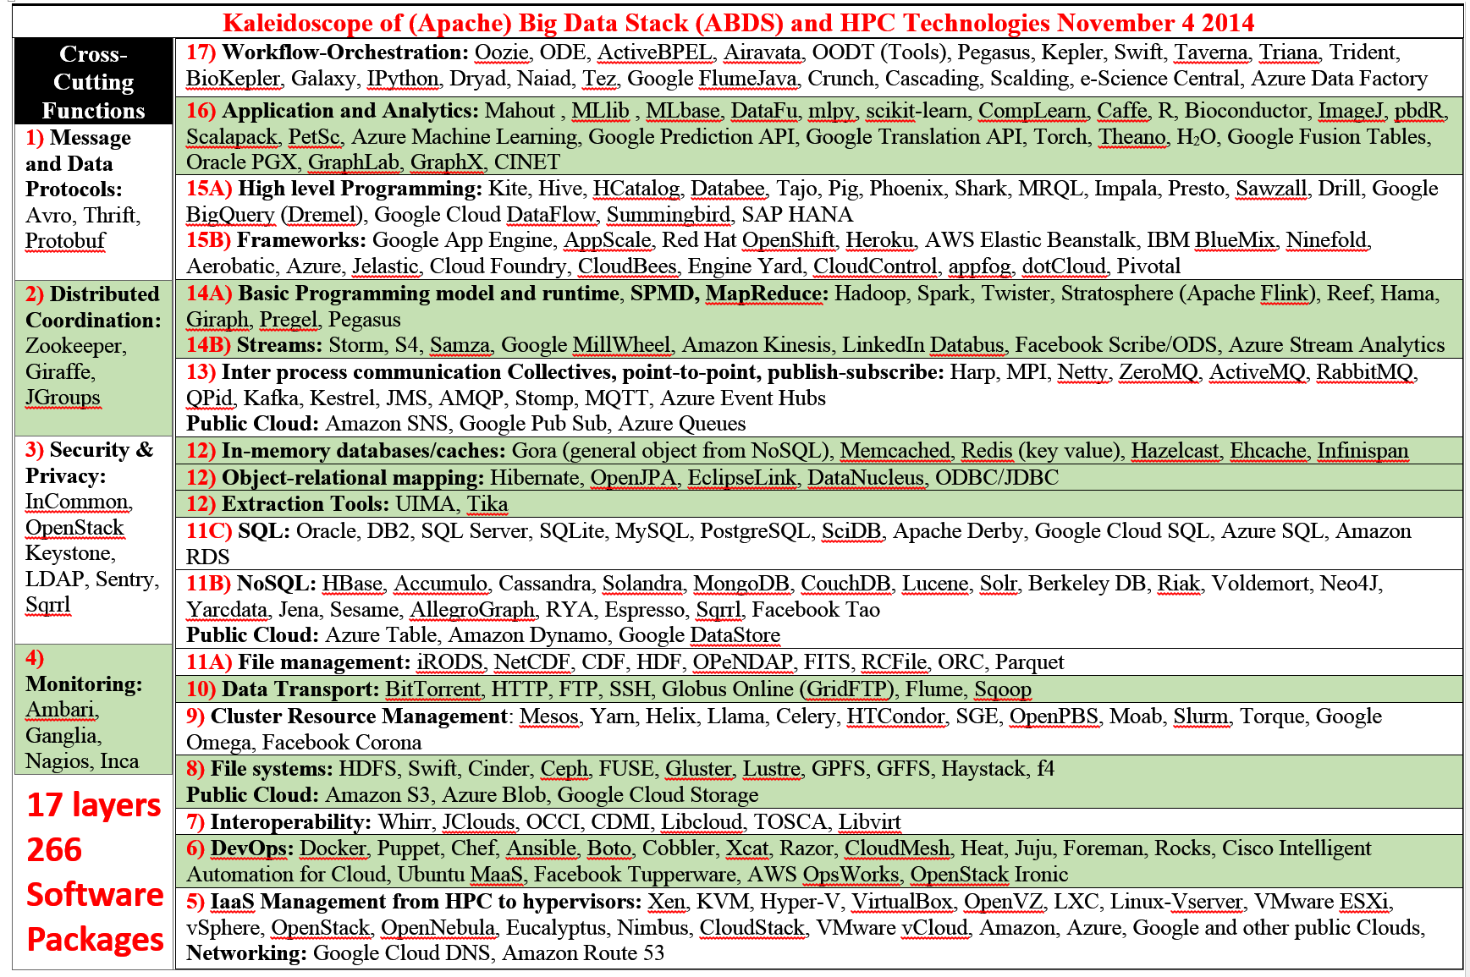
There are a lot of Big Data and HPC Software systems
Challenge! Manage environment offering these different components

Slide 3
Maybe a Big Data Initiative would include
We don’t need 266 software packages so can choose e.g.
Workflow: IPython, Pegasus or Kepler (replaced by tools like Tez?)
Data Analytics: Mahout, R, ImageJ, Scalapack
High level Programming: Hive, Pig
Parallel Programming model: Hadoop, Spark, Giraph (Twister4Azure, Harp), MPI;
Streaming: Storm, Kapfka or RabbitMQ (Sensors)
In-memory: Memcached
Data Management: Hbase, MongoDB, MySQL or Derby
Distributed Coordination: Zookeeper
Cluster Management: Yarn, Slurm
File Systems: HDFS, Lustre
DevOps: Cloudmesh, Chef, Puppet, Docker, Cobbler
IaaS: Amazon, Azure, OpenStack, Libcloud
Monitoring: Inca, Ganglia, Nagios

Slide 4
CloudMesh SDDSaaS Architecture
Cloudmesh is a open source http://cloudmesh.github.io toolkit:
A software-defined distributed system encompassing virtualized and bare-metal infrastructure, networks, application, systems and platform software with a unifying goal of providing Computing as a Service.
The creation of a tightly integrated mesh of services targeting multiple IaaS frameworks
The ability to federate a number of resources from academia and industry. This includes existing FutureSystems infrastructure, Amazon Web Services, Azure, HP Cloud, Karlsruhe using several IaaS frameworks
The creation of an environment in which it becomes easier to experiment with platforms and software services while assisting with their deployment and execution.
The exposure of information to guide the efficient utilization of resources. (Monitoring)
Support reproducible computing environments
IPython-based workflow as an interoperable onramp
Cloudmesh exposes both hypervisor-based and bare-metal provisioning to users and administrators
Access through command line, API, and Web interfaces.

Slide 5
Cloudmesh and SDDSaaS Stack for HPC-ABDS
One Chef recipe per IU CS Masters Student ….
Data Distributed and Streaming …
Just examples from 266 components
IPython, Pegasus, Kepler, FlumeJava, Tez, Cascading
Orchestration
Mahout, MLlib, R
SaaS
HPC-ABDS at 4 levels
Hadoop, Giraph, Storm
PaaS
IaaS
Docker, OpenStack, Bare metal
NaaS
OpenFlow
BMaaS
Cobbler
Abstract
Interfaces removes tool dependency

Slide 6
Cloudmesh: from IaaS(NaaS) to Workflow (Orchestration)
(IaaS Orchestration) Virtual Cluster
Heat
Python
Components
Chef or Puppet (Recipes/Puppies)
Infrastructure
VMs, Docker, Networks, Baremetal
(SaaS Orchestration)
Workflow
IPython
Pegasus etc.
Data
Images
HPC-ABDS Software components defined in Chef. Python (Cloudmesh) controls deployment (virtual cluster) and execution (workflow)

Slide 7
Cloudmesh Functionality
Virtual Machine Management
IaaS Abstraction
Provisioning Management
Rain
Cloud Shifting
Cloud Bursting
Experiment Management
Shell
IPython
Information Services
CloudMetrics
Accounting
Internal
External
Cloudmesh
User On-Ramp
Amazon, Azure, FutureSystems, Comet, XSEDE, ExoGeni, Other Science Clouds
Notes:
Due to its integrated services Cloudmesh provides the ability to be an onramp for other clouds.
It provides information services to various system level sensors to give access to sensor and utilization data. Internally, it can be used to optimize the system usage.
The provisioning experience from FutureGrid has taught us that we need to provide
the creation of new clouds (rain)
the repartitioning of resources between services (cloud shifting)
and the integration of external cloud resources in case of over provisioning (cloud bursting)
As we deal with many IaaS frameworks, we need an abstraction layer on top of the IaaS framework.
Experiment management is conducted with workflows controlled in shells, Python/iPython, as well as systems such as OpenStack's Heat.
Accounting is supported through additional services such as user management and charge rate management.
Not all features are yet implemented. Figure shows the main functionality that we target at this time to implement.

Slide 8
Cloudmesh Components I
Cobbler: Python based provisioning of bare-metal or hypervisor-based systems
Apache Libcloud: Python library for interacting with many of the popular cloud service providers using a unified API. (One Interface To Rule Them All)
Celery is an asynchronous task queue/job queue environment based on RabbitMQ or equivalent and written in Python
OpenStack Heat is a Python orchestration engine for common cloud environments managing the entire lifecycle of infrastructure and applications.
Docker (written in Go) is a tool to package an application and its dependencies in a virtual Linux container
OCCI is an Open Grid Forum cloud instance standard
Slurm is an open source C based job scheduler from HPC community with similar functionalities to OpenPBS

Slide 9
Cloudmesh Components II
Chef Ansible Puppet Salt are system configuration managers. Scripts are used to define system
Razor cloud bare metal provisioning from EMC/puppet
Juju from Ubuntu orchestrates services and their provisioning defined by charms across multiple clouds
Xcat (Originally we used this) is a rather specialized (IBM) dynamic provisioning system
Foreman written in Ruby/Javascript is an open source project that helps system administrators manage servers throughout their lifecycle, from provisioning and configuration to orchestration and monitoring. Builds on Puppet or Chef

Slide 10
… Working with VMs in Cloudmesh
Search
VMs
Panel with VM Table (HP)

Slide 11
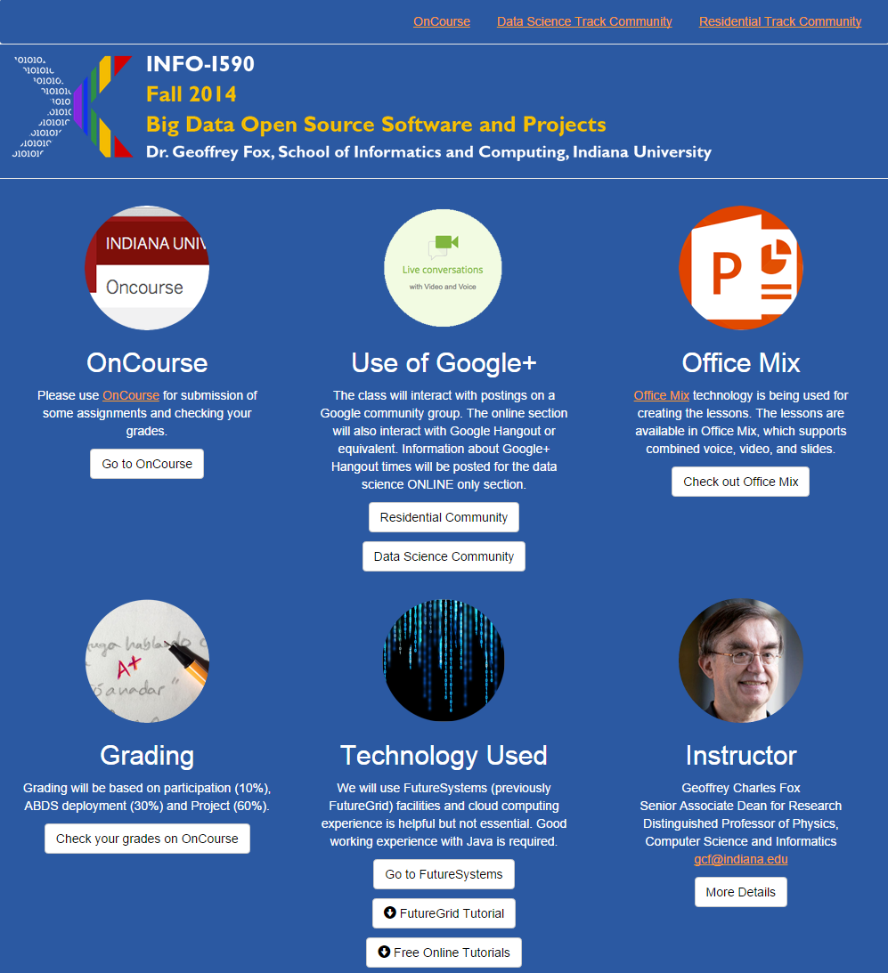
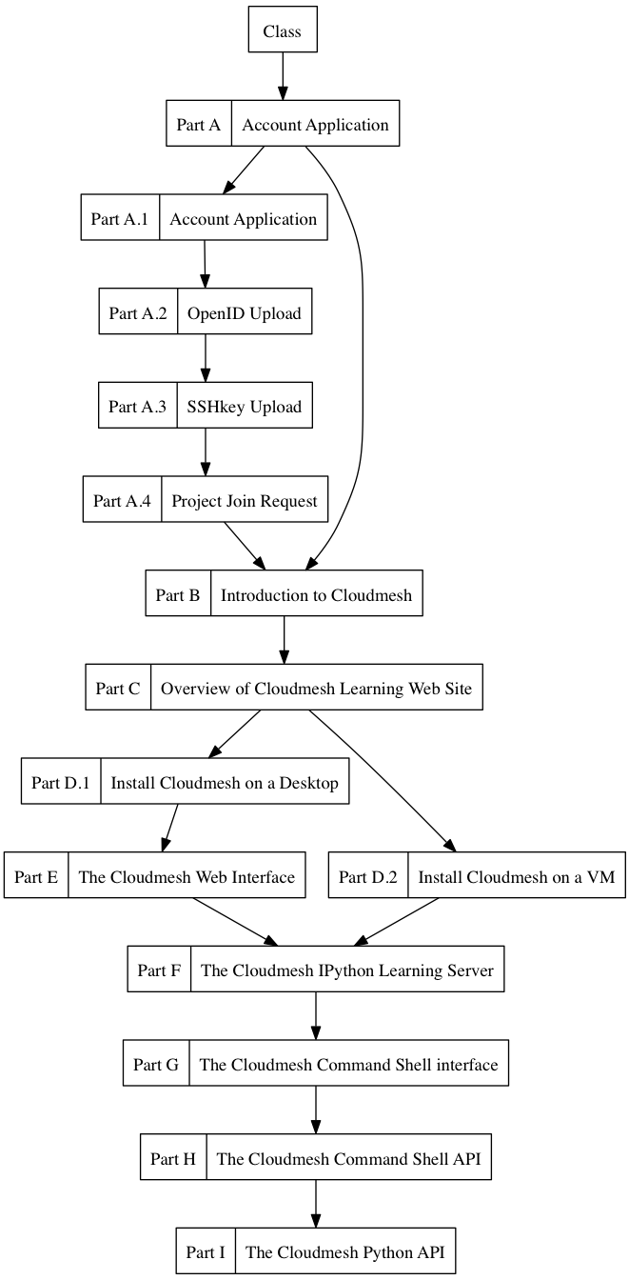
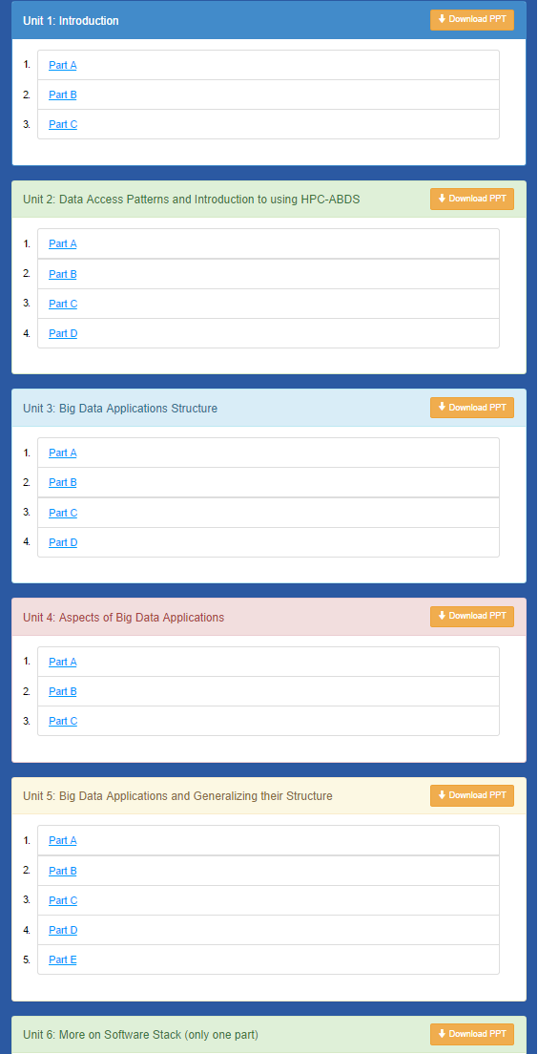
Cloudmesh MOOC Videos

