Slide 1

Characteristics of Future Big Data Platforms
CBD 2017
The Fifth International Conference on Advanced Cloud and Big Data
`
Geoffrey Fox, August 13, 2017
Digital Science Center
Department of Intelligent Systems Engineering
gcf@indiana.edu, http://www.dsc.soic.indiana.edu/, http://spidal.org/

Slide 2
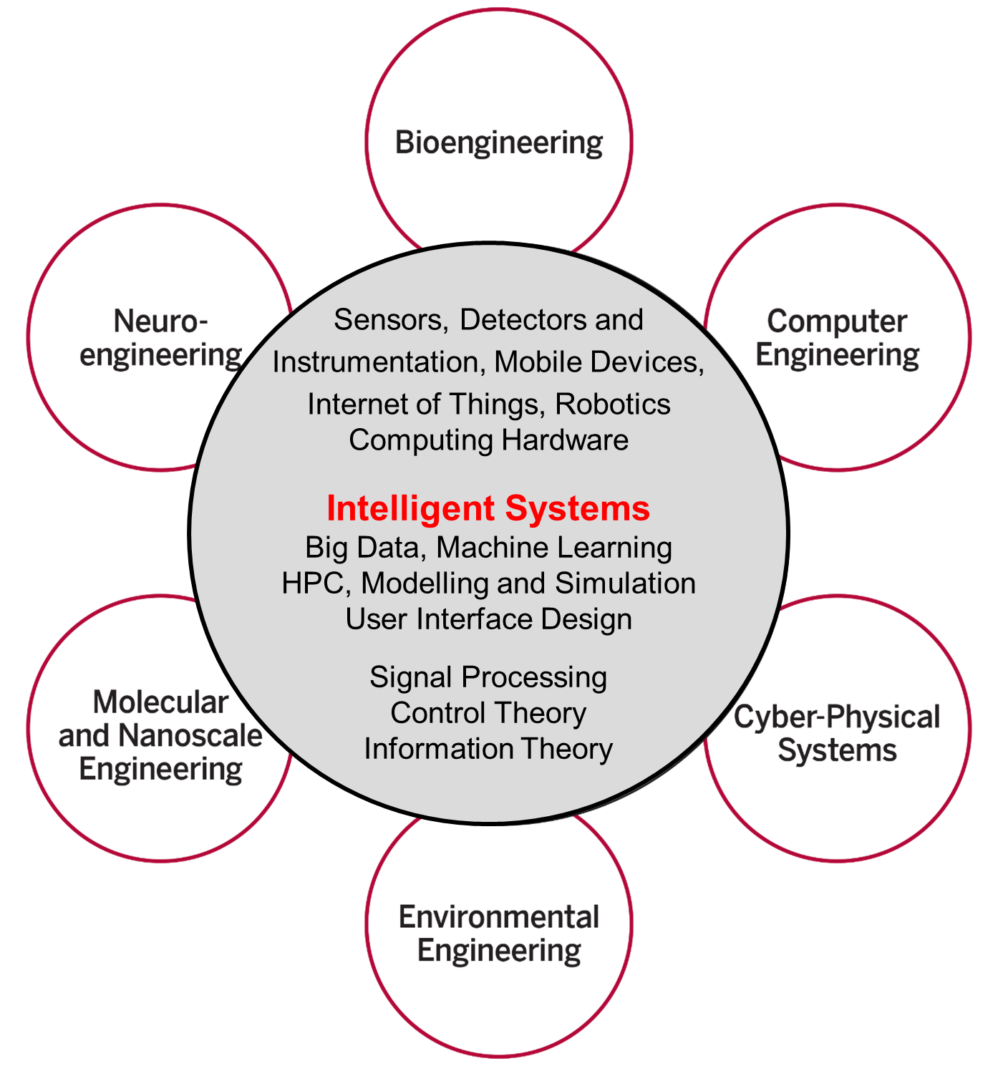
Intelligent Systems Engineering at Indiana University
All students do basic engineering plus machine learning (AI), Modelling& Simulation, Internet of Things
Also courses on HPC, cloud computing, edge computing, deep learning and physical optimization (this conference)
Fits recent headlines:
Google, Facebook, And Microsoft Are Remaking Themselves Around AI
How Google Is Remaking Itself As A “Machine Learning First” Company
If You Love Machine Learning, You Should Check Out General Electric

Slide 3
Abstract
We discuss requirements of data analysis computing platforms satisfying different cost, performance and usability issues in different application classes.
We use the Ogres, which provide a means of understanding and characterizing the most common application workloads across commercial, government and scientific domains. We stress similarities and differences between simulations and data analytics.
Turning to hardware and software, we introduce HPC-ABDS, the High-Performance Computing (HPC) enhanced Apache Big Data Stack (ABDS), which uses the major open source Big Data software environment but develops the principles allowing the use of HPC software and hardware to achieve good performance. We present several big data performance studies.
We expect both conventional clouds and HPC clusters to be important and suggest DevOps as an approach to automate the deployment of software-defined applications on different hardware platforms

Slide 4
Important Trends I
Data gaining in importance compared to simulations
  Data analysis techniques changing with old and new applications
All forms of IT increasing in importance; both data and simulations increasing
Internet of Things and Edge Computing growing in importance
Exascale initiative driving large supercomputers
Use of public clouds increasing rapidly
  Clouds becoming diverse with subsystems containing GPU’s, FPGA’s, high performance networks, storage, memory …
  They have economies of scale; hard to compete with
Serverless (server hidden) computing attractive to user:
“No server is easier to manage than no server”
Notes:
Barga Edge and Serverless driving AWS

Slide 5
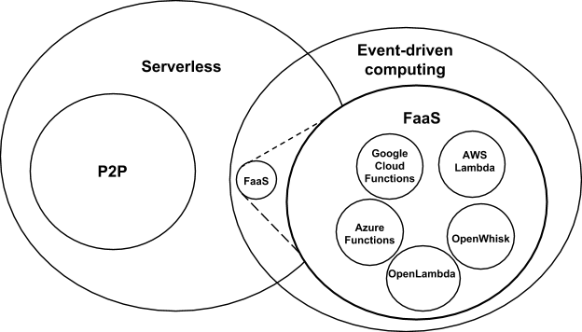
Event-Driven and Serverless Computing
Cloud-owner Provided Cloud-native platform for
Short-running, Stateless computation and
Event-driven applications which
Scale up and down instantly and automatically and
Charges for actual usage at a millisecond granularity
Note GridSolve was FaaS
Notes:
Short-running, Stateless computation may go away

Slide 6
Important Trends II
Rich software stacks:
  HPC (High Performance Computing) for Parallel Computing
  Apache for Big Data Software Stack ABDS including some edge computing (streaming data)
On general principles parallel and distributed computing have different requirements even if sometimes similar functionalities
  Apache stack ABDS typically uses distributed computing concepts
  For example, Reduce operation is different in MPI (Harp) and Spark
Big Data requirements are not clear but there are a few key use types
  Pleasingly parallel processing (including local machine learning LML) as of different tweets from different users with perhaps MapReduce style of statistics and visualizations; possibly Streaming
  Database model with queries again supported by MapReduce for horizontal scaling
  Global Machine Learning GML with single job using multiple nodes as classic parallel computing
  Deep Learning certainly needs HPC – possibly only multiple small systems
Current workloads stress 1) and 2) and are suited to current clouds and to ABDS (with no HPC)
  This explains why Spark with poor GML performance is so successful

Slide 7
Predictions/Assumptions
Supercomputers will be essential for large simulations and will run other applications
HPC Clouds or Next-Generation Commodity Systems will be a dominant force
  Merge Cloud HPC and (support of) Edge computing
  Clouds running in multiple giant datacenters offering all types of computing
  Distributed data sources associated with device and Fog processing resources
  Server-hidden computing and Function as a Service FaaS for user pleasure
  Support a distributed event-driven serverless dataflow computing model covering batch and streaming data as HPC-FaaS
  Needing parallel and distributed (Grid) computing ideas
  Span Pleasingly Parallel to Data management to Global Machine Learning

Slide 8
Convergence Points (Nexus) for
HPC-Cloud-Edge- Big Data-Simulation
Nexus 1: Applications – Divide use cases into Data and Model and compare characteristics separately in these two components with 64 Convergence Diamonds (features)
Nexus 2: Software – High Performance Computing (HPC) Enhanced Big Data Stack HPC-ABDS. 21 Layers adding high performance runtime to Apache systems (Hadoop is fast!). Establish principles to get good performance from Java or C programming languages.
  HPC-FaaS Programming Model
Nexus 3: Hardware – Use Serverless Infrastructure as a Service IaaS and DevOps (HPCCloud 2.0) to automate deployment of event-driven software defined systems on hardware designed for functionality and performance e.g. appropriate disks, interconnect, memory
Deliver Solutions (wisdom) as a Service HPCCloud 3.0
DevOps not discussed in this talk

Slide 9
Data and Model in Big Data and Simulations I
Need to discuss Data and Model as problems have both intermingled, but we can get insight by separating which allows better understanding of Big Data - Big Simulation “convergence” (or differences!)
The Model is a user construction and it has a “concept”, parameters and gives results determined by the computation. We use term “model” in a general fashion to cover all of these.
Big Data problems can be broken up into Data and Model
  For clustering, the model parameters are cluster centers while the data is set of points to be clustered
  For queries, the model is structure of database and results of this query while the data is whole database queried and SQL query
  For deep learning with ImageNet, the model is chosen network with model parameters as the network link weights. The data is set of images used for training or classification

Slide 10
Data and Model in Big Data and Simulations II
Simulations can also be considered as Data plus Model
  Model can be formulation with particle dynamics or partial differential equations defined by parameters such as particle positions and discretized velocity, pressure, density values
  Data could be small when just boundary conditions
  Data large with data assimilation (weather forecasting) or when data visualizations are produced by simulation
Big Data implies Data is large but Model varies in size
  e.g. LDA (Latent Dirichlet Allocation) with many topics or deep learning has a large model
  Clustering or Dimension reduction can be quite small in model size
Data often static between iterations (unless streaming); Model parameters vary between iterations
Data and Model Parameters are often confused in papers as term data used to describe the parameters of models.
Models in Big Data and Simulations have many similarities and allow convergence

Slide 11
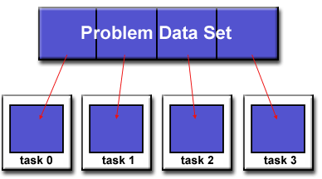
Parallel Computing: Big Data and Simulations
All the different programming models (Spark, Flink, Storm, Naiad, MPI/OpenMP) have the same high level approach
Break Problem Data and/or Model-parameters into parts assigned to separate nodes, processes, threads
In parallel, do computations typically leaving data untouched but changing model-parameters. Called Maps in MapReduce parlance
If Pleasingly parallel, that’s all it is
If Globally parallel, need to communicate computations between nodes during job
Communication mechanism (TCP, RDMA, Native Infiniband) can vary
Communication Style (Point to Point, Collective, Pub-Sub) can vary
Possible need for sophisticated dynamic changes in
partioning (load balancing)
Computation either on fixed tasks or flow between tasks
Choices: “Automatic Parallelism or Not”
Choices: “Complicated Parallel Algorithm or Not”
Fault-Tolerance model can vary
Output model can vary: RDD or Files or Pipes

Slide 12
Use Case Analysis

Slide 13
51 Detailed Use Cases: Contributed July-September 2013
Covers goals, data features such as 3 V’s, software, hardware
Government Operation(4): National Archives and Records Administration, Census Bureau
Commercial(8): Finance in Cloud, Cloud Backup, Mendeley (Citations), Netflix, Web Search, Digital Materials, Cargo shipping (as in UPS)
Defense(3): Sensors, Image surveillance, Situation Assessment
Healthcare and Life Sciences(10): Medical records, Graph and Probabilistic analysis, Pathology, Bioimaging, Genomics, Epidemiology, People Activity models, Biodiversity
Deep Learning and Social Media(6): Driving Car, Geolocate images/cameras, Twitter, Crowd Sourcing, Network Science, NIST benchmark datasets
The Ecosystem for Research(4): Metadata, Collaboration, Language Translation, Light source experiments
Astronomy and Physics(5): Sky Surveys including comparison to simulation, Large Hadron Collider at CERN, Belle Accelerator II in Japan
Earth, Environmental and Polar Science(10): Radar Scattering in Atmosphere, Earthquake, Ocean, Earth Observation, Ice sheet Radar scattering, Earth radar mapping, Climate simulation datasets, Atmospheric turbulence identification, Subsurface Biogeochemistry (microbes to watersheds), AmeriFlux and FLUXNET gas sensors
Energy(1): Smart grid
Published by NIST as http://nvlpubs.nist.gov/nistpubs/SpecialPublications/NIST.SP.1500-3.pdf with common set of 26 features recorded for each use-case; “Version 2” https://bigdatawg.nist.gov/V2_output_docs.php
26 Features for each use case Biased to science

Slide 14
Sample Features of 51 NIST Use Cases I
PP (26) “All” Pleasingly Parallel or Map Only
MR (18) Classic MapReduce MR (add MRStat below for full count)
MRStat (7) Simple version of MR where key computations are simple reduction as found in statistical averages such as histograms and averages
MRIter (23) Iterative MapReduce or MPI (Flink, Spark, Twister)
Graph (9) Complex graph data structure needed in analysis
Fusion (11) Integrate diverse data to aid discovery/decision making; could involve sophisticated algorithms or could just be a portal
Streaming (41) Some data comes in incrementally and is processed this way
Classify (30) Classification: divide data into categories
S/Q (12) Index, Search and Query

Slide 15
Sample Features of 51 Use Cases II
CF (4) Collaborative Filtering for recommender engines
LML (36) Local Machine Learning (Independent for each parallel entity) – application could have GML as well
GML (23) Global Machine Learning: Deep Learning, Clustering, LDA, PLSI, MDS,
  Large Scale Optimizations as in Variational Bayes, MCMC, Lifted Belief Propagation, Stochastic Gradient Descent, L-BFGS, Levenberg-Marquardt .
  Hopefully usesscalable parallel algorithm
Workflow (51) or Orchestration is always present
GIS (16) Geotagged data and often displayed in ESRI, Microsoft Virtual Earth, Google Earth, GeoServer etc.
HPC (5) Classic large-scale simulation of cosmos, materials, etc. generating (visualization) data
Agent (2) Simulations of models of data-defined macroscopic entities represented as agents

Slide 16
Classifying Use Cases
The Big Data Ogres built on a collection of 51 big data uses gathered by the NIST Public Working Group where 26 properties were gathered for each application.
This information was combined with other studies including the Berkeley dwarfs, the NAS parallel benchmarks and the Computational Giants of the NRC Massive Data Analysis Report.
The Ogre analysis led to a set of 50 features divided into four views that could be used to categorize and distinguish between applications.
The four views are Problem Architecture (Macro pattern); Execution Features (Micro patterns); Data Source and Style; and finally the Processing View or runtime features.
We generalized this approach to integrate Big Data and Simulation applications into a single classification looking separately at Data and Model with the total facets growing to 64 in number, called convergence diamonds, and split between the same 4 views.
A mapping of facets into work of the SPIDAL project has been given.

Slide 17
64 Features in 4 views for Unified Classification of Big Data and Simulation Applications
41/51 Streaming
26/51 Pleasingly Parallel
25/51 Mapreduce

Slide 18
Problem Architecture View (Meta or MacroPatterns)
Pleasingly Parallel – as in BLAST, Protein docking, some (bio-)imagery including Local Analytics or Machine Learning – ML or filtering pleasingly parallel, as in bio-imagery, radar images (pleasingly parallel but sophisticated local analytics)
Classic MapReduce: Search, Index and Query and Classification algorithms like collaborative filtering (G1 for MRStat in Features, G7)
Map-Collective: Iterative maps + communication dominated by “collective” operations as in reduction, broadcast, gather, scatter. Common datamining pattern
Map-Point to Point: Iterative maps + communication dominated by many small point to point messages as in graph algorithms
Map-Streaming: Describes streaming, steering and assimilation problems
Shared Memory: Some problems are asynchronous and are easier to parallelize on shared rather than distributed memory – see some graph algorithms
SPMD: Single Program Multiple Data, common parallel programming feature
BSP or Bulk Synchronous Processing: well-defined compute-communication phases
Fusion: Knowledge discovery often involves fusion of multiple methods.
Dataflow: Important application features often occurring in composite Ogres
Use Agents: as in epidemiology (swarm approaches) This is Model only
Workflow: All applications often involve orchestration (workflow) of multiple components
Most (11 of total 12) are properties of Data+Model
Notes:
Big dwarfs are Ogres
Implement Ogres in ABDS+

Slide 19
Note Problem and System Architecture as efficient execution says they must match
Global Machine Learning
Classic Cloud Workload
These 3 are focus of Twister2 but we need to preserve capability on first 2 paradigms

Slide 20
Software
HPC-ABDS
HPC-FaaS

Slide 21





NSF 1443054: CIF21 DIBBs: Middleware and High Performance Analytics Libraries for Scalable Data Science
Ogres Application Analysis
HPC-ABDS Software
Harp and Twister2 Building Blocks
SPIDAL Data Analytics Library
Software: MIDAS
HPC-ABDS

Slide 22
HPC-ABDS
Integrated wide range of HPC and Big Data technologies.
I gave up updating list in January 2016!

Slide 23
Components of Big Data Stack
Google likes to show a timeline; we can build on (Apache version of) this
2002 Google File System GFS ~HDFS (Level 8)
2004 MapReduce Apache Hadoop (Level 14A)
2006 Big Table Apache Hbase (Level 11B)
2008 Dremel Apache Drill (Level 15A)
2009 Pregel Apache Giraph (Level 14A)
2010 FlumeJava Apache Crunch (Level 17)
2010 Colossus better GFS (Level 18)
2012 Spanner horizontally scalable NewSQL database ~CockroachDB (Level 11C)
2013 F1 horizontally scalable SQL database (Level 11C)
2013 MillWheel ~Apache Storm, Twitter Heron (Google not first!) (Level 14B)
2015 Cloud Dataflow Apache Beam with Spark or Flink (dataflow) engine (Level 17)
Functionalities not identified: Security(3), Data Transfer(10), Scheduling(9), DevOps(6), serverless computing (where Apache has OpenWhisk) (5)
HPC-ABDS Levels in ()

Slide 24
Big Data ABDS HPCCloud 3.0 HPC, Cluster
17. Orchestration Beam, Crunch, Tez, Cloud Dataflow Kepler, Pegasus, Taverna
16. Libraries MLlib/Mahout, TensorFlow, CNTK, R, Python ScaLAPACK, PETSc, Matlab
15A. High Level Programming Pig, Hive, Drill Domain-specific Languages
15B. Platform as a Service App Engine, BlueMix, Elastic Beanstalk XSEDE Software Stack
Languages Java, Erlang, Scala, Clojure, SQL, SPARQL, Python Fortran, C/C++, Python
14B. Streaming Storm, Kafka, Kinesis
13,14A. Parallel Runtime Hadoop, MapReduce MPI/OpenMP/OpenCL
2. Coordination Zookeeper
12. Caching Memcached
11. Data Management Hbase, Accumulo, Neo4J, MySQL iRODS
10. Data Transfer Sqoop GridFTP
9. Scheduling Yarn, Mesos Slurm
8. File Systems HDFS, Object Stores Lustre
1, 11A Formats Thrift, Protobuf FITS, HDF
5. IaaS OpenStack , Docker Linux, Bare-metal, SR-IOV
Infrastructure CLOUDS Clouds and/or HPC SUPERCOMPUTERS
HPC-ABDS Integrated
Software
Different choices in software systems in Clouds and HPC. HPC-ABDS takes cloud software augmented by HPC when needed to improve performance
16 of 21 layers plus languages
CUDA, Exascale Runtime

Slide 25



Implementing Twister2 at a high level
Cloud
HPC
Cloud
HPC
Fog
Cloud
HPC
Centralized HPC Cloud + IoT Devices
Centralized HPC Cloud + Edge = Fog + IoT Devices

Slide 26
Twister2: “Next Generation Grid - Edge – HPC Cloud”
Original 2010 Twister paper has 878 citations; it was a particular approach to MapCollective iterative processing for machine learning
Re-engineer current Apache Big Data and HPC software systems as a toolkit
Support a serverless (cloud-native) dataflow event-driven FaaS (microservice) framework running across application and geographic domains.
  Support all types of Data analysis from GML to Edge computing
Build on Cloud best practice but use HPC wherever possible to get high performance
Smoothly support current paradigms Hadoop, Spark, Flink, Heron, MPI, DARMA …
Use interoperable common abstractions but multiple polymorphic implementations.
  i.e. do not require a single runtime
Focus on Runtime but this implies HPC-FaaS programming and execution model
This defines a next generation Grid based on data and edge devices – not computing as in old Grid
See long paper http://dsc.soic.indiana.edu/publications/Twister2.pdf

Slide 27

Proposed Twister2 Approach
Unit of Processing is an Event driven Function (a microservice) replacing libraries
  Can have state that may need to be preserved in place (Iterative MapReduce)
  Functions can be single or 1 of 100,000 maps in large parallel code
Processing units run in HPC clouds, fogs or devices but these all have similar architecture (see AWS Greengrass)
  Fog (e.g. car) looks like a cloud to a device (radar sensor) while public cloud looks like a cloud to the fog (car)
Analyze the runtime of existing systems (More study needed)
  Hadoop, Spark, Flink, Naiad (best logo) Big Data Processing
  Storm, Heron Streaming Dataflow
  Kepler, Pegasus, NiFi workflow systems
  Harp Map-Collective, MPI and HPC AMT runtime like DARMA
  And approaches such as GridFTP and CORBA/HLA (!) for wide area data links

Slide 28
Comparing Spark Flink and MPI
On Global Machine Learning.
Note I said Spark and Flink are successful on LML not GML

Slide 29
Machine Learning with MPI, Spark and Flink
Three algorithms implemented in three runtimes
  Multidimensional Scaling (MDS)
  Terasort
  K-Means
Implementation in Java
  MDS is the most complex algorithm - three nested parallel loops
  K-Means - one parallel loop
  Terasort - no iterations

Slide 30

HPC Runtime versus ABDS distributed Computing Model on Data Analytics
Hadoop writes to disk and is slowest; Spark and Flink spawn many processes and do not support AllReduce directly;
MPI does in-place combined reduce/broadcast and is fastest
Need Polymorphic Reduction capability choosing best implementation
Use HPC architecture with
  Mutable model
  Immutable data

Slide 31



Multidimensional Scaling: 3 Nested Parallel Sections
MDS execution time on 16 nodes with 20 processes in each node with varying number of points
MDS execution time with 32000 points on varying number of nodes. Each node runs 20 parallel tasks

Slide 32

Flink MDS Dataflow Graph

Slide 33
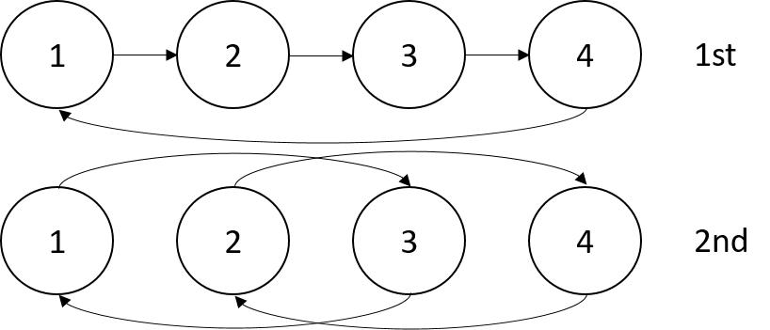


Terasort
Transfer data using MPI
Sorting 1TB of data records
Terasort execution time in 64 and 32 nodes. Only MPI shows the sorting time and communication time as other two frameworks doesn't provide a viable method to accurately measure them. Sorting time includes data save time. MPI-IB - MPI with Infiniband
Partition the data using a sample and regroup

Slide 34
K-Means Algorithm and Dataflow Specification
Point data set is partitioned and loaded to multiple map tasks
  Custom input format for loading the data as block of points
Full centroid data set is loaded at each map task
Iterate over the centroids
  Calculate the local point average at each map task
  Reduce (sum) the centroid averages to get a global centroids
  Broadcast the new centroids back to the map tasks
Data Set <Points>
Data Set <Initial Centroids>
Map (nearest centroid calculation)
Reduce (update centroids)
Data Set <Updated Centroids>
Broadcast

Slide 35
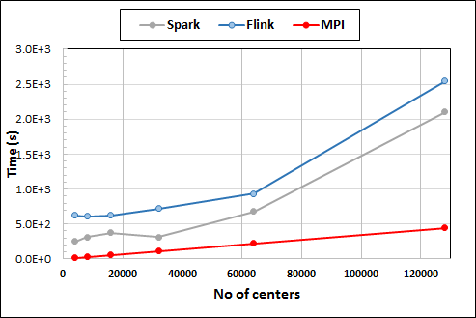
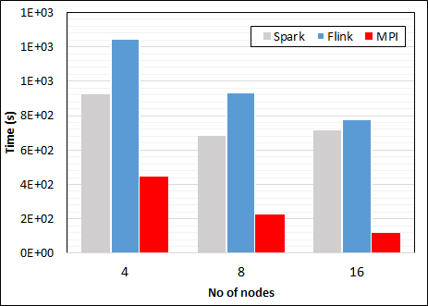
K-Means Clustering in Spark, Flink, MPI
K-Means execution time on 8 nodes with 20 processes in each node with 1 million points and varying number of centroids. Each point has 2 attributes.
K-Means execution time on varying number of nodes with 20 processes in each node with 1 million points and 64000 centroids. Each point has 2 attributes.
K-Means performed well on all three platforms when the computation time is high and communication time is low as illustrated in 10 million points. After lowering the computation and increasing the communication by setting the points to 1 million, the performance gap between MPI and the other two platforms increased.
Notes:
Note the differences in communication architectures
Note times are in log scale
Bars indicate compute only times, which is similar across these frameworks
Overhead is dominated by communications in Flink and Spark

Slide 36
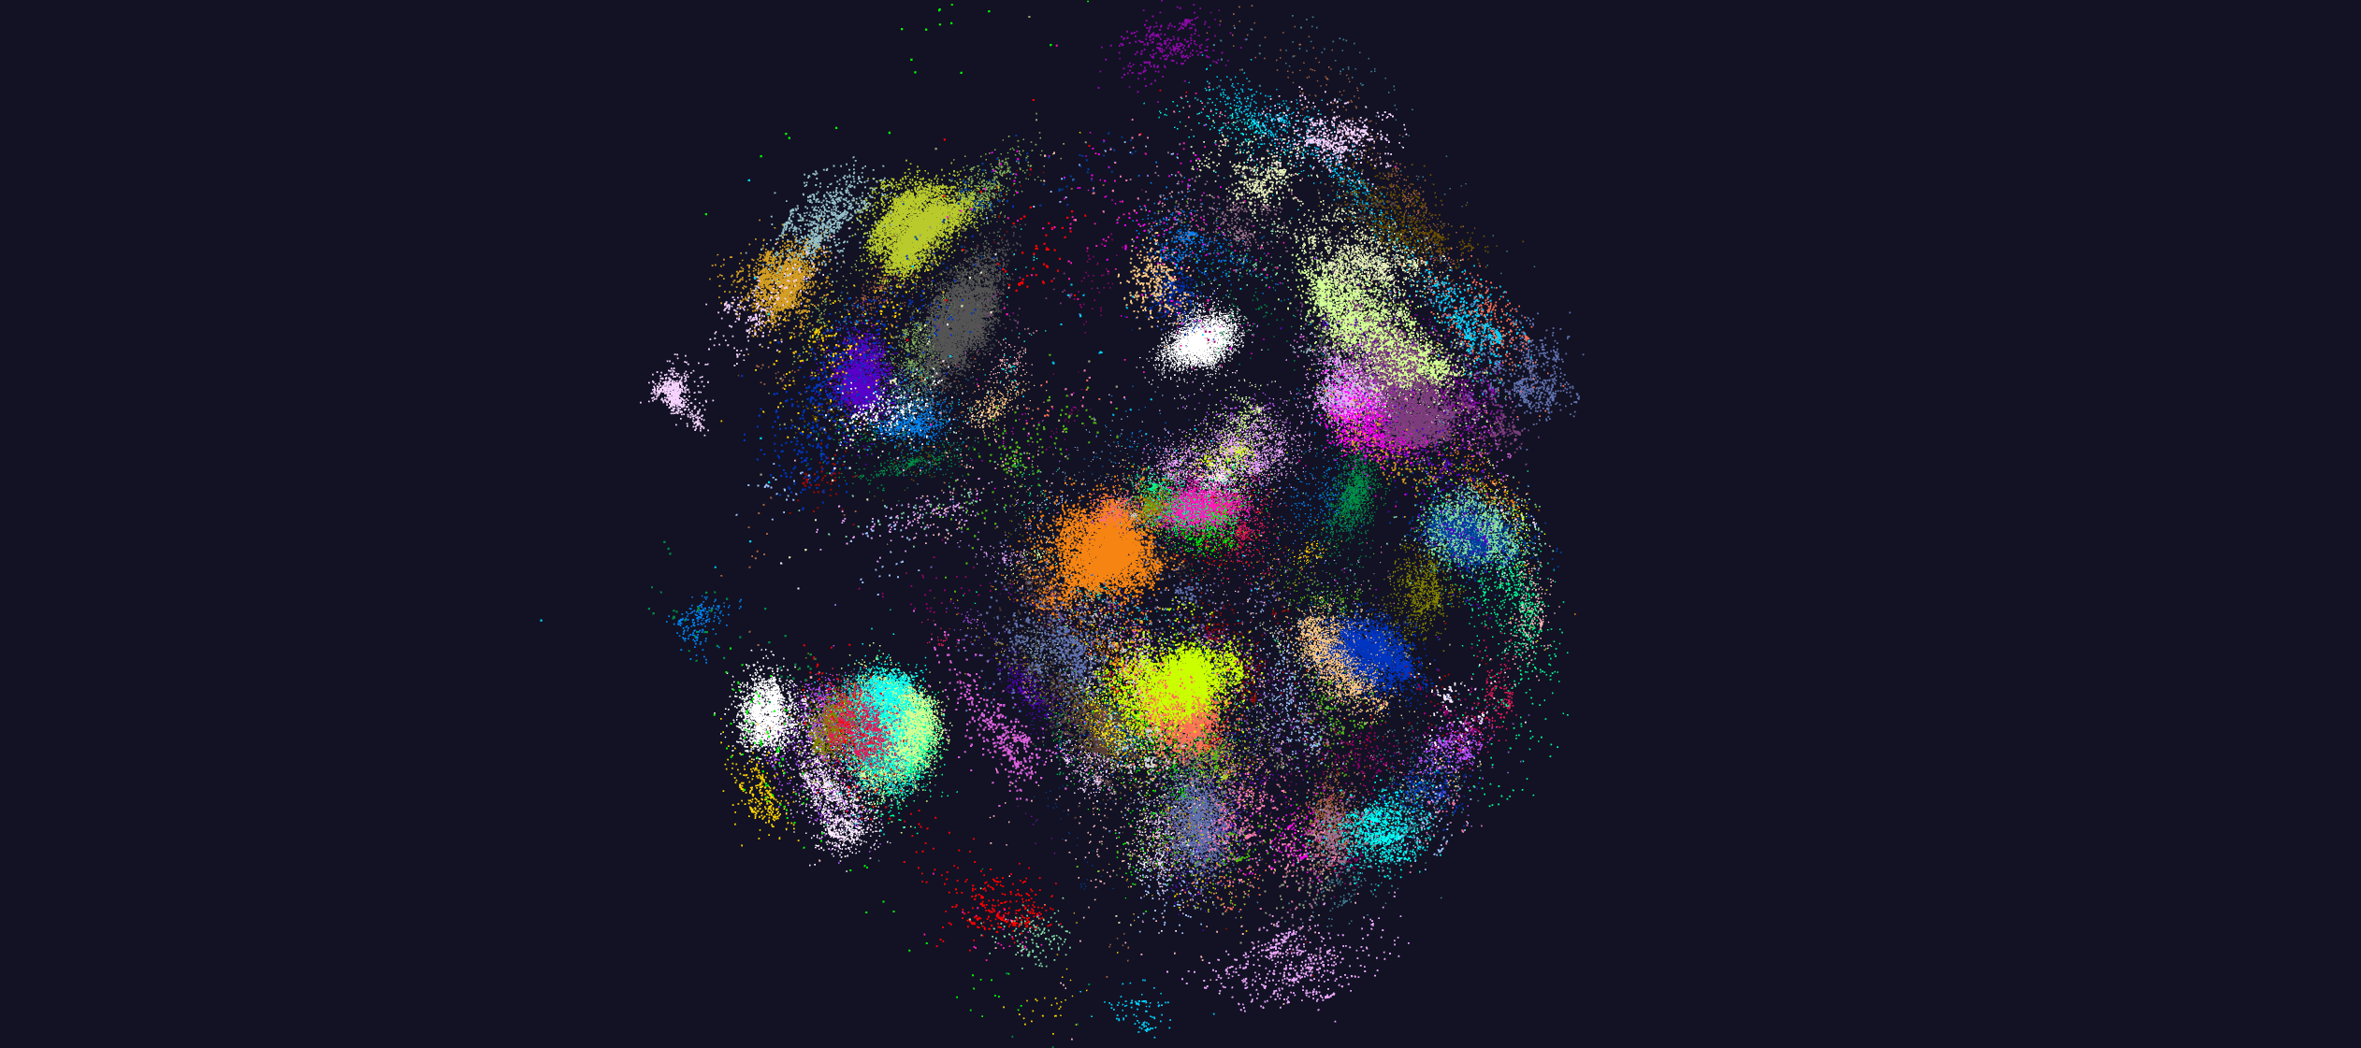
https://spidal-gw.dsc.soic.indiana.edu/public/resultsets/668018718
Global Machine Learning for O(N²) Clustering and Dimension Reduction MDS to 3D for 170,000 Fungi sequences – Performance analysis follows
211 Clusters
MDS allows user (visual) control of clustering process

Slide 37
Performance Factors
Threads
  Can threads easily speedup your application?
  Processes versus Threads
Affinity
  How to place threads/processes across cores?
  Why should we care?
Communication
  Why Inter-Process Communication (IPC) is expensive?
  How to improve?
Other factors
  Garbage collection
  Serialization/Deserialization
  Memory references and cache
  Data read/write

Slide 38
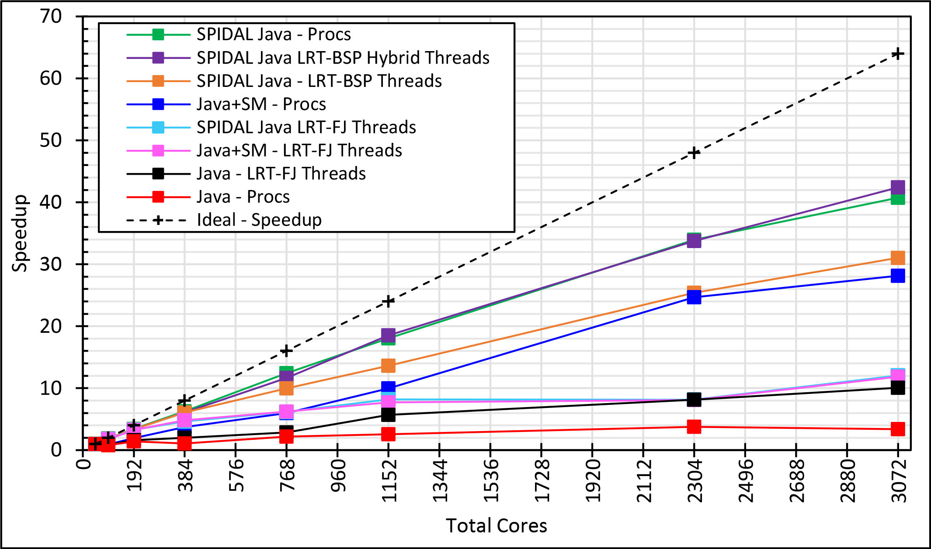
Java MPI performs well after optimization
Speedup compared to 1 process per node on 48 nodes
BSP Threads are better than FJ and at their best match Java MPI
128 24 core Haswell nodes on SPIDAL 200K DA-MDS Code
Best MPI; inter and intra node
MPI; inter/intra node; Java not optimized
Best FJ Threads intra node; MPI inter node

Slide 39
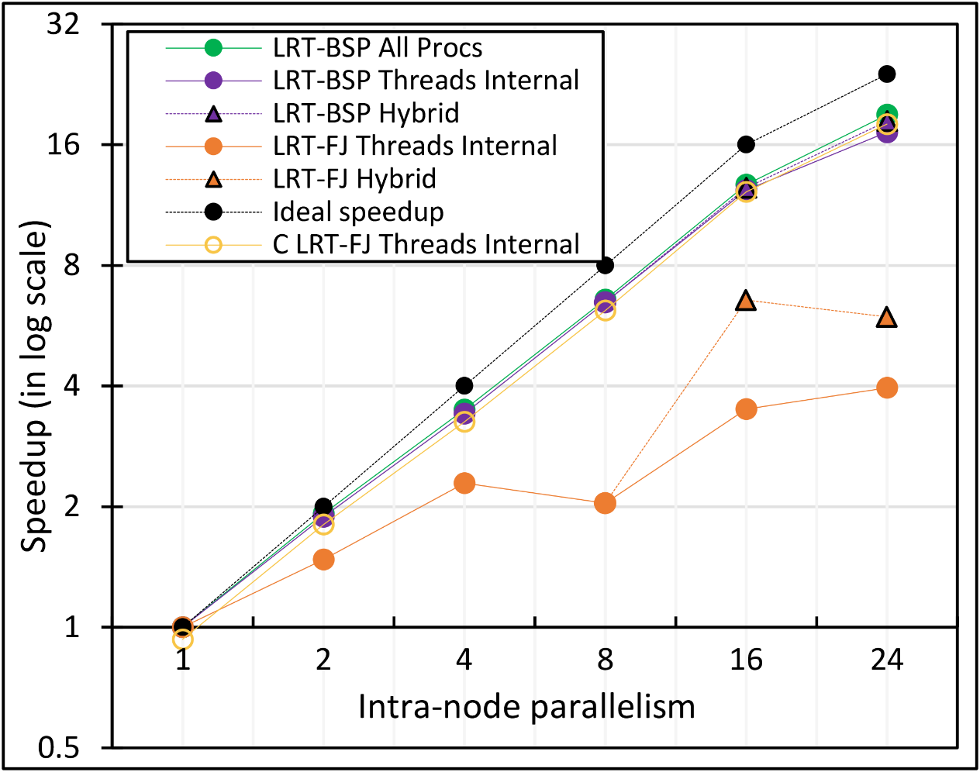
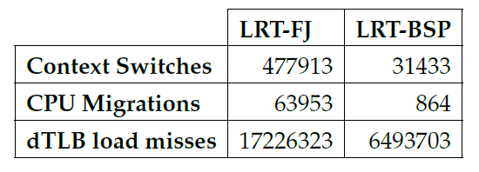
Performance Dependence on Number of Cores
All MPI internode
  All Processes
LRT BSP Java
  All Threads internal to node
  Hybrid – Use one process per chip
LRT Fork Join Java
  All Threads
  Hybrid – Use one process per chip
Fork Join C
All Threads
24-core node (16 nodes total)
15x
74x
2.6x

Slide 40
Java versus C Performance
C and Java Comparable with Java doing better on larger problem sizes
All data from one million point dataset with varying number of centers on 16 nodes 24 core Haswell

Slide 41
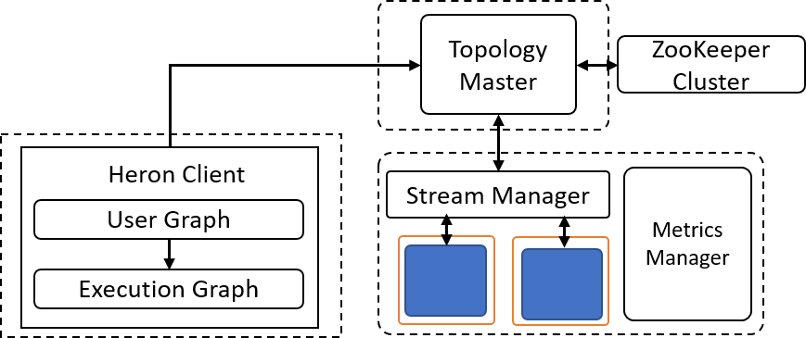
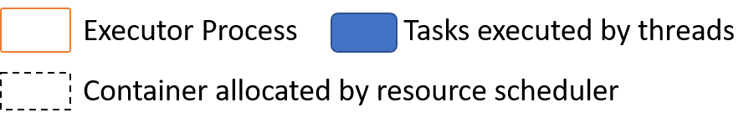
Heron Architecture
Each topology runs as a single standalone Job
Topology Master handles the Job
Can run on any resource scheduler (Mesos, Yarn, Slurm)
Each task run as a separate Java Process (Instance)
Stream manager acts as a network router/bridge between tasks in different containers
Every task in a container connects to a stream manager running in that container

Slide 42
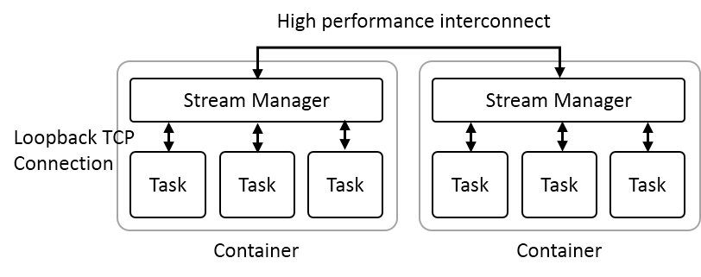
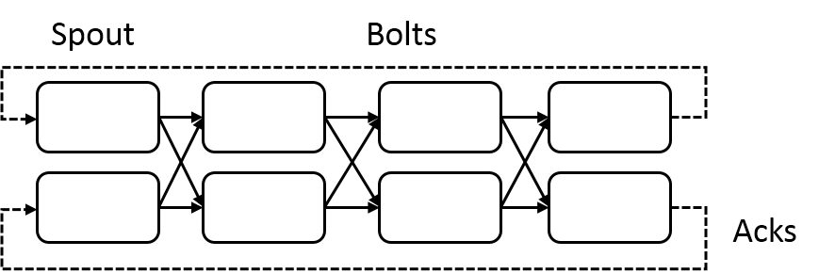
Heron Streaming Architecture
System Management
Add HPC
Infiniband
Omnipath
Inter node
Intranode
Typical Dataflow Processing Topology
User Specified Dataflow
All Tasks Long running
No context shared apart from dataflow
Parallelism 2; 4 stages

Slide 43
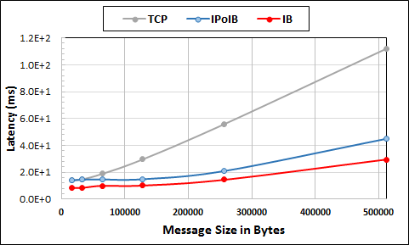
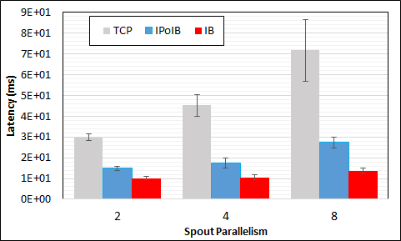
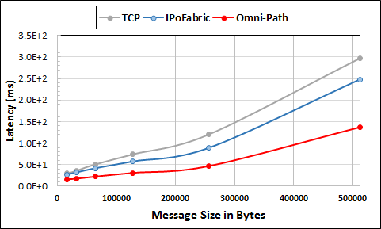
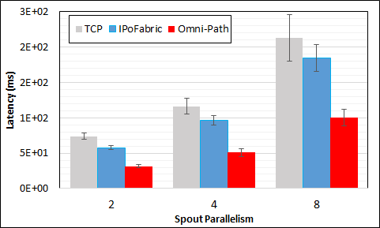
Heron High Performance Interconnects
Infiniband & Intel Omni-Path integrations
Using Libfabric as a library
Natively integrated to Heron through Stream Manager without needing to go through JNI

Slide 44
Implementing Twister2 in detail

Slide 45
What do we need in runtime for distributed HPC FaaS
Finish examination of all the current tools
Handle Events
Handle State
Handle Scheduling and Invocation of Function
Define and build infrastructure for data-flow graph that needs to be analyzed including data access API for different applications
Handle data flow execution graph with internal event-driven model
Handle geographic distribution of Functions and Events
Design and build dataflow collective and P2P communication model (build on Harp)
Decide which streaming approach to adopt and integrate
Design and build in-memory dataset model (RDD improved) for backup and exchange of data in data flow (fault tolerance)
Support DevOps and server-hidden (serverless) cloud models
Support elasticity for FaaS (connected to server-hidden)
Green is initial (current) work

Slide 46
Communication Models
MPI Characteristics: Tightly synchronized applications
  Efficient communications (µs latency) with use of advanced hardware
  In place communications and computations (Process scope for state)
Basic dataflow: Model a computation as a graph
  Nodes do computations with Task as computations and
  edges are asynchronous communications
  A computation is activated when its input data dependencies
  are satisfied
Streaming dataflow: Pub-Sub with data partitioned into streams
  Streams are unbounded, ordered data tuples
  Order of events important and group data into time windows
Machine Learning dataflow: Iterative computations and keep track of state
  There is both Model and Data, but only communicate the model
  Collective communication operations such as AllReduce AllGather
  Can use in-place MPI style communication
W
S
W
G
S
Dataflow
W

Slide 47
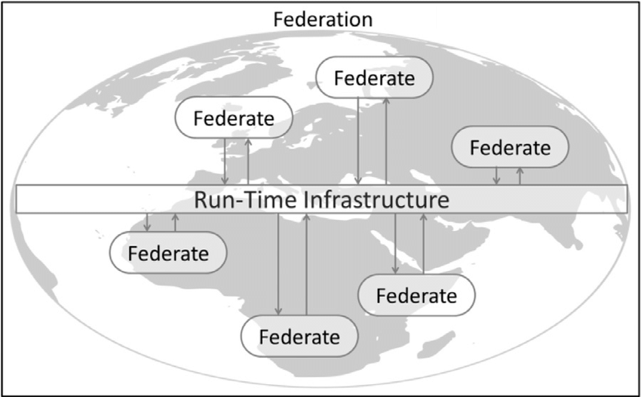
Naiad Timely Dataflow HLA Distributed Simulation

Slide 48
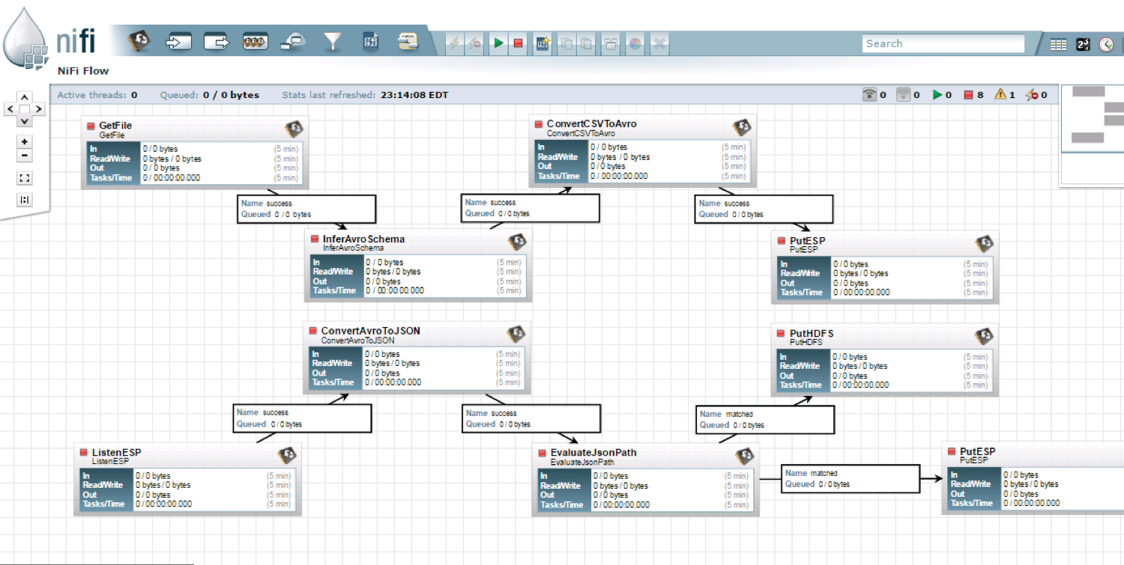
NiFi Workflow

Slide 49
Dataflow for a linear algebra kernel
Typical target of HPC AMT System
Danalis 2016

Slide 50
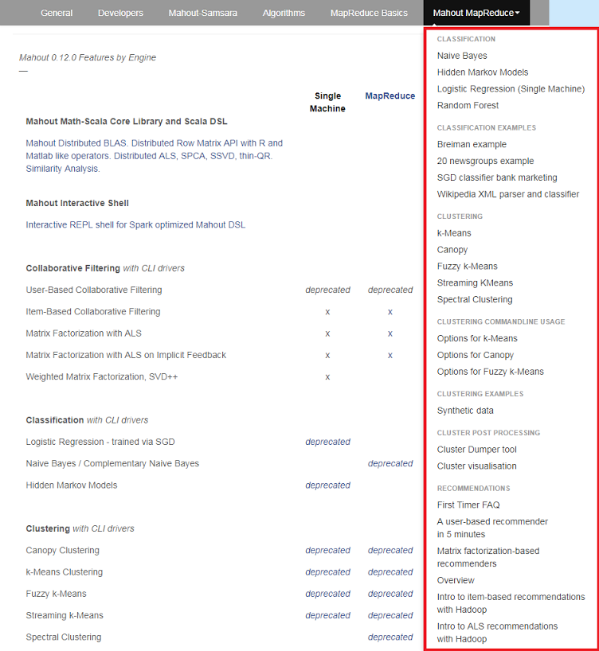
Mahout and SPIDAL
Mahout was Hadoop machine learning library but largely abandoned as Spark outperformed Hadoop
SPIDAL outperforms Spark Mllib and Flink due to better communication and in-place dataflow.
SPIDAL also has community algorithms
  Biomolecular Simulation
  Graphs for Network Science
  Image processing for pathology and polar science

Slide 51
Core SPIDAL Parallel HPC Library with Collective Used
DA-MDS Rotate, AllReduce, Broadcast
Directed Force Dimension Reduction AllGather, Allreduce
Irregular DAVS Clustering Partial Rotate, AllReduce, Broadcast
DA Semimetric Clustering Rotate, AllReduce, Broadcast
K-means AllReduce, Broadcast, AllGather DAAL
SVM AllReduce, AllGather
SubGraph Mining AllGather, AllReduce
Latent Dirichlet Allocation Rotate, AllReduce
Matrix Factorization (SGD) Rotate DAAL
Recommender System (ALS) Rotate DAAL
Singular Value Decomposition (SVD) AllGather DAAL
QR Decomposition (QR) Reduce, Broadcast DAAL
Neural Network AllReduce DAAL
Covariance AllReduce DAAL
Low Order Moments Reduce DAAL
Naive Bayes Reduce DAAL
Linear Regression Reduce DAAL
Ridge Regression Reduce DAAL
Multi-class Logistic Regression Regroup, Rotate, AllGather
Random Forest AllReduce
Principal Component Analysis (PCA) AllReduce DAAL
DAAL implies integrated with Intel DAAL Optimized Data Analytics Library (Runs on KNL!)

Slide 53
Dataflow Graph State and Scheduling
State is a key issue and handled differently in systems
  CORBA, AMT, MPI and Storm/Heron have long running tasks that preserve state
  Spark and Flink preserve datasets across dataflow node using in-memory databases
  All systems agree on coarse grain dataflow; only keep state by exchanging data.
Scheduling is one key area where dataflow systems differ
  Dynamic Scheduling (Spark)
    Fine grain control of dataflow graph
    Graph cannot be optimized
  Static Scheduling (Flink)
    Less control of the dataflow graph
    Graph can be optimized

Slide 54
Fault Tolerance and State
Similar form of check-pointing mechanism is used already in HPC and Big Data
  although HPC informal as doesn’t typically specify as a dataflow graph
  Flink and Spark do better than MPI due to use of database technologies; MPI is a bit harder due to richer state but there is an obvious integrated model using RDD type snapshots of MPI style jobs
Checkpoint after each stage of the dataflow graph
  Natural synchronization point
  Let’s allows user to choose when to checkpoint (not every stage)
  Save state as user specifies; Spark just saves Model state which is insufficient for complex algorithms

Slide 55
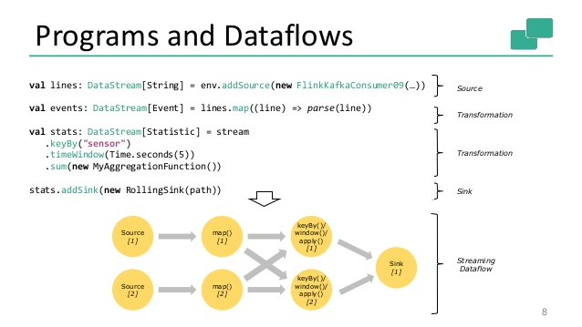
Spark Kmeans Flink Streaming Dataflow
P = loadPoints()
C = loadInitCenters()
for (int i = 0; i < 10; i++) {
T = P.map().withBroadcast(C)
C = T.reduce() }
Store C in RDD

Slide 56
Summary of Twister2:
Next Generation HPC Cloud + Edge + Grid
We suggest an event driven computing model built around Cloud and HPC and spanning batch, streaming, and edge applications
  Highly parallel on cloud; possibly sequential at the edge
Expand current technology of FaaS (Function as a Service) and server-hidden (serverless) computing
We have built a high performance data analysis library SPIDAL
We have integrated HPC into many Apache systems with HPC-ABDS
We have done a very preliminary analysis of the different runtimes of Hadoop, Spark, Flink, Storm, Heron, Naiad, DARMA (HPC Asynchronous Many Task)
  There are different technologies for different circumstances but can be unified by high level abstractions such as communication collectives
  Need to be careful about treatment of state – more research needed
See long paper http://dsc.soic.indiana.edu/publications/Twister2.pdf

Slide 57
HPCCloud Convergence Architecture
Running same HPC-ABDS software across all platforms but data management machine has different balance in I/O, Network and Compute from “model” machine
  Edge has same software model (HPC-FaaS) but very different resource characteristics
  Note data storage approach: HDFS v. Object Store v. Lustre style file systems is still rather unclear
The Model behaves similarly whether from Big Data or Big Simulation.
Data Management Model for Big Data
and Big Simulation
Cloud
HPC
Fog
Centralized HPC Cloud +
Edge = Fog + IoT Devices

Slide 58
Summary of Big Data HPC Convergence I
Applications, Benchmarks and Libraries
  51 NIST Big Data Use Cases, 7 Computational Giants of the NRC Massive Data Analysis, 13 Berkeley dwarfs, 7 NAS parallel benchmarks
  Unified discussion by separately discussing data & model for each application;
  64 facets– Convergence Diamonds -- characterize applications
  Characterization identifies hardware and software features for each application across big data, simulation; “complete” set of benchmarks (NIST)
Exemplar Ogre and Convergence Diamond Features
  Overall application structure e.g. pleasingly parallel
  Data Features e.g. from IoT, stored in HDFS ….
  Processing Features e.g. uses neural nets or conjugate gradient
  Execution Structure e.g. data or model volume
Need to distinguish data management from data analytics
Management and Search I/O intensive and suitable for classic clouds
  Science data has fewer users than commercial but requirements poorly understood
Analytics has many features in common with large scale simulations
  Data analytics often SPMD, BSP and benefits from high performance networking and communication libraries.
  Decompose Model (as in simulation) and Data (bit different and confusing) across nodes of cluster

Slide 59
Summary of Big Data HPC Convergence II
Software Architecture and its implementation
  HPC-ABDS: Cloud-HPC interoperable software: performance of HPC (High Performance Computing) and the rich functionality of the Apache Big Data Stack.
  Added HPC to Hadoop, Storm, Heron, Spark;
  Twister2 will add to Beam and Flink as a HPC-FaaS programming model
  Could work in Apache model contributing code in different ways
  One approach is an HPC project in Apache Foundation
HPCCloud runs same HPC-ABDS software across all platforms but “data management” nodes have different balance in I/O, Network and Compute from “model” nodes
  Optimize to data and model functions as specified by convergence diamonds rather than optimizing for simulation and big data
Convergence Language: Make C++, Java, Scala, Python (R) … perform well
Training: Students prefer to learn machine learning and clouds and need to be taught importance of HPC to Big Data
Sustainability: research/HPC communities cannot afford to develop everything (hardware and software) from scratch
HPCCloud 2.0 uses DevOps to deploy HPC-ABDS on clouds or HPC
HPCCloud 3.0 delivers Solutions as a Service with an HPC-FaaS programming model

