Slide 1
Summary of Streaming Data Workshop STREAM2015 October 27-28 2015 with still to come STREAM2016 March 21-24 2016 and a few remarks on IU DDDAS work
http://streamingsystems.org/
DDDAS PI Meeting
Geoffrey Fox, Shantenu Jha, Lavanya Ramakrishnan
January 27, 2016

Slide 2
Overall Information I
STREAM2015 proposed in response to NSF ACI’s Dear Colleague Letter [DCL15053] to the community to identify the gaps, requirements and challenges of future production cyberinfrastructure beyond traditional HPC.
Built on ongoing work on technology for streaming and use in DoE – especially for steering and analysis of instruments such as light sources
First workshop AFOSR and NSF funding
October 27-28 2015 Indianapolis
http://streamingsystems.org/ has background material plus STREAM2015 resources
43 attendees (Dr. Darema, myself and Varela from DDDAS)
17 Workshop white papers (from call for participation)
29 Presentations (28 with slides; 23 with videos)
Draft Report http://streamingsystems.org/finalreport.html

Slide 3
Overall Information II
Lot of enthusiasm from participants for workshop, field and continuation of activities
“Different” slice of researchers from normal
Reasonable Industry involvement: Amazon, Google, Microsoft. Johnson Controls (Industrial Internet of Things IIoT)
Missing IBM, Twitter, GE (IIoT leader with Predix) and others
Covered field broadly including technology, applications and education
There will be a DoE focused and funded follow up workshop in Washington DC STREAM2016 March 21-24, 2016
Certainly additional focus on DoE instruments
Working with Rich Carlson of DoE on planning
Also AFOSR funded

Slide 4
High level Contents of Final Report
1 Executive Summary
2 Introduction
3 State of the Art
4 Next Steps and Research Directions
5 Build and Sustain Community
6 Summary
7 Acknowledgements
8 Appendices (a lot of material)
8.1 Participants (43)
8.2 Workshop Presentations (video and slides 29)
8.3 Workshop White Papers (17)
8.4 Citations

Slide 5
What are we Studying
A stream is a possibly unbounded sequence (time series) of events.
Successive events may or may not be correlated and each event may optionally include a timestamp.
Exemplars of streams include time-series data generated by instruments, experiments, simulations, autonomous vehicles or commercial big data applications including e-commerce, social media posts and IIoT.
Steering is defined as the ability to dynamically change the progression of a computational process such as a large-scale simulation via an external computational process. Steering, which is inevitably real-time, might include changing progress of simulations, or realigning experimental sensors, or control of autonomous vehicles.
Streaming and steering often occur together as in DDDAS. An example could be for an exascale simulations where it is impractical to store every timestep and the data must be reduced, resulting in streams which may constitute the final results from the simulation in a manner similar to the way we use data from an instrument in a massive physics experiment.

Slide 6
3. State of the Art
​3.1​ Exemplar applications: Characteristics of Applications, Industry-Science differences.
​3.1.1​ Application Categories and Exemplars
​3.1.2​ Application Characteristics
​3.2​ Current solutions -- Industry, Apache, Domain-Specific
​3.2.1​ Particular Solutions
​3.2.2​ Technology Challenges and Features
​3.3​ Connections - Streaming + HPC convergence. Role of workflow.

Slide 7
Streaming/Steering Application Class |  | Details and Examples | Features
1 | DDDAS, (Industrial) Internet of Things, Control, Cyberphysical Systems, | Software Defined Machines, Smart buildings, transportation, Electrical Grid, Environmental and seismic sensors, Robotics, Autonomous vehicles, Drones | Real-time response often needed; data varies from large to small events, heterogeneity in data sizes and timescales
2 | Internet of People: including wearables | Smart watches, bands, health, glasses, telemedicine | Small independent events
3 | Social media, Twitter, cell phones, blogs, e-commerce and financial transactions | Study of information flow, online algorithms, outliers, graph analytics | Sophisticated analytics across many events; text and numerical data
4 | Satellite and airborne monitors, National Security: Justice, Military | Surveillance, remote sensing, Missile defense, Mission planning, Anti-submarine, Naval tactical cloud | Often large volumes of heterogeneous data and sophisticated image analysis
5 | Astronomy, Light and Neutron Sources, TEM, Instruments like LHC, Sequencers | Scientific Data Analysis in real time or batch from “large” sources. LSST, DES, SKA in astronomy | Real-time or sometimes batch, or even both. large complex events
6 | Data Assimilation | Integrate typically distributed data into simulations to enhance quality. | Link large scale parallel simulations with time dependent data. Sensitivity to latency.
7 | Analysis of Simulation Results | Climate, Fusion, Molecular Dynamics, Materials. Typically local or in-situ data. HPC Big Data Convergence | Increasing bottleneck as simulations scale in size.
8 | Steering and Control | Aerial platforms. Control of simulations or Experiments. Network monitoring. Data could be local or distributed | Variety of scenarios with similarities to robotics. Fault tolerance often critical

Slide 8
“State of the Art I”
Classification of Application
Initial investigation of application characteristics to define/develop classification
Event size, synchronicity, time & length scales..
See table on last slide
Current solutions
Impressive commercial solutions for commercial applications: applicability to science and Government(e.g. AFOSR) unclear.
Plethora of “local point” solutions (see report for detailed listing) but few end-to-end general streaming infrastructures outside open sourced big data systems (Apache Spark, Flink, Storm, Samza).
Opens up issues in distributed computing, e.g., performance, fault-tolerance, dynamic resource management.

Slide 9
“State of the Art II”
Convergence of Streaming + HPC
Commercial and Apache solutions do not address this space
DDDAS leader in area
Interaction between “big data” “big simulation” and “streaming data” technologies
Integrate streaming data with HPC simulations identified by DoE as key exascale project issue
Plethora of issues in distributed workflow
Current XSEDE and DoE infrastructure not optimized for streaming data

Slide 10
Topics in Next Steps and Research Directions
​​​​4.1​ New Algorithms
​4.2​ Programming and Runtime Model; Languages
​4.3​ Benchmarks and Application Collections and Scenarios
​4.4​ Streaming Software System and Algorithm Library
​4.5​ Streaming System Infrastructure and its Characteristics (NSF’s goal in funding)
​4.6​ Steering and Human in the Loop

Slide 11
Future Research Directions I
Algorithms including existing and new online (touch each data point once) and sampling methods
Needed even for batch jobs to reduce O(N²) algorithms to O(NlogN) or reduce volume by sampling
Research but little robust “production” algorithms
Programming Models and runtime
Note commercial solutions are better than existing Apache solutions (4 year old commercial systems!)
e.g. Twitter announces Heron to replace Storm; Amazon Kinesis built to improve Storm performance
Links to HPC runtime, dataflow and publish-subscribe technologies

Slide 12
Future Research Directions II
Benchmarks and Application Collections and Scenarios
Note huge amount of big data benchmarks (BigDataBench) but no streaming focus
Participant talks/white papers suggested a few
Streaming Software System and Algorithm Library
Note lack of streaming algorithms
Streaming System infrastructure
What NSF wanted!
Leverage HPC – Big Data convergence
Steering and Human in the Loop
Another DDDAS focus and DoE AIM project “Analysis in Motion” Initiative http://aim.pnnl.gov

Slide 13
Near Term Action Items
Workshop brought together an interesting interdisciplinary community – need to build and sustain e.g. with NSF RCN?
Understand different applications e.g. relation between science, government and commercial application characteristics
Feed into benchmarks
Develop Benchmarks and Application Collections
DDDAS has many and some from participants
Prototyping of existing and potentially new systems in different data center architectures (NSF and DoE focus?)
Clouds
HPC
External and internal I/O

Slide 14
STREAM2016 Follow-on Workshop
Sponsored by DoE and AFOSR
No travel funds
http://streamingsystems.org/stream2016.html
March 21-24 (2 days in this window) Washington DC
By invitation: Please send 1-2 page white papers by February 24 2016 to Geoffrey Fox gcf@Indiana.edu
Address any topics as in (or outside!) STREAM2015. Draft final report at
http://streamingsystems.org/finalreport.html
Also see talks and white papers at STREAM2015

Slide 15
AFOSR FA9550-13-1-0225: Cloud-Based Perception and Control of Sensor Nets and Robot Swarms
Geoffrey Fox, David Crandall,
Supun Kamburugamuve, Jangwon Lee, Jingya Wang

Slide 16
“Map Streaming” Architecture used in Apache Storm and Commercial Solutions
Dataflow for computing (maps)
Data (Streaming Events) buffered by publish-subscribe brokers
Apache Kafka
RabbitMQ ….
IU looked at parallel computing for several robot/drone applications
IU released HPC enhancements to Storm for higher performance inter-map communication
https://github.com/iotcloud

Slide 17
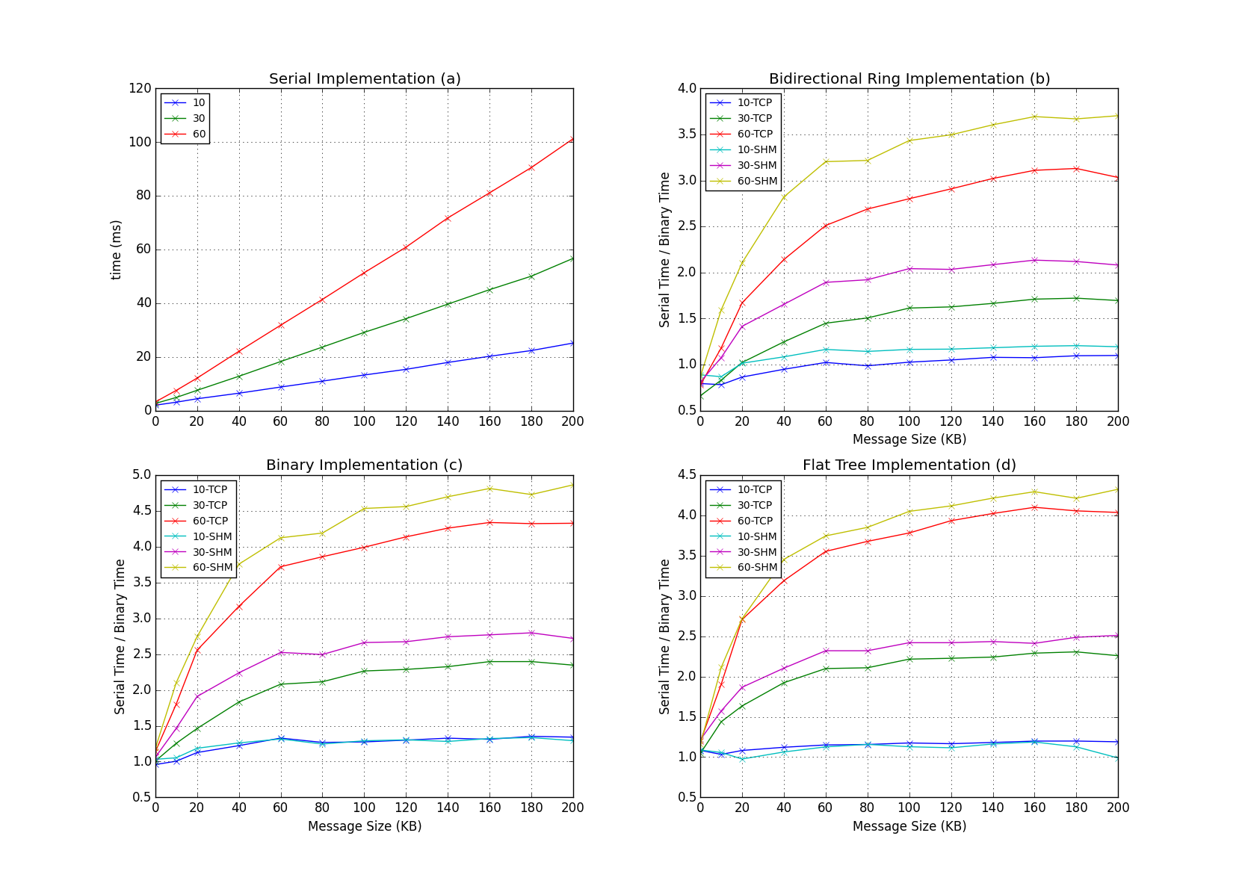
Original and new Storm Broadcast Algorithms
Speedup of latency with both TCP based and Shared Memory (for intra-node communication) based communications for different algorithms and sizes
Bidirectional Ring
Original
Binary Tree
Flat Tree

Slide 18
Original and new Storm Broadcast Algorithms
Throughput with both TCP based and (for intra-node communication) Shared Memory based communications for different algorithms and sizes
Bidirectional Ring
Original
Binary Tree
Flat Tree

Slide 19
Deep learning in interactive applications
State of the art deep learning-based object detectors can recognize among hundreds of object classes
This capability would be very useful for mobile devices, including robots
But, compute requirements are enormous
Model for a single object has millions, billions of parameters
Classification requires ~20 sec/image on a high end CPU,
and ~2 sec/image on a high-end GPU
Use Regions with Convolutional Neural Networks CNNs (R-CNNs) trained on ImageNet (obviously not best as non optimized image collection)

Slide 20
Recognition on an aerial drone
Scenario: a drone needs to navigate through cluttered environment to locate a particular object
Major challenges
Communications link with limited bandwidth
Long, unknown latencies for network and cloud
Real-time decisions needed for stability control

Slide 21
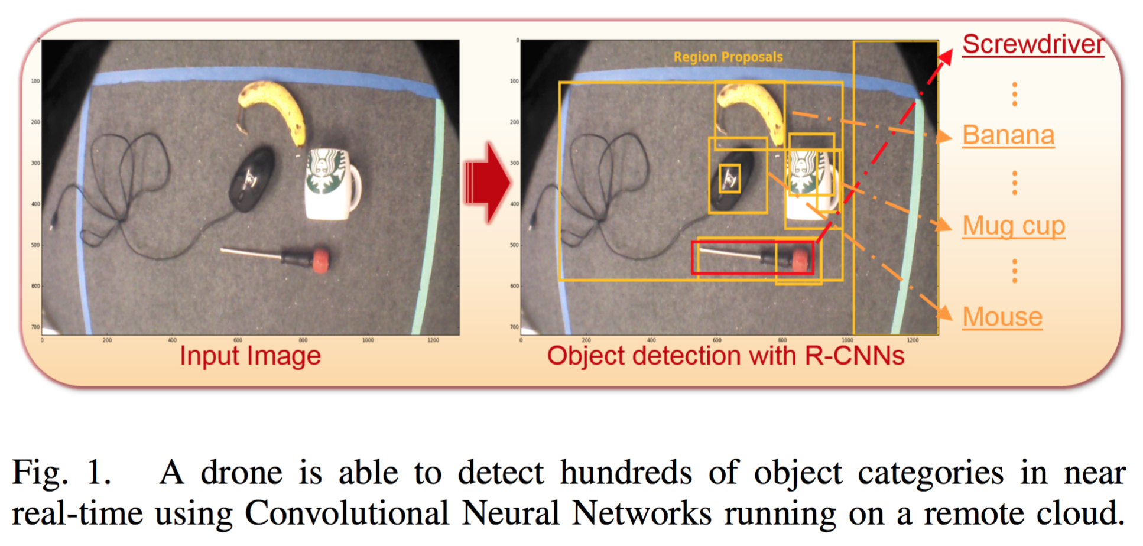

Slide 22
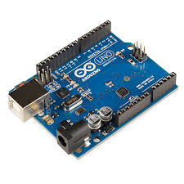
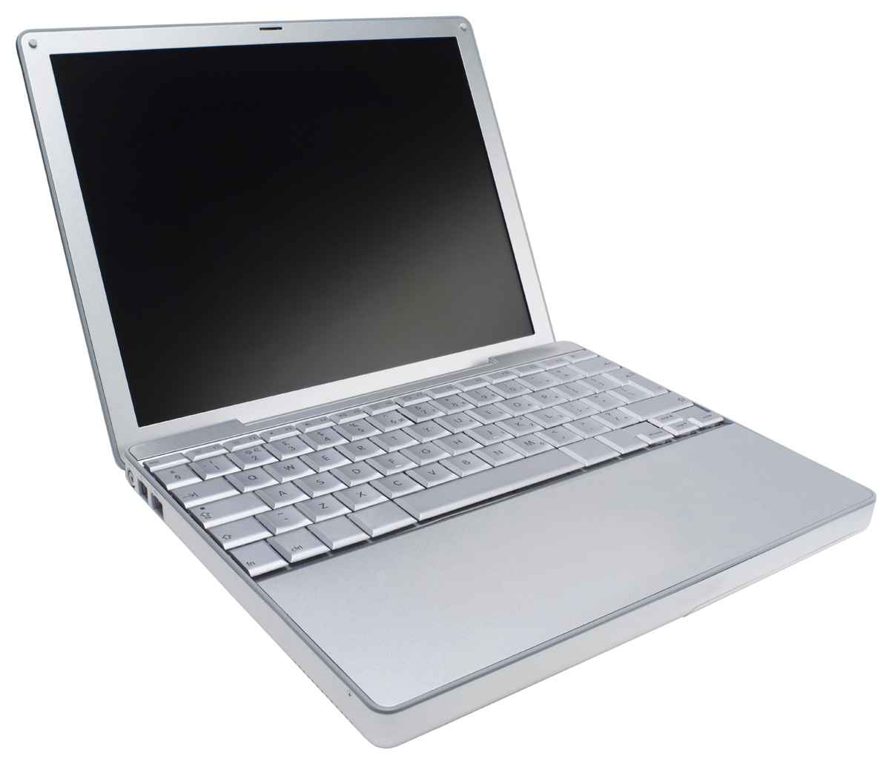
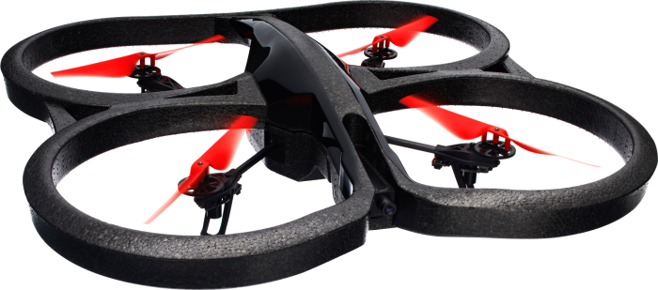
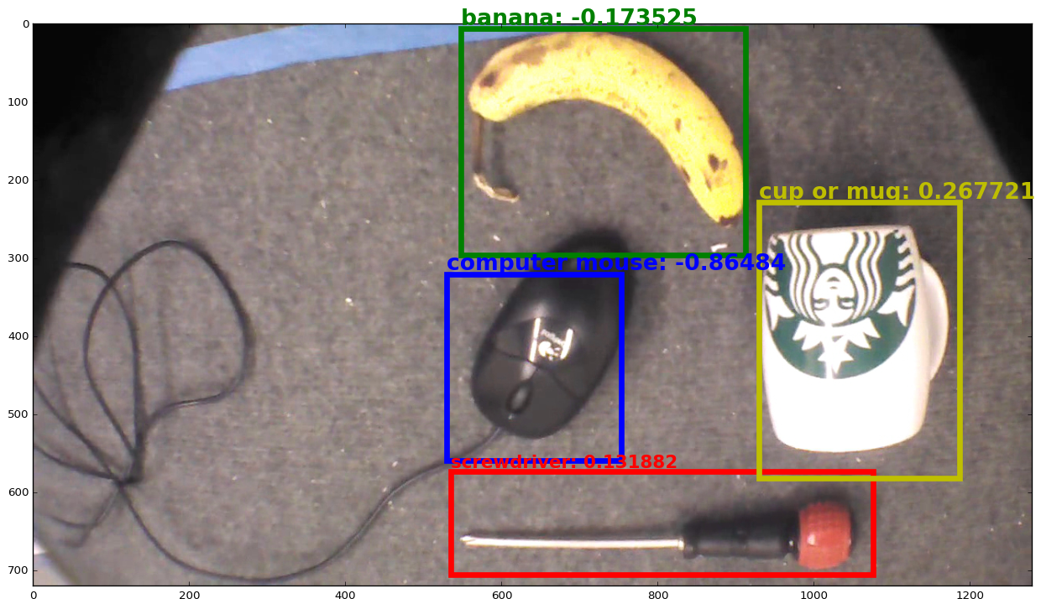
Hierarchical Recognition Pipeline
On drone
Near drone
Far away
Images @ 60Hz
Images @ 10Hz
Images @ <1Hz
Landmark recognition, object detection
Deep CNN-based object recognition
Servo
commands
Low-level feature extraction for stability control
High-level navigation commands
Recognized objects
Detected object location
PID Control

Slide 23
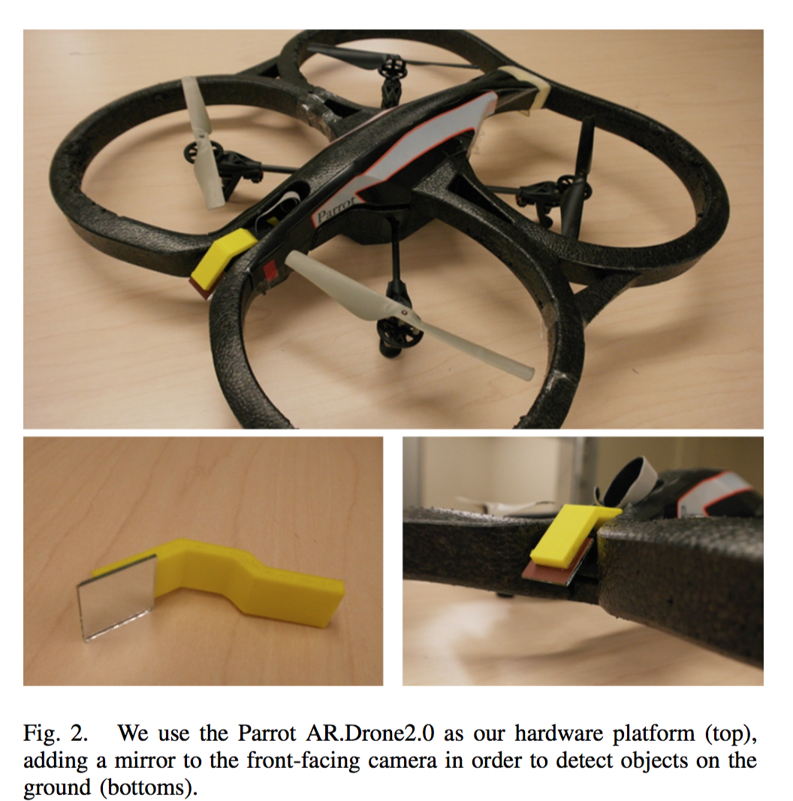
https://github.com/iotcloud
As this camera has highest resolution

Slide 24
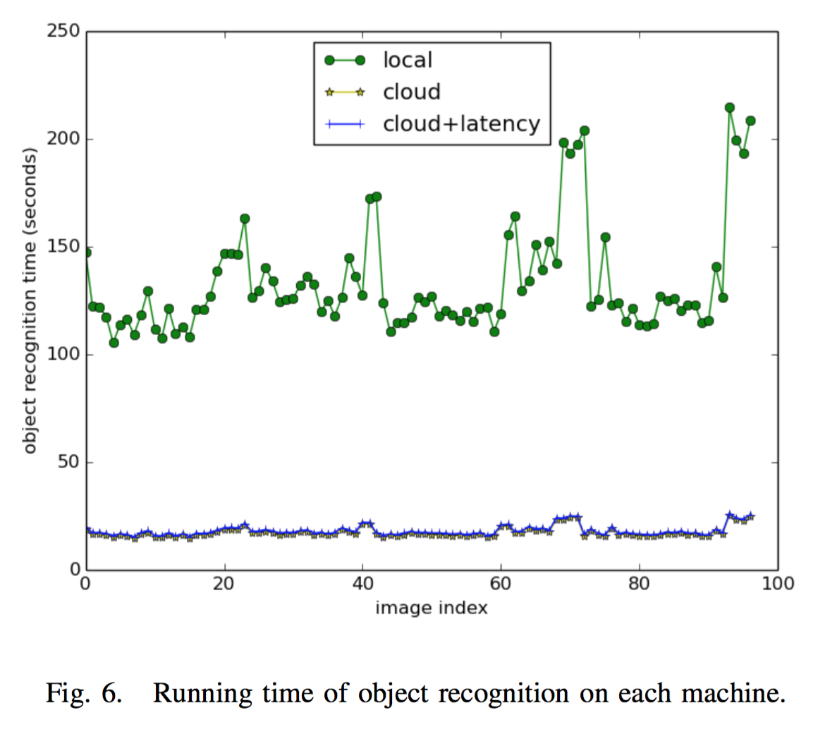
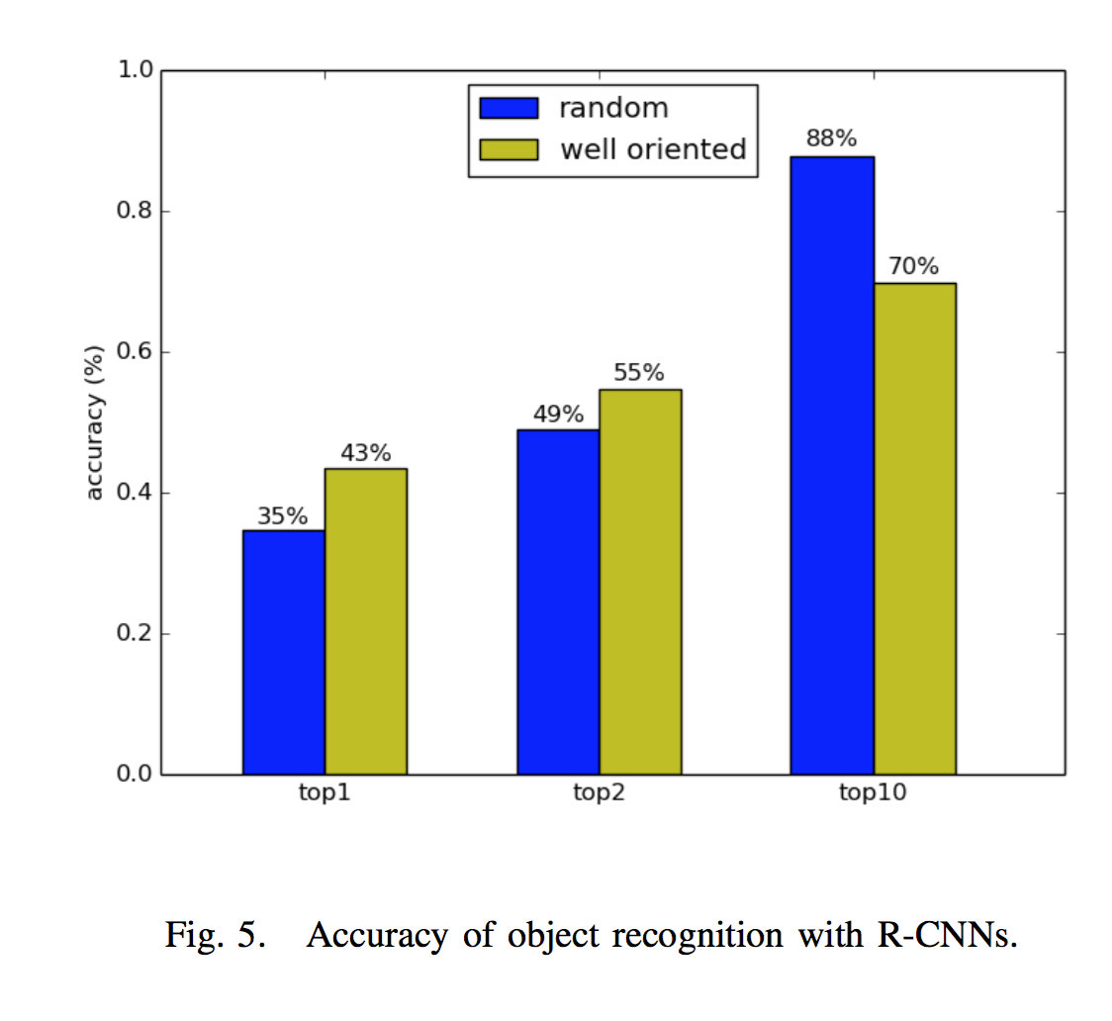
Regions with CNNs (R-CNNs)
Does much better than “part-based models”

