Slide 1
Big Data, Simulations and HPC Convergence
BDEC: Big Data and Extreme-scale Computing
June 15-17 2016 Frankfurt
http://www.exascale.org/bdec/meeting/frankfurt
Geoffrey Fox, Judy Qiu, Shantenu Jha, Saliya Ekanayake, Supun Kamburugamuve
June 16, 2016
gcf@indiana.edu
http://www.dsc.soic.indiana.edu/, http://spidal.org/ http://hpc-abds.org/kaleidoscope/
Department of Intelligent Systems Engineering
School of Informatics and Computing, Digital Science Center
Indiana University Bloomington

Slide 2
Components in Big Data HPC Convergence
Applications, Benchmarks and Libraries
51 NIST Big Data Use Cases, 7 Computational Giants of the NRC Massive Data Analysis, 13 Berkeley dwarfs, 7 NAS parallel benchmarks
Unified discussion by separately discussing data & model for each application;
64 facets– Convergence Diamonds -- characterize applications
Pleasingly parallel or Streaming used for data & model;
O(N²) Algorithm relevant to model for big data or big simulation
“Lustre v. HDFS” just describes data
“Volume” large or small separately for data and model
Characterization identifies hardware and software features for each application across big data, simulation; “complete” set of benchmarks (NIST)
Software Architecture and its implementation
HPC-ABDS: Cloud-HPC interoperable software: performance of HPC (High Performance Computing) and the rich functionality of the Apache Big Data Stack.
Added HPC to Hadoop, Storm, Heron, Spark; will add to Beam and Flink
Work in Apache model contributing code
Run same HPC-ABDS across all platforms but “data management” nodes have different balance in I/O, Network and Compute from “model” nodes
Optimize to data and model functions as specified by convergence diamonds
Do not optimize for simulation and big data

Slide 3
64 Features in 4 views for Unified Classification of Big Data and Simulation Applications
Both
Simulations
Analytics
(Model for Data)
(Not surprising! Nearly all Data)
(All Model for simulations & Data Analytics)
(The details : Mix of Data and Model)
(Nearly all combination of Data+Model)

Slide 4
HPC-ABDS

Slide 5
HPC-ABDS Activities of NSF14-43054
Level 17: Orchestration: Apache Beam (Google Cloud Dataflow)
Level 16: Applications: Datamining for molecular dynamics, Image processing for remote sensing and pathology, graphs, streaming, bioinformatics, social media, financial informatics, text mining
Level 16: Algorithms: Generic and application specific; SPIDAL Library
Level 14: Programming: Storm, Heron (Twitter replaces Storm), Hadoop, Spark, Flink. Improve Inter- and Intra-node performance; science data structures
Level 13: Runtime Communication: Enhanced Storm and Hadoop (Spark, Flink, Giraph) using HPC runtime technologies, Harp
Level 11: Data management: Hbase and MongoDB integrated via use of Beam and other Apache tools; enhance Hbase
Level 9: Cluster Management: Integrate Pilot Jobs with Yarn, Mesos, Spark, Hadoop; integrate Storm and Heron with Slurm
Level 6: DevOps: Python Cloudmesh virtual Cluster Interoperability

Slide 6
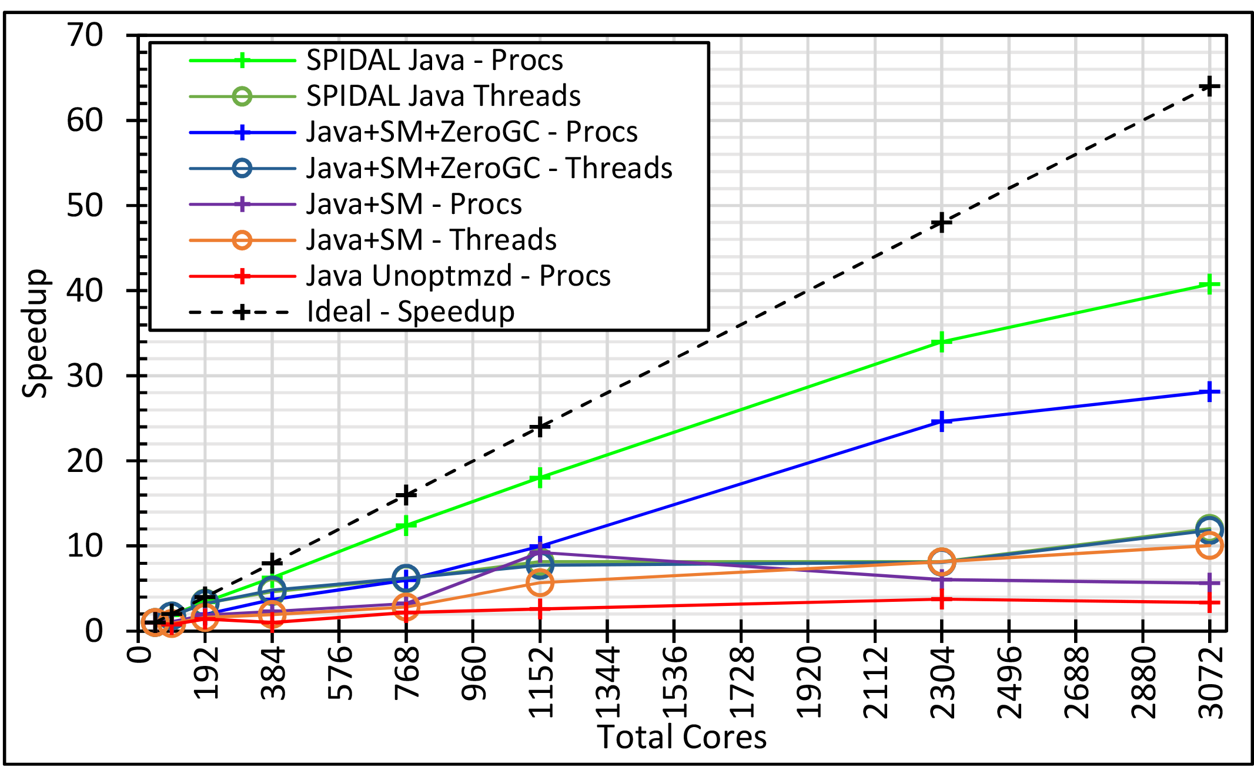
Convergence Language: Recreating Java Grande 128 24 core Haswell nodes on SPIDAL Data Analytics Best Java factor of 10 faster than “out of the box”; comparable to C++
Speedup compared to 1 process per node on 48 nodes
Best MPI; inter and intra node
MPI; inter/intra node; Java not optimized
Best Threads intra node; MPI inter node

