Slide 1
HPC Cloud and Big Data Testbed
Geoffrey Fox, November 21, 2017
Department of Intelligent Systems Engineering
gcf@indiana.edu, http://www.dsc.soic.indiana.edu/, http://spidal.org/
Work with Judy Qiu, Peng Bo, Supun Kamburugamuve, Kannan Govindarajan, Pulasthi Wickramasinghe
`

Slide 2
Big Data Processing Systems
Application Requirements: The structure of application clearly impacts needed hardware and software
  Pleasingly parallel
  Workflow
  Global Machine Learning
Data model: SQL, NoSQL; File Systems, Object store; Lustre, HDFS
Distributed data from distributed sensors and instruments (Internet of Things) requires Edge computing model
  Device – Fog – Cloud model and streaming data software and algorithms
Hardware: node (accelerators such as GPU or KNL for deep learning) and multi-node architecture configured as HPC Cloud;
  Disks speed and location
This implies software requirements
Analytics
Data management
Streaming or Repository access or both

Slide 3
Motivating Remarks
Use of public clouds increasing rapidly
  Clouds becoming diverse with subsystems containing GPU’s, FPGA’s, high performance networks, storage, memory …
Rich software stacks:
  HPC (High Performance Computing) for Parallel Computing less used than
  Apache for Big Data Software Stack ABDS including some edge computing (streaming data)
Messaging is used pervasively for parallel and distributed computing with
Service-oriented Systems, Internet of Things and Edge Computing growing in importance using messages differently from each other and parallel computing.
Serverless (server hidden) computing attractive to user:
“No server is easier to manage than no server”
A lot of confusion coming from different communities (database, distributed, parallel computing, machine learning, computational/data science) investigating similar ideas with little knowledge exchange and mixed up (unclear) requirements
Notes:
Barga Edge and Serverless driving AWS

Slide 4
Requirements
On general principles parallel and distributed computing have different requirements even if sometimes similar functionalities
  Apache stack ABDS typically uses distributed computing concepts
  For example, Reduce operation is different in MPI (Harp) and Spark
Large scale simulation requirements are well understood
Big Data requirements are not clear but there are a few key use types
  Pleasingly parallel processing (including local machine learning LML) as of different tweets from different users with perhaps MapReduce style of statistics and visualizations; possibly Streaming
  Database model with queries again supported by MapReduce for horizontal scaling
  Global Machine Learning GML with single job using multiple nodes as classic parallel computing
  Deep Learning certainly needs HPC – possibly only multiple small systems
Current workloads stress 1) and 2) and are suited to current clouds and to ABDS (with no HPC)
  This explains why Spark with poor GML performance is so successful and why it can ignore MPI even though MPI best technology for parallel computing

Slide 5
Predictions/Assumptions
Supercomputers will be essential for large simulations and will run other applications
HPC Clouds or Next-Generation Commodity Systems will be a dominant force
  Merge Cloud HPC and (support of) Edge computing
  Federated Clouds running in multiple giant datacenters offering all types of computing
  Distributed data sources associated with device and Fog processing resources
  Server-hidden computing and Function as a Service FaaS for user pleasure
  Support a distributed event-driven serverless dataflow computing model covering batch and streaming data as HPC-FaaS
  Needing parallel and distributed (Grid) computing ideas
  Span Pleasingly Parallel to Data management to Global Machine Learning

Slide 6
Convergence Points for HPC-Cloud-Edge- Big Data-Simulation
Applications – Divide use cases into Data and Model and compare characteristics separately in these two components with 64 Convergence Diamonds (features).
  Identify importance of streaming data, pleasingly parallel, global/local machine-learning
Software – Single model of High Performance Computing (HPC) Enhanced Big Data Stack HPC-ABDS. 21 Layers adding high performance runtime to Apache systems HPC-FaaS Programming Model
  Serverless Infrastructure as a Service IaaS
Hardware system designed for functionality and performance of application type e.g. disks, interconnect, memory, CPU acceleration different for machine learning, pleasingly parallel, data management, streaming, simulations
  Use DevOps to automate deployment of event-driven software defined systems on hardware: HPCCloud 2.0
Total System Solutions (wisdom) as a Service: HPCCloud 3.0

Slide 7
Collaboration Areas
Hardware Infrastructure
  Exploring different hardware ideas: disk speed and size, accelerators or not, network, CPU, memory size
  Access to testbeds to explore hardware, software, applications at large enough scale (# nodes) to test parallel implementations
  DevOps to automate deployment (HPC) Cloud 2.0 for IBM
  Consider commercial clouds as hosts: Amazon, Azure, Baidu, Google …..
Middleware/Systems Software
  Cover range of applications: Streaming to Batch; Pleasing Parallel to Database to Global Machine Learning; Security; Data analytics to management
  Build and test on different hardware for different applications
Applications and Algorithms
  Gather requirements from users at Fudan and Indiana (and outside)
  Contribute use cases to V3 of NIST Public Big Data use case survey
  Choose applications and implement with “Middleware/Systems Software” on “Hardware Infrastructure”; derive lessons for systems and advance application area

Slide 8
Intelligent System Engineering Computing Infrastructure
For research and education
ISE arranged as a collection of centers and laboratories
64-node FPGA+ARM + four 10G Ethernet Cluster Proteus
16 K80 GPU + 16 P100 Volta Deep Learning Cluster Romeo (Minje Kim, David Crandall)
128 node Haswell + Infiniband Machine Learning Testbed Juliet
64 node Intel Knights Landing + Omnipath Machine Learning Testbed Tango
24 node Xeon Platinum + Infiniband Cloud Computing Cluster Victor
Plus University has substantial supercomputing resources Big Red 2

Slide 9
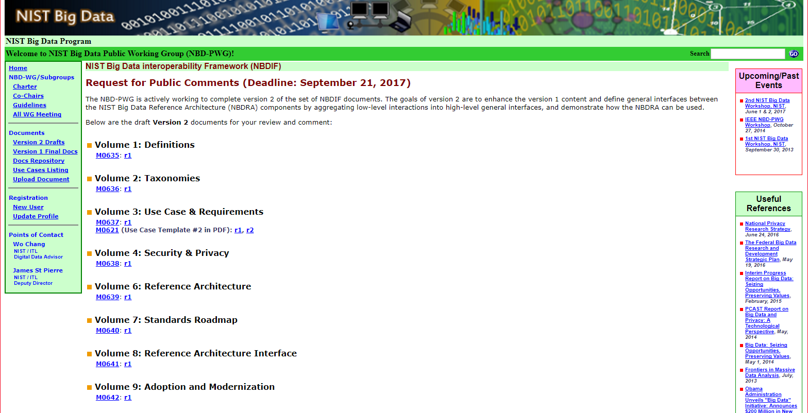
NIST Big Data Public Working Group
Standards
Best Practice
https://bigdatawg.nist.gov/V2_output_docs.php
Indiana
Indiana

Slide 10
64 Features in 4 views for Unified Classification of Big Data and Simulation Applications
41/51 Streaming
26/51 Pleasingly Parallel
25/51 Mapreduce

Slide 11
Software
HPC-ABDS
HPC-FaaS

Slide 12
HPC-ABDS
Integrated wide range of HPC and Big Data technologies.
I gave up updating list in January 2016!

Slide 13
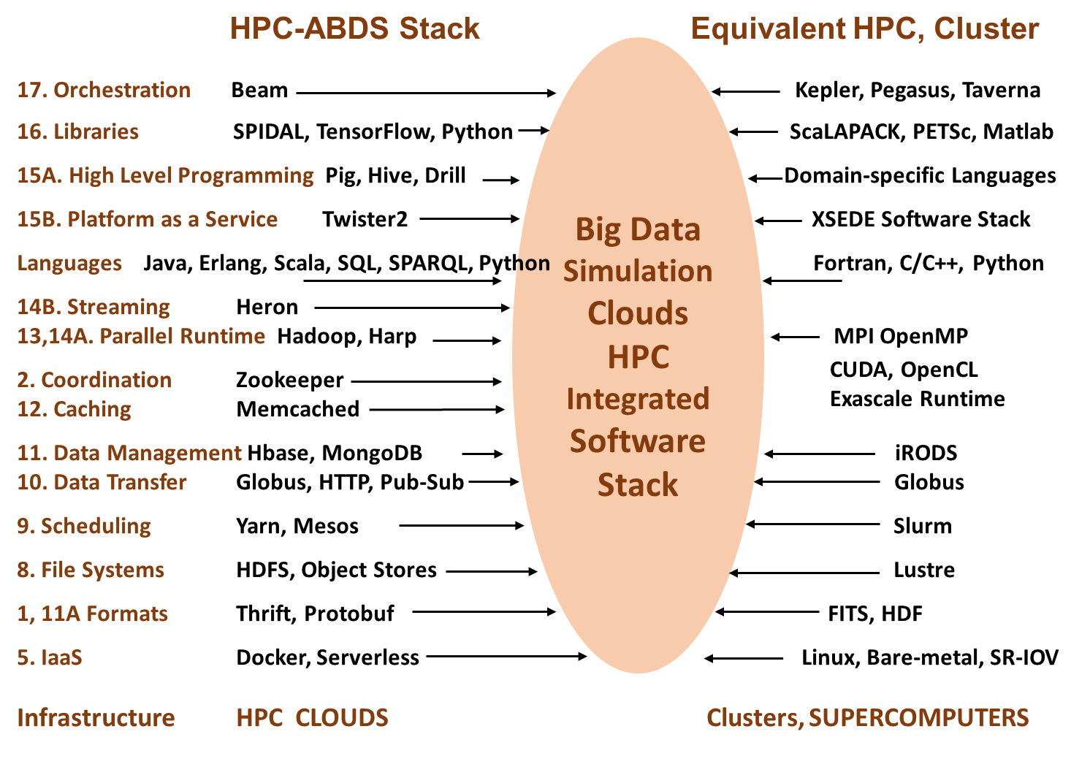
Different choices in software systems in Clouds and HPC. HPC-ABDS takes cloud software augmented by HPC when needed to improve performance
16 of 21 layers plus languages

Slide 14
Note Problem and System Architecture as efficient execution says they must match
Global Machine Learning
Classic Cloud Workload
These 3 are focus of Twister2 but we need to preserve capability on first 2 paradigms

Slide 15
Machine Learning Library

Slide 16
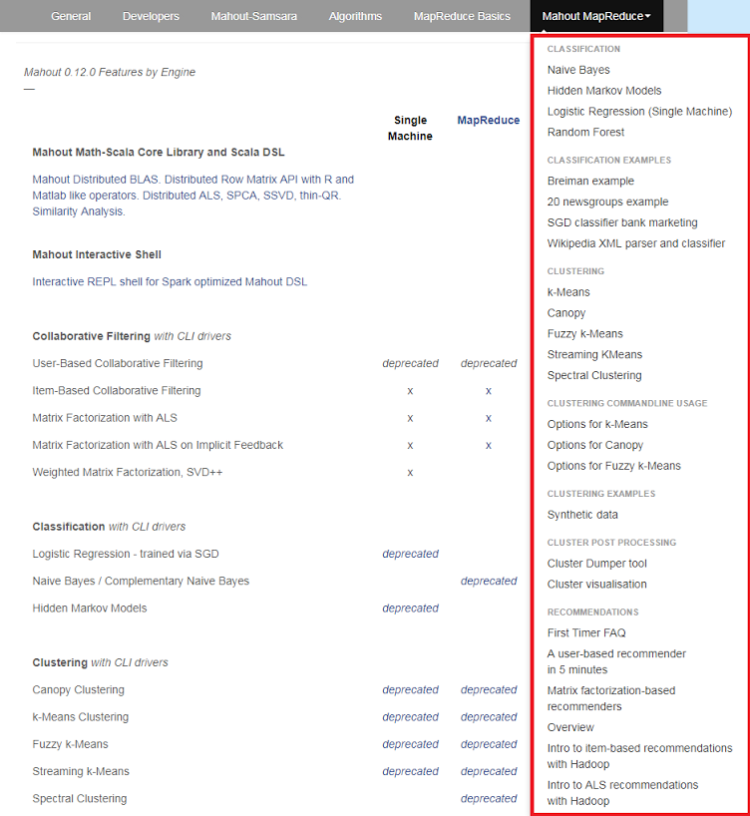
Mahout and SPIDAL
Mahout was Hadoop machine learning library but largely abandoned as Spark outperformed Hadoop
SPIDAL outperforms Spark Mllib and Flink due to better communication and in-place dataflow.
SPIDAL also has community algorithms
  Biomolecular Simulation
  Graphs for Network Science
  Image processing for pathology and polar science

Slide 17
Core SPIDAL Parallel HPC Library with Collective Used
DA-MDS Rotate, AllReduce, Broadcast
Directed Force Dimension Reduction AllGather, Allreduce
Irregular DAVS Clustering Partial Rotate, AllReduce, Broadcast
DA Semimetric Clustering Rotate, AllReduce, Broadcast
K-means AllReduce, Broadcast, AllGather DAAL
SVM AllReduce, AllGather
SubGraph Mining AllGather, AllReduce
Latent Dirichlet Allocation Rotate, AllReduce
Matrix Factorization (SGD) Rotate DAAL
Recommender System (ALS) Rotate DAAL
Singular Value Decomposition (SVD) AllGather DAAL
QR Decomposition (QR) Reduce, Broadcast DAAL
Neural Network AllReduce DAAL
Covariance AllReduce DAAL
Low Order Moments Reduce DAAL
Naive Bayes Reduce DAAL
Linear Regression Reduce DAAL
Ridge Regression Reduce DAAL
Multi-class Logistic Regression Regroup, Rotate, AllGather
Random Forest AllReduce
Principal Component Analysis (PCA) AllReduce DAAL
DAAL implies integrated with Intel DAAL Optimized Data Analytics Library (Runs on KNL!)

Slide 18
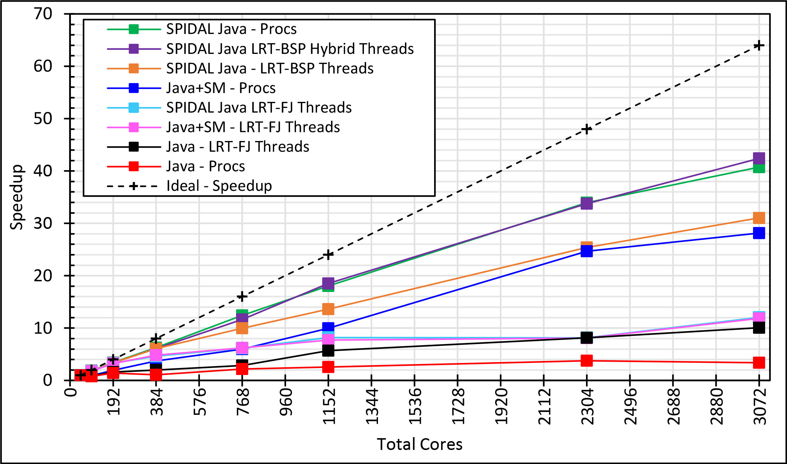
Java MPI performs well after optimization
Speedup compared to 1 process per node on 48 nodes
BSP Threads are better than FJ and at their best match Java MPI
128 24 core Haswell nodes on SPIDAL 200K DA-MDS Code
Best MPI; inter and intra node
MPI; inter/intra node; Java not optimized
Best FJ Threads intra node; MPI inter node

Slide 19

HPC Runtime versus ABDS distributed Computing Model on Data Analytics
Hadoop writes to disk and is slowest; Spark and Flink spawn many processes and do not support AllReduce directly;
MPI does in-place combined reduce/broadcast and is fastest
Need Polymorphic Reduction capability choosing best implementation
Use HPC architecture with
  Mutable model
  Immutable data

Slide 20

Dataflow at Different Grain sizes
Coarse Grain Dataflows links jobs in such a pipeline
Visualization
Dimension
Reduction
Data preparation
Clustering
But internally to each job you can also elegantly express algorithm as dataflow but with more stringent performance constraints
Corresponding to classic Spark K-means Dataflow
P = loadPoints()
C = loadInitCenters()
for (int i = 0; i < 10; i++) {
T = P.map().withBroadcast(C)
C = T.reduce() }
Internal Execution
Dataflow Nodes
Reduce
Iterate
HPC
Communication
Maps
Iterate

Slide 21
Summary of Big Data HPC Convergence I
Applications, Benchmarks and Libraries
  51 NIST Big Data Use Cases, 7 Computational Giants of the NRC report, 13 Berkeley dwarfs, 7 NAS parallel benchmarks
  Unified discussion by separately discussing data & model for each application;
  64 facets– Convergence Diamonds -- characterize applications
  Characterization identifies hardware and software features for each application across big data, simulation; “complete” set of benchmarks (NIST)
Exemplar Ogre and Convergence Diamond Features
  Overall application structure e.g. pleasingly parallel
  Data Features e.g. from IoT, stored in HDFS ….
  Processing Features e.g. uses neural nets or conjugate gradient
  Execution Structure e.g. data or model volume
Need to distinguish data management from data analytics
Management and Search I/O intensive and suitable for classic clouds
  Science data has fewer users than commercial but requirements poorly understood
Analytics has many features in common with large scale simulations
  Data analytics often SPMD, BSP and benefits from high performance networking and communication libraries.
  Decompose Model (as in simulation) and Data (bit different and confusing) across nodes of cluster

Slide 22
Summary of Big Data HPC Convergence II
Software Architecture and its implementation
  HPC-ABDS: Cloud-HPC interoperable software: performance of HPC (High Performance Computing) and the rich functionality of the Apache Big Data Stack.
  Added HPC to Hadoop, Storm, Heron, Spark;
  Twister2 will add to Beam and Flink as a HPC-FaaS programming model
  Could work in Apache model contributing code in different ways
  One approach is an HPC project in Apache Foundation
HPCCloud runs same HPC-ABDS software across all platforms but “data management” nodes have different balance in I/O, Network and Compute from “model” nodes
  Optimize to data and model functions as specified by convergence diamonds rather than optimizing for simulation and big data
Convergence Language: Make C++, Java, Scala, Python (R) … perform well
Training: Students prefer to learn machine learning and clouds and need to be taught importance of HPC to Big Data
Sustainability: research/HPC communities cannot afford to develop everything (hardware and software) from scratch
HPCCloud 2.0 uses DevOps to deploy HPC-ABDS on clouds or HPC
HPCCloud 3.0 delivers Solutions as a Service with an HPC-FaaS programming model

Slide 23
Bringing it together
Twister2

Slide 24



Implementing Twister2 to support a Grid linked to an HPC Cloud
Cloud
HPC
Cloud
HPC
Fog
Cloud
HPC
HPC Cloud can
be federated
Centralized HPC Cloud + IoT Devices
Centralized HPC Cloud + Edge = Fog + IoT Devices

Slide 25
Twister2: “Next Generation Grid - Edge – HPC Cloud”
Our original 2010 Twister paper has 907 citations; it was a particular approach to MapCollective iterative processing for machine learning improving Hadoop
Re-engineer current Apache Big Data and HPC software systems as a toolkit
Support a serverless (cloud-native) dataflow event-driven HPC-FaaS (microservice) framework running across application and geographic domains.
  Support all types of Data analysis from GML to Edge computing
Build on Cloud best practice but use HPC wherever possible to get high performance
Smoothly support current paradigms Hadoop, Spark, Flink, Heron, MPI, DARMA …
Use interoperable common abstractions but multiple polymorphic implementations.
  i.e. do not require a single runtime
Focus on Runtime but this implies HPC-FaaS programming and execution model
This defines a next generation Grid based on data and edge devices – not computing as in old Grid
See paper http://dsc.soic.indiana.edu/publications/twister2_design_big_data_toolkit.pdf

Slide 26
Proposed Twister2 Approach
Unit of Processing is an Event driven Function (a microservice) replaces libraries
  Can have state that may need to be preserved in place (Iterative MapReduce)
  Functions can be single or 1 of 100,000 maps in large parallel code
Processing units run in HPC clouds, fogs or devices but these all have similar software architecture (see AWS Greengrass and Lambda)
  Universal Programming model so Fog (e.g. car) looks like a cloud to a device (radar sensor) while public cloud looks like a cloud to the fog (car)
Build on the runtime of existing systems
  Hadoop, Spark, Flink, Naiad Big Data Processing
  Storm, Heron Streaming Dataflow
  Kepler, Pegasus, NiFi workflow systems
  Harp Map-Collective, MPI and HPC AMT runtime like DARMA
  And approaches such as GridFTP and CORBA/HLA for wide area data links

Slide 27
Twister2 Components I
Area | Component | Implementation | Comments: User API
Architecture Specification | Coordination Points | State and Configuration Management; Program, Data and Message Level | Change execution mode; save and reset state
 | Execution Semantics | Mapping of Resources to Bolts/Maps in Containers, Processes, Threads | Different systems make different choices - why?
 | Parallel Computing | Spark Flink Hadoop Pregel MPI modes | Owner Computes Rule
Job Submission | (Dynamic/Static) Resource Allocation | Plugins for Slurm, Yarn, Mesos, Marathon, Aurora | Client API (e.g. Python) for Job Management
Task System | Task migration | Monitoring of tasks and migrating tasks for better resource utilization | Task-based programming with Dynamic or Static Graph API; FaaS API; Support accelerators (CUDA,KNL)
 | Elasticity | OpenWhisk
 | Streaming and FaaS Events | Heron, OpenWhisk, Kafka/RabbitMQ
 | Task Execution | Process, Threads, Queues
 | Task Scheduling | Dynamic Scheduling, Static Scheduling, Pluggable Scheduling Algorithms
 | Task Graph | Static Graph, Dynamic Graph Generation

Slide 28
Twister2 Components II
Area | Component | Implementation | Comments
Communication API | Messages | Heron | This is user level and could map to multiple communication systems
 | Dataflow Communication | Fine-Grain Twister2 Dataflow communications: MPI,TCP and RMA Coarse grain Dataflow from NiFi, Kepler? | Streaming, ETL data pipelines; Define new Dataflow communication API and library
 | BSP Communication Map-Collective | Conventional MPI, Harp | MPI Point to Point and Collective API
Data Access | Static (Batch) Data | File Systems, NoSQL, SQL | Data API
 | Streaming Data | Message Brokers, Spouts
Data Management | Distributed Data Set | Relaxed Distributed Shared Memory(immutable data), Mutable Distributed Data | Data Transformation API; Spark RDD, Heron Streamlet
Fault Tolerance | Check Pointing | Upstream (streaming) backup; Lightweight; Coordination Points; Spark/Flink, MPI and Heron models | Streaming and batch cases distinct; Crosses all components
Security | Storage, Messaging, execution | Research needed | Crosses all Components

Slide 29
Summary of Twister2: Next Generation HPC Cloud + Edge + Grid
We have built a high performance data analysis library SPIDAL supporting Global and Local Machine Learning
We have integrated HPC into many Apache systems with HPC-ABDS
  SPIDAL ML library currently implemented as Harp on Hadoop but PHI needs richer Spark (and Heron for Streaming?)
Twister2 will offer Hadoop, Spark (batch big data), Heron (Streaming) and MPI(parallel computing)
  Event driven computing model built around Cloud and HPC and spanning batch, streaming, and edge applications
  Highly parallel on cloud; possibly sequential at the edge
Integrate current technology of FaaS (Function as a Service) and server-hidden (serverless) computing (OpenWhisk) with HPC and Apache batch/streaming systems
Apache systems use dataflow communication which is natural for distributed systems but inevitably slow for classic parallel computing
  Twister2 has dataflow and parallel communication models

