Slide 1
Engineering Cyberinfrastructure in Intelligent Systems Engineering at Indiana University
Geoffrey Fox, Judy Qiu, Martin Swany, Thomas Sterling, Gregor von Laszewski
November 20, 2017
Department of Intelligent Systems Engineering
http://www.dsc.soic.indiana.edu/
`

Slide 2
Martin Swany: Photon Lightweight Messaging
Photon provides consistent remote direct memory access (RDMA) semantics over varied interconnect technologies such as InfiniBand and Cray’s Aries and Gemini fabrics.
Goal: minimize latency and maximize throughput for high-performance applications and runtime systems that can benefit from distributed, direct memory operations over a network.
Memory management and asynchronous progress are exposed at a fine granularity, decoupling data transfers from the notification path.
Photon supports active messages.

Slide 3
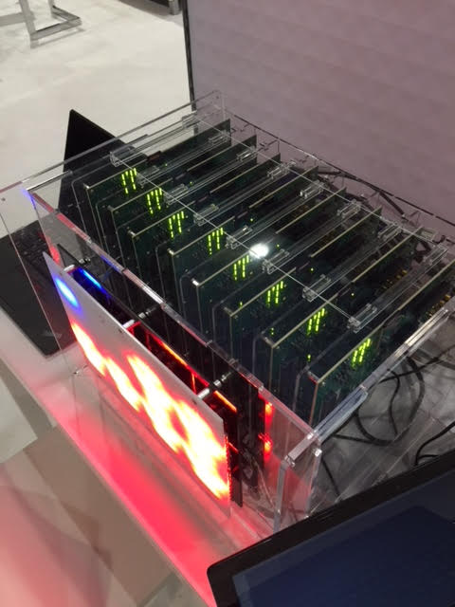
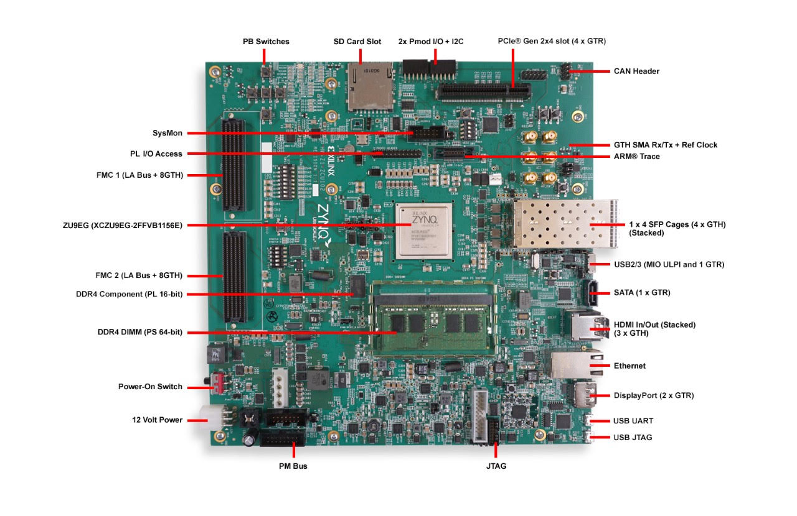
Swany: FPGA Machines
Node of 64 node ISE FPGA Lab Machine Proteus with Xilinx boards aimed at computing and networking
Currently have an 8 node prototype shown on right
4-core ARM + FPGA

Slide 4
Thomas Sterling CREST-II R&D Program
Next generation exascale (supercomputing) hardware and software
Strategic Focus Projects
Tactical Focus Projects
HPX+ Parallel runtime Software
Software Runtime System
For conventional and CCA targets
Reduction to practice for ParalleX
Fault tolerance, energy, real-time
Advanced introspective scheduling
CCA Dataflow Hardware
Continuum Computer Architecture CCA
Fonton architecture
Simultac architecture
Name space translation
Routing of parcels
System engineering
Packaging, power, cooling
ParalleX Programming Model
Execution model
Formal specification & testing
Dynamic adaptive, introspective
Fault tolerance, energy, real-time
Using DIET high speed networking hardware
Programming Interface
Intermediate representation
Compiler for runtime system
Graph algorithms/applications
Meta-data parallelism discovery
Concurrent edge spanning

Slide 5
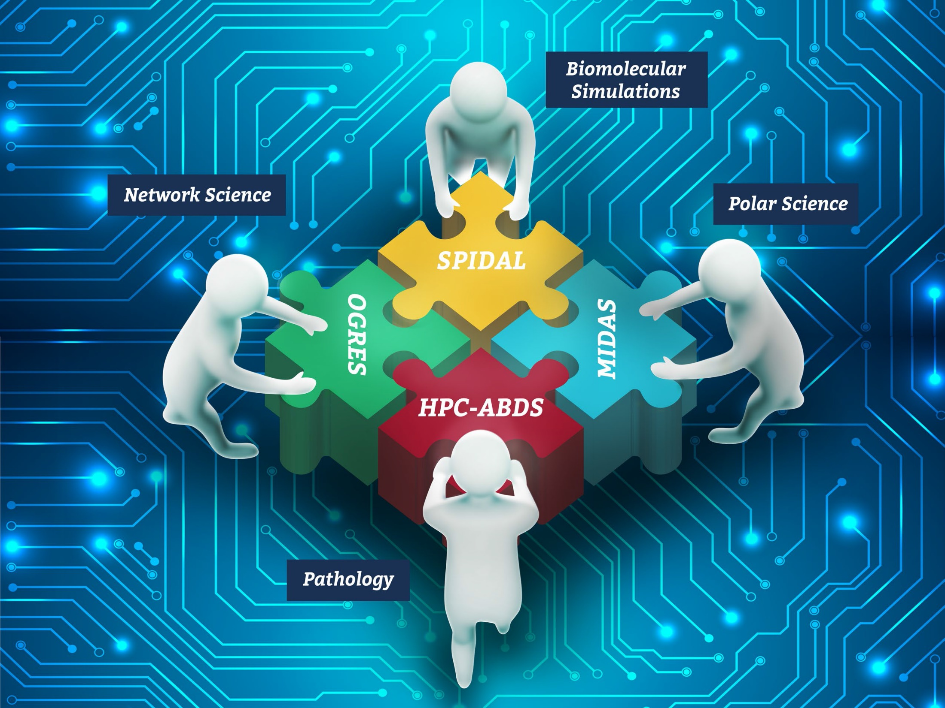
Fox/ Qiu/Crandall NSF 1443054: CIF21 DIBBs: Middleware and High Performance Analytics Libraries for Scalable Data Science
Ogres Big Data Application Feature Analysis
Midas Middleware: HPC-ABDS and HPC-FaaS Software Harp and Twister2 Building Blocks
SPIDAL Data Analytics Library
Weekly Collaboration Meetings NSF PI Meetings Substantial Management Overhead $1M a year for 5 years
Large Interdisciplinary Project – 7 institutions
Cyberinfrastructure – Algorithms - Applications
Software: MIDAS HPC-ABDS

Slide 6
Qiu/Fox Core SPIDAL Parallel HPC Library with Collective Used
DA-MDS Rotate, AllReduce, Broadcast
Directed Force Dimension Reduction AllGather, Allreduce
Irregular DAVS Clustering Partial Rotate, AllReduce, Broadcast
DA Semimetric Clustering Rotate, AllReduce, Broadcast
K-means AllReduce, Broadcast, AllGather DAAL
SVM AllReduce, AllGather
SubGraph Mining AllGather, AllReduce
Latent Dirichlet Allocation Rotate, AllReduce
Matrix Factorization (SGD) Rotate DAAL
Recommender System (ALS) Rotate DAAL
Singular Value Decomposition (SVD) AllGather DAAL
QR Decomposition (QR) Reduce, Broadcast DAAL
Neural Network AllReduce DAAL
Covariance AllReduce DAAL
Low Order Moments Reduce DAAL
Naive Bayes Reduce DAAL
Linear Regression Reduce DAAL
Ridge Regression Reduce DAAL
Multi-class Logistic Regression Regroup, Rotate, AllGather
Random Forest AllReduce
Principal Component Analysis (PCA) AllReduce DAAL
DAAL implies integrated with Intel DAAL Optimized Data Analytics Library (Runs on KNL!)

Slide 7
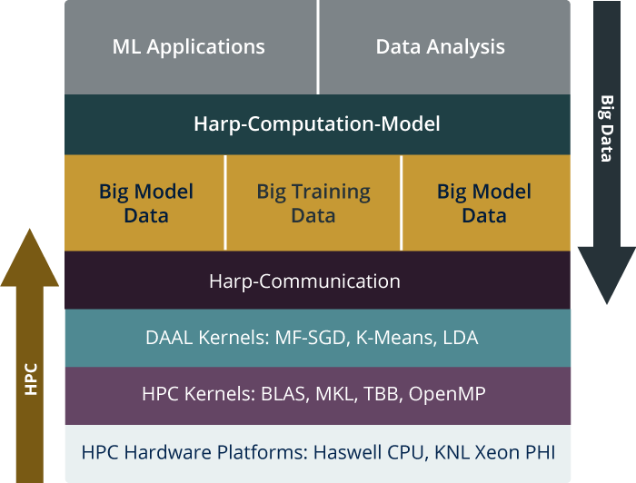
Judy Qiu: Harp-DAAL for high performance machine learning
HPC-ABDS is Cloud-HPC interoperable software with the performance of HPC (High Performance Computing) and the rich functionality of the commodity Apache Big Data Stack. This concept is illustrated by Harp-DAAL.
High Level Usability: Python Interface, well documented and packaged modules
Middle Level Data-Centric Abstractions: Computation Model and optimized communication patterns
Low Level optimized for Performance: HPC kernels Intel® DAAL and advanced hardware platforms such as Xeon and Xeon Phi

Slide 8
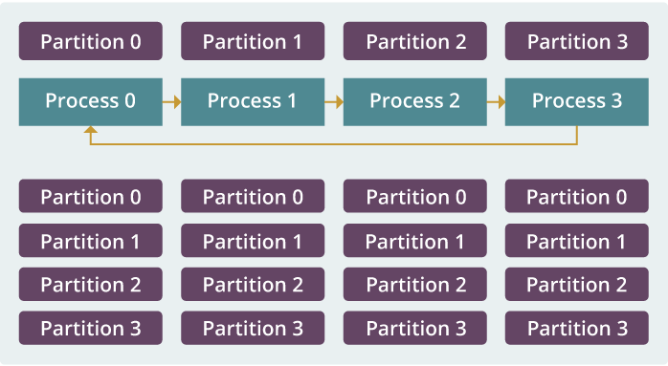
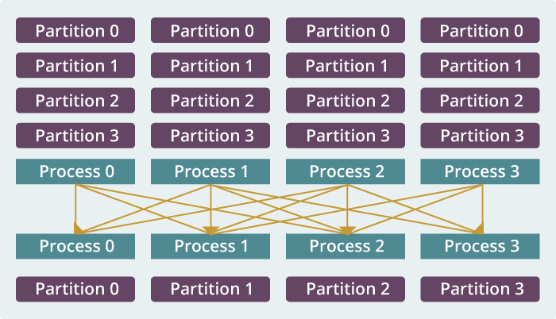
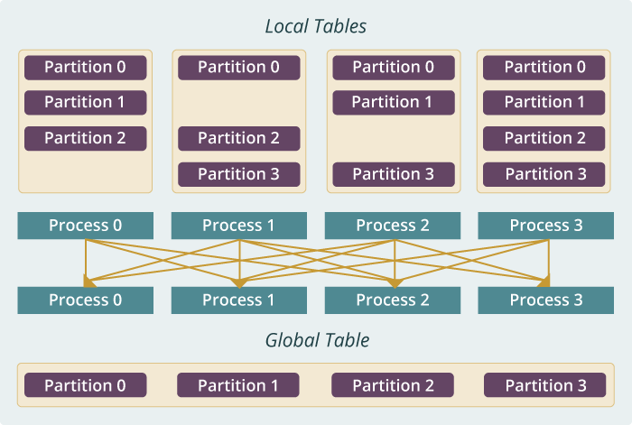
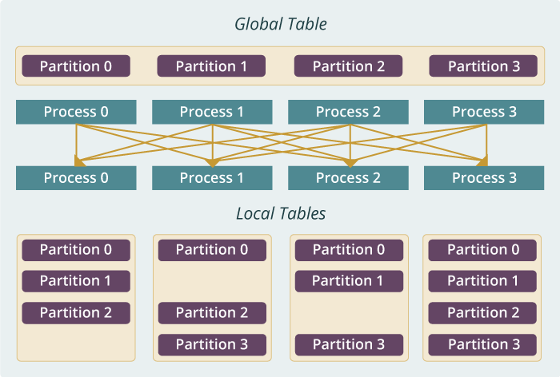
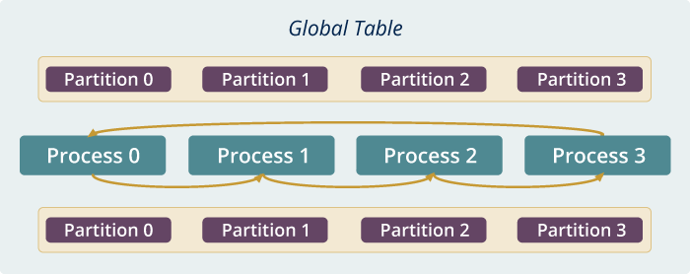
Qiu MIDAS run time software for Harp
broadcast
reduce
allreduce
allgather
regroup
push & pull
rotate
Map Collective Run time merges MapReduce and HPC

Slide 9
Harp v. Spark Harp v. Torch Harp v. MPI
Datasets: 5 million points, 10 thousand centroids, 10 feature dimensions
10 to 20 nodes of Intel KNL7250 processors
Harp-DAAL has 15x speedups over Spark MLlib
Datasets: 500K or 1 million data points of feature dimension 300
Running on single KNL 7250 (Harp-DAAL) vs. single K80 GPU (PyTorch)
Harp-DAAL achieves 3x to 6x speedups
Datasets: Twitter with 44 million vertices, 2 billion edges, subgraph templates of 10 to 12 vertices
25 nodes of Intel Xeon E5 2670
Harp-DAAL has 2x to 5x speedups over state-of-the-art MPI-Fascia solution

Slide 10
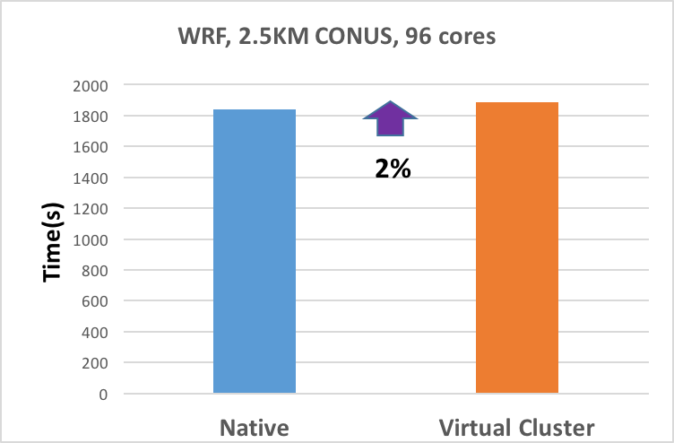
WRF Weather Modeling
Virtual Cluster Performance
96-core (4-node) virtual cluster
Nearest-neighbor communication
Test Case: 3hr Forecast, 2.5km resolution of Continental US (CONUS).
Scalable algorithms
2% slower w/ SR-IOV vs native IB.
Gregor von Laszewski Virtual Cluster Goal: Provide near bare metal HPC performance and management experience for groups that can manage their own clusters.
Virtual Cluster Enabling Technologies
KVM—Lets us run virtual machines (all processor features)
SR-IOV—Makes MPI go fast on VMs
Rocks—Systems management
ZFS—Disk image management
VLANs—Isolate virtual cluster management network
pkeys—Isolate virtual cluster IB network
Nucleus —Coordination (scheduling, provisioning, status, etc.)
Client – Cloudmesh control of DevOps

Slide 11
Geoffrey Fox Twister2: “Next Generation Grid - Edge – HPC Cloud”
The original 2010 Twister paper was a particular approach to MapCollective iterative processing for machine learning improving Hadoop (Harp also builds on Twister)
Twister2 re-engineers current Apache Big Data and HPC software systems as a toolkit
Support a serverless (cloud-native) dataflow event-driven HPC-FaaS (microservice) framework running across application and geographic domains.
Support all types of Data analysis from Global Machine Learning to Edge computing
Build on Cloud best practice but use HPC wherever possible to get high performance
Smoothly support current paradigms Hadoop, Spark, Flink, Heron, MPI, DARMA …
Includes IoTCloud Cloud computing Robot/IoT control software
Use interoperable common abstractions but multiple polymorphic implementations.
Focus on Runtime but this implies HPC-FaaS programming and execution model
This defines a next generation Grid based on data and edge devices – not computing as in old Grid
See paper http://dsc.soic.indiana.edu/publications/twister2_design_big_data_toolkit.pdf

Slide 12
Intelligent System Engineering Computing Infrastructure
For research and education
ISE arranged as a collection of centers and laboratories
64-node FPGA+ARM + four 10G Ethernet Cluster (Swany) Proteus
Collection of small Raspbery Pi Clusters with Docker Rubus
16 K80 GPU + 16 P100 Volta Deep Learning Cluster (Minje Kim, David Crandall) Romeo
128 node Haswell + Infiniband Machine Learning Testbed Juliet
64 node Intel Knights Landing + Omnipath Machine Learning Testbed Tango
32 node Xeon Platinum + Infiniband Cloud Computing Clusters (Docker, Openstack) Victor, Tempest
Plus University has substantial supercomputing resources Big Red 2

