Slide 1
High Performance Big Data Computing
Fudan University
Shanghai
Geoffrey Fox, June 5, 2018
Department of Intelligent Systems Engineering
gcf@indiana.edu, http://www.dsc.soic.indiana.edu/, http://spidal.org/
`,
Work with Judy Qiu, Supun Kamburugamuva, Shantenu Jha, Kannan Govindarajan, Pulasthi Wickramasinghe, Gurhan Gunduz, Ahmet Uyar

Slide 2
What is High Performance Big Data Computing?
Artificial Intelligence is a dominant disruptive technology affecting all our activities including business, education, research, and society. Further, several companies have proposed AI first strategies. The AI disruption is typically associated with big data coming from edge (the people!), repositories or sophisticated scientific instruments such as telescopes, light sources and gene sequencers.
Artificial Intelligence First requires High Performance Big Data Computing i.e. mammoth computing resources such as clouds, supercomputers, hyperscale systems (see Gartner) and their distributed integration.
We need new developments in hardware, algorithms and software for big data systems of transformational capability on computer architectures ranging from commodity clouds, hybrid HPC-clouds, and supercomputers.
We need performance and security that scales and fully exploit the specialized features (communication, memory, energy, I/O, accelerator) of each different architecture.
There will be a range of Applications from pleasingly parallel, MapReduce, to Machine Learning (e.g., Random Forest, SVM, Latent Dirichlet Allocation, Clustering and Dimension Reduction), Deep Learning, and Large Graph Analytics.

Slide 3
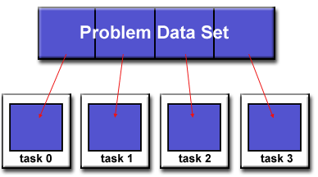
Parallel Computing: Big Data and Simulations
All the different programming models (Spark, Flink, Storm, Naiad, MPI/OpenMP) have the same high level approach but application requirements and system architecture can give different appearance
First: Break Problem Data and/or Model-parameters into parts assigned to separate nodes, processes, threads
Then: In parallel, do computations typically leaving data untouched but changing model-parameters. Called Maps in MapReduce parlance; typically owner computes rule.
If Pleasingly parallel, that’s all it is except for management
If Globally parallel, need to communicate results of computations between nodes during job
Communication mechanism (TCP, RDMA, Native Infiniband) can vary
Communication Style (Point to Point, Collective, Pub-Sub) can vary
Possible need for sophisticated dynamic changes in
partioning (load balancing)
Computation either on fixed tasks or flow between tasks
Choices: “Automatic Parallelism or Not”
Choices: “Complicated Parallel Algorithm or Not”
Fault-Tolerance model can vary
Output model can vary: RDD or Files or Pipes

Slide 4
Requirements
On general principles parallel and distributed computing have different requirements even if sometimes similar functionalities
  Apache stack ABDS typically uses distributed computing concepts
  For example, Reduce operation is different in MPI (Harp) and Spark
Large scale simulation requirements are well understood BUT
Big Data requirements are not agreed but there are a few key use types
  Pleasingly parallel processing (including local machine learning LML) as of different tweets from different users with perhaps MapReduce style of statistics and visualizations; possibly Streaming
  Database model with queries again supported by MapReduce for horizontal scaling
  Global Machine Learning GML with single job using multiple nodes as classic parallel computing
  Deep Learning certainly needs HPC – possibly only multiple small systems
Current workloads stress 1) and 2) and are suited to current clouds and to Apache Big Data Software (with no HPC)
  This explains why Spark with poor GML performance can be so successful

Slide 5
Local and Global Machine Learning
Many applications use LML or Local machine Learning where machine learning (often from R or Python or Matlab) is run separately on every data item such as on every image
But others are GML Global Machine Learning where machine learning is a basic algorithm run over all data items (over all nodes in computer)
  maximum likelihood or χ² with a sum over the N data items – documents, sequences, items to be sold, images etc. and often links (point-pairs).
  GML includes Graph analytics, clustering/community detection, mixture models, topic determination, Multidimensional scaling, (Deep) Learning Networks
Note Facebook may need lots of small graphs (one per person and ~LML) rather than one giant graph of connected people (GML)

Slide 6
Features of AI First Big Data Processing Systems
Application Requirements: The structure of application clearly impacts needed hardware and software
  Pleasingly parallel
  Workflow
  Global Machine Learning
Data model: SQL, NoSQL; File Systems, Object store; Lustre, HDFS
Distributed data from distributed sensors and instruments (Internet of Things) requires Edge computing model
  Device – Fog – Cloud model and streaming data software and algorithms
Hardware: node (accelerators such as GPU or KNL for deep learning) and multi-node architecture configured as AI First HPC Cloud;
  Disks speed and location
This implies software requirements
Analytics
Data management
Streaming or Repository access or both

Slide 7
Data and Model in Big Data and Simulations I
Need to discuss Data and Model as problems have both intermingled, but we can get insight by separating which allows better understanding of Big Data - Big Simulation “convergence” (or differences!)
The Model is a user construction and it has a “concept”, parameters and gives results determined by the computation. We use term “model” in a general fashion to cover all of these.
Big Data problems can be broken up into Data and Model
  For clustering, the model parameters are cluster centers while the data is set of points to be clustered
  For queries, the model is structure of database and results of this query while the data is whole database queried and SQL query
  For deep learning with ImageNet, the model is chosen network with model parameters as the network link weights. The data is set of images used for training or classification

Slide 8
Data and Model in Big Data and Simulations II
Simulations can also be considered as Data plus Model
  Model can be formulation with particle dynamics or partial differential equations defined by parameters such as particle positions and discretized velocity, pressure, density values
  Data could be small when just boundary conditions
  Data large with data assimilation (weather forecasting) or when data visualizations are produced by simulation
Big Data implies Data is large but Model varies in size
  e.g. LDA (Latent Dirichlet Allocation) with many topics or deep learning has a large model
  Clustering or Dimension reduction can be quite small in model size
Data often static between iterations (unless streaming); Model parameters vary between iterations
Data and Model Parameters are often confused in papers as term data used to describe the parameters of models.
Models in Big Data and Simulations have many similarities and allow convergence

Slide 9
Convergence/Divergence Points for AI First
HPC-Cloud-Edge- Big Data-Simulation
Applications – Divide use cases into Data and Model and compare characteristics separately in these two components with 64 Convergence Diamonds (features).
  Identify importance of streaming data, pleasingly parallel, global/local machine-learning
Software – Single model of High Performance Computing (HPC) Enhanced Big Data Stack HPC-ABDS. 21 Layers adding high performance runtime to Apache systems HPC-FaaS Programming Model
  Serverless Infrastructure as a Service IaaS
Hardware system designed for functionality and performance of application type e.g. disks, interconnect, memory, CPU acceleration different for machine learning, pleasingly parallel, data management, streaming, simulations
  Use DevOps to automate deployment of event-driven software defined systems on hardware: HPCCloud 2.0
Total System Solutions (wisdom) as a Service: AI First HPCCloud 3.0

Slide 10



Implies a Data Grid linked to an
AI First HPC Cloud
Cloud
HPC
Cloud
HPC
Fog
Cloud
HPC
AI First HPC Cloud can be federated
Centralized AI First HPC Cloud + IoT Devices
Centralized AI First HPC Cloud + Edge = Fog + IoT Devices

Slide 11
Predictions/Assumptions
HPC Clouds or Next-Generation Commodity Systems will be a dominant force
  Merge Cloud HPC and (support of) Edge and AI First computing
  Federated Clouds running in multiple giant datacenters offering all types of computing
  Distributed data sources associated with device and Fog processing resources
  Server-hidden computing and AI First Function as a Service FaaS for user pleasure supporting scalable Machine Learning Functions
  Support a distributed event-driven serverless dataflow AI First computing model covering batch and streaming data as HPC-FaaS
  Needing parallel and distributed (Grid) computing ideas
  Span Pleasingly Parallel to Data management to Global Machine Learning
Although Supercomputers will be essential for large simulations, they will be components of high performance big data computing systems

Slide 12
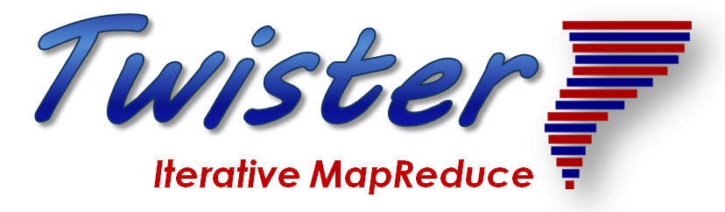
Structure of AI First Applications
http://www.iterativemapreduce.org/

Slide 13
Distinctive Features of Applications
Ratio of data to model sizes: vertical axis on next slide
Importance of Synchronization – ratio of inter-node communication to node computing: horizontal axis on next slide
Sparsity of Data or Model; impacts value of GPU’s or vector computing
Irregularity of Data or Model
Geographic distribution of Data as in edge computing; use of streaming (dynamic data) versus batch paradigms
Dynamic model structure as in some iterative algorithms

Slide 14
Difficulty in Parallelism
Size of Synchronization constraints
Need a toolkit covering all applications with same API but different implementations
Loosely Coupled
Tightly Coupled
HPC Clouds
High Performance Interconnect
HPC Clouds/Supercomputers
Memory access also critical
Commodity Clouds
Size of Disk I/O
MapReduce as in scalable databases
Global Machine Learning
e.g. parallel clustering
Deep Learning
Unstructured Adaptive Sparsity
Medium size Jobs
Pleasingly Parallel
Often independent events
Graph Analytics e.g. subgraph mining
LDA
Current major Big Data category
Linear Algebra at core (typically not sparse)
Large scale simulations
Parameter sweep simulations
Structured Adaptive Sparsity
Huge Jobs
Spectrum of Applications and Algorithms
There is also distribution seen in grid/edge computing
Exascale Supercomputers

Slide 15
Five Major Application Structures
Global Machine Learning
Always Classic Cloud Workload
Add High Performance Big Data Workload
Note Problem and System Architecture ae similar as efficient execution says they must match

Slide 16
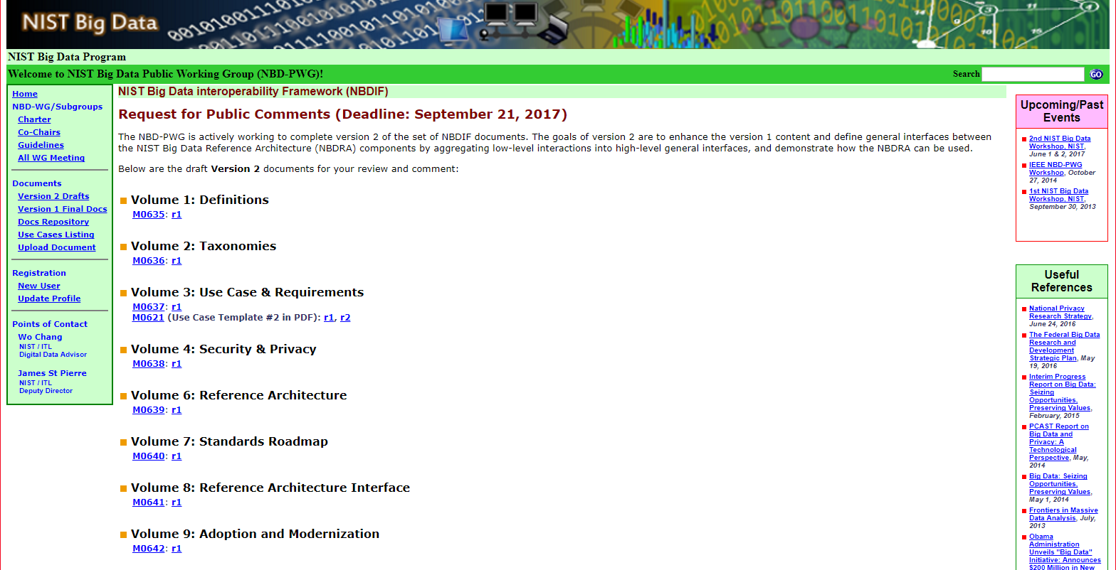
NIST Big Data Public Working Group
Standards
Best Practice
https://bigdatawg.nist.gov/V2_output_docs.php
Indiana
Indiana

Slide 17
51 Detailed Use Cases: Contributed July-September 2013
Covers goals, data features such as 3 V’s, software, hardware
Government Operation(4): National Archives and Records Administration, Census Bureau
Commercial(8): Finance in Cloud, Cloud Backup, Mendeley (Citations), Netflix, Web Search, Digital Materials, Cargo shipping (as in UPS)
Defense(3): Sensors, Image surveillance, Situation Assessment
Healthcare and Life Sciences(10): Medical records, Graph and Probabilistic analysis, Pathology, Bioimaging, Genomics, Epidemiology, People Activity models, Biodiversity
Deep Learning and Social Media(6): Driving Car, Geolocate images/cameras, Twitter, Crowd Sourcing, Network Science, NIST benchmark datasets
The Ecosystem for Research(4): Metadata, Collaboration, Language Translation, Light source experiments
Astronomy and Physics(5): Sky Surveys including comparison to simulation, Large Hadron Collider at CERN, Belle Accelerator II in Japan
Earth, Environmental and Polar Science(10): Radar Scattering in Atmosphere, Earthquake, Ocean, Earth Observation, Ice sheet Radar scattering, Earth radar mapping, Climate simulation datasets, Atmospheric turbulence identification, Subsurface Biogeochemistry (microbes to watersheds), AmeriFlux and FLUXNET gas sensors
Energy(1): Smart grid
Published by NIST as http://nvlpubs.nist.gov/nistpubs/SpecialPublications/NIST.SP.1500-3.pdf with common set of 26 features recorded for each use-case; “Version 2” nearly published
26 Features for each use case Biased to science

Slide 18
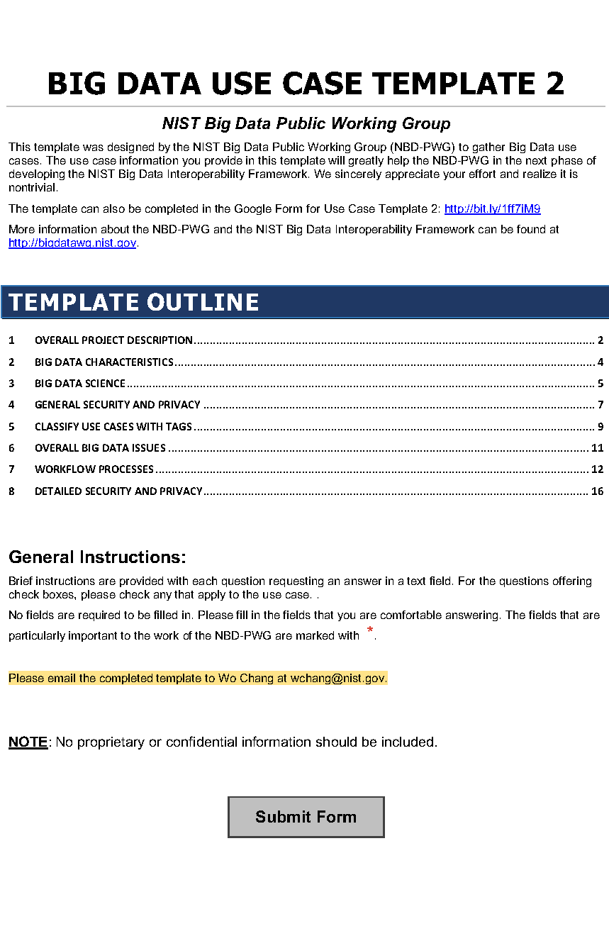
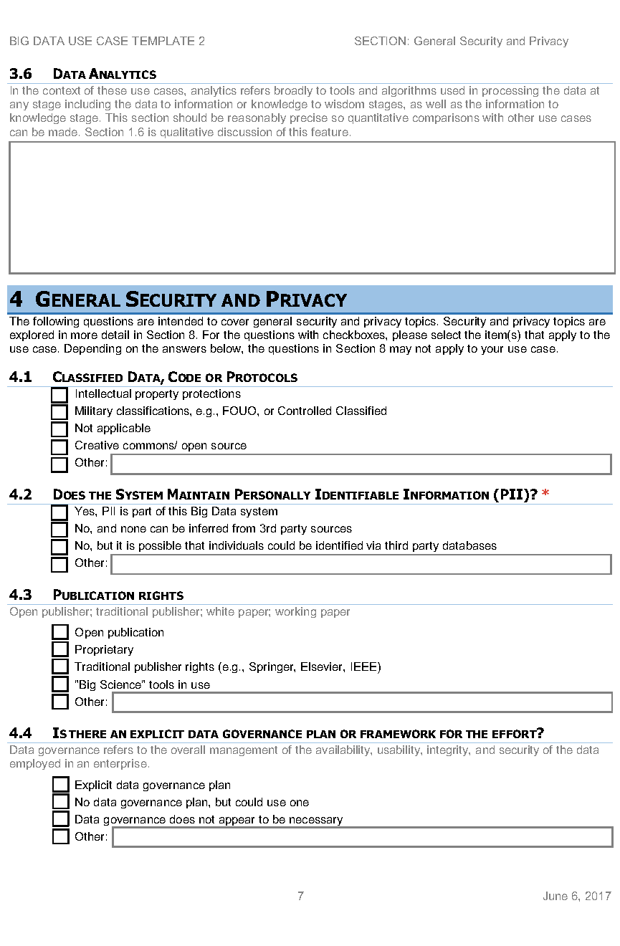
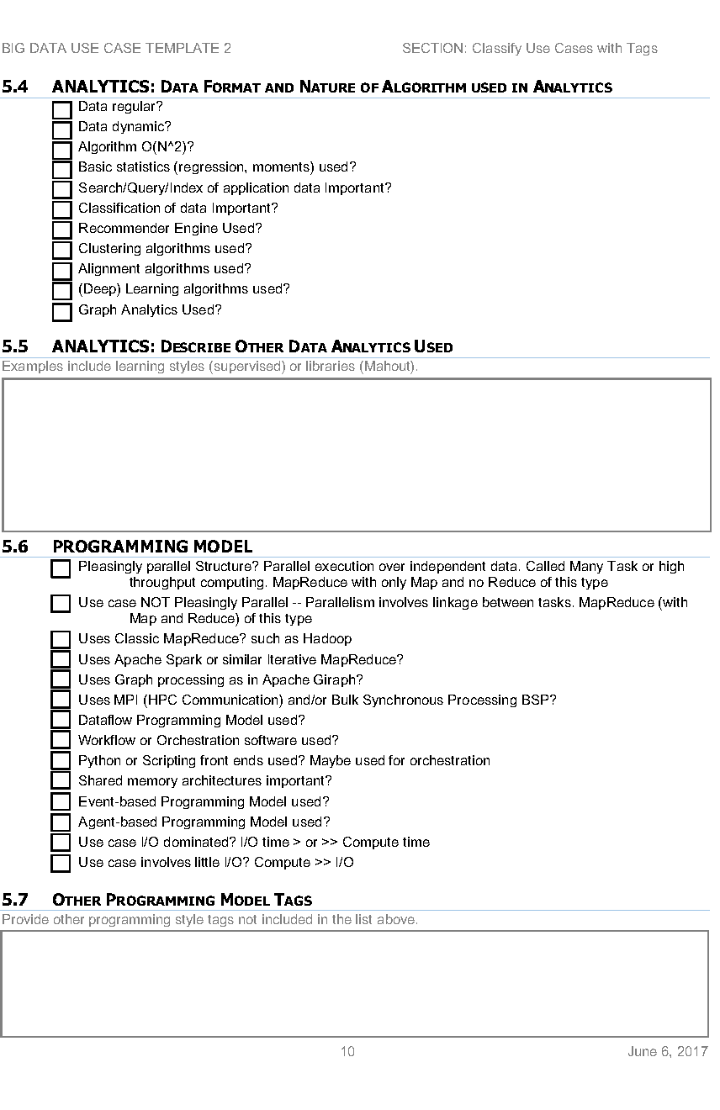
https://bigdatawg.nist.gov/_uploadfiles/M0621_v2_7345181325.pdf http://hpc-abds.org/kaleidoscope/survey/
Version 2 of Survey with Security and Tags

Slide 19
Sample Features of 51 Use Cases I
PP (26) “All” Pleasingly Parallel or Map Only
MR (18) Classic MapReduce MR (add MRStat below for full count)
MRStat (7) Simple version of MR where key computations are simple reduction as found in statistical averages such as histograms and averages
MRIter (23) Iterative MapReduce or MPI (Flink, Spark, Twister)
Graph (9) Complex graph data structure needed in analysis
Fusion (11) Integrate diverse data to aid discovery/decision making; could involve sophisticated algorithms or could just be a portal
Streaming (41) Some data comes in incrementally and is processed this way
Classify (30) Classification: divide data into categories
S/Q (12) Index, Search and Query

Slide 20
Sample Features of 51 Use Cases II
CF (4) Collaborative Filtering for recommender engines
LML (36) Local Machine Learning (Independent for each parallel entity) – application could have GML as well
GML (23) Global Machine Learning: Deep Learning, Clustering, LDA, PLSI, MDS,
  Large Scale Optimizations as in Variational Bayes, MCMC, Lifted Belief Propagation, Stochastic Gradient Descent, L-BFGS, Levenberg-Marquardt . Can call EGO or Exascale Global Optimization with scalable parallel algorithm
Workflow (51) Universal
GIS (16) Geotagged data and often displayed in ESRI, Microsoft Virtual Earth, Google Earth, GeoServer etc.
HPC (5) Classic large-scale simulation of cosmos, materials, etc. generating (visualization) data
Agent (2) Simulations of models of data-defined macroscopic entities represented as agents

Slide 21
AI First interactive analysis of observational scientific data
AI enhanced Science Analysis Code, Mahout, R, Harp, Scikit-Learn, Tensorflow
Grid or Many Task Software, Hadoop, Spark, Giraph, Twister2 …
Data Storage: HDFS, Hbase, File Collection
Transport batch of data to primary analysis data system
Direct Transfer
Streaming Twitter data for Social Networking
Streaming Twitter data for Social Networking
Streaming Twitter data for Social Networking
Streaming Twitter data for Social Networking
Local Accumulate and initial computing
Local Accumulate and initial computing
Local Accumulate and initial computing
Local Accumulate and initial computing
Examples include LHC, Remote Sensing, Astronomy and Bioinformatics
Record Scientific Data in “field”
Record Scientific Data in “field”
Record Scientific Data in “field”
Record Scientific Data in “field”

Slide 22
Orchestrate multiple sequential and parallel data transformations and/or AI First analytics processing using a workflow manager
Nearly all workloads need to link multiple stages together. That is what workflow or orchestration does.
Technology like Hadoop is mainly aimed at individual stages
Specify AI First Analytics Pipeline
Orchestration Layer (Workflow)
AI Analytic-1
AI Analytic-2
Analytic-3
(Visualize)
Hadoop, Spark, Giraph, Twister2 …
Data Storage: HDFS, Hbase ….

Slide 23
Classifying Use Cases
The Big Data Ogres built on a collection of 51 big data uses gathered by the NIST Public Working Group where 26 properties were gathered for each application.
This information was combined with other studies including the Berkeley dwarfs, the NAS parallel benchmarks and the Computational Giants of the NRC Massive Data Analysis Report.
The Ogre analysis led to a set of 50 features divided into four views that could be used to categorize and distinguish between applications.
The four views are Problem Architecture (Macro pattern); Execution Features (Micro patterns); Data Source and Style; and finally the Processing View or runtime features.
We generalized this approach to integrate Big Data and Simulation applications into a single classification looking separately at Data and Model with the total facets growing to 64 in number, called convergence diamonds, and split between the same 4 views

Slide 24
64 Features in 4 views for Unified Classification of Big Data and Simulation Applications
41/51 Streaming
26/51 Pleasingly Parallel
25/51 Mapreduce

Slide 25
AI First Platforms
Comparing Spark, Flink and MPI
http://www.iterativemapreduce.org/

Slide 26
Machine Learning with MPI, Spark and Flink
Three algorithms implemented in three runtimes
  Multidimensional Scaling (MDS)
  Terasort
  K-Means (drop as no time and looked at later)
Implementation in Java
  MDS is the most complex algorithm - three nested parallel loops
  K-Means - one parallel loop
  Terasort - no iterations
With care, Java performance ~ C performance
Without care, Java performance << C performance (details omitted)

Slide 27



Multidimensional Scaling: 3 Nested Parallel Sections
Kmeans also bad – see later
Flink
Spark
MPI
MPI Factor of 20-200 Faster than Spark/Flink
MDS execution time with 32000 points on varying number of nodes. Each node runs 20 parallel tasks
Spark, Flink No Speedup
MDS execution time on 16 nodes with 20 processes in each node with varying number of points

Slide 28


Terasort
Sorting 1TB of data records
Terasort execution time in 64 and 32 nodes. Only MPI shows the sorting time and communication time as other two frameworks doesn't provide a clear method to accurately measure them. Sorting time includes data save time.
MPI-IB - MPI with Infiniband
Partition the data using a sample and regroup

Slide 29

HPC Runtime versus ABDS distributed Computing Model on Data Analytics
Hadoop writes to disk and is slowest; Spark and Flink spawn many processes and do not support AllReduce directly;
MPI does in-place combined reduce/broadcast and is fastest
Need Polymorphic Reduction capability choosing best implementation
Use HPC architecture with
  Mutable model
  Immutable data

Slide 30
Software
HPC-ABDS
HPC-FaaS
AI First Analytics
http://www.iterativemapreduce.org/

Slide 31





NSF 1443054: CIF21 DIBBs: Middleware and High Performance Analytics Libraries for Scalable Data Science
Ogres Application Analysis
HPC-ABDS and HPC-FaaS Software
Harp and Twister2 Building Blocks
SPIDAL Data Analytics Library
Software: MIDAS
HPC-ABDS

Slide 32
HPC-ABDS
Integrated wide range of HPC and Big Data technologies.
I gave up updating list in January 2016!

Slide 33
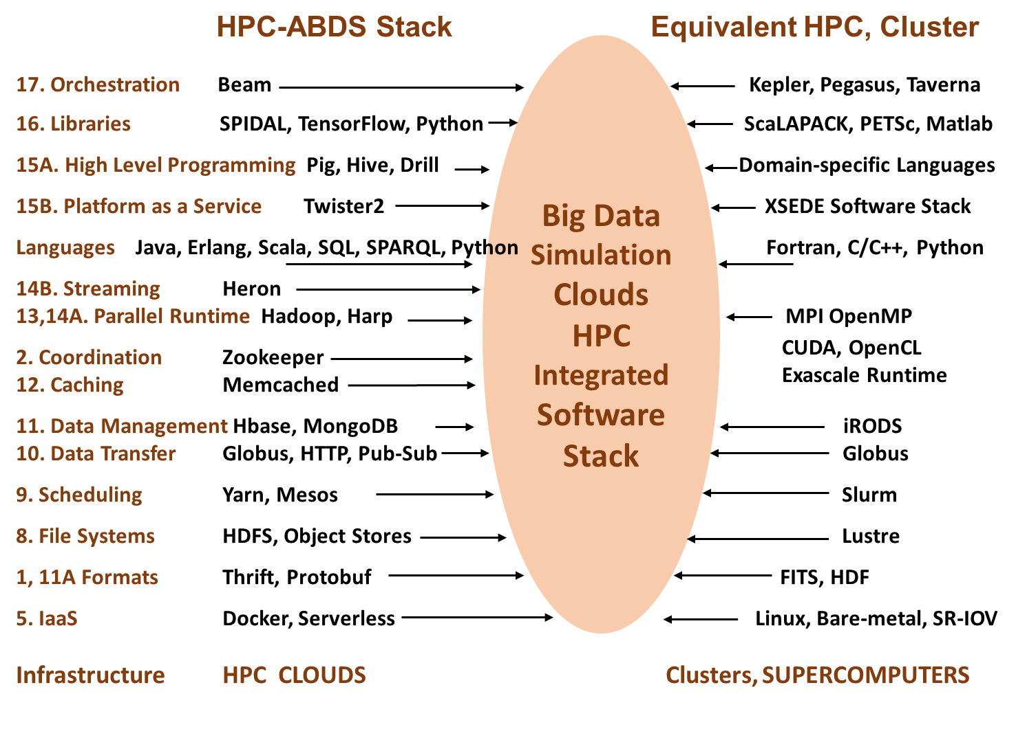
Different choices in software systems in Clouds and HPC. HPC-ABDS takes cloud software augmented by HPC when needed to improve performance
16 of 21 layers plus languages

Slide 34
Harp Plugin for Hadoop: Adding High Performance
Work of Judy Qiu

Slide 35
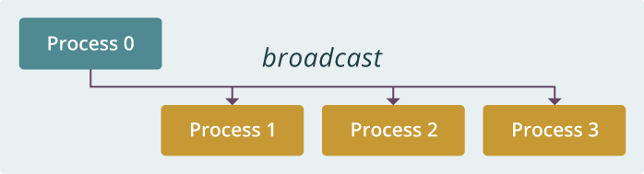
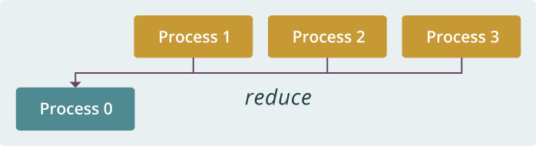
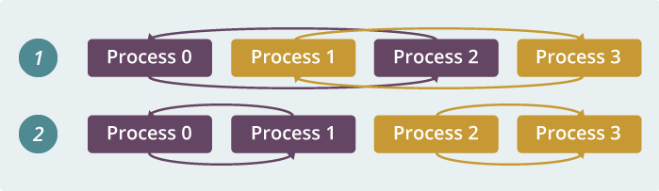
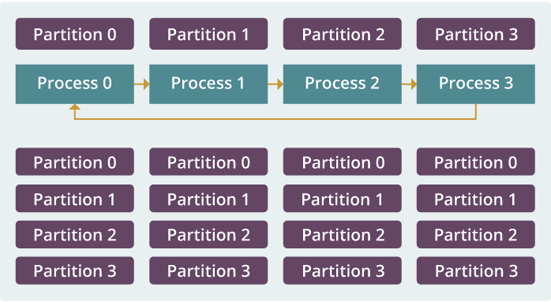
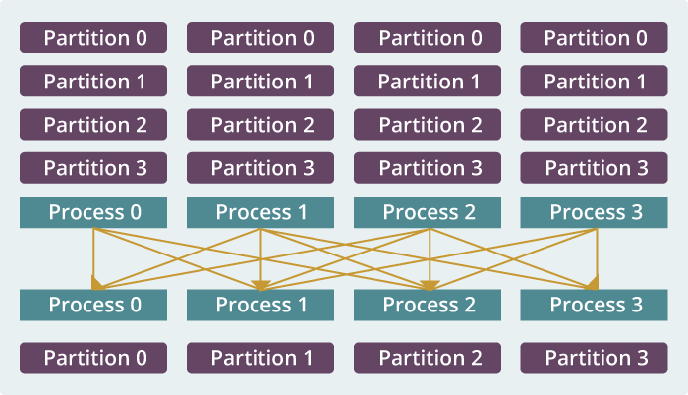
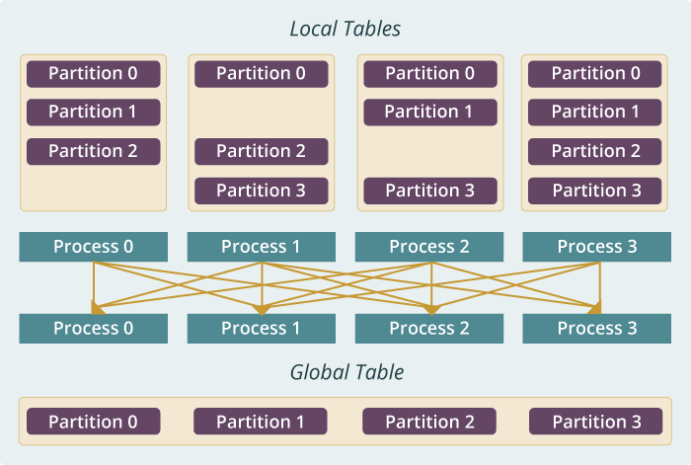
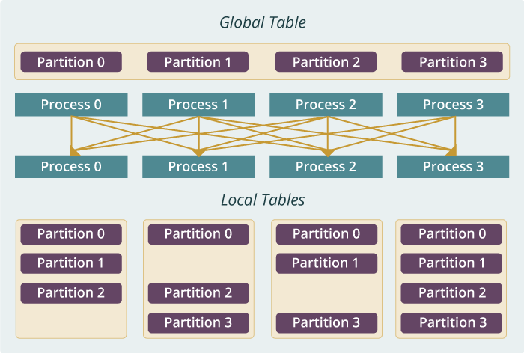
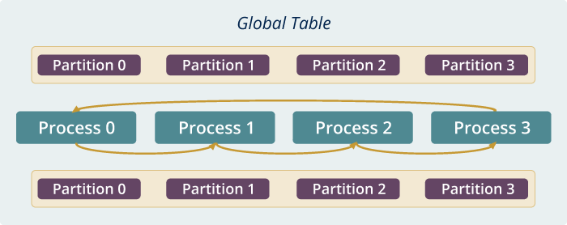
Run time software for Harp
broadcast
reduce
allreduce
allgather
regroup
push & pull
rotate
Map Collective Run time merges MapReduce and HPC

Slide 36
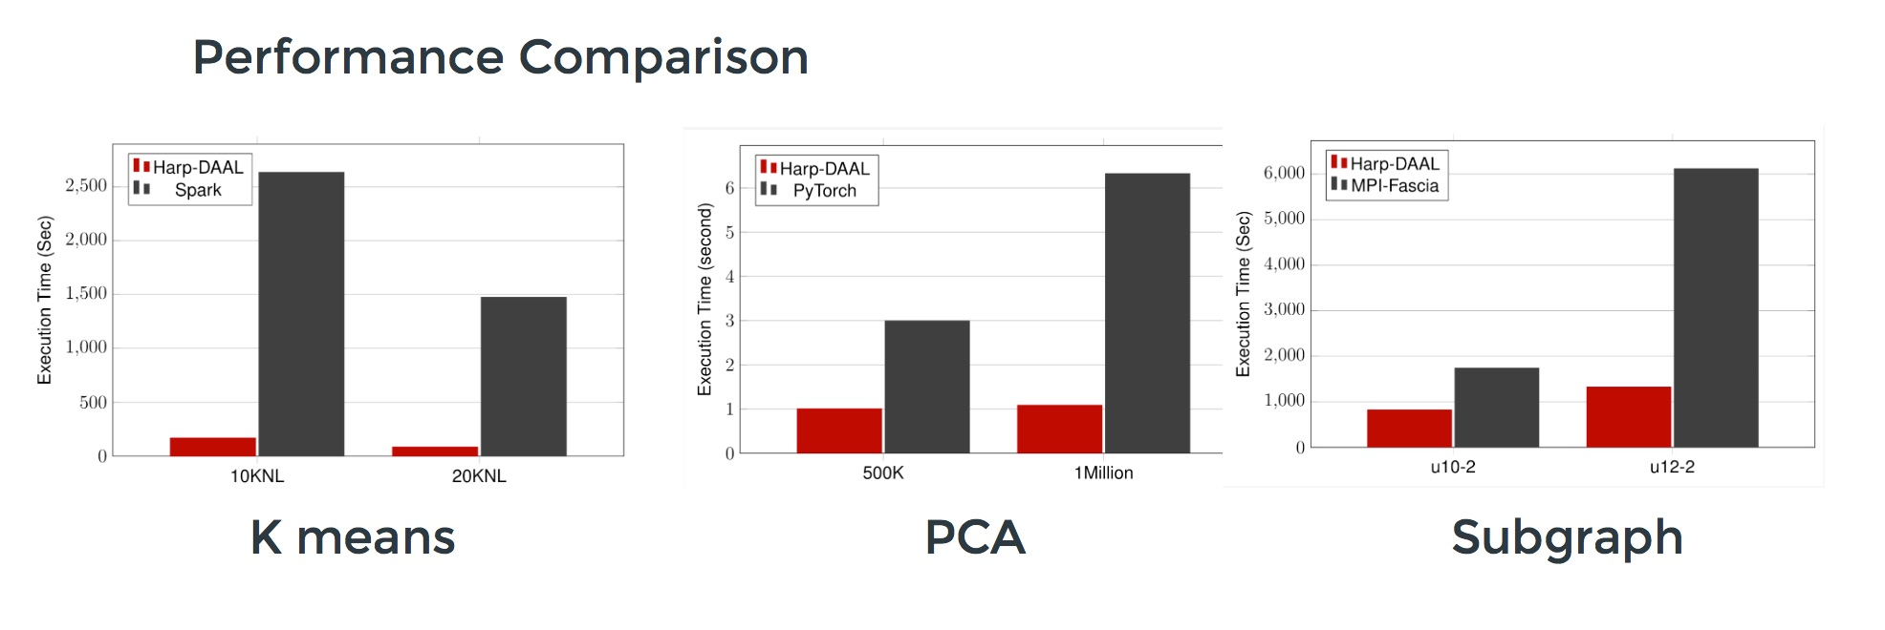
Harp v. Spark Harp v. Torch Harp v. MPI
Datasets: 5 million points, 10 thousand centroids, 10 feature dimensions
10 to 20 nodes of Intel KNL7250 processors
Harp-DAAL has 15x speedups over Spark MLlib
Datasets: 500K or 1 million data points of feature dimension 300
Running on single KNL 7250 (Harp-DAAL) vs. single K80 GPU (PyTorch)
Harp-DAAL achieves 3x to 6x speedups
Datasets: Twitter with 44 million vertices, 2 billion edges, subgraph templates of 10 to 12 vertices
25 nodes of Intel Xeon E5 2670
Harp-DAAL has 2x to 5x speedups over state-of-the-art MPI-Fascia solution

Slide 37
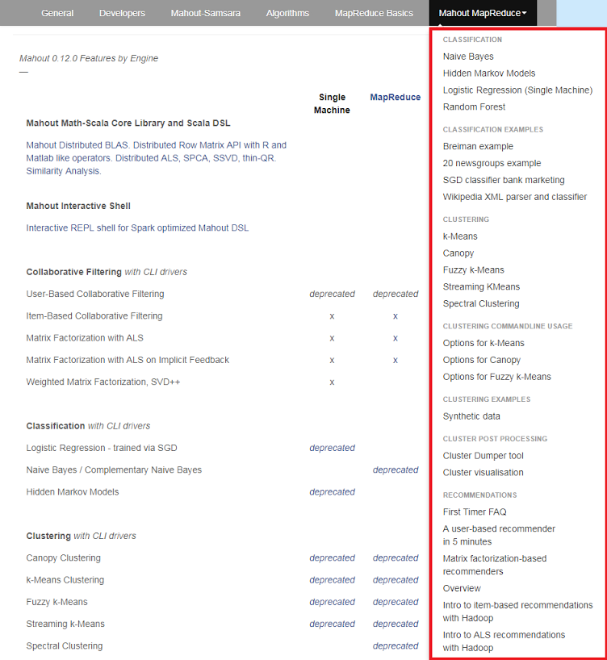
Mahout and SPIDAL
Mahout was Hadoop machine learning library but largely abandoned as Spark outperformed Hadoop
SPIDAL outperforms Spark MLlib and Flink due to better communication and better dataflow or BSP communication.
Has Harp-(DAAL) optimized machine learning interface
SPIDAL also has community algorithms
  Biomolecular Simulation
  Graphs for Network Science
  Image processing for pathology and polar science

Slide 38
Qiu Core SPIDAL Parallel HPC Library with Collective Used
DA-MDS Rotate, AllReduce, Broadcast
Directed Force Dimension Reduction AllGather, Allreduce
Irregular DAVS Clustering Partial Rotate, AllReduce, Broadcast
DA Semimetric Clustering (Deterministic Annealing) Rotate, AllReduce, Broadcast
K-means AllReduce, Broadcast, AllGather DAAL
SVM AllReduce, AllGather
SubGraph Mining AllGather, AllReduce
Latent Dirichlet Allocation Rotate, AllReduce
Matrix Factorization (SGD) Rotate DAAL
Recommender System (ALS) Rotate DAAL
Singular Value Decomposition (SVD) AllGather DAAL
QR Decomposition (QR) Reduce, Broadcast DAAL
Neural Network AllReduce DAAL
Covariance AllReduce DAAL
Low Order Moments Reduce DAAL
Naive Bayes Reduce DAAL
Linear Regression Reduce DAAL
Ridge Regression Reduce DAAL
Multi-class Logistic Regression Regroup, Rotate, AllGather
Random Forest AllReduce
Principal Component Analysis (PCA) AllReduce DAAL
DAAL implies integrated on node with Intel DAAL Optimized Data Analytics Library

Slide 39
Ways of adding AI First High Performance
Fix performance issues in Spark, Heron, Hadoop, Flink etc.
  Messy as some features of these big data systems intrinsically slow in some (not all) cases
  All these systems are “monolithic” and difficult to deal with individual components
Execute HPBDC from classic big data system with custom communication environment – approach of Harp for the relatively simple Hadoop environment
Provide a native Mesos/Yarn/Kubernetes/HDFS high performance execution environment – goal of Twister2
Execute with MPI in classic (Slurm, Lustre) HPC environment
Add modules to existing frameworks like Scikit-Learn or Tensorflow either as new capability or as a higher performance version of existing module.

Slide 40
Implementing Twister2 in detail I
http://www.iterativemapreduce.org/
This breaks rule from 2012-2017 of not “competing” with but rather “enhancing” Apache

Slide 41
Twister2: “Next Generation Grid - Edge – HPC Cloud” Programming Environment
Analyze the runtime of existing systems
  Hadoop, Spark, Flink, Pregel Big Data Processing
  OpenWhisk and commercial FaaS
  Storm, Heron, Apex Streaming Dataflow
  Kepler, Pegasus, NiFi workflow systems
  Harp Map-Collective, MPI and HPC AMT runtime like DARMA
  And approaches such as GridFTP and CORBA/HLA (!) for wide area data links
A lot of confusion coming from
different communities (database,
distributed, parallel computing,
machine learning, computational/
data science) investigating similar
ideas with little knowledge exchange
and mixed up (unclear) requirements
http://www.iterativemapreduce.org/

Slide 42
Integrating HPC and Apache Programming Environments
Harp-DAAL with a kernel Machine Learning library exploiting the Intel node library DAAL and HPC communication collectives within the Hadoop ecosystem.
  Harp-DAAL supports all 5 classes of data-intensive AI first computation, from pleasingly parallel to machine learning and simulations.
Twister2 is a toolkit of components that can be packaged in different ways
  Integrated batch or streaming data capabilities familiar from Apache Hadoop, Spark, Heron and Flink but with high performance.
  Separate bulk synchronous and data flow communication;
  Task management as in Mesos, Yarn and Kubernetes
  Dataflow graph execution models
  Launching of the Harp-DAAL library with native Mesos/Kubernetes/HDFS environment
  Streaming and repository data access interfaces,
  In-memory databases and fault tolerance at dataflow nodes. (use RDD to do classic checkpoint-restart)

Slide 43
Approach
Clearly define and develop functional layers (using existing technology when possible)
Develop layers as independent components
Use interoperable common abstractions but multiple polymorphic implementations.
Allow users to pick and choose according to requirements such as
  Communication + Data Management
  Communication + Static graph
Use HPC features when possible

Slide 44
Twister2 Components I
Area | Component | Implementation | Comments: User API
Architecture Specification | Coordination Points | State and Configuration Management; Program, Data and Message Level | Change execution mode; save and reset state
 | Execution Semantics | Mapping of Resources to Bolts/Maps in Containers, Processes, Threads | Different systems make different choices - why?
 | Parallel Computing | Spark Flink Hadoop Pregel MPI modes | Owner Computes Rule
Job Submission | (Dynamic/Static) Resource Allocation | Plugins for Slurm, Yarn, Mesos, Marathon, Aurora | Client API (e.g. Python) for Job Management
Task System | Task migration | Monitoring of tasks and migrating tasks for better resource utilization | Task-based programming with Dynamic or Static Graph API; FaaS API; Support accelerators (CUDA,KNL)
 | Elasticity | OpenWhisk
 | Streaming and FaaS Events | Heron, OpenWhisk, Kafka/RabbitMQ
 | Task Execution | Process, Threads, Queues
 | Task Scheduling | Dynamic Scheduling, Static Scheduling, Pluggable Scheduling Algorithms
 | Task Graph | Static Graph, Dynamic Graph Generation

Slide 45
Twister2 Components II
Area | Component | Implementation | Comments
Communication API | Messages | Heron | This is user level and could map to multiple communication systems
 | Dataflow Communication | Fine-Grain Twister2 Dataflow communications: MPI,TCP and RMA Coarse grain Dataflow from NiFi, Kepler? | Streaming, ETL data pipelines; Define new Dataflow communication API and library
 | BSP Communication Map-Collective | Conventional MPI, Harp | MPI Point to Point and Collective API
Data Access | Static (Batch) Data | File Systems, NoSQL, SQL | Data API
 | Streaming Data | Message Brokers, Spouts
Data Management | Distributed Data Set | Relaxed Distributed Shared Memory(immutable data), Mutable Distributed Data | Data Transformation API; Spark RDD, Heron Streamlet
Fault Tolerance | Check Pointing | Upstream (streaming) backup; Lightweight; Coordination Points; Spark/Flink, MPI and Heron models | Streaming and batch cases distinct; Crosses all components
Security | Storage, Messaging, execution | Research needed | Crosses all Components

Slide 46
Implementing Twister2 in detail II
http://www.iterativemapreduce.org/
Look at Communication in detail

Slide 47
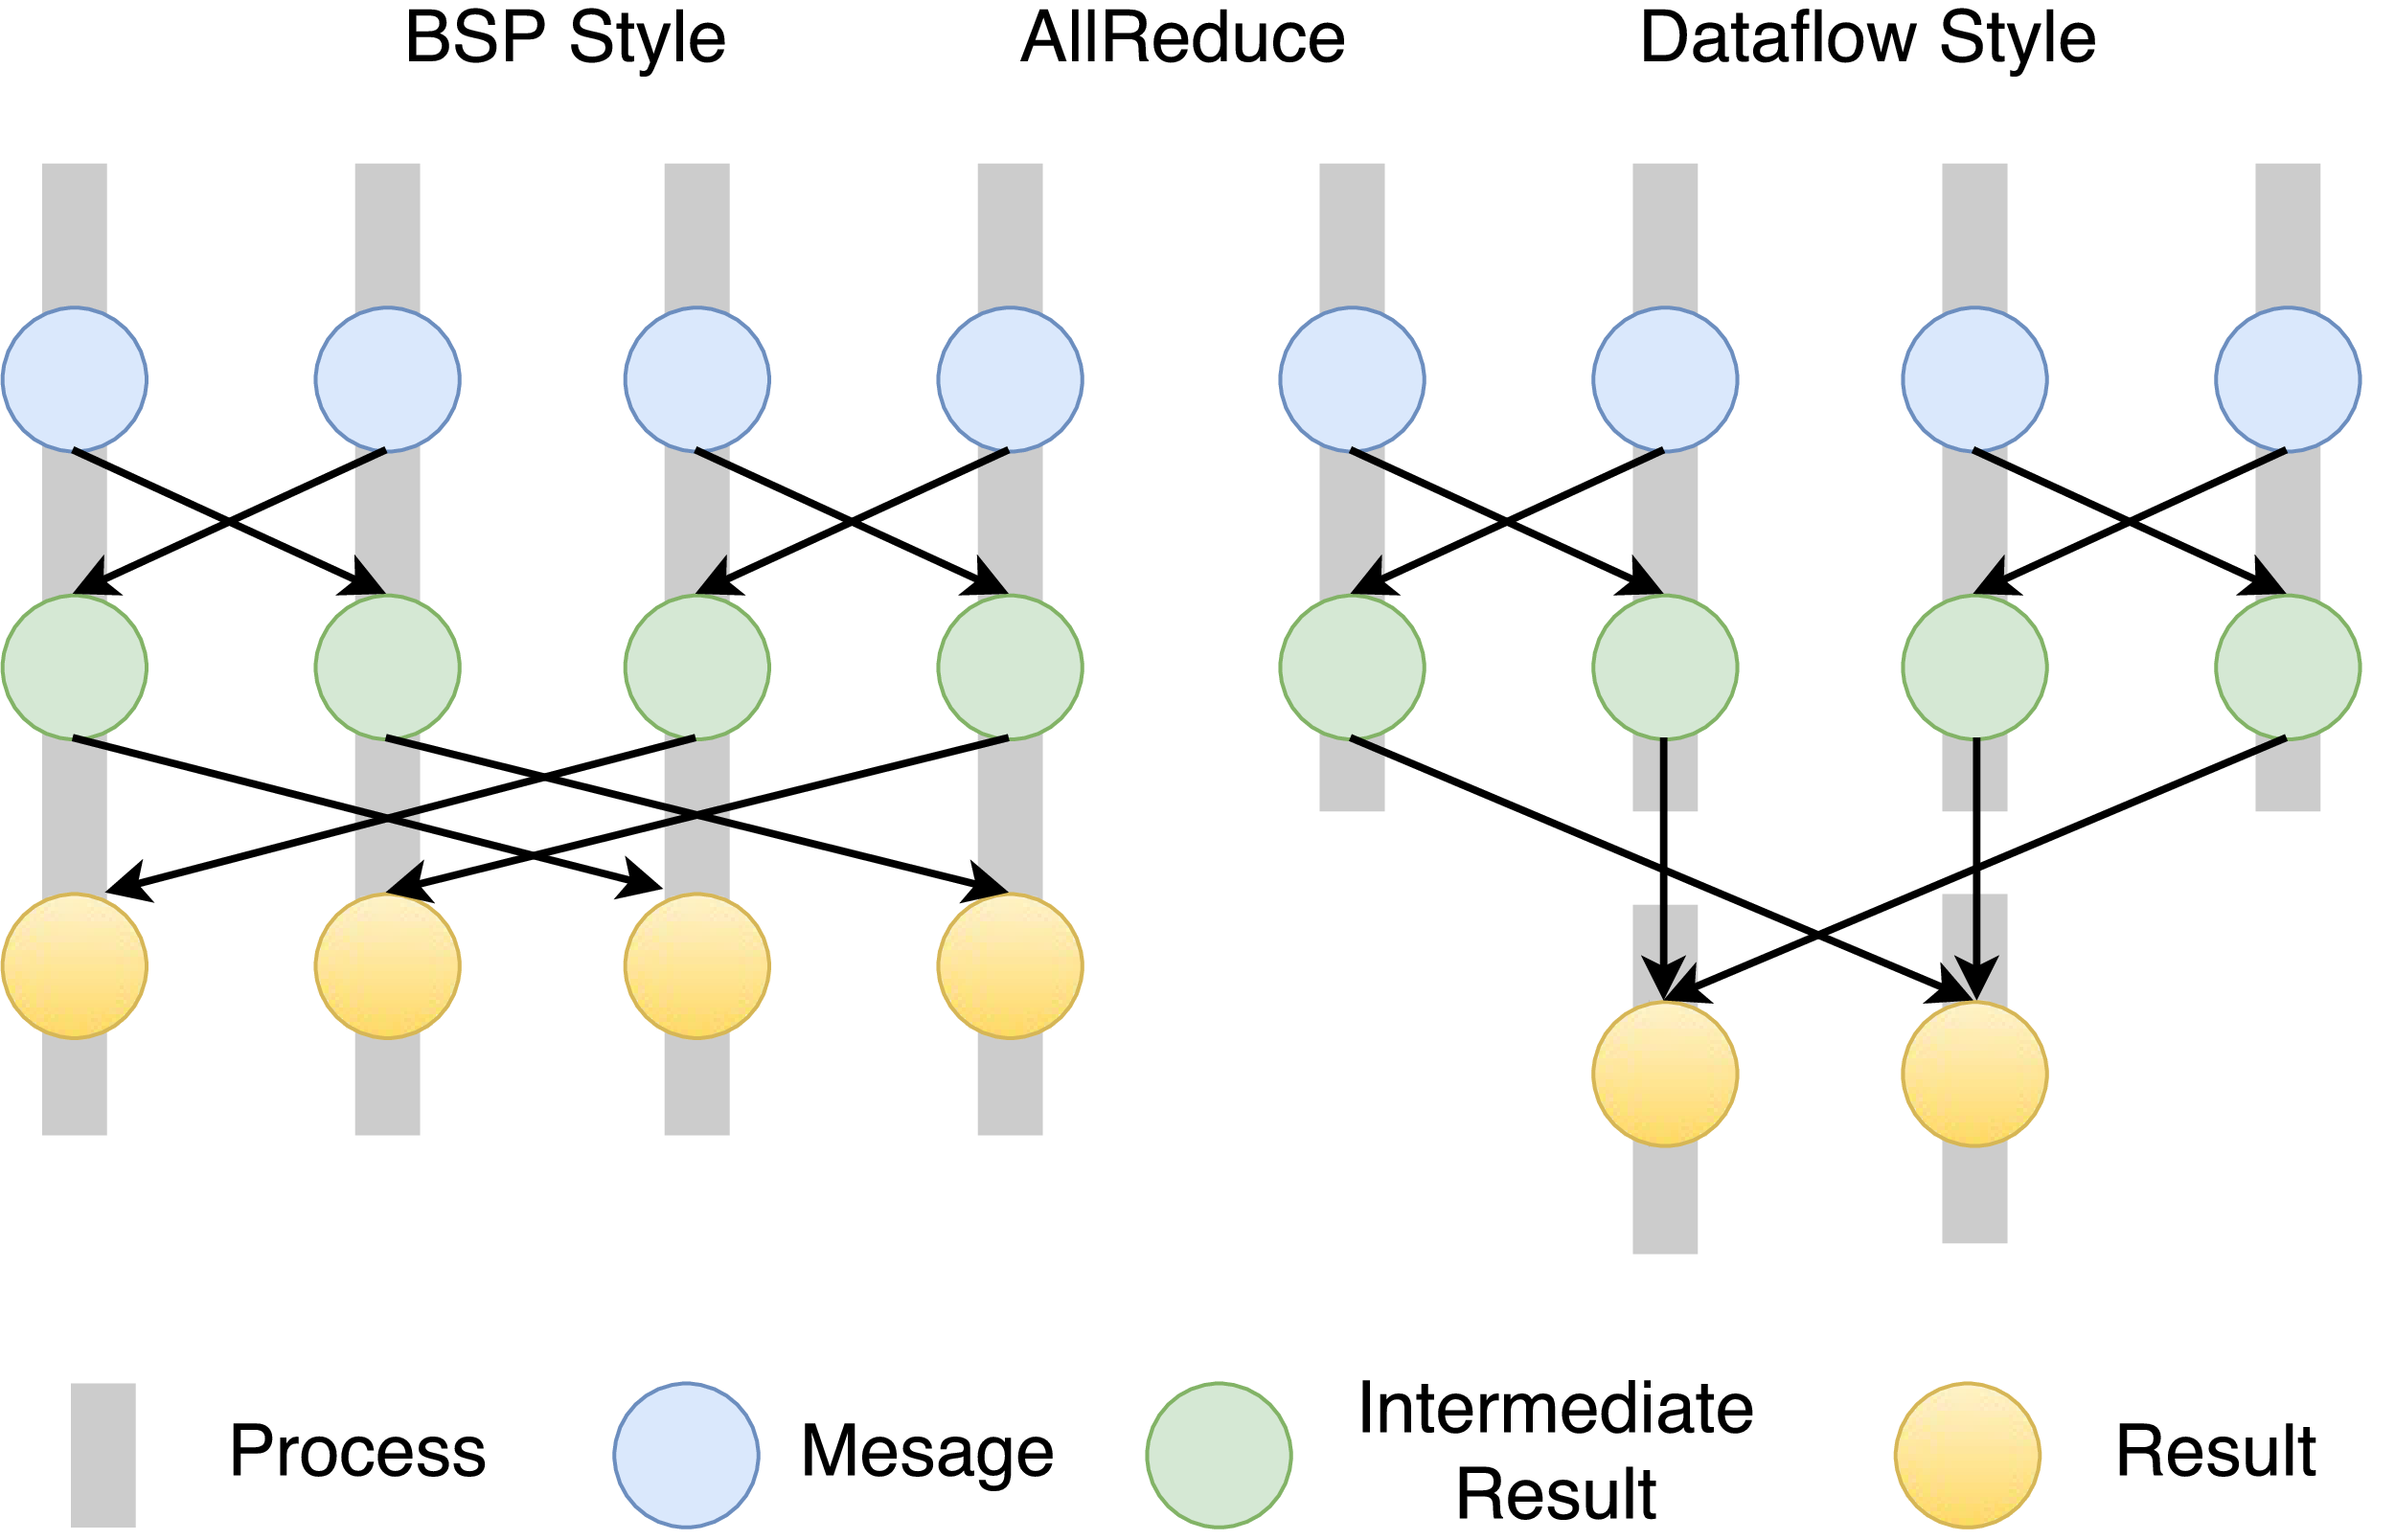
Twister2 Dataflow Communications
Twister:Net offers two communication models
  BSP (Bulk Synchronous Processing) communication using TC or MPI separated from its task management plus extra Harp collectives
plus a new Dataflow library DFW built using MPI software but at data movement not message level
  Non-blocking
  Dynamic data sizes
  Streaming model
    Batch case is modeled as a finite stream
  The communications are between a set of
  tasks in an arbitrary task graph
  Key based communications
  Communications spilling to disks
  Target tasks can be different from source tasks

Slide 48
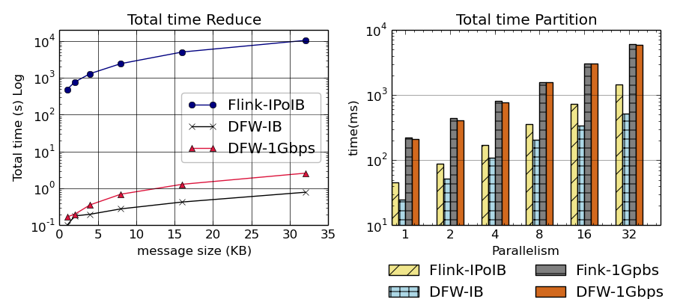
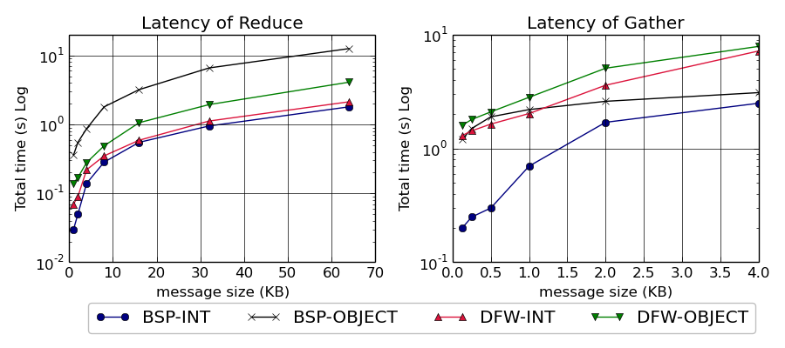
Flink, BSP and DFW Performance
Total time for Flink and Twister:Net for Reduce and Partition operations in 32 nodes with 640-way parallelism. The time is for 1 million messages in each parallel unit, with the given message size
Latency for Reduce and Gather operations in 32 nodes with 256-way parallelism. The time is for 1 million messages in each parallel unit, with the given message size. For BSP-Object case we do two MPI calls with MPIAllReduce / MPIAllGather first to get the lengths of the messages and the actual call. InfiniBand network is used.

Slide 49
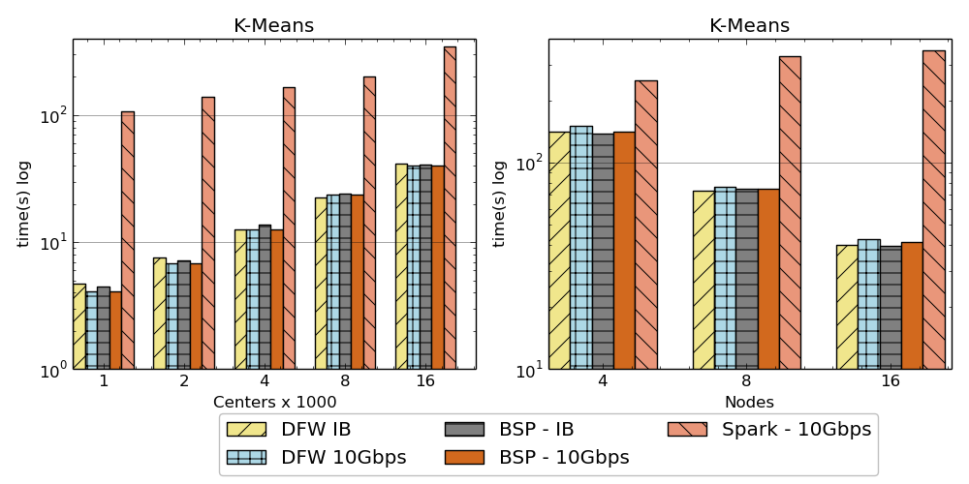
K-Means algorithm performance
Spark, DFW, BSP for Twister2
IB (Infiniband) and 10Gbps Ethernet
AllReduce Communication
Left: K-means job execution time on 16 nodes with varying centers, 2 million points with 320-way parallelism. Right: K-Means with 4,8 and 16 nodes where each node having 20 tasks. 2 million points with 16000 centers used.

Slide 50
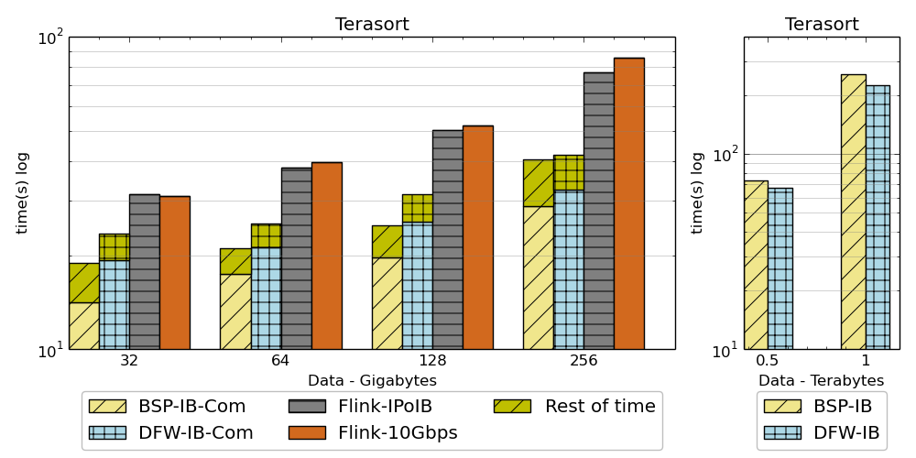
Sorting Records
For DFW case, a single node can get congested if many processes send messages simultaneously.
Left: Terasort time on a 16 node cluster with 384 parallelism. BSP and DFW shows the communication time. Right: Terasort on 32 nodes with .5 TB and 1TB datasets. Parallelism of 320. Right 16 node cluster (Victor), Left 32 node cluster (Juliet) with InfiniBand.
Partition the data using a sample and regroup
BSP algorithm waits for others to send messages in a ring topology and can be inefficient compared to DFW case where processes do not wait.

Slide 51
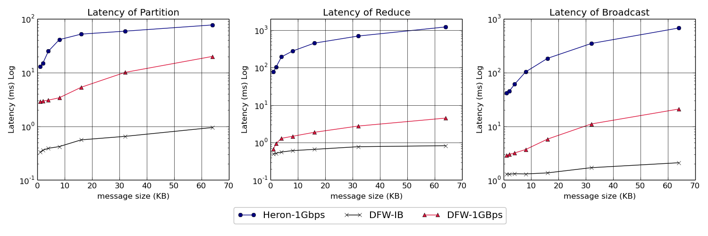
Twister:Net and Apache Heron for Streaming
Latency of Apache Heron and Twister:Net DFW (Dataflow) for Reduce, Broadcast and Partition operations in 16 nodes with 256-way parallelism

Slide 52
Implementing Twister2 in detail III
http://www.iterativemapreduce.org/
State

Slide 53
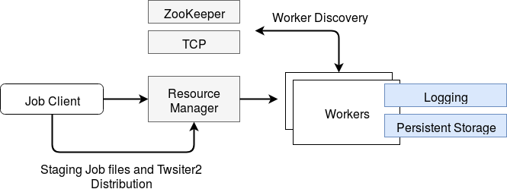
Resource Allocation
Job Submission & Management
  twister2 submit
Resource Managers
    Slurm
    Nomad
    Kubernetes
    Mesos

Slide 54
Kubernetes and Mesos Worker Initialization Times
Kubernetes
Mesos
It takes around 5 seconds to initialize a worker in Kubernetes.
It takes around 3 seconds to initialize a worker in Mesos.
When 3 workers are deployed in one executor or pod, initialization times are faster in both systems.

Slide 55

Dataflow at Different Grain sizes
Coarse Grain Dataflows links jobs in such a pipeline
Visualization
Dimension
Reduction
Data preparation
Clustering
But internally to each job you can also elegantly express algorithm as dataflow but with more stringent performance constraints
Corresponding to classic Spark K-means Dataflow
P = loadPoints()
C = loadInitCenters()
for (int i = 0; i < 10; i++) {
T = P.map().withBroadcast(C)
C = T.reduce() }
Internal Execution
Dataflow Nodes
Reduce
Iterate
HPC
Communication
Maps
Iterate

Slide 56
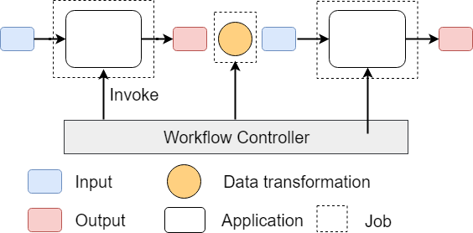
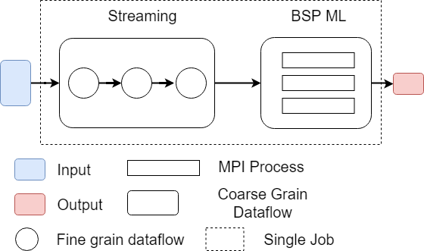
Workflow vs Dataflow: Different grain sizes and different performance trade-offs
The fine-grain dataflow can expand from Edge to Cloud
Coarse-grain Dataflow
Workflow Controlled by Workflow Engine or a Script
Fine-grain dataflow application running as a single job

Slide 57
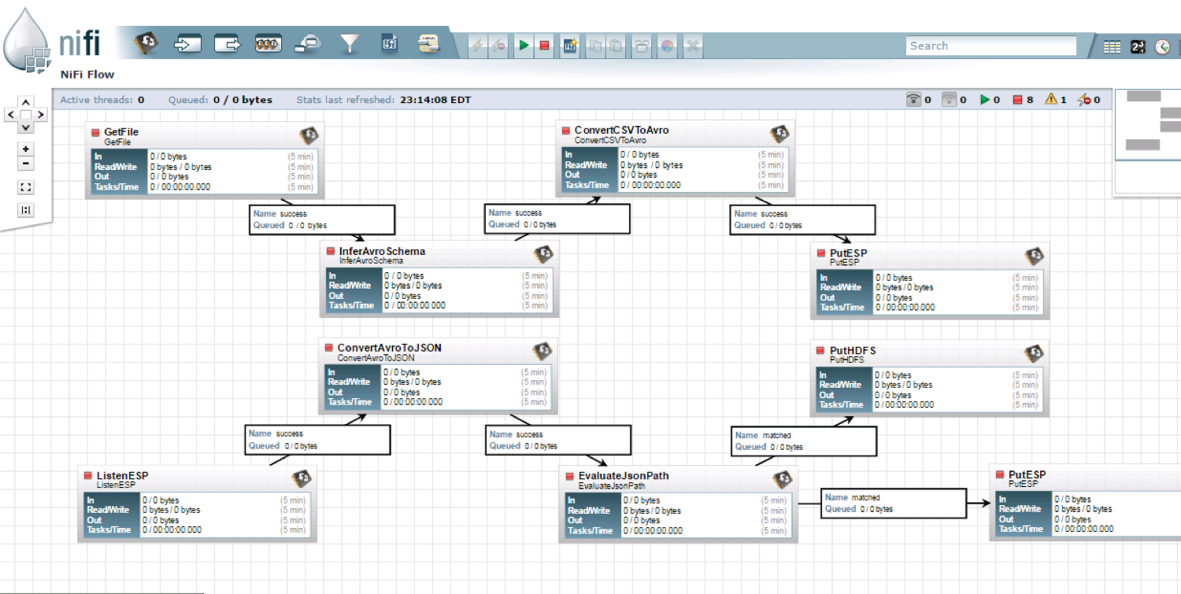
NiFi Coarse-grain Workflow

Slide 58

Flink MDS Dataflow Graph

Slide 59
Systems State Spark Kmeans Dataflow
State is handled differently in systems
  CORBA, AMT, MPI and Storm/Heron have long running tasks that preserve state
  Spark and Flink preserve datasets across dataflow node using in-memory databases
  All systems agree on coarse grain dataflow; only keep state by exchanging data
P = loadPoints()
C = loadInitCenters()
for (int i = 0; i < 10; i++) {
T = P.map().withBroadcast(C)
C = T.reduce() }
Iterate
Save State at Coordination Point
Store C in RDD

Slide 60
Fault Tolerance and State
Similar form of check-pointing mechanism is used already in HPC and Big Data
  although HPC informal as doesn’t typically specify as a dataflow graph
  Flink and Spark do better than MPI due to use of database technologies; MPI is a bit harder due to richer state but there is an obvious integrated model using RDD type snapshots of MPI style jobs
Checkpoint after each stage of the dataflow graph (at location of intelligent dataflow nodes)
  Natural synchronization point
  Let’s allows user to choose when to checkpoint (not every stage)
  Save state as user specifies; Spark just saves Model state which is insufficient for complex algorithms

Slide 61
Futures
Implementing Twister2
AI First High Performance Big Data Computing
http://www.iterativemapreduce.org/

Slide 62
Twister2 Timeline: End of August 2018
Twister:Net Dataflow Communication API
  Dataflow communications with MPI or TCP
Harp for Machine Learning (Custom BSP Communications)
  Rich collectives
  Around 30 ML algorithms
  Other ML libraries – image processing from SPIDAL
  Study link with Tensorflow Scikit-Learn etc.
HDFS Integration
Task Graph
  Streaming - Storm model
  Batch analytics - Hadoop
Deployments on Docker, Kubernetes, Mesos (Aurora), Nomad, Slurm

Slide 63
Twister2 Timeline: End of December 2018
Native MPI integration to Mesos, Yarn
Naiad model based Task system for Machine Learning
Link to Pilot Jobs
Fault tolerance
  Streaming
  Batch
Hierarchical dataflows with Streaming, Machine Learning and Batch integrated seamlessly
Data abstractions for streaming and batch (Streamlets, RDD)
Workflow graphs (Kepler, Spark) with linkage defined by Data Abstractions (RDD)
End to end applications

Slide 64
Twister2 Timeline: After December 2018
Dynamic task migrations
RDMA and other communication enhancements
Integrate parts of Twister2 components as big data systems enhancements (i.e. run current Big Data software invoking Twister2 components)
  Heron (easiest), Spark, Flink, Hadoop (like Harp today)
Support different APIs (i.e. run Twister2 looking like current Big Data Software)
  Hadoop
  Spark (Flink)
  Storm
Refinements like Marathon with Mesos etc.
Function as a Service and Serverless
Support higher level abstractions
  Twister:SQL

Slide 65
Research and Development Areas for AI First Systems
Hardware Infrastructure
  Exploring different hardware ideas: disk speed and size, accelerators or not, network, CPU, memory size
  Access to testbeds to explore hardware, software, applications at large enough scale (# nodes) to test parallel implementations
  DevOps to automate deployment (HPC) Cloud 2.0 for IBM
  Consider commercial clouds as hosts: Amazon, Azure, Baidu, Google …..
Middleware/Systems Software
  Cover range of applications: Streaming to Batch; Pleasing Parallel to Database to Global Machine Learning; Security; Data analytics to management
  Build and test on different hardware for different applications
Applications and Algorithms
  Gather requirements from users
  Contribute use cases to V3 of NIST Public Big Data use case survey
  Choose applications and implement with “Middleware/Systems Software” on “Hardware Infrastructure”; derive lessons for systems and advance application area

Slide 66
AI First High Performance Big Data Computing
Requires integration of current (Apache) Big Data and HPC technologies
  Integration of Big Data and Big Simulation
  Integration of edge to cloud or streaming to batch technologies
Detailed analysis of applications identifies 5 distinctive computation models
We have integrated HPC into many Apache systems as HPC-ABDS with a rich set of collectives
We have analyzed runtimes of Hadoop, Spark, Flink, Storm, Heron and identified key components and proposed a toolkit Twister2 allowing them to be assembled efficiently in different ways for different applications
  AI First can be delivered for all application classes
Apache systems use dataflow communication which is natural for distributed systems but slow for classic parallel computing
  No standard dataflow library (why?). Add Dataflow primitives in MPI-4?
HPC could adopt some of tools of Big Data as in Coordination Points (dataflow nodes), State management (fault tolerance) with RDD (datasets)

