Slide 1
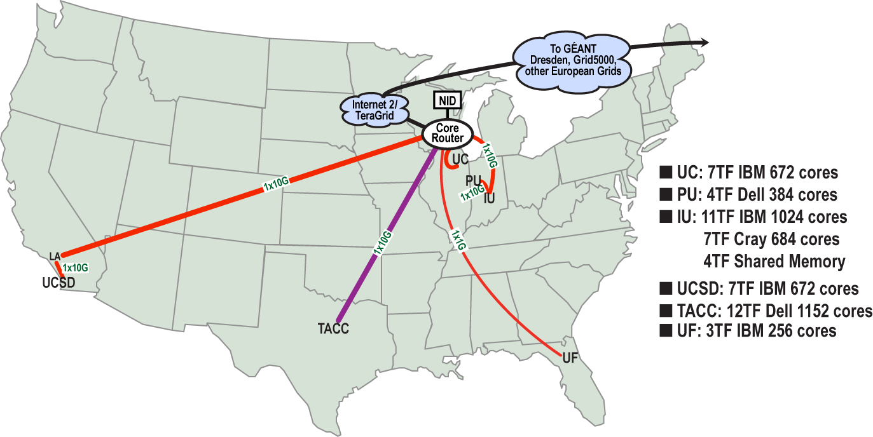
FutureGrid Grid supports Cloud Grid HPC Computing Testbed as a Service (aaS)
12TF Disk rich + GPU 512 cores
NID: Network Impairment Device
Private Public
FG Network
1

Slide 2
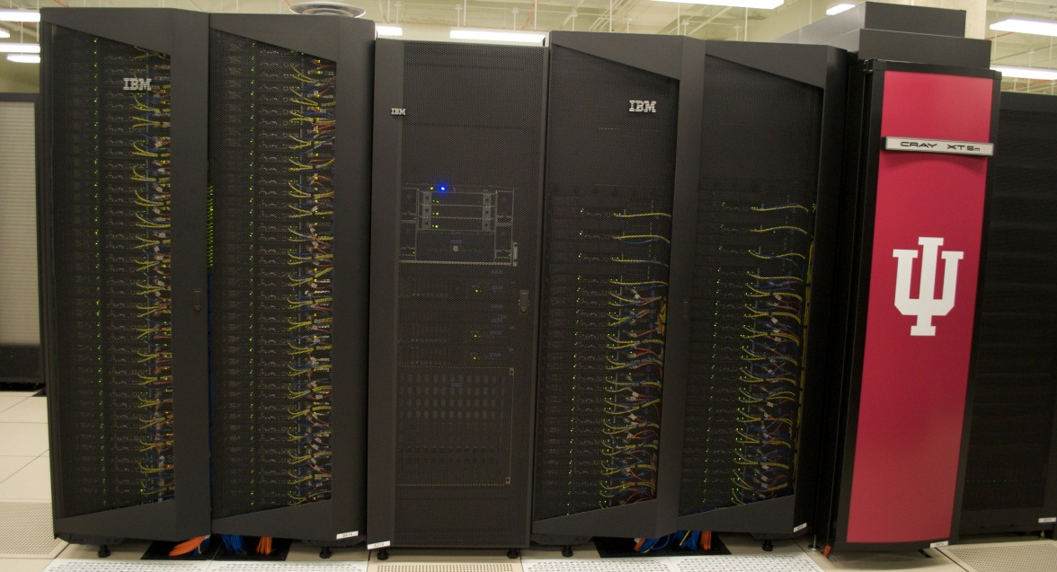
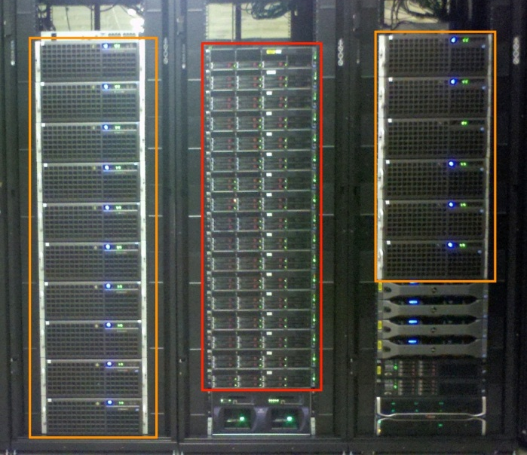
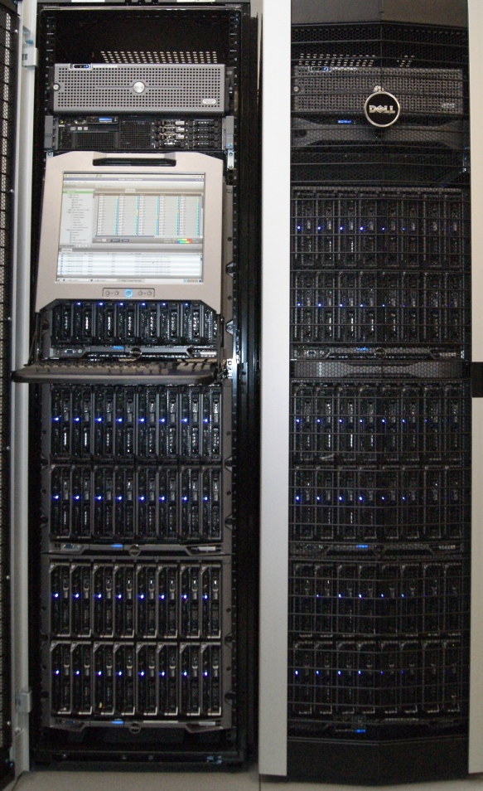
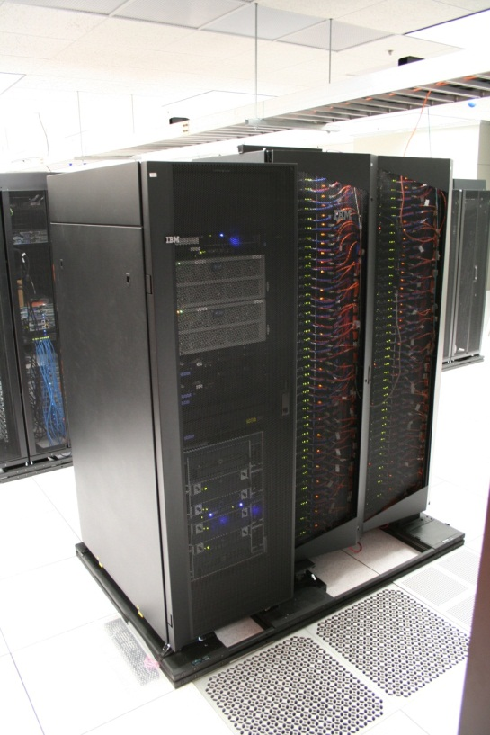
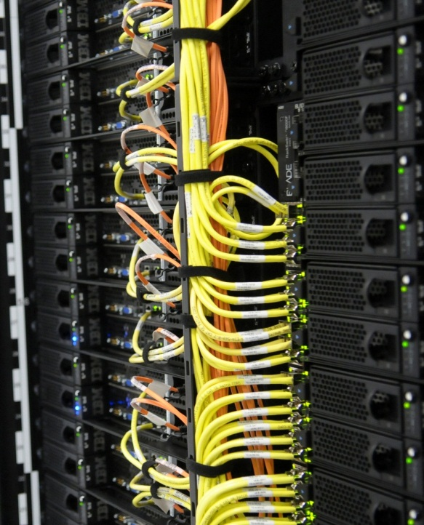
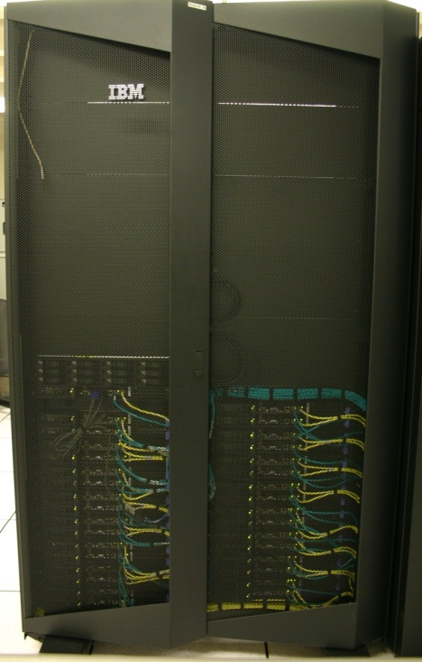
FutureGrid Distributed Testbed-aaS
Bravo Delta (IU)
India (IBM) and Xray (Cray) (IU)
Hotel (Chicago)
Foxtrot (UF)
Sierra (SDSC)
Alamo (TACC)

Slide 3
Examples of FutureGrid Projects
Education and Training: Several classes around the world each semester, HBCU Cloud View of Computing workshop June 2011 and Cloud Summer School July 30—August 3 2012 with over 200 attendees
Technology Evaluation: Test new XSEDE software before deployment; campuses evaluate virtual machines and Hadoop clusters
Computer Science: Research SAGA Pilot Job P* abstraction and HPC-Cloud interoperability; fundamental distributed concurrency control (software transactional memory): leading to paper in leading conference (ICDCS'12)
Understanding Science Clouds: Use Iterative MapReduce for data intensive applications in genomics; benchmarking

Slide 4
FutureGrid offers
Computing Testbed as a Service
FutureGrid Uses
Testbed-aaS Tools
Provisioning
Image Management
IaaS Interoperability
IaaS tools
Expt management
Dynamic Network
Devops
Research
Computing
aaS
Custom Images
Courses
Consulting
Portals
Archival Storage
System e.g. SQL, GlobusOnline
Applications e.g. Amber, Blast
SaaS
FutureGrid Usages
Computer Science
Applications and understanding Science Clouds
Technology Evaluation including XSEDE testing
Education and Training
Cloud e.g. MapReduce
HPC e.g. PETSc, SAGA
Computer Science e.g. Languages, Sensor nets
PaaS
Hypervisor
Bare Metal
Operating System
Virtual Clusters, Networks
IaaS

