Slide 1
Clouds and FutureGrid
MSI-CIEC All Hands Meeting
SDSC January 27 2010
Geoffrey Fox
gcf@indiana.edu
http://www.infomall.org http://www.futuregrid.org
Director, Digital Science Center, Pervasive Technology Institute
Associate Dean for Research and Graduate Studies, School of Informatics and Computing
Indiana University Bloomington
Notes:
SALSA is
Service Aggregated Linked Sequential Activities

Slide 2
Girl's dress
Edit
e-Humanity
Culture/People:
Date Created: | circa 1850
Place: | South Dakota; USA (inferred)
Media/Materials: | Glass pony beads, deerhide/deerskin, elk tooth/teeth, wool cloth, sinew
Techniques: | Sewn, lazy/lane stitch beadwork
Collection History/ Provenance: | Collection history unknown; said to have been collected circa 1850; purchased by MAI in 1916 from an unknown source, possibly with funds donated by Mrs. George (Thea) Heye.
Dimensions: | 112 x 151 cm
Catalog Number: | 5/3776
Source: | National Museum of the American Indian
References: | http://en.wikipedia.org/wiki/Sioux
K. Wilson
Logout
Sioux
Related Artifacts
Search
Total: 2
Total: 5
beads blue dress
girl's dress long sinew
Sioux South Dakota
tan wool 1800’s
Comments / Ratings: 2
Add a Comment / Rating
My grandmother has a dress just like this in her attic. 10.19.2009 9:38AM MST
Reply
X
I love this design. Where can I buy one? ☺ 10.18.2009 1:37PM MST
Reply
X
Average Rating:
(4.0/5.0)
Created by K. Wilson
Notes:
Feedback/Suggestions:

Slide 3
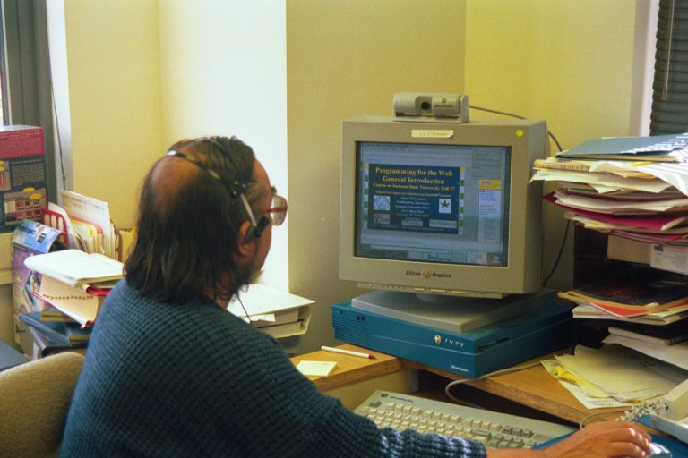
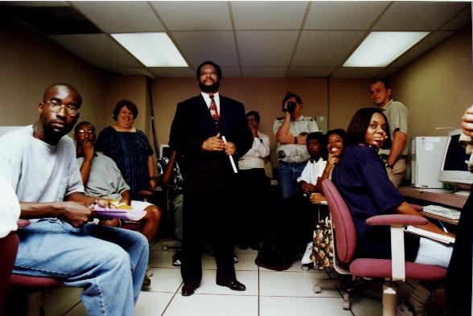
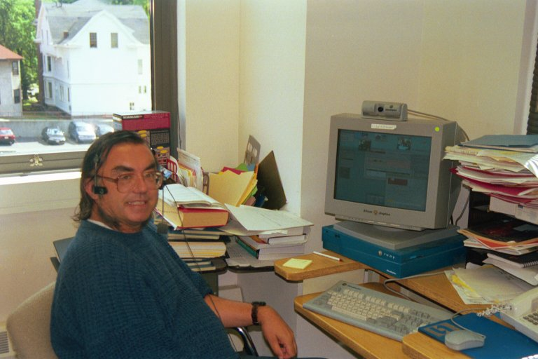
Teaching Jackson State Fall 97 to Spring 2005
Syracuse
JSU

Slide 4
Important Trends
Data Deluge in all fields of science
Also throughout life e.g. web!
Preservation, Access/Use, Programming model
Multicore implies parallel computing important again
Performance from extra cores – not extra clock speed
Clouds – new commercially supported data center model replacing compute grids

Slide 6
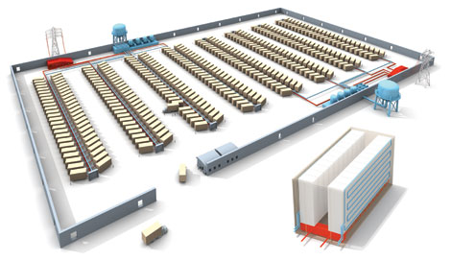
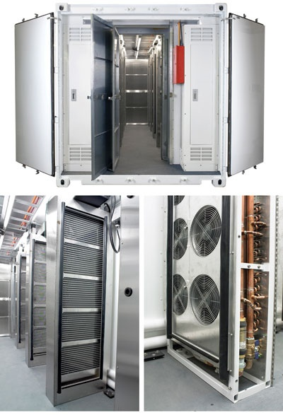
Clouds as Cost Effective Data Centers
Builds giant data centers with 100,000’s of computers; ~ 200 -1000 to a shipping container with Internet access
“Microsoft will cram between 150 and 220 shipping containers filled with data center gear into a new 500,000 square foot Chicago facility. This move marks the most significant, public use of the shipping container systems popularized by the likes of Sun Microsystems and Rackable Systems to date.”

Slide 7
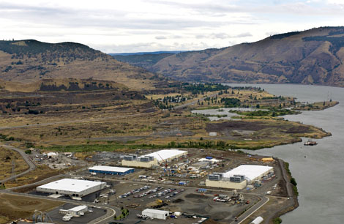
Clouds hide Complexity
SaaS: Software as a Service
IaaS: Infrastructure as a Service or HaaS: Hardware as a Service – get your computer time with a credit card and with a Web interaface
PaaS: Platform as a Service is IaaS plus core software capabilities on which you build SaaS
Cyberinfrastructure is “Research as a Service”
SensaaS is Sensors as a Service
2 Google warehouses of computers on the banks of the Columbia River, in The Dalles, Oregon
Such centers use 20MW-200MW
(Future) each
150 watts per core
Save money from large size, positioning with cheap power and access with Internet

Slide 8
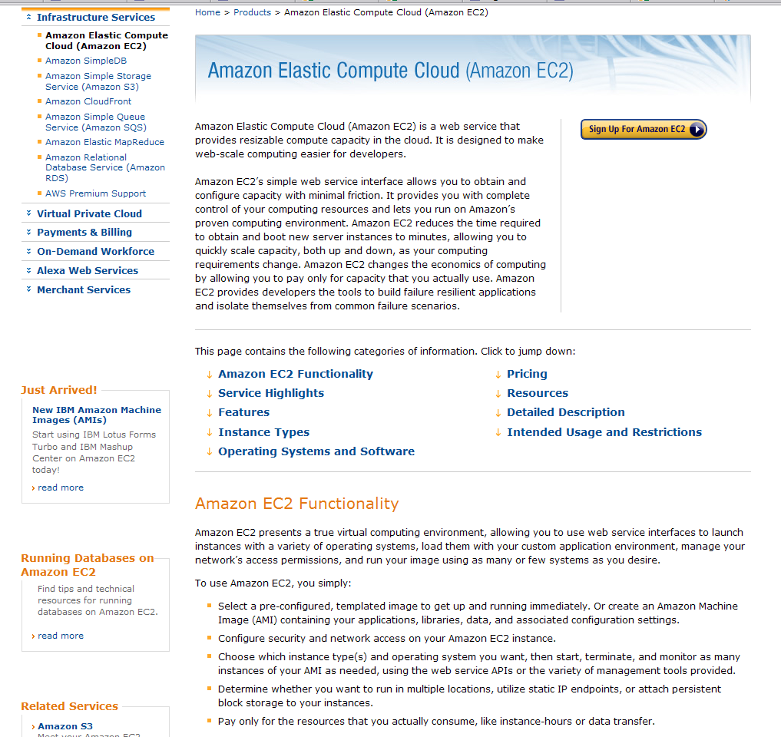

Slide 9
Philosophy of Clouds and Grids
Clouds are (by definition) commercially supported approach to large scale computing
So we should expect Clouds to replace Compute Grids
Current Grid technology involves “non-commercial” software solutions which are hard to evolve/sustain
Maybe Clouds ~4% IT expenditure 2008 growing to 14% in 2012 (IDC Estimate)
Public Clouds are broadly accessible resources like Amazon and Microsoft Azure – powerful but not easy to optimize and perhaps data trust/privacy issues
Private Clouds run similar software and mechanisms but on “your own computers”
Services still are correct architecture with either REST (Web 2.0) or Web Services

Slide 10
Cloud Computing: Infrastructure and Runtimes
Cloud infrastructure: outsourcing of servers, computing, data, file space, utility computing, etc.
Handled through Web services that control virtual machine lifecycles.
Cloud runtimes: tools (for using clouds) to do data-parallel computations.
Apache Hadoop, Google MapReduce, Microsoft Dryad, and others
Designed for information retrieval but are excellent for a wide range of science data analysis applications
Can also do much traditional parallel computing for data-mining if extended to support iterative operations
Not usually on Virtual Machines

Slide 11
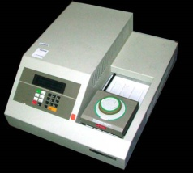
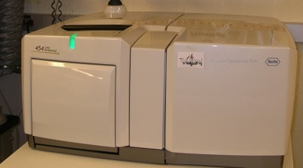
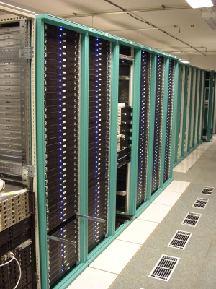
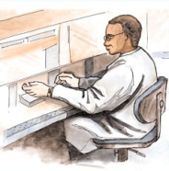
MapReduce “File/Data Repository” Parallelism
Map = (data parallel) computation reading and writing data
Reduce = Collective/Consolidation phase e.g. forming multiple global sums as in histogram
Instruments
Iterative MapReduce (MPI)
Map Map Map Map
Reduce Reduce Reduce
Communication
Reduce
Portals /Users
Disks
Map₁
Map₂
Map₃

Slide 12
FutureGrid
The goal of FutureGrid is to support the research on the future of distributed, grid, and cloud computing.
FutureGrid will build a robustly managed simulation environment or testbed to support the development and early use in science of new technologies at all levels of the software stack: from networking to middleware to scientific applications.
The environment will mimic TeraGrid and/or general parallel and distributed systems – FutureGrid is part of TeraGrid and one of two experimental TeraGrid systems (other is GPU)
This test-bed will succeed if it enables major advances in science and engineering through collaborative development of science applications and related software.
FutureGrid is a (small >5000 core) Science/Computer Science Cloud but it is more accurately a virtual machine based simulation environment

Slide 13
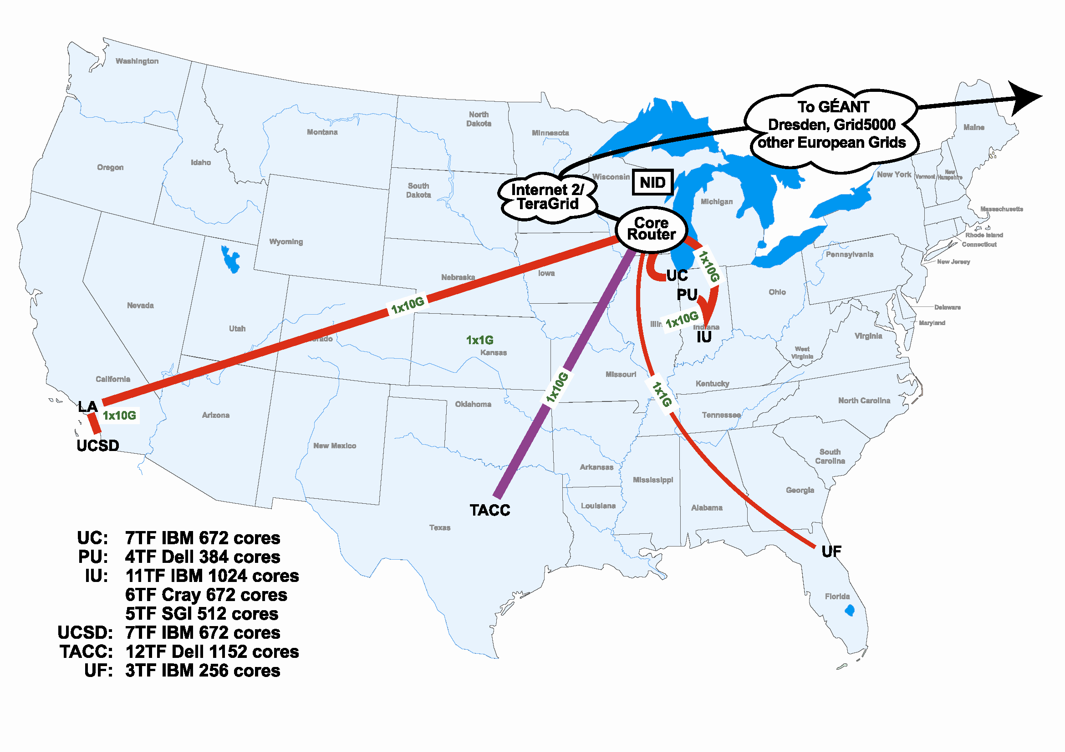
FutureGrid Hardware

Slide 14
Compute Hardware
System type | # CPUs | # Cores | TFLOPS | Total RAM (GB) | Secondary Storage (TB) | Site | Status
Dynamically configurable systems
IBM iDataPlex | 256 | 1024 | 11 | 3072 | 339* | IU | New System
Dell PowerEdge | 192 | 1152 | 8 | 1152 | 15 | TACC | New System
IBM iDataPlex | 168 | 672 | 7 | 2016 | 120 | UC | New System
IBM iDataPlex | 168 | 672 | 7 | 2688 | 72 | SDSC | Existing System
Subtotal | 784 | 3520 | 33 | 8928 | 546
Systems possibly not dynamically configurable
Cray XT5m | 168 | 672 | 6 | 1344 | 339* | IU | New System
Shared memory system TBD | 40 | 480 | 4 | 640 | 339* | IU | New System 4Q2010
Cell BE Cluster | 4 | 80 | 1 | 64 |  | IU | Existing System
IBM iDataPlex | 64 | 256 | 2 | 768 | 1 | UF | New System
High Throughput Cluster | 192 | 384 | 4 | 192 |  | PU | Existing System
Subtotal | 468 | 1872 | 17 | 3008 | 1
Total | 1252 | 5392 | 50 | 11936 | 547

Slide 15
Storage Hardware
System Type | Capacity (TB) | File System | Site | Status
DDN 9550 (Data Capacitor) | 339 | Lustre | IU | Existing System
DDN 6620 | 120 | GPFS | UC | New System
SunFire x4170 | 72 | Lustre/PVFS | SDSC | New System
Dell MD3000 | 30 | NFS | TACC | New System
FutureGrid has dedicated network (except to TACC) and a network fault and delay generator
Can isolate experiments on request; IU runs Network for NLR/Internet2
Additional partner machines could run FutureGrid software and be supported (but allocated in specialized ways)

Slide 16
Network Impairments Device
Spirent XGEM Network Impairments Simulator for jitter, errors, delay, etc
Full Bidirectional 10G w/64 byte packets
up to 15 seconds introduced delay (in 16ns increments)
0-100% introduced packet loss in .0001% increments
Packet manipulation in first 2000 bytes
up to 16k frame size
TCL for scripting, HTML for human configuration

Slide 17
FutureGrid Partners
Indiana University (Architecture, core software, Support)
Purdue University (HTC Hardware)
San Diego Supercomputer Center at University of California San Diego (INCA, Monitoring)
University of Chicago/Argonne National Labs (Nimbus)
University of Florida (ViNE, Education and Outreach)
University of Southern California Information Sciences Institute (Pegasus to manage experiments)
University of Tennessee Knoxville (Benchmarking)
University of Texas at Austin/Texas Advanced Computing Center (Portal)
University of Virginia (OGF, Advisory Board and allocation)
Center for Information Services and GWT-TUD from Technische Universtität Dresden Germany. (VAMPIR)
Blue institutions have FutureGrid hardware

Slide 18
Other Important Collaborators
NSF
Early users from an application and computer science perspective and from both research and education
Grid5000/Aladdin and D-Grid in Europe
Commercial partners such as
Eucalyptus ….
Microsoft (Dryad + Azure) – Note current Azure external to FutureGrid as are GPU systems
Application partners
TeraGrid
Open Grid Forum
Possibly Open Nebula, Open Cirrus Testbed, Open Cloud Consortium, Cloud Computing Interoperability Forum. IBM-Google-NSF Cloud, and other DoE/NSF/… clouds
China, Japan, Korea, Australia, other Europe … ?

Slide 19
FutureGrid Usage Scenarios
Developers of end-user applications who want to develop new applications in cloud or grid environments, including analogs of commercial cloud environments such as Amazon or Google.
Is a Science Cloud for me? Is my application secure?
Developers of end-user applications who want to experiment with multiple hardware environments.
Grid/Cloud middleware developers who want to evaluate new versions of middleware or new systems.
Networking researchers who want to test and compare different networking solutions in support of grid and cloud applications and middleware. (Some types of networking research will likely best be done via through the GENI program.)
Education as well as research
Interest in performance requires that bare metal important

Slide 20
Selected FutureGrid Timeline
October 1 2009 Project Starts
November 16-19 SC09 Demo/F2F Committee Meetings/Chat up collaborators
March 2010 – Significant Hardware available
March 2010 FutureGrid network complete
March 2010 FutureGrid Annual Meeting
April 2010 Several early users
September 2010 All hardware (except Track IIC lookalike) accepted
October 1 2011 FutureGrid allocatable via TeraGrid process – first two years by user/science board led by Andrew Grimshaw

Slide 21
FutureGrid Architecture
Open Architecture allows to configure resources based on images
Managed images allows to create similar experiment environments
Experiment management allows reproducible activities
Through our modular design we allow different clouds and images to be “rained” upon hardware.
Note will be supported 24x7 at “TeraGrid Production Quality”
Will support deployment of “important” middleware including TeraGrid stack, Condor, BOINC, gLite, Unicore, Genesis II

Slide 22
FutureGrid is a new part of TeraGrid
Several Postdoc and Software Engineer Positions open
Please apply

Slide 23
Clouds and Education/Cyberlearning
Clouds are attractive for Education for multiple reasons
Can produce packaged appliances (configured images) that are just what you need to do laboratory
E.g. Grid or MPI appliances
Can provide more secure environments as messing around within image doesn’t compromise basic machine
Cloud Technologies like MapReduce more exciting than MPI
FutureGrid will support development of new courses

