Slide 1
FutureGrid Overview
Bloomington Indiana
January 17 2010
FutureGrid Collaboration
Presented by Geoffrey Fox
gcf@indiana.edu
http://www.infomall.org https://portal.futuregrid.org
Director, Digital Science Center, Pervasive Technology Institute
Associate Dean for Research and Graduate Studies, School of Informatics and Computing
Indiana University Bloomington

Slide 2
Topics to Discuss
Overview 60 Minutes
Management and Budget 40 minutes
Hardware 20 minutes
Software 160 minutes (overview before lunch)
Uses of FutureGrid 45 minutes
User Support 15 minutes
Training Education Outreach 45 minutes
Time includes questions: total 385 minutes

Slide 3
FutureGrid key Concepts I
FutureGrid is an international testbed modeled on Grid5000
Supporting international Computer Science and Computational Science research in cloud, grid and parallel computing (HPC)
Industry and Academia
The FutureGrid testbed provides to its users:
A flexible development and testing platform for middleware and application users looking at interoperability, functionality, performance or evaluation
Each use of FutureGrid is an experiment that is reproducible
A rich education and teaching platform for advanced cyberinfrastructure (computer science) classes

Slide 4
FutureGrid key Concepts I
FutureGrid has a complementary focus to both the Open Science Grid and the other parts of TeraGrid.
FutureGrid is user-customizable, accessed interactively and supports Grid, Cloud and HPC software with and without virtualization.
FutureGrid is an experimental platform where computer science applications can explore many facets of distributed systems
and where domain sciences can explore various deployment scenarios and tuning parameters and in the future possibly migrate to the large-scale national Cyberinfrastructure.
FutureGrid supports Interoperability Testbeds – OGF really needed!
Note a lot of current use Education, Computer Science Systems and Biology/Bioinformatics

Slide 5
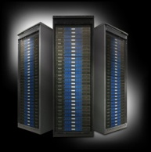
FutureGrid key Concepts III
Rather than loading images onto VM’s, FutureGrid supports Cloud, Grid and Parallel computing environments by dynamically provisioning software as needed onto “bare-metal” using Moab/xCAT
Image library for MPI, OpenMP, Hadoop, Dryad, gLite, Unicore, Globus, Xen, ScaleMP (distributed Shared Memory), Nimbus, Eucalyptus, OpenNebula, KVM, Windows …..
Growth comes from users depositing novel images in library
FutureGrid has ~4000 (will grow to ~5000) distributed cores with a dedicated network and a Spirent XGEM network fault and delay generator
Image1
Image2
…
ImageN
Choose
Load
Run

Slide 6
Dynamic Provisioning Results
Number of nodes
Time elapsed between requesting a job and the jobs reported start time on the provisioned node. The numbers here are an average of 2 sets of experiments.

Slide 7
FutureGrid Partners
Indiana University (Architecture, core software, Support)
Purdue University (HTC Hardware)
San Diego Supercomputer Center at University of California San Diego (INCA, Monitoring)
University of Chicago/Argonne National Labs (Nimbus)
University of Florida (ViNE, Education and Outreach)
University of Southern California Information Sciences (Pegasus to manage experiments)
University of Tennessee Knoxville (Benchmarking)
University of Texas at Austin/Texas Advanced Computing Center (Portal)
University of Virginia (OGF, Advisory Board and allocation)
Center for Information Services and GWT-TUD from Technische Universtität Dresden. (VAMPIR)
Red institutions have FutureGrid hardware

Slide 8
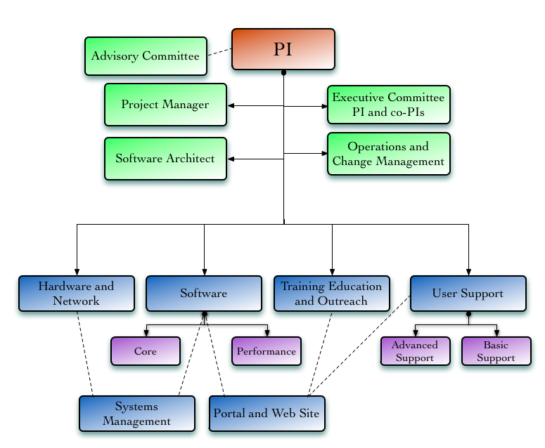
FutureGrid Organization

Slide 9
Compute Hardware
System type | # CPUs | # Cores | TFLOPS | Total RAM (GB) | Secondary Storage (TB) | Site | Status
IBM iDataPlex | 256 | 1024 | 11 | 3072 | 339* | IU | Operational
Dell PowerEdge | 192 | 768 | 8 | 1152 | 30 | TACC | Operational
IBM iDataPlex | 168 | 672 | 7 | 2016 | 120 | UC | Operational
IBM iDataPlex | 168 | 672 | 7 | 2688 | 96 | SDSC | Operational
Cray XT5m | 168 | 672 | 6 | 1344 | 339* | IU | Operational
IBM iDataPlex | 64 | 256 | 2 | 768 | On Order | UF | Operational
Large disk/memory system TBD | 128 | 512 | 5 | 7680 | 768 on nodes | IU | New System TBD
High Throughput Cluster | 192 | 384 | 4 | 192 |  | PU | Not yet integrated
Total | 1336 | 4960 | 50 | 18912 | 1353

Slide 10
Storage Hardware
System Type | Capacity (TB) | File System | Site | Status
DDN 9550 (Data Capacitor) | 339 | Lustre | IU | Existing System
DDN 6620 | 120 | GPFS | UC | New System
SunFire x4170 | 96 | ZFS | SDSC | New System
Dell MD3000 | 30 | NFS | TACC | New System
Will add substantially more disk on node and at IU and UF as shared storage

Slide 11
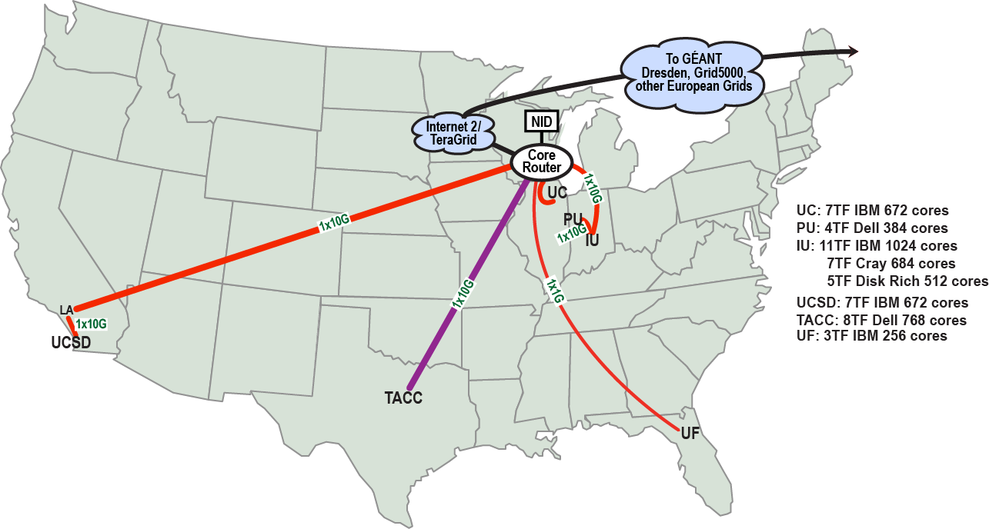
FutureGrid: a Grid/Cloud/HPC Testbed
NID: Network Impairment Device
Private Public
FG Network

Slide 12
FutureGrid: Online Inca Summary

Slide 13
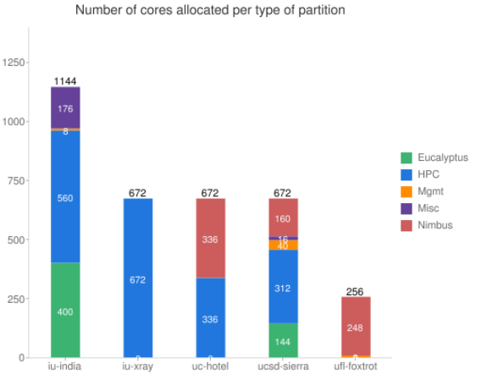
FutureGrid: Inca Monitoring

Slide 14
5 Use Types for FutureGrid
Training Education and Outreach
Semester and short events; promising for MSI
Interoperability test-beds
Grids and Clouds; OGF really needed this
Domain Science applications
Life science highlighted
Computer science
Largest current category
Computer Systems Evaluation
TeraGrid (TIS, TAS, XSEDE), OSG, EGI

Slide 15
Some Current FutureGrid projects I
Project | Institution | Details
Educational Projects
VSCSE Big Data | IU PTI, Michigan, NCSA and 10 sites | Over 200 students in week Long Virtual School of Computational Science and Engineering on Data Intensive Applications & Technologies
LSU Distributed Scientific Computing Class | LSU | 13 students use Eucalyptus and SAGA enhanced version of MapReduce
Topics on Systems: Cloud Computing CS Class | IU SOIC | 27 students in class using virtual machines, Twister, Hadoop and Dryad
Interoperability Projects
OGF Standards | Virginia, LSU, Poznan | Interoperability experiments between OGF standard Endpoints
Sky Computing | University of Rennes 1 | Over 1000 cores in 6 clusters across Grid’5000 & FutureGrid using ViNe and Nimbus to support Hadoop and BLAST demonstrated at OGF 29 June 2010

Slide 16
Some Current FutureGrid projects II
Domain Science Application Projects
Combustion | Cummins | Performance Analysis of codes aimed at engine efficiency and pollution
Cloud Technologies for Bioinformatics Applications | IU PTI | Performance analysis of pleasingly parallel/MapReduce applications on Linux, Windows, Hadoop, Dryad, Amazon, Azure with and without virtual machines
Computer Science Projects
Cumulus | Univ. of Chicago | Open Source Storage Cloud for Science based on Nimbus
Differentiated Leases for IaaS | University of Colorado | Deployment of always-on preemptible VMs to allow support of Condor based on demand volunteer computing
Application Energy Modeling | UCSD/SDSC | Fine-grained DC power measurements on HPC resources and power benchmark system
Evaluation and TeraGrid/OSG Support Projects
Use of VM’s in OSG | OSG, Chicago, Indiana | Develop virtual machines to run the services required for the operation of the OSG and deployment of VM based applications in OSG environments.
TeraGrid QA Test & Debugging | SDSC | Support TeraGrid software Quality Assurance working group
TeraGrid TAS/TIS | Buffalo/Texas | Support of XD Auditing and Insertion functions

Slide 17
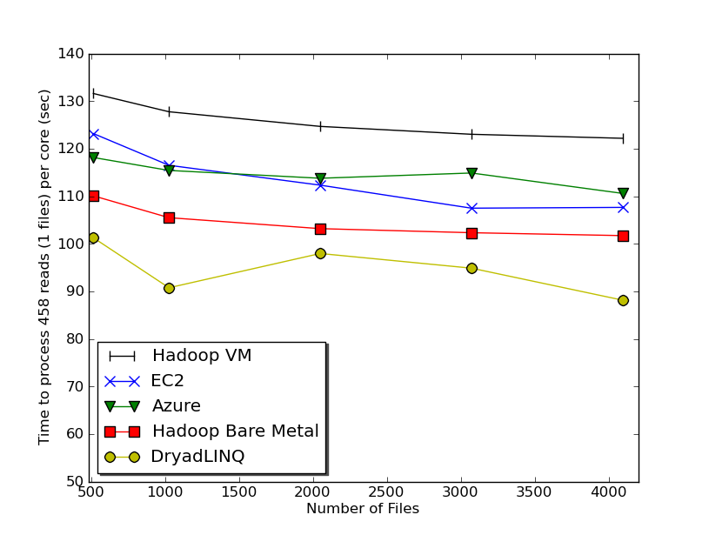
Typical FutureGrid Performance Study
Linux, Linux on VM, Windows, Azure, Amazon Bioinformatics

Slide 18
OGF’10 Demo from Rennes
SDSC
Rennes
Grid’5000 firewall
UF
Lille
UC
Sophia
ViNe provided the necessary inter-cloud connectivity to deploy CloudBLAST across 6 Nimbus sites, with a mix of public and private subnets.

Slide 19
One User Report (Jha) I
The design and development of distributed scientific applications presents a challenging research agenda at the intersection of cyberinfrastructure and computational science.
It is no exaggeration that the US Academic community has lagged in its ability to design and implement novel distributed scientific applications, tools and run-time systems that are broadly-used, extensible, interoperable and simple to use/adapt/deploy.
The reasons are many and resist oversimplification. But one critical reason has been the absence of infrastructure where abstractions, run-time systems and applications can be developed, tested and hardened at the scales and with a degree of distribution (and the concomitant heterogeneity, dynamism and faults) required to facilitate the transition from "toy solutions" to "production grade", i.e., the intermediate infrastructure.

Slide 20
One User Report (Jha) II
For the SAGA project that is concerned with all of the above elements, FutureGrid has proven to be that *panacea*, the hitherto missing element preventing progress towards scalable distributed applications.
In a nutshell, FG has provided a persistent, production-grade experimental infrastructure with the ability to perform controlled experiments, without violating production policies and disrupting production infrastructure priorities.
These attributes coupled with excellent technical support -- the bedrock upon which all these capabilities depend, have resulted in the following specific advances in the short period of under a year:
Standards based development and interoperability tests
Analyzing & Comparing Programming Models and Run-time tools for Computation and Data-Intensive Science
Developing Hybrid Cloud-Grid Scientific Applications and Tools (Autonomic Schedulers) [Work in Conjunction with Manish Parashar's group]

Slide 21
User Support
Being upgraded now as we get into major use “An important lesson from early use is that our projects require less compute resources but more user support than traditional machines. “
Regular support: formed FET or “FutureGrid Expert Team” – initially 14 PhD students and researchers from Indiana University
User gets Portal account at https://portal.futuregrid.org/login
User requests project at https://portal.futuregrid.org/node/add/fg-projects
Each user assigned a member of FET when project approved
Users given machine accounts when project approved
FET member and user interact to get going on FutureGrid
Advanced User Support: limited special support available on request

Slide 22
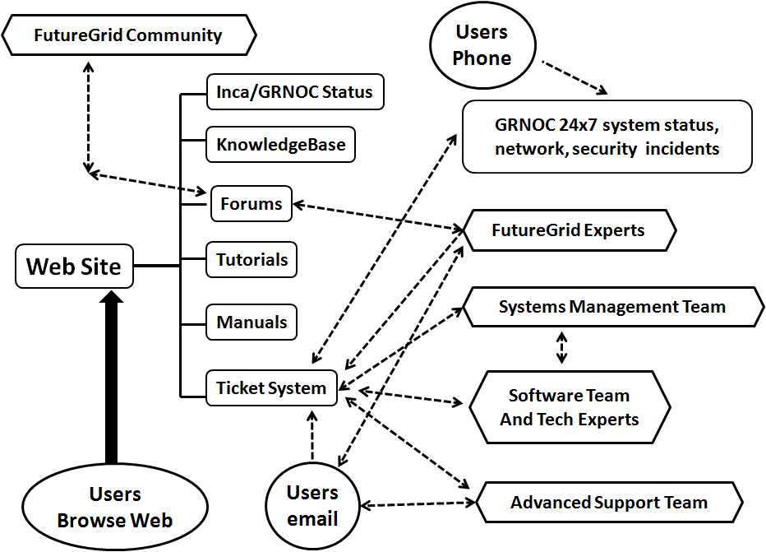
FutureGrid Support Model

Slide 23
Education & Outreach on FutureGrid
Build up tutorials on supported software
Support development of curricula requiring privileges and systems destruction capabilities that are hard to grant on conventional TeraGrid
Offer suite of appliances (customized VM based images) supporting online laboratories
Supporting ~200 students in Virtual Summer School on “Big Data” July 26-30 with set of certified images – first offering of FutureGrid 101 Class; TeraGrid ‘10 “Cloud technologies, data-intensive science and the TG”; CloudCom conference tutorials Nov 30-Dec 3 2010
Experimental class use fall semester at Indiana, Florida and LSU; follow up core distributed system class Spring at IU
Planning ADMI Summer School on Clouds and REU program

Slide 24
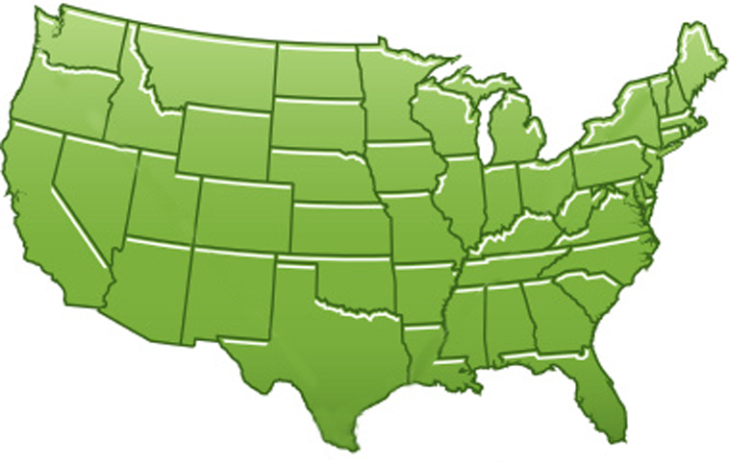
300+ Students learning about Twister & Hadoop
MapReduce technologies, supported by FutureGrid.
July 26-30, 2010 NCSA Summer School Workshop
http://salsahpc.indiana.edu/tutorial
Washington
University
University of
Minnesota
Michigan
State
Johns
Hopkins
Univ.Illinois
at Chicago
Iowa
Penn
State
IBM Almaden
Research Center
Notre
Dame
University of
California at
Los Angeles
Indiana
University
San Diego
Supercomputer
Center
University of
Texas at El Paso
University of
Arkansas
University
of Florida

Slide 25
FutureGrid Tutorials
Tutorial topic 3: Educational Virtual Appliances
Tutorial GA1: Introduction to the Grid Appliance
Tutorial GA2: Creating Grid Appliance Clusters
Tutorial GA3: Building an educational appliance from Ubuntu 10.04
Tutorial GA4: Deploying Grid Appliances using Nimbus
Tutorial GA5: Deploying Grid Appliances using Eucalyptus
Tutorial GA7: Customizing and registering Grid Appliance images using Eucalyptus
Tutorial MP1: MPI Virtual Clusters with the Grid Appliances and MPICH2
Tutorial topic 4: High Performance Computing
Tutorial VA1: Performance Analysis with Vampir
Tutorial VT1: Instrumentation and tracing with VampirTrace
Tutorial topic 1: Cloud Provisioning Platforms
Tutorial NM1: Using Nimbus on FutureGrid
Tutorial NM2: Nimbus One-click Cluster Guide
Tutorial GA6: Using the Grid Appliances to run FutureGrid Cloud Clients
Tutorial EU1: Using Eucalyptus on FutureGrid
Tutorial topic 2: Cloud Run-time Platforms
Tutorial HA1: Introduction to Hadoop using the Grid Appliance
Tutorial HA2: Running Hadoop on FG using Eucalyptus (.ppt)
Tutorial HA2: Running Hadoop on Eualyptus

Slide 26
Software Components
Important as Software is Infrastructure …
Portals including “Support” “use FutureGrid” “Outreach”
Monitoring – INCA, Power (GreenIT)
Experiment Manager: specify/workflow
Image Generation and Repository
Intercloud Networking ViNE
Virtual Clusters built with virtual networks
Performance library
Rain or Runtime Adaptable InsertioN Service for images
Security Authentication, Authorization,
Note Software integrated across institutions and between middleware and systems Management (Google docs, Jira, Mediawiki)
Note many software groups are also FG users

Slide 27
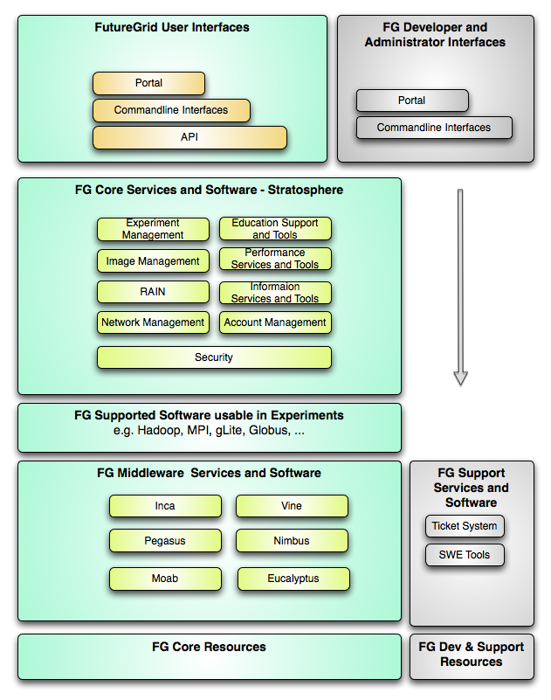
FutureGrid Layered Software Stack
User Supported Software usable in Experiments e.g. OpenNebula, Kepler, Other MPI, Bigtable
Note on Authentication and Authorization
We have different environments and requirements from TeraGrid
Non trivial to integrate/align security model with TeraGrid

Slide 28
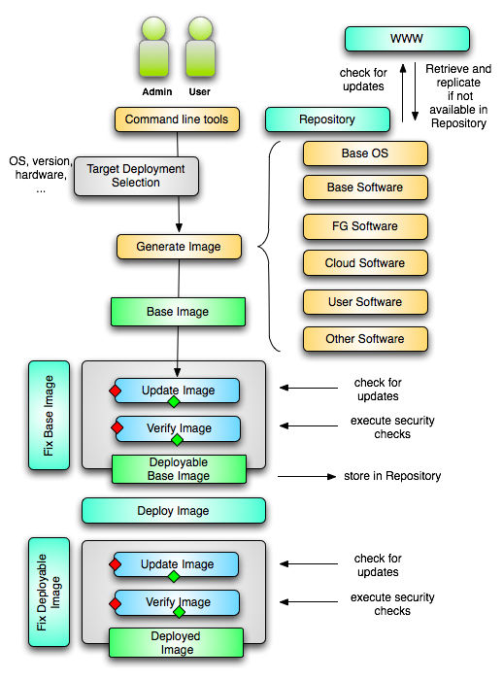
Image Creation
Creating deployable image
User chooses one base mages
User decides who can access the image; what additional software is on the image
Image gets generated; updated; and verified
Image gets deployed
Deployed image gets continuously
Updated; and verified
Note: Due to security requirement an image must be customized with authorization mechanism
limit the number of images through the strategy of "cloning" them from a number of base images.
users can build communities that encourage reuse of "their" images
features of images are exposed through metadata to the community
Administrators will use the same process to create the images that are vetted by them
Customize images in CMS

Slide 29
From Dynamic Provisioning to “RAIN”
In FG dynamic provisioning goes beyond the services offered by common scheduling tools that provide such features.
Dynamic provisioning in FutureGrid means more than just providing an image
adapts the image at runtime and provides besides IaaS, PaaS, also SaaS
We call this “raining” an environment
Rain = Runtime Adaptable INsertion Configurator
Users want to ``rain'' an HPC, a Cloud environment, or a virtual network onto our resources with little effort.
Command line tools supporting this task.
Integrated into Portal
Example ``rain'' a Hadoop environment defined by an user on a cluster.
fg-hadoop -n 8 -app myHadoopApp.jar …
Users and administrators do not have to set up the Hadoop environment as it is being done for them

Slide 30
Rain in FutureGrid

Slide 31
FG RAIN Command
fg-rain –h hostfile –iaas nimbus –image img
fg-rain –h hostfile –paas hadoop …
fg-rain –h hostfile –paas dryad …
fg-rain –h hostfile –gaas gLite …
fg-rain –h hostfile –image img
Authorization is required to use fg-rain without virtualization.

Slide 32
FutureGrid Viral Growth Model
Users apply for a project
Users improve/develop some software in project
This project leads to new images which are placed in FutureGrid repository
Project report and other web pages document use of new images
Images are used by other users
And so on ad infinitum ………

Slide 33
FutureGrid Interaction with Commercial Clouds
We support experiments that link Commercial Clouds and FutureGrid with one or more workflow environments and portal technology installed to link components across these platforms
We support environments on FutureGrid that are similar to Commercial Clouds and natural for performance and functionality comparisons
These can both be used to prepare for using Commercial Clouds and as the most likely starting point for porting to them
One example would be support of MapReduce-like environments on FutureGrid including Hadoop on Linux and Dryad on Windows HPCS which are already part of FutureGrid portfolio of supported software
We develop expertise and support porting to Commercial Clouds from other Windows or Linux environments
We support comparisons between and integration of multiple commercial Cloud environments – especially Amazon and Azure in the immediate future
We develop tutorials and expertise to help users move to Commercial Clouds from other environments

Slide 34
Management

Slide 35
FutureGrid People Roles I
Roles | Individuals(Institution)
PI. | Geoffrey Fox (Indiana University)
Co-PIs. | Kate Keahey (Chicago), Warren Smith (TACC), Jose Fortes (University of Florida), and Andrew Grimshaw (University of Virginia)
Project Manager. | Gary Miksik (Indiana University)
Executive Director/Chair Operations and Change Management Committee | Craig Stewart (Indiana University)
Hardware and Network Team Lead. | David Hancock (Indiana University)
Software Team Lead/ Software Architect. | Gregor von Laszewski (Indiana University)
Systems Management Team Lead. | Greg Pike (Indiana University)
Performance Analysis Team Lead. | Shava Smallen (UCSD/SDSC)
Training, Education, and Outreach Team Lead. | Renato Figueiredo (University of Florida)
User Support Team Lead. | Jonathan Bolte (Indiana University)

Slide 36
FutureGrid People Roles II
Roles | Individuals(Institution)
Funded Site Leads. | Ewa Deelman (USC-ISI), Jack Dongarra/Piotr Luszczek/Terry Moore (Tennessee), Shava Smallen/Phil Papadopoulos (UCSD/SDSC), Jose Fortes/Renato Figueiredo (University of Florida), Kate Keahey (Chicago), Warren Smith (TACC), Andrew Grimshaw (University of Virginia)
Advisory Committee. | Nancy Wilkens-Diehr(SDSC), Shantenu Jha(LSU), Jon Weissman(Minnesota), Ann Chervenak(USC-ISI), Steven Newhouse(EGI), Frederic Desprez(Grid 5000), David Margery (Grid 5000), Morris Riedel (Juelich), Rich Wolski (Eucalyptus), Ruth Pordes (Fermilab-OSG), John Towns (NCSA).

Slide 37
FutureGrid Institutional Roles
Institution | Hardware | Role
Indiana University | 1024 Core iDataPlex, 672 core Cray XT5m Large disk/memory TBD | PI, Software Architecture and Dynamic Provisioning, Web Portal, Cloud Middleware, User support of IU and SDSC machines
Univ. of Chicago | 672 Core iDataPlex | Nimbus and support UC hardware
University of Florida | 256 Core iDataPlex | ViNE Virtual Networking, Training Education and Outreach, support UF hardware
TACC/Univ. Texas | 768 Core Dell PowerEdge | Management Portal and support TACC hardware
UCSD/SDSC | 672 Core iDataPlex | INCA, Monitoring, Performance
Purdue | 384 Core HTC Cluster | Support of Purdue Hardware
Univ. of Virginia | - | Grid Middleware, OGF, User Advisory Board
Univ. of Tennessee | - | Benchmarking, PAPI
USC/ISI | - | Pegasus, Experiment Management
GWT-TUD Dresden | - | VAMPIR Performance Tool

Slide 38
FutureGrid PY1 Expenditures (1 of 2)

Slide 39
FutureGrid PY1 Expenditures (2 of 2)

Slide 40
FutureGrid PY1 Projected vs. Actual Cost By WBS (1 of 3)

Slide 41
FutureGrid PY1 Projected vs. Actual Cost By WBS (2 of 3)

Slide 42
FutureGrid PY1 Projected vs. Actual Cost By WBS (3 of 3)

Slide 43
Grid’5000 and FutureGrid Collaboration
Presented by
Kate Keahey

Slide 44
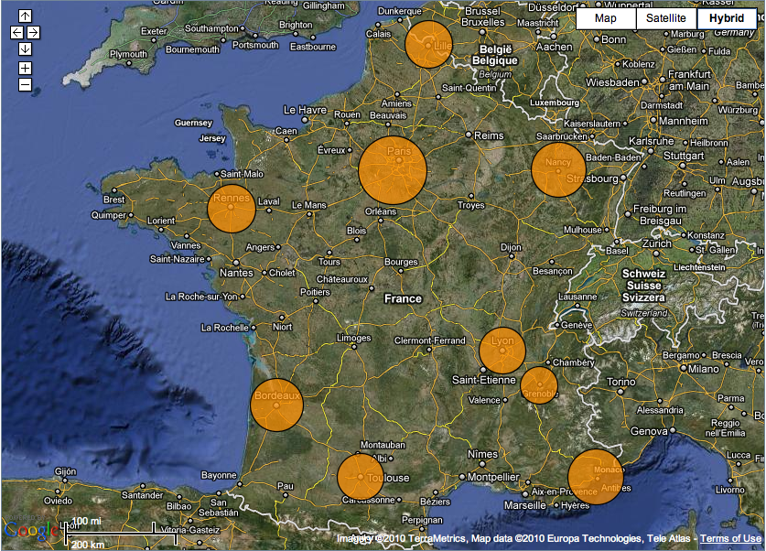
Grid’5000
Experimental testbed
Configurable, controllable, monitorable
Established in 2003
10 sites
9 in France
Porto Allegre in Brazil
~5000+ cores

Slide 45
Benefits of Collaboration
Sharing resources
More resources, different types, more distributed…
Exchange of experience
Grid’5000: significant experience in providing an experimental testbed
FutureGrid: experimentation with new methods of operating this resource
Fostering collaboration between researchers
Experimental methodology for CS
Research forum

Slide 46
Collaboration Goals
Establish ways for Grid’5000 and FutureGrid to use each other’s infrastructure
FutureGrid accounts for Grid’5000 users
Grid’5000 account for FutureGrid users
Policy commitments, documentation and usage
Compatible provisioning frameworks
Discussion on experimental methodology
R&D and educational forum

Slide 47
Collaboration Status
Grid’5000 workshop in 04/10
Evaluation of Grid’5000 tools
Reported on structure and policies
FutureGrid outreach
Ongoing collaboration
FutureGrid account on Grid’5000
“Sky computing” project combining resource of FutureGrid and Grid’5000
Tool sharing among partners: use of TakTuk in experimental framework, use of Nimbus in G5K

Slide 48
Next Steps
Grid’5000 and FutureGrid collaborative workshop
Developing objectives and schedule
Goals for 2011
Well-defined and advertised methods of sharing accounts
Initial discussions about experimental methodology, repeatability and support

Slide 49
Hardware

Slide 50
Compute Hardware
System type | # CPUs | # Cores | TFLOPS | Total RAM (GB) | Secondary Storage (TB) | Site | Status
IBM iDataPlex | 256 | 1024 | 11 | 3072 | 339* | IU | Operational
Dell PowerEdge | 192 | 768 | 8 | 1152 | 30 | TACC | Operational
IBM iDataPlex | 168 | 672 | 7 | 2016 | 120 | UC | Operational
IBM iDataPlex | 168 | 672 | 7 | 2688 | 96 | SDSC | Operational
Cray XT5m | 168 | 672 | 6 | 1344 | 339* | IU | Operational
IBM iDataPlex | 64 | 256 | 2 | 768 | On Order | UF | Operational
Large disk/memory system TBD | 128 | 512 | 5 | 7680 | 768 on nodes | IU | New System TBD
High Throughput Cluster | 192 | 384 | 4 | 192 |  | PU | Not yet integrated
Total | 1336 | 4960 | 50 | 18912 | 1353

Slide 51
Storage Hardware
System Type | Capacity (TB) | File System | Site | Status
DDN 9550 (Data Capacitor) | 339 | Lustre | IU | Existing System
DDN 6620 | 120 | GPFS | UC | New System
SunFire x4170 | 96 | ZFS | SDSC | New System
Dell MD3000 | 30 | NFS | TACC | New System
Will add substantially more disk on node and at IU and UF as shared storage

Slide 52
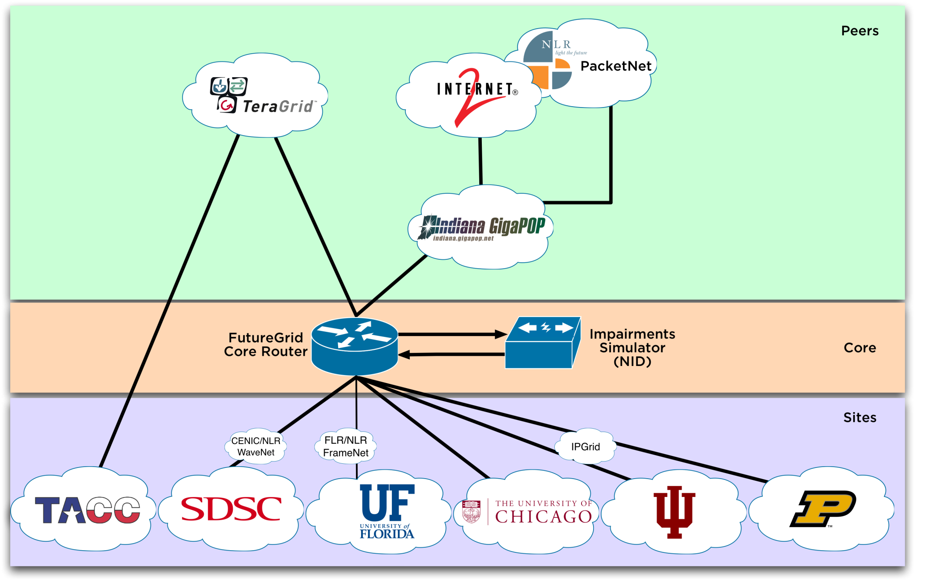
Logical Network Diagram

Slide 53
Network & Internal Interconnects
FutureGrid has dedicated network (except to TACC) and a network fault and delay generator
Can isolate experiments on request; IU runs Network for NLR/Internet2
(Many) additional partner machines could run FutureGrid software and be supported (but allocated in specialized ways)
Machine | Name | Internal Network
IU Cray | xray | Cray 2D Torus SeaStar
IU iDataPlex | india | DDR IB, QLogic switch with Mellanox ConnectX adapters Blade Network Technologies & Force10 Ethernet switches
SDSC iDataPlex | sierra | DDR IB, Cisco switch with Mellanox ConnectX adapters Juniper Ethernet switches
UC iDataPlex | hotel | DDR IB, QLogic switch with Mellanox ConnectX adapters Blade Network Technologies & Juniper switches
UF iDataPlex | foxtrot | Gigabit Ethernet only (Blade Network Technologies; Force10 switches)
TACC Dell | alamo | QDR IB, Mellanox switches and adapters Dell Ethernet switches

Slide 54
Network Impairment Device
Spirent XGEM Network Impairments Simulator for jitter, errors, delay, etc
Full Bidirectional 10G w/64 byte packets
up to 15 seconds introduced delay (in 16ns increments)
0-100% introduced packet loss in .0001% increments
Packet manipulation in first 2000 bytes
up to 16k frame size
TCL for scripting, HTML for manual configuration

Slide 55
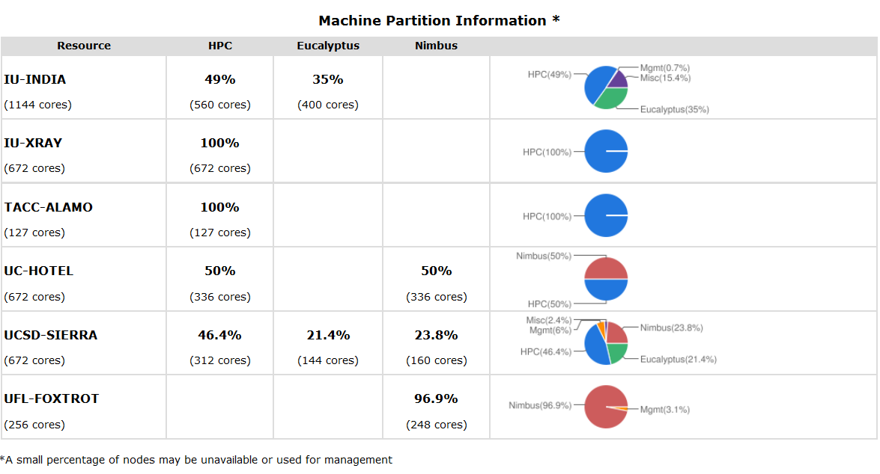
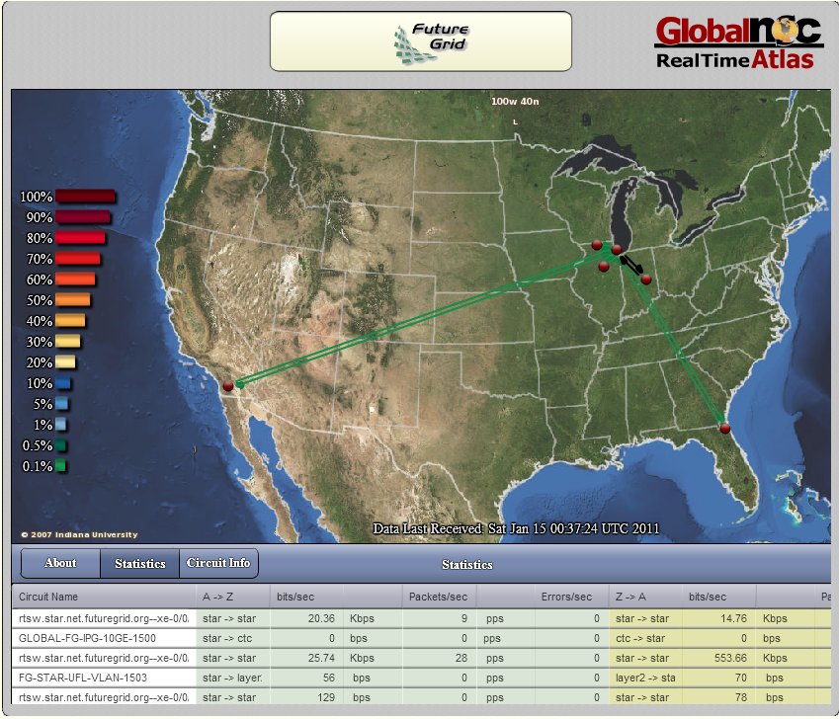
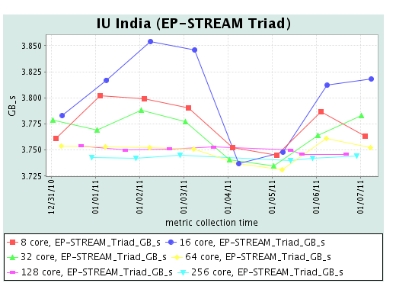
FG Status Screenshot
Partition Table
Globalnoc
Inca

Slide 56
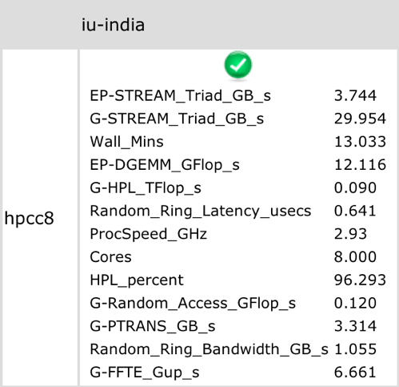
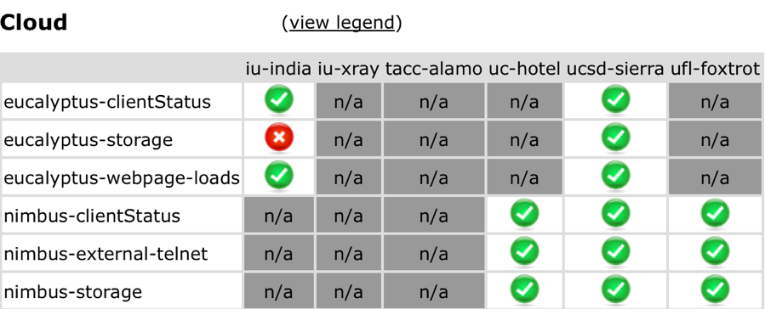
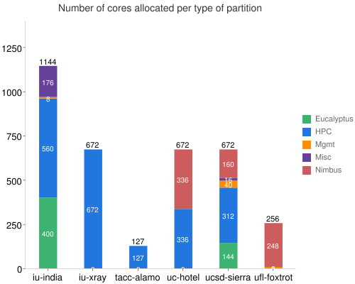
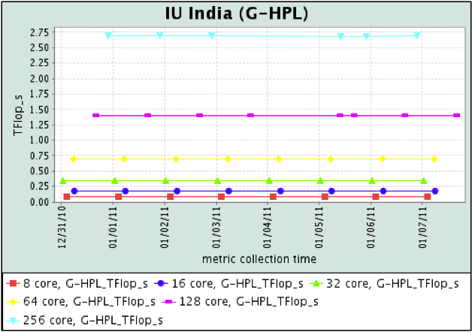
Inca http//inca.futuregrid.org
Status of basic cloud tests
Statistics displayed from HPCC performance measurement
Information on machine partitioning
History of HPCC performance

Slide 57
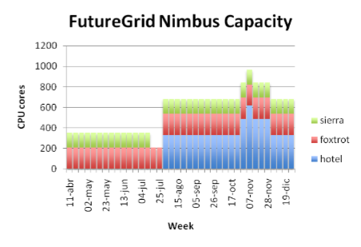
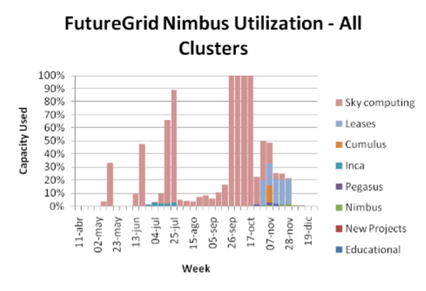
Nimbus IaaS on FutureGrid
Resources:
Hotel (UC) 328 cores
Foxtrot (UFL) 208 cores
Sierra (SDSC) 144 cores
Alamo (TACC), in preparation
Usage so far:
Projects using IaaS
Projects modifying IaaS
Educational
http://futuregrid.org

Slide 58
Hardware Upgrades
Funding available for a refresh in PY3: $400K
Funding for a core system that was originally a shared memory system (mimicking Pittsburgh Track II): $448K
Current suggestion is a data intensive cluster with each node 8 cores, 192GB memory, 12 TB disk and Infiniband interconnect

Slide 59
Strengths, Weaknesses, Opportunities and Threats to FutureGrid

Slide 60
FutureGrid SWOT
Difference from TeraGrid/XD/DEISA/EGI implies need to develop processes and software from scratch
Newness implies need to explain why its useful!
High “user support” load
Software is Infrastructure and must be approached as this
Rich skill base from distributed team
Lots of new education and outreach opportunities
5 interesting use categories: TEO, Interoperability, Domain applications, CS Middleware, System Evaluation
Tremendous student interest in all parts of FutureGrid can be tapped to help support & software development

