Slide 1
Use of FutureGrid January 17 2011 Bloomington IN
See list of projects: https://portal.futuregrid.org/projects
See summary of current project results: https://portal.futuregrid.org/projects/list/results
Or click individual projects

Slide 2
5 Use Types for FutureGrid
Training Education and Outreach
Semester and short events; promising for MSI
Interoperability test-beds
Grids and Clouds; OGF really needed this
Domain Science applications
Life science highlighted
Computer science
Largest current category
Computer Systems Evaluation
TeraGrid (TIS, TAS, XSEDE), OSG, EGI

Slide 3
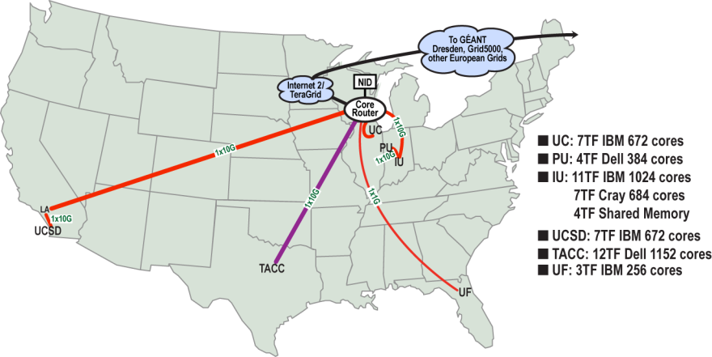
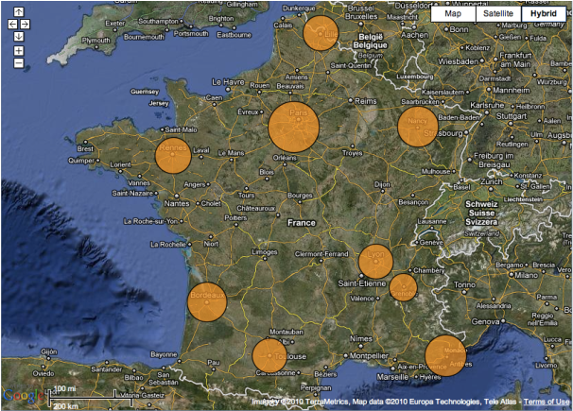
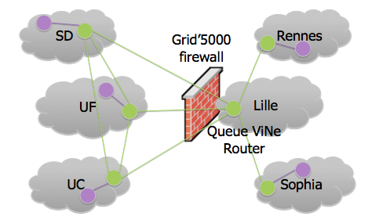
Sky Computing
Work by Pierre Riteau et al,
University of Rennes 1
Sky Computing = a Federation of Clouds
Approach:
Combine resources obtained in multiple Nimbus clouds in FutureGrid and Grid’ 5000
Combine Context Broker, ViNe, fast image deployment
Deployed a virtual cluster of over 1000 cores on Grid5000 and FutureGrid – largest ever of this type
Demonstrated at OGF 29 06/10
TeraGrid ’10 poster
ISGTW article:
www.isgtw.org/?pid=1002832
“Sky Computing”
IEEE Internet Computing, September 2009

Slide 4
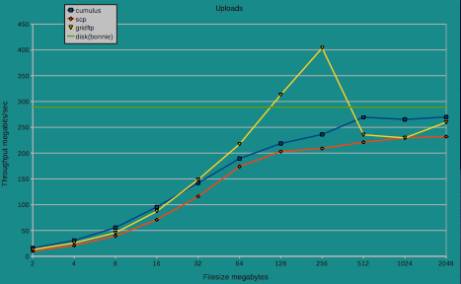
Cumulus Highlights
Work by John Bresnahan,
University of Chicago
Storage clouds on local storage?
Approach:
Customizable back-end systems: POSIX, HDFS, BlobSeer, and multi-node replicated server
S3 compatible: works with popular 3rd party clients
Quota management for scientific applications
Easy to manage and operate
Comparable in performance to existing tools such as GridFTP
SC’10 poster
Cumulus
Cassandra
POSIX
Sector
HDFS
BlobSeer
Notes:
Is there a good web page with a list of those user management tools? Some examples would be good

Slide 5
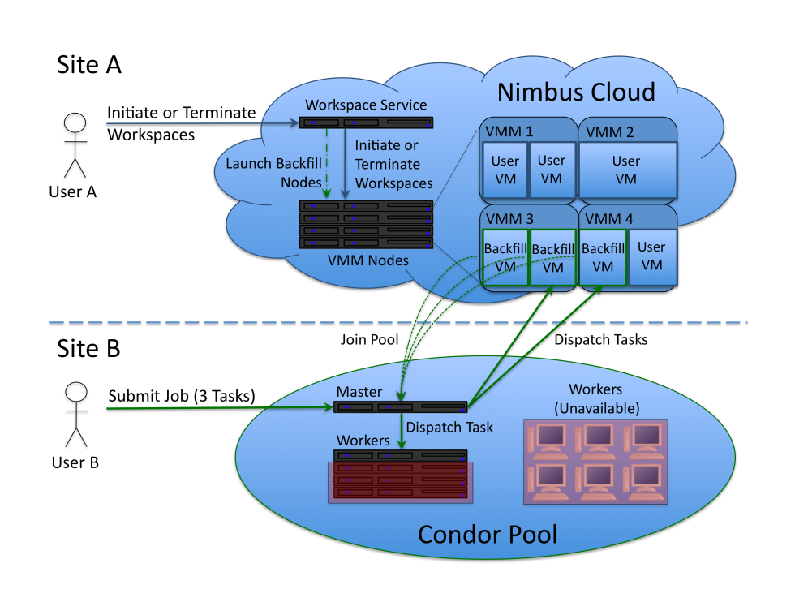
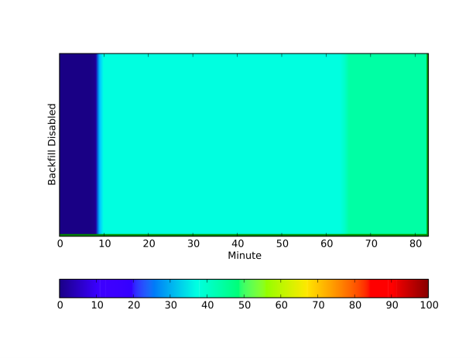
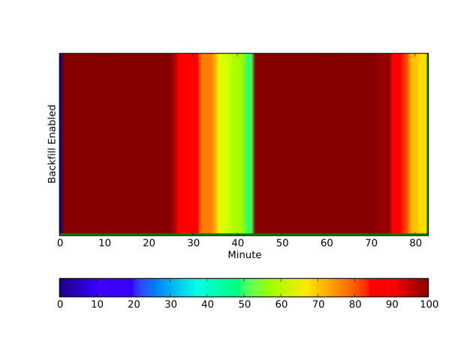
Differentiated Leases
Work by Paul Marshall,
University of Colorado at Boulder
Utilization in on-demand computing
Approach:
Backfill VMs and spot pricing
Bottom line: up to 100% utilization
CCGrid 2011 submission
Nimbus 2.7 contribution
Preparing for running of production workloads on FG @ U Chicago

Slide 6
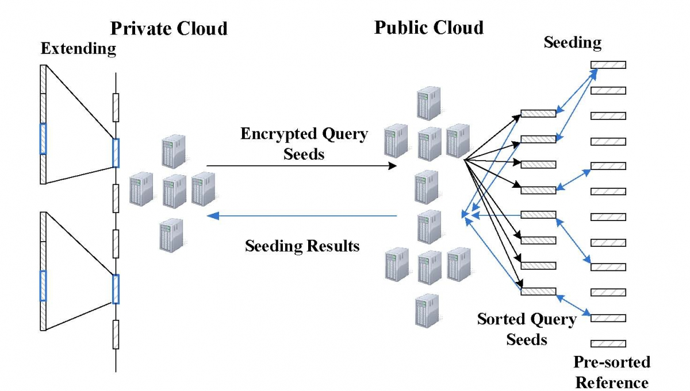
Hybrid Cloud for Privacy
Encrypt reads in private cloud
96% work in Public Cloud

Slide 7
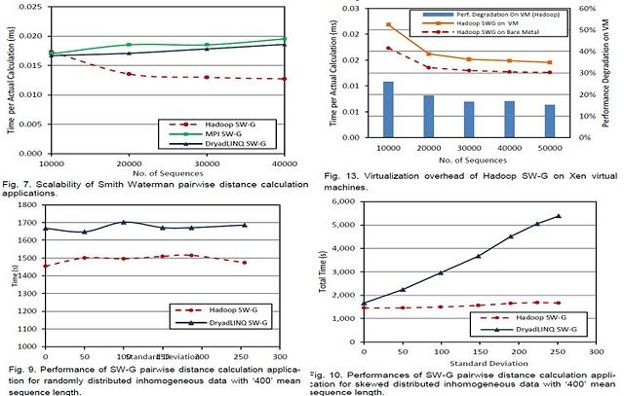
MapReduce Evaluation

Slide 8
Pegasus in FutureGrid
Presented by
Jens Vöckler

Slide 9
How Pegasus Uses FutureGrid
Focus on Eucalyptus and Nimbus
No Moab+Xcat at this point
544 Nimbus + 744 Euca = 1,288 cores
across 4 clusters
in 5 clouds.

Slide 10
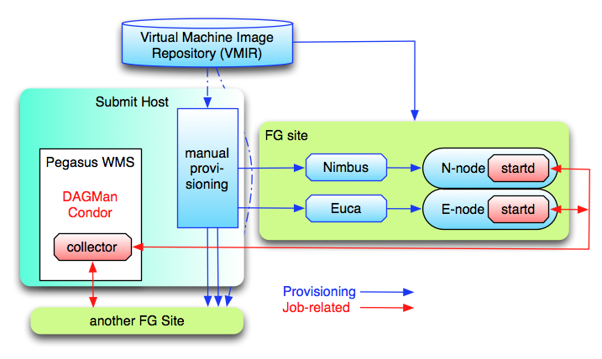
Pegasus FG Interaction
Notes:
The blue arrows, dealing with the provisioning of resources, are currently executed manually.
The red arrows are automatic, i.e. once the provision request starts remote resources, the Condor startd embedded into the image will report back to the submit machine.
Once the resource becomes part of the Condor pool, jobs can be staged to the resource. The Pegasus planner and Condor DAGMan will execute a workflow utilizing remote machines.
File staging is currently dependent on Condor-I/O.

Slide 11
Pegasus Periodogram
Search for extra-solar planets
Wobbles in radial velocity of star, or
Dips in star’s intensity
200k light curves released by Kepler
Experiment is a “ramp-up”:
Try to see where things trip
16k light curves
33k computations (every light curve twice)
Already found places needing adjustments

Slide 12
Periodogram Workflow
Notes:
Independent computations.
Using clustering to reduce communication overhead: fastest plav computations run in sub-second time, but remote grids work best, if you have several minutes of work for them.
“stage-out” is an artificial step required by Pegasus planning that we are working on removing. However, it is neither harmful nor slow.
“True” periodogram computations run 3 algorithms (“ls”, “bls”, “plav”) on all 200k light curves. Estimated 1000 hours of work (41 days).

Slide 13
Requested Resources
Notes:
Running across multiple clouds is sky computing.
30 euca-india + 30 euca-sierra + 20 nimbus-sierra + 20 nimbus-foxtrot + 50 nimbus-hotel = 150 resources

Slide 14
Hosts, Tasks, and Duration
Notes:
Available Hosts: Machines that actually reported back (149)
Active Hosts: Machines that actually partook in the workflow (123)
Jobs: Number of Condor jobs completed (799)
Tasks: Number of Periodogram tasks computed (33082)
Duration: Cumulative duration (in hours) for tasks – totals over 22 days!

Slide 15
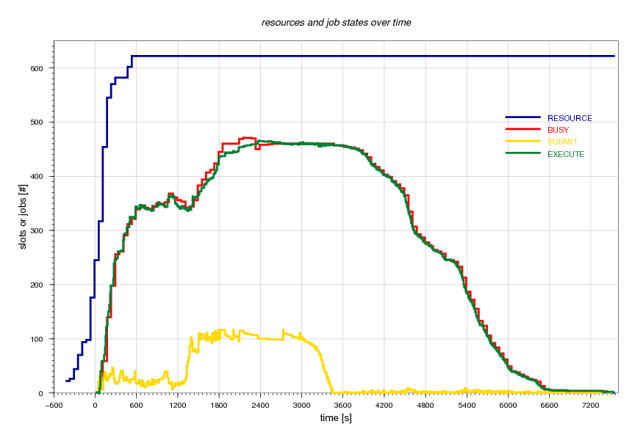
Resource and Job States
Notes:
Workflow completed in a little over 2 hours with all tasks, including staging.
Condor slot count = 2 * core count = 4 * machine count – over-subscribing remote CPUs on purpose.
Blue curve: shows the resources as they report back, tops out at 622 resources, 596 FG cloud resources.
Red curve: shows the slots that Condor thinks are “busy”
Yellow curve: tops out at ~100 idle jobs in Condor Q. Configured that way for scalability and local resource frugality.
Green curve: tops out at ~466 parallel executing tasks, jobs that Condor has in state “running”.

Slide 16
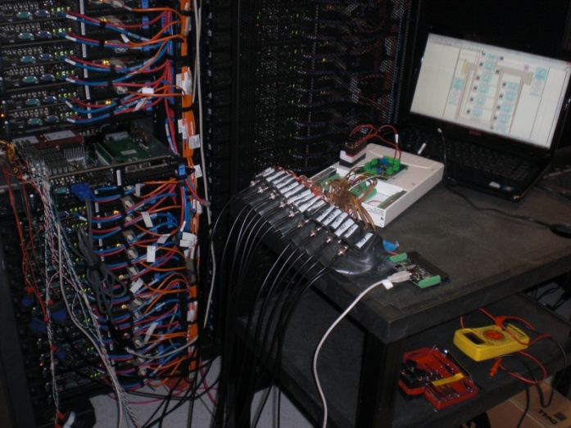
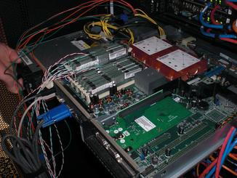
Fine-grained Application Energy Modeling Catherine Olschanowsky (UCSD/SDSC)
PhD student in CSE dept at UCSD
Research: estimate the energy requirements for specific application-resource pairings
Method to collect fine-grained DC power measurements on HPC resources
Energy-centric benchmark infrastructure
Models
FutureGrid experiment:
Required bare metal access to 1 node of Sierra for 2 weeks
Custom-made power monitoring harness attached to CPU and memory
WattsUp device connected to power
Required node recertification by IBM
Power monitoring harness attached to Sierra node
Close-up of harness attachments
Notes:
operation mix and locality characteristics of the applications in the workload affect the energy consumption of the resource.
data locality is the primary source of variation in energy

Slide 17
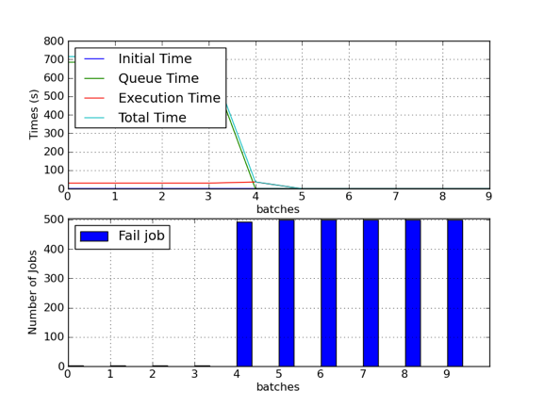
TeraGrid QA Testing and Debugging Shava Smallen (UCSD/SDSC)
Co-lead of TeraGrid Quality Assurance Working Group
GRAM 5 scalability testing
Emulated Science Gateway use
Created virtual cluster via Nimbus on Foxtrot for ~1 month
Discovered bug where large log file was created in user’s home dir
GridFTP 5 testing
Verified data synchronization and server offline mode
Created VM via Nimbus on Sierra and Foxtrot
Discovered small bug in synchronization
GRAM 5 scalability testing results run on 4-node Nimbus cluster on Foxtrot
Notes:
Bugs reported to globus group

Slide 18
Publish/Subscribe Messaging as a Basis for TeraGrid Info Services Warren Smith (TACC)
Lead of TeraGrid Scheduling Working Group
Problems with TeraGrid info services related to scheduling
Information unavailable or 10s of minutes old
Investigate whether a different information system can address
Investigate publish/subscribe messaging services
RabbitMQ and Qpid
Very early results
Services installed in Nimbus virtual machines on a single cluster
RabbitMQ, 1 Python publisher to 20 Python subscribers can deliver 100s of GLUE 2 documents a second
Roughly a dozen systems on TeraGrid publishing, 2 GLUE 2 documents every minute, to under 10 services

Slide 19
XD Technology Insertion Service John Lockman (TACC)
TIS is responsible for evaluating software that may be deployed on XD (TeraGrid follow on)
Creating a Technology Evaluation Laboratory
FutureGrid, other XD systems
Deploy and evaluate software and services in this laboratory
Beginning to experiment with Nimbus on FutureGrid
Expect significant activity as TeraGrid transitions to XD

Slide 20
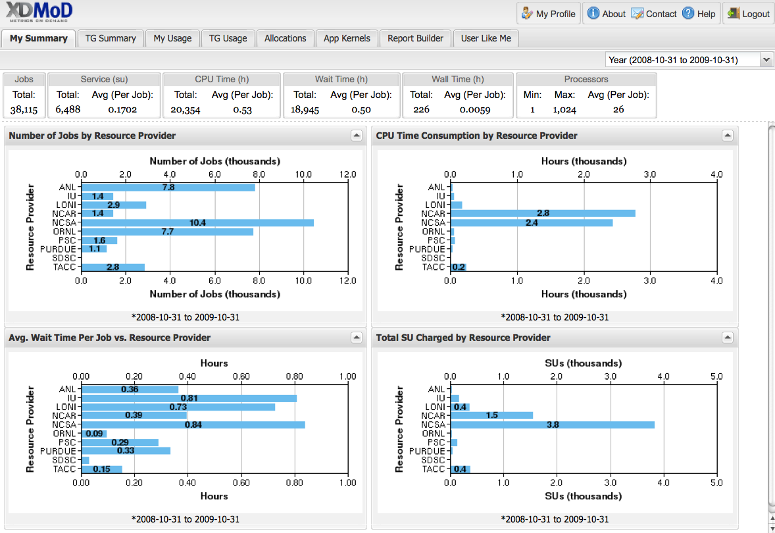
XD Technology Audit Service Charng-Da Lu (University of Buffalo)
Exploring how to utilize the XD TAS framework as part of FG and identify if modifications to TAS need to be made in order to fulfill the needs of FutureGrid
Screenshot of XD Metrics on Demand (XDMoD) portal
Interface.

Slide 21
XD Quality Assurance
Perform QA on software and services before being deployed on XD
After XD TIS recommends a software or service for deployment
Probably different personnel than XD TIS
Expected project

Slide 22
Education and outreach
University of Virginia

Slide 23
Education and outreach
Using FutureGrid compute resources in Grid computing outreach effort – candy.
Using Future Grid in UVA course: Wide Area Distributed Systems in Support of Science in Spring 2011

Slide 24
Interoperability testing
University of Virginia

Slide 25
Grid interoperability testing
Requirements
Usecases
Provide a persistent set of standards-compliant implementations of grid services that clients can test against
Provide a place where grid application developers can experiment with different standard grid middleware stacks without needing to become experts in installation and configuration
Job management (OGSA-BES/JSDL, HPC-Basic Profile, HPC File Staging Extensions, JSDL Parameter Sweep, JSDL SPMD, PSDL Posix)
Resource Name-space Service (RNS), Byte-IO
Interoperability tests/demonstrations between different middleware stacks
Development of client application tools (e.g., SAGA) that require configured, operational backends
Develop new grid applications and test the suitability of different implementations in terms of both functional and non-functional characteristics

Slide 26
Implementation
Deployment
UNICORE 6
OGSA-BES, JSDL (Posix, SPMD)
HPC Basic Profile, HPC File Staging
Genesis II
OGSA-BES, JSDL (Posix, SPMD, parameter sweep)
HPC Basic Profile, HPC File Staging
RNS, ByteIO
EGEE/g-lite
SMOA
OGSA-BES, JSDL (Posix, SPMD)
HPC Basic Profile
UNICORE 6
Xray
Sierra
India
Genesis II
Xray
Sierra
India
Eucalyptus (India, Sierra)

Slide 27
Use
SAGA with Genesis II/UNICORE 6
Jha’s group 10/2010
Kazushige Saga (RENKEI/NAREGI ) 11/2010
OGF events and outreach
10/2009, 10/2010
Interop demo with GIN

Slide 28
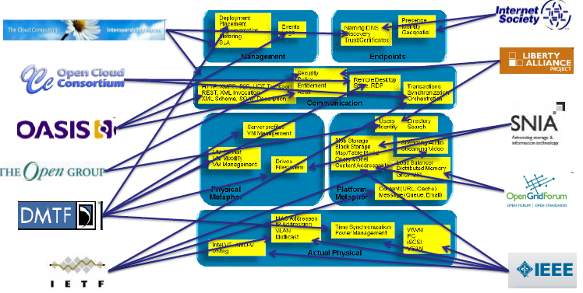
Intercloud standards
Protocols, formats and mechanisms for interoperability
Provided by David Bernstein, Hwawei Tech, IEEE
Notes:
Main point: looking forward to systems built out of multiple clouds there is an urgent need for interoperability standards which will build on new efforts as well as existing ones by a large number of organizations.
A proposal lead by David Bernstein and Steve Diamond is being considered by the IEEE Standards Association for a classic standards effort in this domain. Paralleling this standards development process a testbed is being developed for purposes of research needed to inform and clarify technical research questions relevant to the protocols, formats, mechanisms, etc associated with the standards. This testbed is being developed by the Center for Autonomic Computing at the University of Florida and will use the FutureGrid infrastructure. It is expected that the end users of this testbed will go well beyond UF researchers and include academics and industry researchers developing, using and evaluating standard cloud components (in isolation or combined).

Slide 29
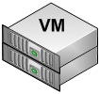
Sky Computing
Tiny ViNe
Tiny ViNe
Virtual Cluster
FutureGrid
Intel Xeon Woodcrest, 2.33 GHz, 2.5 GB RAM, Linux 2.6.16
UCSD
Ethernet
UC
PU
ViNe Download Server
AMD Opteron 248, 2.2 GHz,
3.5 GB RAM, Linux 2.6.32
FutureGrid
UF
1. ViNe-enable sites
UF
2. Configure ViNe VRs
3. Instantiate BLAST VMs
4. Contextualize
Retrieve VM information
ViNe-enable VMs
Configure Hadoop
Intel Xeon Prestonia, 2.4 GHz, 3.5 GB RAM, Linux 2.6.18
Melbourne, Australia
connected to UF (ssh)
Notes:
Main point: We have already depoyed multi-cloud systems using FutureGrid and therefore I a unique position to assist the standards work mentioned in the previous slide. This slide shows the creation of a “virtual cloud” consisting of five clouds connected by a virtual network and the subsequent deployment of execution environments and an application (BLAST). This an example mentioned in Geoffrey presentation, the software presentation and Kate’s presentation so this will be familiar to the attendees and needs not be covered in detail only referenced and linked to what others have said (they will mention the same capability involving also a Grid5000 cloud).
FYI, here is what the figure + animation depicts
1. ViNe-enable sites by launching ViNe VR VMs through Nimbus.
2. ViNe configuration is downloaded from ViNe Download server.
3. Instantiate VMs containing all necessary software to run BLAST (Hadoop+BLAST+databases)
4. Contextualize: get all hostnames, host Ips, host keys, generate Hadoop configuration file, distribute configuration to all VMs, start TinyViNe on UC and PU VMs.

Slide 30
Domain Sciences
University of Virginia

Slide 31
Domain Sciences
Requirements
Usecases
Provide a place where grid application developers can experiment with different standard grid middleware stacks without needing to become experts in installation and configuration
Develop new grid applications and test the suitability of different implementations in terms of both functional and non-functional characteristics

Slide 32
Applications
Global Sensitivity Analysis in Non-premixed Counterflow Flames
A 3D Parallel Adaptive Mesh Renement Method for Fluid Structure Interaction: A Computational Tool for the Analysis of a Bio-Inspired Autonomous Underwater Vehicle
Design space exploration with the M5 simulator
Ecotype Simulation of Microbial Metagenomes
Genetic Analysis of Metapopulation Processes in the Silene-Microbotryum Host-Pathogen System
Hunting the Higgs with Matrix Element Methods
Identification of eukaryotic genes derived from mitochondria using evolutionary analysis
Identifying key genetic interactions in Type II diabetes
Using Molecular Simulations to Calculate Free Energy

Slide 33
Computer science
University of Virginia

Slide 34
Use as an experimental facility
Cloud bursting work
Eucalyptus
Amazon
Replicated files & directories
Automatic application configuration and deployment

Slide 35
Computer system Testing & evaluation
University of Virginia

Slide 36
Grid Test-bed
Requirements
Usecases
Systems of sufficient scale to test realistically
Sufficient bandwidth to stress communication layer
Non-production environment so production users not impacted when a component fails under test
Multiple sites, with high latency and bandwidth
Cloud interface without bandwidth or CPU charges
XSEDE testing
XSEDE architecture is based on same standards, same mechanisms used here will be used for XSEDE testing
Quality attribute testing, particularly under load and at extremes.
Load (e.g., job rate, number of jobs i/o rate)
Performance
Availability
New application execution
Resources to entice
New platforms (e.g., Cray, Cloud)

Slide 37
Extend XCG onto FutureGrid (XCG- Cross Campus Grid)
Design
Image
Genesis II containers on head nodes of compute resources
Test queues that send the containers jobs
Test scripts that generate thousands of jobs, jobs with significant I/O demands
Logging tools to capture errors and root cause
Custom OGSA-BES container that understands EC2 cloud interface, and “cloud-bursts”

Slide 38
Detailed presentation
Testing at scale
Testing with applications
Testing on the cloud

Slide 39
Stress Testing
High job rate, high number of jobs against a single OGSA-BES container uncovered a race condition that only occurred on India.
Large scale parallel staging of multi-gigabyte files uncovered arbitrary delays for particular clients based on database lock manager priority scheme
About to begin
heterogeneous MPI testing
Down loads and deploys appropriate binary depending on installed MPI
Availability via replication and fault-recovery
Resource (e.g., file, directory) migration
Resource selection for performance

Slide 40
Cloud Bursting
Seamlessly maps FutureGrid and Amazon’s EC2 cloud infrastructure into the Genesis II Grid
Allows for the utilization of diverse resources without the end user having to modify their existing behavior or code
Provides a standards based BES that connects to cloud resources
Allows for the capitalization of cheap and underutilized resources such as Amazon’s EC2 spot instances often with a cost savings of over 60%
Allows for the easy sharing of data such as public datasets on Amazon EC2
Allows for the programmatic expansion and contraction of cloud resources to help cope with elastic demand or prices
Allows for the use of affordable cloud storage to be mapped and used in the existing grid infrastructure
Allows for users to utilize their own cloud credentials while still taking advantage of the existing grid infrastructure

