Slide 1
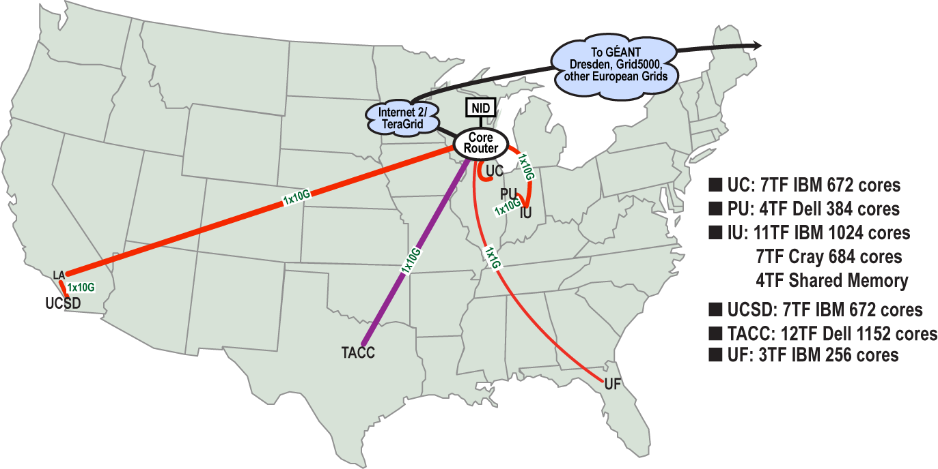
FutureGrid: a Grid Testbed
IU Cray operational, IU IBM (iDataPlex) completed stability test May 6
UCSD IBM operational, UF IBM stability test completed June 12
Network, NID and PU HTC system operational
UC IBM stability test completed June 7; TACC Dell awaiting delivery of components
NID: Network Impairment Device
Private Public
FG Network

Slide 2
FutureGrid Concepts
Support development of new applications and new middleware using Cloud, Grid and Parallel computing (Nimbus, Eucalyptus, Hadoop, Globus, Unicore, MPI, OpenMP. Linux, Windows …) looking at functionality, interoperability, performance
Put the “science” back in the computer science of grid computing by enabling replicable experiments
Open source software built around Moab/xCAT to support dynamic provisioning from Cloud to HPC environment, Linux to Windows ….. with monitoring, benchmarks and support of important existing middleware
June 2010 Initial users; September 2010 All hardware (except IU shared memory system) accepted and major use starts; October 2011 FutureGrid allocatable via TeraGrid process

