Slide 1
Clouds and Grids
Multicore and all that
GADA Panel
November 14 2008
Geoffrey Fox
Community Grids Laboratory, School of informatics
Indiana University
gcf@indiana.edu, http://www.infomall.org
1
Notes:
1

Slide 2
Grids become Clouds
Grids solve problem of too little computing: We need to harness all the world’s computers to do Science
Clouds solve the problem of too much computing: with multicore we have so much power that we need to use effectively to solve user’s problems on “designed (maybe homogeneous)” hardware
One new technology: Virtual Machines enable more dynamic flexible environments but not clearly essential
  Is Virtual Cluster or Virtual Machine right way to think?
Virtualization is pretty inconsistent with parallel computing as virtualization makes it hard to use correct algorithms and correct runtime respecting locality and “reality”
  2 cores in a chip very different algorithm/software than 2 cores in separate chips
Clouds naturally address workflows of “embarrassingly pleasingly parallel” processes – MPI invoked outside cloud

Slide 3
Old Issues
Essentially all “vastly” parallel applications are data parallel including algorithms in Intel’s RMS analysis of future multicore “killer apps”
  Gaming (Physics) and Data mining (“iterated linear algebra”)
So MPI works (Map is normal SPMD; Reduce is MPI_Reduce) but may not be highest performance or easiest to use
Some new issues
Clouds have commercial software; Grids don’t
There is overhead of using virtual machines (if your cloud like Amazon uses them)
There are dynamic, fault tolerance features favoring MapReduce Hadoop and Dryad
No new ideas but several new powerful systems
Developing scientifically interesting codes in C#, C++, Java and using to compare cores, nodes, VM, not VM, Programming models

Slide 4
Intel’s Application Stack

Slide 5
Gartner 2006 Technology Hype Curve

Slide 6
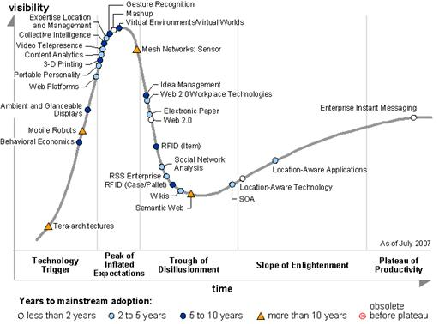
Gartner 2007 Technology Hype Curve
No Grids!
Sensor Nets
Web 2.0

Slide 7
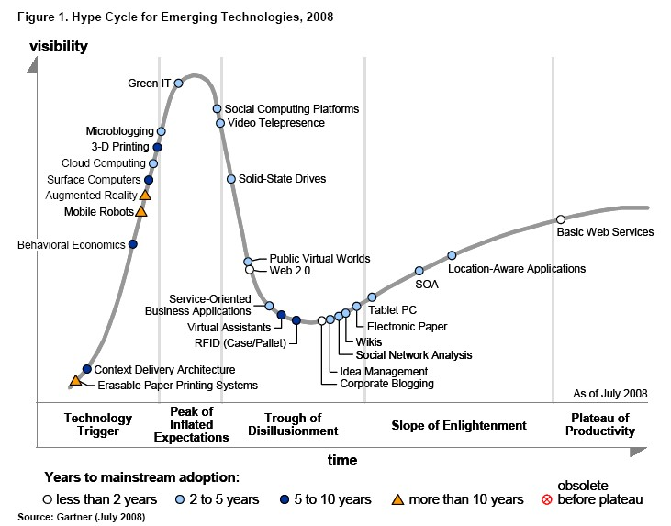
Gartner 2008 Technology Hype Curve
Clouds, Microblogs and Green IT appear
Basic Web Services, Wikis and SOA
becoming mainstream

Slide 8
QuakeSpace
QuakeSim built using Web 2.0 and Cloud Technology
Applications, Sensors, Data Repositories as Services
Computing via Clouds
Portals as Gadgets
Metadata by tagging
Data sharing as in YouTube
Alerts by RSS
Virtual Organizations via Social Networking
Workflow by Mashups
Performance by multicore
Interfaces via iPhone, Android etc.

Slide 9
Sensor Clouds
Note sensors are any time dependent source of information and a fixed source of information is just a broken sensor
  SAR Satellites
  Environmental Monitors
  Nokia N800 pocket computers
  Presentation of teacher in
  distance education
  Text chats of students
  Cell phones
Naturally implemented with dynamic proxies in the Cloud that filter, archive, queue and distribute
Have initial EC2 implementation
  RFID tags and readers
  GPS Sensors
  Lego Robots
  RSS Feeds
  Audio/video: web-cams

Slide 10

The Sensors on the Fun Grid
Laptop for PowerPoint
2 Robots used
Lego Robot GPS Nokia N800 RFID Tag RFID Reader

Slide 12
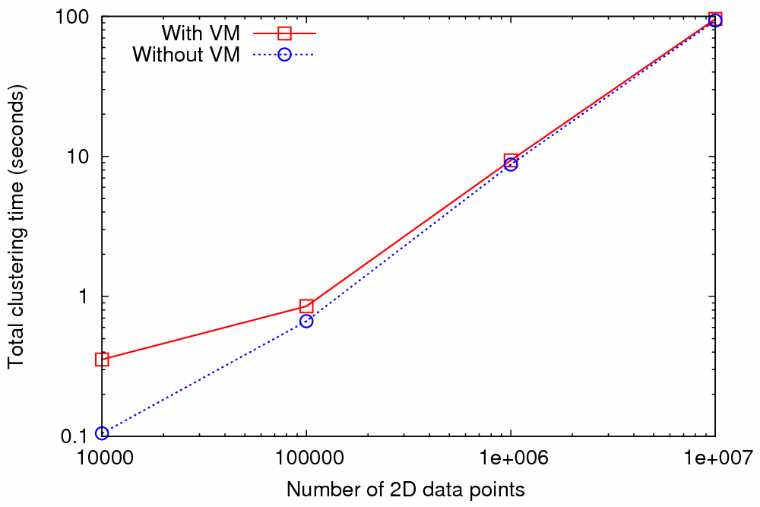
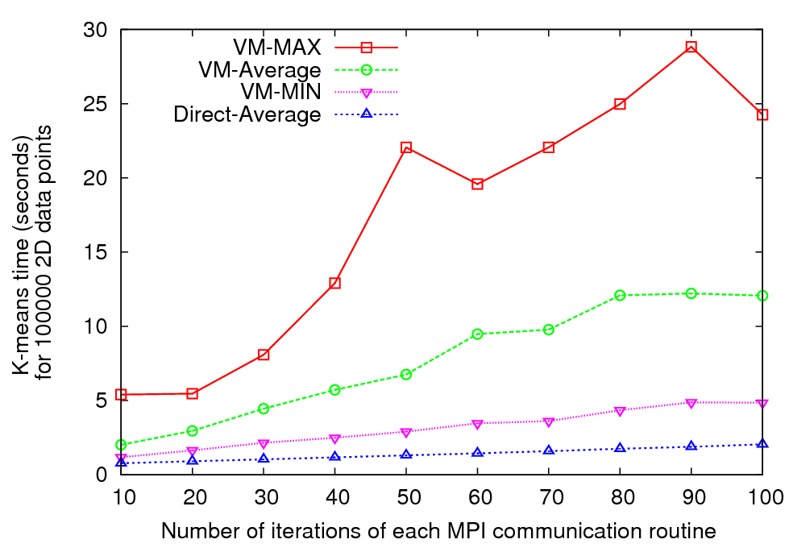
Nimbus Cloud – MPI Performance
Kmeans clustering time vs. the number of 2D data points.
(Both axes are in log scale)
Kmeans clustering time (for 100000 data points) vs. the number of iterations of each MPI communication routine
Graph 1 (Left) - MPI implementation of Kmeans clustering algorithm
Graph 2 (right) - MPI implementation of Kmeans algorithm modified to perform
each MPI communication up to 100 times
Performed using 8 MPI processes running on 8 compute nodes each with AMD Opteron™ processors (2.2 GHz and 3 GB of memory)
Note large fluctuations in VM-based runtime – implies terrible scaling

Slide 13
Nimbus Kmeans Time in secs for 100 MPI calls
Setup 1
Setup 1
VM_MIN | 4.857
VM_Average | 12.070
VM_MAX | 24.255
Setup 3
VM_MIN | 7.736
VM_Average | 17.744
VM_MAX | 32.922
Setup 2
VM_MIN | 5.067
VM_Average | 9.262
VM_MAX | 24.142
Direct
MIN | 2.058
Average | 2.069
MAX | 2.112
Setup 2
Direct
Setup 3
Test Setup | # of cores to the VM OS (domU) | # of cores to the host OS (dom0)
1 | 2 | 2
2 | 1 | 2
3 | 1 | 1

Slide 14
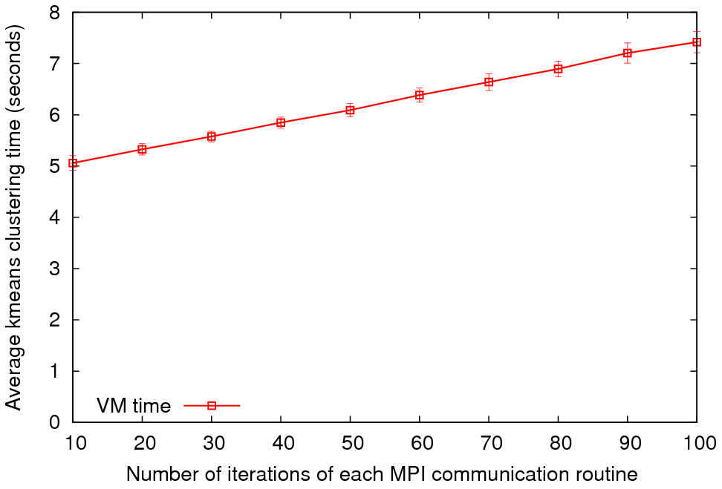
MPI on Eucalyptus Public Cloud
Kmeans Time for 100 iterations
Average Kmeans clustering time vs. the number of iterations of each MPI communication routine
4 MPI processes on 4 VM instances were used
Variable | MPI Time
VM_MIN | 7.056
VM_Average | 7.417
VM_MAX | 8.152
Configuration | VM
CPU and Memory | Intel(R) Xeon(TM) CPU 3.20GHz, 128MB Memory
Virtual Machine | Xen virtual machine (VMs)
Operating System | Debian Etch
gcc | gcc version 4.1.1
MPI | LAM 7.1.4/MPI 2
Network | -
We will redo on larger dedicated hardware
Used for direct (no VM), Eucalyptus and Nimbus

Slide 15
Consider a Collection of Computers
We can have various hardware
  Multicore – Shared memory, low latency
  High quality Cluster – Distributed Memory, Low latency
  Standard distributed system – Distributed Memory, High latency
We can program the coordination of these units by
  Threads on cores
  MPI on cores and/or between nodes
  MapReduce/Hadoop/Dryad../AVS for dataflow
  Workflow linking services
  These can all be considered as some sort of execution unit exchanging messages with some other unit
And there are higher level programming models such as OpenMP, PGAS, HPCS Languages

Slide 16
Data Parallel Run Time Architectures
CCR Ports
Trackers
CCR Ports
Pipes
MPI
Disk HTTP
CCR Ports
Trackers
CCR Ports
Pipes
MPI
Disk HTTP
CCR Ports
Trackers
CCR Ports
Pipes
MPI
Disk HTTP
CCR Ports
Trackers
CCR Ports
Pipes
MPI
Disk HTTP
CGL MapReduce is long running processing with asynchronous distributed
Rendezvous
synchronization
CCR (Multi Threading) uses short or long
running threads communicating via shared memory and
Ports (messages)
Microsoft DRYAD
uses short running processes communicating via pipes, disk or shared memory between cores
CCR (Multi Threading) uses short or long
running threads communicating via shared memory and
Ports (messages)
MPI is long running processes with Rendezvous for message exchange/
synchronization
Yahoo Hadoop uses short running processes communicating via disk and tracking processes

Slide 17
Is Dataflow the answer?
For functional parallelism, dataflow natural as one moves from one step to another
For much data parallel one needs “deltaflow” – send change messages to long running processes/threads as in MPI or any rendezvous model
  Potentially huge reduction in communication cost
For threads no difference but for processes big difference
Overhead is Communication/Computation
Dataflow overhead proportional to problem size N per process
For solution of PDE’s
  Deltaflow overhead is N^{1/3} and computation like N
  So dataflow not popular in scientific computing
For matrix multiplication, deltaflow and dataflow both O(N) and computation N^{1.5}
MapReduce noted that several data analysis algorithms can use dataflow (especially in Information Retrieval)

Slide 18
Dryad
H
MapReduce implemented by Hadoop
Y
n
Y
map(key, value)
U
U
reduce(key, list<value>)
S
4n
S
E.g. Word Count
M
4n
M
map(String key, String value):
// key: document name
// value: document contents
D
n
D
reduce(String key, Iterator values):
// key: a word
// values: a list of counts
X
n
X
U
N
U
N

Slide 19

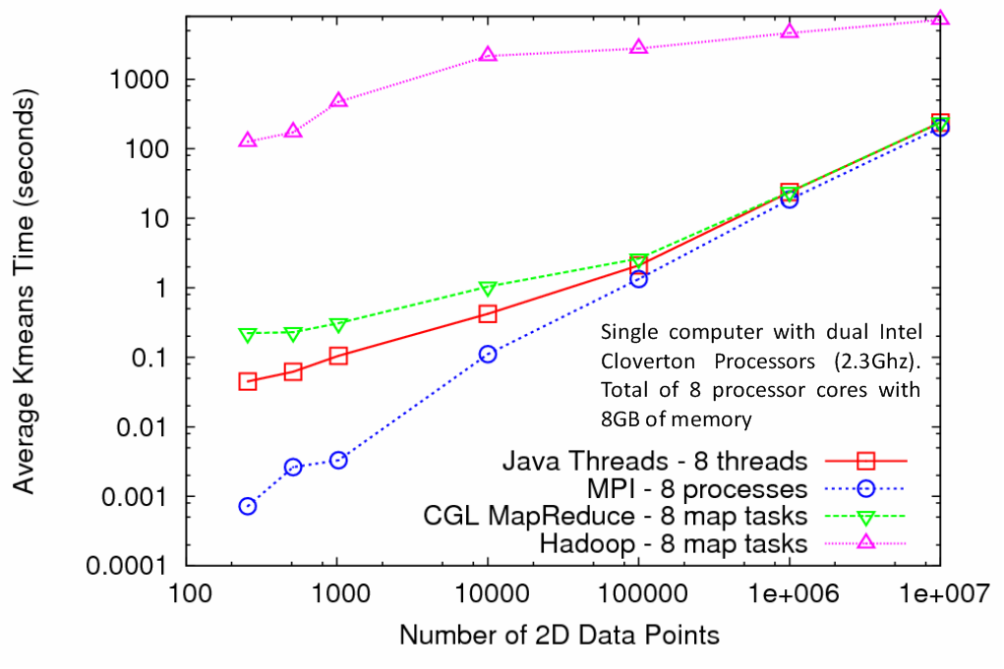
Kmeans Clustering
MapReduce for Kmeans Clustering
Kmeans Clustering, execution time vs. the number of 2D data points (Both axes are in log scale)
All four implementations perform the same Kmeans clustering algorithm
Each test is performed using 5 compute nodes (Total of 40 processor cores)
CGL-MapReduce shows a performance close to the MPI and Threads implementation
Hadoop’s high execution time is due to:
  Lack of support for iterative MapReduce computation
  Overhead associated with the file system based communication

Slide 20
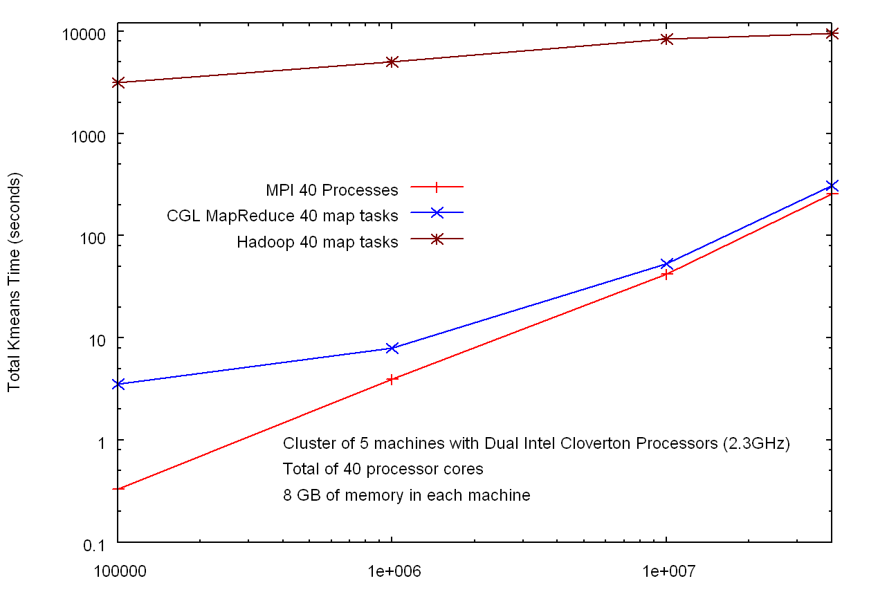
Hadoop v MPI and CGL-MapReduce for Clustering
HADOOP
Factor of 30
Factor of 10³
In memory MapReduce
MPI
Number of Data Points

Slide 21
CGL-MapReduce
Content Dissemination Network
M
Map Worker
Worker Nodes
R
Reduce Worker
D
D
MR
Driver
User
Program
M
M
M
M
D
MRDeamon
R
R
R
R
Data Read/Write
File System
Communication
Data Split
Architecture of CGL-MapReduce
A streaming based MapReduce runtime implemented in Java
All the communications(control/intermediate results) are routed via a content dissemination network
Intermediate results are directly transferred from the map tasks to the reduce tasks – eliminates local files
MRDriver
  Maintains the state of the system
  Controls the execution of map/reduce tasks
User Program is the composer of MapReduce computations
Support both stepped (dataflow) and iterative (deltaflow) MapReduce computations
All communication uses publish-subscribe “queues in the cloud” not MPI

Slide 22
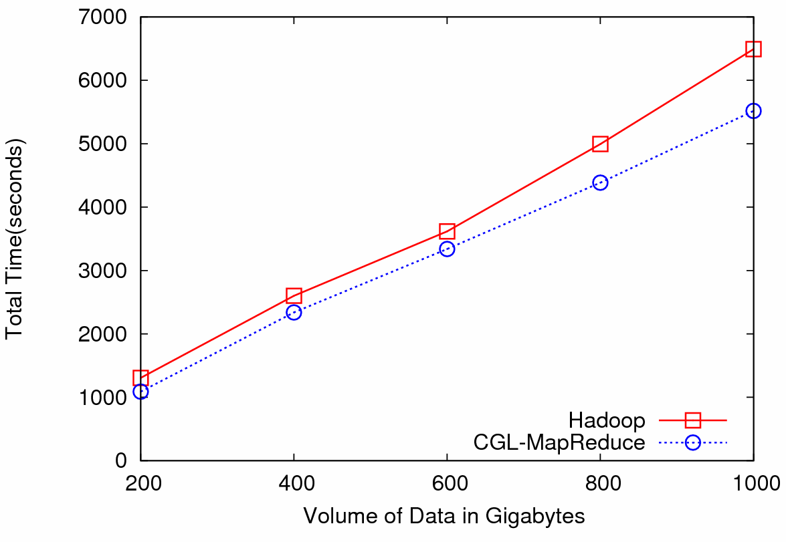

Particle Physics (LHC) Data Analysis
Data: Up to 1 terabytes of data, placed in IU Data Capacitor
Processing:12 dedicated computing nodes from Quarry (total of 96 processing cores)
MapReduce for LHC data analysis
LHC data analysis, execution time vs. the volume of data (fixed compute resources)
Hadoop and CGL-MapReduce both show similar performance
The amount of data accessed in each analysis is extremely large
Performance is limited by the I/O bandwidth
The overhead induced by the MapReduce implementations has negligible effect on the overall computation

Slide 23
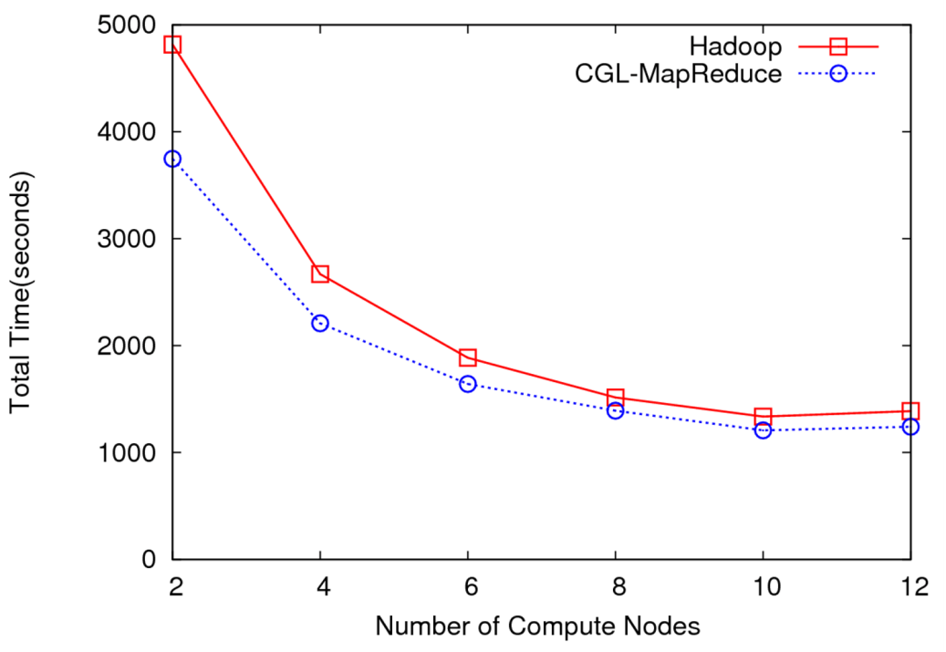
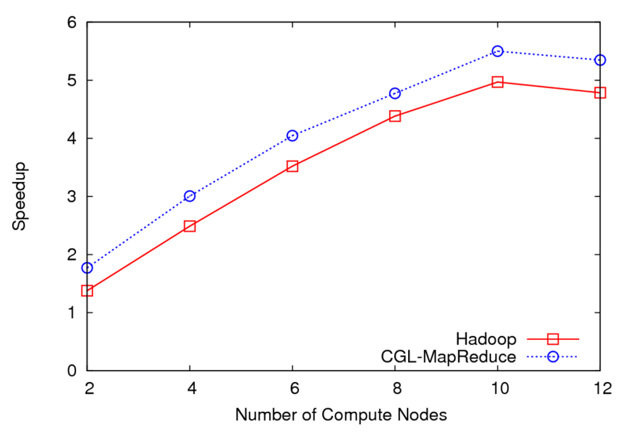
LHC Data Analysis Scalability and Speedup
Execution time vs. the number of compute nodes (fixed data)
Speedup for 100GB of HEP data
100 GB of data
One core of each node is used (Performance is limited by the I/O bandwidth)
Speedup = MapReduce Time / Sequential Time
Speed gain diminish after a certain number of parallel processing units (after around 10 units)

Slide 24
MPI outside the mainstream
Multicore best practice and large scale distributed processing not scientific computing will drive best concurrent/parallel computing environments
Party Line Parallel Programming Model: Workflow (parallel--distributed) controlling optimized library calls
  Core parallel implementations no easier than before; deployment is easier
MPI is wonderful but it will be ignored in real world unless simplified; competition from thread and distributed system technology
CCR from Microsoft – only ~7 primitives – is one possible commodity multicore driver
  It is roughly active messages
  Runs MPI style codes fine on multicore

Slide 25
Windows Thread Runtime System
We implement thread parallelism using Microsoft CCR
(Concurrency and Coordination Runtime) as it supports both MPI rendezvous and dynamic (spawned) threading style of parallelism http://msdn.microsoft.com/robotics/
CCR Supports exchange of messages between threads using named ports and has primitives like:
FromHandler: Spawn threads without reading ports
Receive: Each handler reads one item from a single port
MultipleItemReceive: Each handler reads a prescribed number of items of a given type from a given port. Note items in a port can be general structures but all must have same type.
MultiplePortReceive: Each handler reads a one item of a given type from multiple ports.
CCR has fewer primitives than MPI but can implement MPI collectives efficiently
Can use DSS (Decentralized System Services) built in terms of CCR for service model
DSS has ~35 µs and CCR a few µs overhead

Slide 26
Deterministic Annealing Clustering
Scaled Speedup Tests on 4 8-core Systems
1,600,000 points per C# thread
1, 2, 4. 8, 16, 32-way parallelism
On Windows
Parallel
Overhead
≈ 1-efficiency
= (PT(P)/T(1)-1)
On P processors
= (1/efficiency)-1
32-way
16-way
2-way
8-way
4-way
Nodes
1 2 1 1 4 2 1 2 1 1 4 2 1 4 2 1 2 1 1 4 2 4 2 4 2 2 4 4 4 4
MPI Processes per Node
1 1 2 1 1 2 4 1 2 1 2 4 8 1 2 4 1 2 1 4 8 2 4 1 2 1 8 4 2 1
CCR Threads per Process
1 1 1 2 1 1 1 2 2 4 1 1 1 2 2 2 4 4 8 1 1 2 2 4 4 8 1 2 4 8

Slide 27
Deterministic Annealing for Pairwise Clustering
Clustering is a well known data mining algorithm with K-means best known approach
Two ideas that lead to new supercomputer data mining algorithms
Use deterministic annealing to avoid local minima
Do not use vectors that are often not known – use distances δ(i,j) between points i, j in collection – N=millions of points are available in Biology; algorithms go like N² . Number of clusters
Developed (partially) by Hofmann and Buhmann in 1997 but little or no application
Minimize H_{PC} = 0.5 ∑_{i=1}^{N} ∑_{j=1}^{N} δ(i, j) ∑_{k=1}^{K} M_{i}(k) M_{j}(k) / C(k)
M_{i}(k) is probability that point i belongs to cluster k
C(k) = ∑_{i=1}^{N} M_{i}(k) is number of points in k’th cluster
M_{i}(k) ∝ exp( -ε_{i}(k)/T ) with Hamiltonian ∑_{i=1}^{N} ∑_{k=1}^{K} M_{i}(k) ε_{i}(k)
Reduce T from large to small values to anneal
PCA
2D MDS

Slide 28
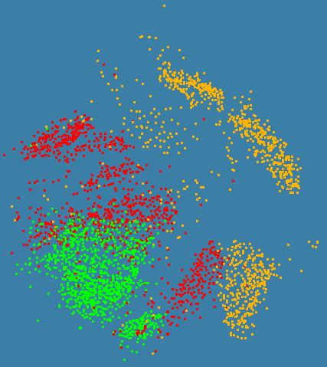
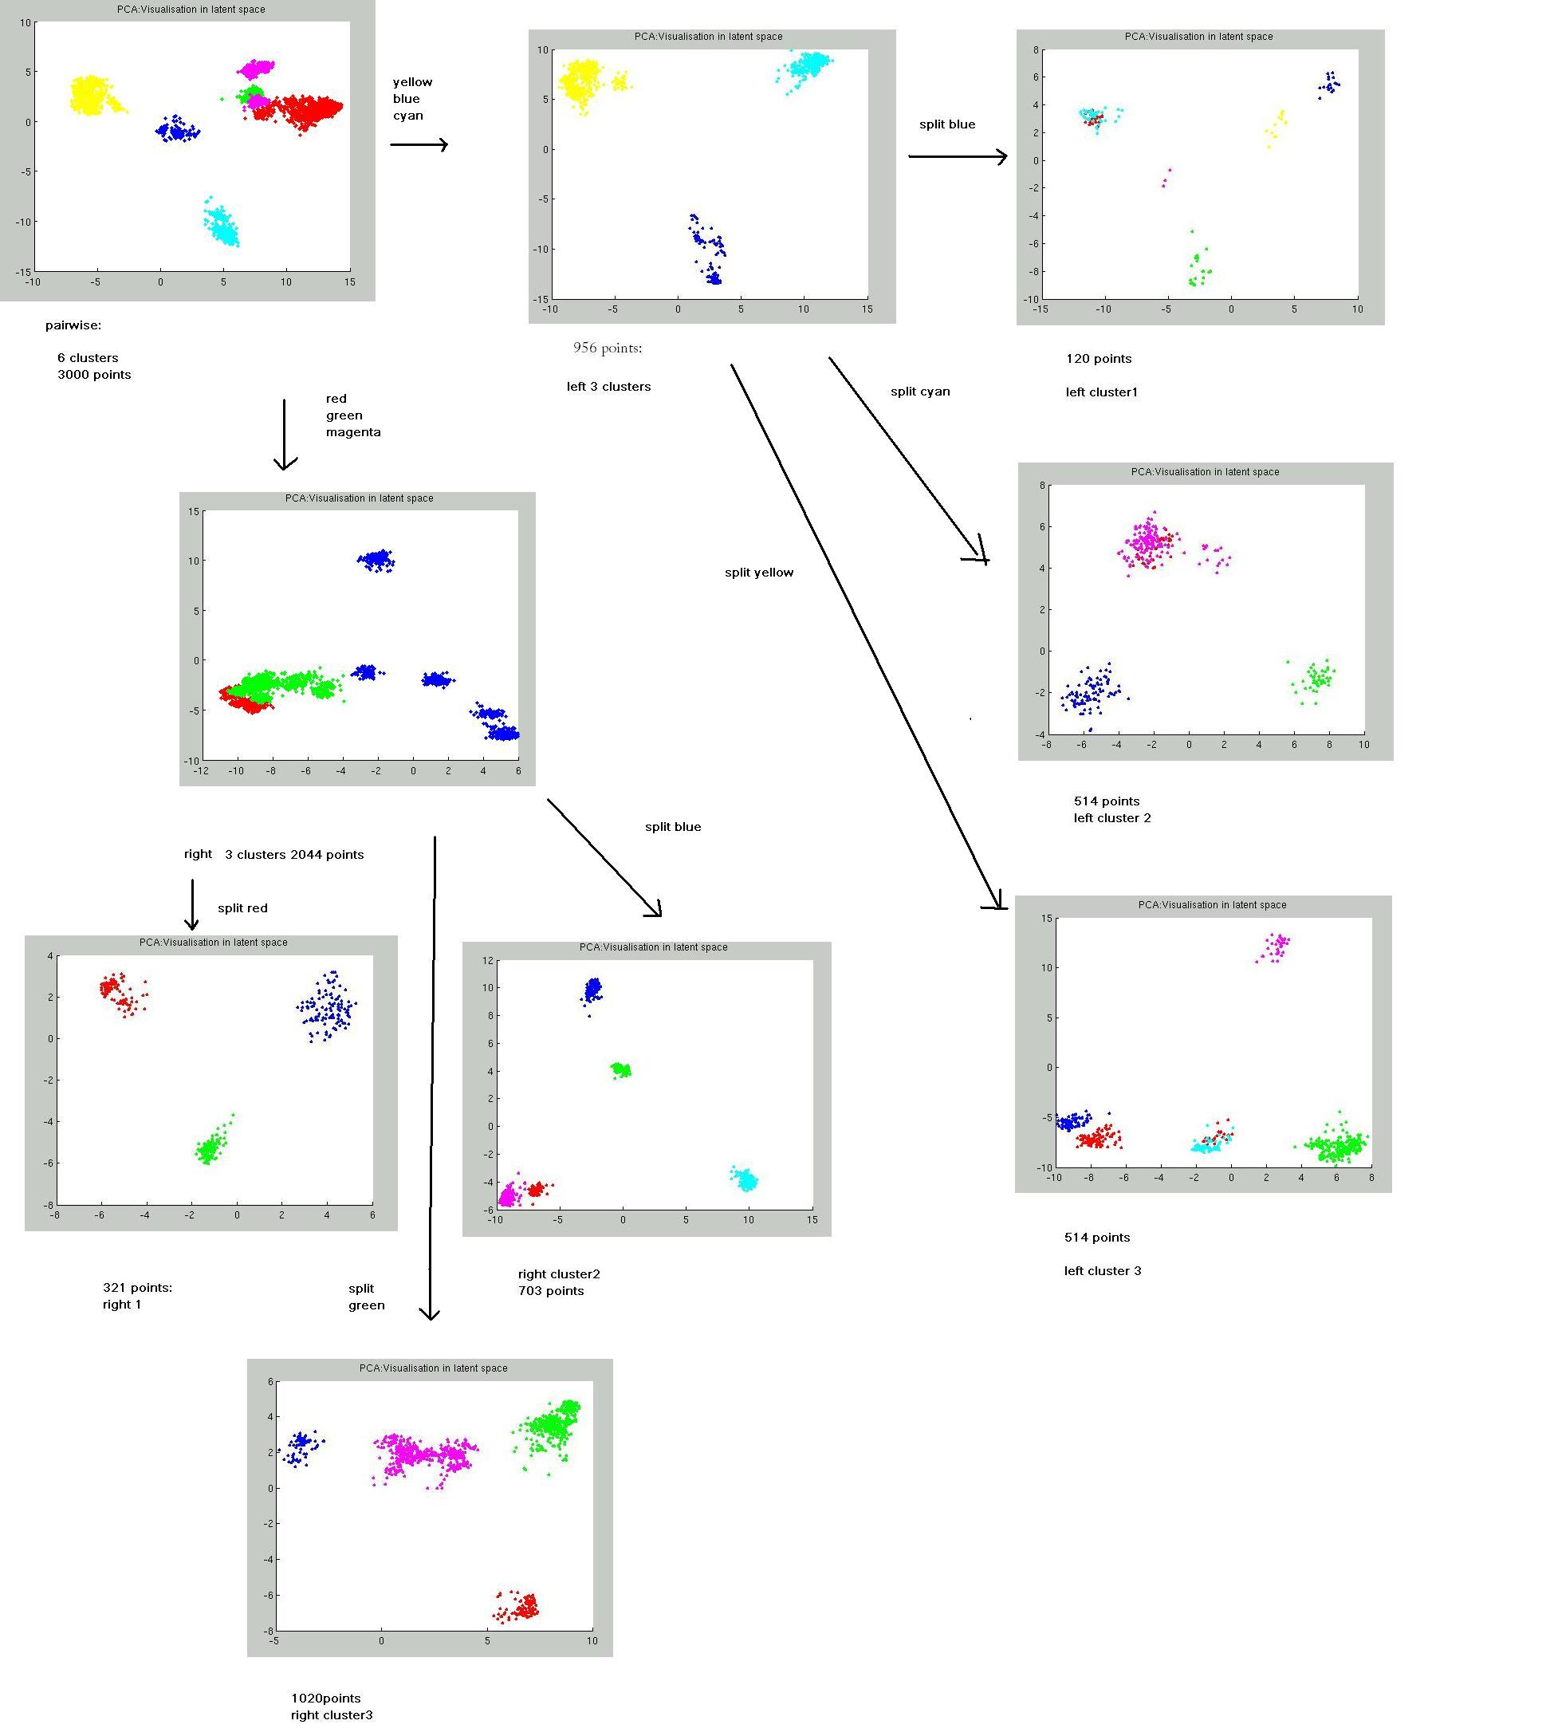
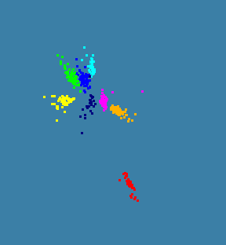
N=3000 sequences each length ~1000 features
Only use pairwise distances will repeat with 0.1 to 0.5 million sequences with a larger machine
C# with CCR and MPI

Slide 29

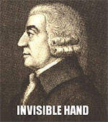



Famous Lolcats
LOL is Internet Slang for
Laughing out Loud

Slide 30


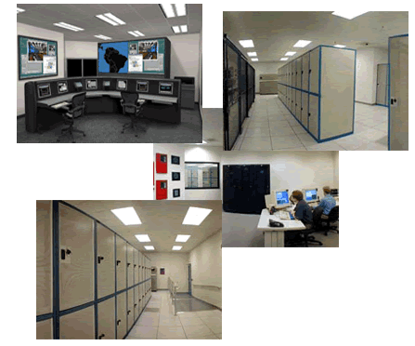
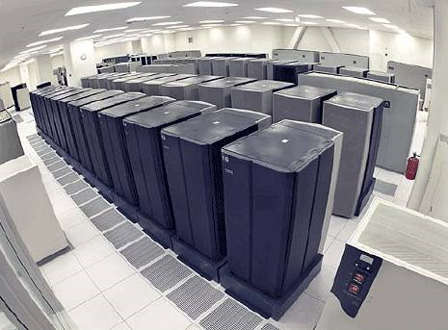
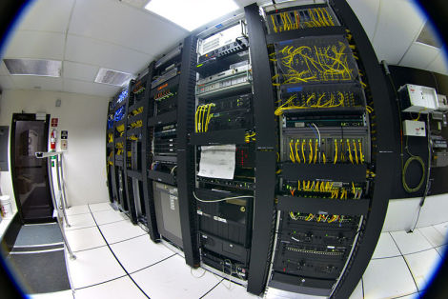
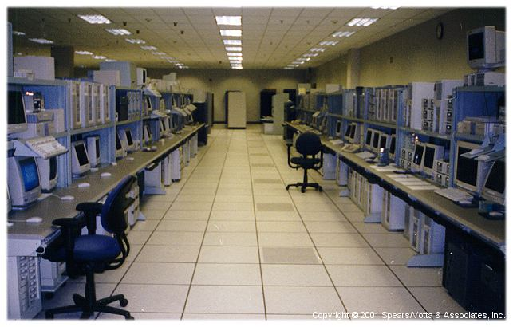
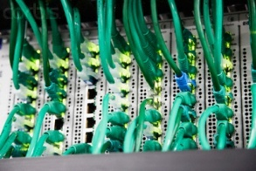
I’M IN UR CLOUD
INVISIBLE COMPLEXITY

