Slide 1
Cloud Computing, Data Mining and Cyberinfrastructure
Chemistry in the Digital Age Workshop, Penn State University, June 11, 2009
Geoffrey Fox
gcf@indiana.edu www.infomall.org/salsa
http://grids.ucs.indiana.edu/ptliupages/
(Presented by Marlon Pierce)
Community Grids Laboratory,
Chair Department of Informatics
School of Informatics Indiana University

Slide 2
Cloud Computing: Infrastructure and Runtimes
Cloud infrastructure: outsourcing of servers, computing, data, file space, etc.
Handled through Web services that control virtual machine lifecycles.
Cloud runtimes:: tools for using clouds to do data-parallel computations.
Apache Hadoop, Google MapReduce, Microsoft Dryad, and others
Designed for information retrieval but are excellent for a wide range of machine learning and science applications.
Apache Mahout
Also may be a good match for 32-128 core computers available in the next 5 years.
Can also do traditional parallel computing
Clustering algorithms: applications for cloud-based data mining.
Run on cloud infrastructure
Implement with cloud runtimes.

Slide 3
Commercial Clouds
Cloud/ Service | Amazon | Microsoft Azure | Google (and Apache)
Data | S3, EBS, SimpleDB | Blob, Table, SQL Services | GFS, BigTable
Computing | EC2, Elastic Map Reduce (runs Hadoop) | Compute Service | MapReduce (not public, but Hadoop)
Service Hosting | None? | Web Hosting Service | AppEngine/AppDrop
Boldfaced names have open source versions

Slide 4
Open Architecture Clouds
Amazon, Google, Microsoft, et al., don’t tell you how to build a cloud.
Proprietary knowledge
Indiana University and others want to document this publically.
What is the right way to build a cloud?
It is more than just running software.
What is the minimum-sized organization to run a cloud?
Department? University? University Consortium? Outsource it all?
Analogous issues in government, industry, and enterprise.
Example issues:
What hardware setups work best? What are you getting into?
What is the best virtualization technology for different problems?
What is the right way to implement S3- and EBS-like data services? Content Distribution Systems? Persistent, reliable service hosting?

Slide 5
Cloud Runtimes
What science can you do on a cloud?

Slide 6
Data-File Parallelism and Clouds
Now that you have a cloud, you may want to do large scale processing with it.
Classic problems are to perform the same (sequential) algorithm on fragments of extremely large data sets.
Cloud runtime engines manage these replicated algorithms in the cloud.
Can be chained together in pipelines (Hadoop) or DAGs (Dryad).
Runtimes manage problems like failure control.
We are exploring both scientific applications and classic parallel algorithms (clustering, matrix multiplication) using Clouds and cloud runtimes.

Slide 7
MapReduce implemented
by Hadoop
H
map(key, value)
reduce(key, list<value>)
Y
n
Y
U
U
S
4n
S
Example: Word Histogram
Start with a set of words
Each map task counts number of occurrences in each data partition
Reduce phase adds these counts
M
4n
M
D
n
D
X
n
X
Dryad supports general dataflow
U
N
U
N

Slide 8
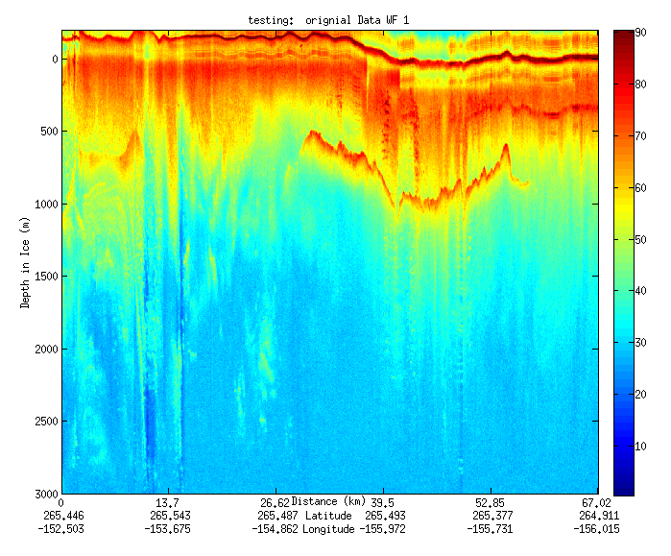
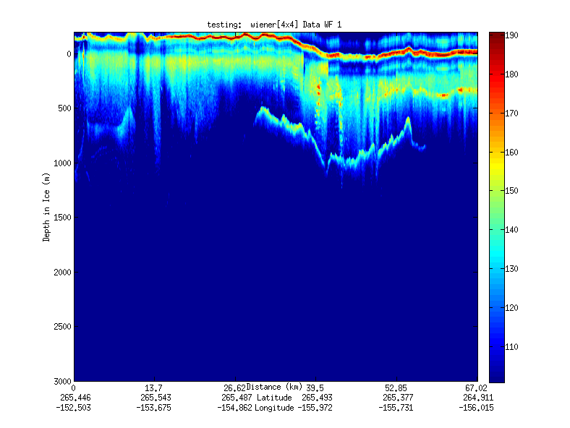
Geospatial Examples
Image processing and mining
Ex: SAR Images from Polar Grid project (J. Wang)
Apply to 20 TB of data
Flood modeling I
Chaining flood models over a geographic area.
Flood modeling II
Parameter fits and inversion problems.
Real time GPS processing
Filter

Slide 9
File/Data Parallel Examples from Biology
EST (Expressed Sequence Tag) Assembly: (Dong) 2 million mRNA sequences generates 540000 files taking 15 hours on 400 TeraGrid nodes (CAP3 run dominates)
MultiParanoid/InParanoid gene sequence clustering: (Dong) 476 core years just for Prokaryotes
Population Genomics: (Lynch) Looking at all pairs separated by up to 1000 nucleotides
Sequence-based transcriptome profiling: (Cherbas, Innes) MAQ, SOAP
Systems Microbiology: (Brun) BLAST, InterProScan
Metagenomics: (Fortenberry, Nelson) Pairwise alignment of 7243 16s sequence data took 12 hours on TeraGrid
All can use Dryad or Hadoop

Slide 10
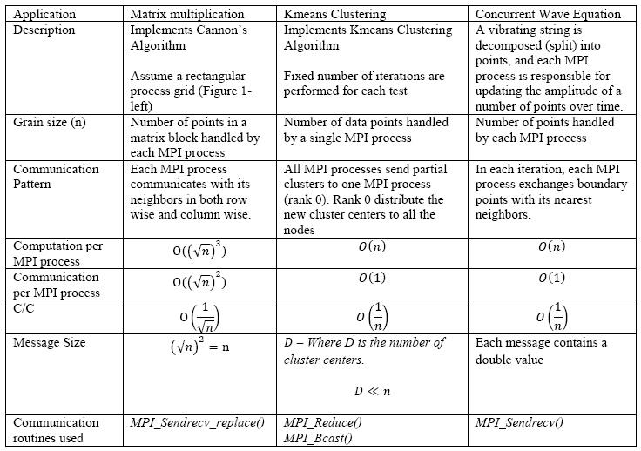
MPI Applications on Clouds

Slide 11
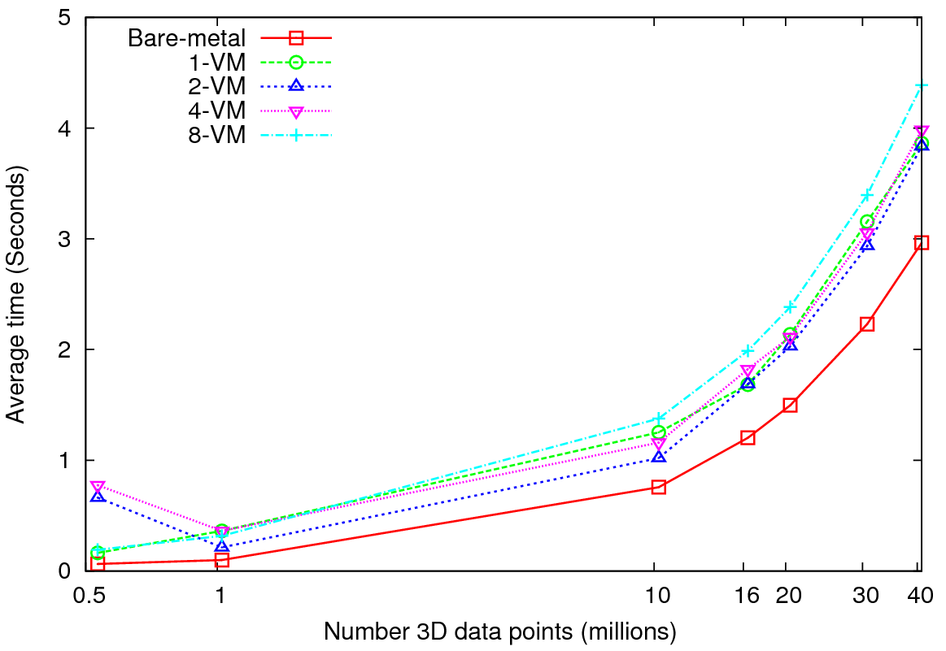
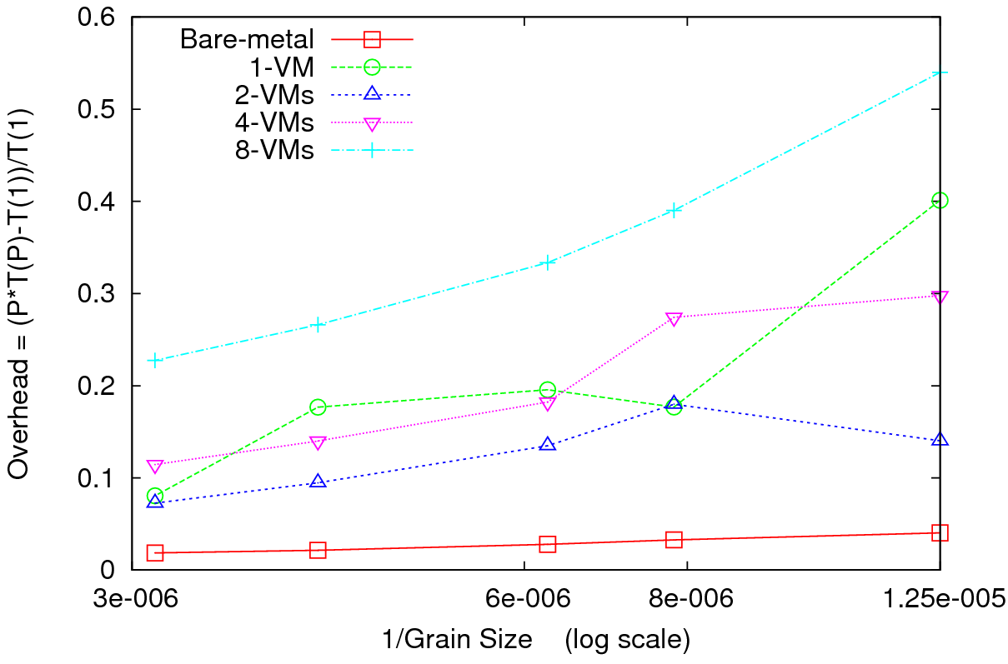
Kmeans Clustering
Performance – 128 CPU cores
Overhead
Perform Kmeans clustering for up to 40 million 3D data points
Amount of communication depends only on the number of cluster centers
Amount of communication << Computation and the amount of data processed
At the highest granularity VMs show at least 3.5 times overhead compared to bare-metal
Extremely large overheads for smaller grain sizes

Slide 12
Deterministic Annealing for Clustering
Highly parallelizable algorithms for data-mining

Slide 13
Deterministic Annealing
F({y}, T)
Solve Linear Equations for each temperature
Nonlinearity effects mitigated by initializing with solution at previous higher temperature
Configuration {y}
Minimum evolving as temperature decreases
Movement at fixed temperature going to local minima if not initialized “correctly

Slide 14
Various Sequence Clustering Results
4500 Points : Pairwise Aligned
3000 Points : Clustal MSA Kimura2 Distance
4500 Points : Clustal MSA
Map distances to 4D Sphere before MDS

Slide 15
Obesity Patient ~ 20 dimensional data
Will use our 8 node Windows HPC system to run 36,000 records
Working with Gilbert Liu IUPUI to map patient clusters to environmental factors
2000 records 6 Clusters
4000 records
8 Clusters
Refinement of 3 of clusters to left into 5

Slide 16
Conclusions
We believe Cloud Computing will dramatically change scientific computing infrastructure.
No more clusters in the closet?
Controllable, sustainable computing.
But we need to know what we are getting into.
Even better, clouds (wherever they are) are well suited for a wide range of scientific and computer science applications.
We are exploring some of these in biology, clustering, geospatial processing, and hopefully chemistry.

