Slide 1
Interpolative Multidimensional Scaling Techniques for the Identification of Clusters in Very Large Sequence Sets
April 27, 2011

Slide 2
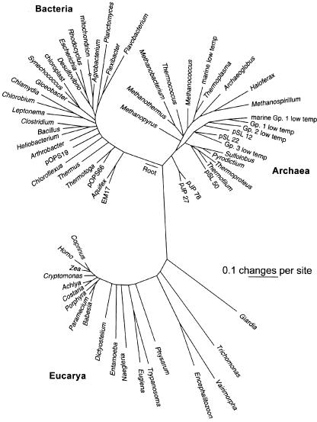
16S rRNA Sequence Diversity and Abundance¹
*
Pyrosequencing capable of generating millions of sequence reads from environmental samples
Computational goal is classification and grouping of sequences
* JE Clarridge, “Impact of 16S rRNA gene sequence analysis for identification of bacteria on clinical microbiology and infectious diseases.” Clin Microbiol Rev. 2004 Oct;17(4)

Slide 3
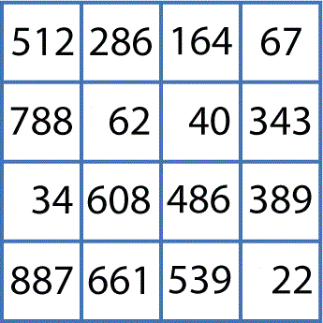
Sequence Clustering
Smith-Waterman / Needleman-Wunsch with
Kimura2 / Jukes-Cantor / Percent-Identity
MPI.NET Implementation
C# Desktop Application based on VTK
Pairwise Clustering
O(NxN)
Cluster Indices
Pairwise Alignment & Distance Calculation
Gene Sequences
Visualization
3D Plot
O(NxN)
Coordinates
Distance Matrix
Multi-Dimensional Scaling
MPI.NET Implementation
Chi-Square / Deterministic Annealing
MPI.NET Implementation
* Note. The implementations of Smith-Waterman and Needleman-Wunsch algorithms are from Microsoft Biology Foundation library

Slide 4
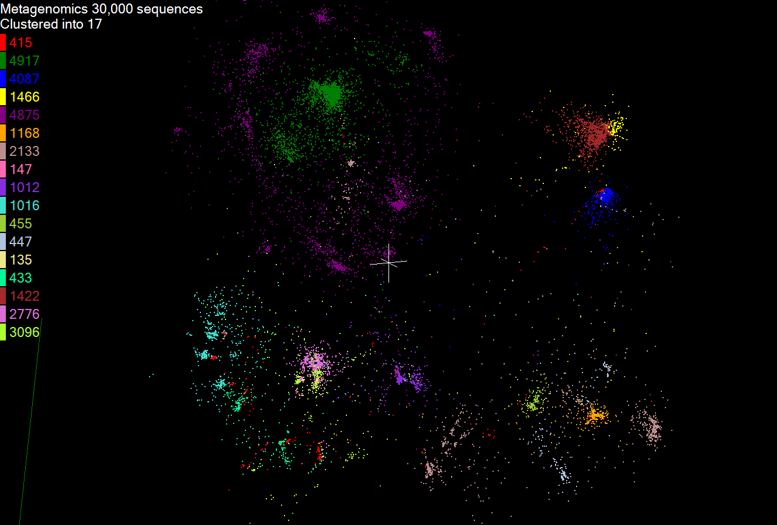
It Works …
Visualization of MDS and clustering results for 30000 gene sequences from an environmental sample. The many different genes are classified by a clustering algorithm and visualized by MDS dimension reduction.
…But …

Slide 5
… There are limitations
Distance calculation prohibitive for large N
MDS prohibitive for large N
Job management difficult for large N

Slide 6
MDS Interpolation
4
O(MxM)
m in-sample
Training
Trained data
N-m
out-of-sample
Interpolated
MDS Map
Interpolation
O(Mx(N-M))

Slide 7
Map Reduce
5
A Parallel Runtime From Information Retrieval
Data Partitions
Map(Key, Value)
A hash function maps the results of the map tasks to r reduce tasks
Reduce(Key, List<Value>)
Reduce Outputs
Implementations support:
Splitting of data
Passing the output of map functions to reduce functions
Sorting the inputs to the reduce function based on the intermediate keys
Quality of services

Slide 8
Twister Programming Model
6
Main program’s process space
Worker Nodes
configureMaps(..)
Local Disk
configureReduce(..)
Cacheable map/reduce tasks
while(condition){
runMapReduce(..)
May send <Key,Value> pairs directly
Map()
Iterations
Reduce()
Combine() operation
Communications/data transfers via the pub-sub broker network & direct TCP
updateCondition()
Main program may contain many MapReduce invocations or iterative MapReduce invocations
} //end while
close()

Slide 9
Computational Advantages
Dimensional scaling allows visual identification of cluster.
Interpolative MDS greatly reduces computational complexity and memory requirements by utilizing pre-mapping results of in-sample subset.

Slide 10
Scaled-up Sequence Clustering
Gene Sequences (N = 1 Million+)
Pairwise Alignment & Distance Calculation
O(MxM)
Select Reference
Reference Sequence Set (M = 100K)
Distance Matrix
Reference Coordinates
N - M Sequence Set (900K)
Interpolative MDS with Pairwise Distance Calculation
x, y, z
Multi-Dimensional Scaling (MDS)
O(MxM)
O(Mx(N-M))
N - M Coordinates
x, y, z
Visualization
3D Plot
* Note. This implementation of the Needleman-Wunsch algorithm is based on the BioJava library

Slide 11
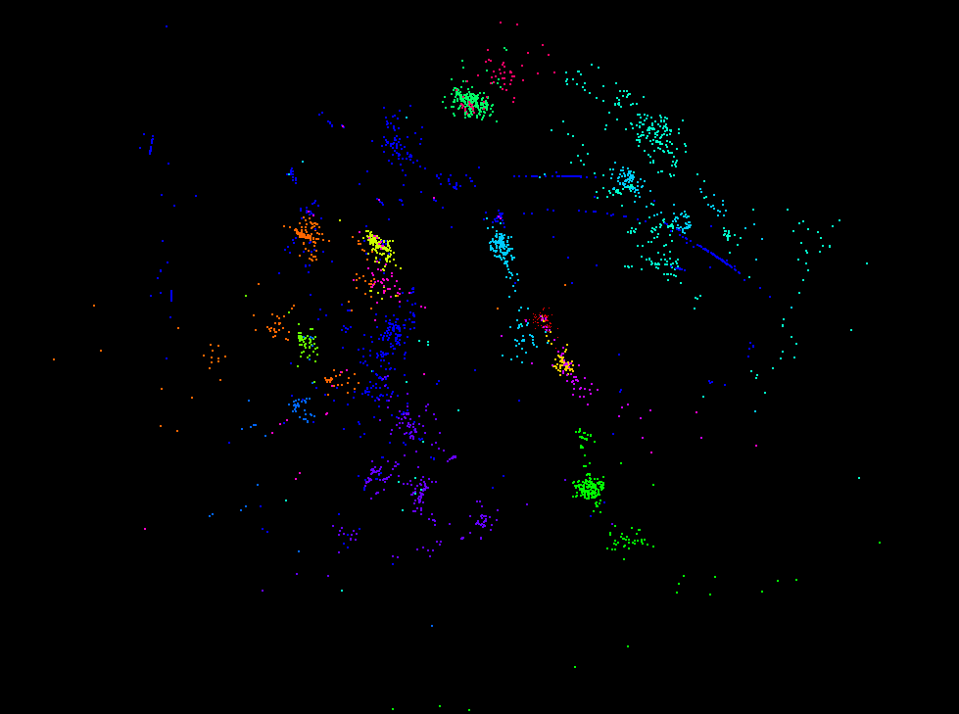
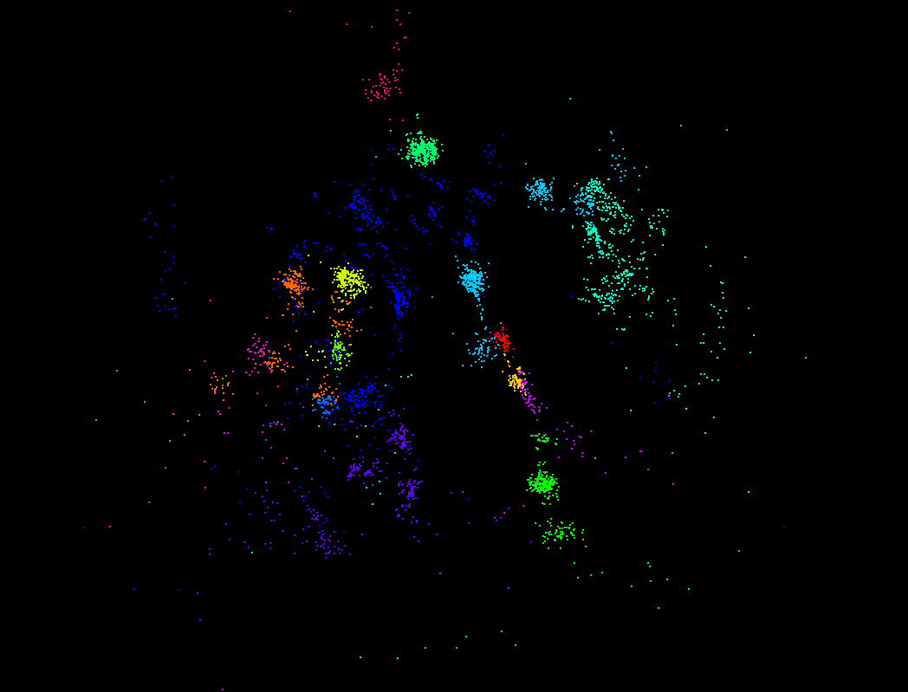
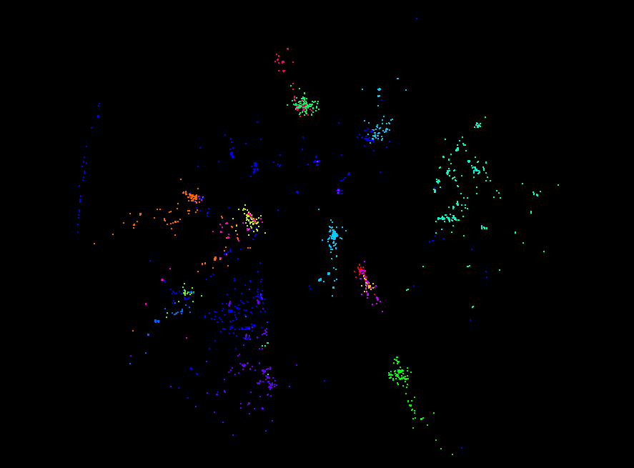
Results – 100K Sequences
MDS – 50K Interpolated
Full MDS
MDS – 90K Interpolated

Slide 12
100K Metagenomics Sequences - Full MDS

Slide 13
100K Metagenomics Sequences – 50K Interpolated Points

Slide 14
100K Metagenomics Sequences – 90K Interpolated Points

Slide 15
Total Wallclock Time (hours)
Number of Interpolated Points
* For 100K sequences, running on 90 nodes (720 cores) of Polar Grid Quarry

Slide 16
Conclusions
Mutlidimensional Scaling can be used to visually identify sequence clusters and direct more detailed studies.
SMACOF-MDS requires only dissimilarity between sequences, not Euclidean distances or feature vectors.
Interpolation can dramatically decrease computational complexity while yielding reasonable results.
Optimal interpolation patterns need to be determined.

Slide 17
Conclusions
Twister supports iterative algorithms (like MDS) and eases multi-thousand job control.

Slide 18
Future Directions
Hierarchical MDS
MDS by Deterministic Annealing
MDS method comparison
Scale-up to 20M+ sequences

Slide 19
Acknowledgements
Salsa Group
Dr. Geoffrey Fox
Dr. Judy Qiu
Seung-Hee Bae
Jong Youl Choi
Jaliya Ekanayake (Microsoft)
Saliya Ekanayake
Thilina Gunarathne
Bingjing Zhang
Hui Li
Yang Ruan
Yuduo Zhou
Tak-Lon Wu
Collaborators
Mina Rho, Indiana University
Qunfeng Donng, University of North Texas
This work is supported by NIH ARRA funding.

Slide 20
Bibliography
Yijun Sun, et al. ESPRIT: estimating species richness using large collections of 16S rRNA pyrosequences. Nucl. Acids Res. (2009) first published online May 5, 2009 doi:10.1093/nar/gkp285.
Xiaohong Qiu, Geoffrey C. Fox (presenter), Huapeng Yuan, Seung-Hee Bae, George Chrysanthakopoulos, Henrik Frystyk Nielsen PARALLEL CLUSTERING AND DIMENSIONAL SCALING ON MULTICORE SYSTEMS Invited talk at the 2008 High Performance Computing & Simulation Conference (HPCS 2008) In Conjunction With The 22nd EUROPEAN CONFERENCE ON MODELLING AND SIMULATION (ECMS 2008) Nicosia, Cyprus June 3 - 6, 2008.
Seung-Hee Bae Parallel Multidimensional Scaling Performance on Multicore Systems at workhop on Advances in High-Performance E-Science Middleware and Applications in Proceedings of eScience 2008 Indianapolis IN December 7-12 2008.
Seung-Hee Bae, Jong Youl Choi, Judy Qiu, Geoffrey Fox Dimension Reduction and Visualization of Large High-dimensional Data via InterpolationProceedings of ACM HPDC 2010 conference, Chicago, Illinois, June 20-25, 2010.
Jaliya Ekanayake, Hui Li, Bingjing Zhang, Thilina Gunarathne, Seung-Hee Bae, Judy Qiu, Geoffrey Fox Twister: A Runtime for Iterative MapReduce March 18 2010. Proceedings of the First International Workshop on MapReduce and its Applications of ACM HPDC 2010 conference, Chicago, Illinois, June 20-25, 2010.
Jaliya Ekanayake Architecture and Performance of Runtime Environments for Data Intensive Scalable Computing Indiana University PhD Exam December 20 2010.

Slide 21
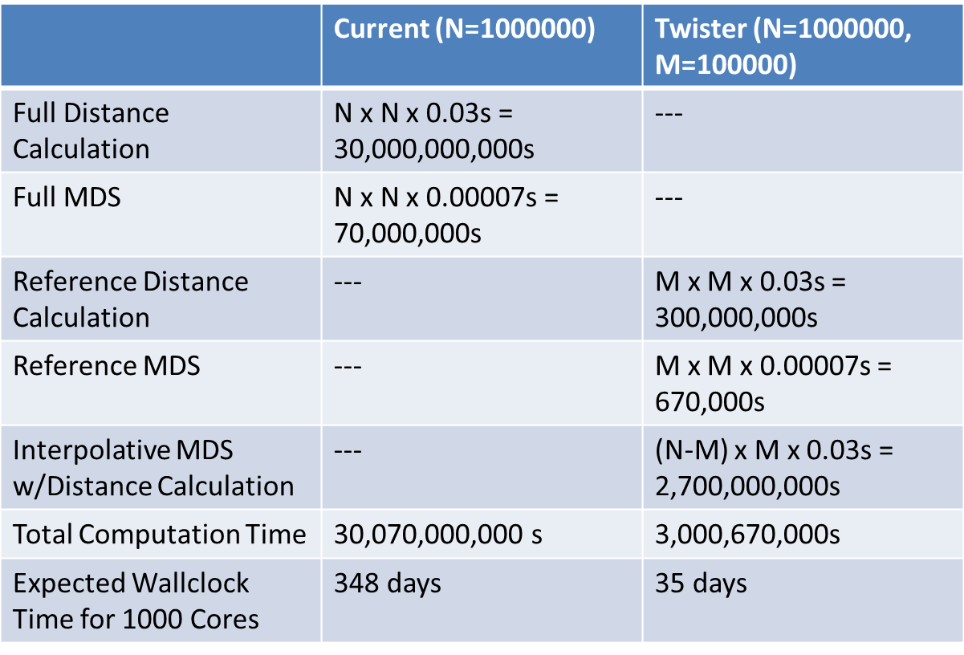
Potential Cost Savings
(Sequence Length ~500)

Slide 22
Multidimensional Scaling (MDS)*
Given the proximity information among points.
Optimization problem to find mapping in target dimension of the given data based on pairwise proximity information while minimize the objective function.
Objective functions: STRESS (1) or SSTRESS (2)
Only needs pairwise distances δ_{ij} between original points (typically not Euclidean)
d_{ij}(X) is Euclidean distance between mapped (3D) points
* I. Borg and P. J. Groenen. Modern Multidimensional Scaling: Theory and Applications. Springer, New York, NY, U.S.A., 2005.

