Slide 1
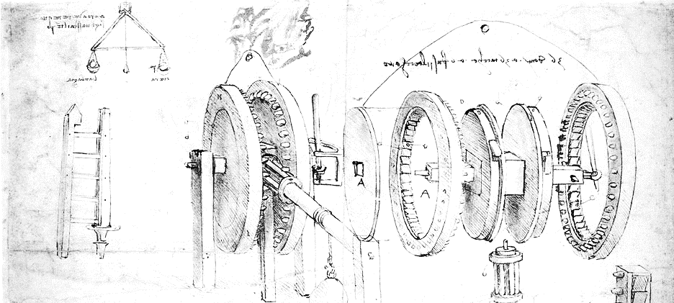
Cloud Evolution
Dennis Gannon
Prof. of CS Emeritus, School of Informatics and Computing
Indiana University
&
Microsoft Research (retired)
www.esciencegroup.com

Slide 2
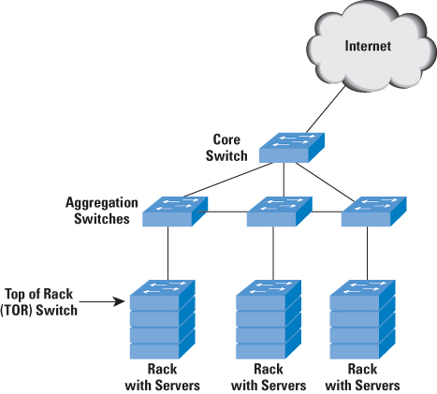
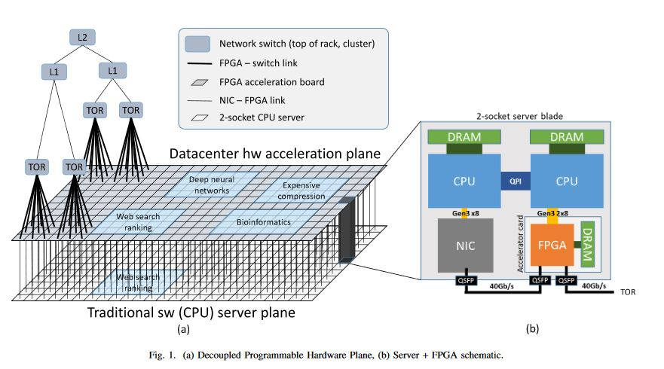
The Data Centers are Evolving
Early days: 2005
Very simple servers
Network outward facing poor interconnect
2008-2016
Software defined networks
Special InfiniBand sub networks
Many different server types
2 cores to 32 cores to GPU accelerations
Efficiency experiments
Geothermal, wind, wave
Containerized server
2017
Azure FPGA accelerated mesh
Google Tensor Processing Unit
Facebook – Open Compute Project
ARM based servers

Slide 3
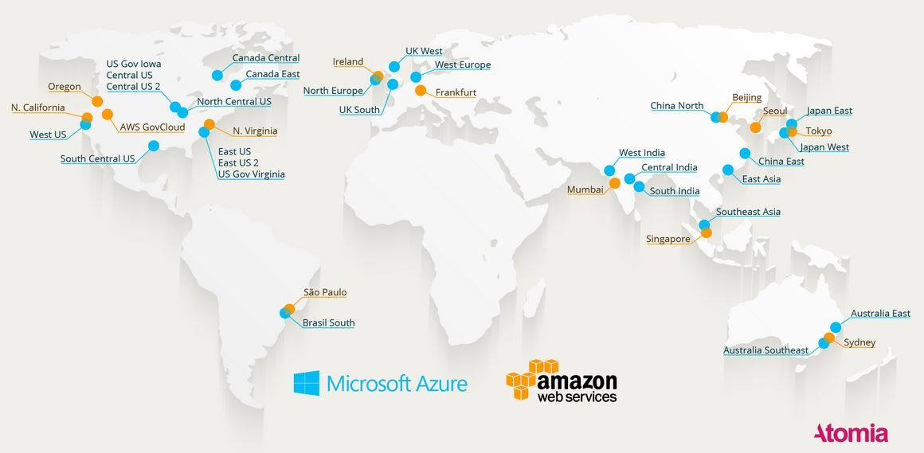
Azure, AWS, Google Global Scale
Already “exascale” by several measures.

Slide 4
Evolving “Cloud Native” Stack & Applications
“Cloud Native” = designed from ground up using the cloud for global scale & massive parallelism.
Cloud Native Apps are
built on top of foundational cloud services like hyper-scale data services (Azure Cosmos DB, Amazon Aurora, Google Spanner)
Often composed of thousands of microservices using Mesos or Kubernetes (and not simple VM-based IaaS)
Designed to scale to millions of (globally distributed) input streams and never go down.
Not ports of conventional applications.

Slide 5
Geoffrey’s Questions
You have been appointed the director of a brand new cloud resource which will be fully operational 2 years from now. How would you design it?
Question should be what would I design?
It would build a fully-responsive “research assistant” that could complete deep scientific document text search and analysis, look for proofs of hard theorems, find connections between ideas and concepts that I did not know existed.
It would surprise me when i returned to work in the morning.
It would totally put Cortana, Alexa and Siri to shame.
I might need 3 years.

Slide 6
What are important academic research issues in Cloud arena?
See previous slide.
Understand how cloud analytics can discover features in large scale climate models and other CFD simulation output.
Design planet-scale graph data architectures
Build a compiler that will map parallel programs to Azure’s FPGA array. (Available at TACC for experiments)
I can run 1000s of docker containers as microservices in Kubernetes or a single Singularity container running an MPI program on a 1000 node cluster.
Is there something better than both?

Slide 7
What computing is not or will not be possible in clouds? Where do classic medium size compute providers such as a University Center position themselves? Are there/Will there be exascale clouds?
Very little, but some is better done on a supercomputer
Make a good deal with AWS, Azure or Google.
Taken in aggregate, it is there now.

