Slide 1
Cloud Technologies for Data Intensive Computing
Cloud Computing and Collaborative Technologies in the Geosciences
September 17-18, 2009, Indianapolis
Geoffrey Fox
gcf@indiana.edu www.infomall.org/salsa
School of Informatics and Computing
and Community Grids Laboratory,
Digital Science Center
Pervasive Technology Institute
Indiana University

Slide 2
Collaborators in SALSA Project
Microsoft Research
Technology Collaboration
Azure
Dennis Gannon
Dryad
Roger Barga
Christophe Poulain
CCR (Threading)
George Chrysanthakopoulos
DSS
Henrik Frystyk Nielsen
Indiana University
SALSA Technology Team
Geoffrey Fox
Xiaohong Qiu
Scott Beason
Jaliya Ekanayake
Thilina Gunarathne
Thilina Gunarathne
Jong Youl Choi
Yang Ruan
Seung-Hee Bae
Applications
Bioinformatics, CGB
Haiku Tang, Mina Rho,
Peter Cherbas, Qunfeng Dong
IU Medical School
Gilbert Liu
Demographics (GIS)
Neil Devadasan
Cheminformatics
Rajarshi Guha (NIH), David Wild
Physics
CMS group at Caltech (Julian Bunn)
Community Grids Lab
and UITS RT – PTI

Slide 3
Data Intensive (Science) Applications
From 1980-200?, we largely looked at HPC for simulation; now we have data deluge
1) Data starts on some disk/sensor/instrument
  It needs to be decomposed/partitioned; often partitioning natural from source of data
2) One runs a filter of some sort extracting data of interest and (re)formatting it
  Pleasingly parallel with often “millions” of jobs
  Communication latencies can be many milliseconds and can involve disks
3) Using same (or map to a new) decomposition, one runs a possibly parallel application that could require iterative steps between communicating processes or could be pleasing parallel
  Communication latencies may be at most some microseconds and involves shared memory or high speed networks
Workflow links 1) 2) 3) with multiple instances of 2) 3)
  Pipeline or more complex graphs
Filters are “Maps” or “Reductions” in MapReduce language

Slide 4






MapReduce “File/Data Repository” Parallelism
Instruments
Map = (data parallel) computation reading and writing data
Reduce = Collective/Consolidation phase e.g. forming multiple global sums as in histogram
Communication via Messages/Files
Portals
/Users
Disks
Map₁
Map₂
Map₃
Reduce
Computers/Disks

Slide 5
Cloud Computing: Infrastructure and Runtimes
Cloud infrastructure: outsourcing of servers, computing, data, file space, etc.
  Handled through Web services that control virtual machine lifecycles.
Cloud runtimes:: tools (for using clouds) to do data-parallel computations.
  Apache Hadoop, Google MapReduce, Microsoft Dryad, and others
  Designed for information retrieval but are excellent for a wide range of science data analysis applications
  Can also do much traditional parallel computing for data-mining if extended to support iterative operations
  Not usually on Virtual Machines

Slide 6
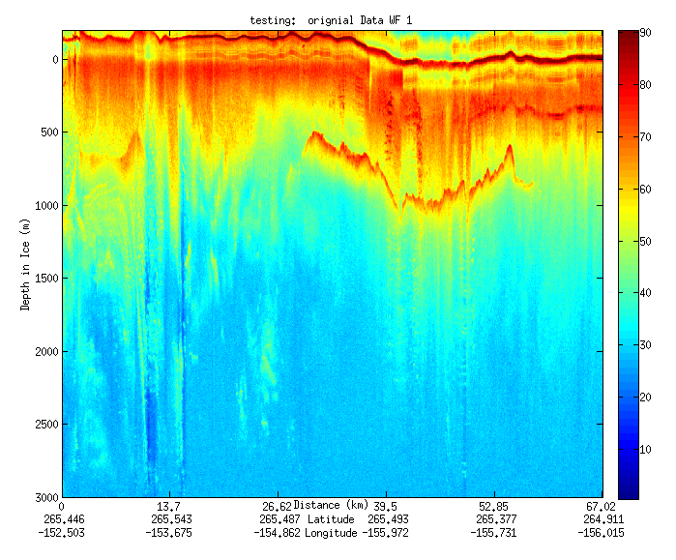
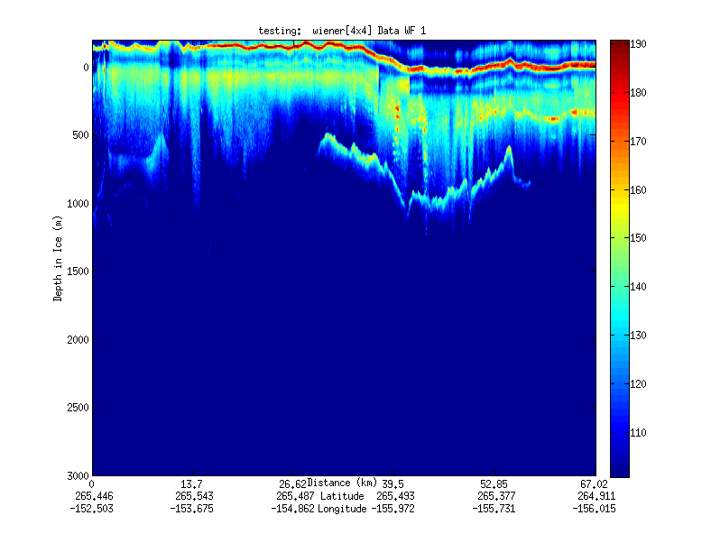
Geospatial Examples on Cloud Infrastructure
Image processing and mining
  SAR Images from Polar Grid (Matlab)
  Apply to 20 TB of data
  Could use MapReduce
Flood modeling
  Chaining flood models over a geographic area.
  Parameter fits and inversion problems.
  Deploy Services on Clouds – current models do not need parallelism
Real time GPS processing (QuakeSim)
  Services and Brokers (publish subscribe Sensor Aggregators) on clouds
  Performance issues not critical
Filter

Slide 7
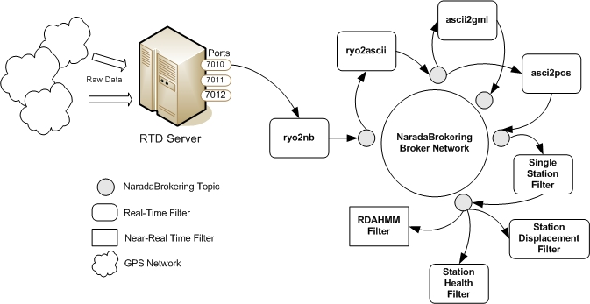
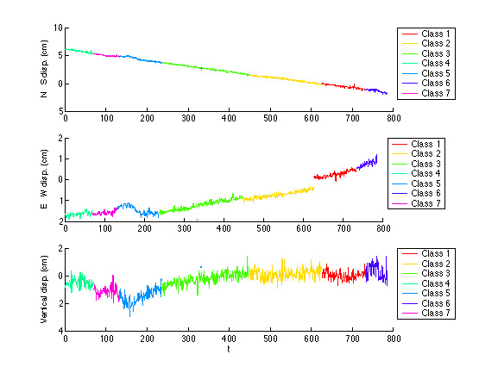
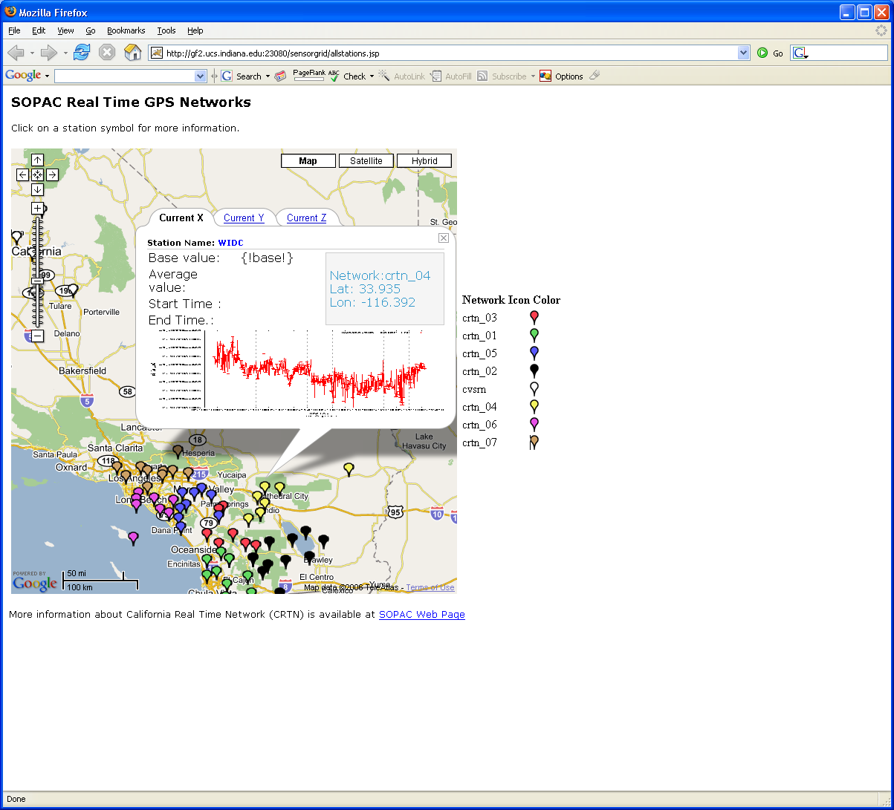
Real-Time GPS Sensor Data-Mining
Services process real time data from ~70 GPS Sensors in Southern California
Brokers and Services on Clouds – no major performance issues
CRTN GPS
Earthquake
Streaming Data
Support
Transformations
Data Checking
Archival
Hidden Markov
Datamining (JPL)
Display (GIS)
Real Time
7
Notes:
7

Slide 8
Application Classes
In the past I discussed application—parallel software/hardware in terms of 5 “Application Architecture” Structures
  1) Synchronous – Lockstep Operation as in SIMD architectures
  2) Loosely Synchronous – Iterative Compute-Communication stages with independent compute (map) operations for each CPU. Heart of most MPI jobs
  3) Asynchronous – Compute Chess; Combinatorial Search often supported by dynamic threads
  4) Pleasingly Parallel – Each component independent – in 1988, I estimated at 20% total in hypercube conference
  5) Metaproblems – Coarse grain (asynchronous) combinations of classes 1)-4). The preserve of workflow.
Grids greatly increased work in classes 4) and 5)
The above largely described simulations and not data processing. Now we should admit the class which crosses classes 2) 4) 5) above
  6) MapReduce++ which describe file(database) to file(database) operations
  6a) Pleasing Parallel Map Only
  6b) Map followed by reductions
  6c) Iterative “Map followed by reductions” – Extension of Current Technologies that supports much linear algebra and datamining
Note overheads in 1) 2) 6c) go like Communication Time/Calculation Time and basic MapReduce pays file read/write costs while MPI is microseconds

Slide 9
Applications & Different Interconnection Patterns
Map Only | Classic MapReduce | Iterative Reductions | Loosely Synchronous
CAP3 Analysis Document conversion (PDF -> HTML) Brute force searches in cryptography Parametric sweeps | High Energy Physics (HEP) Histograms Distributed search Distributed sorting Information retrieval | Expectation maximization algorithms Clustering Linear Algebra | Many MPI scientific applications utilizing wide variety of communication constructs including local interactions
- CAP3 Gene Assembly - PolarGrid Matlab data analysis | - Information Retrieval - HEP Data Analysis - Calculation of Pairwise Distances for ALU Sequences | Kmeans Deterministic Annealing Clustering - Multidimensional Scaling MDS | - Solving Differential Equations and - particle dynamics with short range forces
Input
iterations
Input
Input
map
map
map
Pij
reduce
Output
reduce
Domain of MapReduce and Iterative Extensions
MPI

Slide 10
Cluster Configurations
Feature | GCB-K18 @ MSR | iDataplex @ IU | Tempest @ IU
CPU | Intel Xeon CPU L5420 2.50GHz | Intel Xeon CPU L5420 2.50GHz | Intel Xeon CPU E7450 2.40GHz
# CPU /# Cores per node | 2 / 8 | 2 / 8 | 4 / 24
Memory | 16 GB | 32GB | 48GB
# Disks | 2 | 1 | 2
Network | Giga bit Ethernet | Giga bit Ethernet | Giga bit Ethernet / 20 Gbps Infiniband
Operating System | Windows Server Enterprise - 64 bit | Red Hat Enterprise Linux Server -64 bit | Windows Server Enterprise - 64 bit
# Nodes Used | 32 | 32 | 32
Total CPU Cores Used | 256 | 256 | 768
DryadLINQ
Hadoop / MPI
DryadLINQ / MPI

Slide 11


CAP3 - DNA Sequence Assembly Program
EST (Expressed Sequence Tag) corresponds to messenger RNAs (mRNAs) transcribed from the genes residing on chromosomes. Each individual EST sequence represents a fragment of mRNA, and the EST assembly aims to re-construct full-length mRNA sequences for each expressed gene.
Input files (FASTA)
GCB-K18-N01
\DryadData\cap3\cap3data
10
0,344,CGB-K18-N01
1,344,CGB-K18-N01
…
9,344,CGB-K18-N01
Cap3data.pf
V
V
Cap3data.00000000
\\GCB-K18-N01\DryadData\cap3\cluster34442.fsa
\\GCB-K18-N01\DryadData\cap3\cluster34443.fsa
...
\\GCB-K18-N01\DryadData\cap3\cluster34467.fsa
Output files
Input files
(FASTA)
IQueryable<LineRecord> inputFiles=PartitionedTable.Get <LineRecord>(uri);
IQueryable<OutputInfo> = inputFiles.Select(x=>ExecuteCAP3(x.line));
[1] X. Huang, A. Madan, “CAP3: A DNA Sequence Assembly Program,” Genome Research, vol. 9, no. 9, pp. 868-877, 1999.

Slide 12
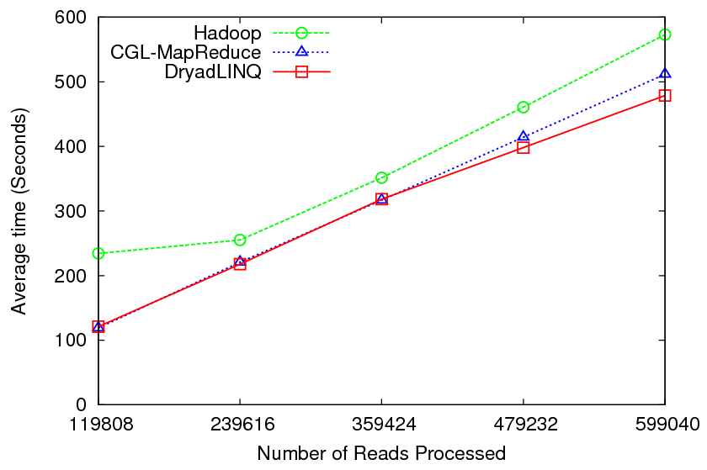
CAP3 - Performance

Slide 13
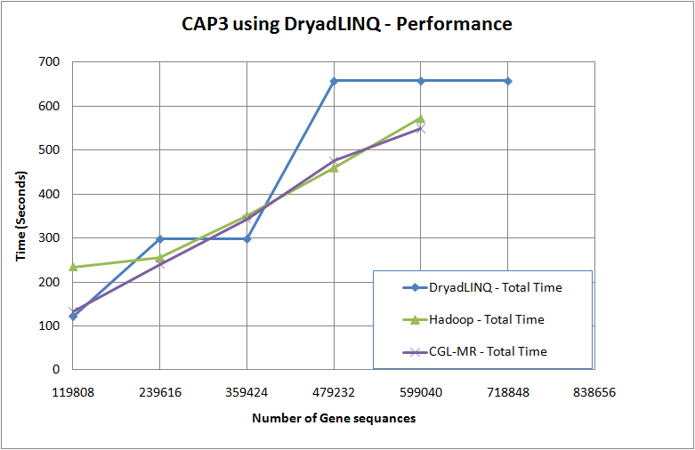
It was not so straight forward though…
Two issues (not) related to DryadLINQ
  Scheduling at PLINQ
  Performance of Threads (make processes)
Inhomogeneity in input data
Original: Fluctuating
12.5-100% utilization of CPU cores
Final
100% utilization of CPU cores

Slide 14
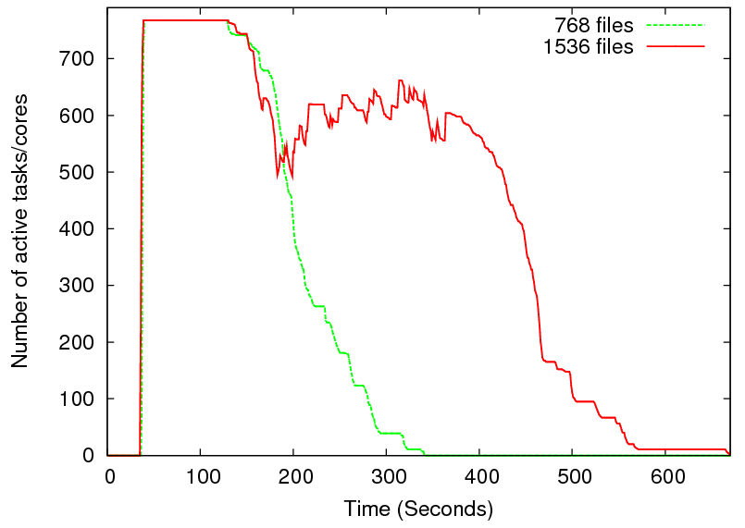
Heterogeneity in Data
2 partitions
per node
1 partition
per node
Two CAP3 tests on Tempest cluster
Long running tasks takes roughly 40% of time
Scheduling of the next partition getting delayed due to the long running tasks
Low utilization

Slide 15
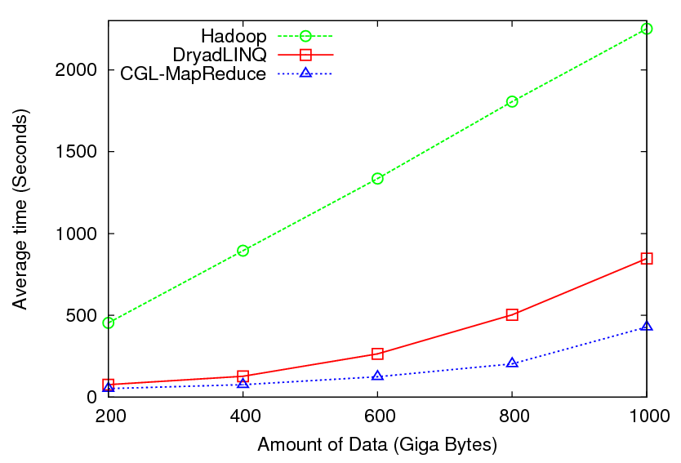

High Energy Physics Data Analysis
Histogramming of events from a large (up to 1TB) data set
Data analysis requires ROOT framework (ROOT Interpreted Scripts)
Performance depends on disk access speeds
Hadoop implementation uses a shared parallel file system (Lustre)
  ROOT scripts cannot access data from HDFS
  On demand data movement has significant overhead
Dryad stores data in local disks
  Better performance

Slide 16

Reduce Phase of Particle Physics
“Find the Higgs” using Dryad
Combine Histograms produced by separate Root “Maps” (of event data to partial histograms) into a single Histogram delivered to Client

Slide 17
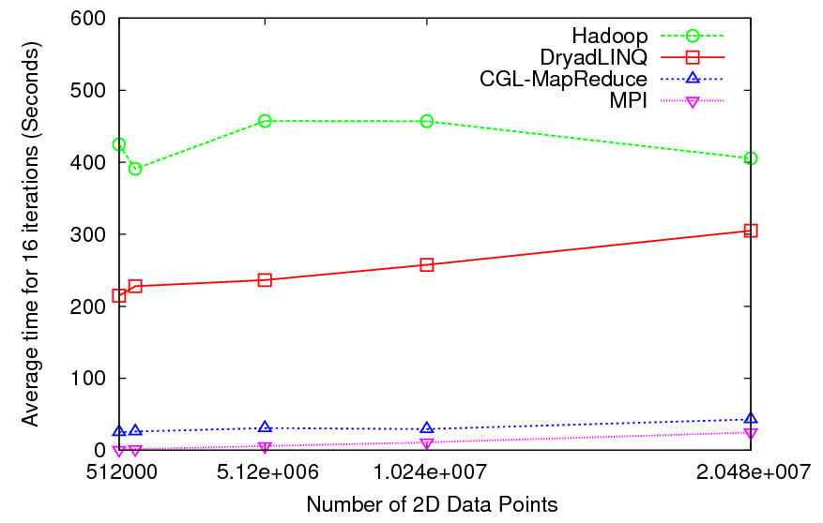

Kmeans Clustering
Time for 20 iterations
Iteratively refining operation
New maps/reducers/vertices in every iteration
File system based communication
Loop unrolling in DryadLINQ provide better performance
The overheads are extremely large compared to MPI
Large
Overheads

Slide 18
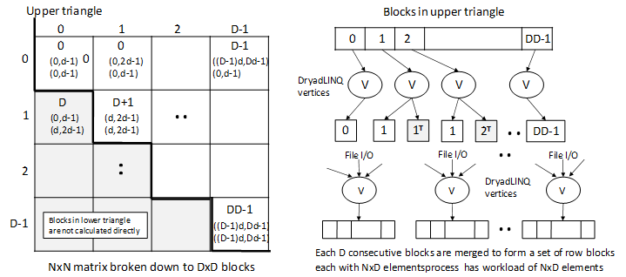
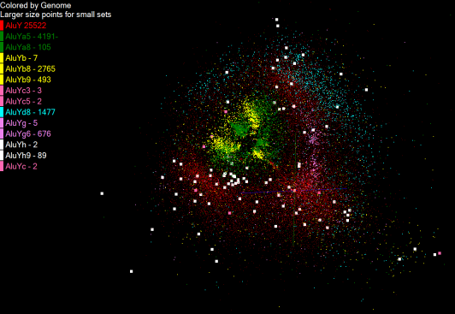
Pairwise Distances – ALU Sequencing
125 million distances
4 hours & 46 minutes
Calculate pairwise distances for a collection of genes (used for clustering, MDS)
O(N^2) problem
“Doubly Data Parallel” at Dryad Stage
Performance close to MPI
Performed on 768 cores (Tempest Cluster)
Processes work better than threads when used inside vertices
100% utilization vs. 70%
Notes:
1~180 lines without threading in DryadLINQ, with threading, it is about 400 lines
MPI ~500 lines
The Alu clustering problem [27] is one of the most challenging problems for sequencing clustering because Alus represent the largest repeat families in human genome. There are about 1 million copies of Alu sequences in human genome, in which most insertions can be found in other primates and only a small fraction (~ 7000) are human-specific. This indicates that the classification of Alu repeats can be deduced solely from the 1 million human Alu elements. Notable, Alu clustering can be viewed as a classical case study for the capacity of computational infrastructures because it is not only of great intrinsic biological interests, but also a problem of a scale that will remain as the upper limit of many other clustering problem in bioinformatics for the next few years, e.g. the automated protein family classification for a few millions of proteins predicted from large metagenomics projects. In our work here we examine Alu samples of 35339 and 50,000 sequences.

Slide 19
Dryad versus MPI for Smith Waterman
Flat is perfect scaling

Slide 20
Dryad versus MPI for Smith Waterman
Flat is perfect scaling

Slide 21
Alu and Sequencing Workflow
Data is a collection of N sequences – 100’s of characters long
  These cannot be thought of as vectors because there are missing characters
  “Multiple Sequence Alignment” (creating vectors of characters) doesn’t seem to work if N larger than O(100)
Can calculate N² dissimilarities (distances) between sequences (all pairs)
Find families by clustering (much better methods than Kmeans). As no vectors, use vector free O(N²) methods
Map to 3D for visualization using Multidimensional Scaling MDS – also O(N²)
N = 50,000 runs in 10 hours (all above) on 768 cores
Our collaborators just gave us 170,000 sequences and want to look at 1.5 million – will develop new algorithms!
MapReduce++ will do all steps as MDS, Clustering just need MPI Broadcast/Reduce

Slide 22


Slide 23
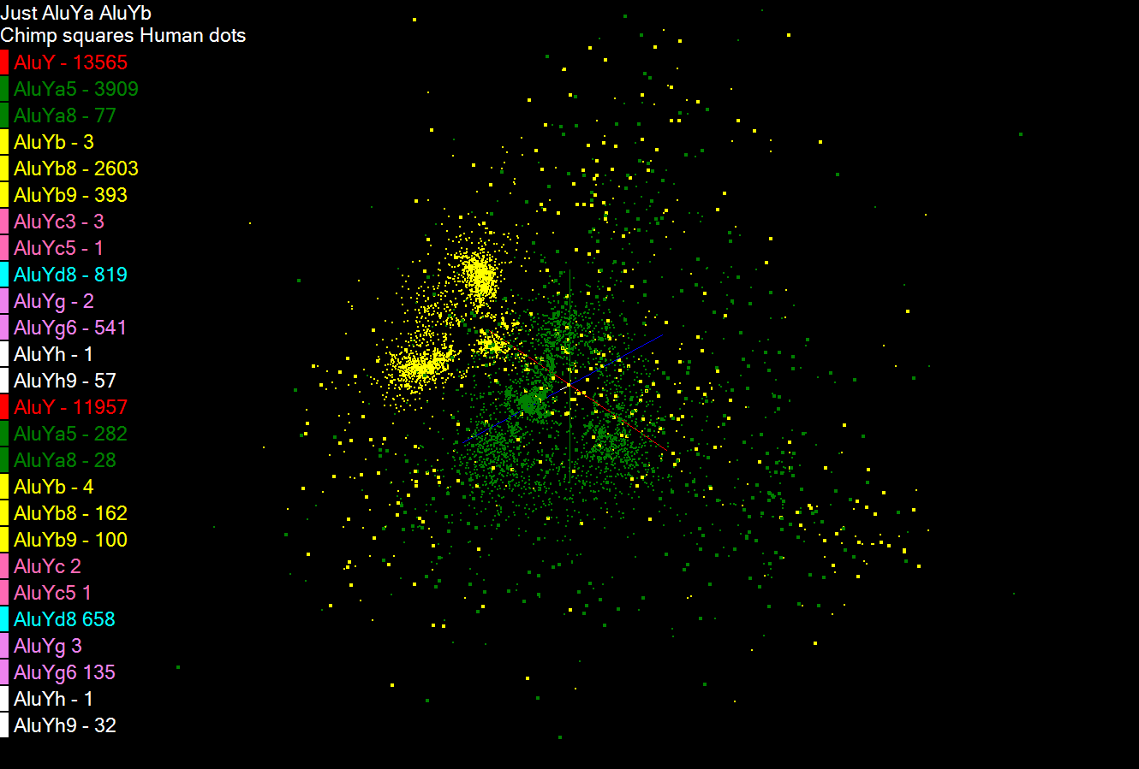

Slide 24
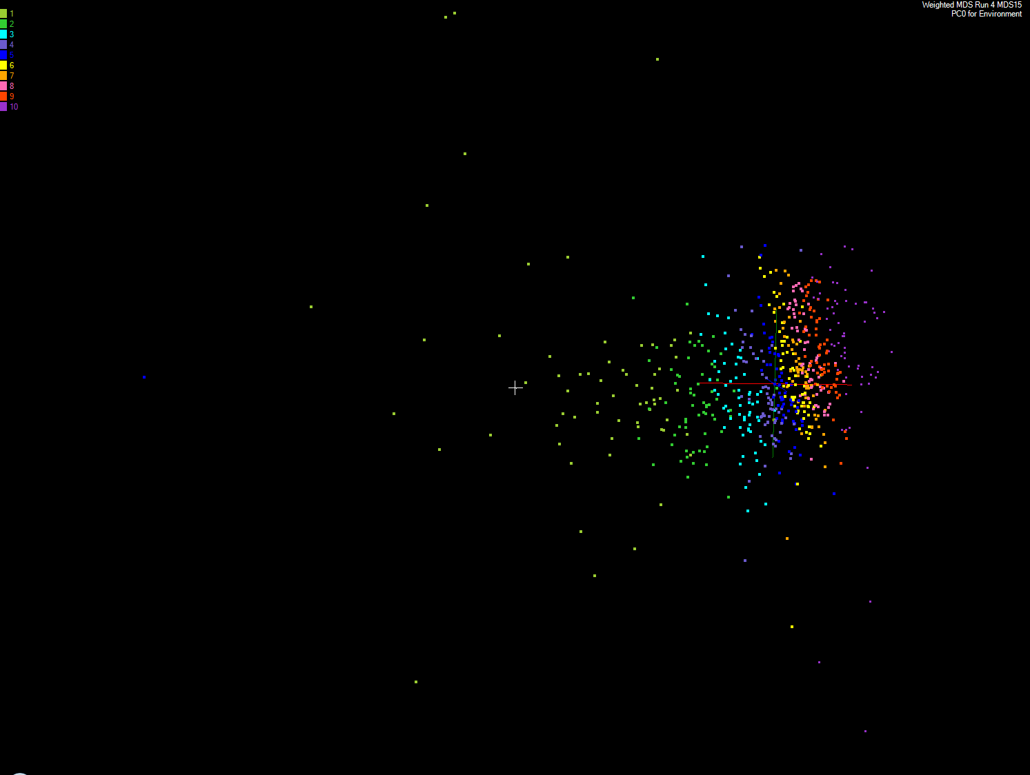
Apply MDS to Patient Record Data
and correlation to GIS properties
MDS and Primary PCA Vector
MDS of 635 Census Blocks with 97 Environmental Properties
Shows expected Correlation with Principal Component – color varies from greenish to reddish as projection of leading eigenvector changes value
Ten color bins used

Slide 25
Some File Parallel Examples from Indiana University Biology Dept.
EST (Expressed Sequence Tag) Assembly: 2 million mRNA sequences generates 540000 files taking 15 hours on 400 TeraGrid nodes (CAP3 run dominates)
MultiParanoid/InParanoid gene sequence clustering: 476 core years just for Prokaryotes
Population Genomics: (Lynch) Looking at all pairs separated by up to 1000 nucleotides
Sequence-based transcriptome profiling: (Cherbas, Innes) MAQ, SOAP
Systems Microbiology (Brun) BLAST, InterProScan
Metagenomics (Fortenberry, Nelson) Pairwise alignment of 7243 16s sequence data took 12 hours on TeraGrid
Study of Alu Sequences (Tang) – will increase current 35339 to 170,000; want 1.5 million in a related study
All can use Dryad (for major parts of computation)

Slide 26
Parallel Runtimes – DryadLINQ vs. Hadoop
Feature | Dryad/DryadLINQ | Hadoop
Programming Model & Language Support | DAG based execution flows. Programmable via C# DryadLINQ Provides LINQ programming API for Dryad | MapReduce Implemented using Java Other languages are supported via Hadoop Streaming
Data Handling | Shared directories/ Local disks | HDFS
Intermediate Data Communication | Files/TCP pipes/ Shared memory FIFO | HDFS/ Point-to-point via HTTP
Scheduling | Data locality/ Network topology based run time graph optimizations | Data locality/ Rack aware
Failure Handling | Re-execution of vertices (data replication not automatic) | Persistence via fault tolerant file system HDFS Re-execution of map and reduce tasks
Monitoring | Monitoring support for execution graphs | Monitoring support of HDFS, and MapReduce computations

Slide 27
DryadLINQ on Cloud
HPC release of DryadLINQ requires Windows Server 2008
Amazon does not provide this VM yet
Used GoGrid cloud provider
Before Running Applications
  Create VM image with necessary software
    E.g. NET framework
  Deploy a collection of images (one by one – a feature of GoGrid)
  Configure IP addresses (requires login to individual nodes)
  Configure an HPC cluster
  Install DryadLINQ
  Copying data from “cloud storage”
  We configured a 32 node virtual cluster in GoGrid

Slide 28
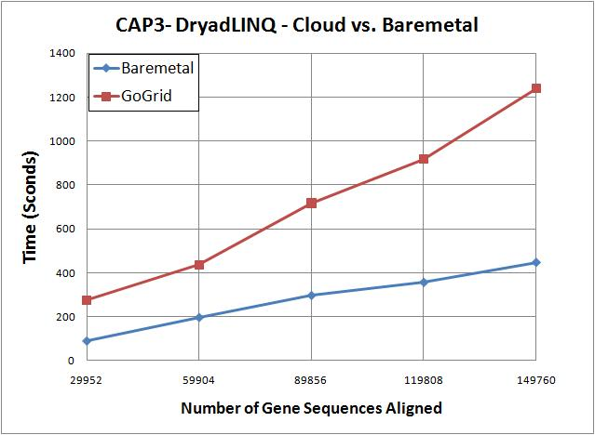
DryadLINQ on Cloud contd..
CAP3 works on cloud
Used 32 CPU cores
100% utilization of virtual CPU cores
3 times more time in cloud than the bare-metal runs on different
CloudBurst and Kmeans did not run on cloud
VMs were crashing/freezing even at data partitioning
  Communication and data accessing simply freeze VMs
  VMs become unreachable
We expect some communication overhead, but the above observations are more GoGrid related than to Cloud

Slide 29
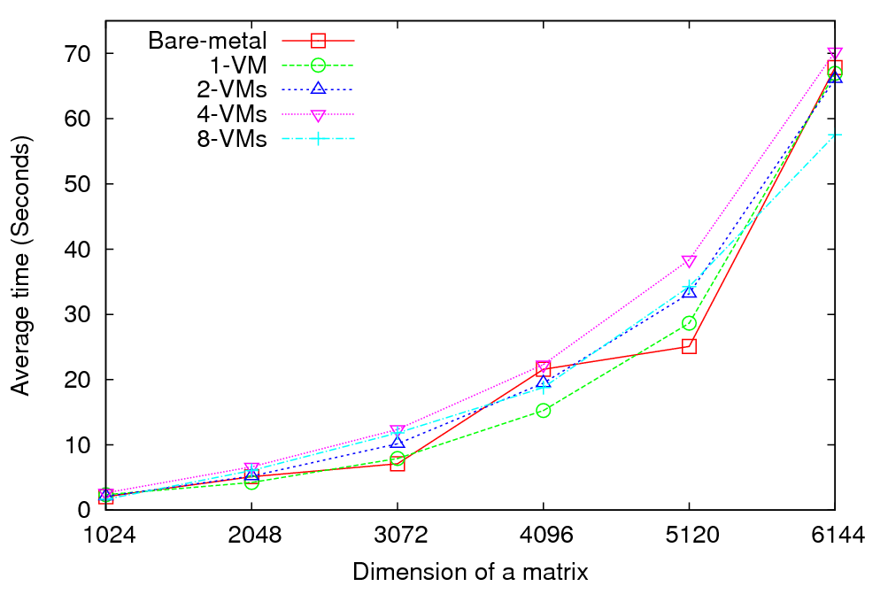
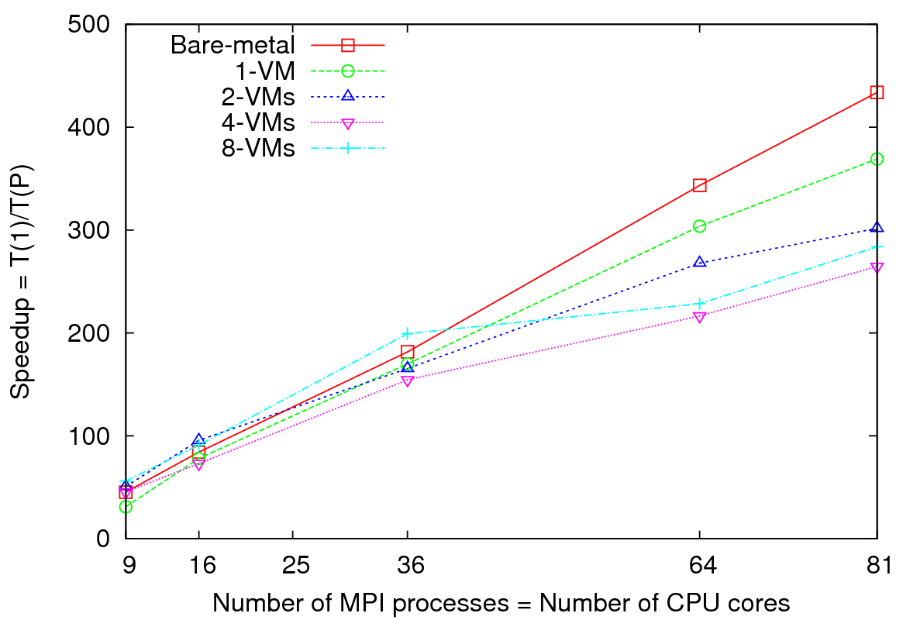
MPI on Clouds: Matrix Multiplication
Performance - 64 CPU cores
Speedup – Fixed matrix size (5184x5184)
Implements Cannon’s Algorithm [1]
Exchange large messages
More susceptible to bandwidth than latency
At 81 MPI processes, at least 14% reduction in speedup is noticeable

Slide 30
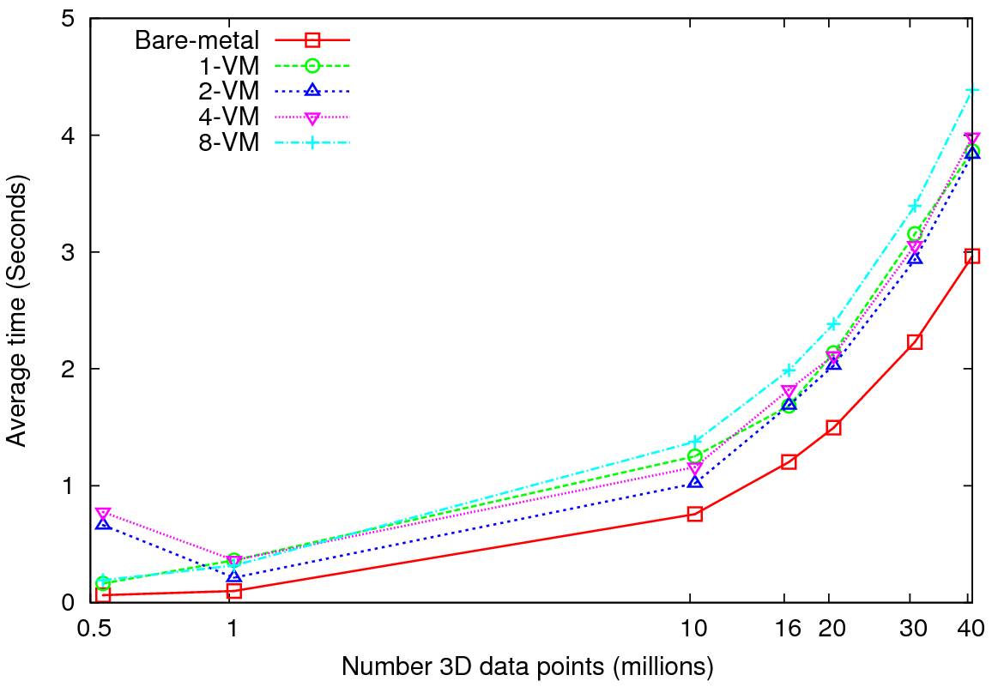
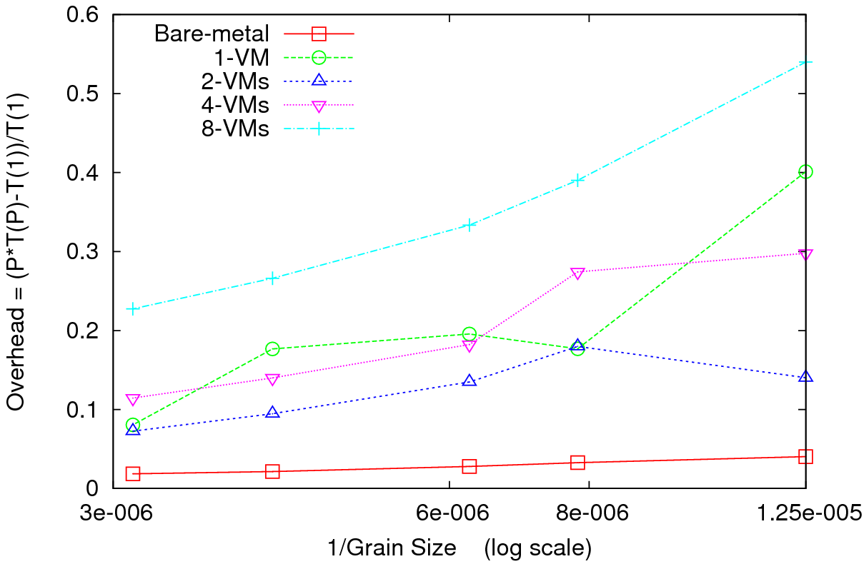
MPI on Clouds Kmeans Clustering
Performance – 128 CPU cores
Overhead
Perform Kmeans clustering for up to 40 million 3D data points
Amount of communication depends only on the number of cluster centers
Amount of communication << Computation and the amount of data processed
At the highest granularity VMs show at least 3.5 times overhead compared to bare-metal
Extremely large overheads for smaller grain sizes

Slide 31
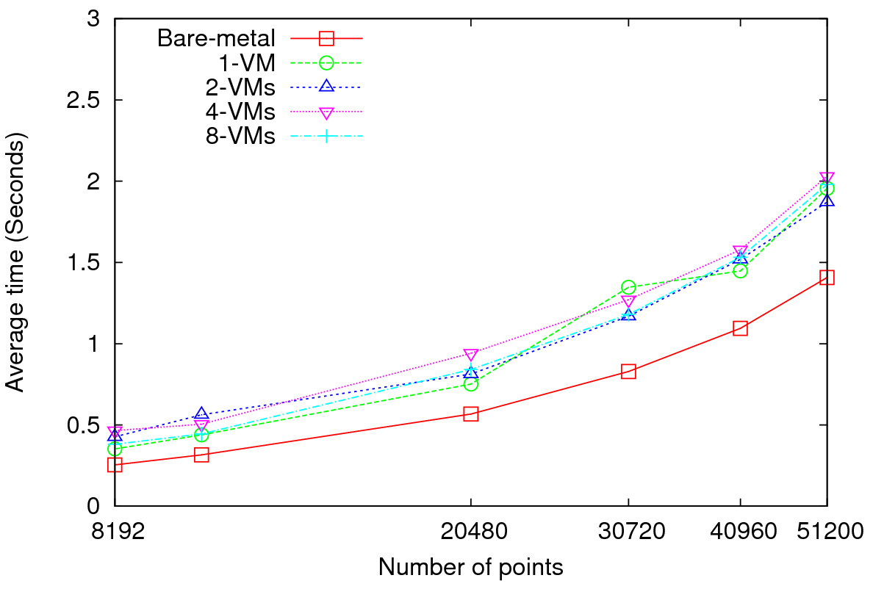
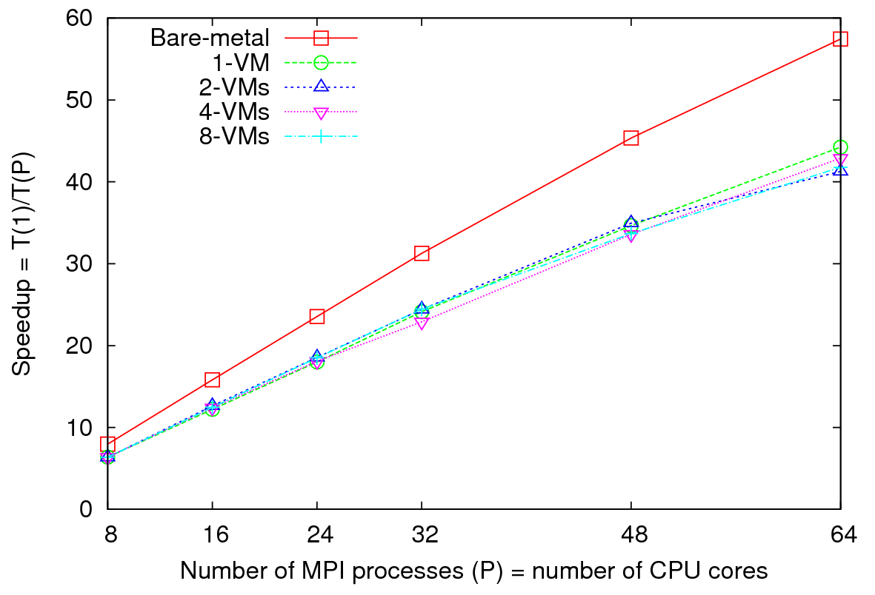
MPI on Clouds
Parallel Wave Equation Solver
Performance - 64 CPU cores
Total Speedup – 30720 data points
Clear difference in performance and speedups between VMs and bare-metal
Very small messages (the message size in each MPI_Sendrecv() call is only 8 bytes)
More susceptible to latency
At 51200 data points, at least 40% decrease in performance is observed in VMs

Slide 32
Data Intensive Architecture
Instruments
User Data
Files
Files
Files
Visualization
User Portal
Knowledge
Discovery
Users
Files
Files
Files
Initial
Processing
Higher Level
Processing
Such as R
PCA, Clustering
Correlations …
Maybe MPI
Prepare for
Viz
MDS

Slide 33
Conclusions
Several applications with various computation, communication, and data access requirements
All DryadLINQ applications work, and in many cases perform better than Hadoop
We can definitely use DryadLINQ (and Hadoop) for scientific analyses
We did not implement (find)
  Applications that can only be implemented using DryadLINQ but not with typical MapReduce
Current release of DryadLINQ has some performance limitations
DryadLINQ hides many aspects of parallel computing from user
Coding is much simpler in DryadLINQ than Hadoop (provided that the performance issues are fixed)
Key issue is support of inhomogeneous data

Slide 34
Notes on Performance
Speed up = T(1)/T(P) = ε (efficiency ) P
  with P processors
Overhead f = (PT(P)/T(1)-1) = (1/ε -1)
is linear in overheads and usually best way to record results if overhead small
For MPI communication f ∝ ratio of data communicated to calculation complexity = n^{-0.5} for matrix multiplication where n (grain size) matrix elements per node
MPI Communication Overheads decrease in size as problem sizes n increase (edge over area rule)
Dataflow communicates all data – Overhead does not decrease
Scaled Speed up: keep grain size n fixed as P increases
Conventional Speed up: keep Problem size fixed n ∝ 1/P
VMs and Windows Threads have runtime fluctuation /synchronization overheads

Slide 35
Gene Sequencing Application
This is first filter in Alu Gene Sequence study – find Smith Waterman dissimilarities between genes
Essentially embarrassingly parallel
Note MPI faster than threading
All 35,229 sequences require 624,404,791 pairwise distances = 2.5 hours with some optimization
This includes calculation and needed I/O to redistribute data)
Parallel Overhead =
(Number of Processes/Speedup) - 1
Two data
set sizes

Slide 36
Why Gather/ Scatter Operation Important
There is a famous factor of 2 in many O(N²) parallel algorithms
We initially calculate in parallel Distance(i,j) between points (sequences) i and j.
  Done in parallel over all processor nodes for say i < j
However later parallel algorithms may want specific Distance(i,j) in specific machines
Our MDS and PWClustering algorithms require each of N processes has 1/N of sequences and for this subset {i} Distance({i},j) for ALL j. i.e. wants both Distance(i,j) and Distance(j,i) stored (in different processors/disk)
The different distributions of Distance(i,j) across processes is in MPI called a scatter or gather operation. This time is included in previous SW timings and is about half total time
  We did NOT get good performance here from either MPI (it should be a seconds on Petabit/sec Infiniband switch) or Dryad
  We will make needed primitives precise and greatly improve performance here

Slide 37
High Performance Robust Algorithms
We suggest that the data deluge will demand more robust algorithms in many areas and these algorithms will be highly I/O and compute intensive
Clustering N= 200,000 sequences using deterministic annealing will require around 750 cores and this need scales like N²
NSF Track 1 – Blue Waters in 2011 – could be saturated by 5,000,000 point clustering

Slide 38
High end Multi Dimension scaling MDS
Given dissimilarities D(i,j), find the best set of vectors x_{i} in d (any number) dimensions minimizing
Σ_{i,j} weight(i,j) (D(i,j) – |x_{i} – x_{j}|^{n})² (*)
Weight chosen to refelect importance of point or perhaps a desire (Sammon’s method) to fit smaller distance more than larger ones
n is typically 1 (Euclidean distance) but 2 also useful
Normal approach is Expectation Maximation and we are exploring adding deterministic annealing to improve robustness
Currently mainly note (*) is “just” γ² and one can use very reliable nonlinear optimizers
  We have good results with Levenberg–Marquardt approach to γ² solution (adding suitable multiple of unit matrix to nonlinear second derivative matrix). However EM also works well
We have some novel features
  Fully parallel over unknowns x_{i}
  Allow “incremental use”; fixing MDS from a subset of data and adding new points
  Allow general d, n and weight(i,j)
  Can optimally align different versions of MDS (e.g. different choices of weight(i,j) to allow precise comparisons
Feeds directly to powerful Point Visualizer

Slide 39
Deterministic Annealing Clustering
Clustering methods like Kmeans very sensitive to false minima but some 20 years ago an EM (Expectation Maximization) method using annealing (deterministic NOT Monte Carlo) developed by Ken Rose (UCSB), Fox and others
Annealing is in distance resolution – Temperature T looks at distance scales of order T^{0.5}.
Method automatically splits clusters where instability detected
Highly efficient parallel algorithm
Points are assigned probabilities for belonging to a particular cluster
Original work based in a vector space e.g. cluster has a vector as its center
Major advance 10 years ago in Germany showed how one could use vector free approach – just the distances D(i,j) at cost of O(N²) complexity.
We have extended this and implemented in threading and/or MPI
We will release this as a service later this year followed by vector version
  Gene Sequence applications naturally fit vector free approach.

Slide 40
Key Features of our Approach
Initially we will make key capabilities available as services that we eventually be implemented on virtual clusters (clouds) to address very large problems
  Basic Pairwise dissimilarity calculations
  R (done already by us and others)
  MDS in various forms
  Vector and Pairwise Deterministic annealing clustering
Point viewer (Plotviz) either as download (to Windows!) or as a Web service
Note all our code written in C# (high performance managed code) and runs on Microsoft HPCS 2008 (with Dryad extensions)

Slide 41
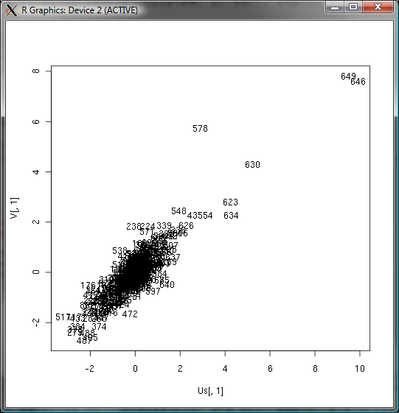
Canonical Correlation
Choose vectors a and b such that the random variables U = a^{T}.X and V = b^{T}.Y maximize the correlation
ρ= cor(a^{T}.X, b^{T}.Y).
X Environmental Data
Y Patient Data
Use R to calculate ρ = 0.76

Slide 42
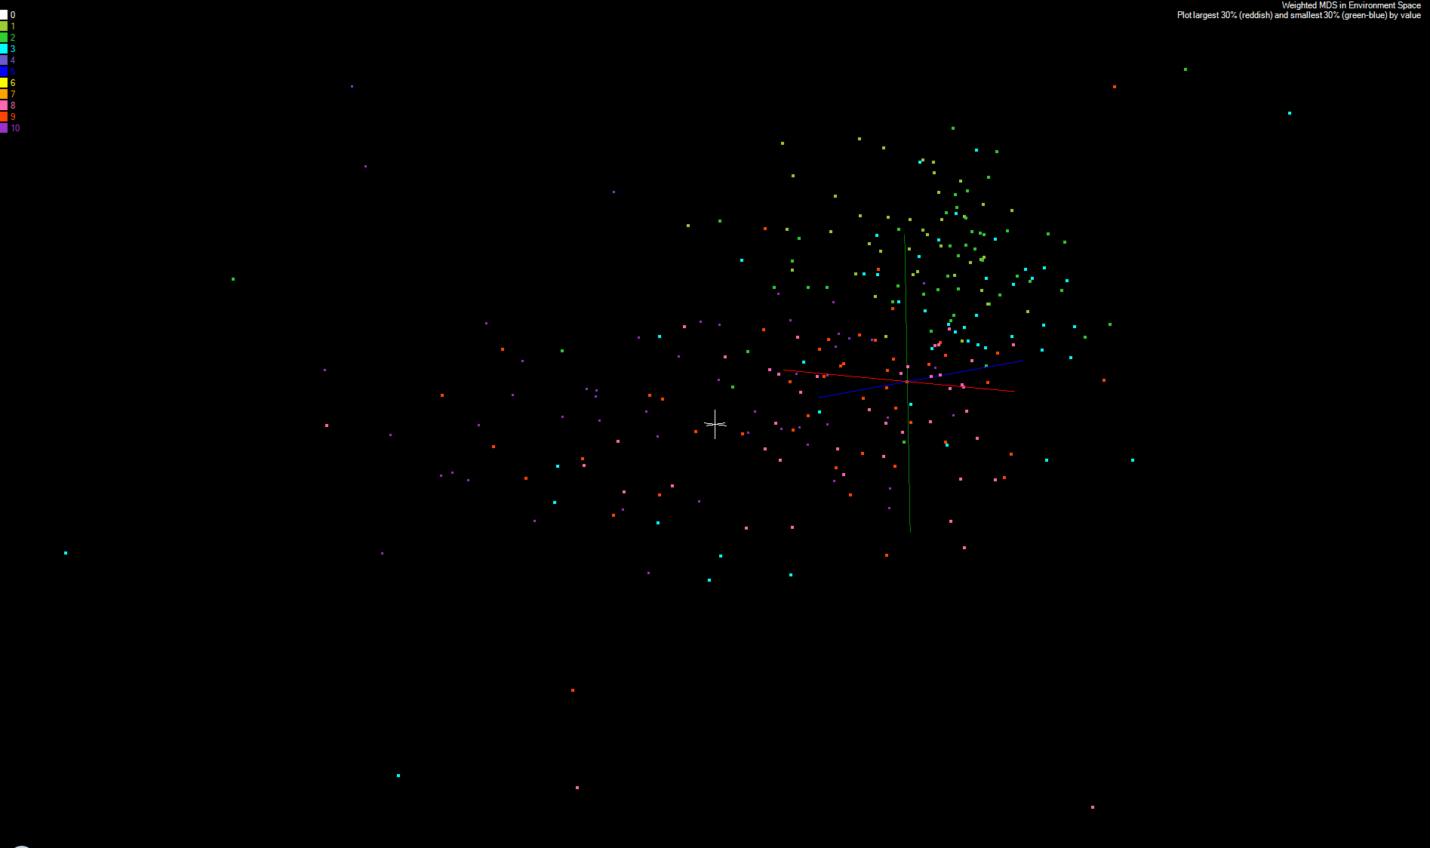
MDS and Canonical Correlation
Projection of First Canonical Coefficient between Environment and Patient Data onto Environmental MDS
Keep smallest 30% (green-blue) and top 30% (red-orchid) in numerical value
Remove small values < 5% mean in absolute value

Slide 43
References
K. Rose, "Deterministic Annealing for Clustering, Compression, Classification, Regression, and Related Optimization Problems," Proceedings of the IEEE, vol. 80, pp. 2210-2239, November 1998
T Hofmann, JM Buhmann Pairwise data clustering by deterministic annealing, IEEE Transactions on Pattern Analysis and Machine Intelligence 19, pp1-13 1997
Hansjörg Klock and Joachim M. Buhmann Data visualization by multidimensional scaling: a deterministic annealing approach Pattern Recognition Volume 33, Issue 4, April 2000, Pages 651-669
Granat, R. A., Regularized Deterministic Annealing EM for Hidden Markov Models, Ph.D. Thesis, University of California, Los Angeles, 2004. We use for Earthquake prediction
Geoffrey Fox, Seung-Hee Bae, Jaliya Ekanayake, Xiaohong Qiu, and Huapeng Yuan, Parallel Data Mining from Multicore to Cloudy Grids, Proceedings of HPC 2008 High Performance Computing and Grids Workshop, Cetraro Italy, July 3 2008
Project website: www.infomall.org/salsa

Slide 44
Lower triangle
0
1
2
N-1
0
Blocks in upper triangle
are not calculated directly
0
1
(1,0)
1
2
2
(2,0)
(2,1)
..
..
N(N-1)/2
N-1
(N-1,N-2)
Space filling curve

Slide 45
 |  |  | M =
0
1
Nx(N-1)/2
..
MPI
P₀
P₁
P_{P}
..
Threading
T₀
T₀
T₀
T₀
T₀
T₀
M/P
M/P
Indexing
M/P
File I/O
_{I/O}
_{I/O}
_{I/O}
..
Merge files
Each process has workload of M/P elements

Slide 46
D blocks
β
Process
P₀
P₁
P₂
P_{DD-1}
0
D-1
0
Upper Triangle
Calculate if
α + β even
1
2
D blocks
α
Lower Triangle
Calculate if
α + β odd
D-1

Slide 47
D blocks
β
Process
P₀
P₁
P₂
P_{P-1}
0
1
2
D-1
0
Not
Calculate
Send
to P2
Send
to PD-1
1
Send
to P0
Send
to PD-1
2
Not
Calculate
Send
to P1
Send
to PD-1
D blocks
α
D-1
Not
Calculate
Send
to P1

Slide 48
Scheduling of Tasks
DryadLINQ Job
Partitions
/vertices
DryadLINQ schedules
Partitions to nodes
Hadoop Schedules map/reduce tasks
directly to CPU cores
1
PLINQ sub tasks
PLINQ explores
Further parallelism
2
Threads
Threads map PLINQ
Tasks to CPU cores
3
CPU cores
Problem
1
4 CPU cores
4 CPU cores
Partitions
1
2
3
Time
Partitions
1
2
3
Time
Better utilization when tasks are homogenous
Under utilization when tasks are non-homogenous

Slide 49
Scheduling of Tasks contd..
Problem
2
PLINQ Scheduler and coarse grained tasks
E.g. A data partition contains 16 records, 8 CPU cores in a node of MSR Cluster
We expect the scheduling of tasks to be as follows
X-ray tool shows this ->
8 CPU cores
100% 50% 50%
utilization of CPU cores
Heuristics at PLINQ (version 3.5) scheduler does not seem to work well for coarse grained tasks
Workaround
  Use “Apply” instead of “Select”
  Apply allows iterating over the complete partition (“Select” allows accessing a single element only)
  Use multi-threaded program inside “Apply” (Ugly solution invoking processes!)
  Bypass PLINQ
Problem
3
Discussed Later

