Slide 1
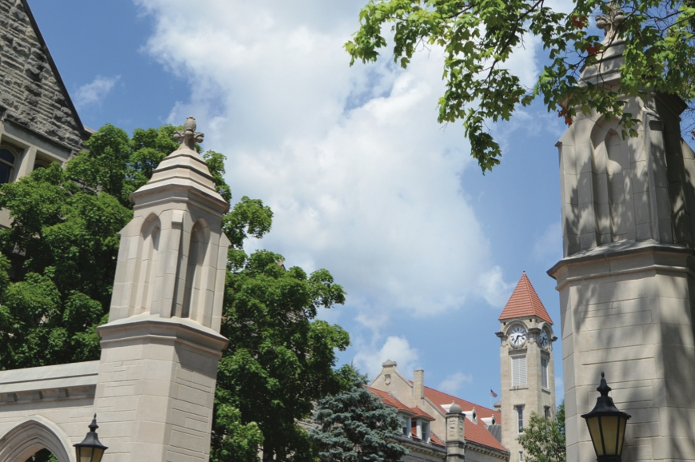
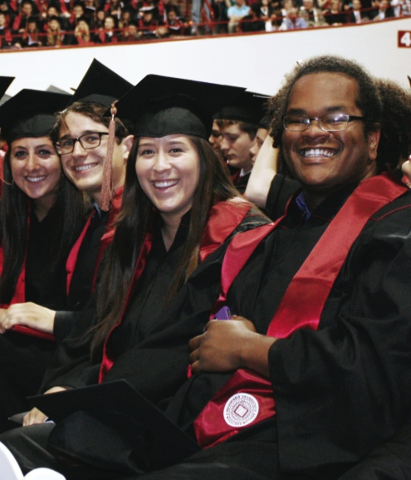
Graduate Student Orientation August 13, 2018
INTELLIGENT SYSTEMS ENGINEERING
INDIANA UNIVERSITY BLOOMINGTON

Slide 2
Hello! New Graduate Students
Third year of Ph.D. and Undergraduate
First year of Masters
Current PhD population- 40
Incoming class of PhD students: 23
Incoming class of MS - 10
New students hail from - Columbia, China, India, Pakistan, Turkey, Sri Lanka, South Korea and the USA.

Slide 3
History of SICE
2000: School of Informatics established—first of its kind in the United States.
2005: Computer Science (established in 1971) becomes part of the school
2009: Becomes School of Informatics and Computing
2013: Library and Information Science (established in 1951) joins the school
2015: Data Science Program launched
2016: Intelligent Systems Engineering launches
2017: Becomes School of Informatics, Computing, and Engineering

Slide 4
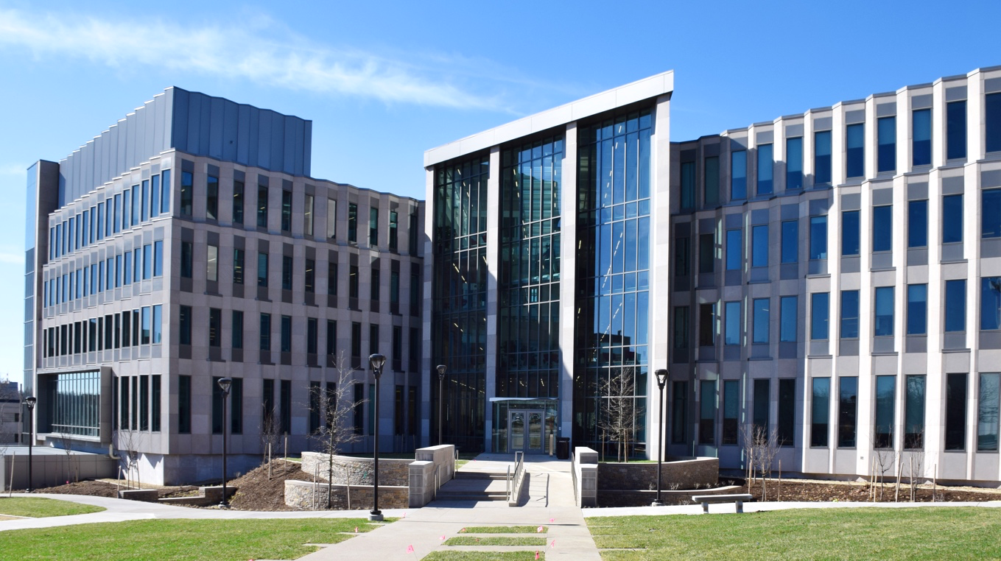
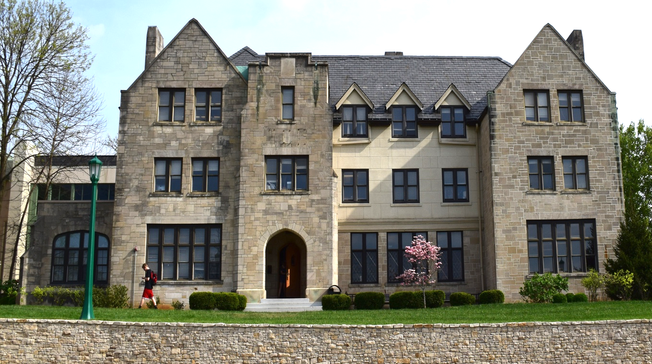
Size of School (2017-18)
Faculty
Students
Research Expenditures
129
(101 Tenure Track)
Undergraduate
1,904
Graduate Students
1,101
$13M
(2017-2018)

Slide 5
Undergraduate Degrees
Computer Science (B.S. and B.A.)
Informatics (B.S.)
Intelligent Systems Engineering (B.S.)
CE, CPS, Nanoengineering, Bioengineering
Ph. D. Degrees
Computer Science
Informatics
Information Science
Intelligent Systems Engineering
6 Tracks (4 UG tracks plus environmental and Neuro-engineering)
Master’s Degrees
Bioinformatics
Computer Science
Data Science (online, in residence, or hybrid)
Human-Computer Interaction/Design
Informatics
Information Science
Intelligent Systems Engineering
Same 6 tracks as Ph.D.
Library Science
Secure Computing

Slide 6
What is Intelligent Systems Engineering?

Slide 7
ISE is:
The practice of system design and building with computing and artificial intelligence as key components:
Intelligent Systems – sense their environment, act accordingly—and use machine learning, artificial intelligence with edge (small devices), and cloud computing
Systems Engineering – design of systems that are the complex interrelation of many elements
Intelligent Systems are purpose-engineered systems—from the raw hardware and embedded systems; through data acquisition and signal processing; and to the transformation of data into decisions and/or knowledge.

Slide 8
What is ISE? (continued)
From the small to the large:
Edge Computing: Embedded Systems and Nanoscale Sensors – computing and sensing will be ubiquitous as we move toward smart homes, smart cities and smart transportation, with computing and intelligent systems helping us lead healthier lives
Cloud and High-Performance Computing – behind all of these edge devices are massive systems that analyze and manage the floods of data that are being produced; they also allow modelling and simulation of the engineered systems
Microsoft Research is building the Global AI Supercomputer linking the Intelligent Cloud to the Intelligent Edge
All students have courses on edge, cloud, HPC systems, machine learning and modelling and simulation.

Slide 9
How is ISE Different?
Artificial Intelligence and Computing are at the core of our curriculum.
We built a modern curriculum that includes up-to-date content and methods.
We incorporated today’s technology and keep our pulse on what tomorrow will bring.
We looked at the field of engineering with fresh eyes without having to retrofit.

Slide 10
Intelligent Systems ~ Artificial Intelligence ~ Machine Learning
2017 Headlines
The Race For AI: Google, Twitter, Intel, Apple In A Rush To Grab Artificial Intelligence Startups
Google, Facebook, And Microsoft Are Remaking Themselves Around AI
Google: The Full Stack AI Company
Bezos Says Artificial Intelligence to Fuel Amazon's Success
Microsoft CEO says artificial intelligence is the 'ultimate breakthrough'
Tesla’s New AI Guru Could Help Its Cars Teach Themselves
Netflix Is Using AI to Conquer the World... and Bandwidth Issues
How Google Is Remaking Itself As A “Machine Learning First” Company
If You Love Machine Learning, You Should Check Out General Electric
The trouble for all of these companies is that finding the talent needed to drive all this AI work can be difficult. (That is where ISE comes in!)
Notes:
until ISE came along

Slide 11
Graduate Program in Intelligent Systems Engineering?

Slide 12
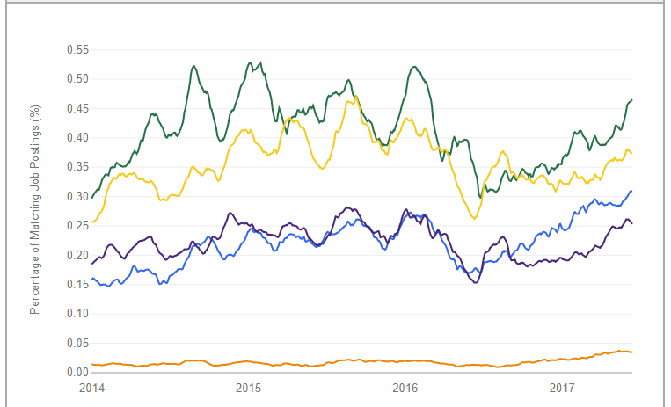
And from indeed.com the jobs are for
Big Data Engineer
Data Scientist
Machine Learning Engineer
Computer Scientist
Artificial Intelligence Engineer

Slide 13
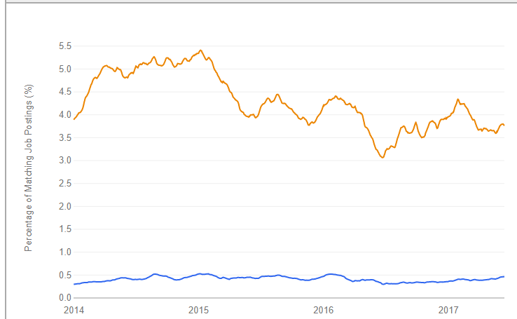
And Computer Engineering is in great demand (scale changed by a factor of 10)
https://www.indeed.com/jobtrends/q-big-data-engineer-q-computer-engineer.html
Computer Engineer
Big Data Engineer

Slide 14
Master’s & Ph.D. Engineering Tracks
Sensors, Detectors, Mobile Devices, Internet of Things, Robotics, Intelligent Systems, Big Data, HPC, Modeling and Simulation, User Interface Design, Signal Processing, Control Theory, Information Theory
BIO
ENVIRO
NANO
NEURO
CE
CPS
Master’s - 30 Credit Hours (Traditional or Accelerated)
Accelerated Masters (4+1) shares 12 credits of graduate courses between both Bachelor’s and Master’s plans of study.
Ph.D. - 90 Credit Hours

Slide 15
Facilities in Intelligent Systems Engineering
Deep Learning Laboratory (Minje Kim): Supported by the Cluster Romeo with Nvidia K80 and Volta GPU's; Tensorflow, Caffe, other software; and diverse large-scale datasets.
Cloud Computing Laboratory (Gregor von Laszewski) Multiple Docker and OpenStack Clusters
High-Performance Big Data Computing Laboratory (Judy Qiu) Haswell, Xeon Platinum and Knight’s Landing clusters. New NEC Vector machine for machine learning
Robotics and Internet of Things Laboratory (Lantao Liu): A smart network of a variety of small devices and robots. A large drone laboratory is being constructed for MESH.
Human Robotics Laboratory (Michael Ryoo) Human-like robots (still being planned)
Network Computing Laboratory (Martin Swany) focused on networked systems with embedded and reconfigurable computing elements for edge computing and the Internet of Things using a large cluster with FPGAs, network processors and software-defined network infrastructure. MESH and Luddy facilities
Visualization Laboratory (Katy Börner): Ultra-high resolution stereo display wall, HTC VIVE, and Microsoft HoloLens setups for data visualization, scientific visualization, and virtual/augmented/mixed reality R&D. Luddy facility
Medical Imaging Laboratory (Eleftherios Garyfallidis): Access to critical brain and other medical datasets. Provide software tools such as DIPY and NILEARN. Also training available for medical visualization and interactive tractography analysis. Major Open Source Software emphasis (also in HPBDC and nanoBIO)
Fibers & Additive Manufacturing Enabled Systems FAMES Laboratory (Alexander Gumennik) engineering of fibers and fabrics, embedding ensembles of nano-transducers and sensors. Major MESH Facility

Slide 16
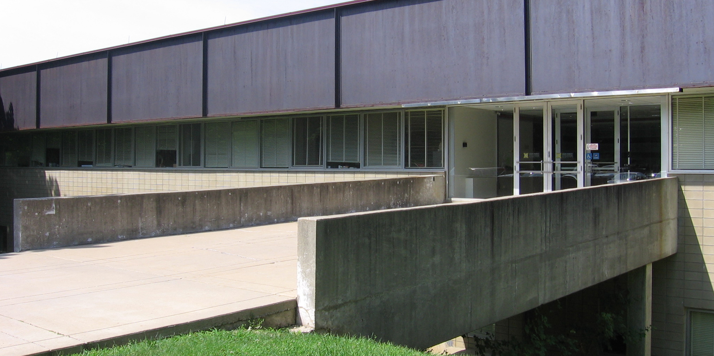
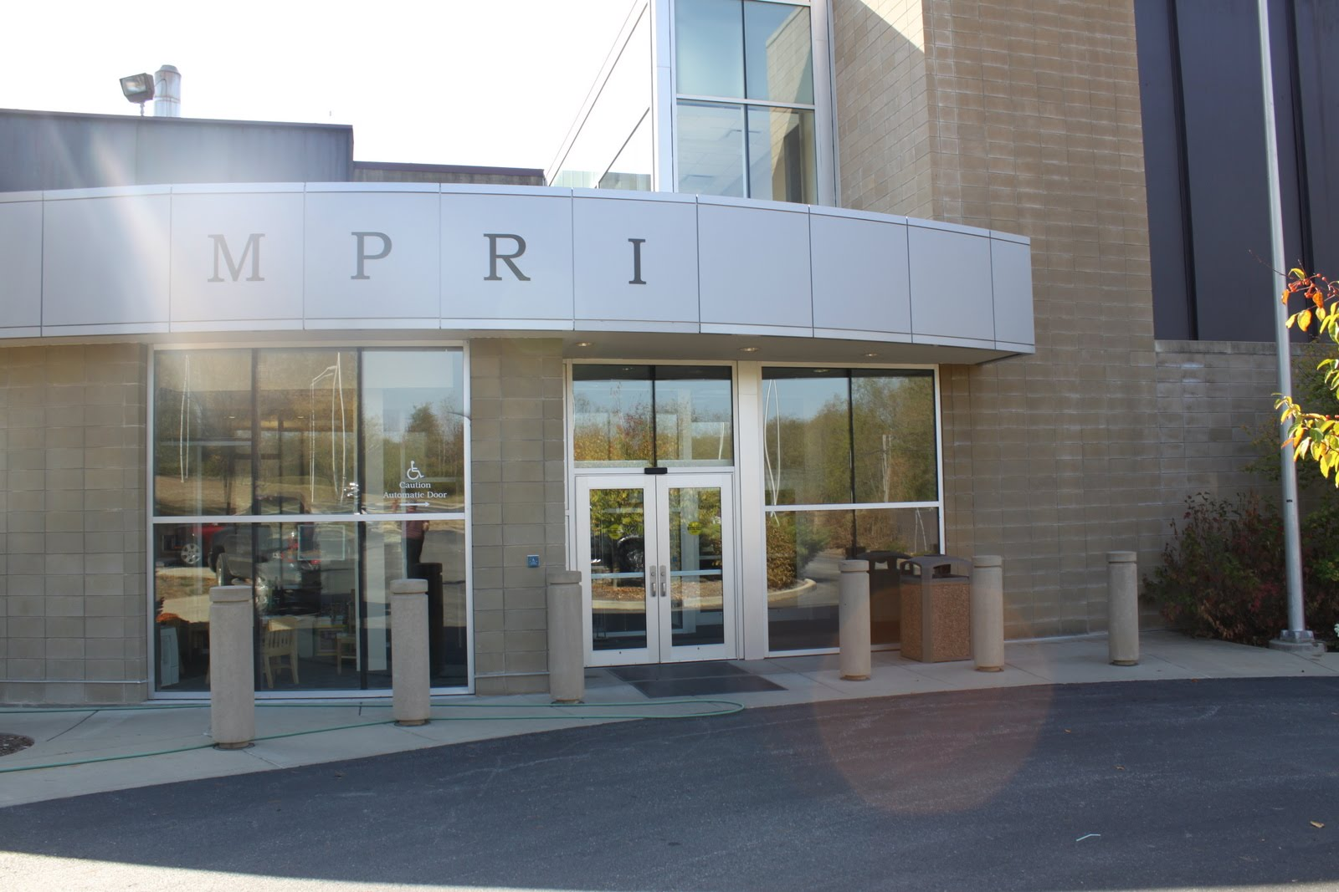
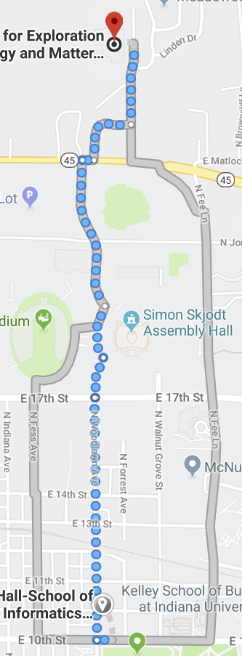
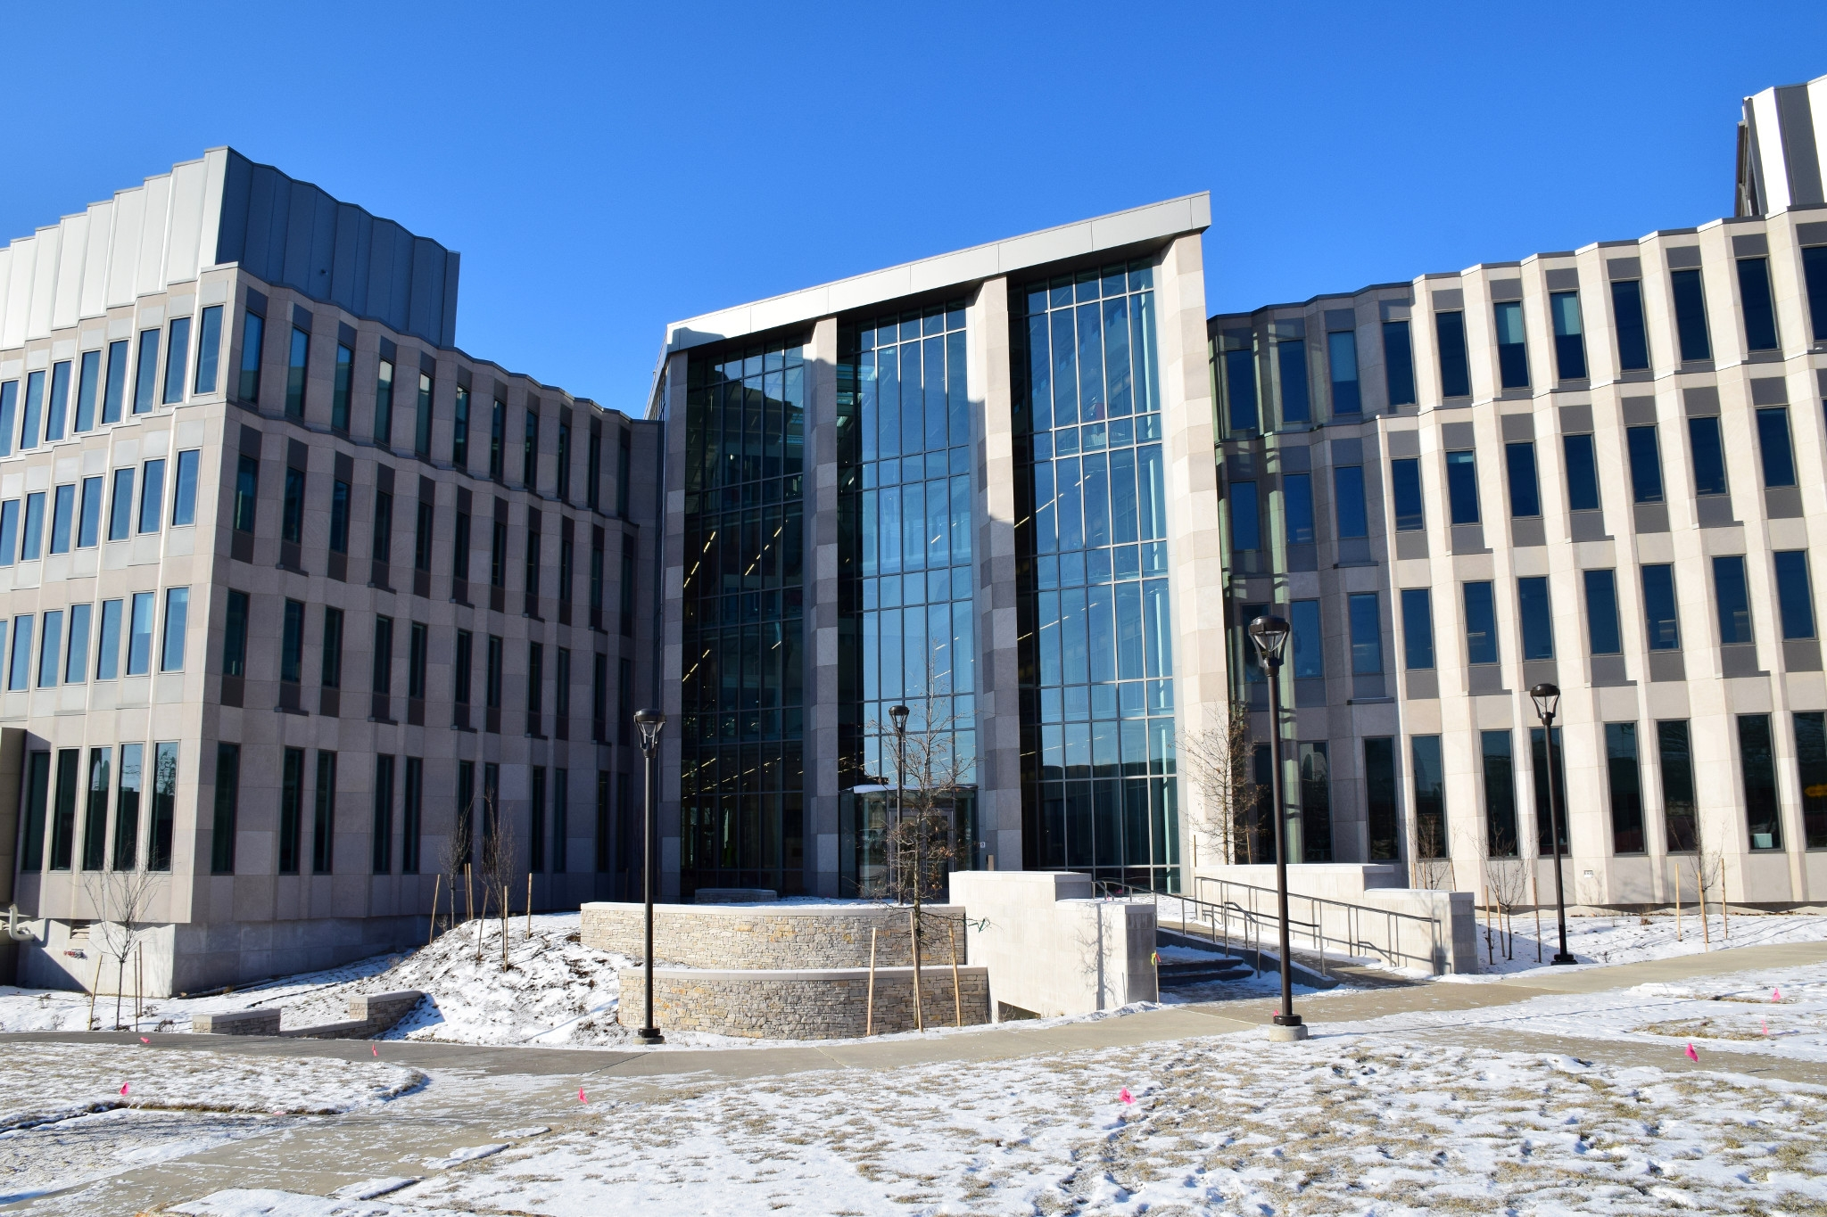
Physics
MESH
ISE
28 min (1.4 miles)
via N Woodlawn Ave
Luddy Hall. Education and ~40% Faculty
MESH major research labs and 60% Faculty
Luddy Hall
Luddy Hall

Slide 17
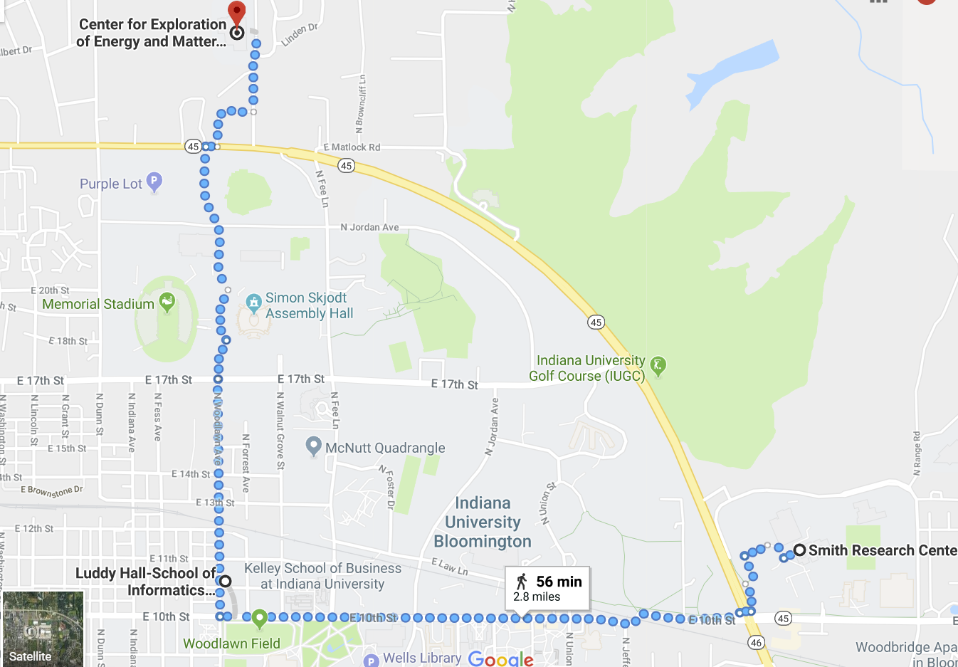
MESH
MESH still being renovated
Currently in Smith and Simon Hall for Bio
ISE will pay Uber charges
28 min (1.4 miles)
New Hospital and Biomedical Research Complex
CIB Cyberinfrastructure building
28 min (1.4 miles)

Slide 18
Meet Our Faculty
Intelligent Systems Engineering

Slide 19
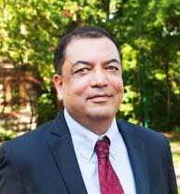
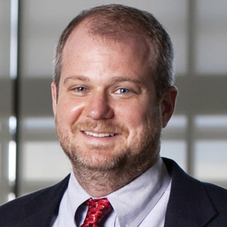
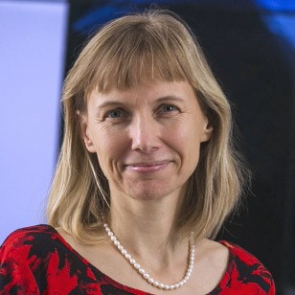
Raj Acharya, CE, Intelligent Systems: Dean of the School of Informatics and Computing, Rudy Professor of Engineering, Computer Science and Informatics
Geoffrey Fox; Chair, CPS, Intelligent Systems: IU distinguished professor, Data Analytics, Parallel computing, Physics.
Martin Swany; Associate Chair, CE, CPS: Network Systems, Embedded Systems, High-Performance Computing, Data Management
Katy Borner, Intelligent Systems: IU distinguished professor, data analysis and visualization, particularly in the areas of science and technology studies.

Slide 20
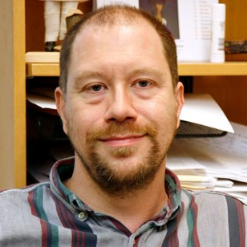
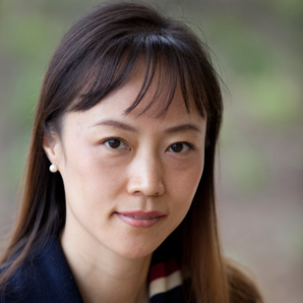
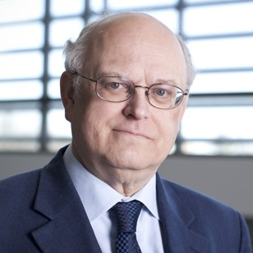
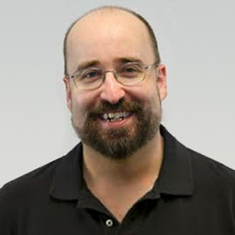
James Glazier; Bio-engineering: Biocomplexity, Virtual Tissue, toxicity.
Judy Qiu; CE, Intelligent Systems: Big Data, Cloud and Parallel Computing.
Thomas Sterling; CE, CPS: Electrical Engineering, Extreme Scale high performance hardware/software
Clint Whaley: CE: HPC Software systems, Performance Engy; Assoc Tenured LSU, Asst. Prof UTSA, PhD CS FSU 2004; MS and Researcher CS UTK, BS Math Oklahoma.

Slide 21
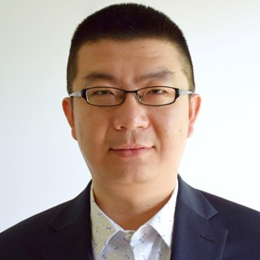
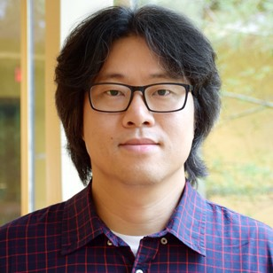
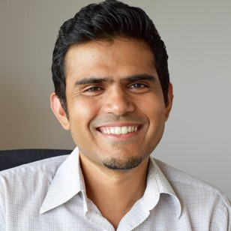
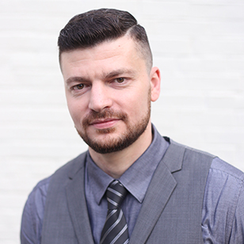
Lei Jiang, CE: HPC hardware studies; Undergrad Computer Science, MS and PhD (Pittsburgh) in Computer Engineering; Industry work with AMD as Senior Design Engineer.
Minje Kim, Intelligent Systems: signal processing & machine learning in multimedia area; Undergrad and MS in computer engineering; PhD (UIUC) in Computer Science
Vikram Jadhao, Nanoengineering: HPC simulation; Physics (UIUC PhD); Postdocs in Department of Materials Science and Engineering at Northwestern; Physics at JHU
Alexander Gumennik, Nanoengineering; Intelligent fibers & 3D printing; Physics & Math Undergraduate, Applied Physics Masters & PhD (Hebrew University), Postdoc Materials Science & Engineering (MIT), Industry Process Engineer in 3D printing

Slide 22
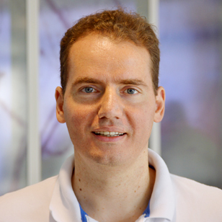
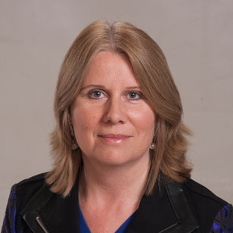
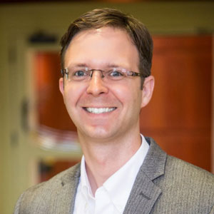
Eleftherios Garyfallidis, Neuroengineering: with software lab for MRI imaging; Undergraduate degree in Computer Science; Masters in Brain & Mind Sciences, PhD in Cognition and Brain Sciences (Neuroscience Cambridge)
Maria Bondesson-Bolin, Bioengineering: Systems biology and computational toxicology and experimental imaging analysis; Undergraduate degree in biology, PhD and research position in Department of Cell and Molecular Biology Karolinska Institutet, Sweden
Paul Macklin, Bioengineering: Modeling and data analysis for medical applications including cancer; Undergraduate degree in Mathematics, Graduate degrees in Industrial, Computational and Applied Mathematics (PhD, UC Irvine)

Slide 23
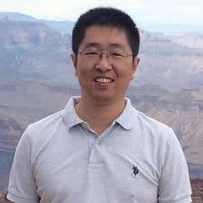
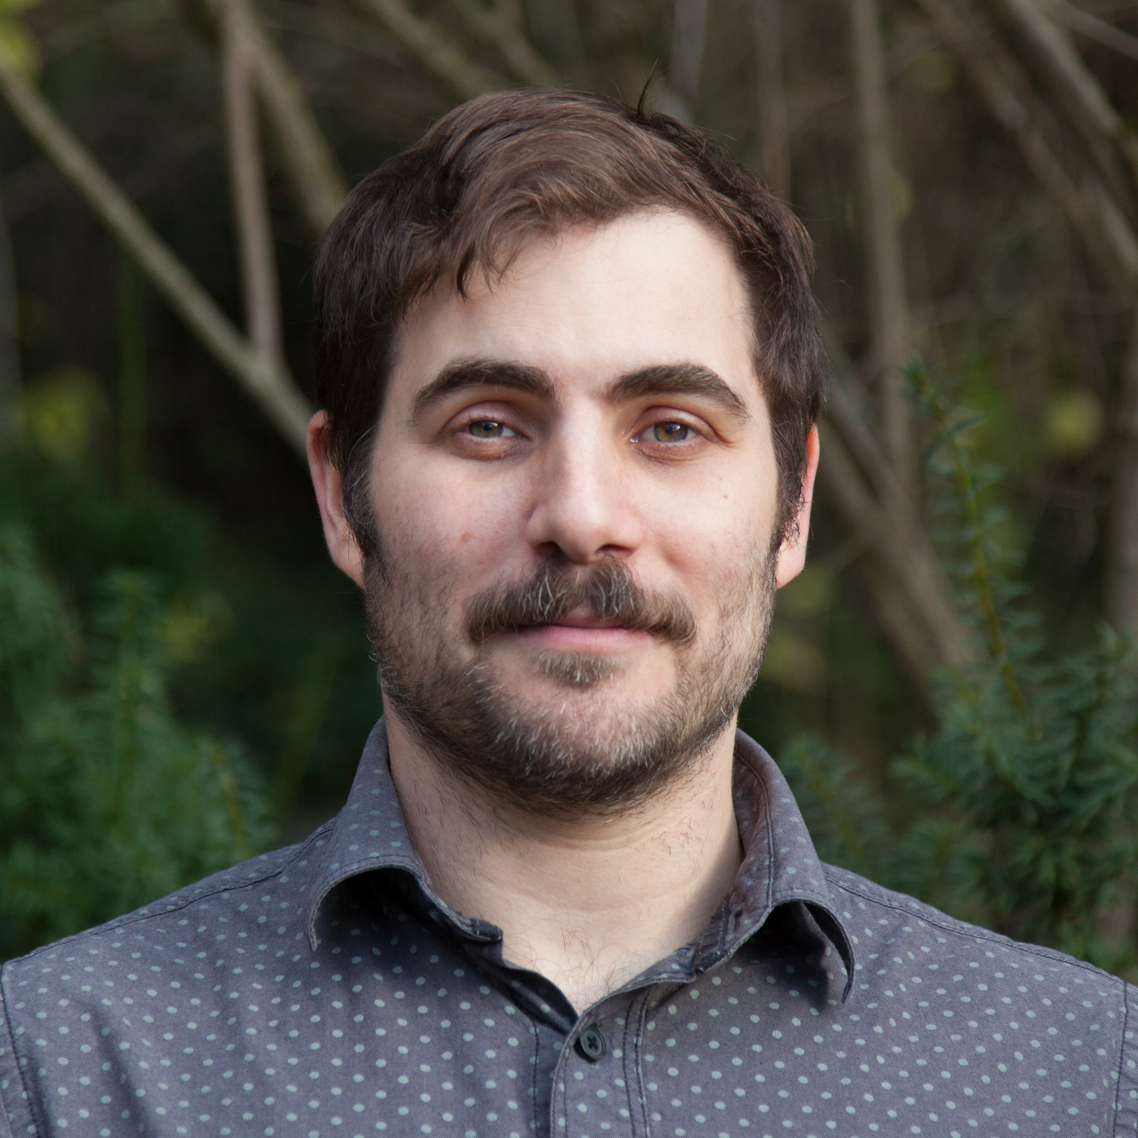
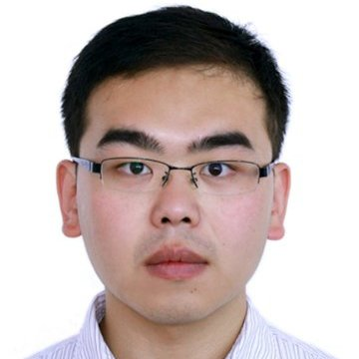
Lantao Liu; CPS, Env: Planning, decision-making, and machine learning methods for autonomous robots; Postdoc USC and CMU Robotics. PhD CS & Eng Texas A&M. BS Control China.
Eatai Roth; Neuro, CPS: Animal-robot flight analogies; Reverse engineers int. living systems (focus on cyber-physical interactions); Postdoc Seattle, Ph.D. ME; BS ME –Pitt; BS Fine Arts – Wash U
Greg Lewis; Bio, CPS: Wearables, Kinsey Institute; Asst. Prof. Psychiatry UNC-Chapel Hill; Ph.D. Bioengineering, UofI Chicago; BA, Psychology UNC-Chapel Hill.
Feng Guo; Bio, Nano: Acoustic tweezers, Biomed devices, & instruments for apps (i.e. Single Cell Analysis, Prenatal Diag., Virology, Neuroscience); Postdoc Stanford, Engineering Science & Mechanics Ph.D. PSU; B.S. Physics, Wuhan 2007. Hindex 20.

Slide 24
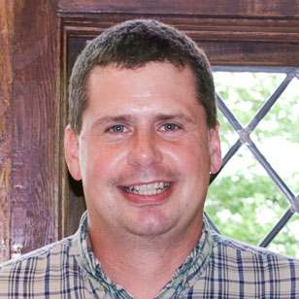
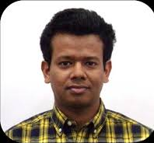
Bryce Himebaugh; CE, CPS: Assistant Clinical Professor, Engineering Education, Embedded Systems, Internet of Things
Ariful Azad; High Performance Computing, Bioinformatics, Parallel and Distributed Computing; Ph. D. Purdue CS 2014; BS Bangladesh CS&Engy 2006
Prateek Sharma; Parallel and Distributed Computing
Software and Systems, Clouds and Big Data Resource Management; Ph. D. Univ. Mass Amherst, 2018; M.Tech. Indian Institute Tech (CS) 2012; MS (Tech) Institute of Tech and Sci Pilani (Information Systems) 2009

Slide 25
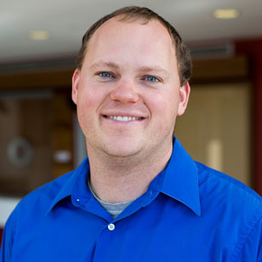
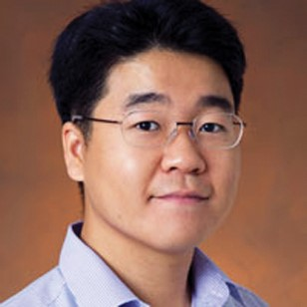
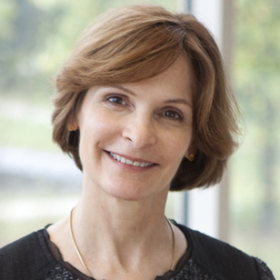
Andrew Lukefahr; Embedded Systems, Computer Architecture; MS and Ph. D. University of Michigan Computer Science & Engy; BS EE/CE University of Missouri
Michael Ryoo; Computer Vision, Video analysis, Robotics; NASA JPL Robotics; Ph.D. (2008) and M.S. (2006) in Computer Engineering at UT Austin, 2008; B.S. in Computer Science at Korea Advanced Institute of Science and Technology (KAIST), 2004
Beth Plale; Full Professor on leave at NSF. Cyberinfrastructure, Data management, Provenance. Postdoctoral Fellows at Georgia Institute of Technology, 2001; Ph.D. in Computer Science at State University of New York Binghamton, 1998

