Slide 1

HPCCloud 3.0: Big Data on Clouds and HPC
International Workshop on Foundations of Big Data Computing (BigDF) in conjunction with HiPC 2016
Hyderabad International Conference Centre, Hyderabad, India
Geoffrey Fox December 19, 2016
gcf@indiana.edu
http://www.dsc.soic.indiana.edu/, http://spidal.org/ http://hpc-abds.org/kaleidoscope/
Department of Intelligent Systems Engineering
School of Informatics and Computing, Digital Science Center
Indiana University Bloomington

Slide 2
Abstract I
We summarize a community discussion http://www.exascale.org/bdec/ of the relationship between Big Data and High Performance Computing HPC with possible "convergence" on aspects of both.
HPC can include both traditional supercomputer simulations and analysis of research data.
We can identify issues for both hardware, software and perhaps more important system requirements.
  The latter includes both application structure studied by NIST http://dsc.soic.indiana.edu/publications/NISTUseCase.pdf and
  Differences from the intrinsically federated nature of research (data) with no "central ownership" as seen in commercial systems, which allow common approaches.

Slide 3
Abstract II
At Indiana University, http://dsc.soic.indiana.edu/publications/HPCBigDataConvergence.pdf , the concept of HPC-ABDS software -- High Performance Computing Enhanced Apache Big Data Stack -- is explored
  where we try to blend the usability and functionality of the community big data stack with the performance of HPC.
Here we examine major Apache Programming environments including Spark, Flink, Hadoop, Storm, Heron and Beam.
We suggest that parallel and distributed computing often implement similar concepts (such as reduction, communication or dataflow) but that these need to be implemented differently to respect the different performance, fault-tolerance, synchronization, and execution flexibility requirements of parallel and distributed programs.
We present early results on the HPC-ABDS strategy of implementing best-practice runtimes for both these computing paradigms in major Apache environments.
The overall strategy leads to HPCCloud 3.0

Slide 4
HPC and/or Cloud 1.0 2.0 3.0
Cloud 1.0: IaaS PaaS
Cloud 2.0: DevOps
Cloud 3.0: Amin Vahdat from Google; Insight (Solution) as a Service from IBM; serverless computing
HPC 1.0 and Cloud 1.0 separate ecosystems
HPCCloud or HPC-ABDS: Take performance of HPC and functionality of Cloud (Big Data) systems
HPCCloud 2.0 Use DevOps to invoke HPC or Cloud software on VM, Docker, HPC infrastructure
HPCCloud 3.0 Automate Solution as a Service using HPC-ABDS on “correct” infrastructure

Slide 5
Why Connect (“Converge”) Big Data and HPC
Two major trends in computing systems are
  Growth in high performance computing (HPC) with an international exascale initiative (China in the lead)
  Big data phenomenon with an accompanying cloud infrastructure of well publicized dramatic and increasing size and sophistication.
Note “Big Data” largely an industry initiative although software used is often open source
  So HPC labels overlaps with “research” e.g. HPC community largely responsible for Astronomy and Accelerator (LHC, Belle, BEPC ..) data analysis
Merge HPC and Big Data to get
  More efficient sharing of large scale resources running simulations and data analytics as HPCCloud 3.0
  Higher performance Big Data algorithms
  Richer software environment for research community building on many big data tools
  Easier sustainability model for HPC – HPC does not have resources to build and maintain a full software stack

Slide 6
Convergence Points (Nexus) for
HPC-Cloud-Big Data-Simulation
Nexus 1: Applications – Divide use cases into Data and Model and compare characteristics separately in these two components with 64 Convergence Diamonds (features)
Nexus 2: Software – High Performance Computing (HPC) Enhanced Big Data Stack HPC-ABDS. 21 Layers adding high performance runtime to Apache systems (Hadoop is fast!). Establish principles to get good performance from Java or C programming languages
Nexus 3: Hardware – Use Infrastructure as a Service IaaS and DevOps (HPCCloud 2.0) to automate deployment of software defined systems on hardware designed for functionality and performance e.g. appropriate disks, interconnect, memory
Deliver Solutions (wisdom) as a Service HPCCloud 3.0

Slide 7
Application Nexus
Use-case Data and Model
NIST Collection
Big Data Ogres
Convergence Diamonds

Slide 8
Data and Model in Big Data and Simulations I
Need to discuss Data and Model as problems have both intermingled, but we can get insight by separating which allows better understanding of Big Data - Big Simulation “convergence” (or differences!)
The Model is a user construction and it has a “concept”, parameters and gives results determined by the computation. We use term “model” in a general fashion to cover all of these.
Big Data problems can be broken up into Data and Model
  For clustering, the model parameters are cluster centers while the data is set of points to be clustered
  For queries, the model is structure of database and results of this query while the data is whole database queried and SQL query
  For deep learning with ImageNet, the model is chosen network with model parameters as the network link weights. The data is set of images used for training or classification

Slide 9
Data and Model in Big Data and Simulations II
Simulations can also be considered as Data plus Model
  Model can be formulation with particle dynamics or partial differential equations defined by parameters such as particle positions and discretized velocity, pressure, density values
  Data could be small when just boundary conditions
  Data large with data assimilation (weather forecasting) or when data visualizations are produced by simulation
Big Data implies Data is large but Model varies in size
  e.g. LDA with many topics or deep learning has a large model
  Clustering or Dimension reduction can be quite small in model size
Data often static between iterations (unless streaming); Model parameters vary between iterations
Data and Model Parameters are often confused in papers as term data used to describe the parameters of models.

Slide 10
51 Detailed Use Cases: Contributed July-September 2013
Covers goals, data features such as 3 V’s, software, hardware
Government Operation(4): National Archives and Records Administration, Census Bureau
Commercial(8): Finance in Cloud, Cloud Backup, Mendeley (Citations), Netflix, Web Search, Digital Materials, Cargo shipping (as in UPS)
Defense(3): Sensors, Image surveillance, Situation Assessment
Healthcare and Life Sciences(10): Medical records, Graph and Probabilistic analysis, Pathology, Bioimaging, Genomics, Epidemiology, People Activity models, Biodiversity
Deep Learning and Social Media(6): Driving Car, Geolocate images/cameras, Twitter, Crowd Sourcing, Network Science, NIST benchmark datasets
The Ecosystem for Research(4): Metadata, Collaboration, Language Translation, Light source experiments
Astronomy and Physics(5): Sky Surveys including comparison to simulation, Large Hadron Collider at CERN, Belle Accelerator II in Japan
Earth, Environmental and Polar Science(10): Radar Scattering in Atmosphere, Earthquake, Ocean, Earth Observation, Ice sheet Radar scattering, Earth radar mapping, Climate simulation datasets, Atmospheric turbulence identification, Subsurface Biogeochemistry (microbes to watersheds), AmeriFlux and FLUXNET gas sensors
Energy(1): Smart grid
Published by NIST as http://nvlpubs.nist.gov/nistpubs/SpecialPublications/NIST.SP.1500-3.pdf with common set of 26 features recorded for each use-case; “Version 2” being prepared
26 Features for each use case Biased to science

Slide 11
Sample Features of 51 Use Cases I
PP (26) “All” Pleasingly Parallel or Map Only
MR (18) Classic MapReduce MR (add MRStat below for full count)
MRStat (7) Simple version of MR where key computations are simple reduction as found in statistical averages such as histograms and averages
MRIter (23) Iterative MapReduce or MPI (Flink, Spark, Twister)
Graph (9) Complex graph data structure needed in analysis
Fusion (11) Integrate diverse data to aid discovery/decision making; could involve sophisticated algorithms or could just be a portal
Streaming (41) Some data comes in incrementally and is processed this way
Classify (30) Classification: divide data into categories
S/Q (12) Index, Search and Query

Slide 12
Sample Features of 51 Use Cases II
CF (4) Collaborative Filtering for recommender engines
LML (36) Local Machine Learning (Independent for each parallel entity) – application could have GML as well
GML (23) Global Machine Learning: Deep Learning, Clustering, LDA, PLSI, MDS,
  Large Scale Optimizations as in Variational Bayes, MCMC, Lifted Belief Propagation, Stochastic Gradient Descent, L-BFGS, Levenberg-Marquardt . Can call EGO or Exascale Global Optimization with scalable parallel algorithm
Workflow (51) Universal
GIS (16) Geotagged data and often displayed in ESRI, Microsoft Virtual Earth, Google Earth, GeoServer etc.
HPC (5) Classic large-scale simulation of cosmos, materials, etc. generating (visualization) data
Agent (2) Simulations of models of data-defined macroscopic entities represented as agents

Slide 13
Classifying Use cases

Slide 14
Classifying Use Cases
The Big Data Ogres built on a collection of 51 big data uses gathered by the NIST Public Working Group where 26 properties were gathered for each application.
This information was combined with other studies including the Berkeley dwarfs, the NAS parallel benchmarks and the Computational Giants of the NRC Massive Data Analysis Report.
The Ogre analysis led to a set of 50 features divided into four views that could be used to categorize and distinguish between applications.
The four views are Problem Architecture (Macro pattern); Execution Features (Micro patterns); Data Source and Style; and finally the Processing View or runtime features.
We generalized this approach to integrate Big Data and Simulation applications into a single classification looking separately at Data and Model with the total facets growing to 64 in number, called convergence diamonds, and split between the same 4 views.
A mapping of facets into work of the SPIDAL project has been given.

Slide 16
64 Features in 4 views for Unified Classification of Big Data and Simulation Applications
Both
Simulations
Analytics
(Model for Big Data)
(Nearly all Data)
(All Model)
(Mix of Data and Model)
(Nearly all Data+Model)

Slide 17
Examples in Problem Architecture View PA
The facets in the Problem architecture view include 5 very common ones describing synchronization structure of a parallel job:
  MapOnly or Pleasingly Parallel (PA1): the processing of a collection of independent events;
  MapReduce (PA2): independent calculations (maps) followed by a final consolidation via MapReduce;
  MapCollective (PA3): parallel machine learning dominated by scatter, gather, reduce and broadcast;
  MapPoint-to-Point (PA4): simulations or graph processing with many local linkages in points (nodes) of studied system.
  MapStreaming (PA5): The fifth important problem architecture is seen in recent approaches to processing real-time data.
  We do not focus on pure shared memory architectures PA6 but look at hybrid architectures with clusters of multicore nodes and find important performances issues dependent on the node programming model.
Most of our codes are SPMD (PA-7) and BSP (PA-8).

Slide 18
6 Forms of MapReduce
Describes Architecture of
- Problem (Model reflecting data)
- Machine
- Software
2 important variants (software) of Iterative MapReduce and Map-Streaming a) “In-place” HPC b) Flow for model and data

Slide 19
Clouds, HPC Clouds
Simulations, Big Data

Slide 20
Considerations on Big Data v. Clouds/HPC
“High Performance” seems natural for Big Data as this needs a lot of processing and HPC could do it faster?
Cons: But much big data processing involves I/O of distributed data and this dominates over computing accelerated by HPC
  Other problems (such as LHC data processing) are compute dominated but this is pleasingly parallel and so parallel computing and nifty HPC algorithms irrelevant
  Other problems (like basic databases) are essentially MapReduce and also do not have tight synchronization constraints addressed by HPC
Pros: Andrew Ng notes that a leading machine learning group must have both deep learning and HPC excellence.
  Some machine learning like topic modelling (LDA), clustering, deep learning, dimension reduction, graph algorithms involve Map-Collective or Map-Point to Point iterative structure and benefit from HPC
  HPC (MPI) often large factors (10-100) faster than Hadoop, Spark, Flink, Storm

Slide 21
Why HPC Cloud architectures?
Exascale simulations needed as have differential equation based models that need small space and time steps and this leads to numerical formulations that need the memory and compute power of an exascale machine to solve individual problems (capability computing)
Big data problems do not have differential operators and it is not obvious that you need a full exascale system to address a single Big Data problem
Rather you will be running lots of jobs that are sometimes pleasingly parallel/MapReduce (Cloud) and sometimes small to medium size HPC jobs which in aggregate are exascale (HPC Cloud) (capacity computing)
  Deep learning doesn’t exhibit massive parallelism due to stochastic gradient descent using small mini-batches of training data
  But deep learning does use small accelerator enhanced HPC clusters.
Note modest size clusters need all the software, hardware and algorithm expertise of HPC.
Systems designed for exascale HPC simulations, should be well suited for HPC cloud if I/O handled correctly (as it is in traditional clouds)
HPCCloud 2.0 uses DevOps to automate deployment on cloud or HPC
HPCCloud 3.0 uses SaaS to deliver Wisdom/Insight as a Service

Slide 22
Comparison of Data Analytics with Simulation I
Simulations (models) produce big data as visualization of results – they are data source
  Or consume often smallish data to define a simulation problem
  HPC simulation in (weather) data assimilation is data + model
Pleasingly parallel often important in both
Both are often SPMD and BSP
  Classic Non-iterative MapReduce is major big data paradigm
  not a common simulation paradigm except where “Reduce” summarizes pleasingly parallel execution as in some Monte Carlos
Big Data often has large collective communication
  Classic simulation has a lot of smallish point-to-point messages
  Motivates MapCollective model
Simulations characterized often by difference or differential operators leading to nearest neighbor sparsity
Some important data analytics can be sparse as in PageRank and “Bag of words” algorithms but many involve full matrix algorithm

Slide 23
Comparison of Data Analytics with Simulation II
There are similarities between some graph problems and particle simulations with a particular cutoff force.
  Both are MapPoint-to-Point problem architecture
Note many big data problems are “long range force” (as in gravitational simulations) as all points are linked.
  Easiest to parallelize. Often full matrix algorithms
  e.g. in DNA sequence studies, distance δ(i, j) defined by BLAST, Smith-Waterman, etc., between all sequences i, j.
  Opportunity for “fast multipole” ideas in big data. See NRC report
Simulations tend to need high precision and very accurate results – partly because of differential operators
Big Data problems often don’t need high accuracy as seen in trend to low precision (16 or 32 bit) deep learning networks
  There are no derivatives and the data has inevitable errors

Slide 24
Example of HPC Analytics

Slide 25
Clustering and Visualization
The SPIDAL Library includes several clustering algorithms with sophisticated features
  Deterministic Annealing
  Radius cutoff in cluster membership
  Elkans algorithm using triangle inequality
They also cover two important cases
  Points are vectors – algorithm O(N) for N points
  Points not vectors – all we know is distance δ(i, j) between each pair of points i and j. algorithm O(N²) for N points
We find visualization important to judge quality of clustering
As data typically not 2D or 3D, we use dimension reduction to project data so we can then view it
Have a browser viewer WebPlotViz that replaces an older Windows system
Clustering and Dimension Reduction are modest HPC applications
Calculating distance δ(i, j) is similar compute load but pleasingly parallel
All examples require HPC but largest size ~600 cores

Slide 26
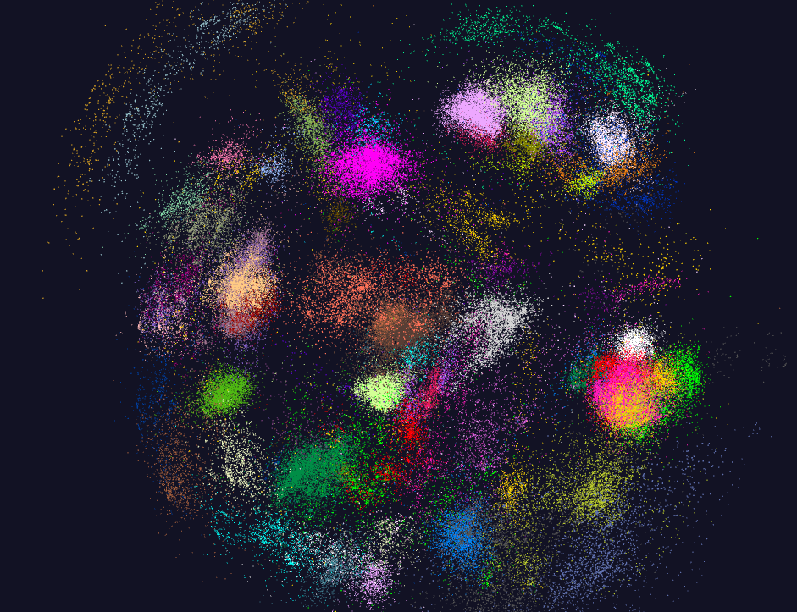
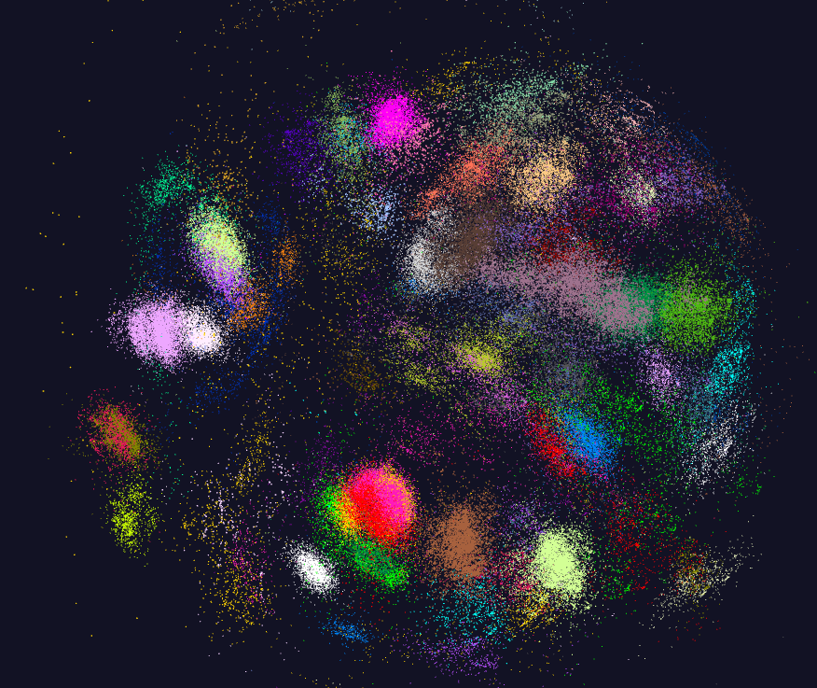
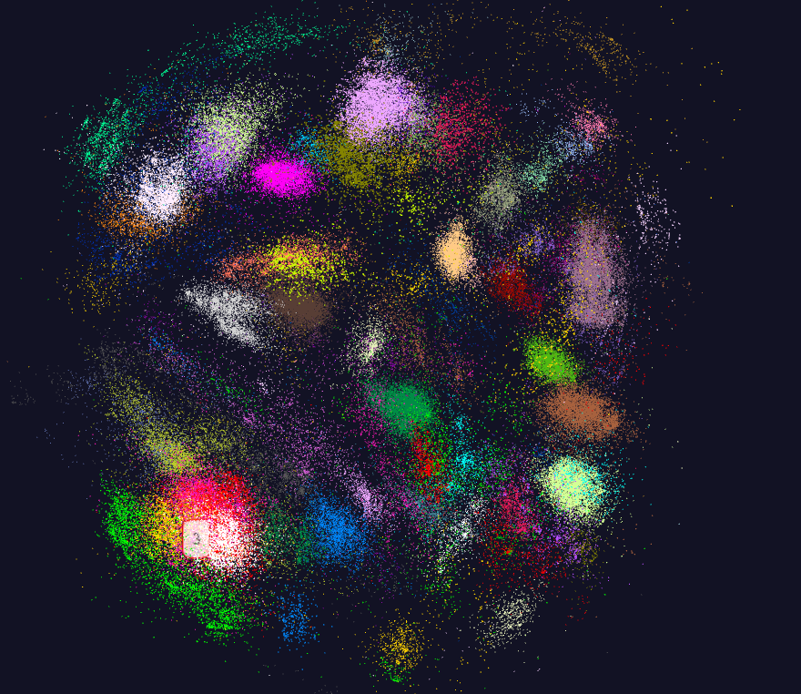
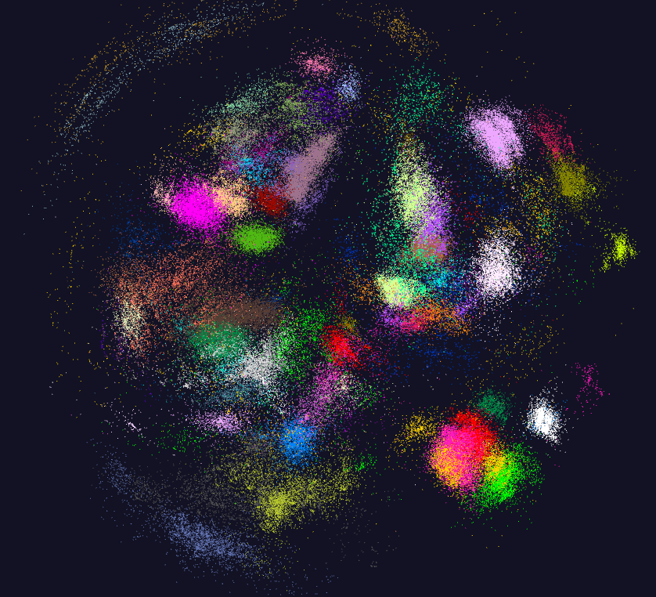
170K Fungi sequences

Slide 27
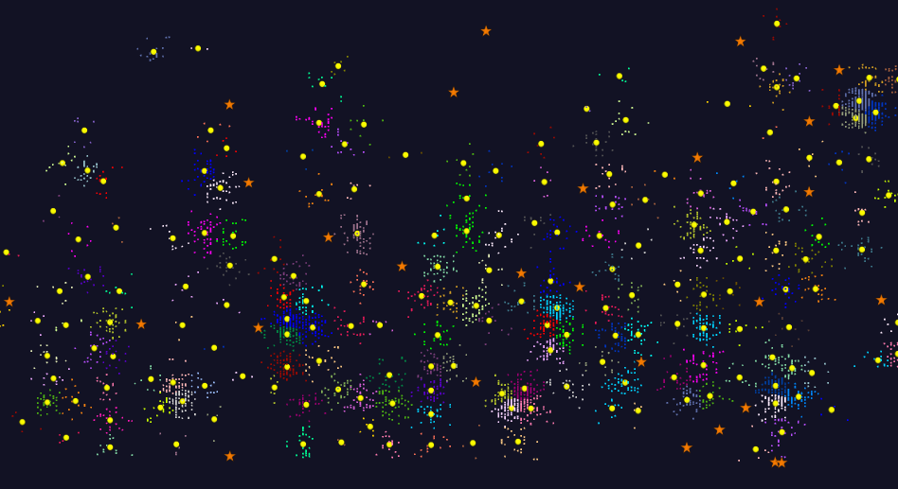
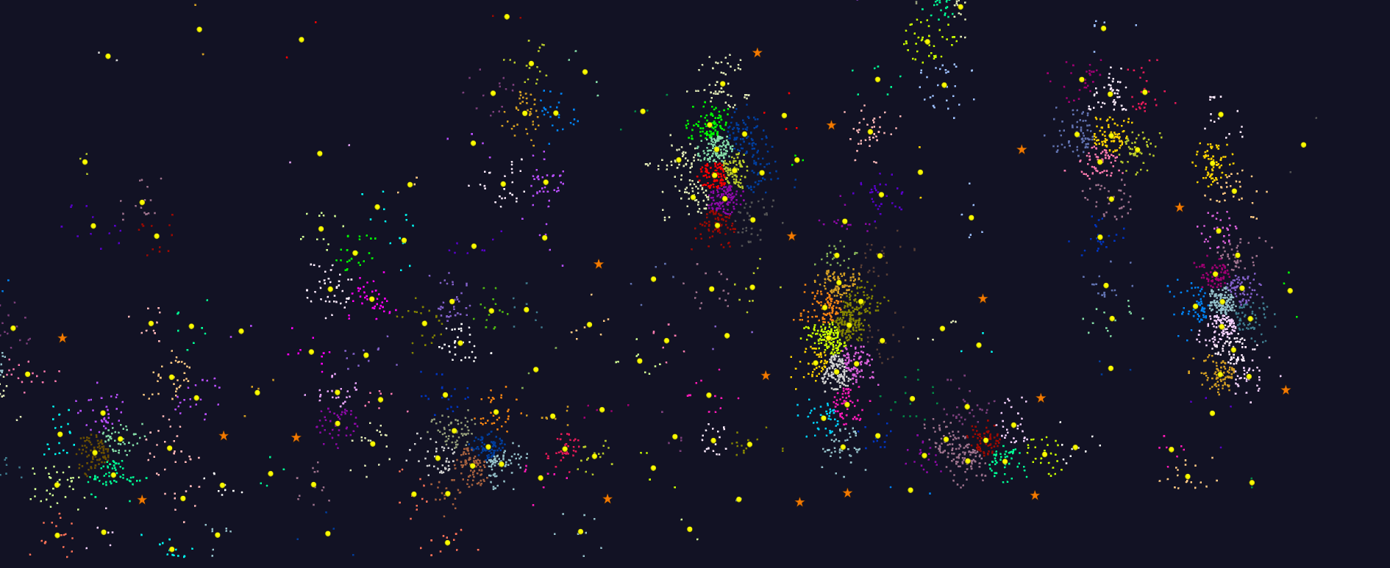
2D Vector Clustering with cutoff at 3 σ
Orange Star – outside all clusters; yellow circle cluster centers
LCMS Mass Spectrometer Peak Clustering. Charge 2 Sample with 10.9 million points and 420,000 clusters visualized in WebPlotViz

Slide 28
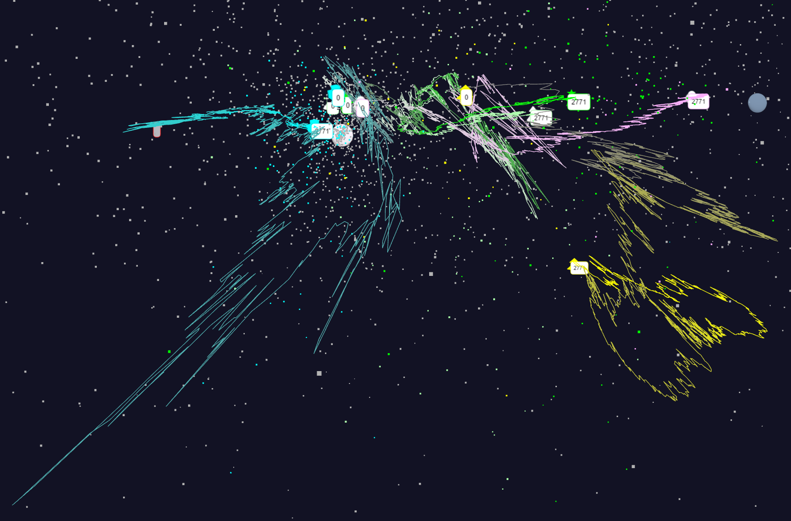
Relative Changes in Stock Values using one day values
Expansion of previous data
S&P
Mid Cap
S&P
Mid Cap
Dow Jones
Dow Jones
+10%
Finance
Finance
Origin
0% change
Energy
Energy
12/19/2016
28

Slide 29
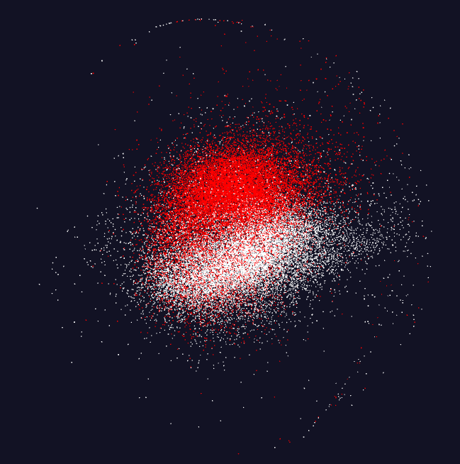
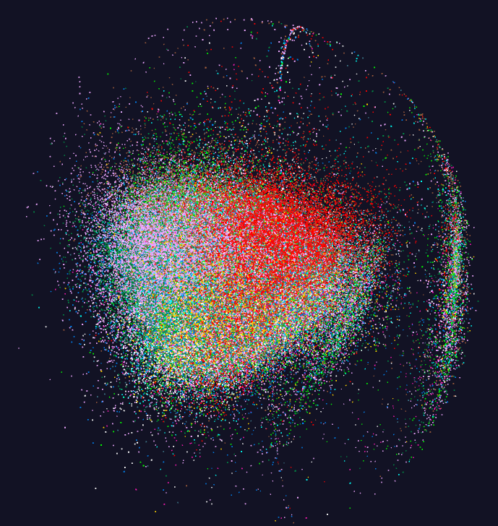
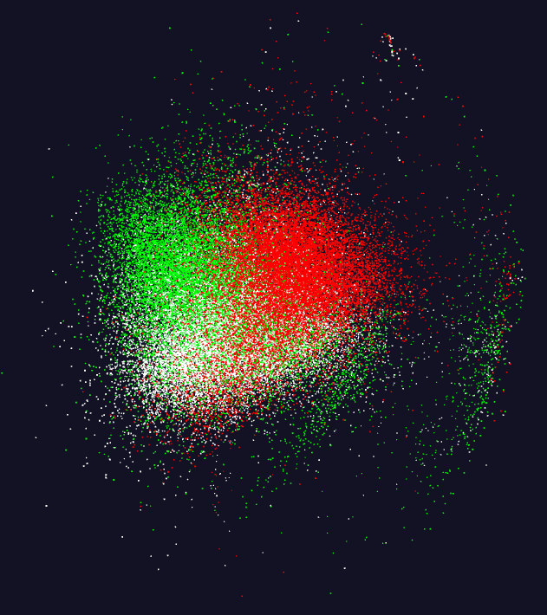
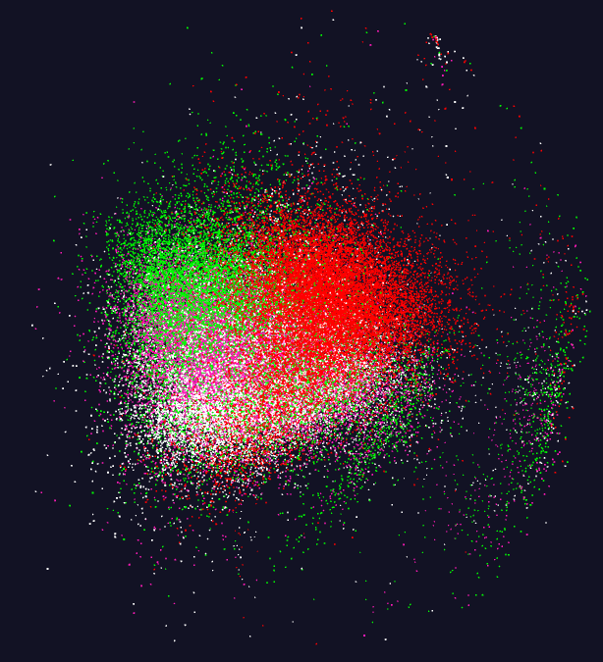
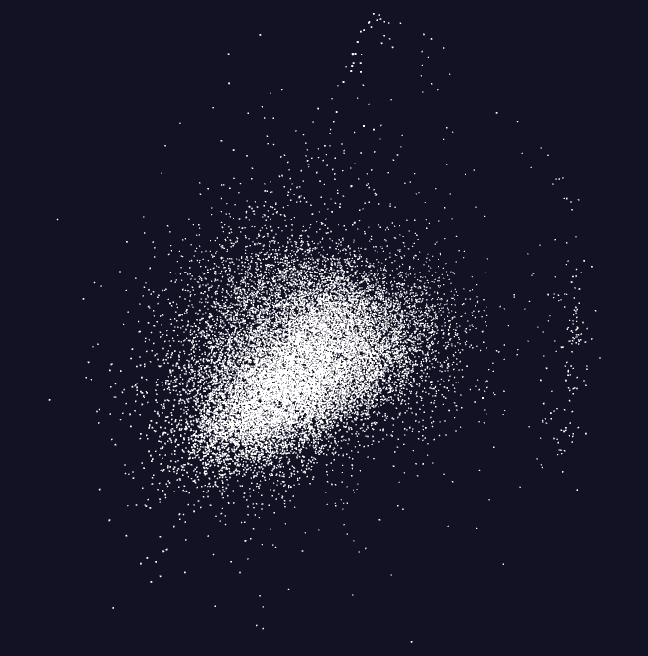
Pathology Image Features (cells)
11 Images
20,000 features per image.
96 properties per feature

Slide 30
Software Nexus
Application Layer On
Big Data Software Components for Programming and Data Processing On
HPC for runtime On
IaaS and DevOps Hardware and Systems
HPC-ABDS
MIDAS
Java Grande

Slide 31
Big Data ABDS HPCCloud 3.0 HPC, Cluster
17. Orchestration Beam, Crunch, Tez, Cloud Dataflow Kepler, Pegasus, Taverna
16. Libraries MLlib/Mahout, TensorFlow, CNTK, R, Python ScaLAPACK, PETSc, Matlab
15A. High Level Programming Pig, Hive, Drill Domain-specific Languages
15B. Platform as a Service App Engine, BlueMix, Elastic Beanstalk XSEDE Software Stack
Languages Java, Erlang, Scala, Clojure, SQL, SPARQL, Python Fortran, C/C++, Python
14B. Streaming Storm, Kafka, Kinesis
13,14A. Parallel Runtime Hadoop, MapReduce MPI/OpenMP/OpenCL
2. Coordination Zookeeper
12. Caching Memcached
11. Data Management Hbase, Accumulo, Neo4J, MySQL iRODS
10. Data Transfer Sqoop GridFTP
9. Scheduling Yarn, Mesos Slurm
8. File Systems HDFS, Object Stores Lustre
1, 11A Formats Thrift, Protobuf FITS, HDF
5. IaaS OpenStack , Docker Linux, Bare-metal, SR-IOV
Infrastructure CLOUDS Clouds and/or HPC SUPERCOMPUTERS
HPC-ABDS IntegratedSoftware
CUDA, Exascale Runtime

Slide 32
HPC-ABDS

Slide 33
Functionality of 21 HPC-ABDS Layers
Message Protocols:
Distributed Coordination:
Security & Privacy:
Monitoring:
IaaS Management from HPC to hypervisors:
DevOps:
Interoperability:
File systems:
Cluster Resource Management:
Data Transport:
A) File management
B) NoSQL
C) SQL
In-memory databases & caches / Object-relational mapping / Extraction Tools
Inter process communication Collectives, point-to-point, publish-subscribe, MPI:
A) Basic Programming model and runtime, SPMD, MapReduce:
B) Streaming:
A) High level Programming:
B) Frameworks
Application and Analytics:
Workflow-Orchestration:
Lesson of large number (350). This is a rich software environment that HPC cannot “compete” with. Need to use and not regenerate
Note level 13 Inter process communication added

Slide 34
Using “Apache” (Commercial Big Data) Data Systems for Science/Simulation
Pro: Use rich functionality and usability of ABDS (Apache Big Data Stack)
Pro: Sustainability model of community open source
Con (Pro for many commercial users): Optimized for fault-tolerance and usability and not performance
Feature: Naturally run on clouds and not HPC platforms
Feature: Cloud is logically centralized, physically distributed but science data typically distributed.
Question: how do science data analysis requirements differ from those commercially e.g. recommender systems heavily used commercially
Approach: HPC-ABDS using HPC runtime and tools to enhance commercial data systems (ABDS on top of HPC)
  Upper level software: ABDS
  Lower level runtime: HPC
  HPCCloud Hardware: HPC or classic cloud dependent on application requirements

Slide 35
SPIDAL Project
Datanet: CIF21 DIBBs: Middleware and High Performance Analytics Libraries for Scalable Data Science
NSF14-43054 started October 1, 2014
Indiana University (Fox, Qiu, Crandall, von Laszewski)
Rutgers (Jha)
Virginia Tech (Marathe)
Kansas (Paden)
Stony Brook (Wang)
Arizona State (Beckstein)
Utah (Cheatham)
A co-design project: Software, algorithms, applications

Slide 36





Co-designing Building Blocks Collaboratively
Software: MIDAS
HPC-ABDS

Slide 37
HPC-ABDS SPIDAL Project Activities
Green is MIDAS
Black is SPIDAL
Level 17: Orchestration: Apache Beam (Google Cloud Dataflow) integrated with Heron/Flink and Cloudmesh on HPC cluster
Level 16: Applications: Datamining for molecular dynamics, Image processing for remote sensing and pathology, graphs, streaming, bioinformatics, social media, financial informatics, text mining
Level 16: Algorithms: Generic and custom for applications SPIDAL
Level 14: Programming: Storm, Heron (Twitter replaces Storm), Hadoop, Spark, Flink. Improve Inter- and Intra-node performance; science data structures
Level 13: Runtime Communication: Enhanced Storm and Hadoop (Spark, Flink, Giraph) using HPC runtime technologies, Harp
Level 12: In-memory Database: Redis + Spark used in Pilot-Data Memory
Level 11: Data management: Hbase and MongoDB integrated via use of Beam and other Apache tools; enhance Hbase
Level 9: Cluster Management: Integrate Pilot Jobs with Yarn, Mesos, Spark, Hadoop; integrate Storm and Heron with Slurm
Level 6: DevOps: Python Cloudmesh virtual Cluster Interoperability

Slide 38
Java Grande
Revisited on 3 data analytics codes
Clustering
Multidimensional Scaling
Latent Dirichlet Allocation all sophisticated algorithms

Slide 39

Java MPI performs better than FJ Threads
128 24 core Haswell nodes on SPIDAL 200K DA-MDS Code
Speedup compared to 1 process per node on 48 nodes
Best MPI; inter and intra node
MPI; inter/intra node; Java not optimized
Best FJ Threads intra node; MPI inter node

Slide 40
Investigating Process and Thread Models
FJ Fork Join Threads lower performance than Long Running Threads LRT
Results
  Large effects for Java
  Best affinity is process and thread binding to cores - CE
  At best LRT mimics performance of “all processes”
6 Thread/Process Affinity Models

Slide 41
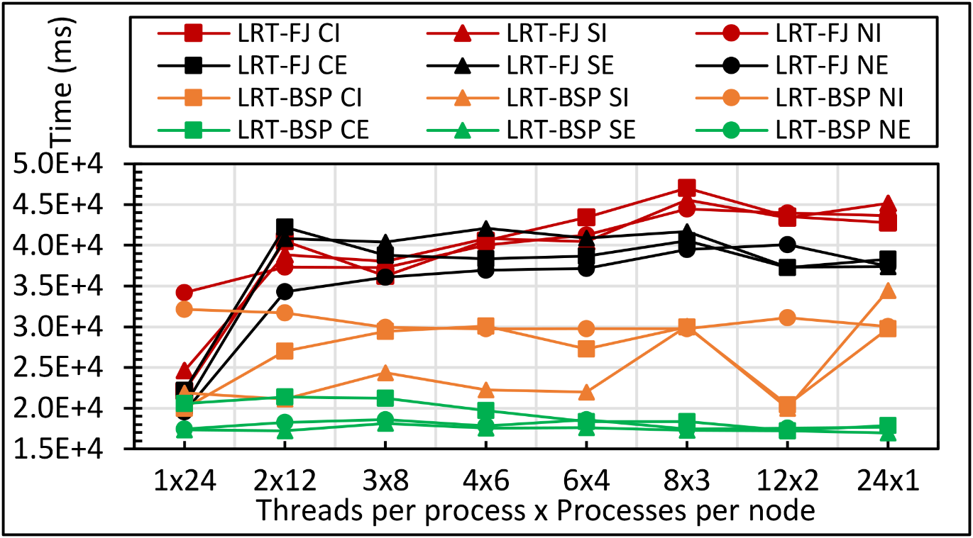
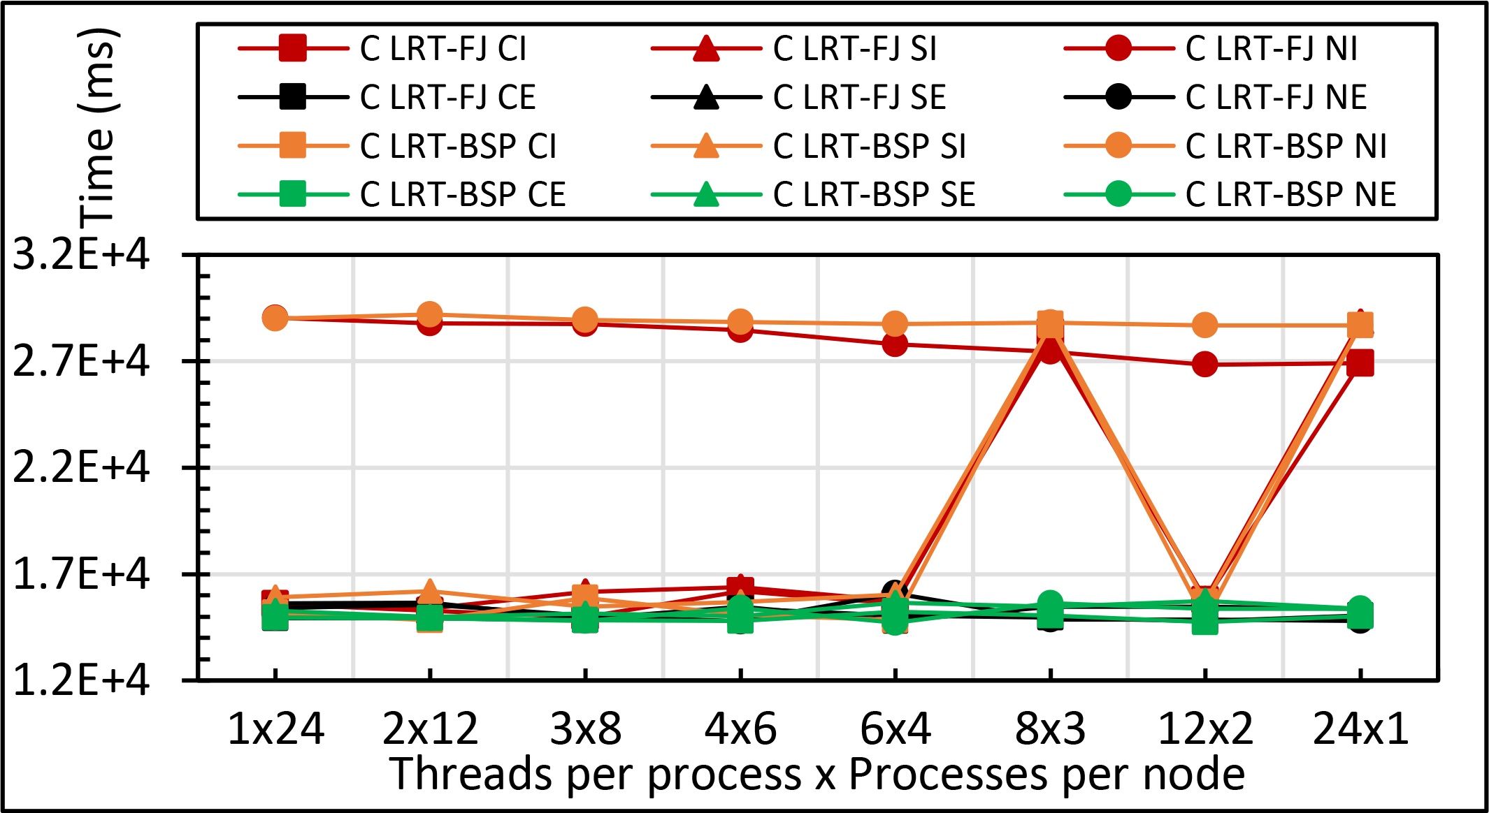
Performance
Sensitivity
Kmeans: 1 million points and 1000 centers performance on 16 24 core nodes for LRT-FJ and LRT-BSP with varying affinity patterns (6 choices) over varying threads and processes
C less sensitive than Java
All processes less sensitive than all processes
Java
C

Slide 42
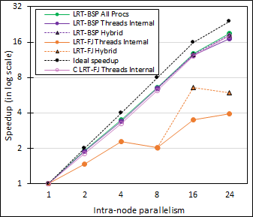
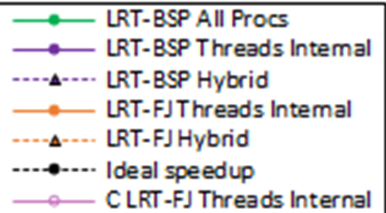
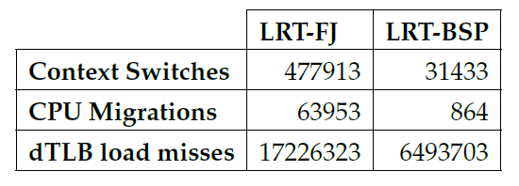
Performance Dependence on Number of Cores inside 24-core node (16 nodes total)
Long-Running Theads LRT Java
  All Processes
  All Threads internal to node
  Hybrid – Use one process per chip
Fork Join Java
  All Threads
  Hybrid – Use one process per chip
Fork Join C
  All Threads
All MPI internode
15x
74x
2.6x

Slide 43
Java versus C Performance
C and Java Comparable with Java doing better on larger problem sizes
All data from one million point dataset with varying number of centers on 16 nodes 24 core Haswell

Slide 44
HPC-ABDS
DataFlow and In-place Runtime

Slide 45
HPC-ABDS Parallel Computing
Both simulations and data analytics use similar parallel computing ideas
Both do decomposition of both model and data
Both tend use SPMD and often use BSP Bulk Synchronous Processing
One has computing (called maps in big data terminology) and communication/reduction (more generally collective) phases
Big data thinks of problems as multiple linked queries even when queries are small and uses dataflow model
Simulation uses dataflow for multiple linked applications but small steps such as iterations are done in place
Reduction in HPC (MPIReduce) done as optimized tree or pipelined communication between same processes that did computing
Reduction in Hadoop or Flink done as separate map and reduce processes using dataflow
  This leads to 2 forms (In-Place and Flow) of Map-X mentioned earlier
Interesting Fault Tolerance issues highlighted by Hadoop-MPI comparisons – not discussed here!

Slide 46

HPC Runtime versus ABDS distributed Computing Model on Data Analytics
Hadoop writes to disk and is slowest; Spark and Flink spawn many processes and do not support allreduce directly; MPI does in-place combined reduce/broadcast

Slide 47

Flink MDS Dataflow Graph

Slide 48
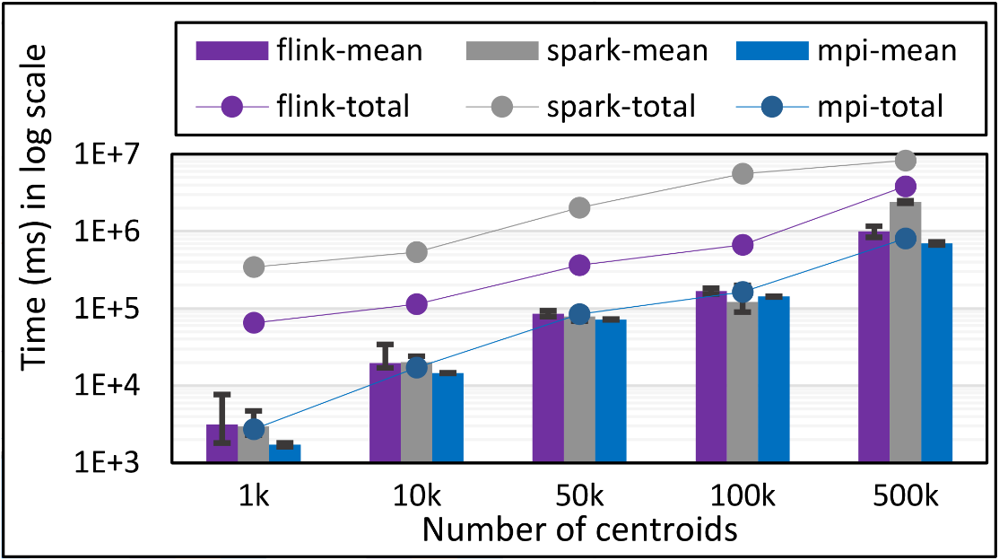
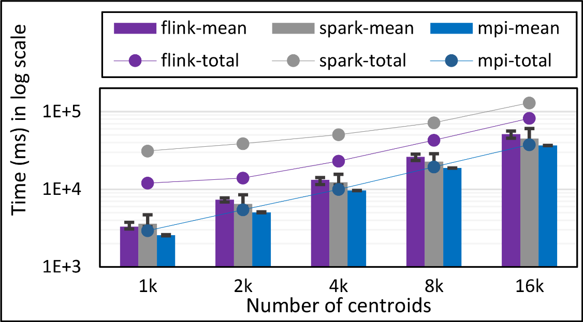
K-Means Clustering in Spark, Flink, MPI
Data Set <Points>
Dataflow for K-means
Map (nearest centroid calculation)
Reduce (update centroids)
Data Set <Initial Centroids>
Data Set <Updated Centroids>
Broadcast
K-Means total and compute times for 1 million 2D points and 1k,10,50k,100k, and 500k centroids for Spark, Flink, and MPI Java LRT-BSP CE. Run on 16 nodes as 24x1.
K-Means total and compute times for 1 million 2D points and 1k,10,50k,100k, and 500k centroids for Spark, Flink, and MPI Java LRT-BSP CE. Run on 16 nodes as 24x1.
K-Means total and compute times for 100k 2D points and1k,2k,4k,8k, and 16k centroids for Spark, Flink, and MPI Java LRT-BSP CE. Run on 1 node as 24x1.
Notes:
Note the differences in communication architectures
Note times are in log scale
Bars indicate compute only times, which is similar across these frameworks
Overhead is dominated by communications in Flink and Spark

Slide 49
HPC-ABDS Parallel Computing
MPI designed for fine grain case and typical of parallel computing used in large scale simulations
  Only change in model parameters are transmitted
  In-place implementation
  Synchronization important as parallel computing
Dataflow typical of distributed or Grid computing workflow paradigms
  Data sometimes and model parameters certainly transmitted
  If used in workflow, large amount of computing and no synchronization constraints
  Caching in iterative MapReduce avoids data communication and in fact systems like TensorFlow, Spark or Flink are called dataflow but usually implement “model-parameter” flow
HPC-ABDS Plan: Add in-place implementations when best to ABDS keeping ABDS Interface as in next slide

Slide 50
Harp (Hadoop Plugin) brings HPC to ABDS
Judy Qiu: Iterative HPC communication; scientific data abstractions
Careful support of distributed data AND distributed model
Avoids parameter server approach but distributes model over worker nodes and supports collective communication to bring global model to each node
Have also added HPC to Apache Storm and Heron; working on adding Parallel Computing Runtime to Distributed computing model built into Apache Spark, Flink, Beam
MapReduce Model
MapCollective Model
MapReduce Applications
MapCollective Applications
M
M
M
M
M
M
M
M
MapReduce V2
Harp
Shuffle
Collective Communication
R
R
YARN

Slide 51
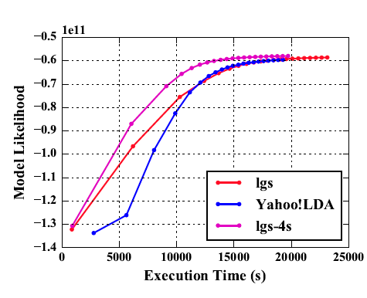
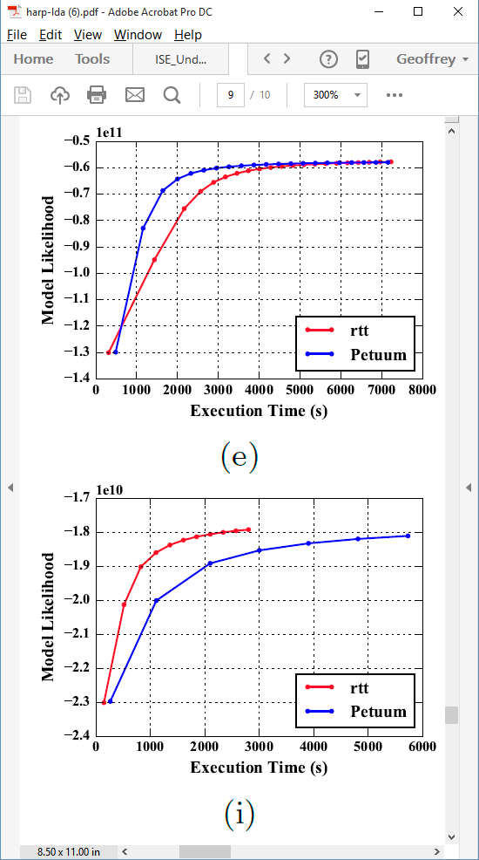
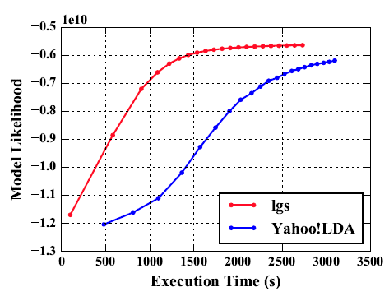
Latent Dirichlet Allocation on 100 Haswell nodes: red is Harp (lgs and rtt)
Clueweb
Clueweb
enwiki
Bi-gram

Slide 52
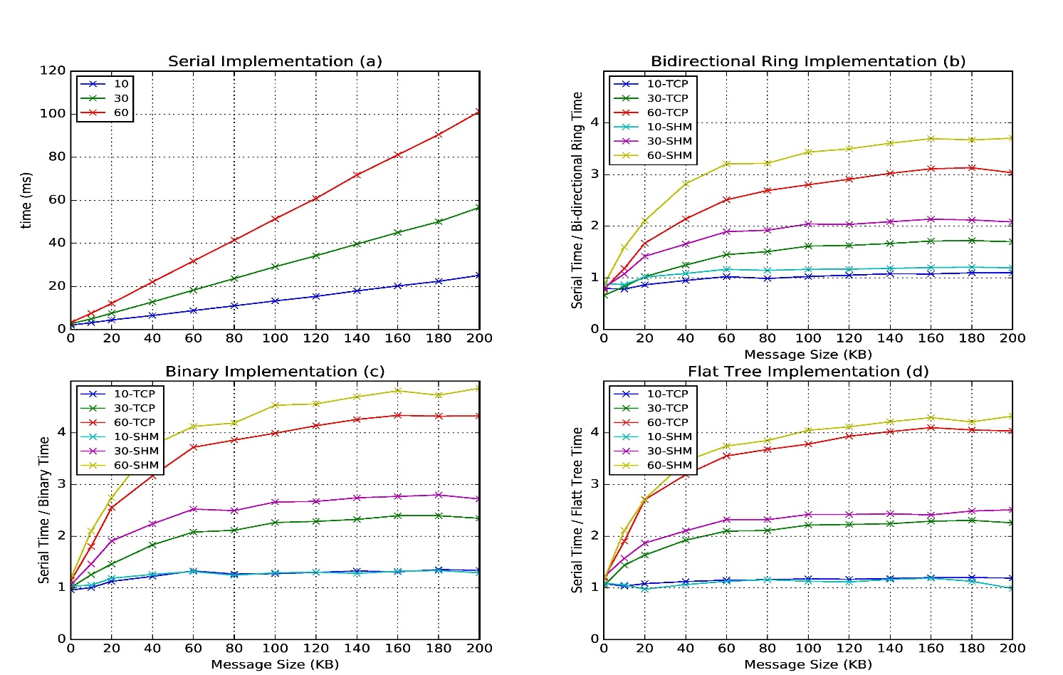
Improvement of Storm (Heron) using HPC communication algorithms
Latency of binary tree, flat tree and bi-directional ring implementations compared to serial implementation. Different lines show varying # of parallel tasks with either TCP communications and shared memory communications(SHM).
Original Time
Speedup Ring
Speedup Binary
Speedup Tree

Slide 53
Infrastructure Nexus
IaaS
DevOps
Cloudmesh HPCCloud 2.0

Slide 54
HPCCloud 2.0 Software Defined Systems
Significant advantages in specifying job software with scripts such as Chef, Puppet, Ansible – “Software Defined Systems” (SDS)
  Choose Ansible as Python based
Less voluminous than machine images; easier to ensure latest version; easy to recreate image on demand after crashes
In work with NIST, we looked at 87 applications from two of our “big data on cloud” classes and from NIST itself (6)
The 6 NIST use cases need 27 Ansible roles (distinct software subsystems) and full set of 87 needed 62 separate roles (average 4.75 roles per use case)
https://docs.google.com/spreadsheets/d/1e8-pzWn-7lz47-gIAra0VzCX6IkAypa8Cu5YG5MES_4
With NIST Public Big Data group, looking at mapping SDS to system architecture
Preparing Ansible specifications of many subsystems and use cases
Note many public Ansible roles (Ansible Galaxy collection) do NOT expose full functionality of software and/or have errors
Microservices, HPCCloud 3.0 and serverless computing build on SDS https://youtu.be/iNN9KAsQ3G8?t=8m Amin Vahdat (Google)
  Amazon Lambda, Google Cloud Functions, Microsoft Azure Functions,
  IBM OpenWhisk; WOSC2017 workshop June 2017

Slide 55
27 Ansible Roles and Re-use in 6 NIST use cases
ID | 6 NIST Use Cass | Hadoop | Mesos | Spark | Storm | Pig | Hive | Drill | HDFS | HBase | Mysql | MongoDB | RethinkDB | Mahout | D3, Tableau | nltk | MLlib | Lucene/Solr | OpenCV | Python | Java | maven | Ganglia | Nagios | spark supervisord | zookeeper | AlchemyAPI | R
1 | NIST Fingerprint Matching | x |  | x |  |  | x | x |  | x | x |  |  |  |  |  |  |  |  |  | x | x | x | x | x | x
2 | Human and Face Detection |  | x | x |  |  |  |  |  |  |  |  |  |  |  |  |  |  | x | x |  |  |  |  |  | x
3 | Twitter Analysis |  |  |  | x |  |  |  |  | x |  | x |  |  | x | x |  |  |  | x | x |  |  |  |  | x | x | x
4 | Analytics for Healthcare Data/Health Informatics | x |  | x |  |  |  |  |  | x |  |  |  | x | x |  | x | x |  |  | x |  |  |  |  | x
5 | Spatial Big Data/Spatial Statistics/Geographic Information Systems | x |  | x |  |  |  |  |  |  |  |  |  | x | x |  | x |  |  |  | x | x
6 | Data Warehousing and Data Mining | x |  | x |  | x | x |  |  | x |  | x |  | x | x |  | x | x |  |  | x |  |  |  |  | x
count |  | 4 | 1 | 5 | 1 | 1 | 2 | 1 | 0 | 4 | 1 | 2 | 0 | 3 | 4 | 1 | 3 | 2 | 1 | 2 | 5 | 2 | 3 | 1 | 1 | 5 | 1 | 1

Slide 56
Cloudmesh HPCCloud 2.0 DevOps Tool
Model: Define software configuration with tools like Ansible (Chef, Puppet); instantiate on a virtual cluster
Save scripts not virtual machines and let script build applications
Cloudmesh is an easy-to-use command line program/shell and portal to interface with heterogeneous infrastructures taking script as input
  It first defines virtual cluster and then instantiates script on it
  It has several common Ansible defined software built in
Supports OpenStack, AWS, Azure, SDSC Comet, virtualbox, libcloud supported clouds as well as classic HPC and Docker infrastructures
  Has an abstraction layer that makes it possible to integrate other IaaS frameworks
Managing VMs across different IaaS providers is easier
Demonstrated interaction with various cloud providers:
  FutureSystems, Chameleon Cloud, Jetstream, CloudLab, Cybera, AWS, Azure, virtualbox
Status: AWS, and Azure, VirtualBox, Docker need improvements; we focus currently on SDSC Comet and NSF resources that use OpenStack
Interoperability Layer to build HPCCloud 2.0

Slide 57
Cloudmesh Architecture
Software Engineering Process
We define a basic virtual cluster which is a set of instances with a common security context
We then add basic tools including languages Python Java etc.
Then add management tools such as Yarn, Mesos, Storm, Slurm etc …..
Then add roles for different HPC-ABDS PaaS subsystems such as Hbase, Spark
  There will be dependencies e.g. Storm role uses Zookeeper
Any one project picks some of HPC-ABDS PaaS Ansible roles and adds >=1 SaaS that are specific to their project and for example read project data and perform project analytics
E.g. there will be an OpenCV role used in Image processing applications

Slide 58
HPCCloud and Summary of Big Data - Big Simulation Convergence
HPC-Clouds convergence? (easier than converging higher levels in stack)
Can HPC continue to do it alone?
Convergence Diamonds
HPC-ABDS Software on differently optimized hardware infrastructure

Slide 59
HPCCloud Convergence Architecture
Running same HPC-ABDS software across all platforms but data management machine has different balance in I/O, Network and Compute from “model” machine
  Note data storage approach: HDFS v. Object Store v. Lustre style file systems is still rather unclear
The Model behaves similarly whether from Big Data or Big Simulation.
Data Management Model for Big Data
and Big Simulation
HPCCloud Capacity-style Operational Model matches hardware features with application requirements

Slide 60
Summary of Big Data HPC Convergence I
Applications, Benchmarks and Libraries
  51 NIST Big Data Use Cases, 7 Computational Giants of the NRC Massive Data Analysis, 13 Berkeley dwarfs, 7 NAS parallel benchmarks
  Unified discussion by separately discussing data & model for each application;
  64 facets– Convergence Diamonds -- characterize applications
  Characterization identifies hardware and software features for each application across big data, simulation; “complete” set of benchmarks (NIST)
Exemplar Ogre and Convergence Diamond Features
  Overall application structure e.g. pleasingly parallel
  Data Features e.g. from IoT, stored in HDFS ….
  Processing Features e.g. uses neural nets or conjugate gradient
  Execution Structure e.g. data or model volume
Need to distinguish data management from data analytics
Management and Search I/O intensive and suitable for classic clouds
  Science data has fewer users than commercial but requirements poorly understood
Analytics has many features in common with large scale simulations
  Data analytics often SPMD, BSP and benefits from high performance networking and communication libraries.
  Decompose Model (as in simulation) and Data (bit different and confusing) across nodes of cluster

Slide 61
Summary of Big Data HPC Convergence II
Software Architecture and its implementation
  HPC-ABDS: Cloud-HPC interoperable software: performance of HPC (High Performance Computing) and the rich functionality of the Apache Big Data Stack.
  Added HPC to Hadoop, Storm, Heron, Spark; could add to Beam and Flink
  Could work in Apache model contributing code in different ways
  One approach is an HPC project in Apache Foundation
HPCCloud runs same HPC-ABDS software across all platforms but “data management” nodes have different balance in I/O, Network and Compute from “model” nodes
  Optimize to data and model functions as specified by convergence diamonds rather than optimizing for simulation and big data
Convergence Language: Make C++, Java, Scala, Python (R) … perform well
Training: Students prefer to learn machine learning and clouds and need to be taught importance of HPC to Big Data
Sustainability: research/HPC communities cannot afford to develop everything (hardware and software) from scratch
HPCCloud 2.0 uses DevOps to deploy HPC-ABDS on clouds or HPC
HPCCloud 3.0 delivers Solutions as a Service

