Slide 1
HPBD&IS 2020
5
4
3
1
2
Open Now

Slide 2
HPBD&IS 2020
International Conference on High Performance Big Data and Intelligent Systems
Opening Ceremony

Slide 3
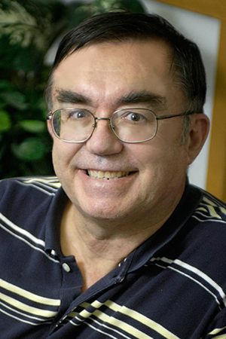
HPBD&IS 2020
International Conference on High Performance Big Data and Intelligent Systems
Address by the General Chair
Distinguished Professor of Engineering, Computing, and Physics and director of the Digital Science Center in School of Informatics, Computing, and Engineering at Indiana University, USA. A Fellow of APS (Physics) and ACM (Computing) and works on the interdisciplinary interface between computing and applications.
Prof. Geoffrey Fox
Indiana University, USA

Slide 4
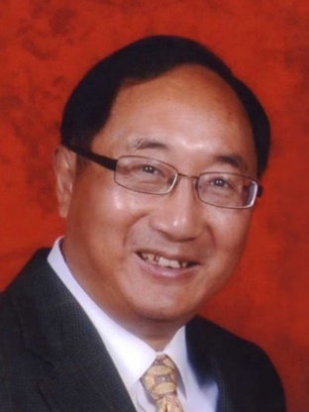
HPBD&IS 2020
International Conference on High Performance Big Data and Intelligent Systems
Address by the General Chair
Distinguished Professor and the past Chair of the Department of Computer Science at the Illinois Institute of Technology, IEEE Fellow and a guest faculty in the Division of Mathematics and Computer Science at Argonne National Laboratory. He received the Overseas Outstanding Contribution Award from the China Computer Federation in 2018, the IEEE CS Golden Core Award from the IEEE CS society in 2017, and is the current Associate Editor-in-Chief (AEIC) of IEEE Transactions on Parallel and Distributed Systems (TPDS). His research interests include parallel and distributed processing, memory and I/O systems, software system for Big Data applications, and performance evaluation and optimization.
Prof. Xian-He Sun
Illinois Institute of Technology , USA

Slide 5
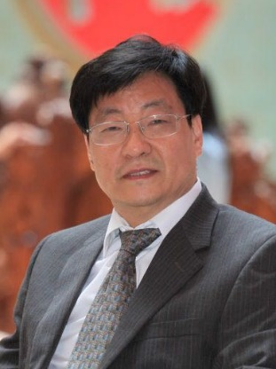
HPBD&IS 2020
International Conference on High Performance Big Data and Intelligent Systems
Address by the Program Chair
IEEE Fellow, is the Dean of Faculty of Science and Technology, University of Macau and a Chair Professor of Computer and Information Science. He also holds a courtesy position as the Director of the Center for Cloud Computing in Shenzhen Institutes of Advanced Technology (SIAT), Chinese Academy of Sciences. Dr. Xu's main research interests lie in parallel and distributed computing, with an emphasis on resource management for system's performance, reliability, availability, power efficiency, and security and in big data and data-driven intelligence applications. Dr. Xu has been the Chair of IEEE Technical Committee on Distributed Processing (TCDP) since 2015.
Prof. Cheng-Zhong Xu
University of Macau, China

Slide 6
Program Highlights
89 Submissions from 8 Countries and Regions.
China, United States, United Kingdom, Canada, Australia, India, Russia, Macau
35 papers are accepted (39.33% acceptance rate).
Each paper receives at lease 3 reviewers, and a maximum of 5 reviewers.
Papers only with positive average score (>0) can be accepted.
Strong Accept (3), Accept (2), Weak Accept (1)
Borderline (0)
Weak reject (-1), Reject (-2), Strong reject (-3)

Slide 7
Program Committees
119 PC Members come from 17 Countries and regions.
China, USA, Australia, France, UK, Canada, India, Russia, Italy, Thailand, Morocco,
Turkey, Iran, Portugal, Spain, Greece, Macau
Each PC member reviews 1~5 papers according to his/her research interests.

Slide 8
Group Photo
HPBD&IS 2020
International Conference on High Performance Big Data and Intelligent Systems
HPBD&IS 2020

Slide 9
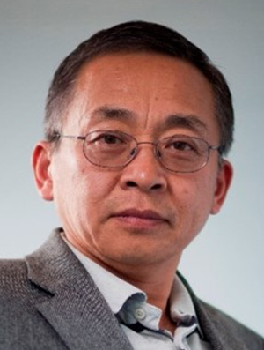
HPBD&IS 2020
International Conference on High Performance Big Data and Intelligent Systems
Address by the Steering Committee Chair
Professor Yang has served in the professional society in various capacities including General Chair of the ACM/IEEE International Symposium on Computer Architecture (ISCA2011), IEEE International Conference on Network, Architecture, and Storage (NAS), IEEE Workshop on Storage Network Architecture and Parallel I/Os (SNAPI); IEEE Distinguished Speaker; Editor of IEEE Transactions on Parallel and Distributed Systems; Program Committee member of numerous international conferences. He is the principal scientist of Shenzhen DAPU Microelectronics Co., Ltd.. He is an IEEE Fellow, and his research interests include Computer Architectures, Memory Systems, I/O and Data Storage Architectures, Storage Networking (SAN, NAS, and LAN), Parallel and Distributed Computing (software and hardware), Embedded Computer Systems and Applications, Computer Applications in Biomedical Systems.
Prof. Qing Yang
University of Rhode Island, USA
Shenzhen DAPU Microelectronics Co., Ltd., China

Slide 10
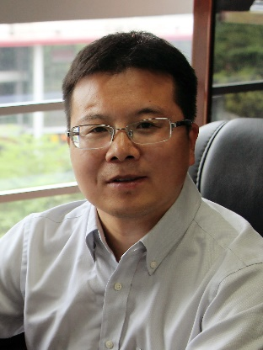
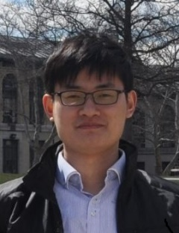
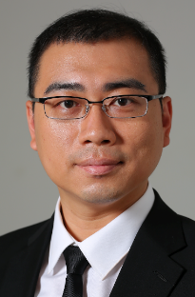
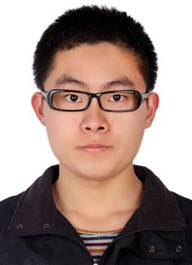
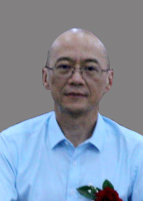
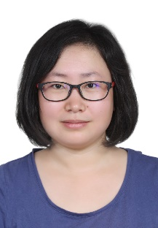
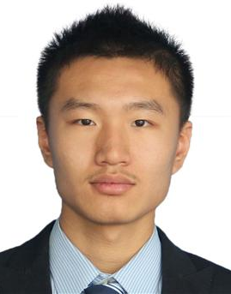
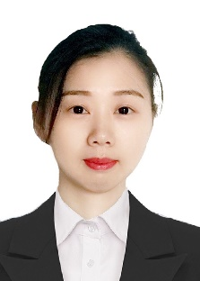
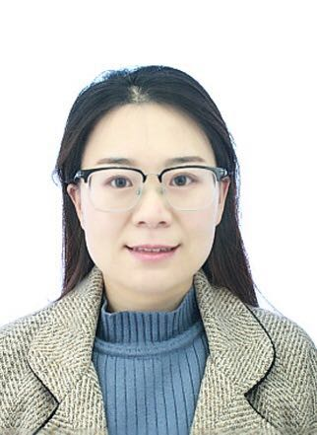
Organization Structure
HPBD&IS 2020
Steering
Committee Chair
General Chair
Program Chair
Publication
Chair
Publicity
Chair
Qing Yang
Xian-He Sun
Geoffrey Fox
Cheng-Zhong Xu
Weijun Li
KeJiang Ye
Keke Gai
Website
Chair
Organizing Chair
Conference Secretary
Xin Ning
Xiang Li
Lina Yu
Shuang Li
Zhiwei Li
Baoli Lu
Yaxuan Lu

Slide 11
HPBD&IS 2020
International Conference on High Performance Big Data and Intelligent Systems
Keynote Speech
dLABEL: A Label-Based Data Representation and its implementation on Big Data I/O Systems
Prof. Xian-He Sun
Illinois Institute of Technology, USA
Distinguished Professor and the past Chair of the Department of Computer Science at the Illinois Institute of Technology, IEEE Fellow and guest faculty in the Division of Mathematics and Computer Science at Argonne National Laboratory.

