Slide 1
Sunrise or Sunset: Exploring the Design Space of Big Data Software Stacks
HPBDC 2017 3rd IEEE International Workshop on
High-Performance Big Data Computing
May 29, 2017
gcf@indiana.edu
http://www.dsc.soic.indiana.edu/, http://spidal.org/ http://hpc-abds.org/kaleidoscope/
Department of Intelligent Systems Engineering
School of Informatics and Computing, Digital Science Center
Indiana University Bloomington

Slide 2
Panel Tasking
The panel will discuss the following three issues:
Are big data software stacks mature or not?
  If yes, what is the new technology challenge?
  If not, what are the main driving forces for new-generation big data software stacks?
  What chances are provided for the academia communities in exploring the design spaces of big data software stacks?

Slide 3
Are big data software stacks mature or not?
The solutions are numerous and powerful
  One can get good (and bad) performance in an understandable reproducible fashion
  Surely need better documentation and packaging
The problems (and users) are definitely not mature (i.e. not understood, and key issues not agreed)
  Many academic fields are just starting to use big data and some are still restricted to small data
  e.g. Deep Learning is not understood in many cases outside the well publicized commercial cases (voice, translation, images)
In many areas, applications are pleasingly parallel or involve MapReduce; performance issues are different from HPC
  Common is lots of independent Python or R jobs

Slide 4
Why use Spark Hadoop Flink rather than HPC?
Yes if you value ease of programming over performance.
  This could be the case for most companies where they can find people who can program in Spark/Hadoop much more easily than people who can program in MPI.
  Most of the complications including data, communications are abstracted away to hide the parallelism so that average programmer can use Spark/Flink easily and doesn't need to manage state, deal with file systems etc.
  RDD data support very helpful
For large data problems involving heterogeneous data sources such as HDFS with unstructured data, databases such as HBase etc
Yes if one needs fault tolerance for our programs.
  Our 13-node Moe “big data” (Hadoop twitter analysis) cluster at IU faces such problems around once per month. One can always restart the job, but automatic fault tolerance is convenient.

Slide 5
Why use HPC and not Spark, Flink, Hadoop?
The performance of Spark, Flink, Hadoop on classic parallel data analytics is poor/dreadful whereas HPC (MPI) is good
One way to understand this is to note most Apache systems deliberately support a dataflow programming model
e.g. for Reduce, Apache will launch a bunch of tasks and eventually bring results back
  MPI runs a clever AllReduce interleaved “in-place” tree
Maybe can preserve Spark, Flink programming model but change implementation “under the hood” where optimization important.
Note explicit dataflow is efficient and preferred at coarse scale as used in workflow systems
  Need to change implementations for different problems

Slide 6

HPC Runtime versus ABDS distributed Computing Model on Data Analytics
Hadoop writes to disk and is slowest; Spark and Flink spawn many processes and do not support AllReduce directly;
MPI does in-place combined reduce/broadcast and is fastest

Slide 7


Multidimensional Scaling MDS Results with Flink, Spark and MPI
MDS execution time on 16 nodes with 20 processes in each node with varying number of points
MDS execution time with 32000 points on varying number of nodes. Each node runs 20 parallel tasks
MDS performed poorly on Flink due to its lack of support for nested iterations. In Flink and Spark the algorithm doesn’t scale with the number of nodes.

Slide 8
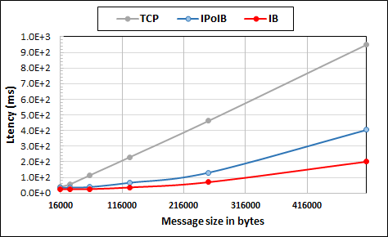
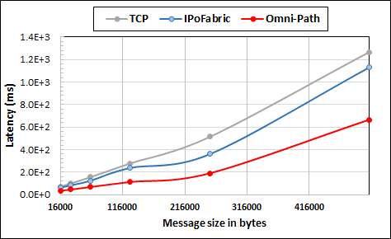
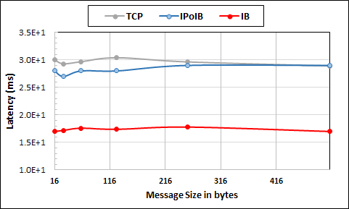
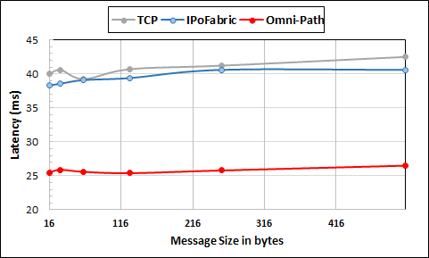
Intel Haswell Cluster with 2.4GHz Processors and 56Gbps Infiniband and 1Gbps Ethernet
Intel KNL Cluster with 1.4GHz Processors and 100Gbps Omni-Path and 1Gbps Ethernet
Large messages
Small messages
Parallelism of 2 and using 8 Nodes
Parallelism of 2 and using 4 Nodes
Twitter Heron Streaming Software using HPC Hardware

Slide 9
Knights Landing KNL Data Analytics: Harp, Spark, NOMAD
Single Node and Cluster performance: 1.4GHz 68 core nodes
Kmeans SGD ALS
Strong Scaling Multi Node Parallelism Scaling - Omnipath Interconnect
Strong Scaling Single Node Core Parallelism Scaling

Slide 10
Components of Big Data Stack
Google likes to show a timeline
2002 Google File System GFS ~HDFS
2004 MapReduce Apache Hadoop
2006 Big Table Apache Hbase
2008 Dremel Apache Drill
2009 Pregel Apache Giraph
2010 FlumeJava Apache Crunch
2010 Colossus better GFS
2012 Spanner horizontally scalable NewSQL database ~CockroachDB
2013 F1 horizontally scalable SQL database
2013 MillWheel ~Apache Storm, Twitter Heron
2015 Cloud Dataflow Apache Beam with Spark or Flink (dataflow) engine
Functionalities not identified: Security, Data Transfer, Scheduling, serverless computing

Slide 11
What is the new technology challenge?
Integrate systems that offer full capabilities
  Scheduling
  Storage
  “Database”
  Programming Model (dataflow and/or “in-place” control-flow) and corresponding runtime
  Analytics
  Workflow
  Function as a Service and Event-based Programming
For both Batch and Streaming
Distributed and Centralized (Grid versus Cluster)
Pleasingly parallel (Local machine learning) and Global machine learning (large scale parallel codes)

Slide 12
What are the main driving forces for new-generation big data software stacks?
Applications ought to drive new-generation big data software stacks but (at many universities) academic applications lag commercial use in big data area and needs are quite modest
  This will change and we can expect big data software stacks to become more important
Note University compute systems historically offer HPC and not Big Data Expertise.
  We could anticipate users moving to public clouds (away from university systems) but
  Users will still want support
Need a Requirements Analysis that builds in application changes that might occur as users get more sophisticated
Need to help (train) users to explore big data opportunities

Slide 13
What chances are provided for the academia communities in exploring the design spaces of big data software stacks?
We need more sophisticated applications to probe some of the most interesting areas
But most near term opportunities are in pleasing parallel (often streaming data) areas
  Popular technology like DASK http://dask.pydata.org for parallel NumPy is pretty inefficient
Clarify when to use dataflow (and Grid technology) and
When to use HPC parallel computing (MPI)
Likely to require careful consideration of grain size and data distribution
Certain to involve multiple mechanisms (hidden from user) if want highest performance (combine HPC and Apache Big Data Stack)

