Slide 1

Twister2: A High-Performance Big Data Programming Environment
HPBDC 2018: The 4th IEEE International Workshop on High-Performance Big Data, Deep Learning, and Cloud Computing
Geoffrey Fox, May 21, 2018
Judy Qiu, Supun Kamburugamuve
Department of Intelligent Systems Engineering
gcf@indiana.edu, http://www.dsc.soic.indiana.edu/, http://spidal.org/
`,
Work with Shantenu Jha, Kannan Govindarajan, Pulasthi Wickramasinghe, Gurhan Gunduz, Ahmet Uyar

Slide 2
Abstract
We analyse the components that are needed in programming environments for Big Data Analysis Systems with scalable HPC performance and the functionality of ABDS – the Apache Big Data Software Stack.
One highlight is Harp-DAAL which is a machine library exploiting the Intel node library DAAL and HPC communication collectives within the Hadoop ecosystem.
Another highlight is Twister2 which consists of a set of middleware components to support batch or streaming data capabilities familiar from Apache Hadoop, Spark, Heron and Flink but with high performance
Twister2 covers bulk synchronous and data flow communication; task management as in Mesos, Yarn and Kubernetes; dataflow graph execution models; launching of the Harp-DAAL library; streaming and repository data access interfaces, in-memory databases and fault tolerance at dataflow nodes.
Similar capabilities are available in current Apache systems but as integrated packages which do not allow needed customization for different application scenarios.

Slide 3
Requirements
On general principles parallel and distributed computing have different requirements even if sometimes similar functionalities
  Apache stack ABDS typically uses distributed computing concepts
  For example, Reduce operation is different in MPI (Harp) and Spark
Large scale simulation requirements are well understood
Big Data requirements are not agreed but there are a few key use types
  Pleasingly parallel processing (including local machine learning LML) as of different tweets from different users with perhaps MapReduce style of statistics and visualizations; possibly Streaming
  Database model with queries again supported by MapReduce for horizontal scaling
  Global Machine Learning GML with single job using multiple nodes as classic parallel computing
  Deep Learning certainly needs HPC – possibly only multiple small systems
Current workloads stress 1) and 2) and are suited to current clouds and to Apache Big Data Software (with no HPC)
  This explains why Spark with poor GML performance can be so successful

Slide 4
Difficulty in Parallelism
Size of Synchronization constraints
Need a toolkit covering all applications with same API but different implementations
Loosely Coupled
Tightly Coupled
HPC Clouds
High Performance Interconnect
HPC Clouds/Supercomputers
Memory access also critical
Commodity Clouds
Size of Disk I/O
MapReduce as in scalable databases
Global Machine Learning
e.g. parallel clustering
Deep Learning
Unstructured Adaptive Sparsity
Medium size Jobs
Pleasingly Parallel
Often independent events
Graph Analytics e.g. subgraph mining
LDA
Current major Big Data category
Linear Algebra at core (typically not sparse)
Large scale simulations
Parameter sweep simulations
Structured Adaptive Sparsity
Huge Jobs
Spectrum of Applications and Algorithms
There is also distribution seen in grid/edge computing
Exascale Supercomputers

Slide 5
Need a toolkit covering 5 main paradigms with same API but different implementations
Note Problem and System Architecture as efficient execution says they must match
Global Machine Learning
Classic Cloud Workload
These 3 are focus of Twister2 but we need to preserve capability on first 2 paradigms

Slide 6
Comparing Spark, Flink and MPI
On Global Machine Learning GML.

Slide 7
Machine Learning with MPI, Spark and Flink
Three algorithms implemented in three runtimes
  Multidimensional Scaling (MDS)
  Terasort
  K-Means (drop as no time and looked at later)
Implementation in Java
  MDS is the most complex algorithm - three nested parallel loops
  K-Means - one parallel loop
  Terasort - no iterations
With care, Java performance ~ C performance
Without care, Java performance << C performance (details omitted)

Slide 8



Multidimensional Scaling: 3 Nested Parallel Sections
Kmeans also bad – see later
Flink
Spark
MPI
MPI Factor of 20-200 Faster than Spark/Flink
MDS execution time with 32000 points on varying number of nodes. Each node runs 20 parallel tasks
Spark, Flink No Speedup
MDS execution time on 16 nodes with 20 processes in each node with varying number of points

Slide 9


Terasort
Sorting 1TB of data records
Terasort execution time in 64 and 32 nodes. Only MPI shows the sorting time and communication time as other two frameworks doesn't provide a clear method to accurately measure them. Sorting time includes data save time.
MPI-IB - MPI with Infiniband
Partition the data using a sample and regroup

Slide 10
Software
HPC-ABDS
HPC-FaaS

Slide 11





NSF 1443054: CIF21 DIBBs: Middleware and High Performance Analytics Libraries for Scalable Data Science
Ogres Application Analysis
HPC-ABDS and HPC-FaaS Software
Harp and Twister2 Building Blocks
SPIDAL Data Analytics Library
Software: MIDAS
HPC-ABDS

Slide 12
HPC-ABDS
Integrated wide range of HPC and Big Data technologies.
I gave up updating list in January 2016!

Slide 13
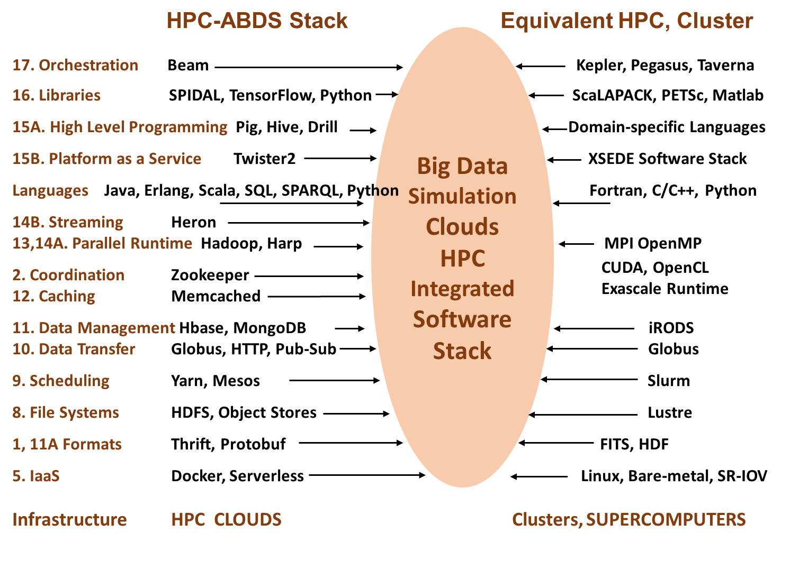
Different choices in software systems in Clouds and HPC. HPC-ABDS takes cloud software augmented by HPC when needed to improve performance
16 of 21 layers plus languages

Slide 14
Harp Plugin for Hadoop: Important part of Twister2
Work of Judy Qiu

Slide 15
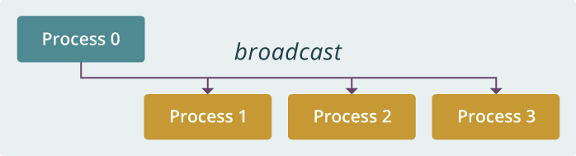
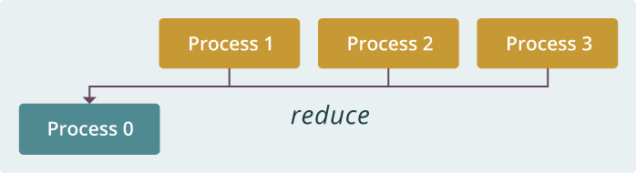
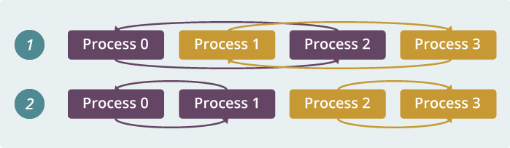
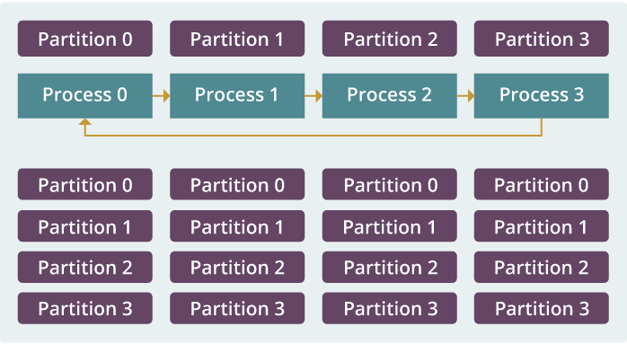
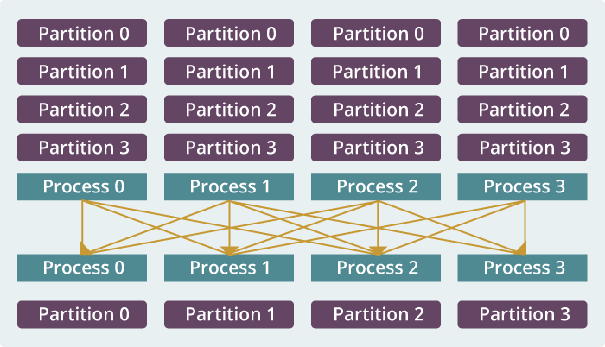
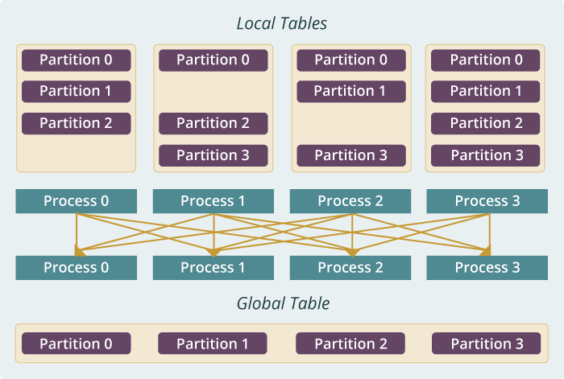
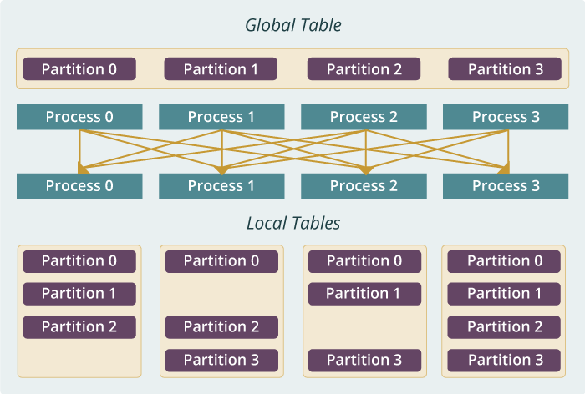
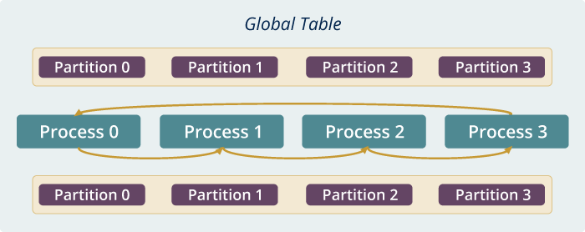
Run time software for Harp
broadcast
reduce
allreduce
allgather
regroup
push & pull
rotate
Map Collective Run time merges MapReduce and HPC

Slide 16
Dynamic Rotation Control for Latent Dirichlet Allocation and Matrix Factorization SGD (stochastic gradient descent)
Multi-Thread Execution
Model Parameters
From Rotation
Model Related Data
Computes until the time arrives, then starts model rotation to address load imbalance
Other Model Parameters
From Caching

Slide 17
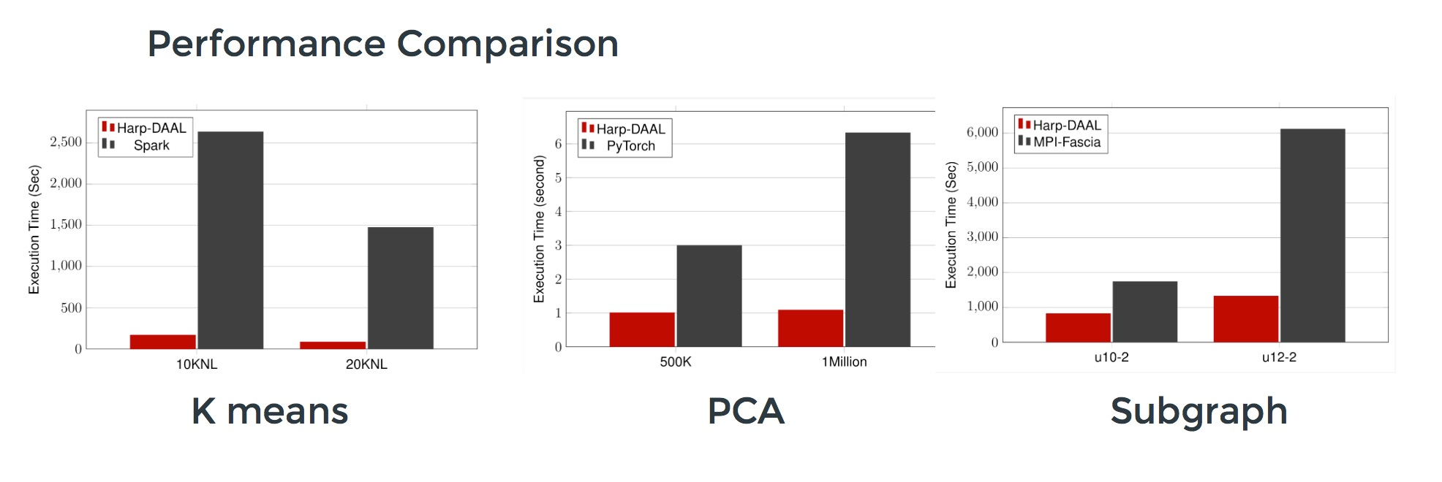
Harp v. Spark Harp v. Torch Harp v. MPI
Datasets: 5 million points, 10 thousand centroids, 10 feature dimensions
10 to 20 nodes of Intel KNL7250 processors
Harp-DAAL has 15x speedups over Spark MLlib
Datasets: 500K or 1 million data points of feature dimension 300
Running on single KNL 7250 (Harp-DAAL) vs. single K80 GPU (PyTorch)
Harp-DAAL achieves 3x to 6x speedups
Datasets: Twitter with 44 million vertices, 2 billion edges, subgraph templates of 10 to 12 vertices
25 nodes of Intel Xeon E5 2670
Harp-DAAL has 2x to 5x speedups over state-of-the-art MPI-Fascia solution

Slide 18
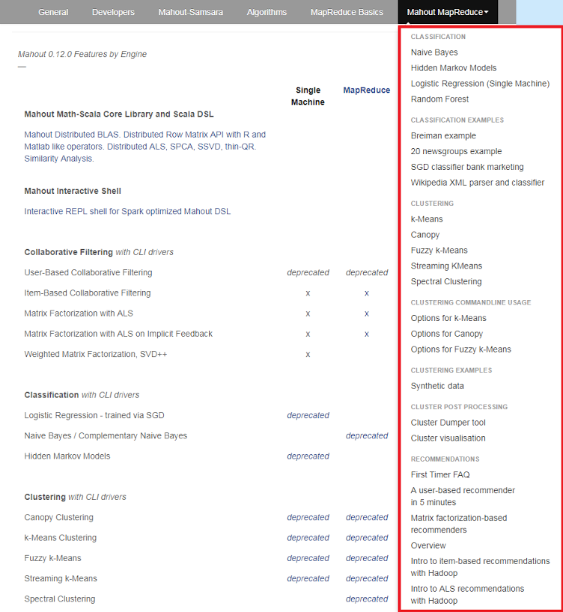
Mahout and SPIDAL
Mahout was Hadoop machine learning library but largely abandoned as Spark outperformed Hadoop
SPIDAL outperforms Spark MLlib and Flink due to better communication and better dataflow or BSP communication.
Has Harp-(DAAL) optimized machine learning interface
SPIDAL also has community algorithms
  Biomolecular Simulation
  Graphs for Network Science
  Image processing for pathology and polar science

Slide 19
Qiu Core SPIDAL Parallel HPC Library with Collective Used
DA-MDS Rotate, AllReduce, Broadcast
Directed Force Dimension Reduction AllGather, Allreduce
Irregular DAVS Clustering Partial Rotate, AllReduce, Broadcast
DA Semimetric Clustering (Deterministic Annealing) Rotate, AllReduce, Broadcast
K-means AllReduce, Broadcast, AllGather DAAL
SVM AllReduce, AllGather
SubGraph Mining AllGather, AllReduce
Latent Dirichlet Allocation Rotate, AllReduce
Matrix Factorization (SGD) Rotate DAAL
Recommender System (ALS) Rotate DAAL
Singular Value Decomposition (SVD) AllGather DAAL
QR Decomposition (QR) Reduce, Broadcast DAAL
Neural Network AllReduce DAAL
Covariance AllReduce DAAL
Low Order Moments Reduce DAAL
Naive Bayes Reduce DAAL
Linear Regression Reduce DAAL
Ridge Regression Reduce DAAL
Multi-class Logistic Regression Regroup, Rotate, AllGather
Random Forest AllReduce
Principal Component Analysis (PCA) AllReduce DAAL
DAAL implies integrated on node with Intel DAAL Optimized Data Analytics Library

Slide 20
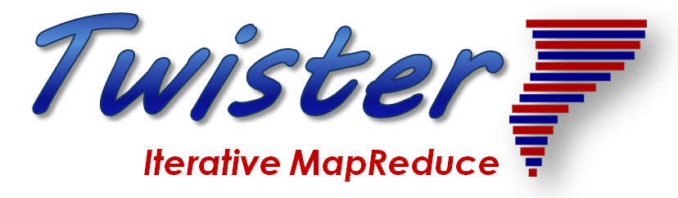
Implementing Twister2 in detail I
http://www.iterativemapreduce.org/
This breaks rule from 2012-2017 of not “competing” with but rather “enhancing” Apache

Slide 21
Twister2: “Next Generation Grid - Edge – HPC Cloud” Programming Environment
Analyze the runtime of existing systems
  Hadoop, Spark, Flink, Pregel Big Data Processing
  OpenWhisk and commercial FaaS
  Storm, Heron, Apex Streaming Dataflow
  Kepler, Pegasus, NiFi workflow systems
  Harp Map-Collective, MPI and HPC AMT runtime like DARMA
  And approaches such as GridFTP and CORBA/HLA (!) for wide area data links
A lot of confusion coming from
different communities (database,
distributed, parallel computing,
machine learning, computational/
data science) investigating similar
ideas with little knowledge exchange
and mixed up (unclear) requirements
http://www.iterativemapreduce.org/

Slide 22
Integrating HPC and Apache Programming Environments
Harp-DAAL with a kernel Machine Learning library exploiting the Intel node library DAAL and HPC communication collectives within the Hadoop ecosystem. The broad applicability of Harp-DAAL is supporting all 5 classes of data-intensive computation, from pleasingly parallel to machine learning and simulations.
Twister2 is a toolkit of components that can be packaged in different ways
  Integrated batch or streaming data capabilities familiar from Apache Hadoop, Spark, Heron and Flink but with high performance.
  Separate bulk synchronous and data flow communication;
  Task management as in Mesos, Yarn and Kubernetes
  Dataflow graph execution models
  Launching of the Harp-DAAL library
  Streaming and repository data access interfaces,
  In-memory databases and fault tolerance at dataflow nodes. (use RDD to do classic checkpoint-restart)

Slide 23
Approach
Clearly define and develop functional layers (using existing technology when possible)
Develop layers as independent components
Use interoperable common abstractions but multiple polymorphic implementations.
Allow users to pick and choose according to requirements such as
  Communication + Data Management
  Communication + Static graph
Use HPC features when possible

Slide 24
Twister2 Components I
Area | Component | Implementation | Comments: User API
Architecture Specification | Coordination Points | State and Configuration Management; Program, Data and Message Level | Change execution mode; save and reset state
 | Execution Semantics | Mapping of Resources to Bolts/Maps in Containers, Processes, Threads | Different systems make different choices - why?
 | Parallel Computing | Spark Flink Hadoop Pregel MPI modes | Owner Computes Rule
Job Submission | (Dynamic/Static) Resource Allocation | Plugins for Slurm, Yarn, Mesos, Marathon, Aurora | Client API (e.g. Python) for Job Management
Task System | Task migration | Monitoring of tasks and migrating tasks for better resource utilization | Task-based programming with Dynamic or Static Graph API; FaaS API; Support accelerators (CUDA,KNL)
 | Elasticity | OpenWhisk
 | Streaming and FaaS Events | Heron, OpenWhisk, Kafka/RabbitMQ
 | Task Execution | Process, Threads, Queues
 | Task Scheduling | Dynamic Scheduling, Static Scheduling, Pluggable Scheduling Algorithms
 | Task Graph | Static Graph, Dynamic Graph Generation

Slide 25
Twister2 Components II
Area | Component | Implementation | Comments
Communication API | Messages | Heron | This is user level and could map to multiple communication systems
 | Dataflow Communication | Fine-Grain Twister2 Dataflow communications: MPI,TCP and RMA Coarse grain Dataflow from NiFi, Kepler? | Streaming, ETL data pipelines; Define new Dataflow communication API and library
 | BSP Communication Map-Collective | Conventional MPI, Harp | MPI Point to Point and Collective API
Data Access | Static (Batch) Data | File Systems, NoSQL, SQL | Data API
 | Streaming Data | Message Brokers, Spouts
Data Management | Distributed Data Set | Relaxed Distributed Shared Memory(immutable data), Mutable Distributed Data | Data Transformation API; Spark RDD, Heron Streamlet
Fault Tolerance | Check Pointing | Upstream (streaming) backup; Lightweight; Coordination Points; Spark/Flink, MPI and Heron models | Streaming and batch cases distinct; Crosses all components
Security | Storage, Messaging, execution | Research needed | Crosses all Components

Slide 26
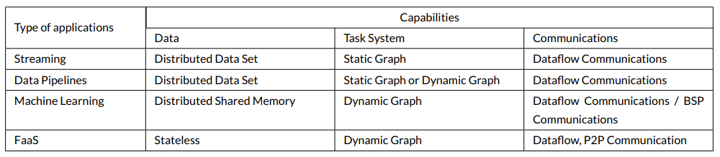
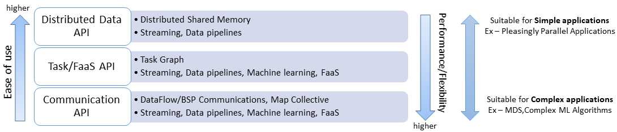
Different applications at different layers
Spark, Flink
Hadoop,
Heron,
Storm
None

Slide 27
Implementing Twister2 in detail II
http://www.iterativemapreduce.org/
Look at Communication in detail

Slide 28
Communication Models
MPI Characteristics: Tightly synchronized applications
  Efficient communications (µs latency) with use of advanced hardware
  In place communications and computations (Process scope for state)
Basic dataflow: Model a computation as a graph
  Nodes do computations with Task as computations and
  edges are asynchronous communications
  A computation is activated when its input data dependencies
  are satisfied
Streaming dataflow: Pub-Sub with data partitioned into streams
  Streams are unbounded, ordered data tuples
  Order of events important and group data into time windows
Machine Learning dataflow: Iterative computations and keep track of state
  There is both Model and Data, but typically only communicate the model
  Collective communication operations such as AllReduce AllGather (no differential operators in Big Data problems)
  Can use in-place MPI style communication
W
S
W
G
S
Dataflow
W

Slide 29
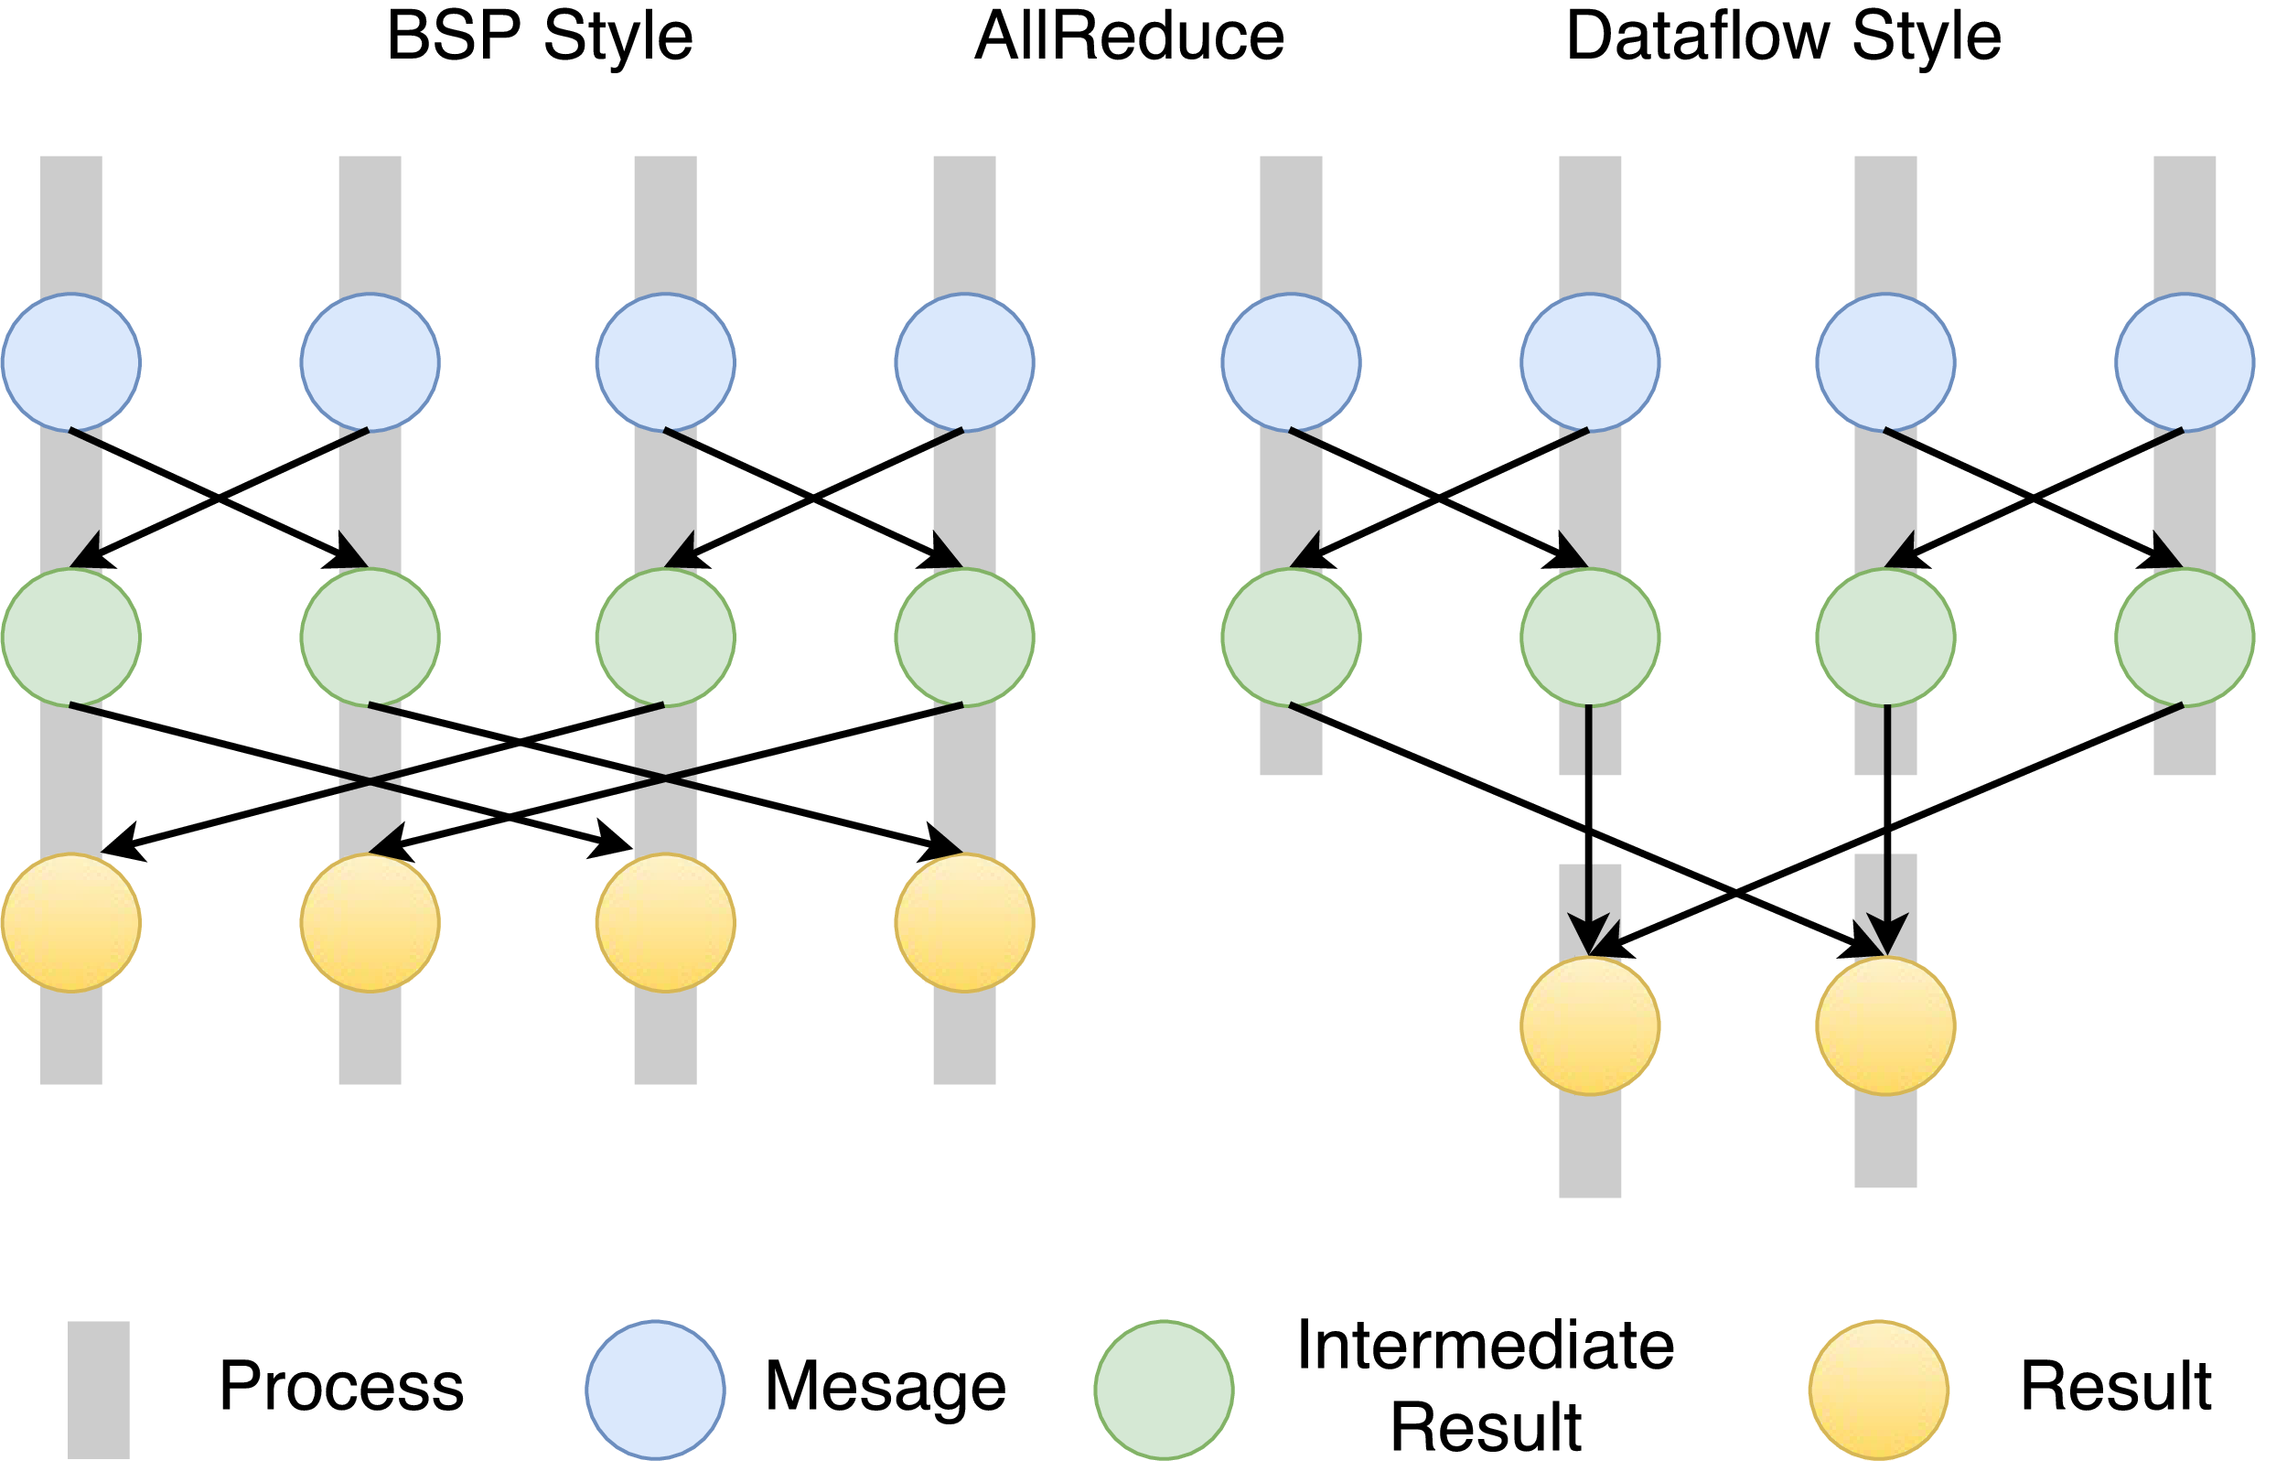
Twister2 Dataflow Communications
Twister:Net offers two communication models
  BSP (Bulk Synchronous Processing) communication using TC or MPI separated from its task management plus extra Harp collectives
plus a new Dataflow library DFW built using MPI software but at data movement not message level
  Non-blocking
  Dynamic data sizes
  Streaming model
    Batch case is modeled as a finite stream
  The communications are between a set of
  tasks in an arbitrary task graph
  Key based communications
  Communications spilling to disks
  Target tasks can be different from source tasks

Slide 30
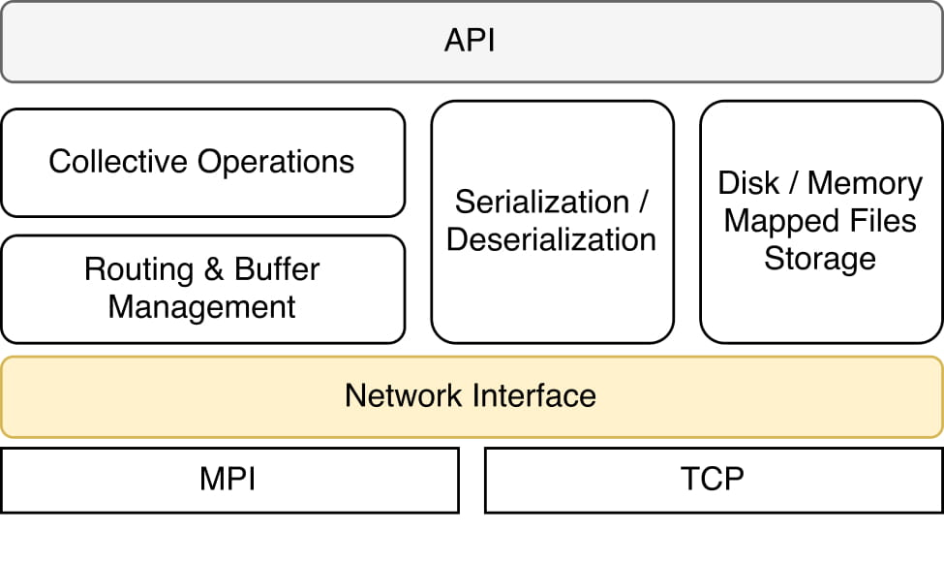
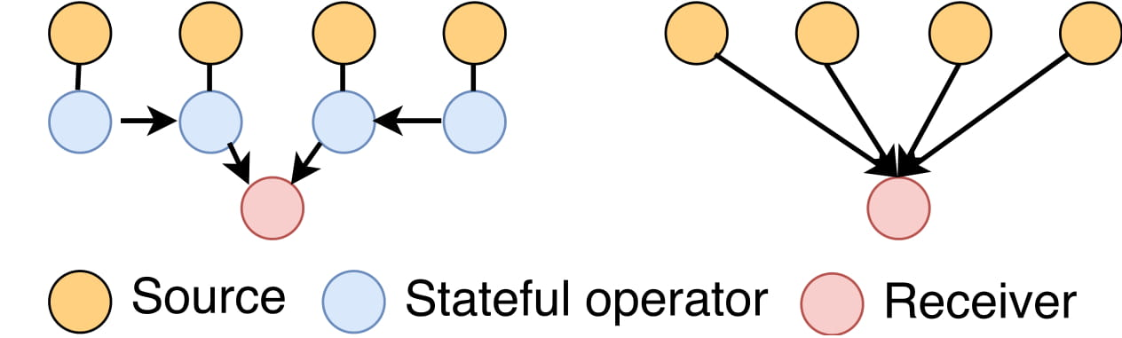
Twister:Net
Communication operators are stateful
  Buffer data
  handle imbalanced dynamically sized communications,
  act as a combiner
Thread safe
Initialization
  MPI
  TCP / ZooKeeper
Buffer management
  The messages are serialized by the library
Back-pressure
  Uses flow control by the underlying channel
Architecture
Reduce | Gather | Partition | Broadcast
AllReduce | AllGather | Keyed-Partition
Keyed-Reduce | KeyedGather
Optimized operation vs Basic (Flink, Heron)
Batch and Streaming versions of above currently available

Slide 31
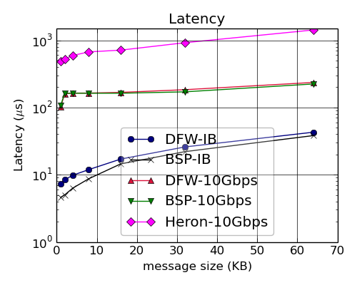
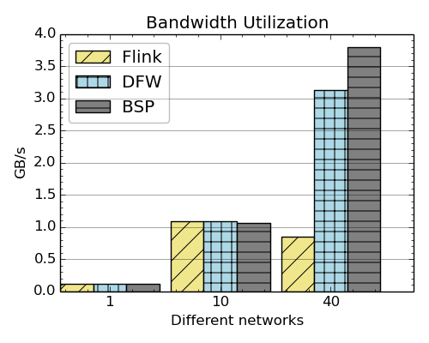
Bandwidth & Latency Kernel
Latency and bandwidth between two tasks running in two nodes
Latency of MPI and Twister:Net with different message sizes on a two-node setup
Bandwidth utilization of Flink, Twister2 and OpenMPI over 1Gbps, 10Gbps and IB with Flink on IPoIB

Slide 32
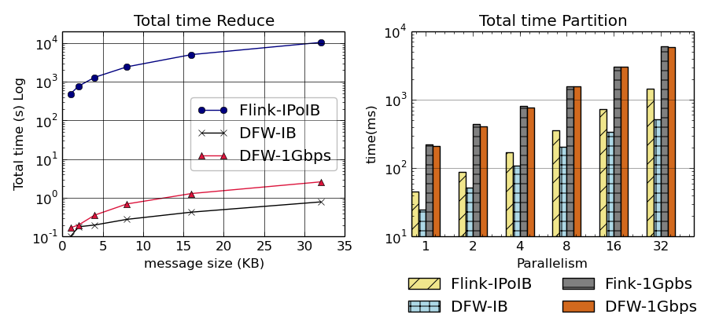
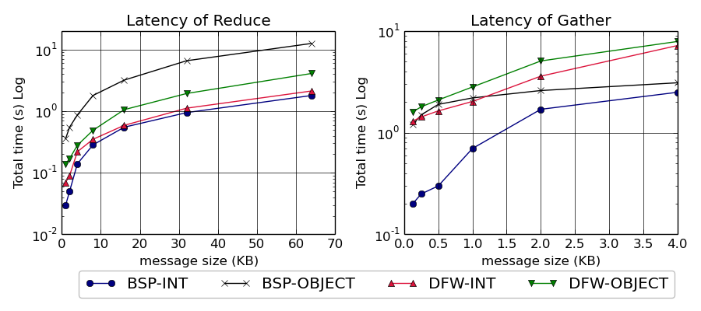
Flink, BSP and DFW Performance
Total time for Flink and Twister:Net for Reduce and Partition operations in 32 nodes with 640-way parallelism. The time is for 1 million messages in each parallel unit, with the given message size
Latency for Reduce and Gather operations in 32 nodes with 256-way parallelism. The time is for 1 million messages in each parallel unit, with the given message size. For BSP-Object case we do two MPI calls with MPIAllReduce / MPIAllGather first to get the lengths of the messages and the actual call. InfiniBand network is used.

Slide 33
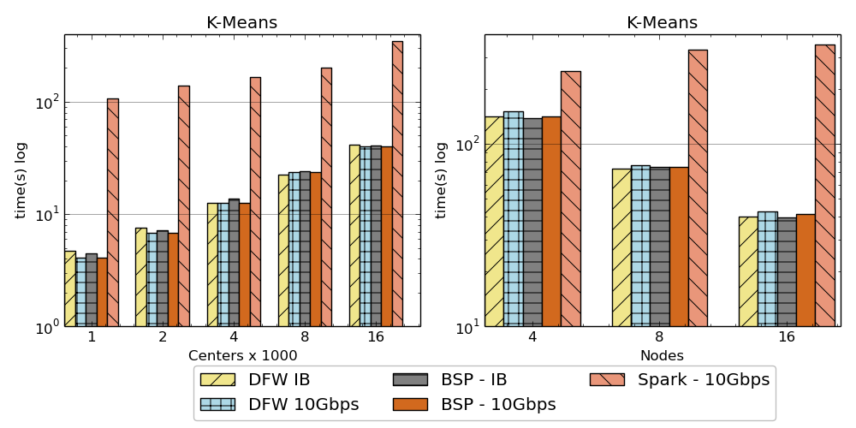

K-Means algorithm performance
AllReduce Communication
Left: K-means job execution time on 16 nodes with varying centers, 2 million points with 320-way parallelism. Right: K-Means wth 4,8 and 16 nodes where each node having 20 tasks. 2 million points with 16000 centers used.

Slide 34
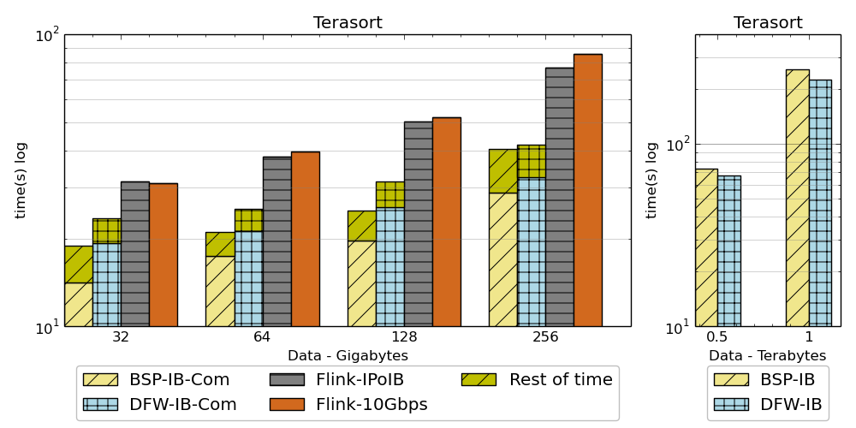
Sorting Records
For DFW case, a single node can get congested if many processes send message simultaneously.
Left: Terasort time on a 16 node cluster with 384 parallelism. BSP and DFW shows the communication time. Right: Terasort on 32 nodes with .5 TB and 1TB datasets. Parallelism of 320. Right 16 node cluster (Victor), Left 32 node cluster (Juliet) with InfiniBand.
Partition the data using a sample and regroup
BSP algorithm waits for others to send messages in a ring topology and can be in-efficient compared to DFW case where processes do not wait.

Slide 35
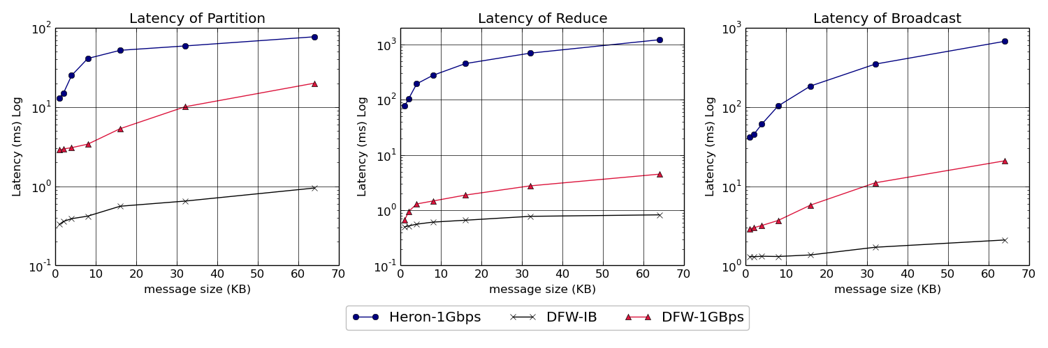
Twister:Net and Apache Heron for Streaming
Latency of Apache Heron and Twister:Net DFW (Dataflow) for Reduce, Broadcast and Partition operations in 16 nodes with 256-way parallelism

Slide 36
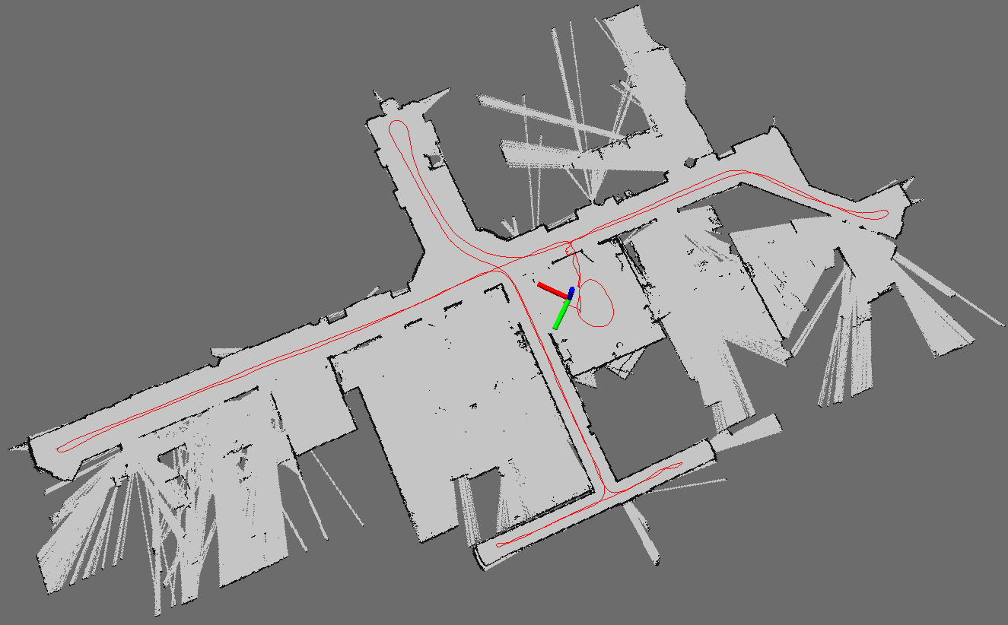
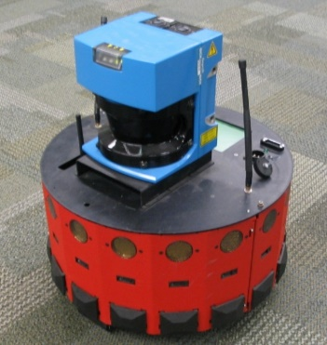
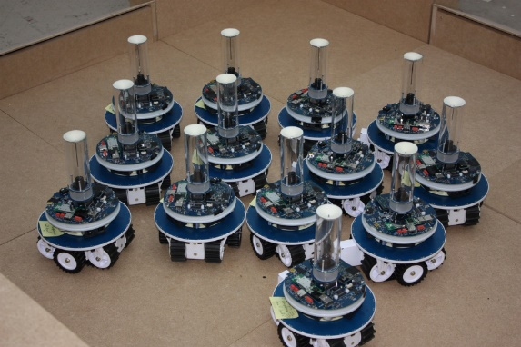
Robot Algorithms
Simultaneous Localization and Mapping
N-Body Collision Avoidance
Map Built from Robot data
Robot with a Laser Range Finder
Robots need to avoid collisions when they move

Slide 37
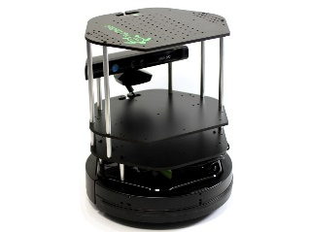
SLAM Simultaneous Localization and Mapping
Rao blackwellized particle filter based SLAM
Sending to
pub-sub
Sending to
Persisting
to storage
Multiple
streaming
workflows
Streaming
workflow
A stream application with some tasks running in parallel
Gateway
Message Brokers
RabbitMQ, Kafka
Streaming SLAM Algorithm
Apache Storm
End to end delays without any processing is less than 10ms
Hosted in FutureSystems OpenStack cloud which is accessible through IU network

Slide 38
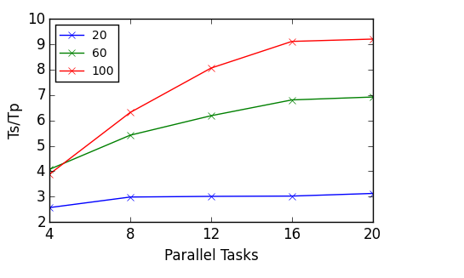
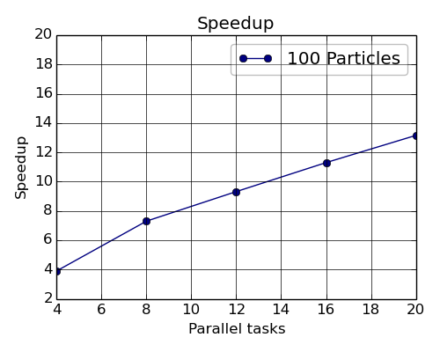
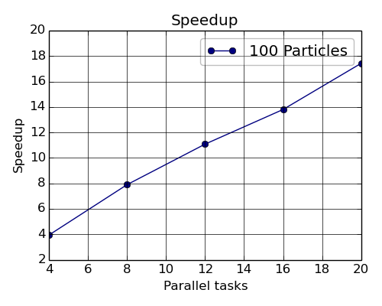
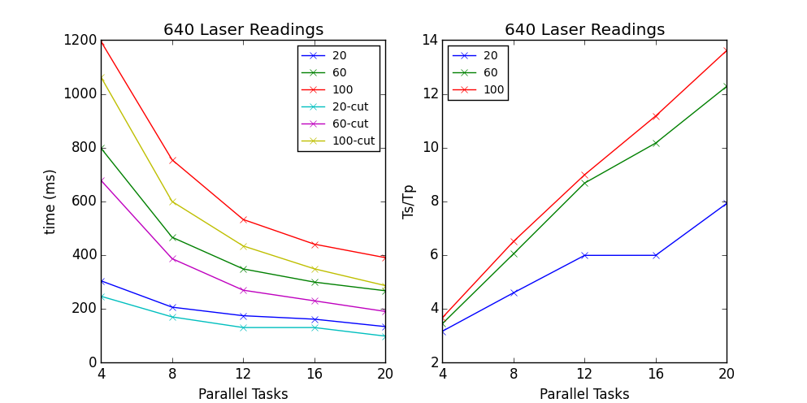
Performance of SLAM Storm v. Twister2
180 Laser readings
Twister2 Implementation speedup.
640 Laser readings
180 Laser readings
640 Laser readings
Storm Implementation Speedup

Slide 39
Implementing Twister2 in detail III
http://www.iterativemapreduce.org/
State

Slide 40
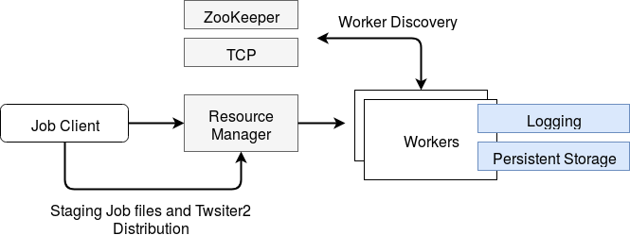
Resource Allocation
Job Submission & Management
  twister2 submit
Resource Managers
    Slurm
    Nomad
    Kubernetes
    Mesos

Slide 41
Kubernetes and Mesos Worker Initialization Times
Kubernetes
Mesos
It takes around 5 seconds to initialize a worker in Kubernetes.
It takes around 3 seconds to initialize a worker in Mesos.
When 3 workers are deployed in one executor or pod, initialization times are faster in both systems.

Slide 42
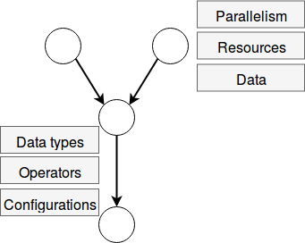
Task System
User defined operator
Generate computation graph dynamically
  Dynamic scheduling of tasks
  Allow fine grained control of the graph
Generate computation graph statically
  Dynamic or static scheduling
  Suitable for streaming and data query applications
  Hard to express complex computations, especially with loops
Hybrid approach
  Combine both static and dynamic graphs
Communication

Slide 43
Task Graph Execution
User Graph
Scheduler
Scheduler Plan
Execution Planner
Execution Plan
Executor
Worker Plan
Network
Scheduling Algorithms
Task Scheduler is pluggable
Executor is pluggable
Scheduler running on all the workers
Streaming
  Round robin
  First fit
Batch
  Data locality aware

Slide 44

Dataflow at Different Grain sizes
Coarse Grain Dataflows links jobs in such a pipeline
Visualization
Dimension
Reduction
Data preparation
Clustering
But internally to each job you can also elegantly express algorithm as dataflow but with more stringent performance constraints
Corresponding to classic Spark K-means Dataflow
P = loadPoints()
C = loadInitCenters()
for (int i = 0; i < 10; i++) {
T = P.map().withBroadcast(C)
C = T.reduce() }
Internal Execution
Dataflow Nodes
Reduce
Iterate
HPC
Communication
Maps
Iterate

Slide 45
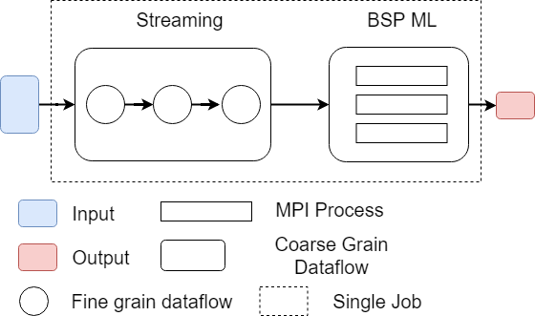
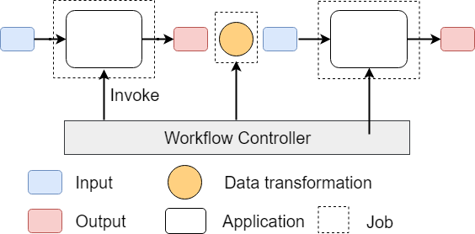
Workflow vs Dataflow: Different grain sizes and different performance trade-offs
The dataflow can expand from Edge to Cloud
Workflow Controlled by Workflow Engine or a Script
Dataflow application running as a single job

Slide 46
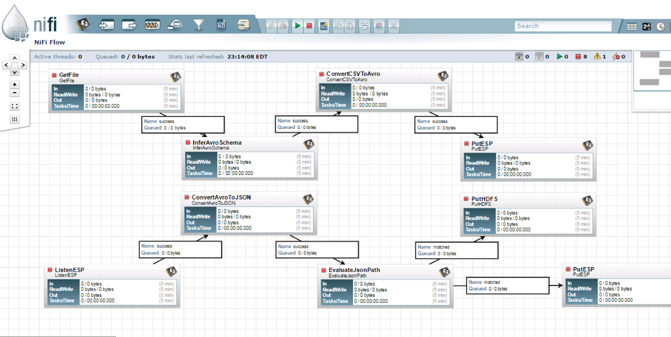
NiFi Workflow

Slide 47

Flink MDS Dataflow Graph

Slide 48
Systems State Spark Kmeans Dataflow
State is handled differently in systems
  CORBA, AMT, MPI and Storm/Heron have long running tasks that preserve state
  Spark and Flink preserve datasets across dataflow node using in-memory databases
  All systems agree on coarse grain dataflow; only keep state by exchanging data
P = loadPoints()
C = loadInitCenters()
for (int i = 0; i < 10; i++) {
T = P.map().withBroadcast(C)
C = T.reduce() }
Iterate
Save State at Coordination Point
Store C in RDD

Slide 49
Fault Tolerance and State
Similar form of check-pointing mechanism is used already in HPC and Big Data
  although HPC informal as doesn’t typically specify as a dataflow graph
  Flink and Spark do better than MPI due to use of database technologies; MPI is a bit harder due to richer state but there is an obvious integrated model using RDD type snapshots of MPI style jobs
Checkpoint after each stage of the dataflow graph (at location of intelligent dataflow nodes)
  Natural synchronization point
  Let’s allows user to choose when to checkpoint (not every stage)
  Save state as user specifies; Spark just saves Model state which is insufficient for complex algorithms

Slide 50
Implementing Twister2
Futures
http://www.iterativemapreduce.org/

Slide 51
Twister2 Timeline: End of August 2018
Twister:Net Dataflow Communication API
  Dataflow communications with MPI or TCP
Harp for Machine Learning (Custom BSP Communications)
  Rich collectives
  Around 30 ML algorithms
HDFS Integration
Task Graph
  Streaming - Storm model
  Batch analytics - Hadoop
Deployments on Docker, Kubernetes, Mesos (Aurora), Nomad, Slurm

Slide 52
Twister2 Timeline: End of December 2018
Native MPI integration to Mesos, Yarn
Naiad model based Task system for Machine Learning
Link to Pilot Jobs
Fault tolerance
  Streaming
  Batch
Hierarchical dataflows with Streaming, Machine Learning and Batch integrated seamlessly
Data abstractions for streaming and batch (Streamlets, RDD)
Workflow graphs (Kepler, Spark) with linkage defined by Data Abstractions (RDD)
End to end applications

Slide 53
Twister2 Timeline: After December 2018
Dynamic task migrations
RDMA and other communication enhancements
Integrate parts of Twister2 components as big data systems enhancements (i.e. run current Big Data software invoking Twister2 components)
  Heron (easiest), Spark, Flink, Hadoop (like Harp today)
Support different APIs (i.e. run Twister2 looking like current Big Data Software)
  Hadoop
  Spark (Flink)
  Storm
Refinements like Marathon with Mesos etc.
Function as a Service and Serverless
Support higher level abstractions
  Twister:SQL

Slide 54
Summary of Twister2: Next Generation HPC Cloud + Edge + Grid
We have built a high performance data analysis library SPIDAL
We have integrated HPC into many Apache systems with HPC-ABDS with rich set of collectives
We have done a preliminary analysis of the different runtimes of Hadoop, Spark, Flink, Storm, Heron, Naiad, DARMA (HPC Asynchronous Many Task) and identified key components
There are different technologies for different circumstances but can be unified by high level abstractions such as communication/data/task API’s
Apache systems use dataflow communication which is natural for distributed systems but slower for classic parallel computing
  No standard dataflow library (why?). Add Dataflow primitives in MPI-4?
HPC could adopt some of tools of Big Data as in Coordination Points (dataflow nodes), State management (fault tolerance) with RDD (datasets)
Could integrate dataflow and workflow in a cleaner fashion
Not clear so many big data and resource management approaches needed

