Slide 1

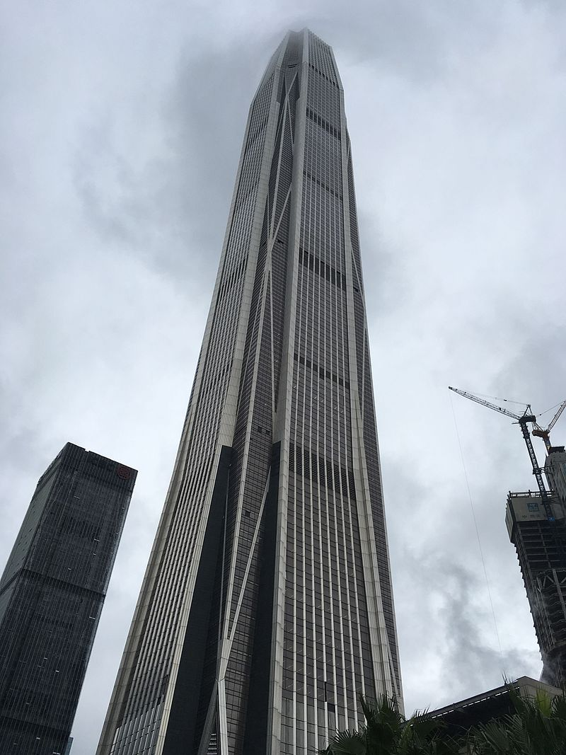
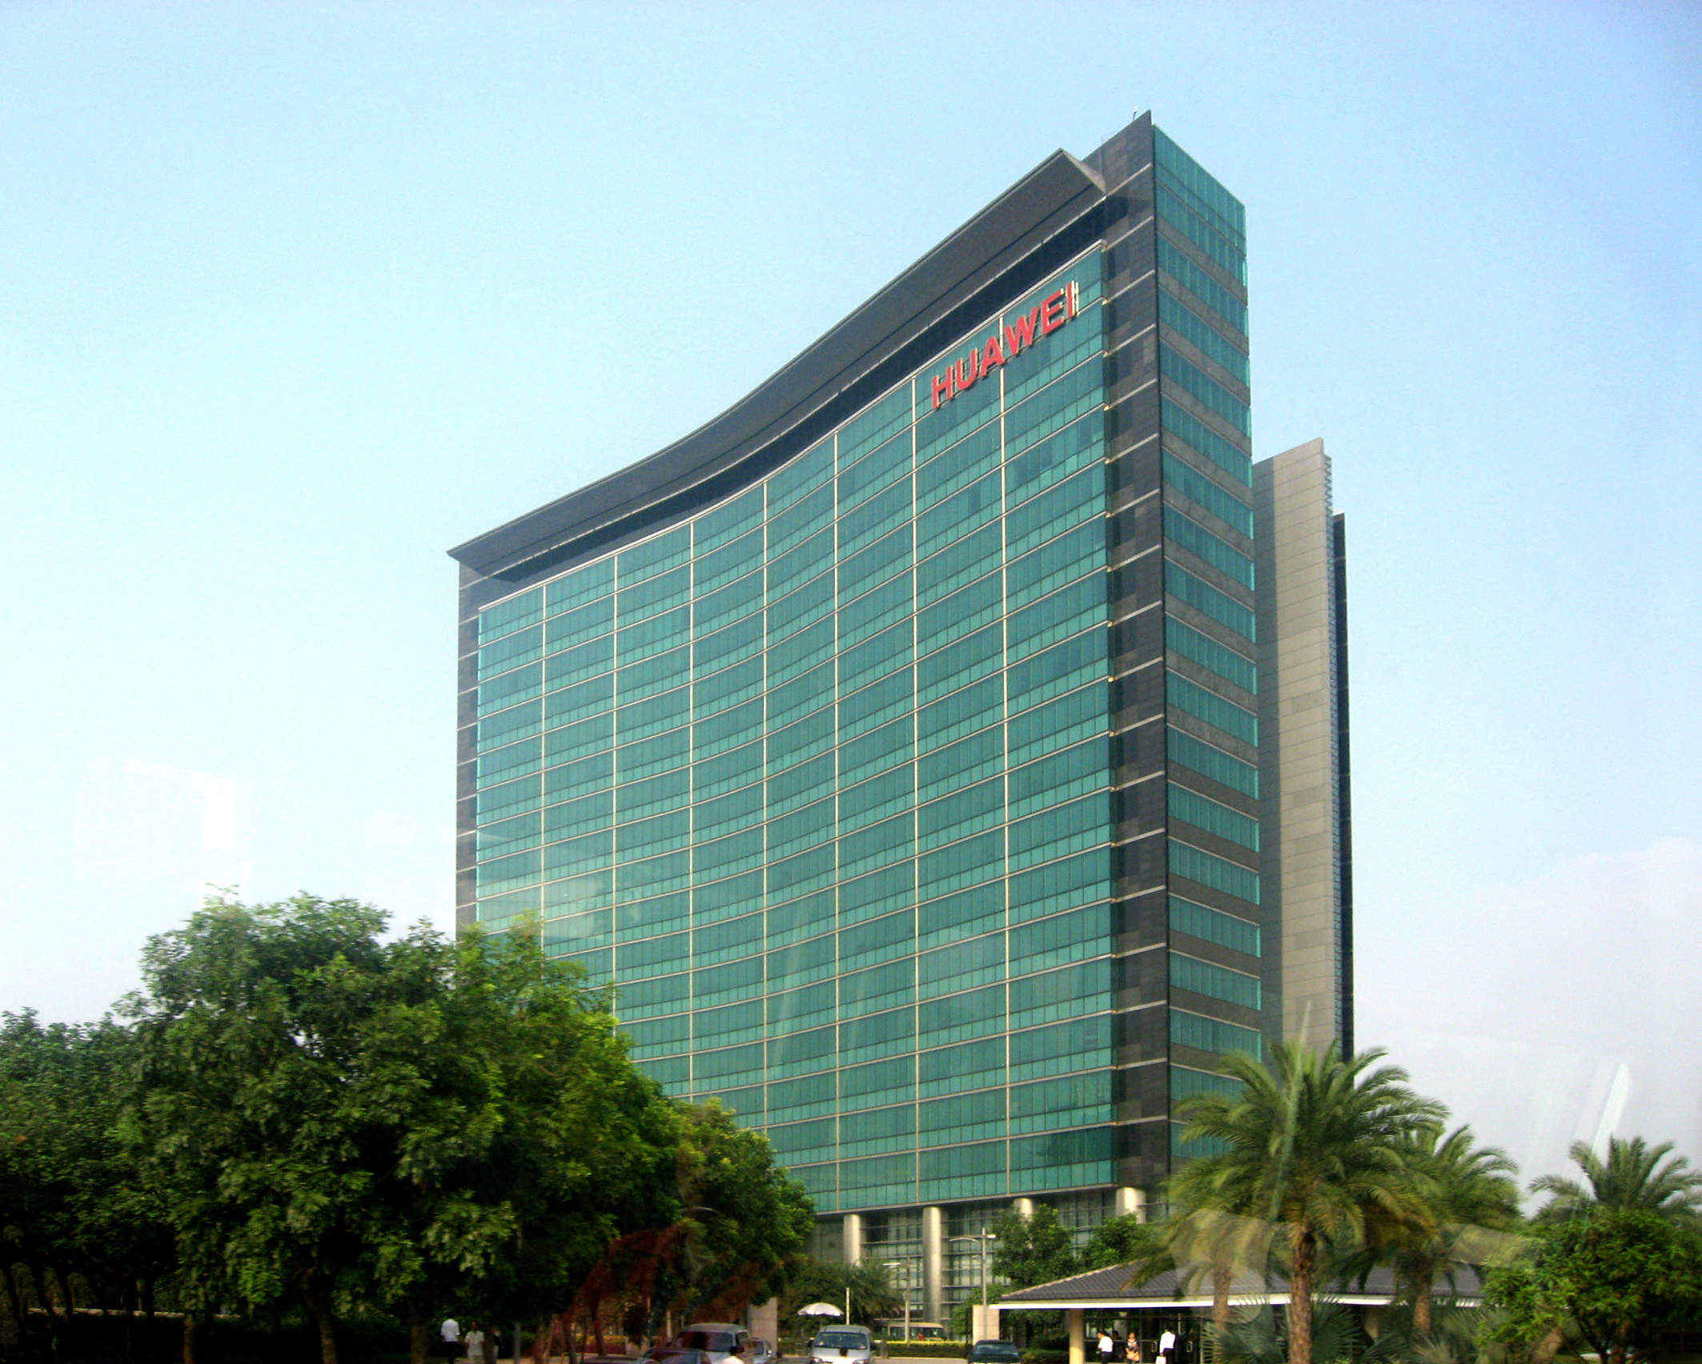
HPC, AI, and Big Data, what is the future of CS research and how should we support them?
Shenzhen, China
Geoffrey Fox, May 10, 2019
gcf@indiana.edu,
http://www.dsc.soic.indiana.edu/,
http://spidal.org/
Digital
Science Center

Slide 2
Panel Charge
HPC (including Cloud), AI and Big Data are the current hot issues in computing, could you comment on:
What is the relation of the three areas (including, is AI the driving force of the other two, etc.), and why do you think so (please introduce your background first)?
Many agree that the new burst of AI is due to the advance of computing and the availability of big data. Do you agree with it? In any case, please provide your comment on
  what we can do to maintain the current AI momentum?
  Is the future of HPC and big data tied to the development of AI?
  Do you expect a fundamental breakthrough in AI, why or why not?
What are the suggestions you like to give to researchers and funding agencies on investing and simulating scientific discovery and innovation along the line of HPC, big data and AI?

Slide 3
Security
Security
AI
AI
CS
CS
IoT, ML
IoT, ML

Slide 4
Big Data
TensorFlow
Clouds
Supercomputer
Edge

Slide 5
GCP
GCP
Big Data
Big Data
Clouds
Clouds
AWS
AWS
Azure

Slide 6
Importance of HPC, Cloud and Big Data Community
HPC Community malingering in terms of new faculty advertisements, student interest, papers published
This is happening even though processing Big Data obviously requires HPC unless it is dominantly Hadoop style big data management
SysML Conference Stanford March 31 - April 2, 2019 is the mainstream systems + ML community and “taking over” (15.5 Academia to 14.5 Industry)
HPC community should be more modest and try to join main stream
  Otherwise they will be ignored as mainstream larger and supported by Industry
Cloud Community quite strong in Industry; relatively small academically as Industry has many advantages
Big data community strong in Academia and Industry although definition less clear as most things are big data.

Slide 7
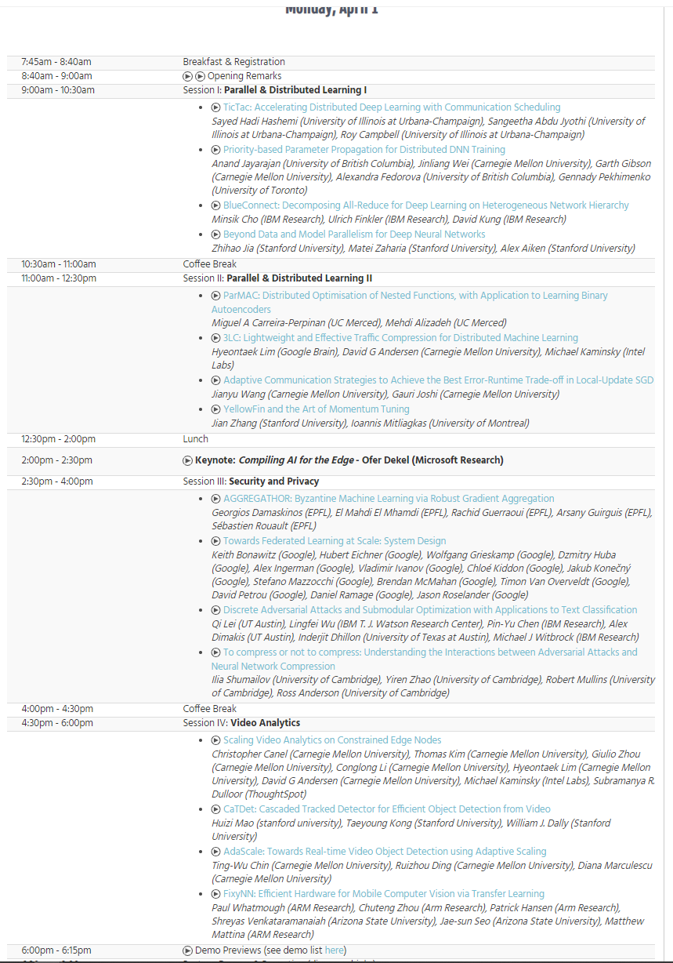
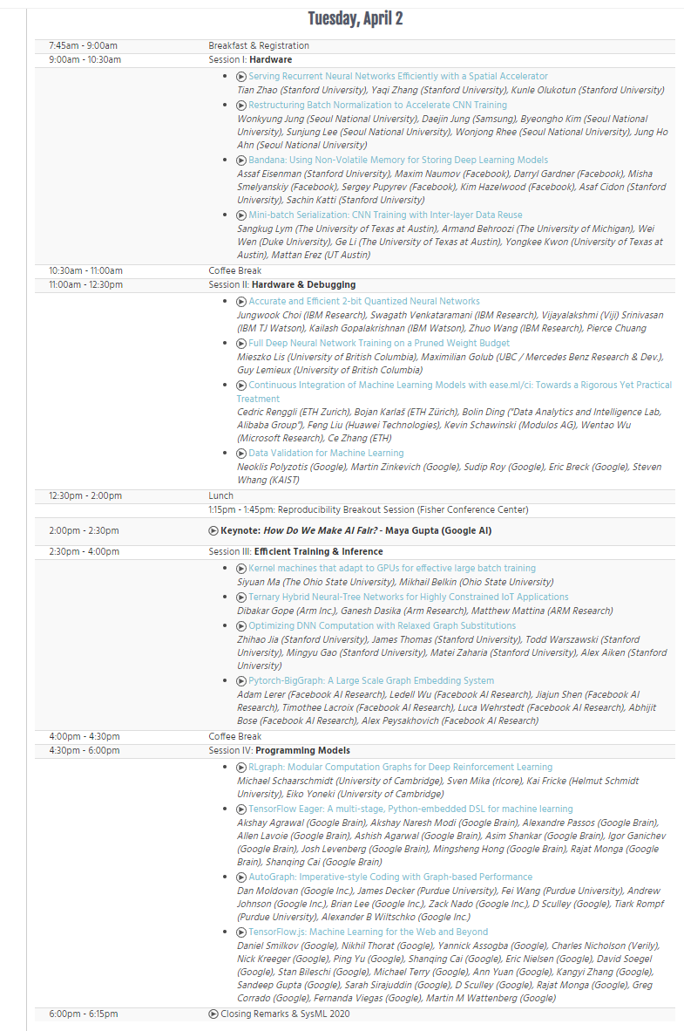
SysML Conference Stanford March 31 - April 2, 2019

Slide 8
Importance of AI
AI (and several forms of ML) will dominate the next 10 years and it has distinctive impact on applications whereas HPC, Clouds and Big Data are less distinctive enablers
  We should replace emphasis on data science with AI First X where X runs over areas where AI can help e.g. AI First Engineering; AI First Cyberinfrastructure; AI First Social Science etc.
Not only do we have HPCrunsML (most effective way to run AI)
  Contribute to MLPerf
But more promising is MLforHPC where AI enhances HPC (and all computation) as discussed in my keynote
  Should give zettaflop effective performance running on today’s machines before we build exascale

Slide 9
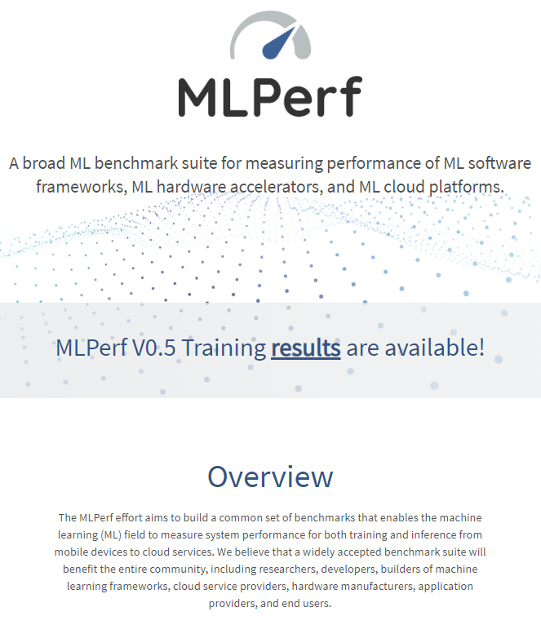
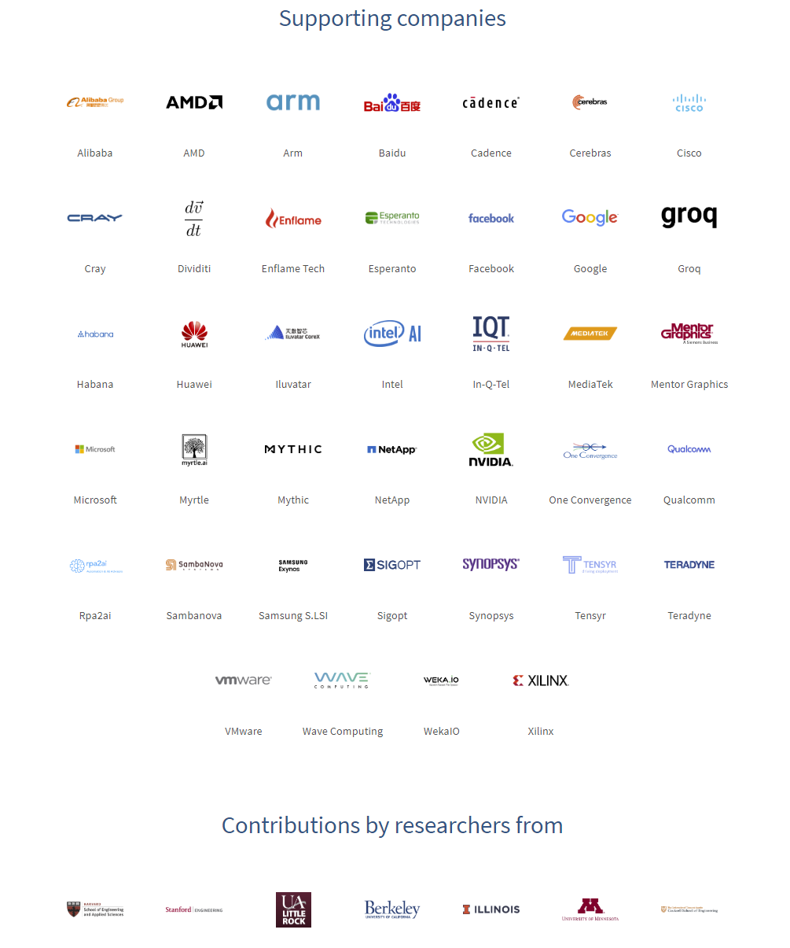
Note Industry Dominance

Slide 10
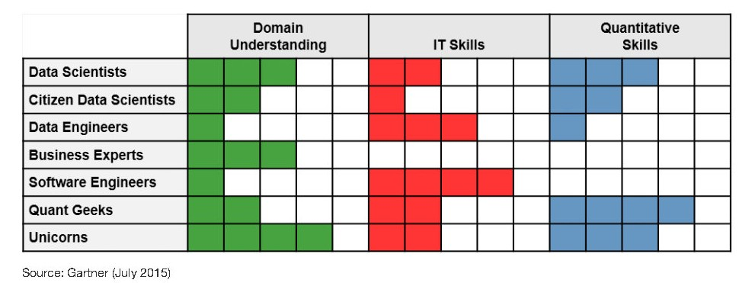
Gartner on Data Science, Data Engineering and Software Engineering
Gartner says that job numbers in data science teams are
10% - Data Scientists are quite small fraction
20% - Citizen Data Scientists ("decision makers")
30% - Data Engineers
20% - Business experts
15% - Software engineers
5% - Quant geeks
~0% - Unicorns
(very few exist!)

Slide 11
Communities/Expertise in Future World
Hard core ML community enhances Machine Learning Algorithms
AI First Engineering community uses and advances
  AI
  HPC and Cyberinfrastructure
  Parallel and Distributed Computing
  Edge Computing and Internet of Things
To build High Performance Big Data systems addressing all important research and community/industry needs
All of this part of Applied Computer Science

