Slide 1
Performance Analysis of High Performance Parallel Applications on Virtualized Resources
Jaliya Ekanayake and Geoffrey Fox
Indiana University 501 N Morton Suite 224 Bloomington IN 47404
{Jekanaya, gcf}@indiana.edu

Slide 2
Private Cloud Infrastructure
Eucalyptus and Xen based private cloud infrastructure
Eucalyptus version 1.4 and Xen version 3.0.3
Deployed on 16 nodes each with 2 Quad Core Intel Xeon processors and 32 GB of memory
All nodes are connected via a 1 giga-bit connections
Bare-metal and VMs use exactly the same software environments
Red Hat Enterprise Linux Server release 5.2 (Tikanga) operating system. OpenMPI version 1.3.2 with gcc version 4.1.2.

Slide 3
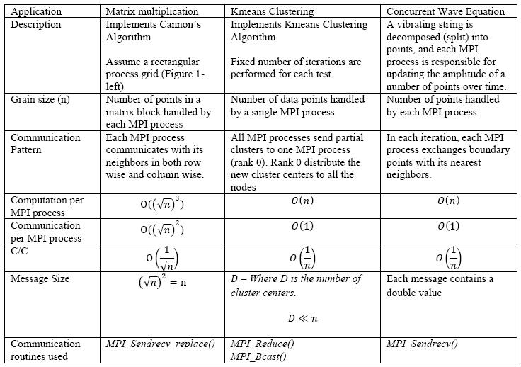
MPI Applications

Slide 4
Different Hardware/VM configurations
Ref | Description | Number of CPU cores accessible to the virtual or bare-metal node | Amount of memory (GB) accessible to the virtual or bare-metal node | Number of virtual or bare-metal nodes deployed
BM | Bare-metal node | 8 | 32 | 16
1-VM-8-core | 1 VM instance per bare-metal node | 8 | 30 (2GB is reserved for Dom0) | 16
2-VM-4- core | 2 VM instances per bare-metal node | 4 | 15 | 32
4-VM-2-core | 4 VM instances per bare-metal node | 2 | 7.5 | 64
8-VM-1-core | 8 VM instances per bare-metal node | 1 | 3.75 | 128
Invariant used in selecting the number of MPI processes
Number of MPI processes = Number of CPU cores used

Slide 5
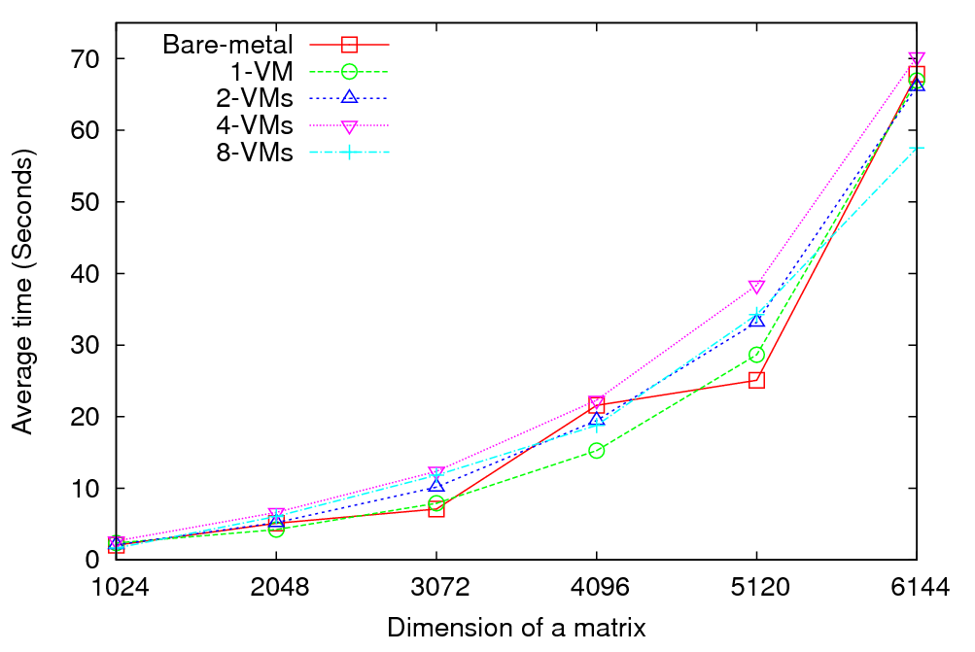
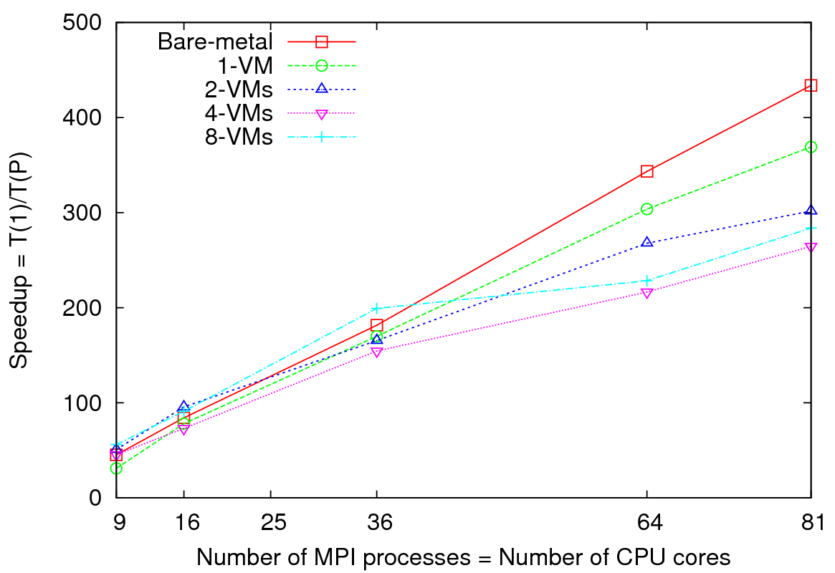
Matrix Multiplication
Performance - 64 CPU cores
Speedup – Fixed matrix size (5184x5184)
Implements Cannon’s Algorithm [1]
Exchange large messages
More susceptible to bandwidth than latency
At 81 MPI processes, at least 14% reduction in speedup is noticeable
[1] S. Johnsson, T. Harris, and K. Mathur, “Matrix multiplication on the connection machine,” In Proceedings of the 1989 ACM/IEEE Conference on Supercomputing (Reno, Nevada, United States, November 12 - 17, 1989). Supercomputing '89. ACM, New York, NY, 326-332. DOI= http://doi.acm.org/10.1145/76263.76298

Slide 6
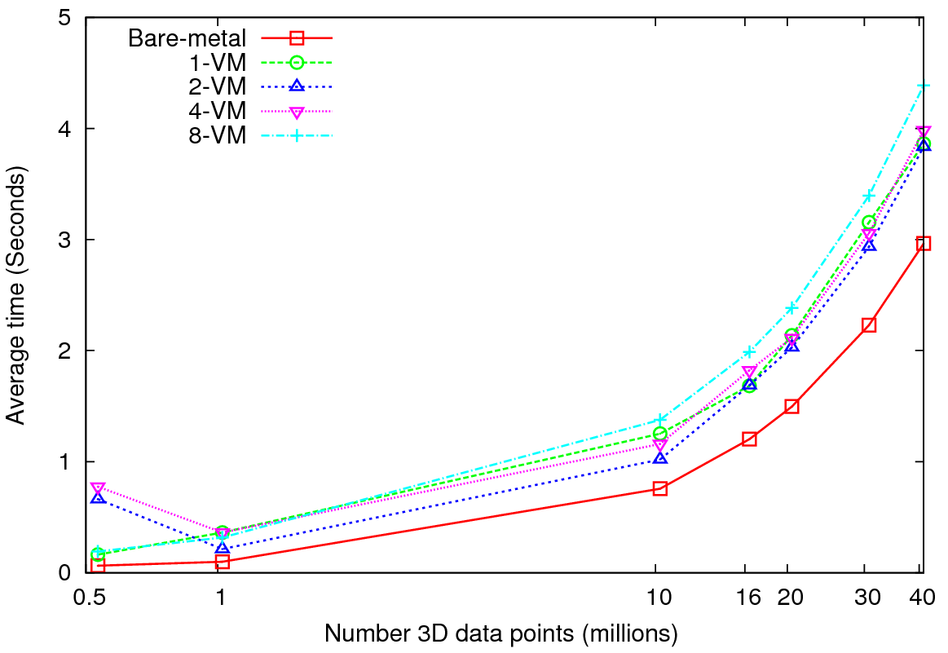
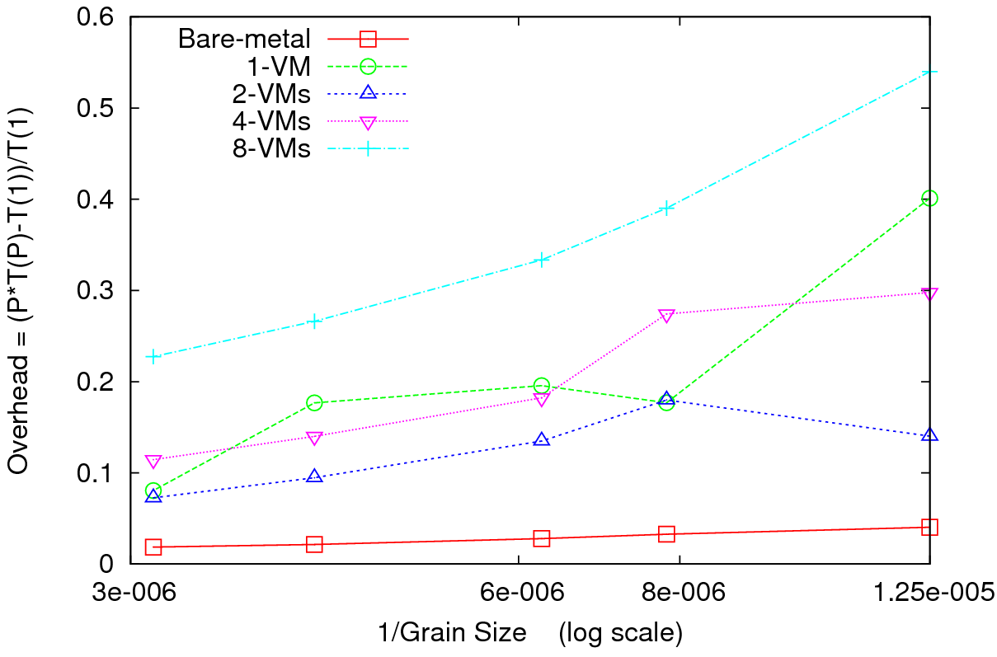
Kmeans Clustering
Performance – 128 CPU cores
Overhead
Perform Kmeans clustering for up to 40 million 3D data points
Amount of communication depends only on the number of cluster centers
Amount of communication << Computation and the amount of data processed
At the highest granularity VMs show at least 3.5 times overhead compared to bare-metal
Extremely large overheads for smaller grain sizes

Slide 7
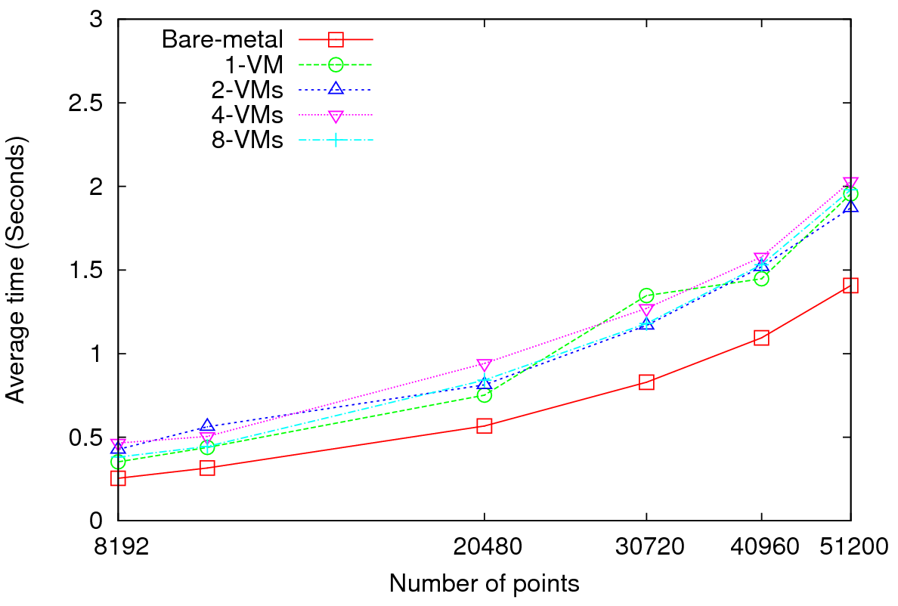
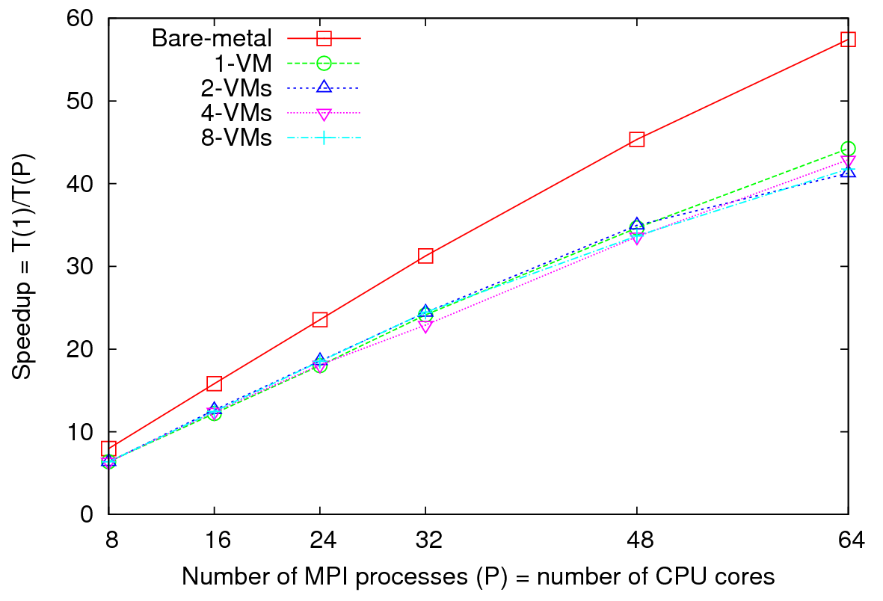
Concurrent Wave Equation Solver
Performance - 64 CPU cores
Total Speedup – 30720 data points
Clear difference in performance and speedups between VMs and bare-metal
Very small messages (the message size in each MPI_Sendrecv() call is only 8 bytes)
More susceptible to latency
At 51200 data points, at least 40% decrease in performance is observed in VMs

Slide 8
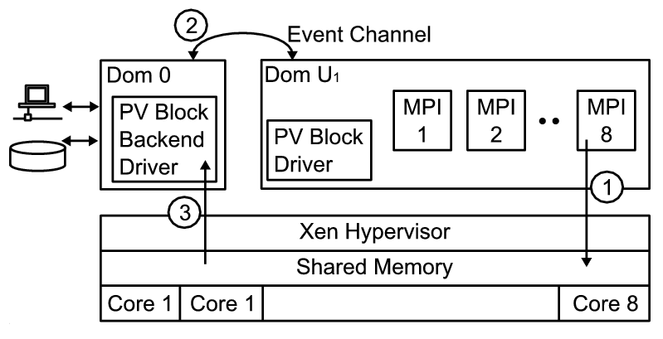
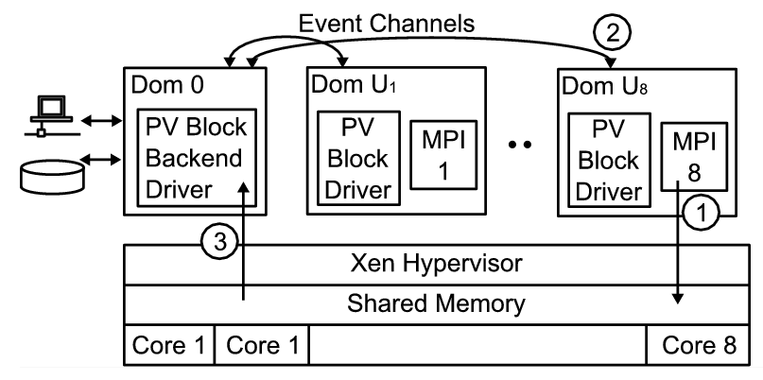
Higher latencies -1
Xen configuration for 1-VM per node
8 MPI processes inside the VM
Xen configuration for 8-VMs per node
1 MPI process inside each VM
domUs (VMs that run on top of Xen para-virtualization) are not capable of performing I/O operations
dom0 (privileged OS) schedules and executes I/O operations on behalf of domUs
More VMs per node => more scheduling => higher latencies

Slide 9
Higher latencies -2
Kmeans Clustering
Lack of support for in-node communication => “Sequentilizing” parallel communication
Better support for in-node communication in OpenMPI outperforms LAM-MPI for 1-VM per node configuration
In 8-VMs per node, 1 MPI process per VM configuration, both OpenMPI and LAM-MPI perform equally well

Slide 10
Conclusions and Future Works
It is plausible to use virtualized resources for HPC applications
MPI applications experience moderate to high overheads when performed on virtualized resources
Applications sensitive to latencies experience higher overheads
Bandwidth does not seem to be an issue
More VMs per node => Higher overheads
In-node communication support is crucial when multiple parallel processes are run on a single VM
Applications such as MapReduce may perform well on VMs ?
(milliseconds to seconds latencies they already have in communication may absorb the latencies of VMs without much effect)

