Slide 1
Perspectives on High-Performance Computing in a Big Data World
Perspectives on High-Performance Computing in a Big Data World
The 28th International Symposium on High-Performance Parallel and Distributed Computing
gcf@indiana.edu, http://www.dsc.soic.indiana.edu/, http://spidal.org/
ACM HPDC 2019, Phoenix, Arizona, USA
Geoffrey Fox | June 27, 2019

Slide 2
Outline
Discussion of Communities from HPC to Edge to Big Data to Machine Learning and Cloud
Aligning with Industry in an AI First world
“Machine Learning for Systems” or MLforHPC
Scenarios
Examples
Some open questions
Conclusions
Supported by National Science Foundation through Awards
1443054 CIF21 DIBBs: Middleware and High Performance Analytics Libraries for Scalable Data Science
1720625 Network for Computational Nanotechnology - Engineered nanoBIO Node

Slide 3
Data on the Evolution of Interests and Communities

Slide 4
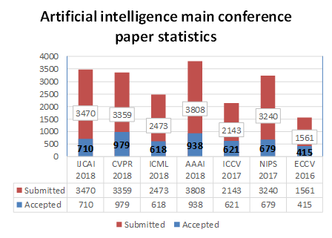
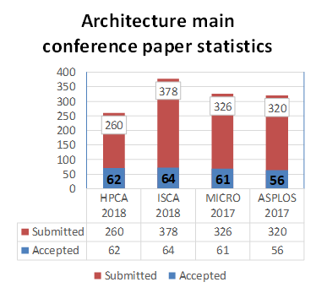
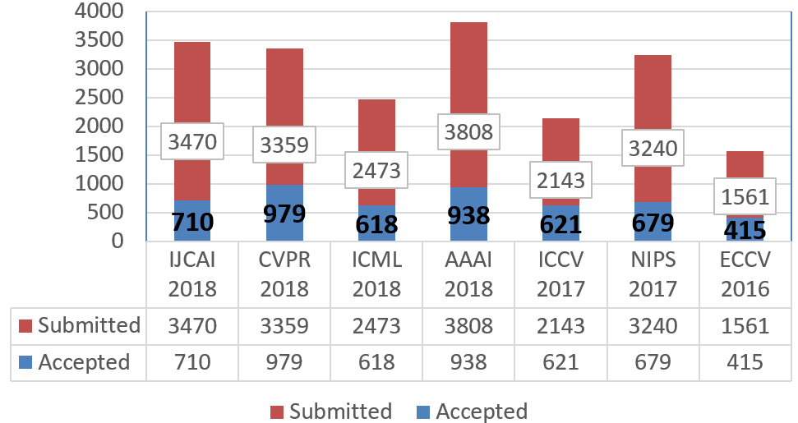
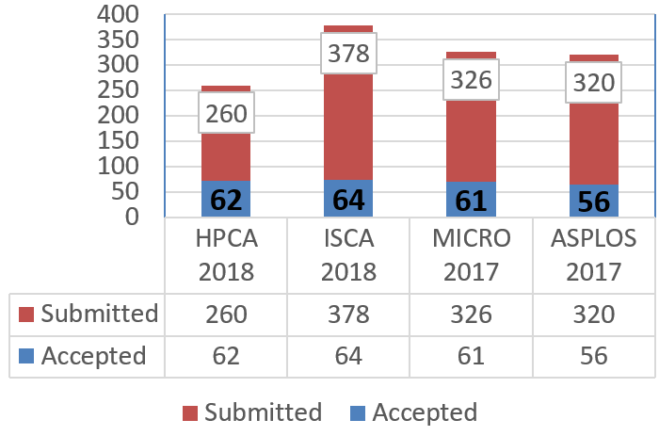
Qian Depei: The difference between AI and computer architecture academic research is hot
H5index 45 158 91 56 89 101 98 46 54 41 50
Number of papers published 4960 vs 243
Notes:
AI ML conferences have many more papers and bigger h5 index than computer architecture

Slide 5
Papers Submitted: Comparing 4 Conference Types
SumCI: SC, eScience, CCGrid, IPDPS
SumCloud: IEEE Cloud, Cloudcom
Notes:
Summary

Slide 6
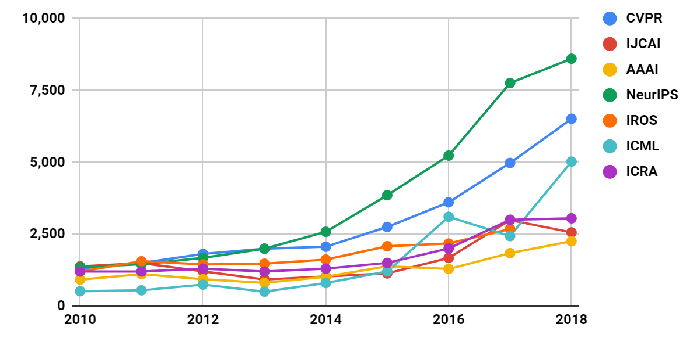
Attendance at Major AI Conferences
Notes:
AI conferences shoot up 2014 onwards

Slide 7
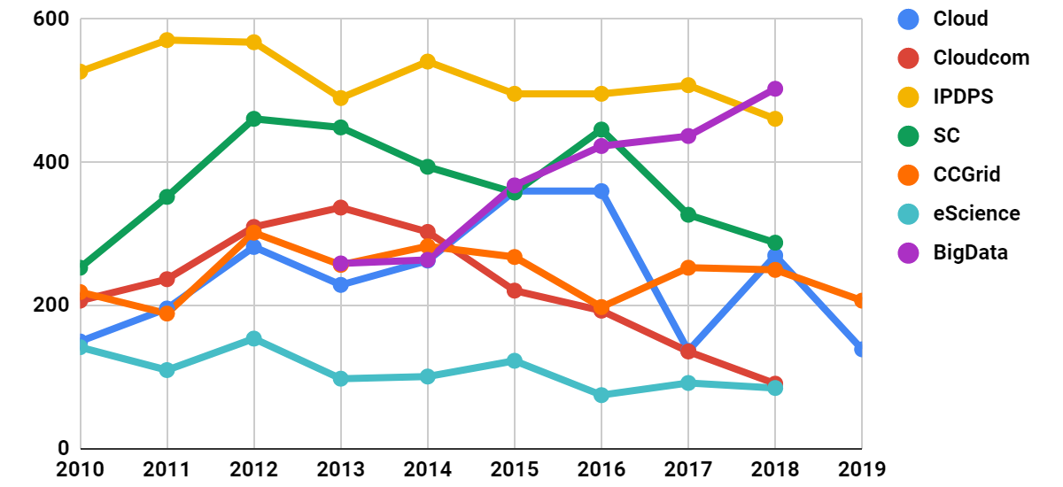
Papers Submitted at 7 Conferences
h5index
39
28
43
47
37
<12
25
Notes:
Clouds also decreasing
Big data growing but quite small

Slide 8
H5-index Conferences: AI, Big Data, Cloud, Systems, Other
158 CVPR: Conference on Computer Vision and Pattern Recognition
101 NeurIPS: Neural Information Processing Systems
98 ECCV: European Conference on Computer Vision
91 ICML: International Conference on Machine Learning
89 ICCV: International Conference on Computer Vision
85 CHI: Computer Human Interaction
80 INFOCOM: Joint Conference of the Computer and Communications Societies
77 WWW: International World Wide Web Conferences
73 VLDB: International Conference on Very Large Databases
73 SIGKDD: International Conference on Knowledge discovery and data mining
71 ICRA: International Conference on Robotics and Automation
56 AAAI: Assoc. Adv. AI Conference on Artificial Intelligence
54 ISCA: International Symposium on Computer Architecture
50 IROS: International Conference on Intelligent Robots and Systems
50 ASPLOS: International Conference on Architectural Support for Programming Languages and Operating Systems
47 SC: International Conference on High Performance Computing, Networking, Storage and Analysis
46 HPCA: International Symposium on High Performance Computer Architecture
45 IJCAI: International Joint Conference on Artificial Intelligence
43 BMVC: British Machine Vision Conference
43 IPDPS: International Symposium on Parallel & Distributed Processing
41 MICRO: International Symposium on Microarchitecture
39 CLOUD: International Conference on Cloud Computing
39 OSDI: Symposium on Operating Systems Design and Implementation
37 OOPSLA: SIGPLAN International Conference on Object-Oriented Programming, Systems, Languages, and Applications
37 PPOPP: SIGPLAN Symposium on Principles & Practice of Parallel Programming
37 CCGrid: International Symposium on Cluster Computing and the Grid
34 ICIP: International Conference on Image Processing
34 ICPR: International Conference on Pattern Recognition
30 SoCC: Symposium on Cloud Computing
29 ECAI: European Conference on Artificial Intelligence
29 HPDC: International Symposium on High Performance Distributed Computing
28 CloudCom: International Conference on Cloud Computing Technology and Science
26 ICS: International Conference on Supercomputing
25 Big Data: International Conference on Big Data
21 CLUSTER: International Conference on Cluster Computing
21 SPAA: Symposium on Parallelism in Algorithms and Architectures
20 ICPP: International Conference on Parallel Processing
18 ICCSA: International Conference on Computational Science and Its Applications
15 SBAC-PAD: International Symposium on Computer Architecture and High Performance Computing
14 DS-RT: International Symposium on Distributed Simulation and Real-Time Applications
Some didn’t make h5-index cut of >=12
Notes:
Escience below cut
H5 shows dominance of AI

Slide 9
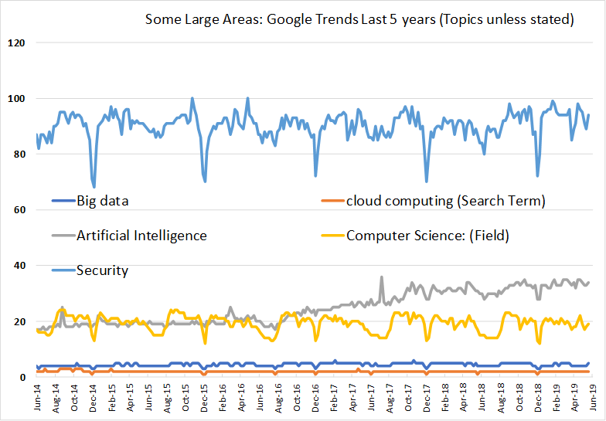
Some large areas: Google Trends last 5 years (Topics unless otherwise stated)
Search terms require exact match - topics are broader but sometimes are not available
SECURITY MAX IS 100
Security
Artificial Intelligence
Computer Science (Field)
Big Data
Cloud Computing (Search Term)
Notes:
●AI rising
●Security and CS Flattish
●Clouds and Big Data small

Slide 10
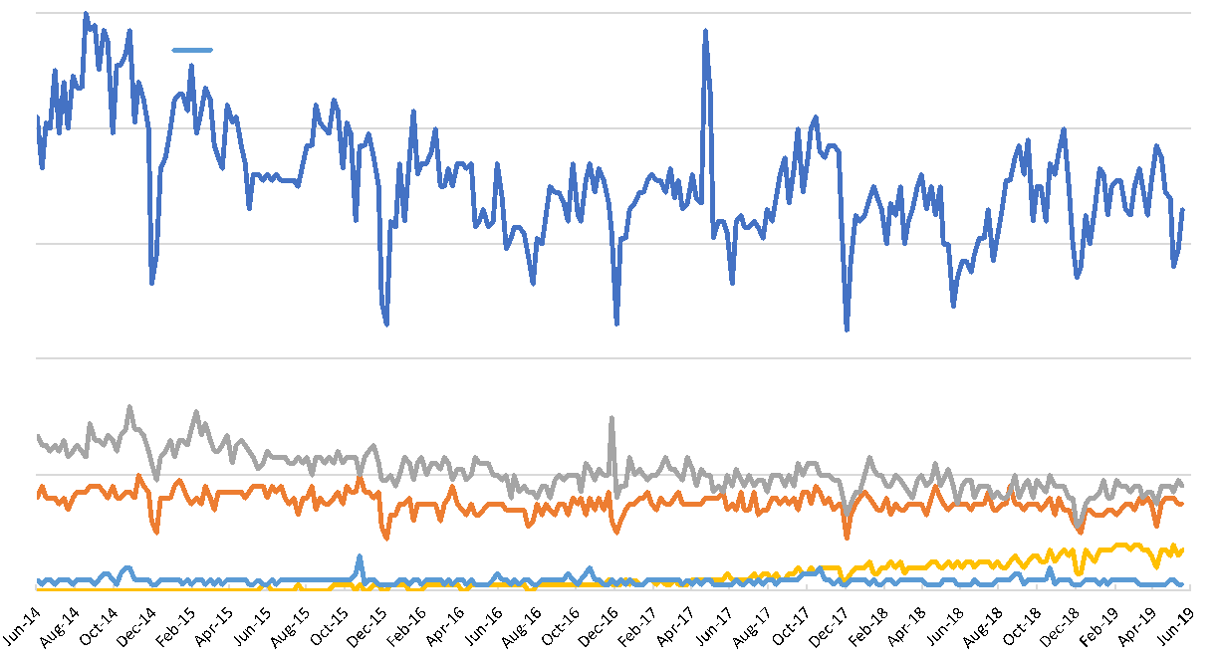
Some smaller areas: Google Trends last 5 years (Topics unless stated)
Cloud Computing (Search Term)
Grid Computing
HPC
Edge Computing
SuperComputing (Search Term)

Slide 11
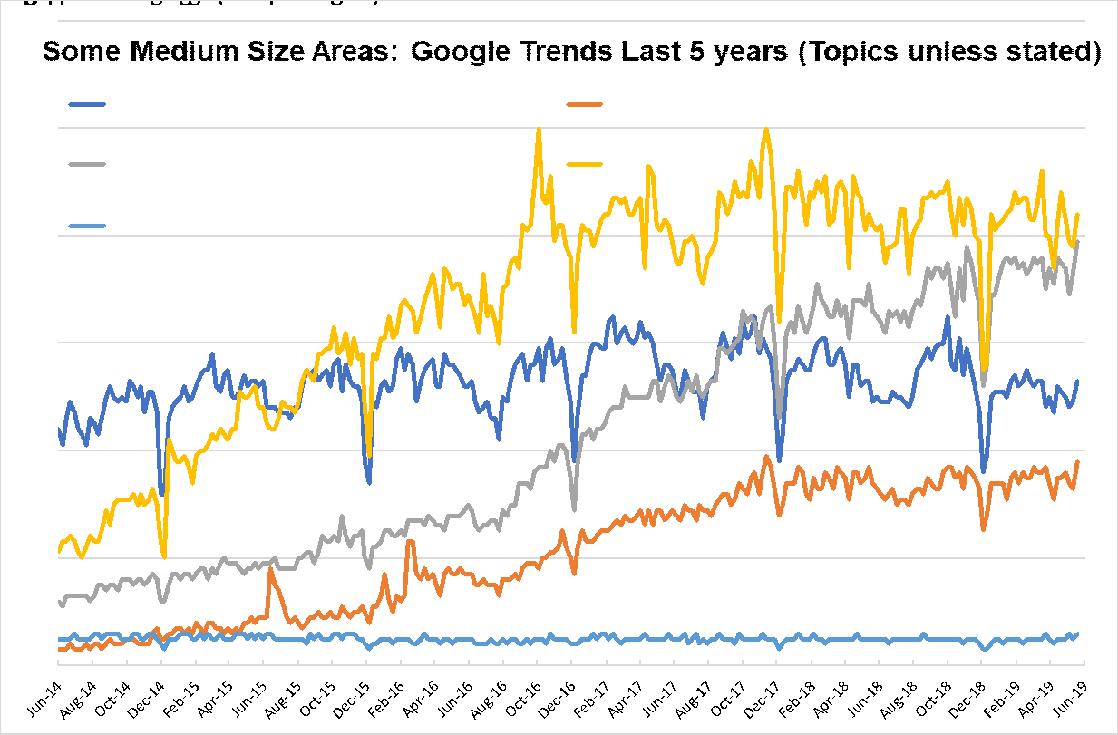
Some medium size areas: Google Trends last 5 years (Topics unless otherwise stated)
AI IS 10X BIG DATA, CYBERINFRASTRUCTURE, EXASCALE SMALL
Internet of Things
Machine Learning (Search Term)
Big Data
Deep Learning
High Performance Computing (HPC)
Notes:
●IoT ML DL growing
●Big Data HPC flattish with HPC < Big Data

Slide 12
More on the Evolution of Interests and Communities
AI/ML
Systems
HPC
Cloud
Big Data

Slide 13
Importance of HPC, Cloud and Big Data Community
HPC/HPDC Community not growing in terms of obvious metrics such as new faculty advertisements, student interest, papers published
This is happening even though processing Big Data obviously requires HPC unless it is dominantly Hadoop style big data management
HPC community could perhaps align better with mainstream (Industry) systems
Otherwise they may be ignored as mainstream larger and supported by Industry
SysML Conference Stanford March 31 - April 2, 2019 is a new mainstream systems + ML community (note speaker ratio as 15.5 Academia to 14.5 Industry)
Cloud Community quite strong in Industry; relatively small academically as Industry has some advantages
Big data community strong in Academia and Industry although definition less clear as most things are big data; growing but still quite small in terms of dedicated activities

Slide 14
Importance of AI
AI (and several forms of ML) will dominate the next 10 years and it has distinctive impact on applications whereas HPC, Clouds and Big Data are important and essential enablers
AI First popular with Industry with 2017 Headlines
The Race For AI: Google, Twitter, Intel, Apple In A Rush To Grab Artificial Intelligence Startups
Google, Facebook, And Microsoft Are Remaking Themselves Around AI
Google: The Full Stack AI Company
Bezos Says Artificial Intelligence to Fuel Amazon's Success
Microsoft CEO says artificial intelligence is the 'ultimate breakthrough'
Tesla’s New AI Guru Could Help Its Cars Teach Themselves
Netflix Is Using AI to Conquer the World... and Bandwidth Issues
How Google Is Remaking Itself As A “Machine Learning First” Company
If You Love Machine Learning, You Should Check Out General Electric
Could refine emphasis on data science with AI First X
where X runs over areas where AI can help
e.g. AI First Engineering; AI First Cyberinfrastructure; AI First Social Science etc.

Slide 15
Aligning with Industry

Slide 16
Learning from Industry
Industry playing a larger role than 10-20 years ago in advancing research as well as development (where they always led)
So useful to work with and learn from them: here are four important directions
All Industry: Public and Private Clouds 94% workloads in 2021: we should focus on HPC Clouds and maximize HPC Cloud Interoperability
ML Companies: Work with MLPerf
Microsoft: Global AI Supercomputer: we should be part of global scope and research architecture
Google: Machine Learning for Systems and Systems for Machine Learning: use ML for Systems to transform all computing (simulations and analytics)

Slide 17
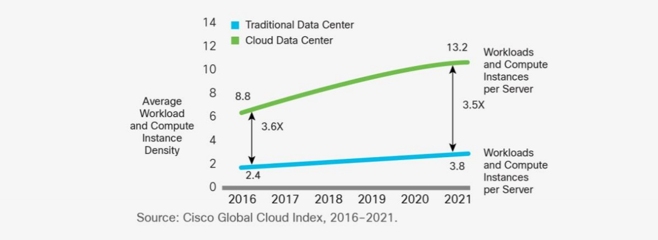
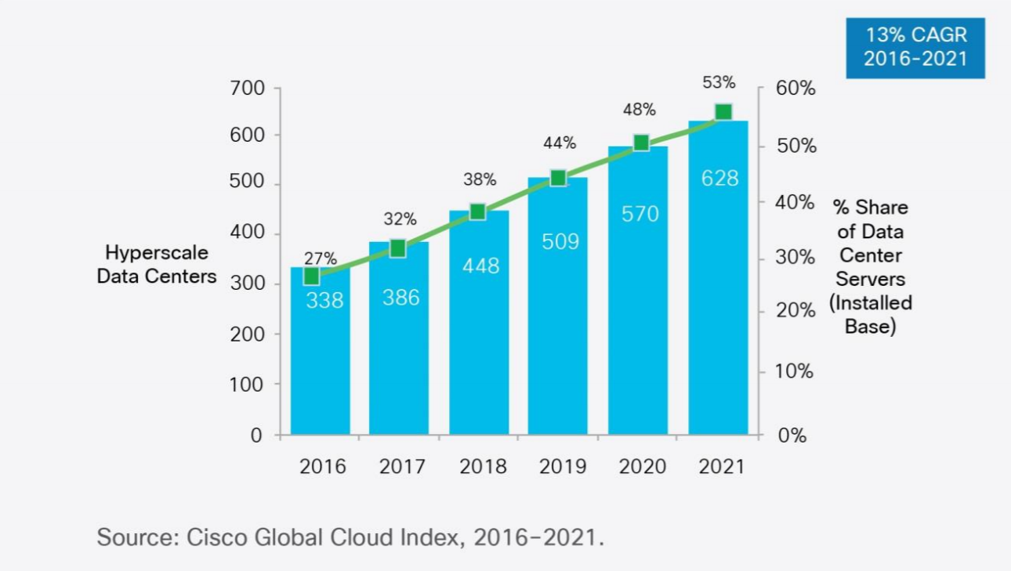
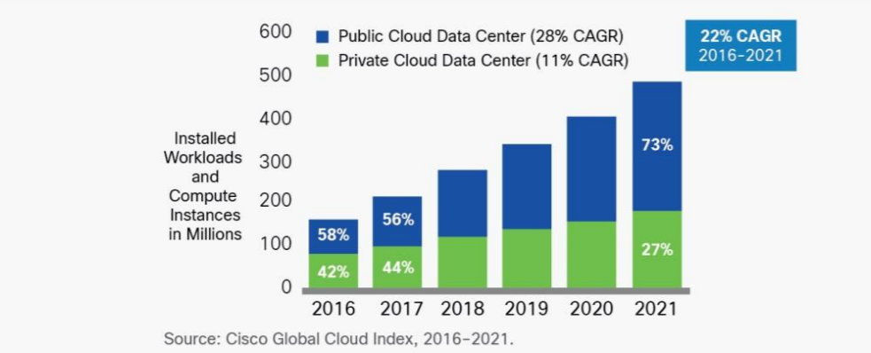
Dominance of Cloud Computing
Number of instances per server
94 percent of workloads and compute instances will be processed by cloud data centers (22% CAGR) by 2021-- only six percent will be processed by traditional data centers (-5% CAGR).
Hyperscale data centers will grow from 338 in number at the end of 2016 to 628 by 2021. They will represent 53 percent of all installed data center servers by 2021. They form a distributed Compute (on data) grid with some 50 million servers
Analysis from CISCO https://www.cisco.com/c/en/us/solutions/collateral/service-provider/global-cloud-index-gci/white-paper-c11-738085.html updated November 2018
Number of Cloud Data Centers
Number of Public or Private Cloud Data Center Instances

Slide 18
Learning from Industry
Industry playing a larger role than 10-20 years ago in advancing research as well as development (where they always led)
So we need to work with and learn from them: here are four important directions
All Industry: Public and Private Clouds 94% workloads in 2021: we should focus on HPC Clouds
ML Companies: Work with MLPerf
Microsoft: Global AI Supercomputer: we should be part of global scope and research architecture
Google: Machine Learning for Systems and Systems for Machine Learning: use ML for Systems to transform all computing (simulations and analytics)

Slide 19
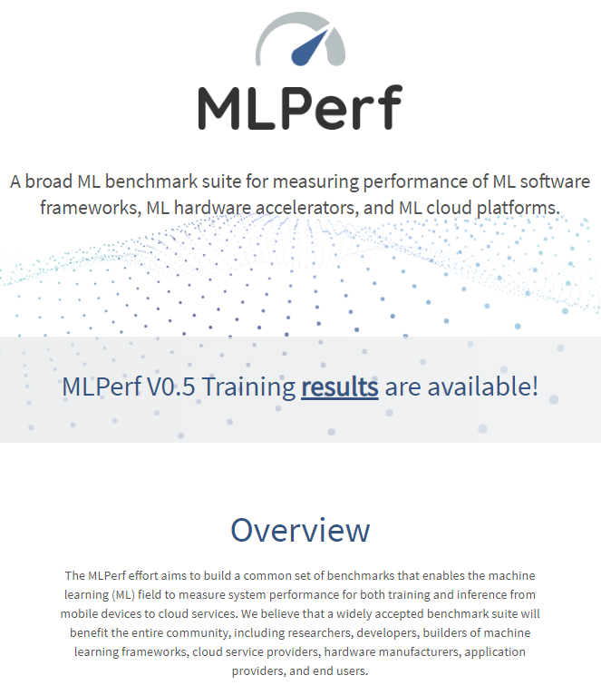
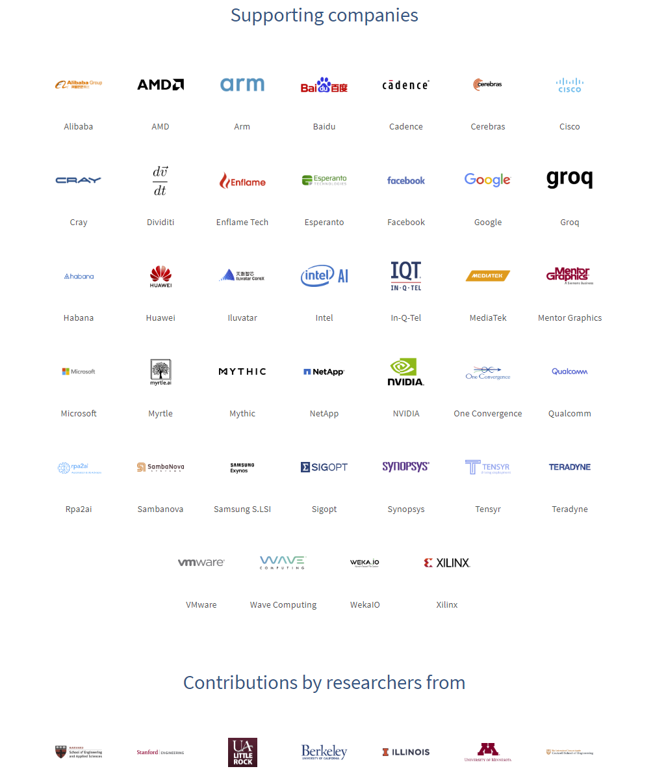
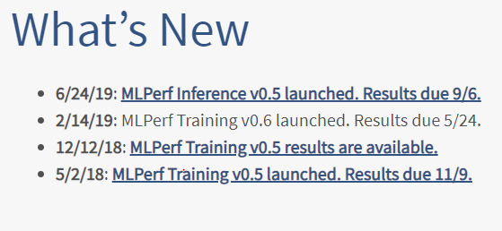
MLPerf's mission is to build fair and useful benchmarks for measuring training and inference performance of ML hardware, software, and services. MLPerf was founded in February, 2018 as a collaboration of companies and researchers from educational institutions. MLPerf is presently led by volunteer working group chairs. MLPerf could not exist without open source code and publically available datasets others have generously contributed to the community.
Get Involved
Join the forum
Join working groups
Attend community meetings
Make your organization an official supporter of MLPerf
Ask questions, or raise issues
Note Industry Dominance

Slide 20
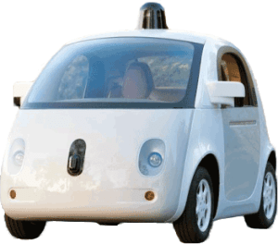
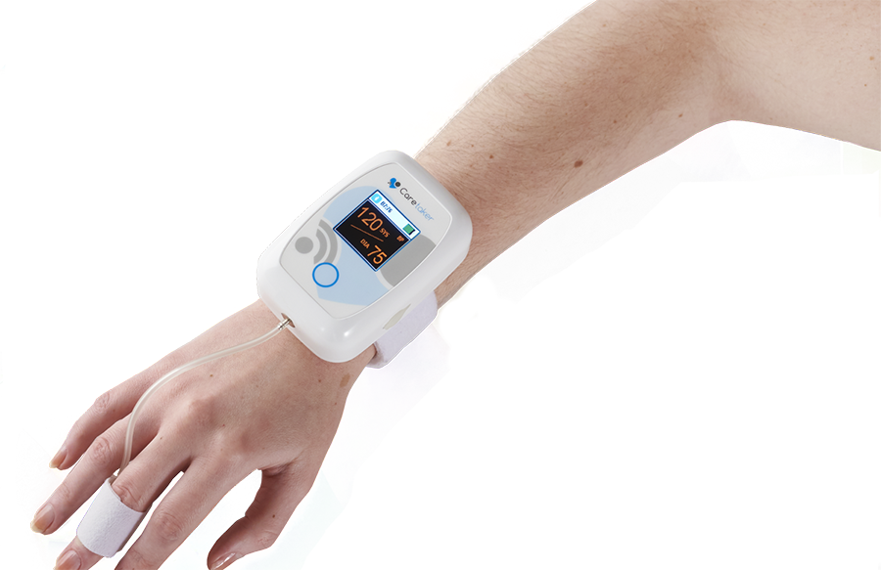
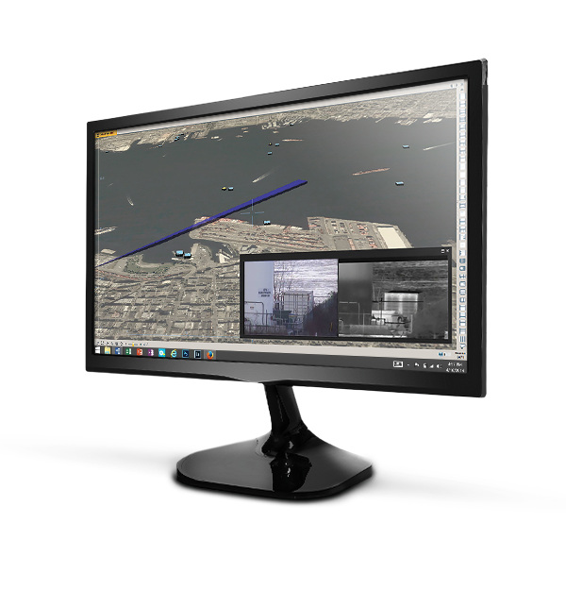
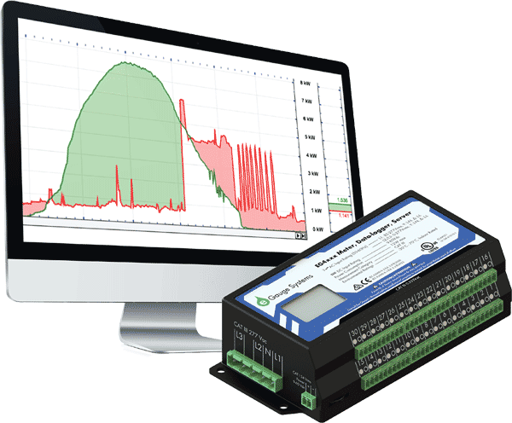
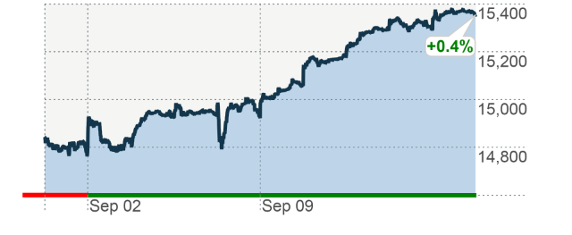
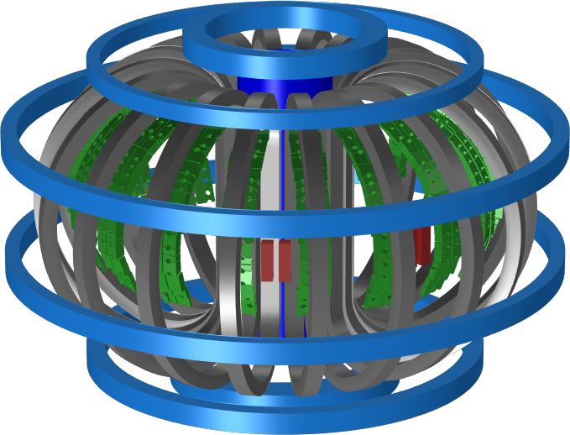
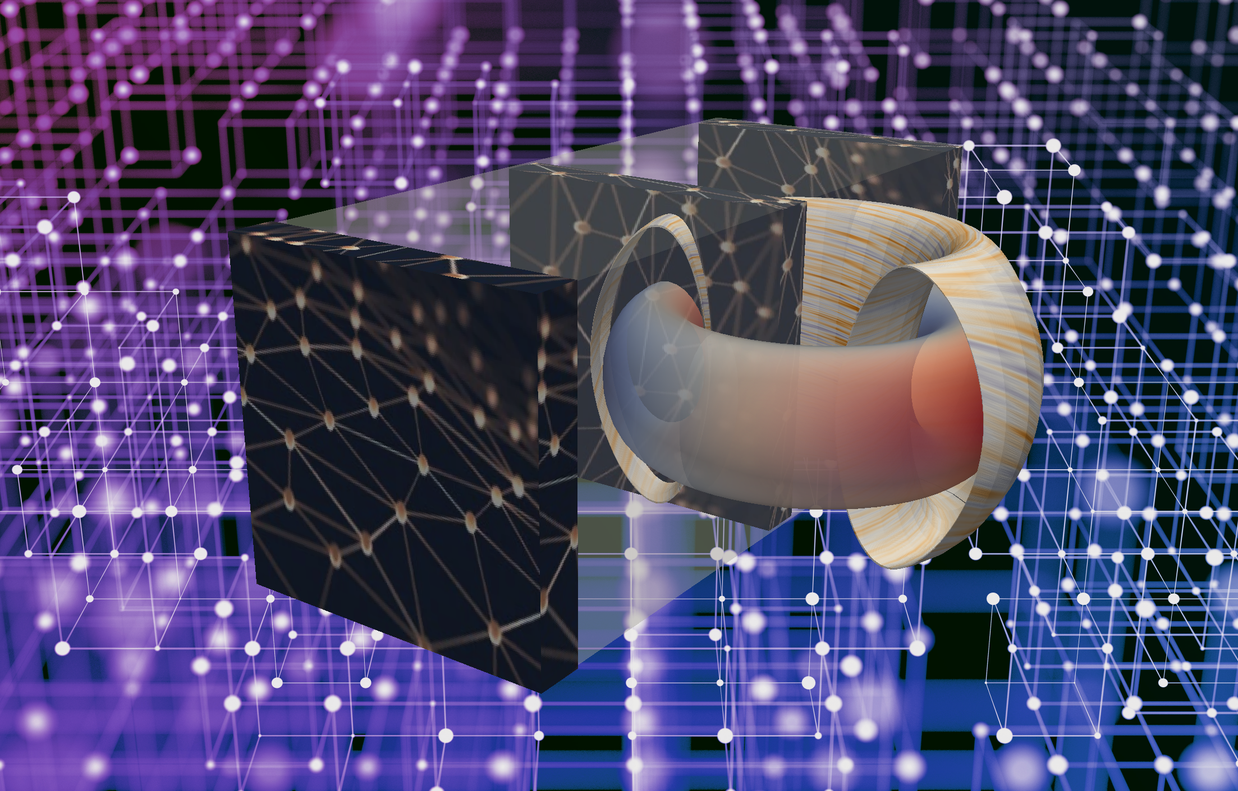
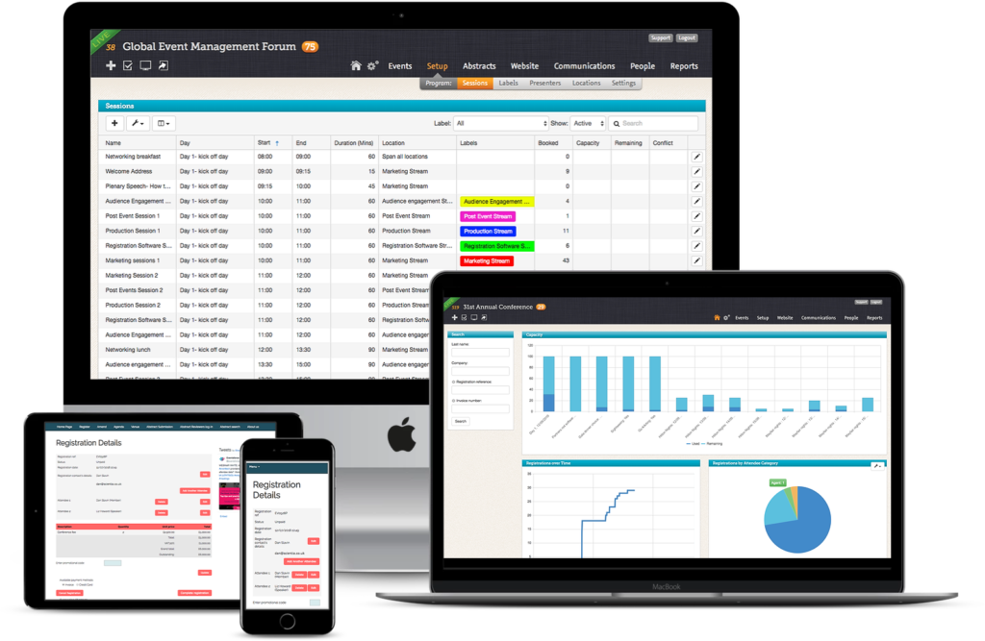
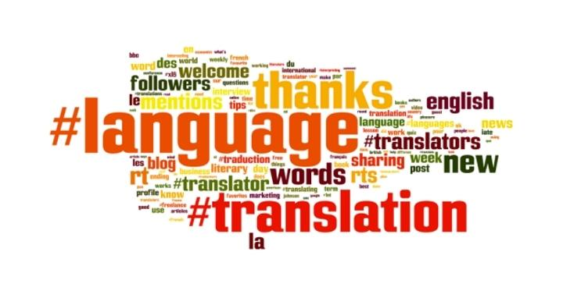
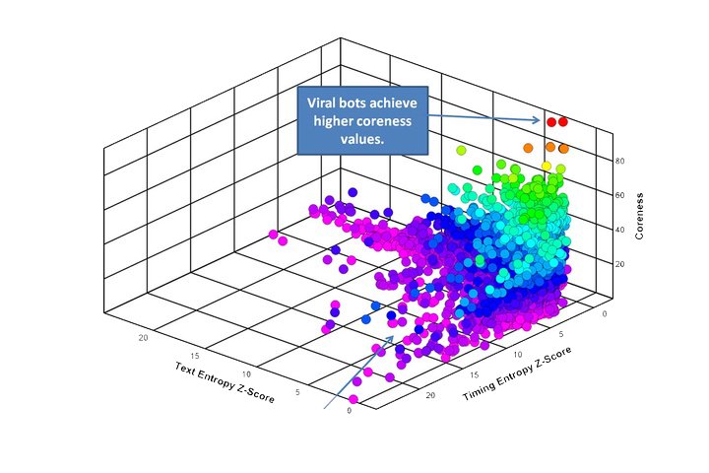
Performance of Time Series Machine Learning Algorithms (MLPerf)
Areas | Applications | Model | Data sets | Papers
Transportation | Cars, Taxis, Freeway Detectors | TT-RNN , BNN, LSTM | Caltrans highway traffic [1], Taxi/Uber trips [2-5] | [6-8]
Medical | Wearables, Medical instruments: EEG, ECG, ERP, Patient Data | LSTM, RNN | OPPORTUNITY [9-10], EEG [11-14], MIMIC [15] | [16-20]
Cybersecurity | Intrusion, classify traffic, anomaly detection | LSTM | GPL loop dataset [21], SherLock [22] | [21, 23-25]
General Social Statistics | Household electric use, Economic, Finance, Demographics, Industry | CNN, RNN | Household electric [26], M4Competition [27], | [28-29]
Finance | Stock Prices versus time | CNN, RNN | Available academically from Wharton [30] | [31]
Science | Climate, Tokamak | Markov, RNN | USHCN climate [32] | [33-35]
Software Systems | Events | LSTM | Enterprise SW system [36] | [36-37]
Language and Translation | Pre-trained Data | Transformer [38] | [39-40] | [41-42]Mesh Tensorflow
Google Speech | All-Neural On-Device Speech Recognizer | RNN-T |  | [43]
IndyCar Racing | Real-time car and track detectors | HTM |  | [44]
Social media | Twitter | Online Clustering | Available from Twitter | [45-46]
Notes:
http://jeffnolan.com/wp/2015/11/23/the-fascinating-implications-for-autonomous-vehicles/
https://www.comsol.com/blogs/analyzing-a-component-of-the-iter-tokamak-with-simulation/
https://www.oreilly.com/ideas/identifying-viral-bots-and-cyborgs-in-social-media
https://www.caretakermedical.net/
https://www.eventsforce.com/
https://money.cnn.com/2013/09/13/investing/stocks-markets/index.html
https://www.stickpng.com/img/icons-logos-emojis/tech-companies/twitter-logo
https://www.flir.com/products/cameleon-tactical/
https://www.androidpolice.com/2019/03/12/google-bringing-faster-on-device-speech-recognition-to-gboard-starting-with-pixel-phones/

Slide 21
Learning from Industry
Industry playing a larger role than 10-20 years ago in advancing research as well as development (where they always led)
So we need to work with and learn from them: here are four important directions
All Industry: Public and Private Clouds 94% workloads in 2021: we should focus on HPC Clouds and maximize HPC
ML Companies: Work with MLPerf
Microsoft: Global AI Supercomputer: we should be part of global scope and research architecture
Google: Machine Learning for Systems and Systems for Machine Learning: use ML for Systems to transform all computing (simulations and analytics)

Slide 22
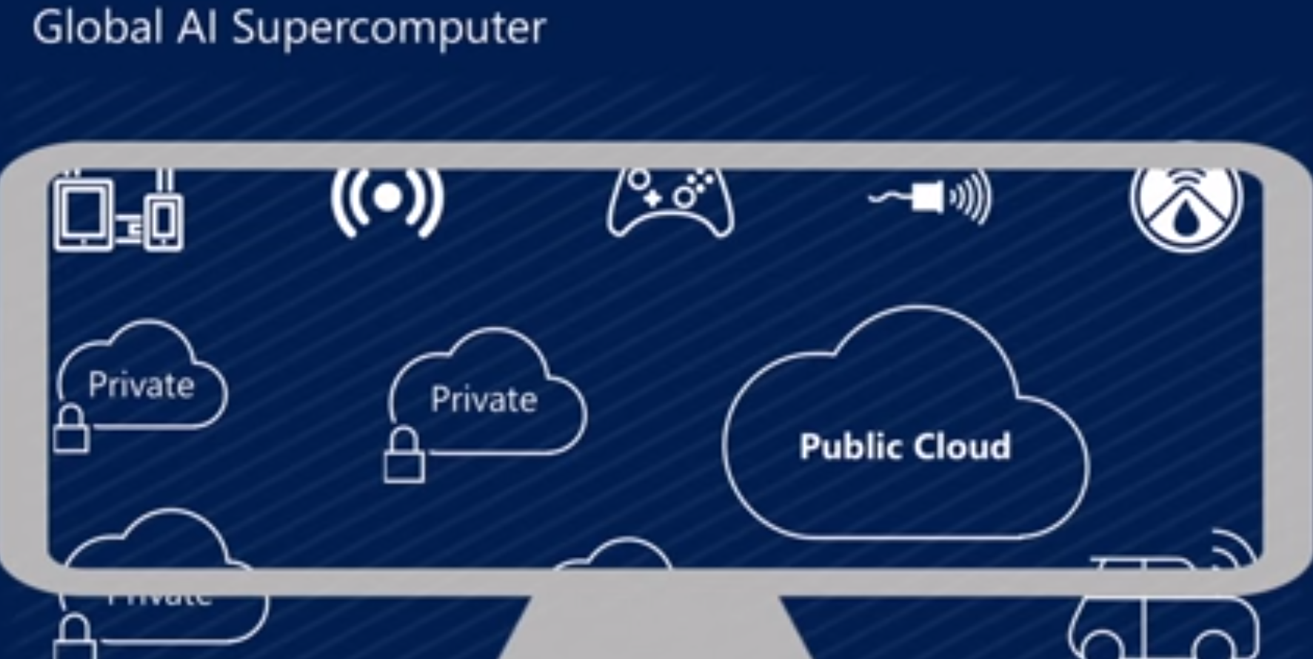
Microsoft Summer 2018: Global AI Supercomputer
By Donald Kossmann

Slide 23
Overall Global AI and Modeling Supercomputer GAIMSC Architecture
Global says we are all involved - it is an HPDC system
I added “Modeling” to get the Global AI and Modeling Supercomputer GAIMSC
There is only a cloud at the logical center but it’s physically distributed and domated by a few major players
Modeling was meant to include classic simulation oriented supercomputers
Even in Big Data, one needs to build a model for the machine learning to use
GAIMSC will use classic HPC for data analytics which has similarities to big simulations (HPCforML)
GAIMSC must also support I/O centric data management with Hadoop etc.
Nature of I/O subsystem controversial for such HPC clouds
Lustre v. HDFS; importance of SSD and NVMe;
HPC Clouds would suggest that MPI runs well on Mesos and Kubernetes and with Java and Python

Slide 24
Learning from Industry
Industry playing a larger role than 10-20 years ago in advancing research as well as development (where they always led)
So we need to work with and learn from them: here are four important directions
All Industry: Public and Private Clouds 94% workloads in 2021: we should focus on HPC Clouds and maximize
ML Companies: Work with MLPerf
Microsoft: Global AI Supercomputer: we should be part of global scope and research architecture
Google: Machine Learning for Systems and Systems for Machine Learning: use ML for Systems to transform all computing (simulations and analytics)

Slide 25
Dean at NeurIPS
DECEMBER 2017
ML for optimizing parallel computing (load balancing)
Learned Index Structure
ML for Data-center Efficiency
ML to replace heuristics and user choices (Autotuning)

Slide 26
Implications of Machine Learning for Systems and Systems for Machine Learning
We could replace “Systems” by “Cyberinfrastructure” or by “HPC” and/or “HPDC”
I use HPC as we are aiming at systems that support big data or big simulations and almost by (my) definition could naturally involve HPC.
So we get ML for HPC and HPC for ML or ML for HPDC and HPDC for ML
HPC for ML is very important but has been quite well studied and understood
It makes data analytics run much faster
ML for HPC is transformative both as a technology and for application progress enabled
If it is ML for HPC running ML, then we have the creepy situation of the AI supercomputer improving itself
Microsoft 2018 faculty summit discussed ML to improve Big Data systems e.g. configure database system.

Slide 27
MLforHPDC/HPC (ML for Systems) in detail
MLforHPDC/HPC can be further subdivided into several categories:
MLafterHPC: ML analyzing results of HPC as in trajectory analysis and structure identification in biomolecular simulations. Well established and successful
MLControl: Using simulations (with HPC) and ML in control of experiments and in objective driven computational campaigns. Here simulation surrogates are very valuable to allow real-time predictions.
MLAutotuning: Using ML to configure (autotune) ML or HPC simulations.
MLaroundHPC: Using ML to learn from simulations and produce learned surrogates for the simulations or parts of simulations. The same ML wrapper can also learn configurations as well as results. Most Important.

Slide 28
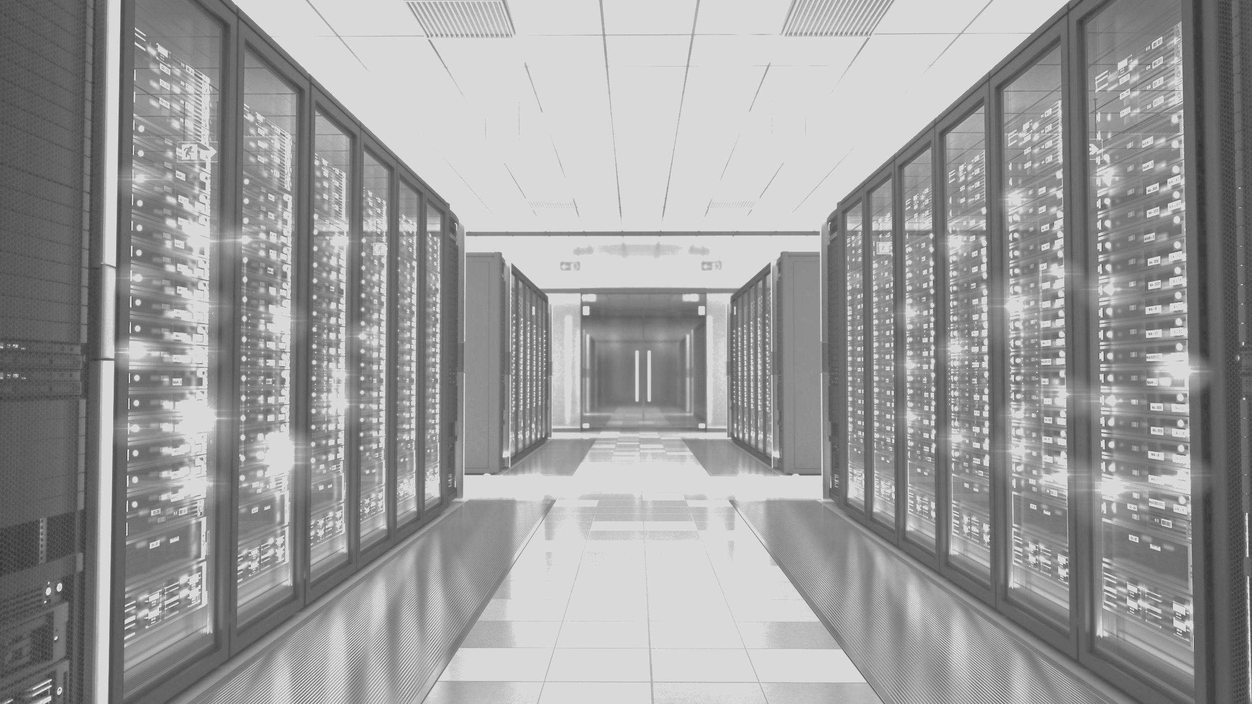
MLaroundHPDC/HPC
MLAutotuning

Slide 29
Status of MLforHPC Research
ML for HPDC or Systems
http://dsc.soic.indiana.edu/publications/Learning%20EverywhereResource.pdf
111 Citations (mainly 2017 or later) with very short comments
MLaroundHPC/MLAutotuning: not much on Computer Science or Partial Differential equations
Particle Dynamics: largest component with, smart sampling, effective potentials, “Computation Results from Computation defining Parameters” with “simple” deep learning replacing sophisticated dimension reduction; material science properties very active
Give examples from nanoparticle simulations
Agent-based Simulations in networked systems or virtual tissues. Perhaps most promising as inevitably data driven as no fundamental equations for cells, cars, people, bacteria
Review plan to develop new approach to computational systems biology -- simulate organisms based on models for cell

Slide 30
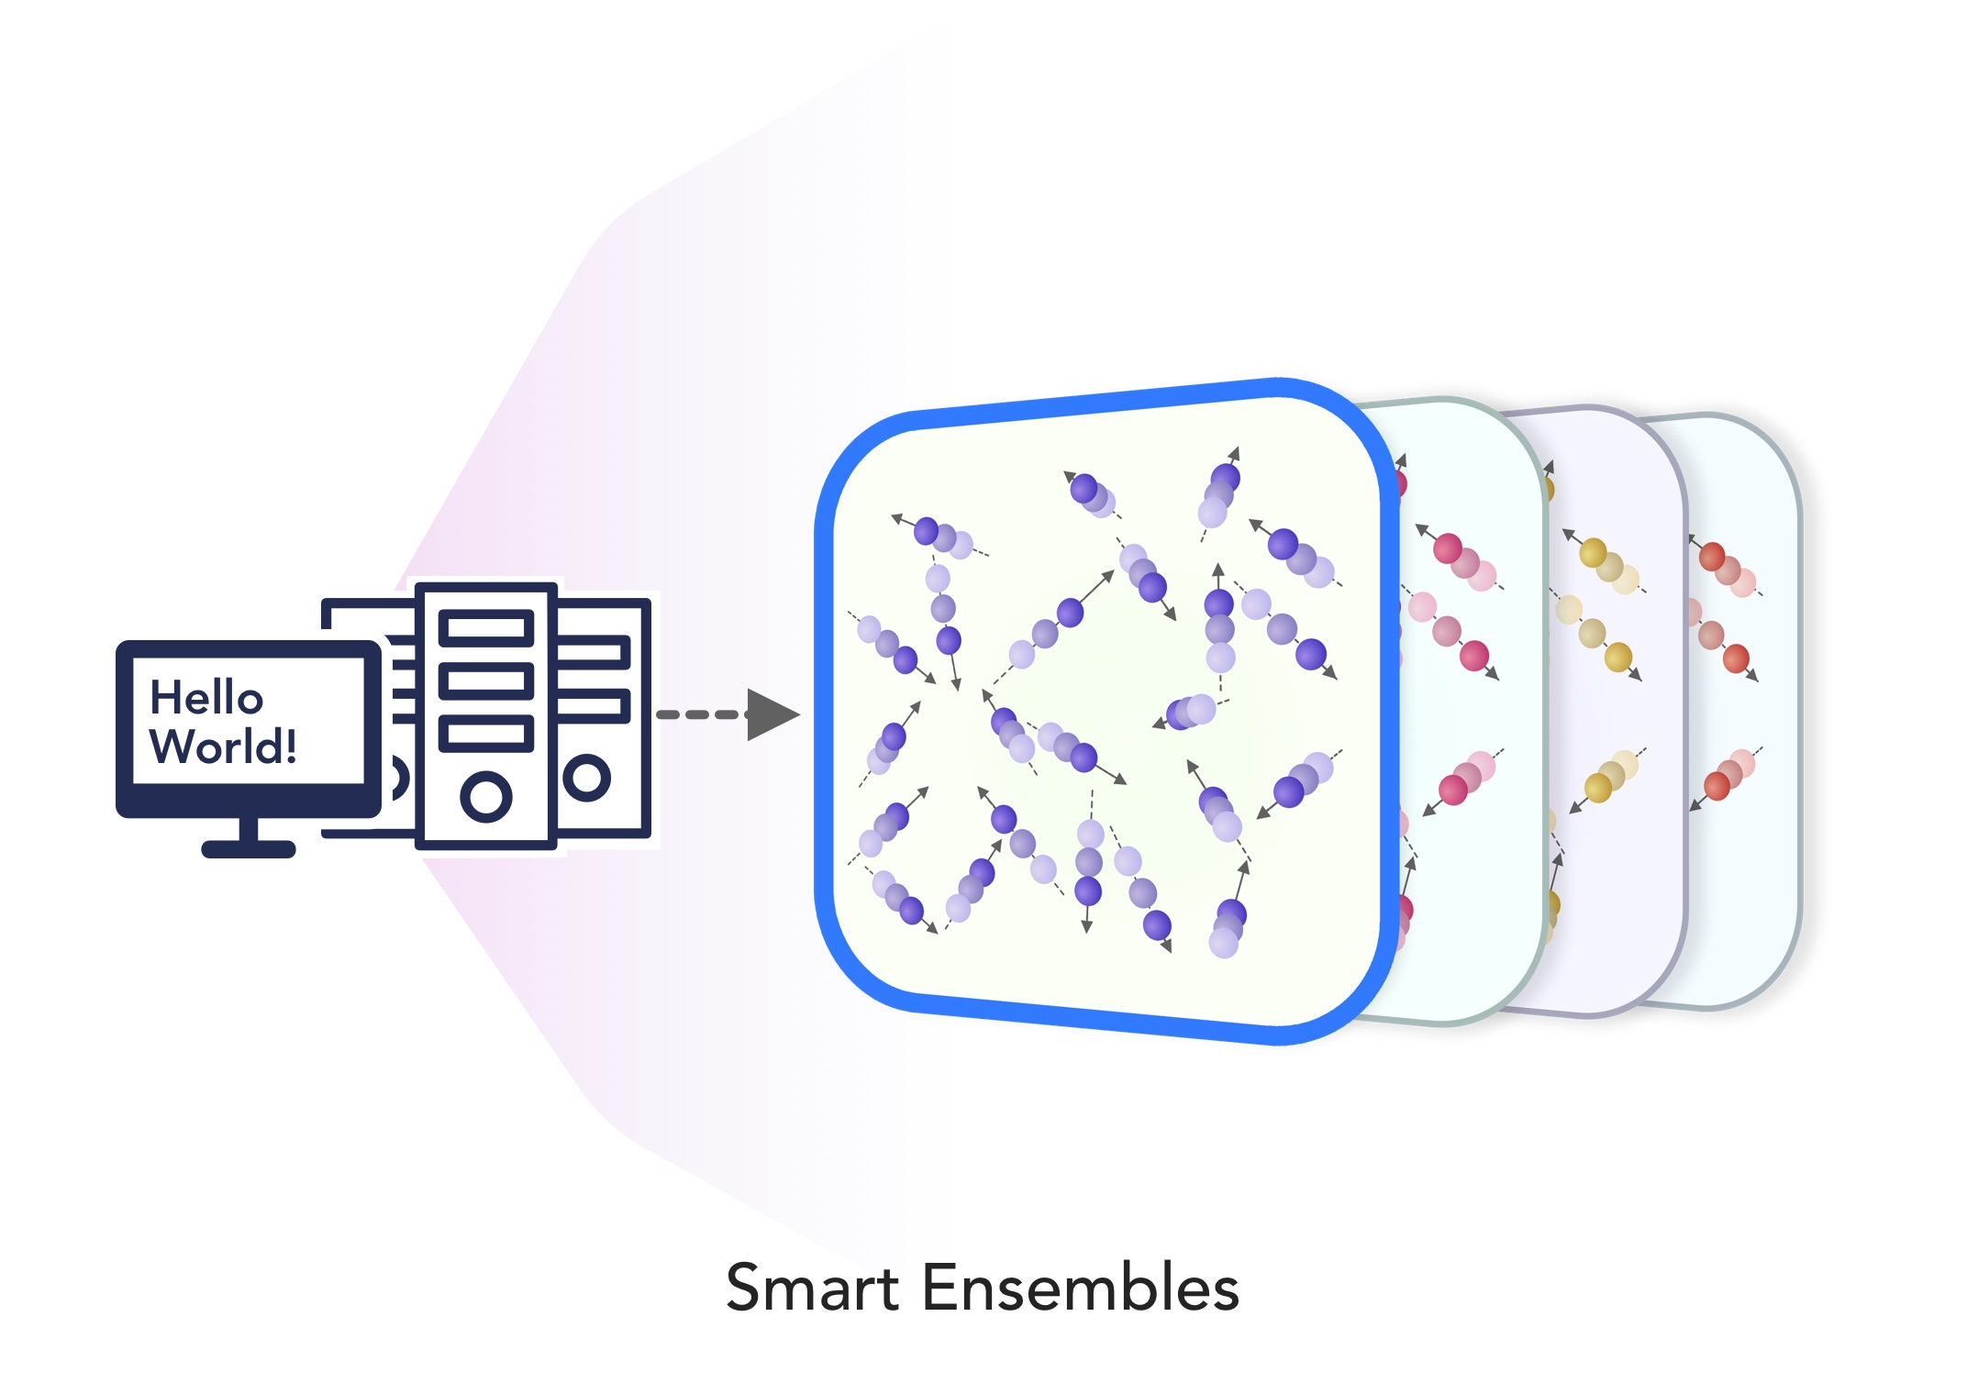
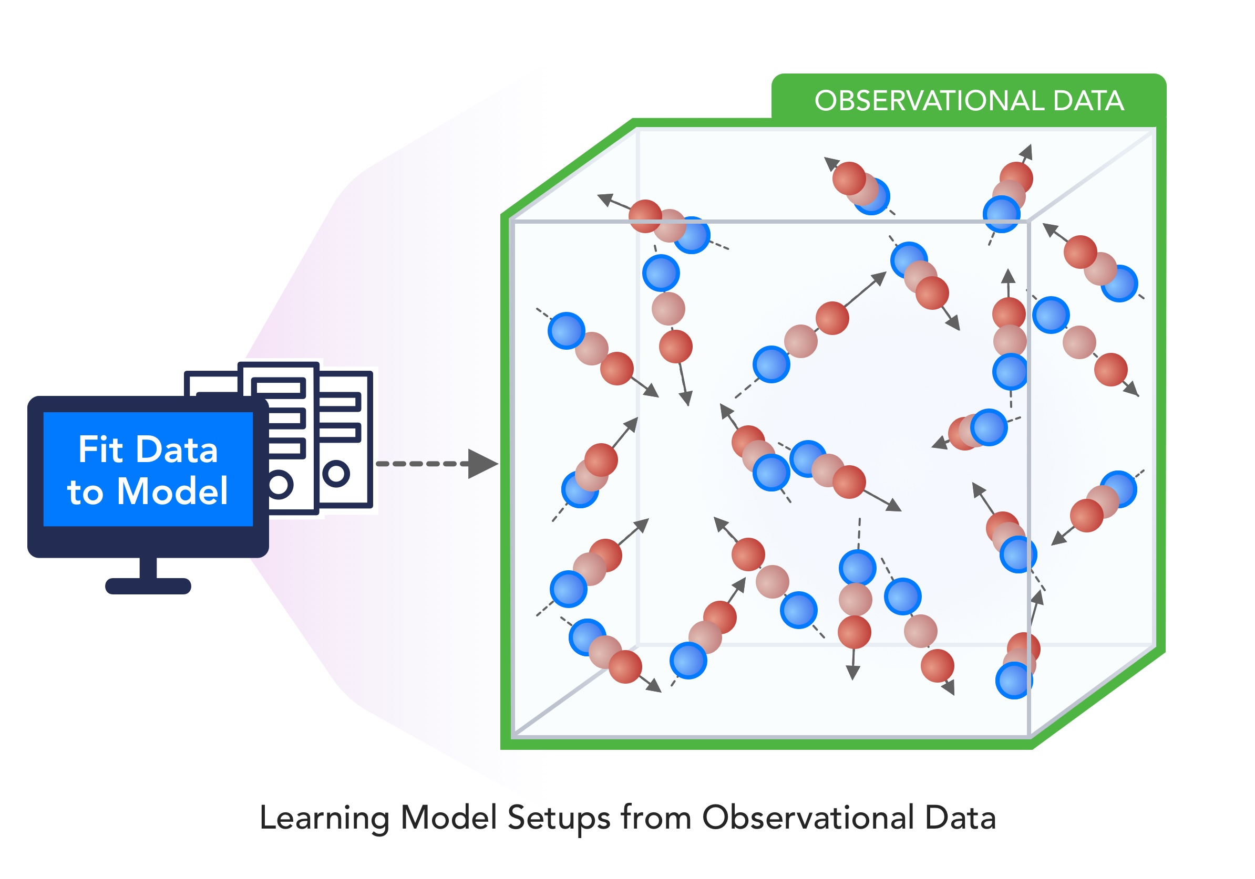
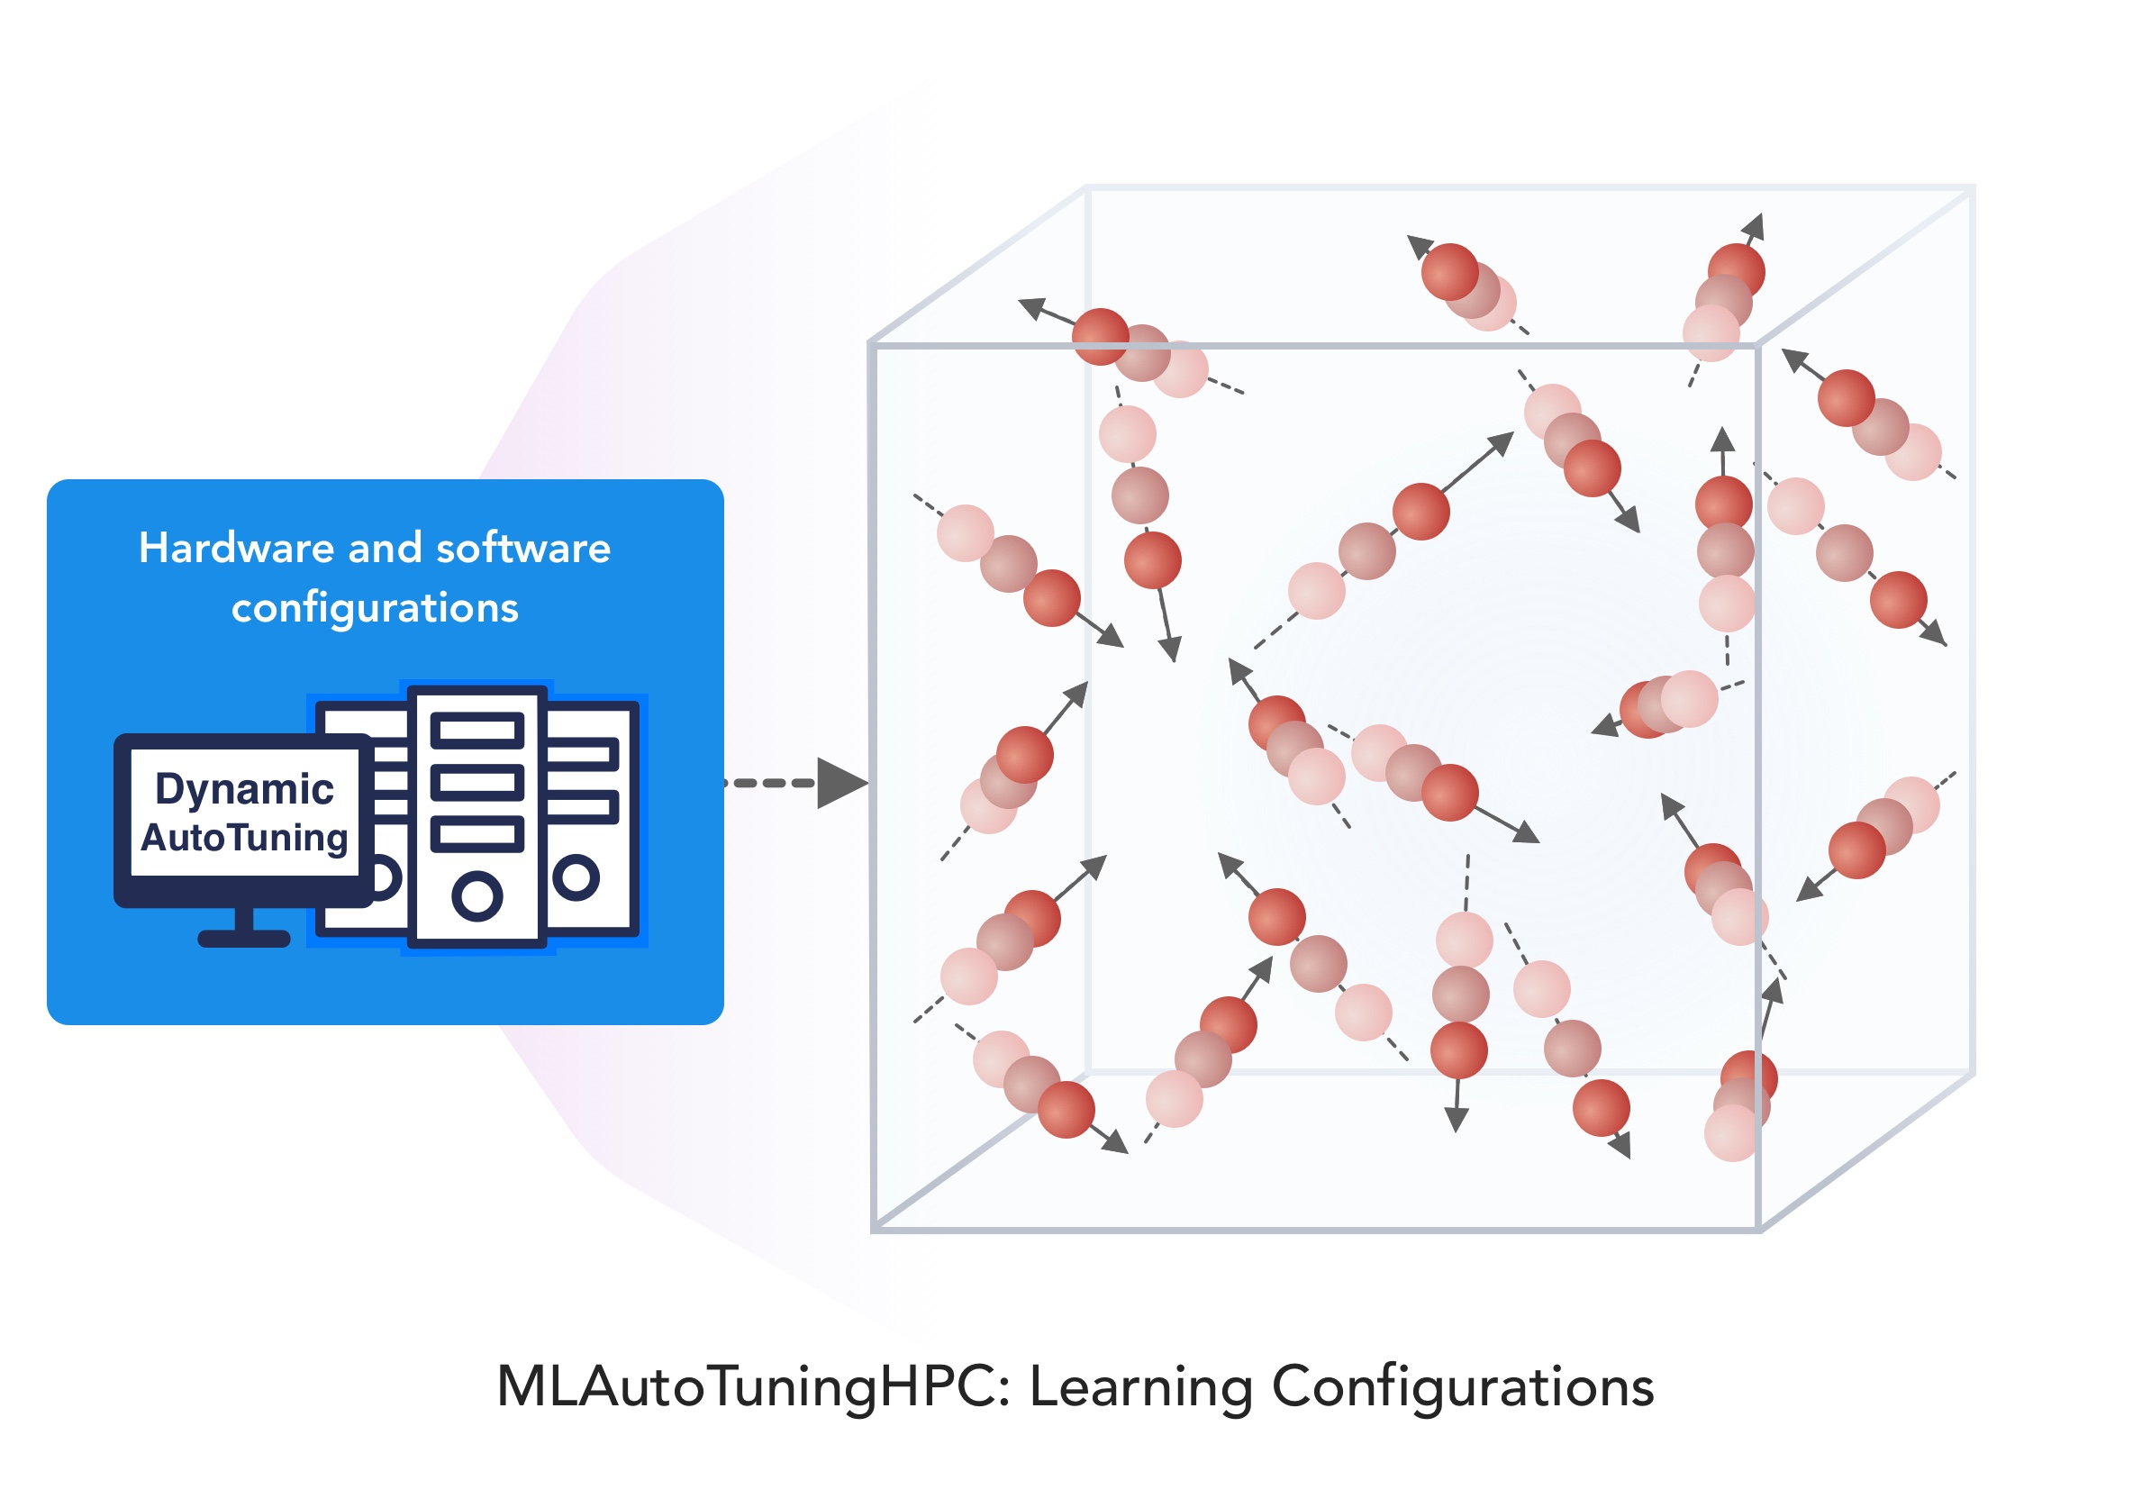
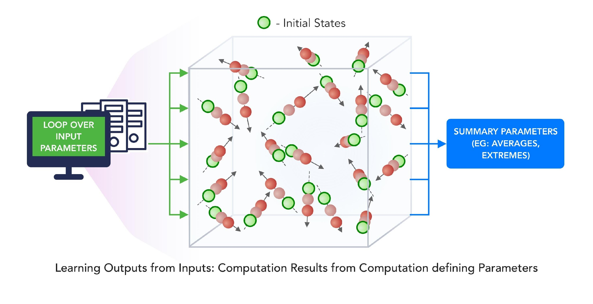
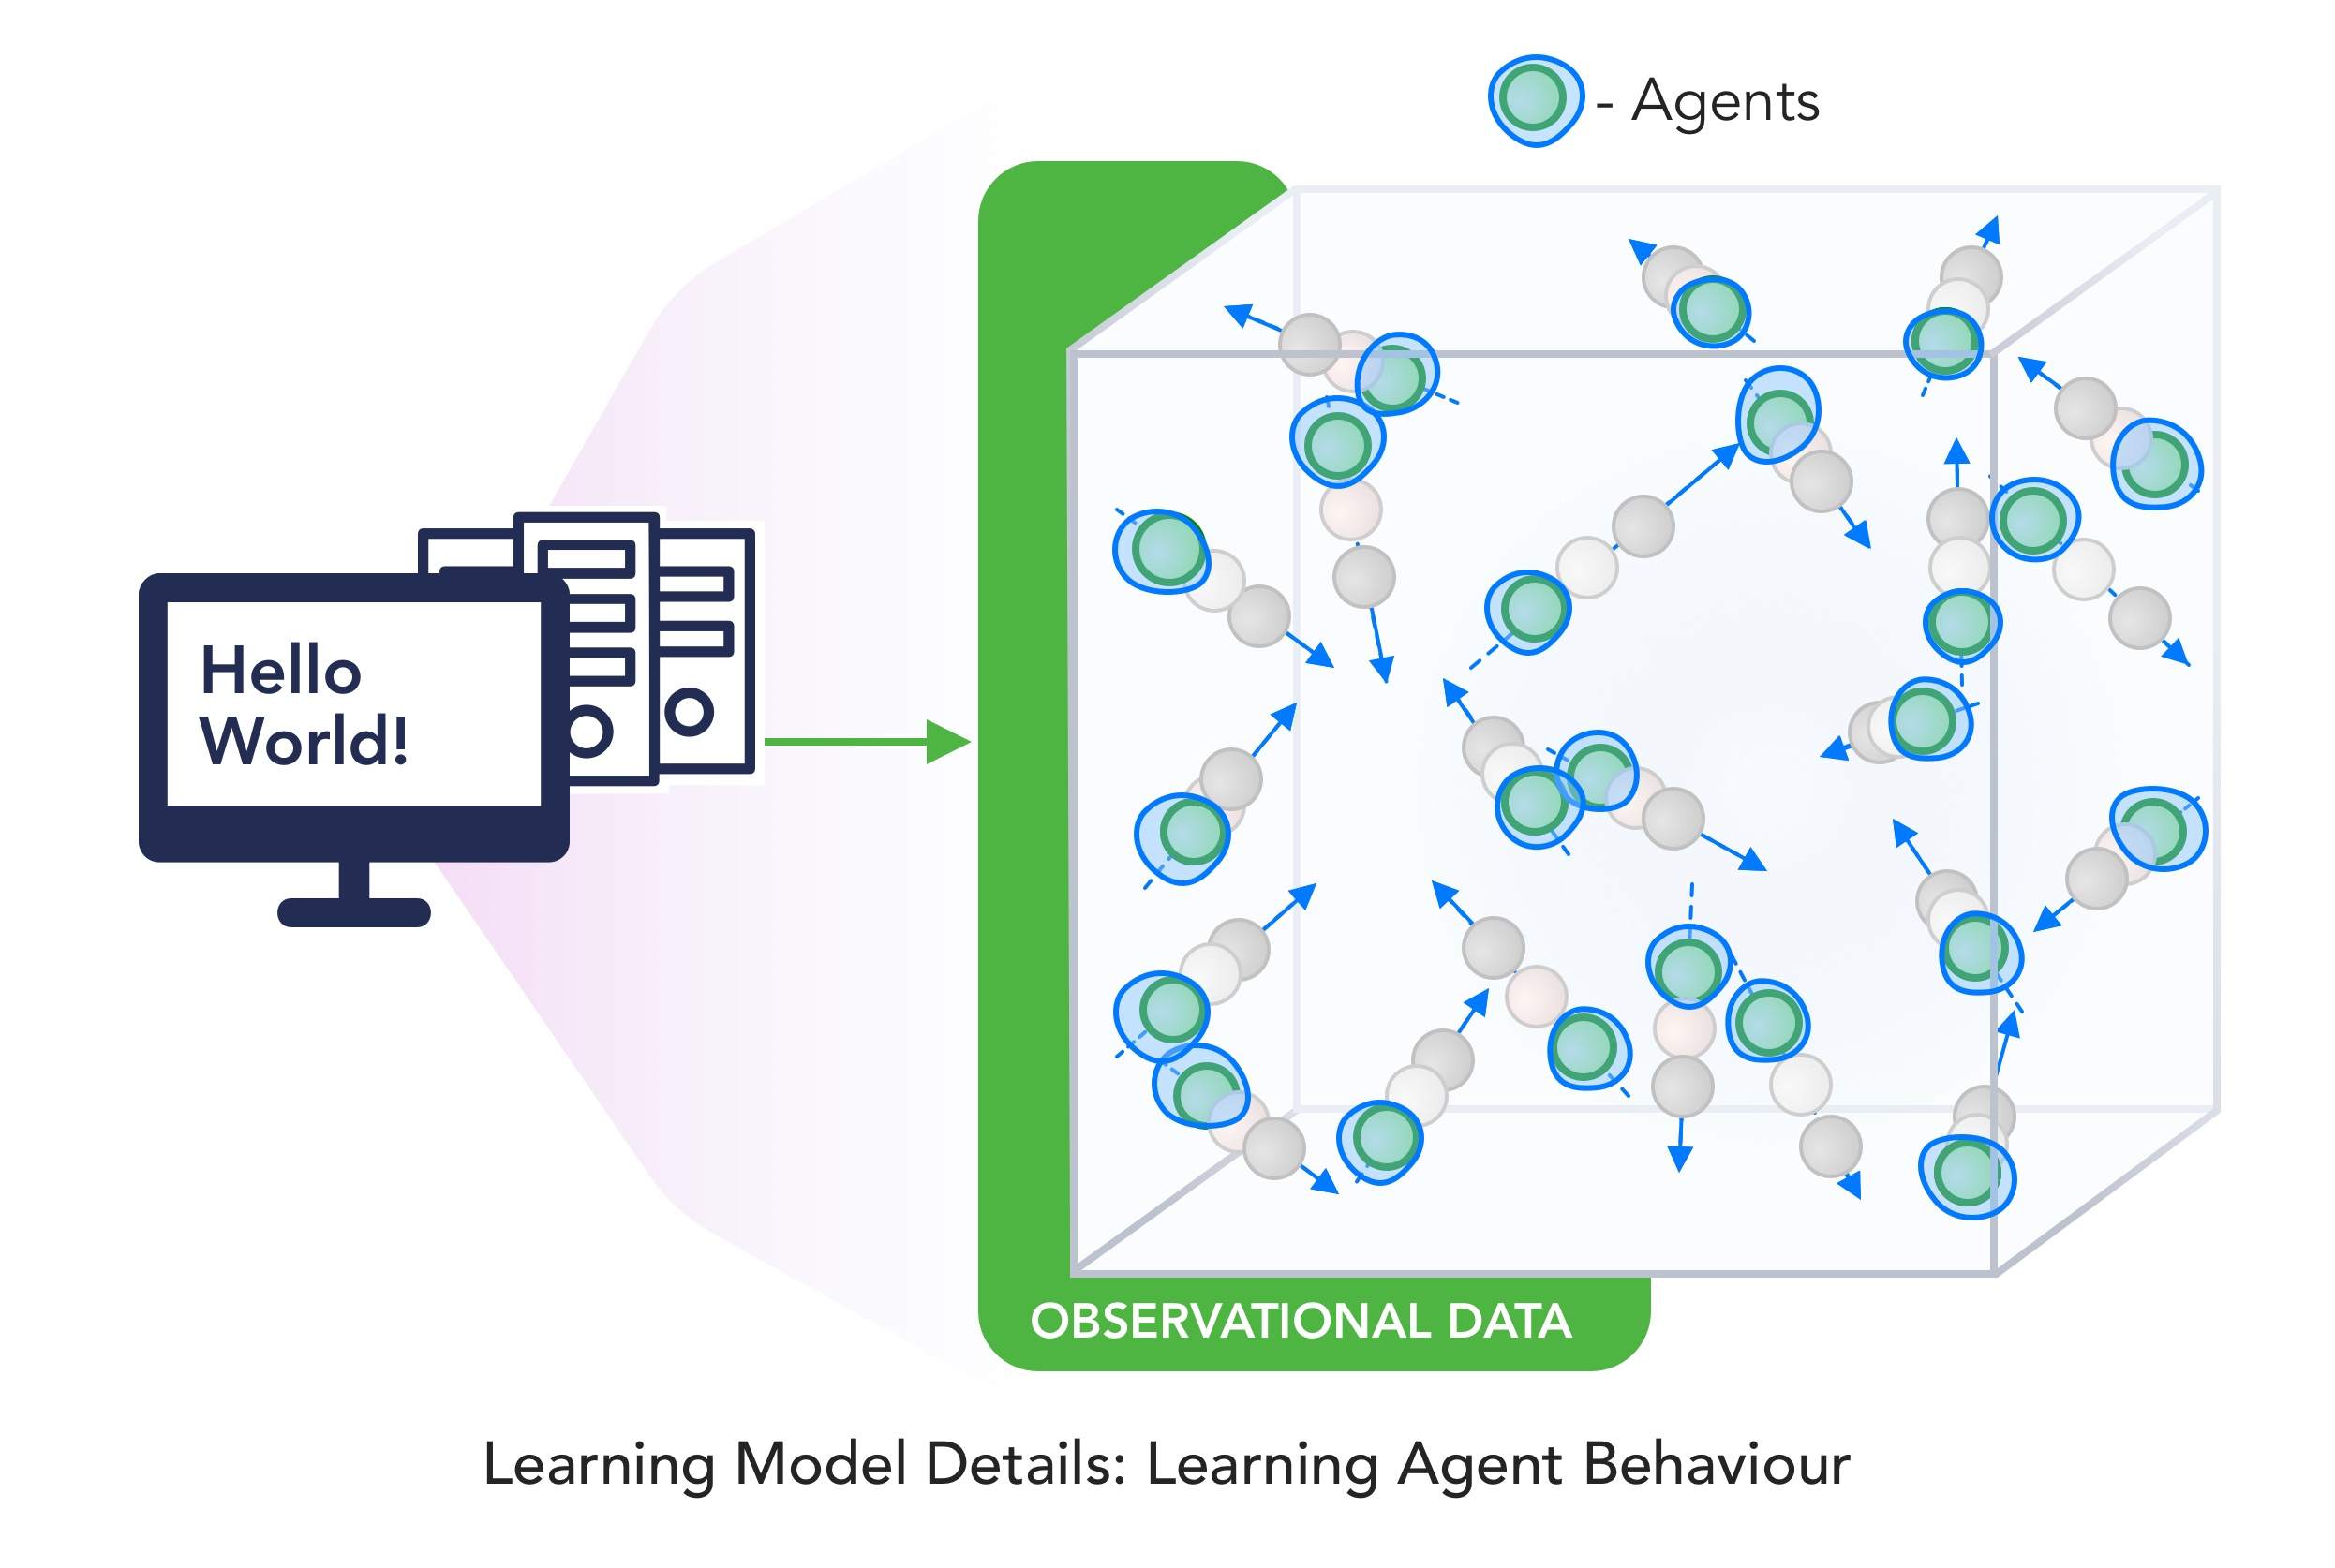
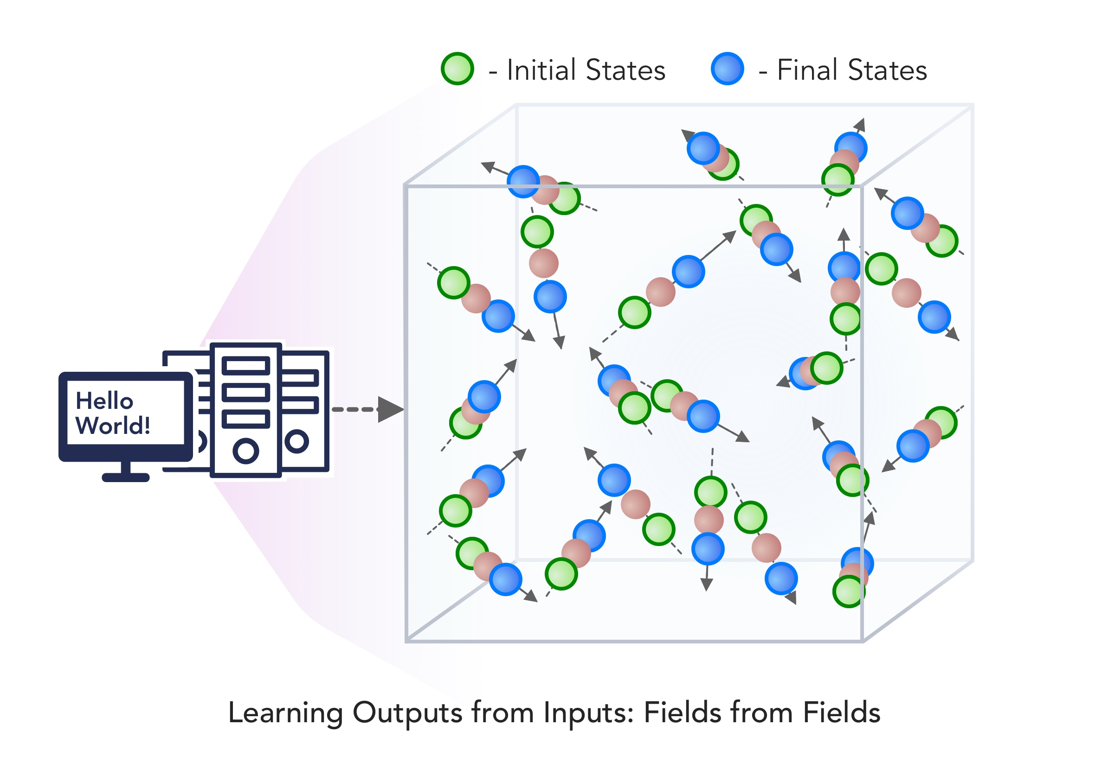
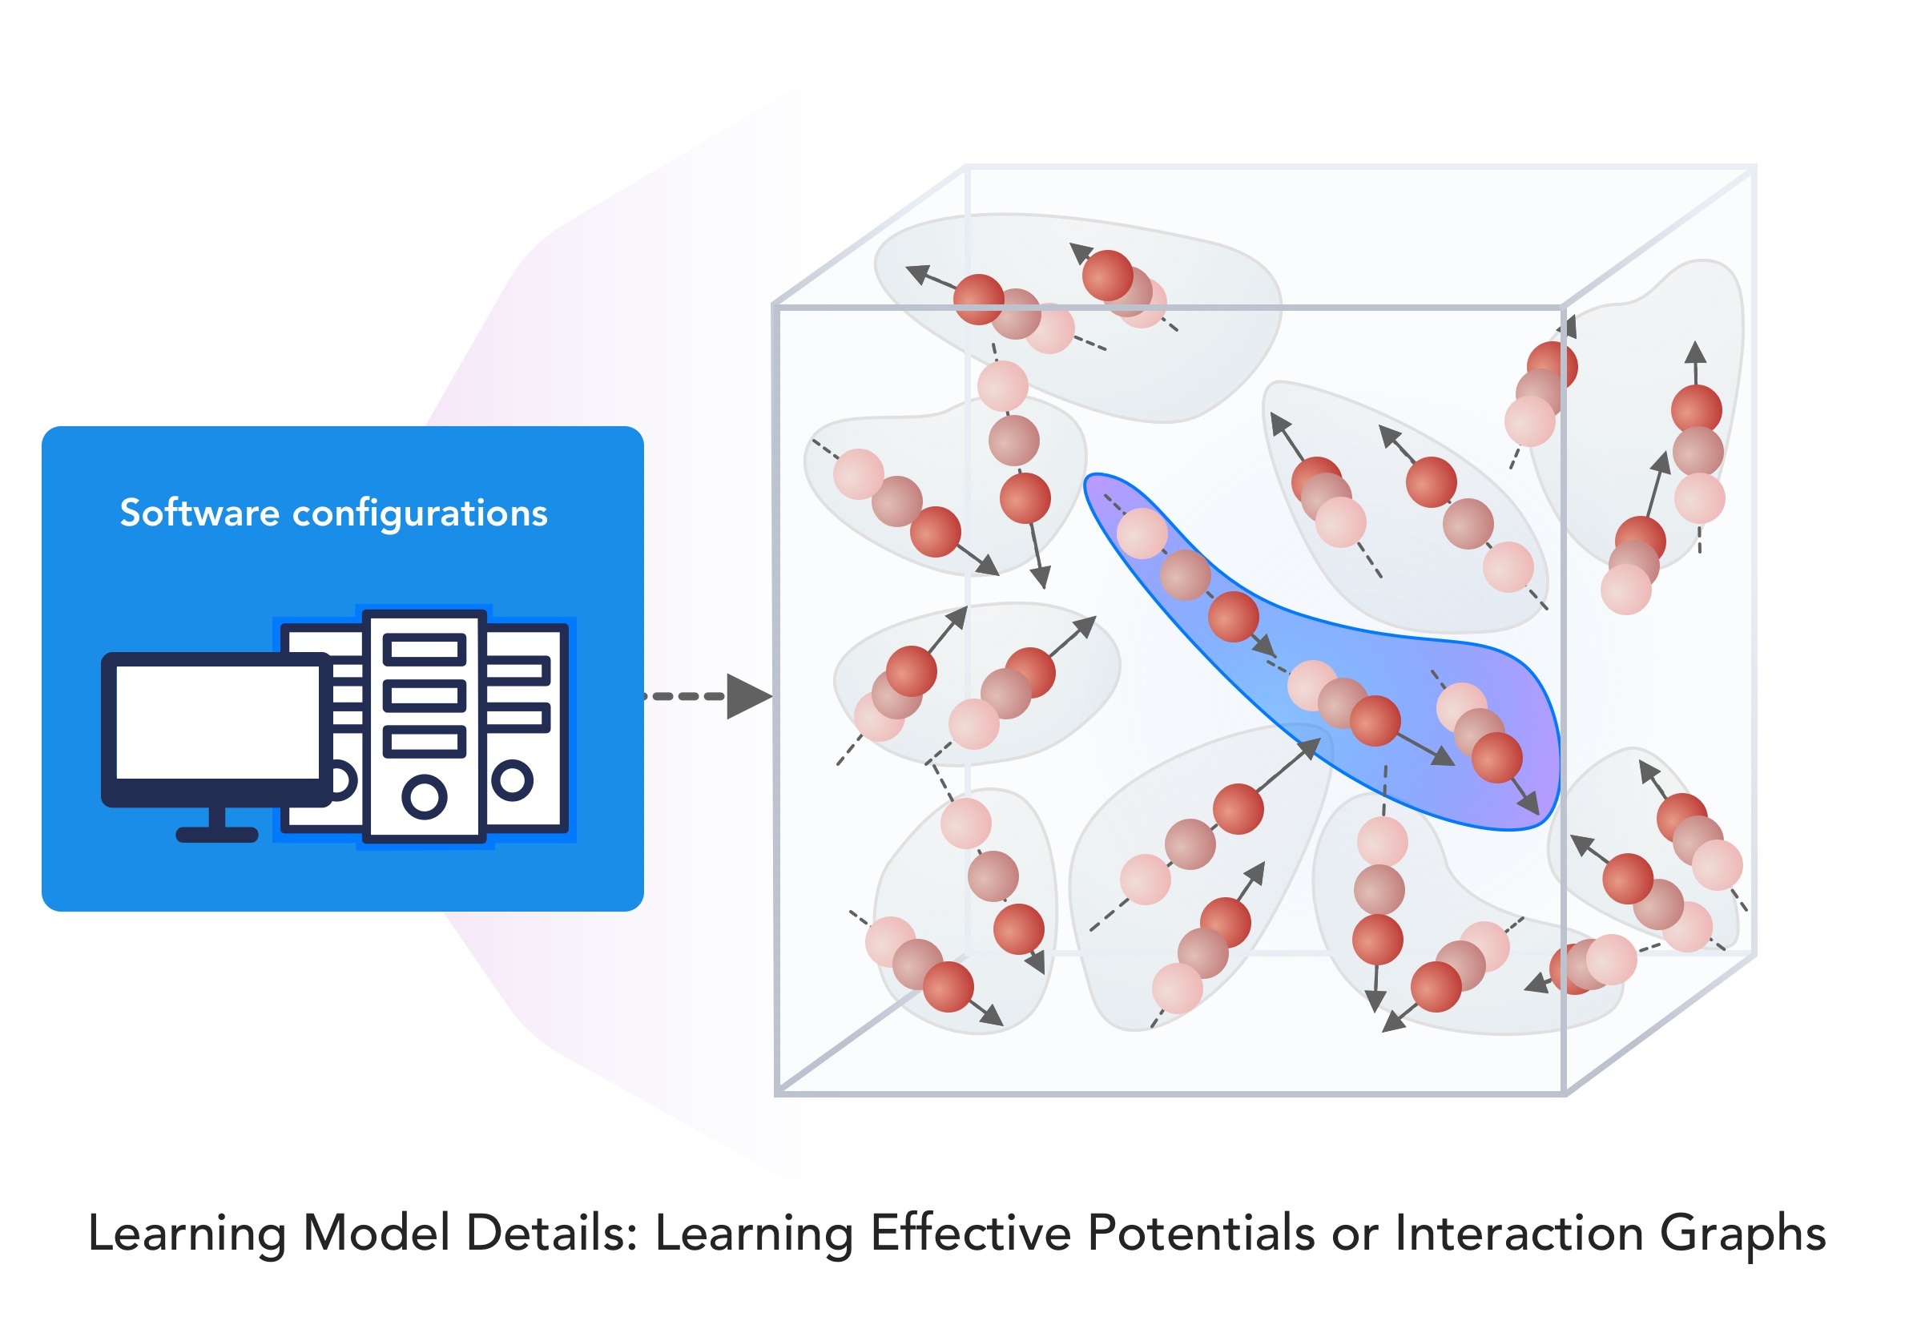
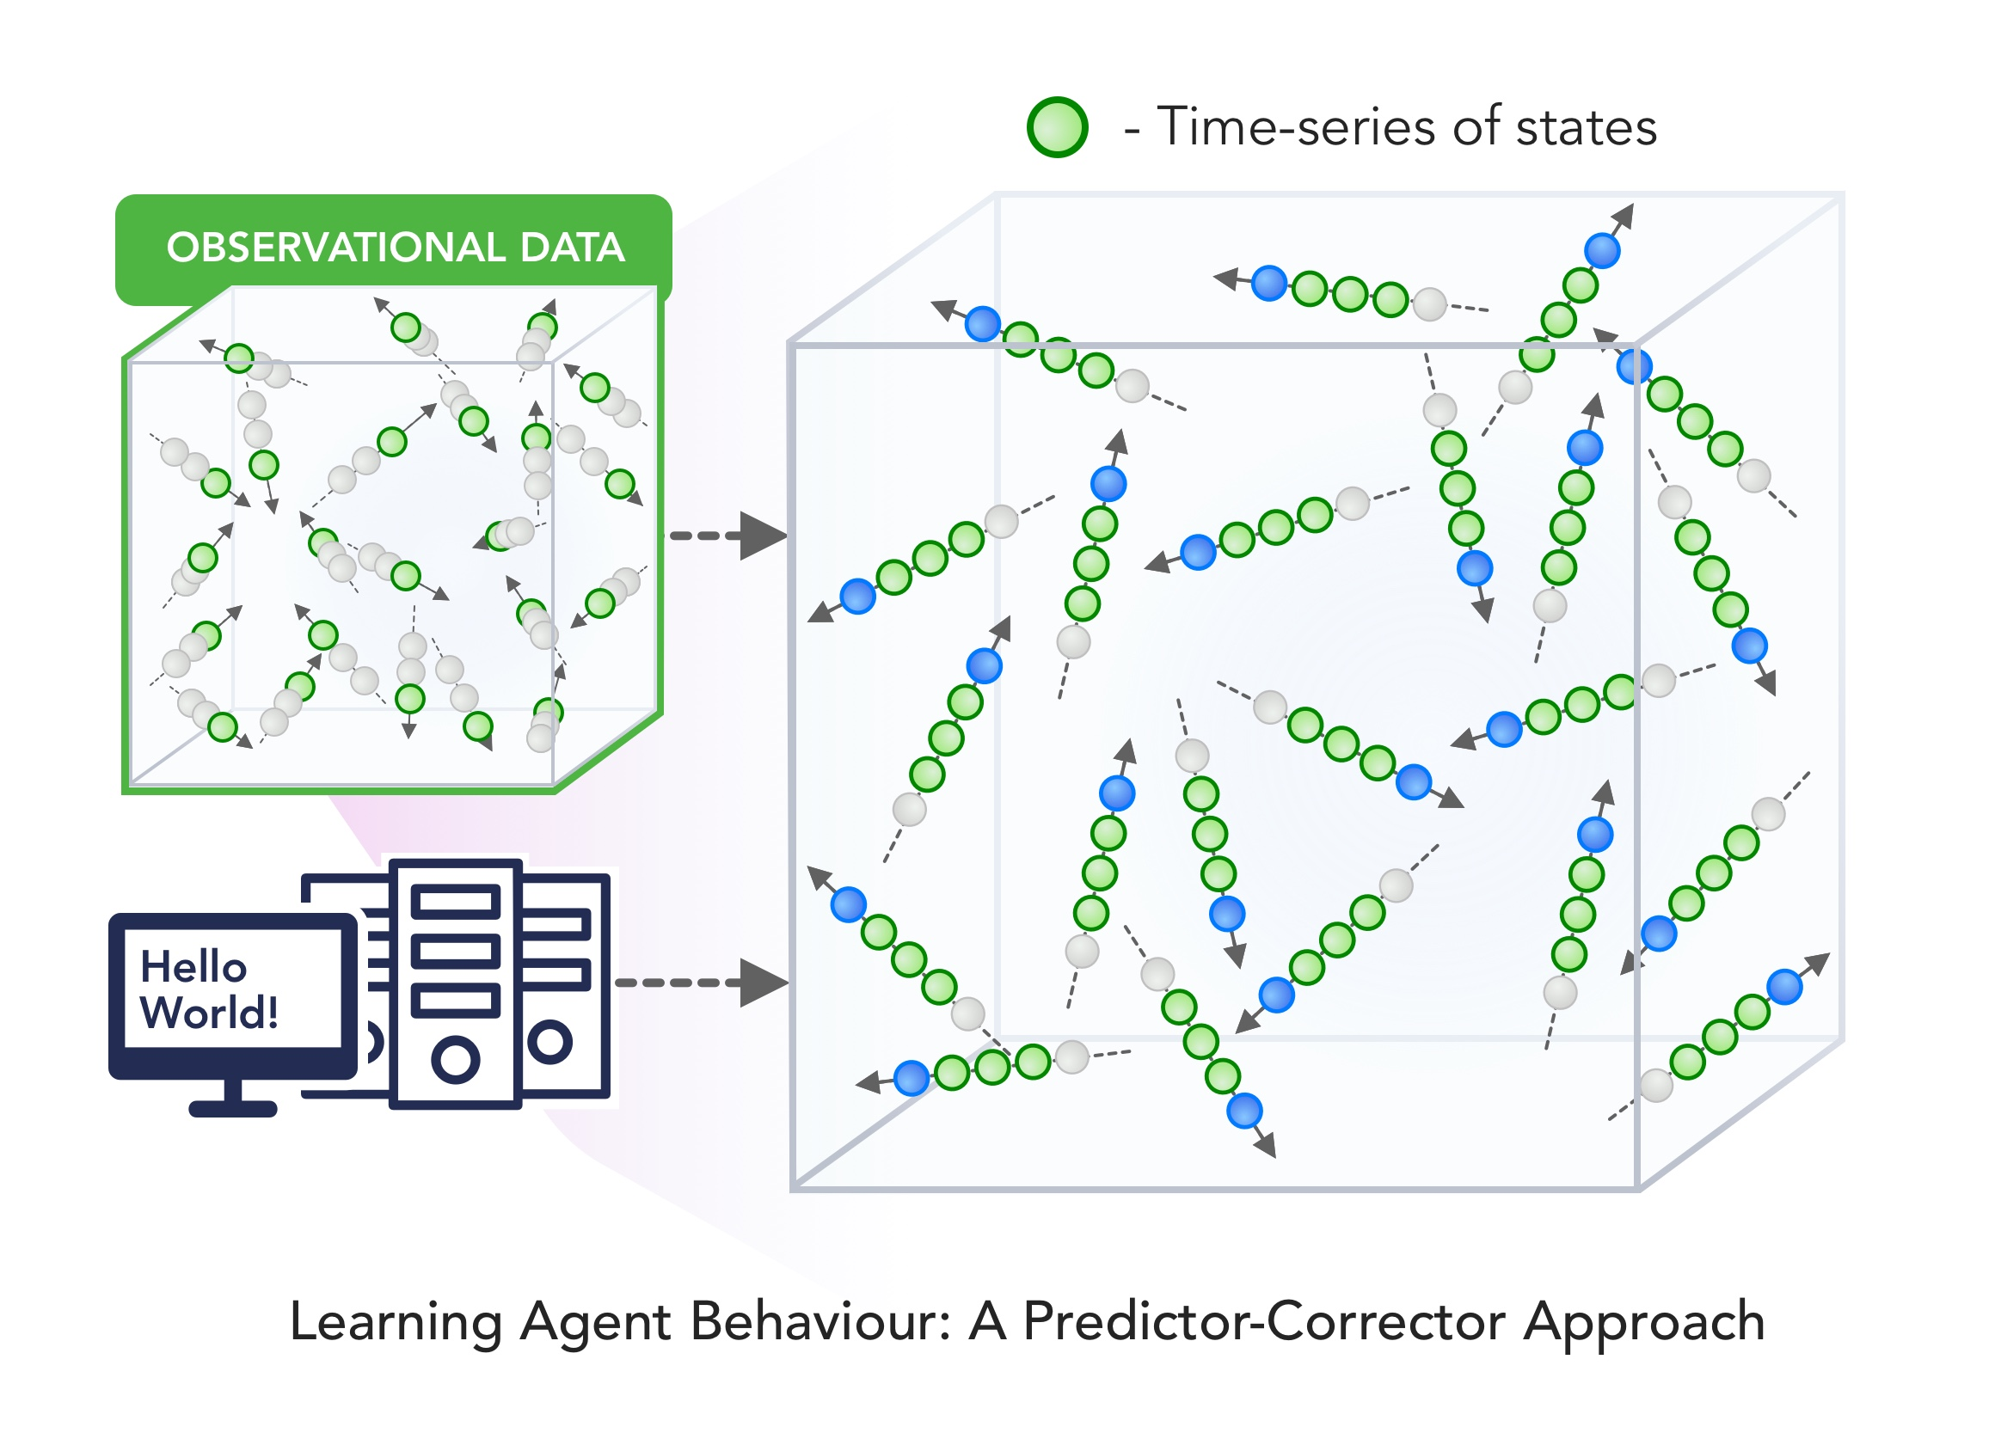
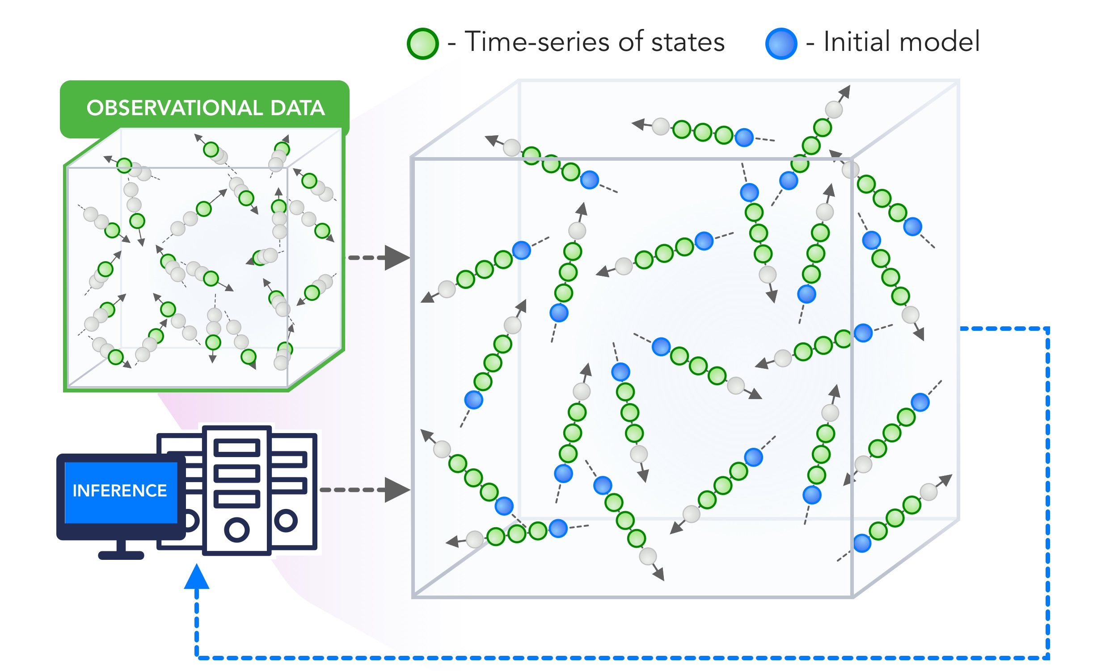
9 MLaroundHPC Scenarios
INPUT
OUTPUT

Slide 31
MLAutoTuningHPC: Learning Configurations
This is classic Autotuning and one optimizes some mix of performance and quality of results with the learning network inputting the configuration parameters of the computation.
This includes initial values and also dynamic choices such as block sizes for cache use, variable step sizes in space and time.
It can also include discrete choices as to the type of solver to be used.

Slide 32
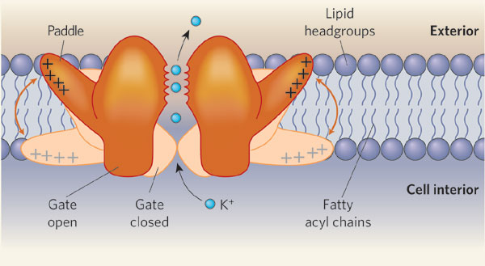
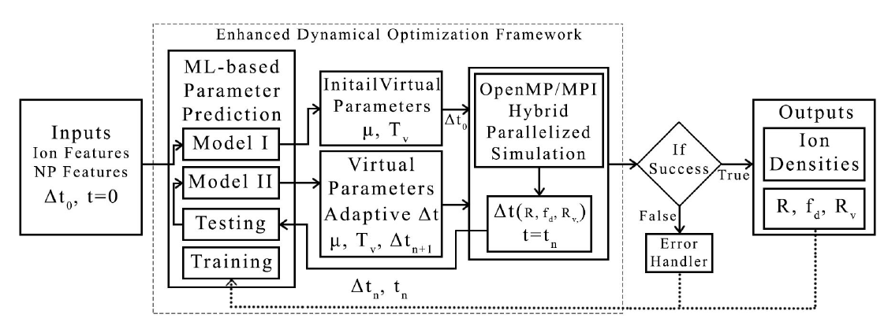
MLAutotunedHPC. Machine Learning for Parameter Auto-tuning in Molecular Dynamics Simulations: Efficient Dynamics of Ions near Polarizable Nanoparticles (NPs)
Integration of machine learning (ML) methods for parameter prediction for MD simulations by demonstrating how they were realized in MD simulations of ions near polarizable NPs.
Note ML used at start and end of simulation blocks
JCS Kadupitiya,
Geoffrey Fox,
Vikram Jadhao
ML-Based Simulation Configuration
Inference I
Inference I
Inference II
Inference II
Testing
Testing
Training
Training

Slide 33
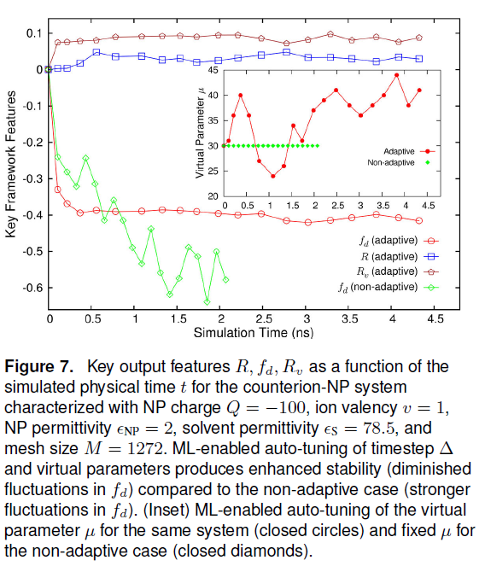
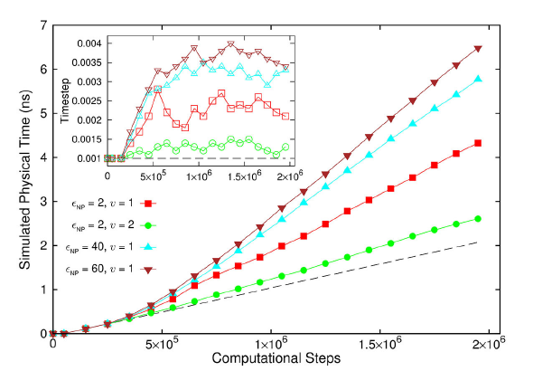
Results for Nanosimulation MLAutotuning
Key characteristics of simulated system showing greater stability for ML enabled adaptive approach.
Auto-tuning of parameters generated accurate dynamics of ions for 10 million steps while improving the stability.
Integrated with ML-enhanced framework with hybrid OpenMP/MPI
Maximum speedup of 3 from MLAutoTuning and a maximum speedup of 600 from the combination of ML and parallel computing.
Quality of simulation measured by time simulated per step with increasing use of ML enhancements. (Larger is better).
Inset is timestep used

Slide 34
MLAutoTuningHPC: Smart Ensembles
Here we choose the best set of parameters to achieve some computation goal
Such as providing the most efficient training set with defining parameters spread well over the relevant phase space.

Slide 35
MLforHPC Simulation Surrogates
MLaroundHPC: Learning Outputs from Inputs:
Computation Results from Computation defining Parameters
Here one just feeds in a modest number of meta-parameters that the define the problem and learn a modest number of calculated answers.
This presumably requires fewer training samples than “fields from fields” and is main use so far
Operationally same as SimulationTrainedML but with a different goal: In SimulationTrainedML the simulations are performed to directly train an AI system rather than the AI system being added to learn a simulation.

Slide 36
MLaroundHPC: ML for High Performance Surrogates of nanosimulations
An example of Learning Outputs from Inputs: Computation Results from Computation defining Parameters
Employed to extract the ionic structure in electrolyte solutions confined by planar and spherical surfaces.
Written with C++ and accelerated with hybrid MPI-OpenMP.
MLaroundHPC successfully learns desired features associated with the output ionic density that are in excellent agreement with the results from explicit molecular dynamics simulations.
Will be deployed on nanoHUB for education (an attractive use of surrogates)

Slide 37
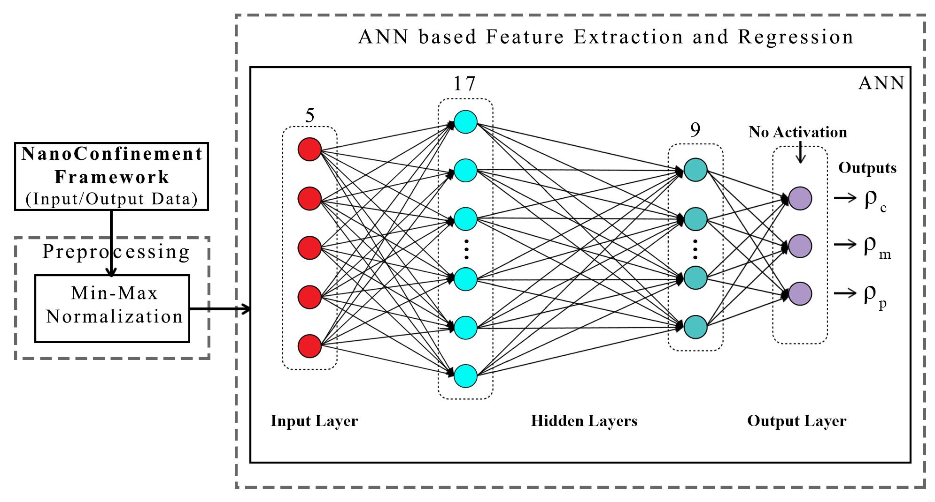
ANN for Regression
Dataset having 6,864 simulation configurations was created for training and testing (0.7:0.3) the ML model.
Note learning network quite small
ANN was trained to predict three continuous variables; Contact density ρ_{c} , mid-point (center of the slit) density ρ_{m} , and peak density ρ_{p}
TensorFlow, Keras and Sklearn libraries were used in the implementation
Adam optimizer, xavier normal distribution, mean square loss function, dropout regularization.

Slide 38
Parameter Prediction in Nanosimulation
ANN based regression model predicted Contact density ρ_{c} , mid-point (center of the slit) density ρ_{m} , and peak density ρ_{p} accurately with a success rate of 95:52% (MSE ~ 0:0000718), 92:07% (MSE ~ 0:0002293), and 94:78% (MSE ~ 0:0002306) respectively, easily outperforming other non-linear regression models
Success means within error bars (2 sigma) of Molecular Dynamics Simulations

Slide 39
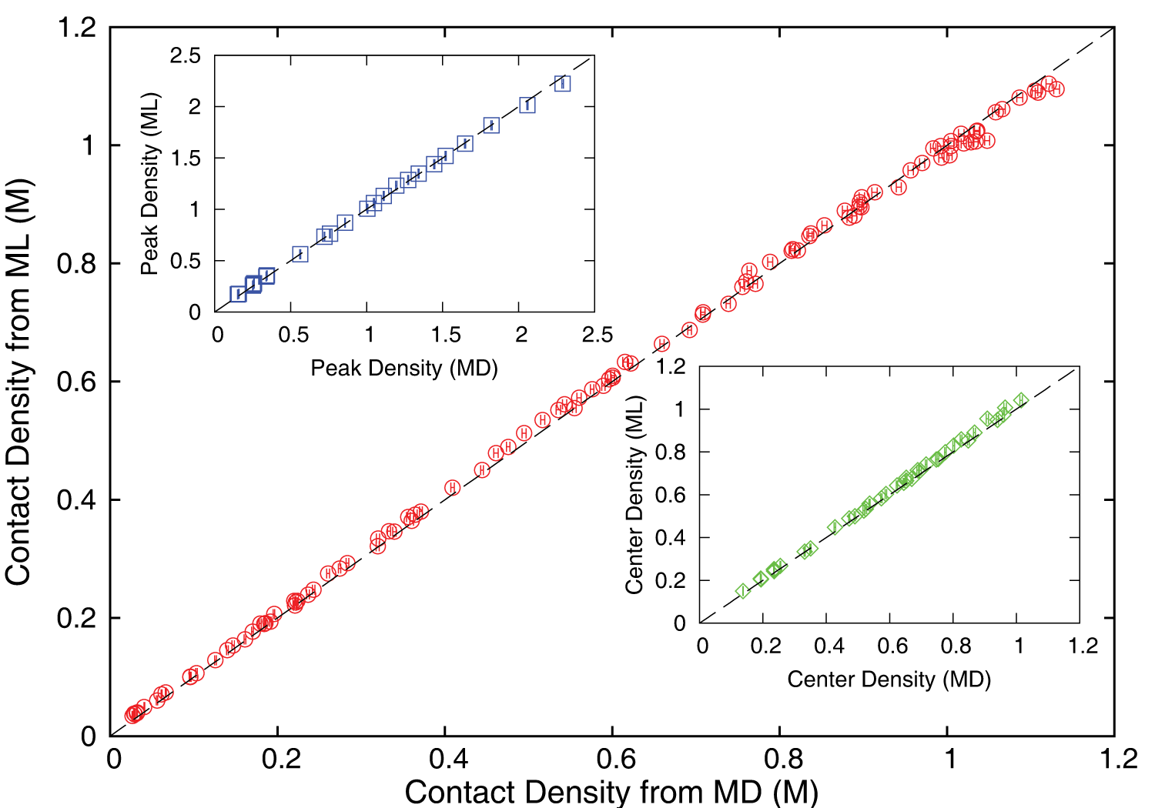
Accuracy comparison between ML predictions and MD simulation results
ρ_{c ,} ρ_{m} and ρ_{p} predicted by the ML model were found to be in excellent agreement with those calculated using the MD method; data from either approach fall on the dashed lines which indicate perfect correlation.

Slide 40
Speedup of MLaroundHPC
T_{seq} is sequential time
T_{train} time for a (parallel) simulation used in training ML
T_{learn} is time per point to run machine learning
T_{lookup} is time to run inference per instance
N_{train} number of training samples
N_{lookup} number of results looked up
Becomes T_{seq}/T_{train} if ML not used
Becomes T_{seq}/T_{lookup} (10⁵ faster in our case) if inference dominates (will overcome end of Moore’s law and win the race to zettascale)
Another factor as inferences uses one core; parallel simulation 128 cores
Strong scaling as no need to parallelize more than effective number of nodes
N_{train} is 7K to 16K in our work

Slide 41
MLforHPC Simulation Surrogates
MLaroundHPC: b) Learning Outputs from Inputs: Fields from Fields
Here one feeds in initial conditions and the neural network learns the result where initial and final results are fields
There is also c) Learning Outputs from Inputs: output fields from Computation defining Parameters combining a) and b)

Slide 42
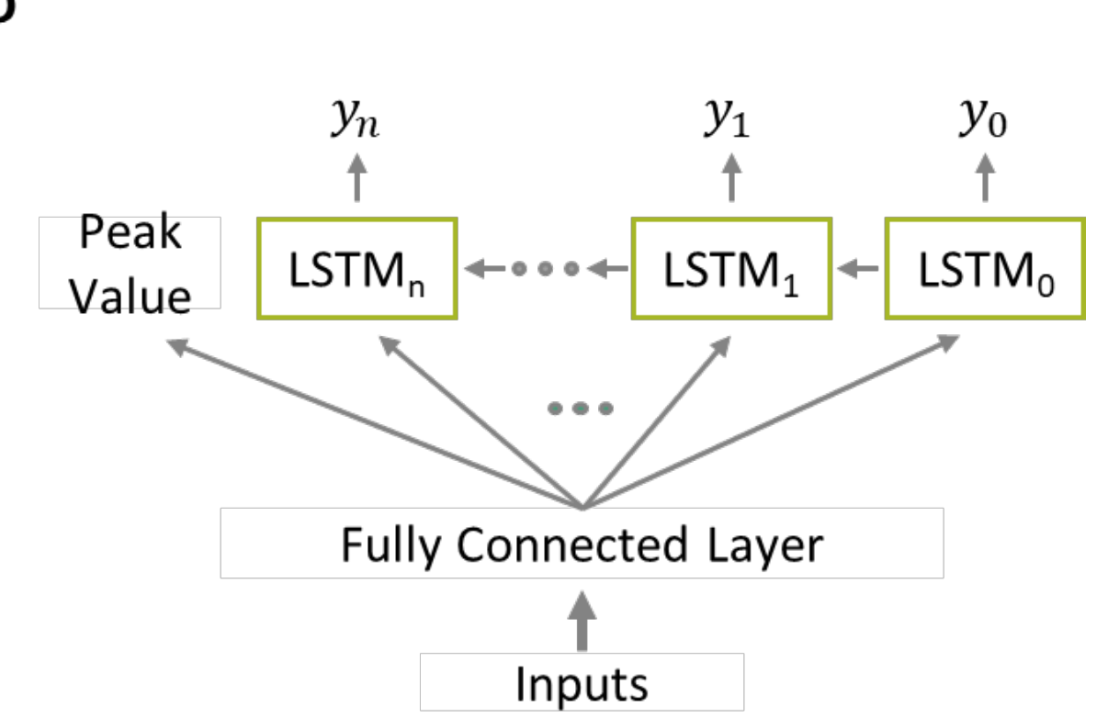
How does one do this for case c) ?
If you are learning particular output features (as in Computation Results from Computation defining Parameters), then a simple (not necessarily deep) neural net suffices
If you want to learn the output fields (from either input fields or input Computation defining Parameters), then a more sophisticated approach is appropriate
Recent paper “Massive computational acceleration by using neural networks to emulate mechanism based biological models” uses 501 LSTM units to represent a one-dimensional grid of values which is output of a two-dimensional gene circuit simulation which only depends on radius.
Note LSTM models sequences and one gets
Sequences in either time (usual LSTM application) or space
The ML representation allowed a much richer parameter sweep showing features not in training set
Performance improved by factor 30,000

Slide 43
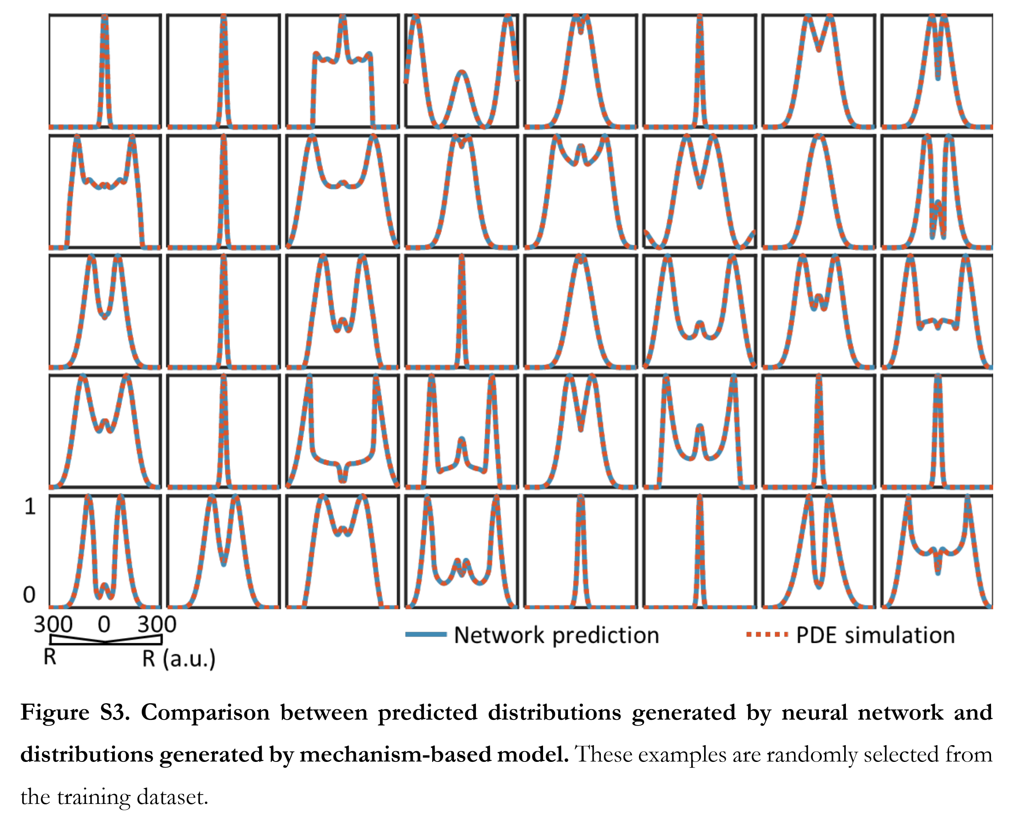
Massive computational acceleration by using neural networks to emulate mechanism based biological models

Slide 44
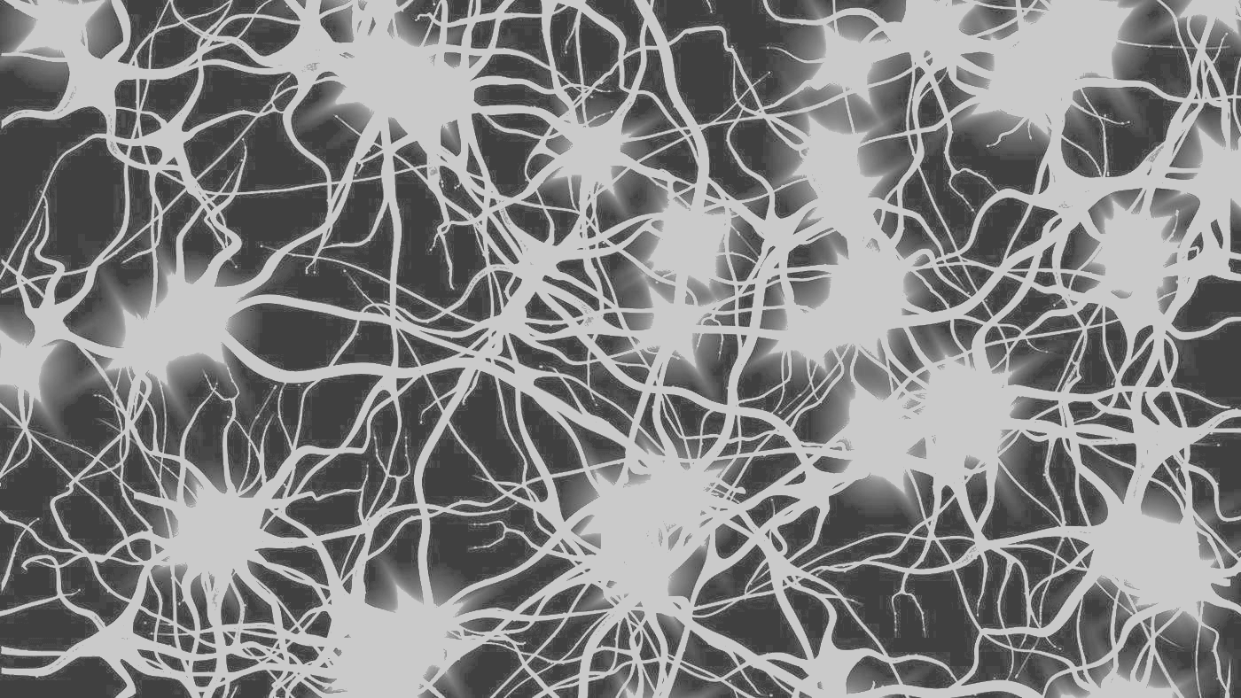
Learning Model Details
Agents and Time-Series Case Studies

Slide 45
MLaroundHPC: Learning Model Details
a) Learning Agent Behavior One has a model such as a set of cells as agents modeling a virtual tissue. One can use ML to learn dynamics of cells replacing detailed computations by ML surrogates.
As can be millions to billions of such agents the performance gain can be huge as each agent uses same learned model..
This is MLaroundHPC for cells but MLAutotuning for multi-cell (tissue) phase

Slide 46
MLaroundHPC: Learning Model Details
b) Learning Effective Potentials or Interaction Graphs An effective potential is an analytic, quasi-empirical or quasi-phenomenological potential that combines multiple, perhaps opposing, effects into a single potential.
This is classic coarse graining strategy
Deep Learning replacing dimension reduction techniques

Slide 47
MLaroundHPC: Learning Model Details ML for Data Assimilation
Take the case where we have “videos” recording observational data i.e. data is a high dimensional (spatial extent) time series
(c) Learning Agent Behavior – a Predictor-Corrector approach Here one time steps models and at each step optimize the parameters to minimize divergence between simulation and ground truth data.
Example: produce a generic model organism such as an embryo. Take this generic model as a template and learn the different adjustments for particular individual organisms.
Build on Ride hailing work
Current state of the art expresses spatial structure as a convolutional neural net and time dependence as recurrent neural net (LSTM)

Slide 48
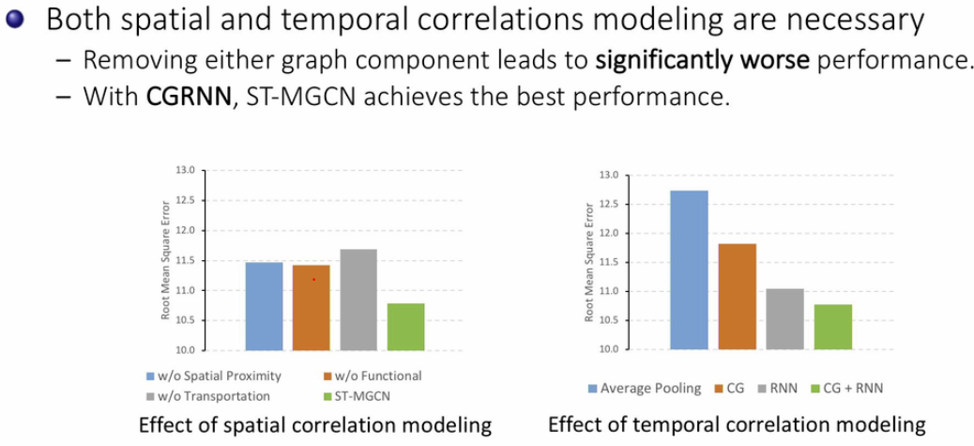
Yan Liu@USC ICML 2019 Time Series workshop
Include Space (Convolutional Graph) and Time (RNN)

Slide 49
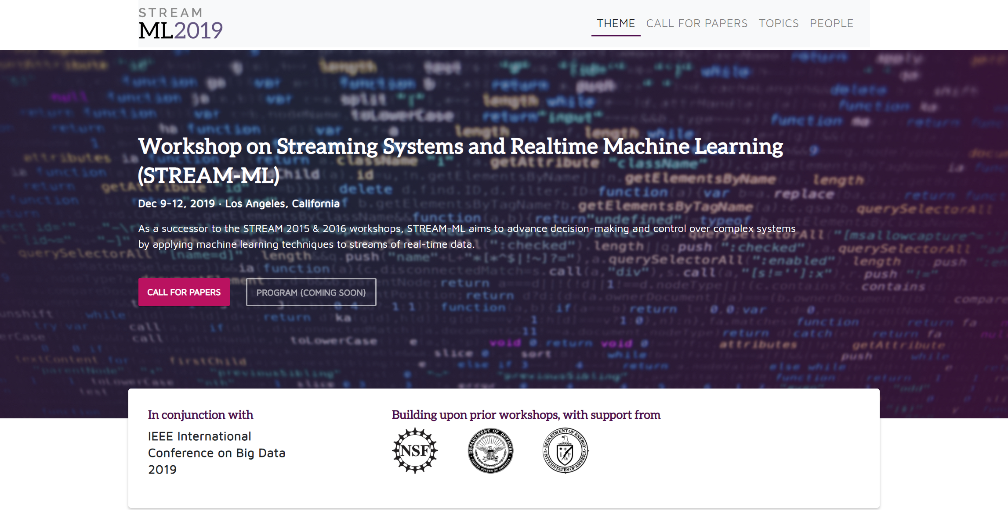

Slide 50
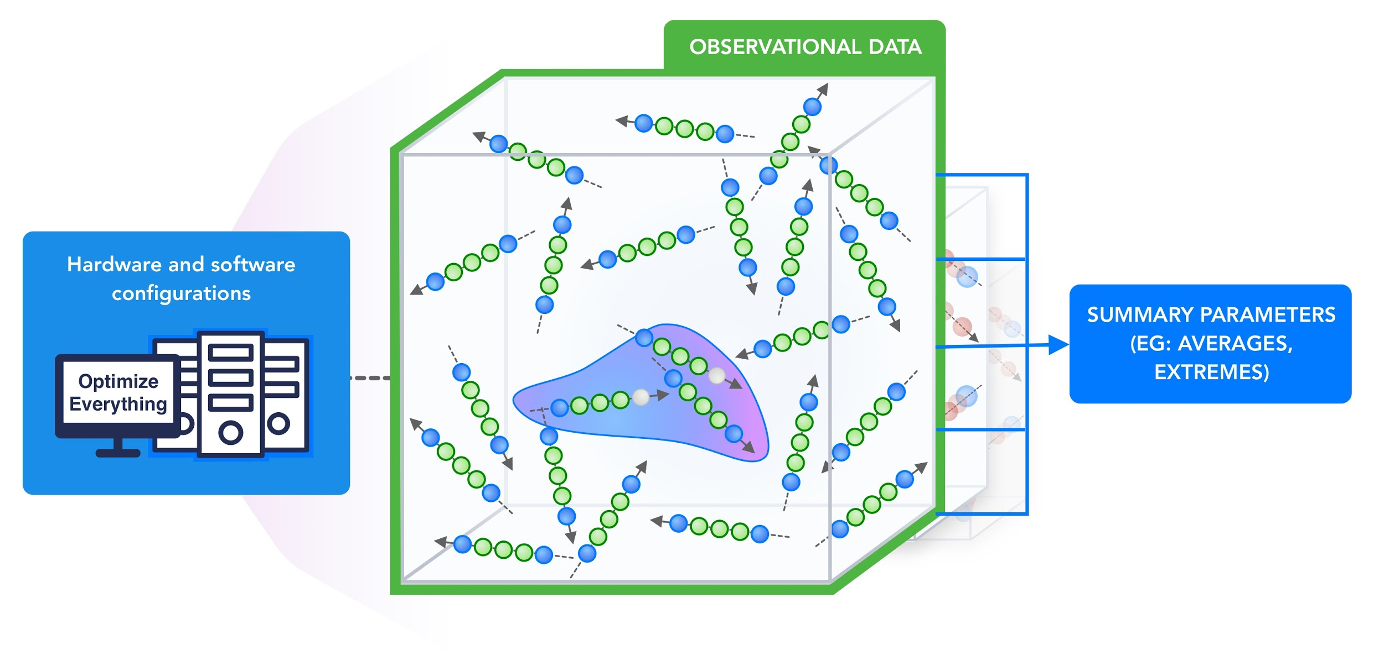
Actually Really Need To do Everything Simultaneously in MLaroundHPC

Slide 51
Simulating Biological Organisms (with James Glazier @IU)
Learning Agent Behavior Replace components by learned surrogates (Reaction Kinetics Coupled ODE’s)
All steps use MLAutotuning
Smart Ensembles
Predictor-Corrector

Slide 52
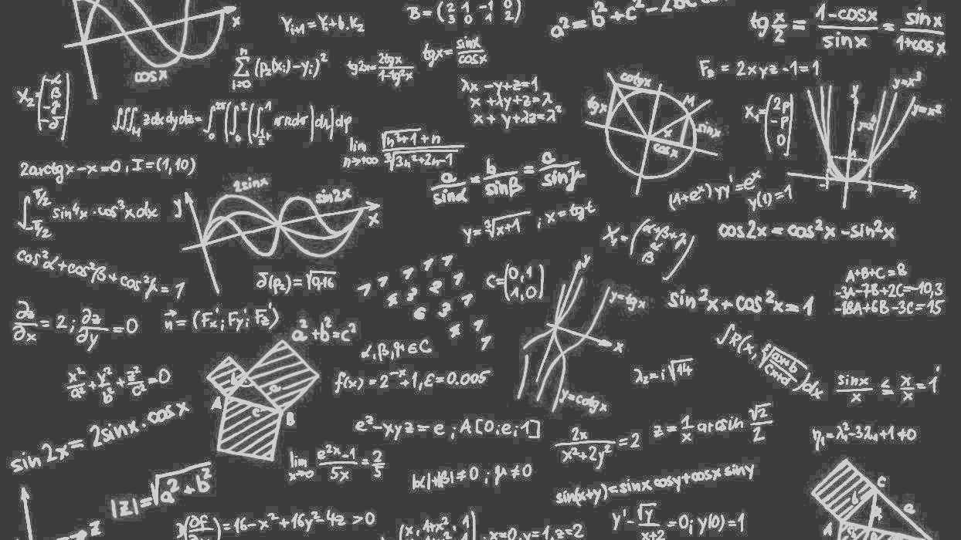
Challenges and Opportunities
Computer Science Issues

Slide 53
Computer Science Issues I
Hundreds of Ph. D. theses!
What computations can be assisted by what ML in which of 9 scenarios
What is performance of different DL (ML) choices in compute time and capability
What can we do with zettascale computing?
Redesign all algorithms so they can be ML-assisted
Dynamic interplay (of data and control) between simulations and ML seems likely but not clear at present
There ought to be important analogies between time series and this area (as simulations are 4D time series?)
Exploit MLPerf examples?

Slide 54
Computer Science Issues II
Little study of best ANN structure especially for hardest cases such as “predict fields from fields” and ML assisted data assimilation
Not known how large training set needs to be.
Most published data has quite small training sets
I am surprised that there is not a rush to get effective performances on simulations of exascale and zettascale on current machines
Interesting load balancing issues if in parallel case some points learnt using surrogates and some points calculated from scratch
Little or no study of either predicting errors or in fact of getting floating point numbers from deep learning.

Slide 55
System Hardware for ML and HPC - HPCforML
HPCforML needs to support high performance computation and high performance I/O
Communication needs to be good for all machine learning unless it is pleasingly parallel
Graph algorithms can have high MPI/synchronization overhead as well as demands on memory systems
Not certain that deep learning will always be suitable for GPU’s and some papers claim CPU’s better than GPU’s on RNN/LSTM whereas
GPU’s are better than CPU’s on CNN’s used in many cases
Need high speed networks, local fast disks and accelerator which can vary by application
Note pleasingly parallel computations dominate many areas and these will not need high performance communication

Slide 56
System Hardware for ML and HPC - MLforHPC
MLforHPC needs to support large scale simulations, large scale data analytics and their integration
Integration sometimes as distinct ML and HPC computation jobs – run simulation for training data and then run ML
But sometimes intertwined in a single job.
Dynamic MLAutotuning, Effective potential and ML assisted data assimilation give intertwined jobs
Need ML optimization and Simulation optimization spread through machine and fast ways for ML and simulation to exchange data
This could imply heterogenous accelerators and fast I/O and internode communication to enable ML and Computation to run together.

Slide 57
Conclusions

Slide 58
Conclusions
HPDC/HPC is essential for the future of the world
Everybody needs systems
Need to align communities to ensure HPC importance recognized
1
HPC is essential for the future of the world
Everybody needs systems
Need to align communities
2
Good to work closely with industry
Student Internships, Collaborations such as Contribute to MLPerf
Global AI and Modeling Supercomputer GAIMSC good framework with HPC Cloud linked to HPC Edge
Training on cloud; Inference and some training on the edge
3
MLforHPDC/HPC very promising where we could aim at
First Zettascale effective performance in next 2 years
Hardware/Software aimed at general ML assisted speedup of computation
Your health can be engineered with ML-assisted personalized nanodevices designed based on the ML-assisted digital twin of disease in your tissues
4

Slide 59
Extras
Graphs measuring popularity of areas

Slide 60
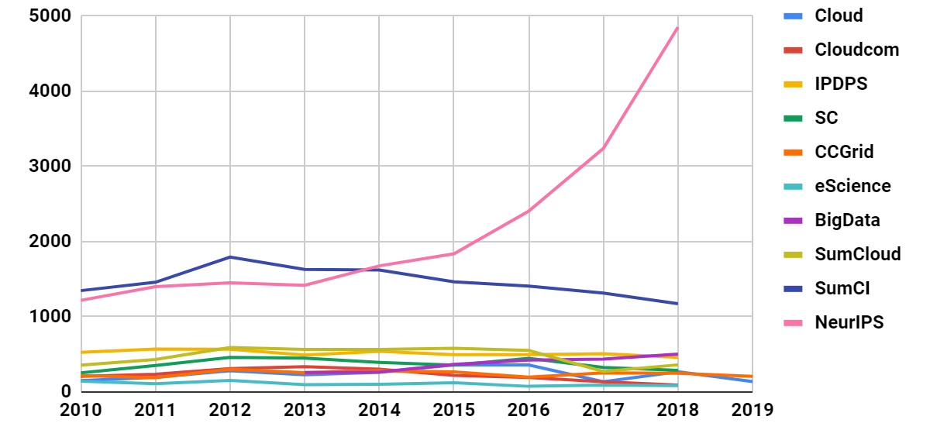
Papers Submitted: Comparing 7 Conferences and 2 Sums
HPDC not included as talk given there SoCC (other major cloud conference) not included as could find no statistics
Notes:
One measure of papers in HPC/CI/Grid community shows slow decline while AI explodes
We will see curves at bottom later

Slide 61
Arxiv Publications from Aiindex.org
In 2017, absolute number of papers are
AI: 23,922 CS: 383,279 All: 3,032,731

Slide 62
H5-index correlated with conference size
H5 is h-index calculated over the last 5 years produced in July 2018
Notes:
H5 index may be unreliable

Slide 63
Some smaller areas: Google Trends last 5 years (Topics unless otherwise stated)
Parallel Computing (Programming Paradigm)
HPC
Edge Computing
Fog Computing
Cyberinfrastructure
Notes:
●Some small fields. Edge growing but pretty small

Slide 64
Some growing areas: Google Trends last 5 years (Topics unless otherwise stated)
Artificial Intelligence
Amazon Web Services
Azure (Comp. App)
Docker (Software)
Kubernetes (Comp. App)
Notes:
●Cloud features growing quite fast

Slide 65
Extras
Details on SysML conference

Slide 66
SysML Conference Stanford March 31 - April 2, 2019

Slide 67
Extras
Data Science and Jobs

Slide 68
Gartner on Data Science, Data Engineering and Software Engineering
Gartner says that job numbers in data science teams are
10% - Data Scientists are quite small fraction
20% - Citizen Data Scientists ("decision makers")
30% - Data Engineers
20% - Business experts
15% - Software engineers
5% - Quant geeks
~0% - Unicorns (very few exist!)

Slide 69
Indeed.com Trends

Slide 70
Indeed.com Trends
Note Job Seeker and Jobs posted reversed

Slide 71
Gartner says that 3 times as many jobs for data engineers as data scientists.
NIPS 2015 http://papers.nips.cc/paper/5656-hidden-technical-debt-in-machine-learning-systems.pdf

Slide 72
Communities/Expertise in Future World
Hard core ML community enhances Machine Learning Algorithms
AI First Engineering community uses and advances
AI
HPC and Cyberinfrastructure
Parallel and Distributed Computing
Edge Computing and Internet of Things
To build High Performance Big Data systems addressing many important research and community/industry needs
All of this part of Applied Computer Science

Slide 73
Extras
More details in GAIMSC -- especially edge

Slide 74
Overall Global AI and Modeling Supercomputer GAIMSC Architecture II
There is a very distributed set of devices surrounded by local Fog computing; this forms the logically and physically distributed edge
The edge is structured and largely data
These are two differences from the Grid of the past
e.g. self driving car will have its own fog and will not share fog with truck that it is about to collide with
The cloud and edge will both be very heterogeneous with varying accelerators, memory size and disk structure.

Slide 75
Overall Global AI and Modeling Supercomputer GAIMSC Architecture II
There is a very distributed set of devices surrounded by local Fog computing; this forms the logically and physically distributed edge
The edge is structured and largely data
These are two differences from the Grid of the past
e.g. self driving car will have its own fog and will not share fog with truck that it is about to collide with
The cloud and edge will both be very heterogeneous with varying accelerators, memory size and disk structure.

Slide 76
Extras
HPC for ML Details

Slide 77
HPCforML (Systems for ML) in detail
HPCforML can be further subdivided
HPCrunsML: Using HPC to execute ML with high performance
SimulationTrainedML: Using HPC simulations to train ML algorithms, which are then used to understand experimental data or simulations. (Return to this as similar to MLaroundHPC)
Twister2 supports HPCrunsML by using high performance technology everywhere and this has been my major emphasis over last 5 years

Slide 78
Diversion on Twister2

Slide 79
Twister2 Highlights I
“Big Data Programming Environment” such as Hadoop, Spark, Flink, Storm, Heron but uses HPC wherever appropriate and outperforms Apache systems – often by large factors
Runs preferably under Kubernetes Mesos Nomad but Slurm supported
Highlight is high performance dataflow supporting iteration, fine-grain, coarse grain, dynamic, synchronized, asynchronous, batch and streaming
Three distinct communication environments
DFW Dataflow with distinct source and target tasks; data not message level; Data-level Communications spilling to disks as needed
BSP for parallel programming; MPI is default. Inappropriate for dataflow
Storm API for streaming events with pub-sub such as Kafka
Rich state model (API) for objects supporting in-place, distributed, cached, RDD (Spark) style persistence with Tsets (see Pcollections in Beam, Datasets in Flink, Streamlets in Storm, Heron)

Slide 80
Twister2 Highlights II
Can be a pure batch engine
Not built on top of a streaming engine
Can be a pure streaming engine supporting Storm/Heron API
Not built on on top of a batch engine
Fault tolerance (June 2019) as in Spark or MPI today; dataflow nodes define natural synchronization points
Many API’s: Data, Communication, Task
High level hiding communication and decomposition (as in Spark) and low level (as in MPI)
DFW supports MPI and MapReduce primitives: (All)Reduce, Broadcast, (All)Gather, Partition, Join with and without keys
Component based architecture -- it is a toolkit
Defines the important layers of a distributed processing engine
Implements these layers cleanly aiming at high performance data analytics

Slide 81
Parallel SVM using SGD execution time for 320K data points with 2000 features and 500 iterations, on 16 nodes with varying parallelism
Times
Spark RDD > Twister2 Tset > Twister2 Task > MPI

Slide 82
MLforHPC in detail
MLforHPC can be further subdivided into several categories:
MLAutotuning: Using ML to configure (autotune) ML or HPC simulations.
MLafterHPC: ML analyzing results of HPC as in trajectory analysis and structure identification in biomolecular simulations
MLaroundHPC: Using ML to learn from simulations and produce learned surrogates for the simulations or parts of simulations. The same ML wrapper can also learn configurations as well as results. Most Important
MLControl: Using simulations (with HPC) in control of experiments and in objective driven computational campaigns. Here the simulation surrogates are very valuable to allow real-time predictions.
Twister2 supports MLforHPC by allowing nodes of HPC dataflow representation to be wrapped with ML and it supports GAIMSC by integrating edge with cloud

Slide 83
Suitable for MLforHPC?
Continually interacting in the Intelligent Aether with
Software model supported by Twister2

Slide 84
Extras
Details on ML for HPC

Slide 85
Comments on Compendium of MLforHPC Research
http://dsc.soic.indiana.edu/publications/Learning%20EverywhereResource.pdf
111 Citations with very short comments
Incomplete (deliberately) on MLafterHPC as this mature but still important
Incomplete on MLControl. Need to improve
Larger fraction of MLaroundHPC and MLAutotuningHPC work where nearly all citations are 2017 or later
Key divisions for MLaroundHPC/MLAutotuning
Computer Science: either use ML to improve algorithm or system architecture to implement: I have not found much work
Particle Dynamics: largest component with, smart sampling, effective potentials, “Computation Results from Computation defining Parameters” with “simple” deep learning replacing sophisticated dimension reduction; material science properties very active
Agent-based Simulations in networked systems or virtual tissues. Perhaps most promising as inevitably data driven as no fundamental equations for cells, cars, people, bacteria
Partial Differential equations: not so well developed as above two areas

Slide 86
MLAutoTuningHPC: Learning Model Setups from Observational Data
Seen when simulation set up as a set of agents.
Tuning agent (model) parameters to optimize agent outputs to available empirical data presents one of the greatest challenges in model construction.

Slide 87
Results for MLAutotuning
Comparison of results for peak densities of counterions between adaptive (ML) and original non-adaptive cases (they look identical)
Ionic densities from MLAutotuned system. Inset compares ML system results with those of slower original system
Key characteristics of simulated system showing greater stability for ML enabled adaptive approach.
Quality of simulation measured by time simulated per step with increasing use of ML enhancements. (Larger is better). Inset is timestep used
An ANN based regression model was integrated with MD simulation and predicted excellent simulation environment 94:3% of the time; human operation is more like 20(student)-50(faculty)% and runs simulation slower to be safe.
Auto-tuning of parameters generated accurate dynamics of ions for 10 million steps while improving the stability.
The integration of ML-enhanced framework with hybrid OpenMP/MPI parallelization techniques reduced the computational time of simulating systems with 1000 of ions and induced charges from 1000 of hours to 10 of hours, yielding a maximum speedup of 3 from MLAutoTuning and a maximum speedup of 600 from the combination of ML and parallel computing.
The approach can be generalized to select optimal parameters in other MD applications & energy minimization problems.

Slide 88
Rapid access to trendlines using ML Surrogates
(Top) Trendlines for contact density vs. ion diameter (Bottom) Trendlines for contact density vs. confinement length
Contact, peak, and center-of-the-slit (mid-point) density vs. salt concentration.
ML predictions are within the error bars generated via MD simulations (1%).

Slide 89
MLControl
Experiment Control Using simulations (possibly with HPC) in control of experiments and in objective driven computational campaigns . Here the simulation surrogates are very valuable to allow real-time predictions. Applied in Material Science and Fusion
Experiment Design One of the biggest challenges of models is the uncertainty in the precise model structures and parameters. Model-based design of experiments (MBDOE) assists in the planning of highly effective and efficient experiments – it capitalizes on the uncertainty in the models to investigate how to perturb the real system to maximize the information obtained from experiments. MBDOE with new ML assistance identifies the optimal conditions for stimuli and measurements that yield the most information about the system given practical limitations on realistic experiments

Slide 90
Extras
Simulation v Big Data Challenges

Slide 91
Big Data and Simulation Comparison of Difficulty in Parallelism

