Slide 1
High Performance Big Data Computing in the Digital Science Center
HPSA Workshop
April 11, 2018
Geoffrey Fox and Judy Qiu
gcf@indiana.edu http://www.dsc.soic.indiana.edu/, http://spidal.org/ http://hpc-abds.org/kaleidoscope/
Department of Intelligent Systems Engineering
School of Informatics, Computing, and Engineering
Digital Science Center
Indiana University Bloomington

Slide 2
Requirements
On general principles parallel and distributed computing have different requirements even if sometimes similar functionalities
  Apache stack ABDS typically uses distributed computing concepts
  For example, Reduce operation is different in MPI (BSP) and Spark (Dataflow)
Large scale simulation requirements are well understood
Big Data requirements are not agreed but there are a few key use types
  Pleasingly parallel processing (including local machine learning LML) as of different tweets from different users with perhaps MapReduce style of statistics and visualizations; possibly Streaming
  Database model with queries again supported by MapReduce for horizontal scaling
  Global Machine Learning GML with single job using multiple nodes as in classic parallel computing
  Deep Learning certainly needs HPC – possibly only multiple small systems
Current workloads stress 1) and 2) and are suited to current clouds and to ABDS (with no HPC)
  This explains why Spark with poor GML performance is so successful and why it can ignore MPI even though MPI uses best technology for parallel computing

Slide 3





NSF 1443054: CIF21 DIBBs: Middleware and High Performance Analytics Libraries for Scalable Data Science
Ogres Application Analysis
HPC-ABDS and HPC-FaaS Software
Harp and Twister2 Building Blocks
SPIDAL Data Analytics Library
Software: MIDAS
HPC-ABDS

Slide 4
HPC-ABDS
Integrated wide range of HPC and Big Data technologies.
I gave up updating list in January 2016!

Slide 5
Harp Plugin for Hadoop: Important part of Twister2
Work of Judy Qiu

Slide 6
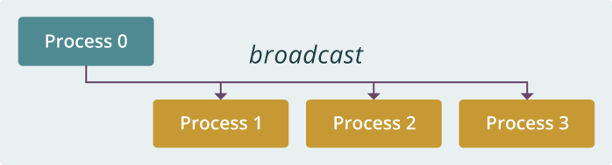
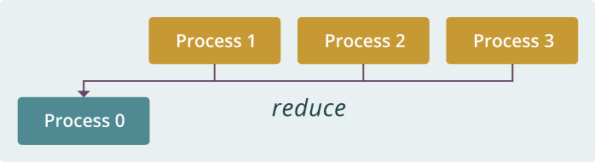
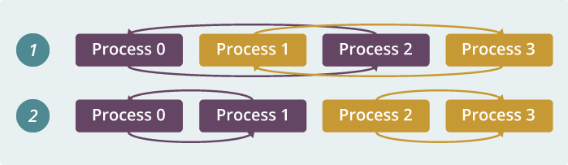
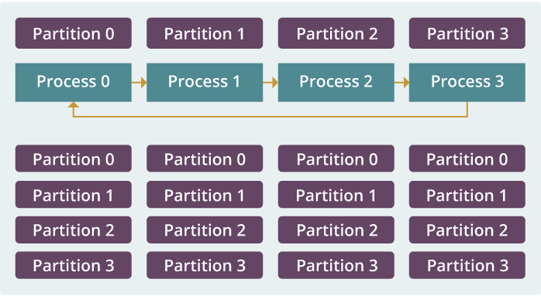
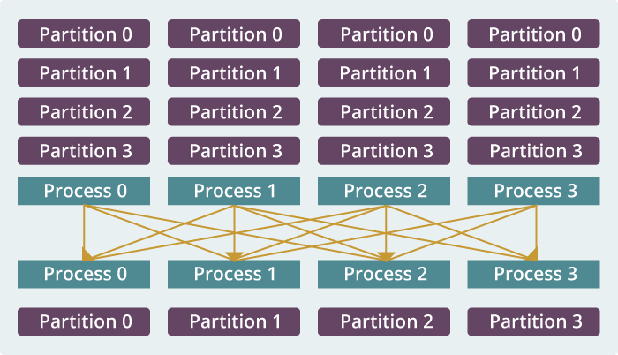
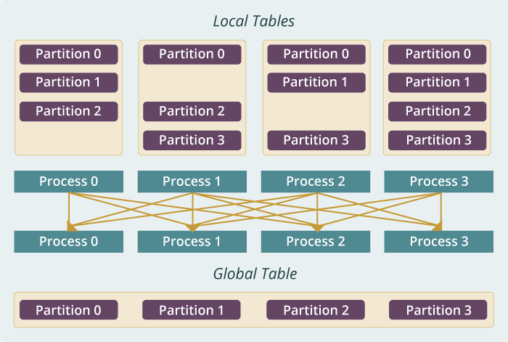
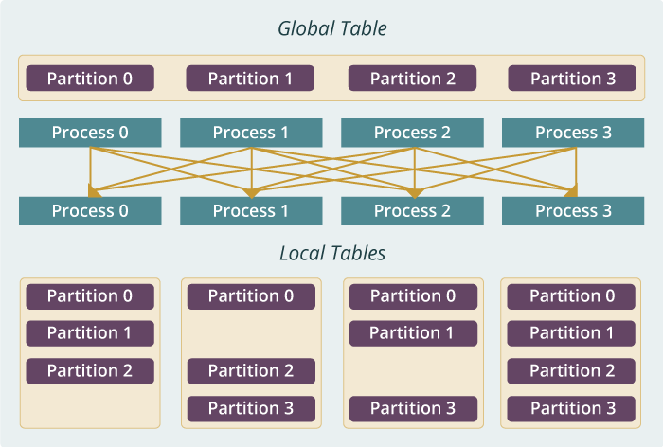
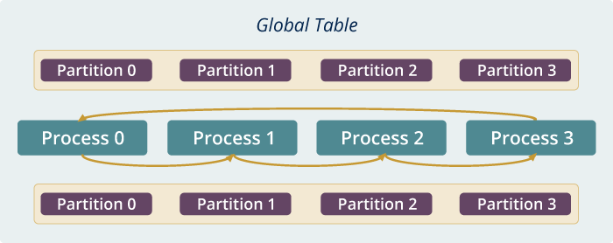
Run time software for Harp
broadcast
reduce
allreduce
allgather
regroup
push & pull
rotate
Map Collective Run time merges MapReduce and HPC

Slide 7
Dynamic Rotation Control for Latent Dirichlet Allocation and Matrix Factorization SGD (stochastic gradient descent)
Multi-Thread Execution
Model Parameters
From Rotation
Model Related Data
Computes until the time arrives, then starts model rotation to address load imbalance
Other Model Parameters
From Caching

Slide 8
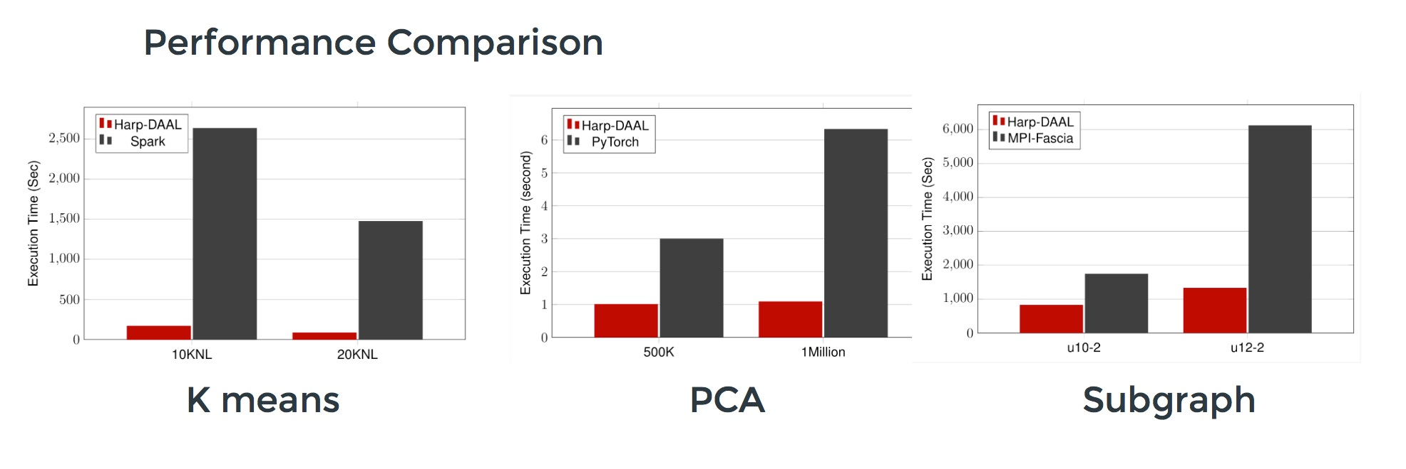
Harp v. Spark Harp v. Torch Harp v. MPI
Datasets: 5 million points, 10 thousand centroids, 10 feature dimensions
10 to 20 nodes of Intel KNL7250 processors
Harp-DAAL has 15x speedups over Spark MLlib
Datasets: 500K or 1 million data points of feature dimension 300
Running on single KNL 7250 (Harp-DAAL) vs. single K80 GPU (PyTorch)
Harp-DAAL achieves 3x to 6x speedups
Datasets: Twitter with 44 million vertices, 2 billion edges, subgraph templates of 10 to 12 vertices
25 nodes of Intel Xeon E5 2670
Harp-DAAL has 2x to 5x speedups over state-of-the-art MPI-Fascia solution

Slide 9
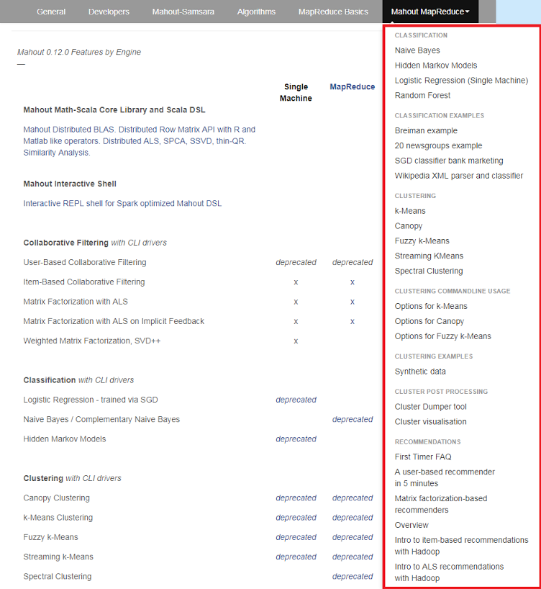
Mahout and SPIDAL
Mahout was Hadoop machine learning library but largely abandoned as Spark outperformed Hadoop
SPIDAL outperforms Spark MLlib and Flink due to better communication and better dataflow or BSP communication.
Has Harp-(DAAL) optimized machine learning interface
SPIDAL also has community algorithms
  Biomolecular Simulation
  Graphs for Network Science
  Image processing for pathology and polar science

Slide 10
Qiu Core SPIDAL Parallel HPC Library with Collective Used
DA-MDS Rotate, AllReduce, Broadcast
Directed Force Dimension Reduction AllGather, Allreduce
Irregular DAVS Clustering Partial Rotate, AllReduce, Broadcast
DA Semimetric Clustering (Deterministic Annealing) Rotate, AllReduce, Broadcast
K-means AllReduce, Broadcast, AllGather DAAL
SVM AllReduce, AllGather
SubGraph Mining AllGather, AllReduce
Latent Dirichlet Allocation Rotate, AllReduce
Matrix Factorization (SGD) Rotate DAAL
Recommender System (ALS) Rotate DAAL
Singular Value Decomposition (SVD) AllGather DAAL
QR Decomposition (QR) Reduce, Broadcast DAAL
Neural Network AllReduce DAAL
Covariance AllReduce DAAL
Low Order Moments Reduce DAAL
Naive Bayes Reduce DAAL
Linear Regression Reduce DAAL
Ridge Regression Reduce DAAL
Multi-class Logistic Regression Regroup, Rotate, AllGather
Random Forest AllReduce
Principal Component Analysis (PCA) AllReduce DAAL
DAAL implies integrated on node with Intel DAAL Optimized Data Analytics Library

Slide 11
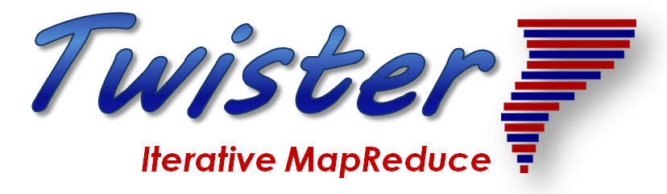
Twister2: “Next Generation Grid - Edge – HPC Cloud” Programming Environment
Analyze the runtime of existing systems
  Hadoop, Spark, Flink, Pregel Big Data Processing
  OpenWhisk and commercial FaaS
  Storm, Heron, Apex Streaming Dataflow
  Kepler, Pegasus, NiFi workflow systems
  Harp Map-Collective, MPI and HPC AMT runtime like DARMA
  And approaches such as GridFTP and CORBA/HLA (!) for wide area data links
A lot of confusion coming from
different communities (database,
distributed, parallel computing,
machine learning, computational/
data science) investigating similar
ideas with little knowledge exchange
and mixed up (unclear) requirements
http://www.iterativemapreduce.org/

Slide 12
Integrating HPC and Apache Programming Environments
Harp-DAAL with a kernel Machine Learning library exploiting the Intel node library DAAL and HPC communication collectives within the Hadoop ecosystem. The broad applicability of Harp-DAAL is supporting all 5 classes of data-intensive computation, from pleasingly parallel to machine learning and simulations.
Twister2 is a toolkit of components that can be packaged in different ways
  Batch or streaming data capabilities familiar from Apache Hadoop, Spark, Heron and Flink but with high performance.
  Separate bulk synchronous and data flow communication;
  Task management as in Mesos, Yarn and Kubernetes
  Dataflow graph execution models
  Launching of the Harp-DAAL library
  Streaming and repository data access interfaces,
  In-memory databases and fault tolerance at dataflow nodes. (use RDD to do classic checkpoint-restart)

Slide 13
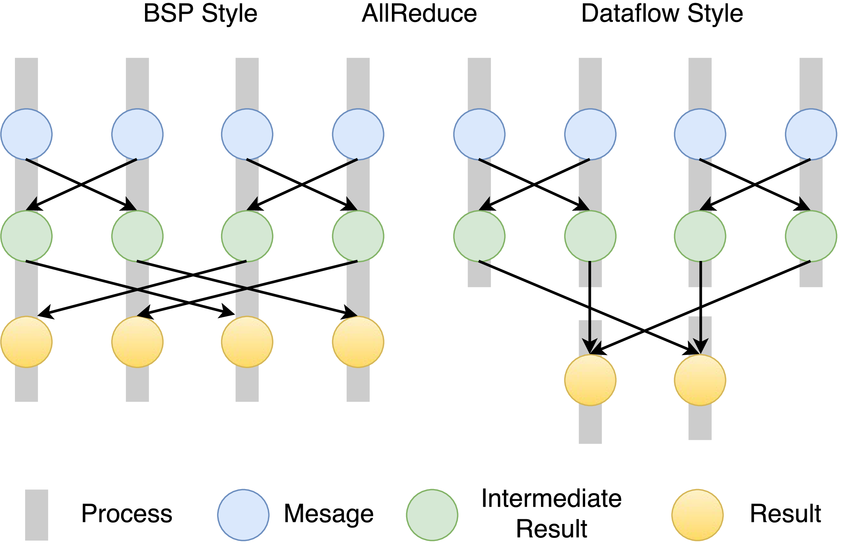
Twister:Net Communication Structure
Twister:Net will offers two communication models
  BSP (Bulk Synchronous Processing) communication using MPI separated from its task management
  plus a new Dataflow library DFW extended from MPI
Spark, Flink, Storm, Heron etc. all use Dataflow communication but there is no standard dataflow libraries and their implementations do not have good performance
Twister:Net Dataflow Communication is designed
according to these requirements.
  The communications are between a set of tasks in an
  arbitrary task graph. (source tasks can be ≠ target tasks)
  Handle communications larger than available memory.
  Dynamic data sizes across communicating tasks.
  Batch is modeled as a special case of streaming
  as in Apache Flink and Apex.
  Keys and their selection are part of the abstraction
MPI-4 should include dataflow and Kubernetes!

Slide 14
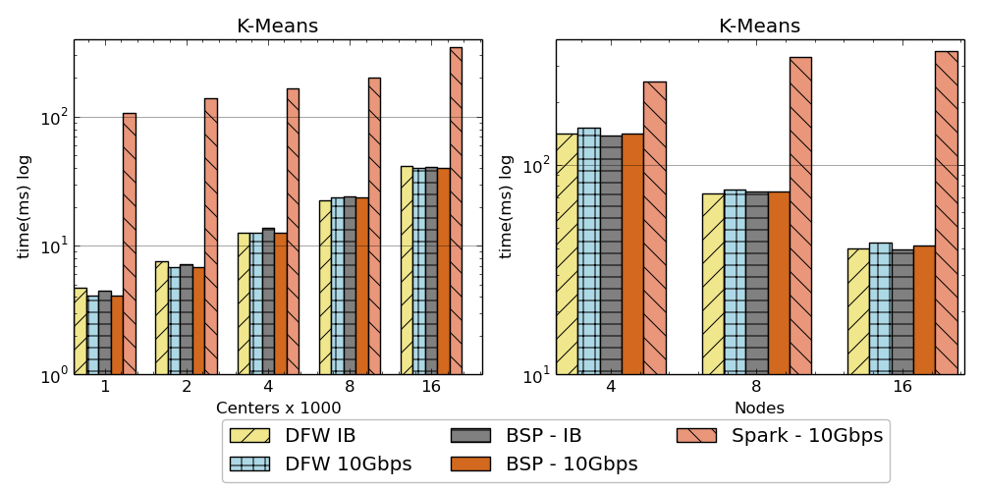
Kmeans Clustering. Twister:Net BSP(MPI) DFW and Spark
Left: K-means job execution time on 16 nodes with varying centers, 2 million points with 320-way parallelism.
Right: K-Means with 4,8 and 16 nodes where each node having 20 tasks. 2 million points with 16000 centers used.

Slide 15
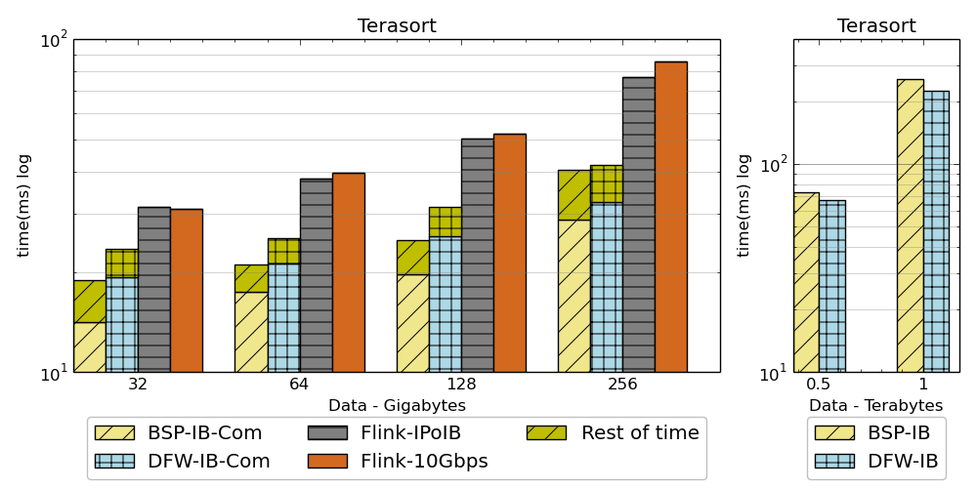
Terasort: Twister:Net BSP(MPI) DFW and Flink
Left: Terasort time on a 16 node cluster with 384 way parallelism. BSP and DFW shows the separate communication time.
Right: Terasort on 32 nodes with .5 TB and 1TB datasets. Parallelism of 320.

Slide 16
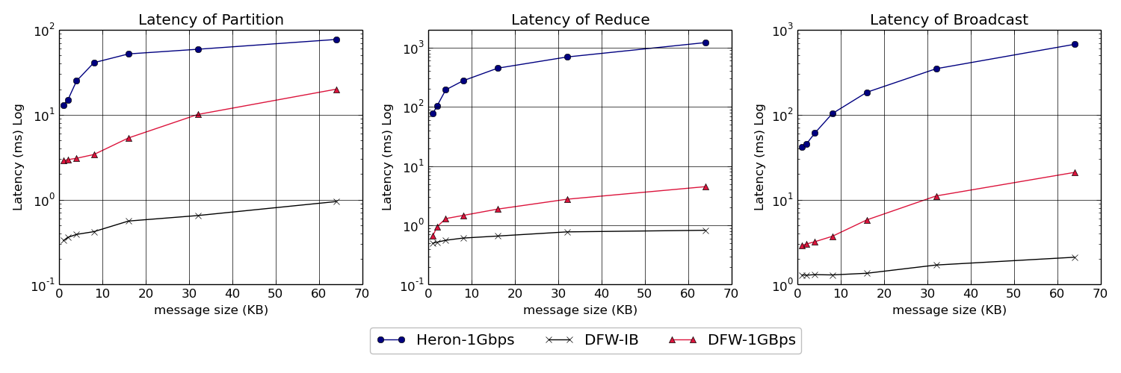
Twister:Net and Apache Heron for Streaming
Latency of Apache Heron and Twister:Net DFW (Dataflow) for Reduce, Broadcast and Partition operations in 16 nodes with 256-way parallelism

Slide 17

Dataflow at Different Grain sizes
Coarse Grain Dataflows links jobs in such a pipeline
Visualization
Dimension
Reduction
Data preparation
Clustering
But internally to each job you can also elegantly express algorithm as dataflow but with more stringent performance constraints
Corresponding to classic Spark K-means Dataflow
P = loadPoints()
C = loadInitCenters()
for (int i = 0; i < 10; i++) {
T = P.map().withBroadcast(C)
C = T.reduce() }
Internal Execution
Dataflow Nodes
Reduce
Iterate
HPC
Communication
Maps
Iterate

