Slide 1
HPSA18:
Logistics
7:00 am – 8:00 am | Breakfast | Luddy Room 3166 (3rd floor)
10:00 am – 10:30 am | Break
12:00 pm – 1:00 pm | Lunch | Community Center (1st floor)
2:40 pm – 3:00 pm | Break
4:30 pm – 6:00 pm | Panel Session | Community Center (1st floor)
6:30 pm – 8:30 pm | Dinner | Finch’s Brasserie Restaurant

Slide 2
Speakers
Rick Van Kooten OVPR, Judy Qiu IU, and X. Sean Wang Fudan: Introduction
Linton Ward, IBM Building the cognitive platform to accelerate innovation (Keynote 1)
Nathan Greeneltch Intel, Learn Faster with Intel Data Analytics Acceleration Library (DAAL)
Takuya Araki NEC, SX-Aurora TSUBASA and its application to machine learning
Anthony Skjellum UTC MPI and MPI-like Middleware in the Age of HPC Analytics
Andrew Younge Sandia, Supporting High Performance Analysts with System Software for Virtualized Supercomputing
Anil Vullikanti Virginia Tech, Finding Trees and Anomalous Subgraphs in Parallel
Albert Jonathan Univ. of Minnesota, Geo-Distributed Clouds For Data Analytics
Tony Hey UK STFC Big Scientific Data and Data Science (Keynote2)
Piotr Luszczek Univ. of Tenessee, HPC Autotuning Techniques for Computational Kernels in Data Analytics
Scott Michael UITS, IU Big Data Infrastructure
Wo Chang NIST, NIST PWG Big Data Reference Architecture for HPC and Analytics
X. Sean Wang Fudan University, Overview including Astronomy (SKA) Data Analysis
Weihua Zhang Fudan, Eunomia: Scaling Concurrent Search Trees under Contention Using HTM
Martin Swany IU, Hardware-Accelerated Network Microservices for Big Data and Extreme Scale Computing
Geoffrey Fox IU, High Performance Big Data Computing in the Digital Science Center
Panel Session (Chair: Dennis Gannon) on 5 year challenges in HPSA

Slide 3
HPSA18:
Timer
20 Minutes presentation including Q/A
5 minutes reminder

Slide 4
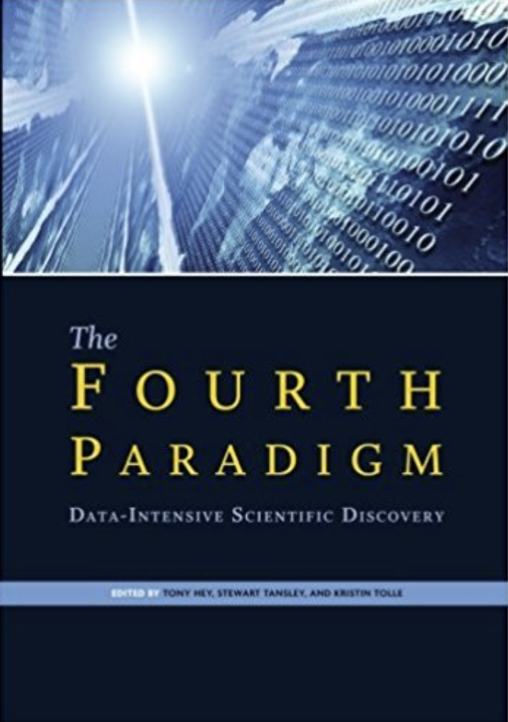
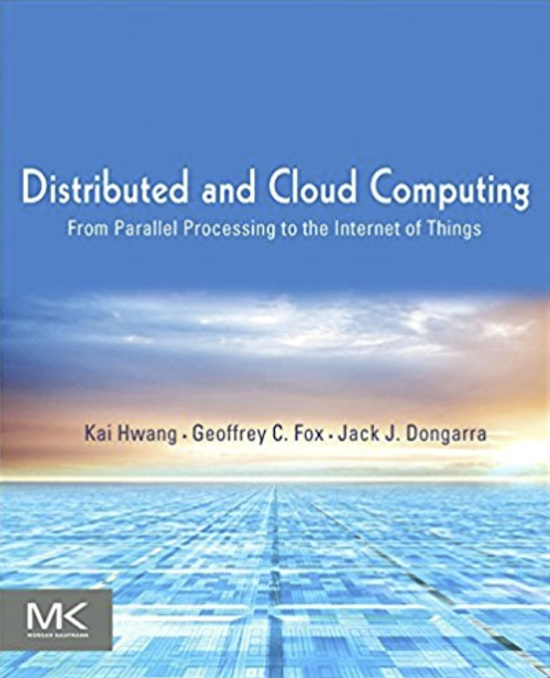
HPSA18:
A path to future Artificial General Intelligence
Theory
Experiments or Observation
Simulation of Theory or model Supercomputers
Data-Driven or The Fourth Paradigm:
Data-Intensive Scientific Discovery (aka Data Science)

Slide 5
HPSA Vision
HPSA involves Large-Scale Data Analytics on High-Performance Computing (HPC) clusters optimized for data analysis.
HPSA has been identified by Gartner in their infrastructure strategies priority matrix under the rubric of Hyperscale computing, as having transformational importance with their top rating in the 5-10 year timeframe.
The potential impact on scientific discovery and economic development from Data Analytics is tremendous.
The workshop features innovative research and development in hardware, algorithms and software for big data systems of transformational capability on computer architectures ranging from commodity clouds, hybrid HPC-clouds, and supercomputers.
It aims at performance and security that scales and fully exploit the specialized features (communication, memory, energy, I/O, accelerator) of each different architecture.
Studies of new architectures and benchmarking of existing systems.
Applications will range from pleasingly parallel, MapReduce, to Machine Learning (e.g., Random Forest, SVM, Latent Dirichlet Allocation, Clustering and Dimension Reduction), Deep Learning, and Large Graph Analytics.

Slide 6
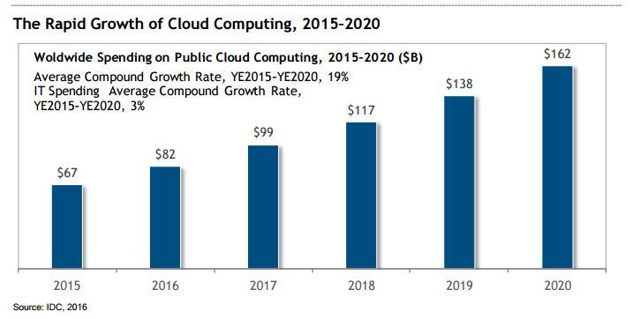
Cloud Computing Spending $

Slide 7
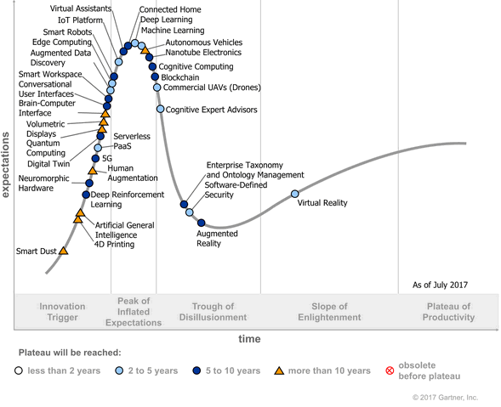
Gartner: Hype Cycle for Emerging Technologies, 2017
Published: 21 July 2017 ID: G00314560
Analyst(s): Mike J. Walker

Slide 8
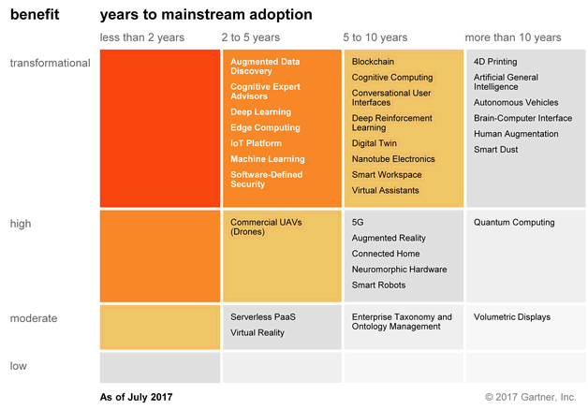
Gartner: Priority Matrix for Emerging Technologies2017
Hype Cycle for Emerging Technologies, 2017
Published: 21 July 2017 ID: G00314560
Analyst(s): Mike J. Walker

Slide 9
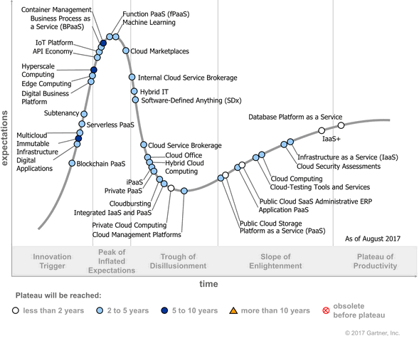
Gartner: Hype Cycle for Cloud Computing, 2017
Published: 01 August 2017 ID: G00315206
Analyst(s): David Mitchell Smith | Ed Anderson

Slide 10
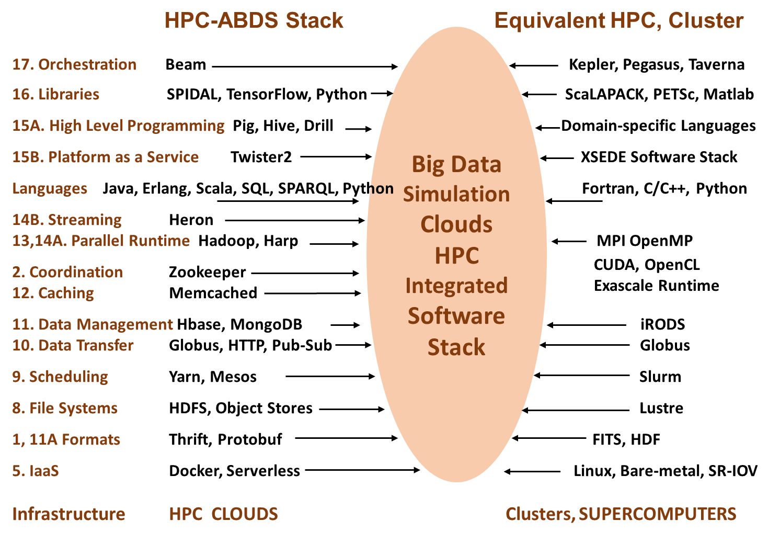
Different choices in software systems in Clouds and HPC
HPC-ABDS takes cloud software augmented by HPC when needed to improve performance
16 of 21 layers plus languages

Slide 11
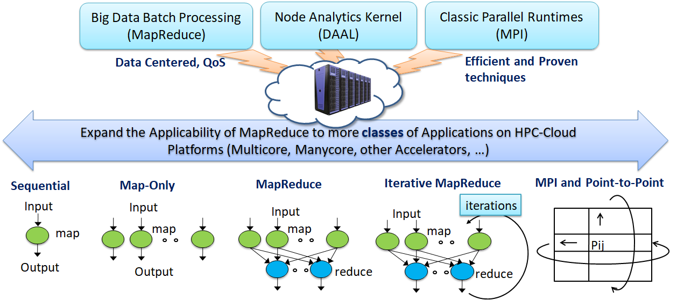
Figure. Cloud-HPC interoperable software for High Performance Big Data Analytics at Scale

Slide 12
Difficulty in Parallelism

Slide 13
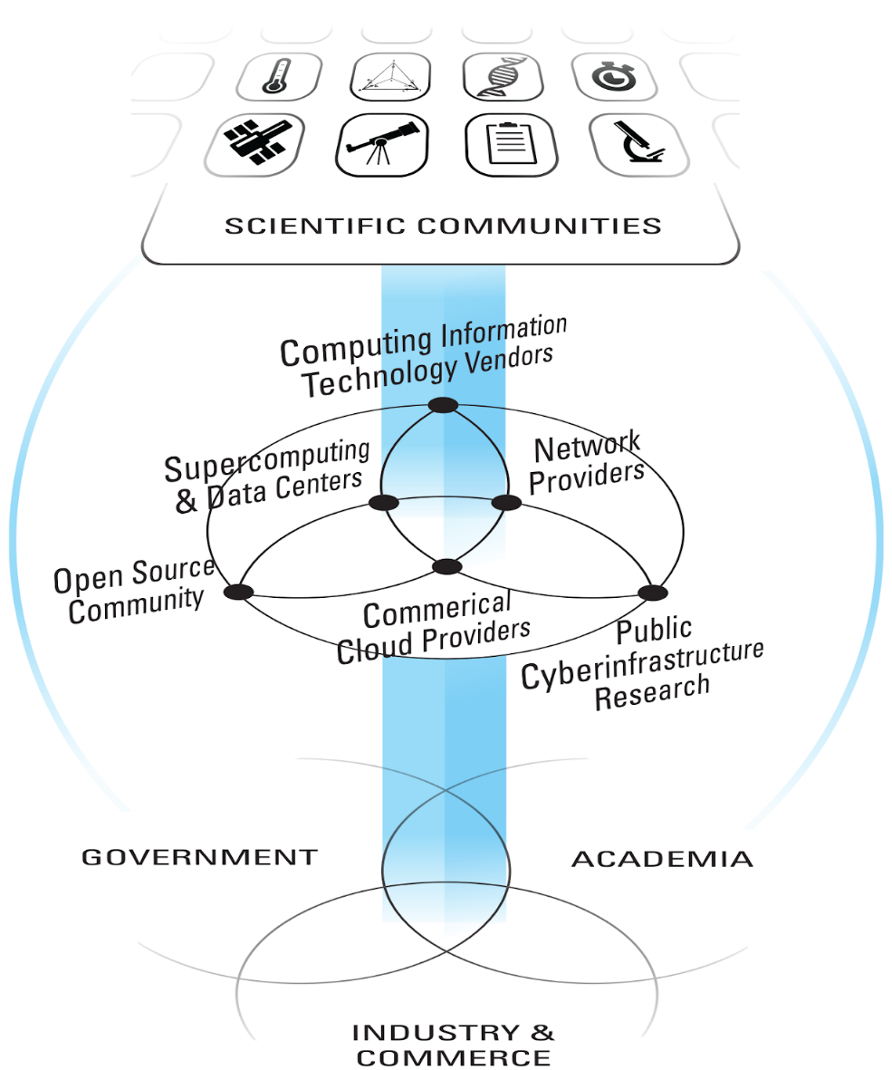
Building a Community of Communities
First BDECng meeting: Indiana University Bloomington October 3-5 2018
The BDECng community is engaged in a shaping strategy and process that builds on the collective expertise of an expanded community: New application domains, Infrastructure providers, Technology community.

