Slide 1
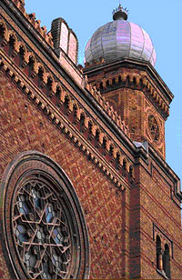
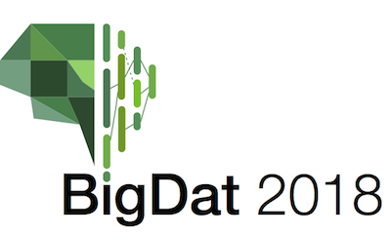
Harp-DAAL: A Next Generation Platform for High Performance Machine Learning on HPC-Cloud
4th International Winter School on Big Data
Timişoara, Romania, January 22-26, 2018
http://grammars.grlmc.com/BigDat2018/
January 25, 2018
Judy Qiu by Geoffrey Fox gcf@indiana.edu
http://www.dsc.soic.indiana.edu/, http://spidal.org/ http://hpc-abds.org/kaleidoscope/
Department of Intelligent Systems Engineering
School of Informatics and Computing, Digital Science Center
Indiana University Bloomington

Slide 2
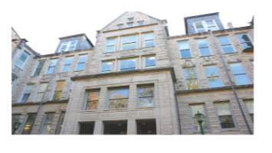

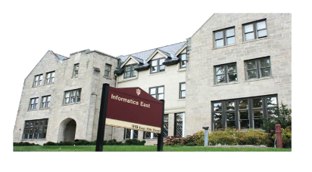


Acknowledgements
We gratefully acknowledge support from NSF, IU and Intel Parallel Computing Center (IPCC) Grant.
Langshi Cheng Bingjing Zhang Bo Peng Kannan Govindarajan, Supun Kamburugamuve, Mihai Avram, Sabra Ossen
Robert Henschel, Craig Stewart, Shaojuan Zhu, Emily Mccallum, Lisa Smith, Tom Zahniser, Jon Omer
Zhao Zhao, Saliya Ekanalyake, Anil Vullikanti, Madhav Marathe
Intelligent Systems Engineering
School of Informatics and Computing
Indiana University

Slide 3
HPC-ABDS and Harp
Map Collective

Slide 4
Motivation of Iterative MapReduce
MapReduce
Classic Parallel Runtimes (MPI)
Data Centered, QoS
Efficient and Proven techniques
Expand the Applicability of MapReduce to more classes of Applications
Sequential
Map-Only
MapReduce
Iterative MapReduce
MPI and Point-to-Point
Input
Input
Input
iterations
Input
map
map
map
map
Pij
Output
Output
reduce
reduce

Slide 5
The Concept of Harp Plug-in
Parallelism Model
Architecture
MapReduce Model
MapCollective Model
MapReduce Applications
MapCollective Applications
Application
M
M
M
M
M
M
M
M
MapReduce V2
Harp
Shuffle
Framework
Collective Communication
R
R
Resource Manager
YARN
Harp is an open-source project developed at Indiana University, it has:
MPI-like collective communication operations that are highly optimized for big data problems.
Harp has efficient and innovative computation models for different machine learning problems.
[3] J. Ekanayake et. al, “Twister: A Runtime for Iterative MapReduce”, in Proceedings of the 1st International Workshop on MapReduce and its Applications of ACM HPDC 2010 conference.
[4] T. Gunarathne et. al, “Portable Parallel Programming on Cloud and HPC: Scientific Applications of Twister4Azure”, in Proceedings of 4th IEEE International Conference on Utility and Cloud Computing (UCC 2011).
[5] B. Zhang et. al, “Harp: Collective Communication on Hadoop,” in Proceedings of IEEE International Conference on Cloud Engineering (IC2E 2015).

Slide 6
Data management
Algorithms
Intel® DAAL is an open-source project that provides:
Algorithms Kernels to Users
    Batch Mode (Single Node)
    Distributed Mode (multi nodes)
    Streaming Mode (single node)
Data Management & APIs to Developers
    Data structure, e.g., Table, Map, etc.
    HPC Kernels and Tools: MKL, TBB, etc.
    Hardware Support: Compiler
  DAAL used inside the container
Data sources
Data dictionaries
Data model
Numeric tables and matrices
Compression
Analysis
Training
Prediction
Services
Memory allocation
Error handling
Collections
Shared pointers

Slide 7
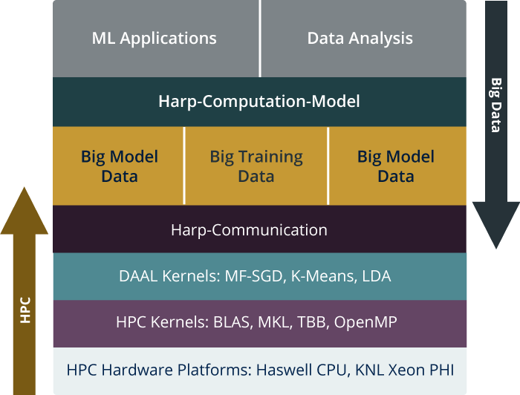
HPC-ABDS is Cloud-HPC interoperable software with the performance of HPC (High Performance Computing) and the rich functionality of the commodity Apache Big Data Stack. This concept is illustrated by Harp-DAAL.
Big Model Parameters
Big Model Parameters
High Level Usability: Python Interface, well documented and packaged modules
Middle Level Data-Centric Abstractions: Computation Model and optimized communication patterns
Low Level optimized for Performance: HPC kernels Intel® DAAL and advanced hardware platforms such as Xeon and Xeon Phi
Harp-DAAL

Slide 8
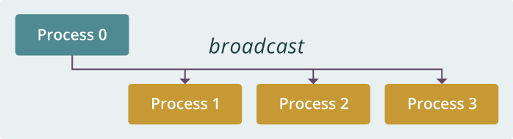
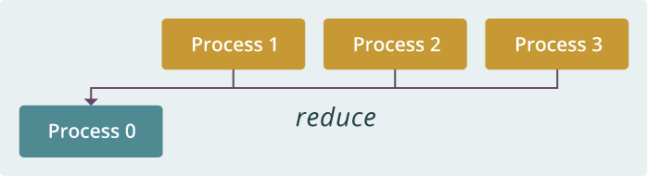
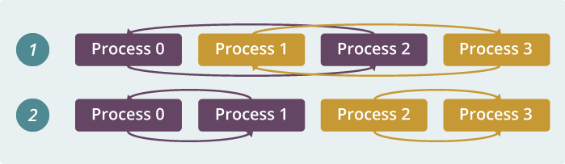
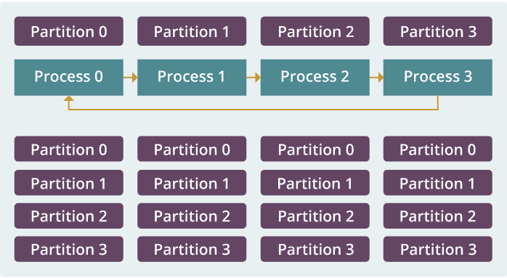
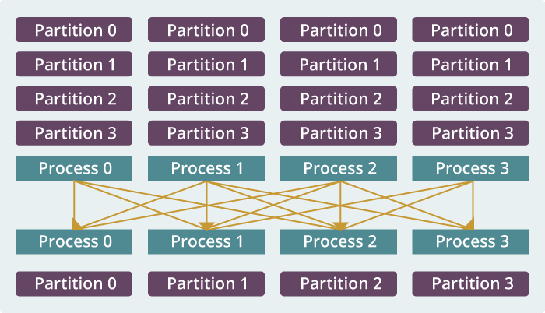
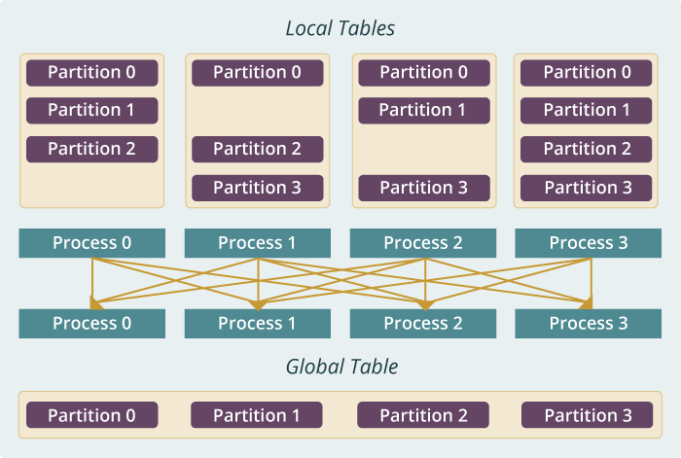
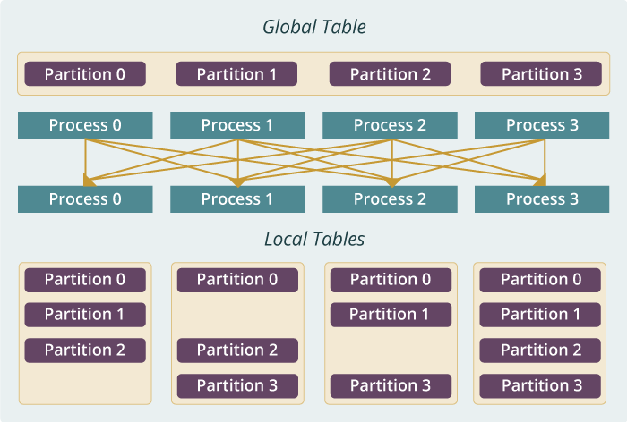
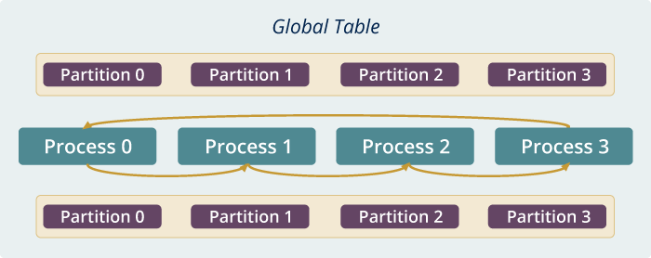
broadcast
reduce
allreduce
allgather
Regroup (shuffle)
push & pull
rotate
Collectives

Slide 9
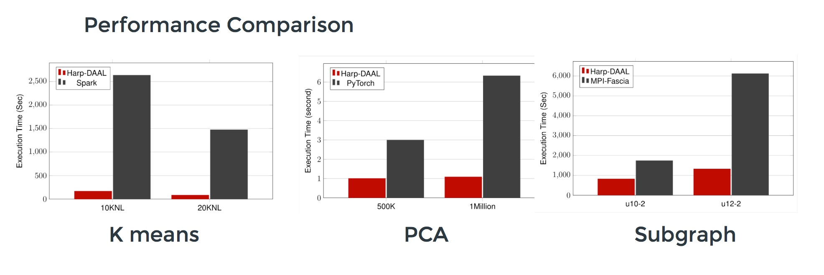
Datasets: 5 million points, 10 thousand centroids, 10 feature dimensions
10 to 20 nodes of Intel KNL7250 processors
Harp-DAAL has 15x speedups over Spark MLlib
Datasets: 500K or 1 million data points of feature dimension 300
Running on single KNL 7250 (Harp-DAAL) vs. single K80 GPU (PyTorch)
Harp-DAAL achieves 3x to 6x speedups
Datasets: Twitter with 44 million vertices, 2 billion edges, subgraph templates of 10 to 12 vertices
25 nodes of Intel Xeon E5 2670
Harp-DAAL has 2x to 5x speedups over state-of-the-art MPI-Fascia solution

Slide 10
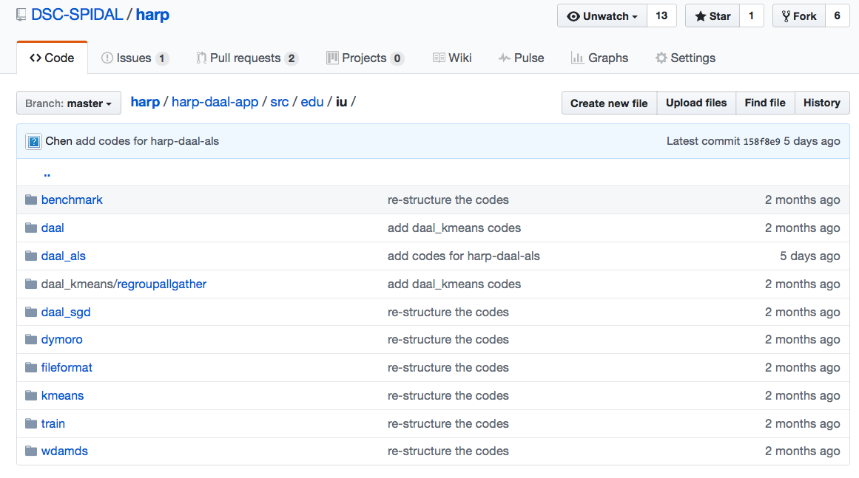
Harp-DAAL: Prototype and Production Code
Available at https://dsc-spidal.github.io/harp
Source codes became available on Github in February, 2017.
Harp-DAAL follows the same standard of DAAL’s original codes
Twelve Applications
  Harp-DAAL Kmeans
  Harp-DAAL MF-SGD
  Harp-DAAL MF-ALS
  Harp-DAAL SVD
  Harp-DAAL PCA
  Harp-DAAL Neural Networks
  Harp-DAAL Naïve Bayes
  Harp-DAAL Linear Regression
  Harp-DAAL Ridge Regression
  Harp-DAAL QR Decomposition
  Harp-DAAL Low Order Moments
  Harp-DAAL Covariance

Slide 11
Scalable Algorithms implemented using Harp
Algorithm | Category | Applications | Features | Computation Model | Collective Communication
K-means | Clustering | Most scientific domain | Vectors | AllReduce | allreduce, regroup+allgather, broadcast+reduce, push+pull
 |  |  |  | Rotation | rotate
Multi-class Logistic Regression | Classification | Most scientific domain | Vectors, words | Rotation | regroup, rotate, allgather
Random Forests | Classification | Most scientific domain | Vectors | AllReduce | allreduce
Support Vector Machine | Classification, Regression | Most scientific domain | Vectors | AllReduce | allgather
Neural Networks | Classification | Image processing, voice recognition | Vectors | AllReduce | allreduce
Latent Dirichlet Allocation | Structure learning (Latent topic model) | Text mining, Bioinformatics, Image Processing | Sparse vectors; Bag of words | Rotation | rotate, allreduce
Matrix Factorization | Structure learning (Matrix completion) | Recommender system | Irregular sparse Matrix; Dense model vectors | Rotation | rotate
Multi-Dimensional Scaling | Dimension reduction | Visualization and nonlinear identification of principal components | Vectors | AllReduce | allgarther, allreduce
Subgraph Mining | Graph | Social network analysis, data mining, fraud detection, chemical informatics, bioinformatics | Graph, subgraph | Rotation | rotate
Force-Directed Graph Drawing | Graph | Social media community detection and visualization | Graph | AllReduce | allgarther, allreduce

Slide 12
Programming Model supported by Harp
Computational Model
Collectives

Slide 13
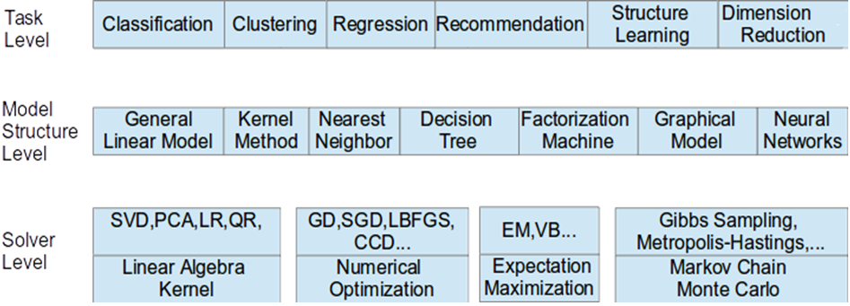
Taxonomy for Machine Learning Algorithms
Optimization and related issues
  Task level only can't capture the traits of computation
  Model is the key for iterative algorithms. The structure (e.g. vectors, matrix, tree, matrices) and size are critical for performance
  Solver has specific computation and communication pattern

Slide 14
Computation Models
Data and Model are typically both parallelized over same processes. Computation involves iterative interaction between data and current model to produce new model.
Data Immutable
Model changes
B. Zhang, B. Peng, and J. Qiu, “Model-centric computation abstractions in machine learning applications,” in Proceedings of
the 3rd ACM SIGMOD Workshop on Algorithms and Systems for MapReduce and Beyond, BeyondMR@SIGMOD 2016
Notes:
For large scale problems:
X distributed; not only the input data, but also the intermediate data during the process of computation not pleasingly parallel, because of dependency determined by the iterative or recursive nature

Slide 15
(A) Locking
Once a process trains a data item, it locks the related model parameters and prevents other processes from accessing them. When the related model parameters are updated, the process unlocks the parameters. Thus the model parameters used in local computation is always the latest.
(C) AllReduce
Each process first fetches all the model parameters required by local computation. When the local computation is completed, modifications of the local model from all processes are gathered to update the model.
(B) Rotation
Each process first takes a part of the shared model and performs training. Afterwards, the model is shifted between processes. Through model rotation, each model parameters are updated by one process at a time so that the model is consistent.
(D) Asynchronous
Each process independently fetches related model parameters, performs local computation, and returns model modifications. Unlike A, workers are allowed to fetch or update the same model parameters in parallel. In contrast to B and C, there is no synchronization barrier.
Harp Computing Models
Inter-node (Container)

Slide 16
Machine Learning Application
Machine Learning Algorithm
Programming Interface
Computation Model
Implementation
Parallelization of
Machine Learning Applications

Slide 17
Example: K-means Clustering
The Allreduce Computation Model
Model
Worker
Worker
Worker
Model B, different collective
Model A
When the model size cannot be held in each machine’s memory
When the model size is small
When the model size is large but can still be held in each machine’s memory
Model A, different collective
broadcast
regroup
push & pull
allreduce
reduce
allgather
rotate

Slide 18
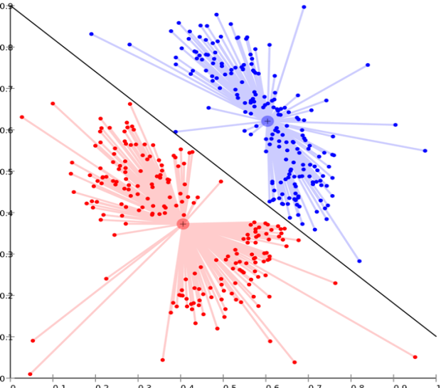
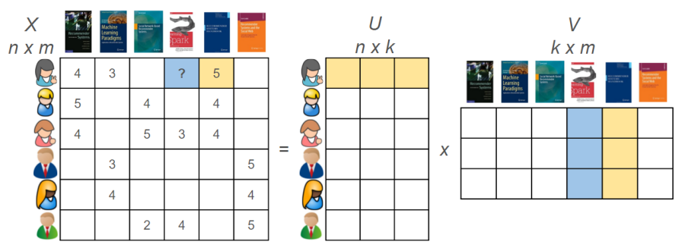
Harp-DAAL Applications
Harp-DAAL-SGD
Stochastic Gradient
Descent
Harp-DAAL-ALS
Alternating Least Squares
Harp-DAAL-Kmeans
Matrix Factorization
Huge model data
Random Memory Access
Rotate Collective
Matrix Factorization
Huge model data
Regular Memory Access
Regroup-Allgather Collective
Clustering
Vectorized computation
Small model data
Regular Memory Access
Langshi Chen, Bo Peng, Bingjing Zhang, Tony Liu, Yiming Zou, Lei Jiang, Robert Henschel, Craig Stewart, Zhang Zhang, Emily Mccallum, Zahniser Tom, Omer Jon, Judy Qiu, Benchmarking Harp-DAAL: High Performance Hadoop on KNL Clusters, in the Proceedings of the International Conference on Cloud Computing (CLOUD 2017), June 25-30, 2017.

Slide 19
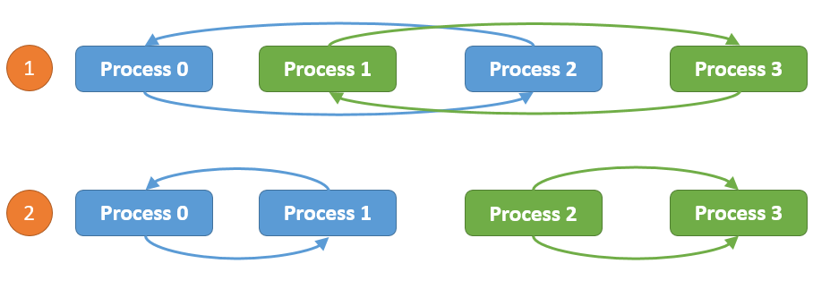
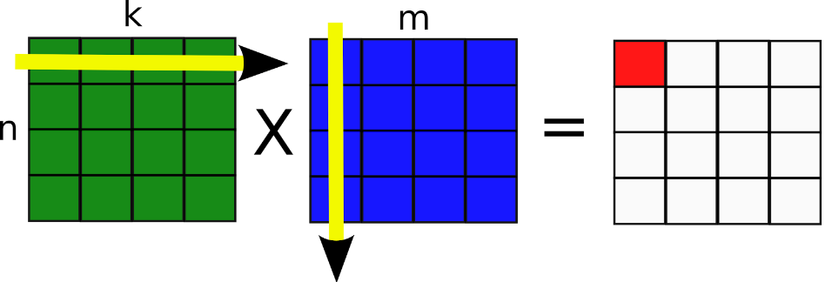
Computation models for K-means
Inter-node: Allreduce, Easy to implement, efficient when model data is not large
Intra-node: Shared Memory, matrix-matrix operations, xGemm: aggregate vector-vector distance computation into matrix-matrix multiplication, higher computation intensity (BLAS-3)
Harp-DAAL-Kmeans vs. Spark-Kmeans:
~ 20x speedup
Harp-DAAL-Kmeans invokes MKL matrix operation kernels at low level
Matrix data stored in contiguous memory space, leading to regular access pattern and data locality

Slide 20
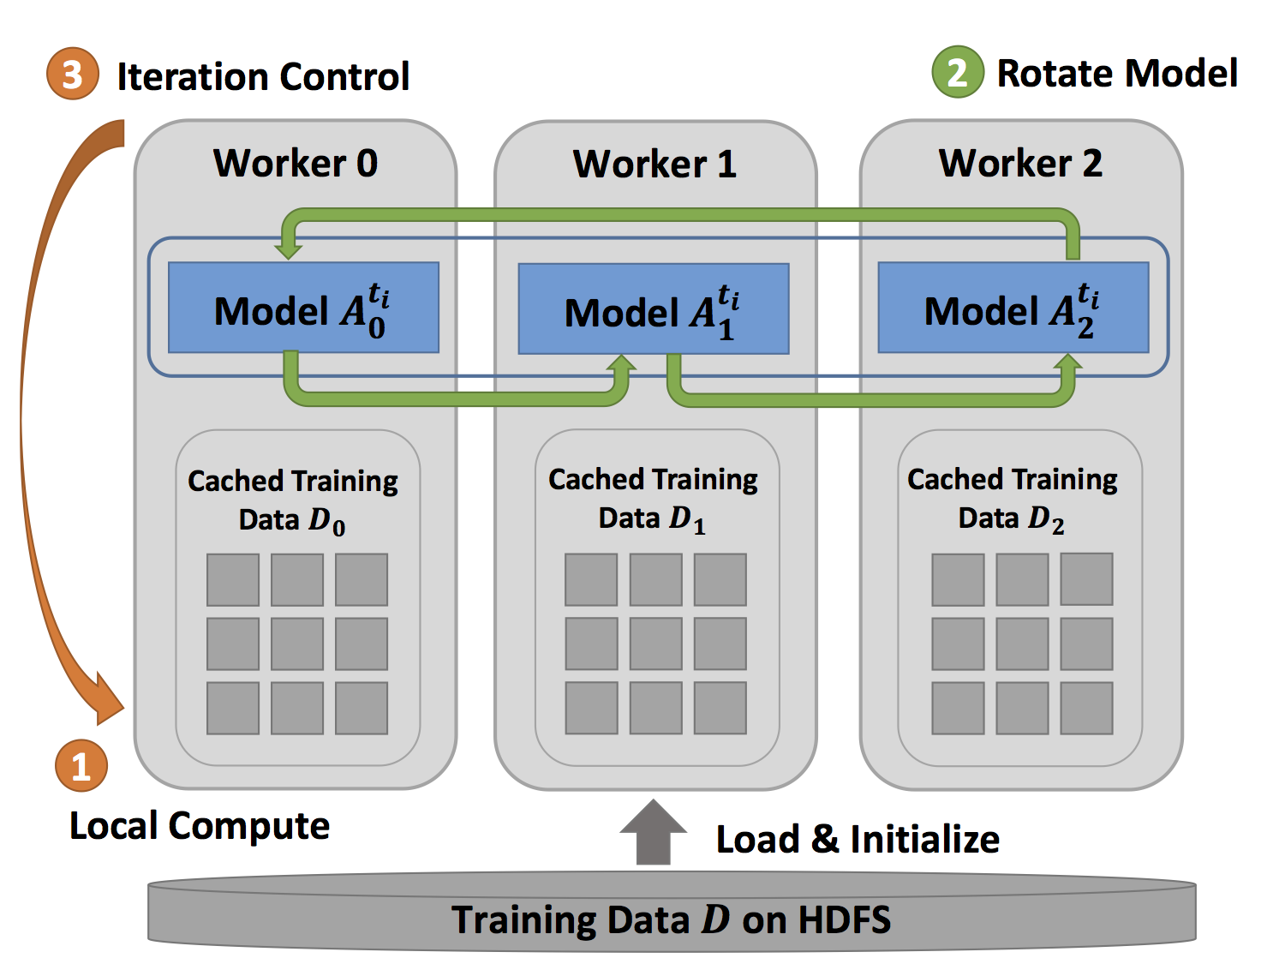
Computation models for MF-SGD
Inter-node: Rotation Efficient when the model data
Is large, good scalability
Harp-DAAL-SGD vs. NOMAD-SGD
Small dataset (MovieLens, Netflix): comparable perf
Large dataset (Yahoomusic, Enwiki): 1.1x to 2.5x, depending on data distribution of matrices
Intra-node: Asynchronous
Random access to model data. Good for thread-level workload balance.

Slide 21


Computation Models for ALS
Inter-node: Allreduce
Intra-node: Shared Memory, Matrix operations xSyrk: symmetric rank-k update
Harp-DAAL-ALS vs. Spark-ALS
20x to 50x speedup
Harp-DAAL-ALS invokes MKL at low level
Regular memory access, data locality in matrix operations

Slide 22
Breakdown of Intra-node Performance on KNL chip
Spark-Kmeans and Spark-ALS dominated by Computation (retiring), no AVX-512 to reduce
retiring Instructions, Harp-DAAL improves L1 cache bandwidth utilization due to AVX-512
Nomad is C/C++ using MPI

Slide 23
Breakdown of Intra-node Performance
Thread scalability:
Harp-DAAL best threads number: 64 (K-means, ALS) and 128 (MF-SGD), more than 128 threads no performance gain
communications between cores intensify
cache capacity per thread also drops significantly
Spark best threads number 256, because Spark could not fully Utilize AVX-512 VPUs
NOMAD-SGD could use AVX VPU, thus has 64 its best thread as is seen in Harp-DAAL-SGD

Slide 24
Case Study
Parallel Latent Dirichlet Allocation for Text Mining
Map Collective Computing Paradigm
Dynamic

Slide 25
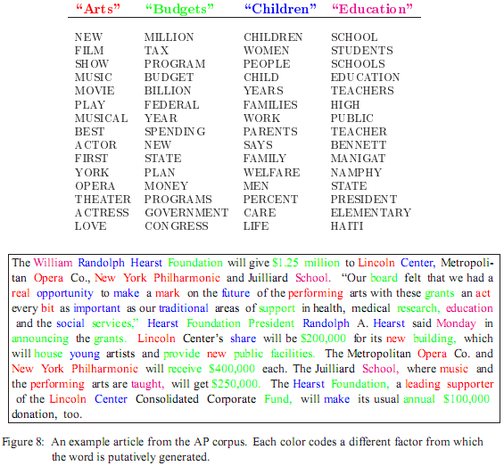
LDA: mining topics in text collection
Huge volume of Text Data
  Information overloading
  What on earth is inside the TEXT Data?
Search
  Find the documents relevant to my need (ad hoc query)
Filtering
  Fixed info needs and dynamic text data
What's new inside?
  Discover something I don't know
Blei, D. M., Ng, A. Y. & Jordan, M. I. Latent Dirichlet Allocation. J. Mach. Learn. Res. 3, 993–1022 (2003).

Slide 26
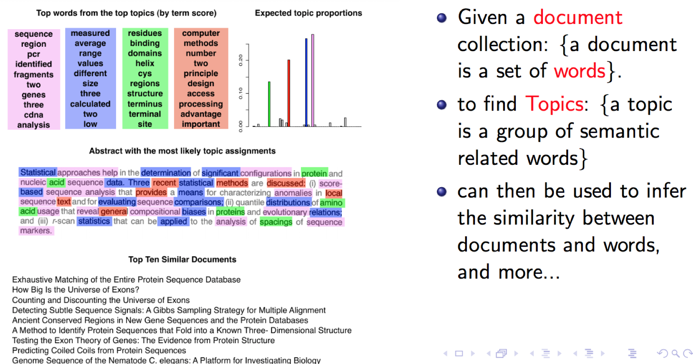
Chance and Statistic Significance in Protein and DNA Sequence Analysis
Samuel Karlin and Volker Brendel

Slide 27
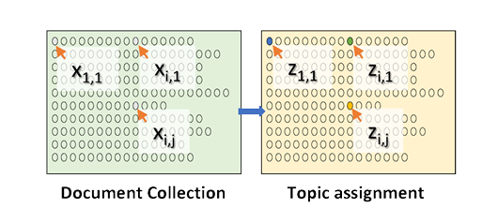
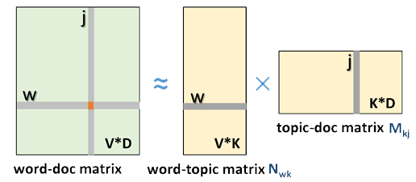
LDA and Topic Models
Topic Models is a modeling technique, modeling the data by probabilistic generative process.
Latent Dirichlet Allocation (LDA) is one widely used topic model.
Inference algorithm for LDA is an iterative algorithm using shared global model data.
Document
Word
Topic: semantic unit inside the data
Topic Model
  documents are mixtures of topics, where a topic is a probability distribution over words
Global Model Data
3.7 million docs
10k topics
1 million words
Topic Discovery
  Normalized co-occurrence matrix
  Mixture components
  Mixture weights
Notes:
global model data should be word-topic matrix or topic-document matrix,

Slide 28
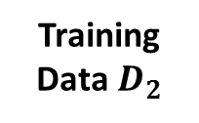
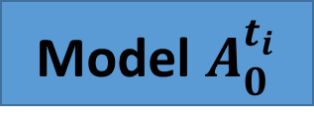
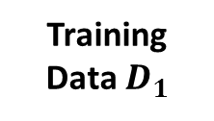
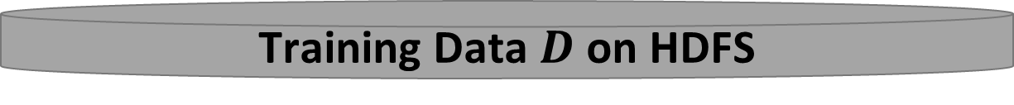
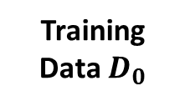
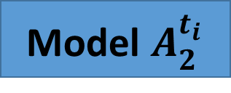
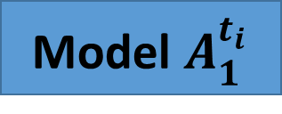
A Parallelization Solution using Model Rotation
3
Iteration Control
2
Rotate Model
Maximizing the effectiveness of parallel model updates for algorithm convergence
Worker 0
Worker 1
Worker 2
Model $A_{0}^{t_{i}}$
Model $A_{1}^{t_{i}}$
Model $A_{2}^{t_{i}}$
Minimizing the overhead of communication for scaling
Training Data $D_{0}$
Training Data $D_{1}$
Training Data${ D}_{2}$
1
Local Compute
Load, Cache & Initialize
Training Data $D$ on HDFS

Slide 29
Collapsed Gibbs Sampling
CGS Model Convergence Speed
LDA Dataset | Documents | Words | Tokens | CGS Parameters
clueweb1 | 76163963 | 999933 | 29911407874 | $$K=10000,α=0.01, β=0.01$$
60 nodes x 20 threads/node
30 nodes x 30 threads/node
K: number of features; α,β hyperparameters;

Slide 30
Harp LDA on Big Red II Supercomputer (Cray)
Harp LDA Scaling Tests
Harp LDA on Juliet (Intel Haswell)
Corpus: 3,775,554 Wikipedia documents, Vocabulary: 1 million words; Topics: 10k topics; alpha: 0.01; beta: 0.01; iteration: 200
Machine settings
  Big Red II: tested on 25, 50, 75, 100 and 125 nodes, each node uses 32 parallel threads; Gemini interconnect
  Juliet: tested on 10, 15, 20, 25, 30 nodes, each node uses 64 parallel threads on 36 core Intel Haswell node (each with 2 chips); infiniband interconnect

Slide 31

Conclusion and Future Directions
HPC-ABDS is a bold ideas developed with ­­Apache Big Data Software Stack integration with High Performance Computing Stack
    ABDS (Many Big Data applications or algorithms need HPC for performance)
    HPC (needs software model productivity and sustainability)
Harp-DAAL is an implementation of HPC-ABDS that gives fast solutions for machine learning and graph applications. This supports high performance Hadoop (with Harp collective communication and high performance Intel® DAAL kernel library enhancement) on Intel® Xeon™ and Xeon Phi ™ architectures.
Identification of 4 computation models for machine learning applications and development of Harp library of Collectives to use at Reduce phase.
There are 12 Harp-DAAL algorithms and a total of 34 algorithms in SPIDAL library
Start HPC Cloud incubator project in Apache to bring HPC-ABDS to community

