Slide 1

High Performance Processing of Streaming Data
Workshops on Dynamic Data Driven Applications Systems(DDDAS) In conjunction with: 22nd International Conference on
High Performance Computing (HiPC), Bengaluru, India
Supun Kamburugamuve, Saliya Ekanayake, Milinda Pathirage and Geoffrey Fox December 16, 2015
gcf@indiana.edu
http://www.dsc.soic.indiana.edu/, http://spidal.org/ http://hpc-abds.org/kaleidoscope/
Department of Intelligent Systems Engineering
School of Informatics and Computing, Digital Science Center
Indiana University Bloomington

Slide 2
Software Philosophy
We use the concept of HPC-ABDS High Performance Computing enhanced Apache Big Data Software Stack illustrated on next slide.
HPC-ABDS is a collection of 350 software systems used in either HPC or best practice Big Data applications. The latter include Apache, other open-source and commercial systems
HPC-ABDS helps ABDS by allowing HPC to add performance to ABDS software systems
HPC-ABDS helps HPC by bringing the rich functionality and software sustainability model of commercial and open source software. These bring a large community and expertise that is reasonably easy to find as it is broadly taught both in traditional courses and by community activities such as Meet up groups were for example:
  Apache Spark 107,000 meet-up members in 233 groups
  Hadoop 40,000 and installed in 32% of company data systems 2013
  Apache Storm 9,400 members
This talk focuses on Storm; its use and how one can add high performance

Slide 3
High Performance Computing Apache Big Data Software Stack
Green implies HPC
Integration

Slide 4
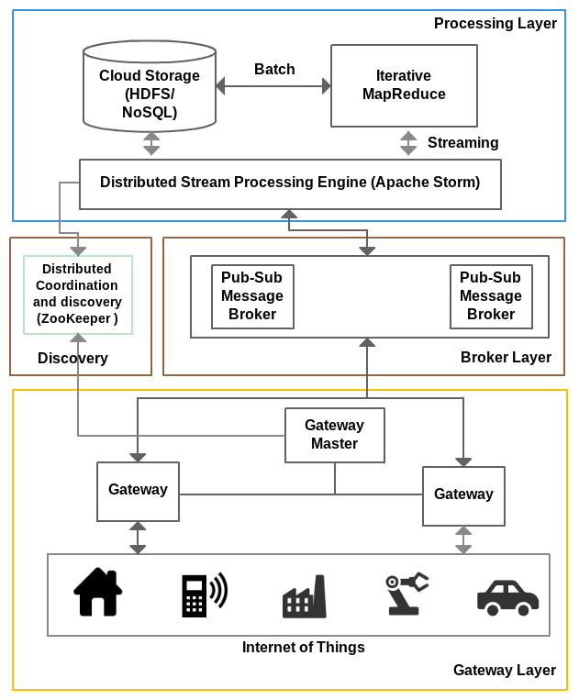
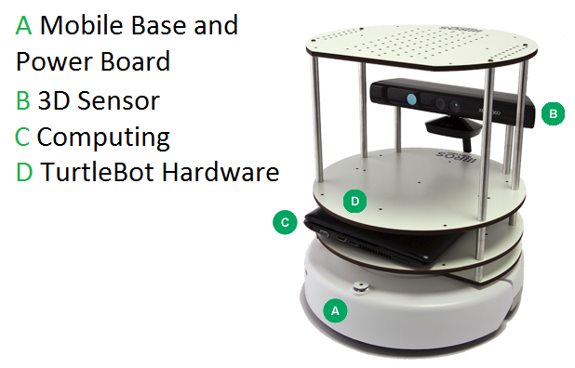
IOTCloud
Device → Pub-Sub→Storm → Datastore → Data Analysis
Apache Storm provides scalable distributed system for processing data streams coming from devices in real time.
For example Storm layer can decide to store the data in cloud storage for further analysis or to send control data back to the devices
Evaluating Pub-Sub Systems ActiveMQ, RabbitMQ, Kafka, Kestrel
Turtlebot and Kinect

Slide 5
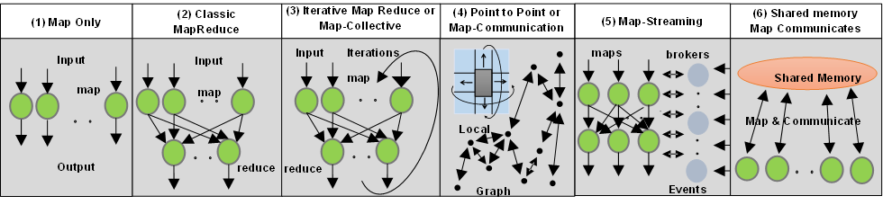
6 Forms of MapReduce cover “all” circumstances
Describes different aspects
- Problem
- Machine
- Software
If these different aspects match, one gets good performance

Slide 6
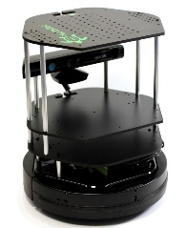
Cloud controlled Robot Data Pipeline
Gateway
Sending to
pub-sub
Sending to
Persisting
to storage
Multiple
streaming
workflows
Streaming
workflow
A stream application with some tasks running in parallel
Message Brokers
RabbitMQ, Kafka
Streaming Workflows
Apache Storm
Apache Storm comes from Twitter and supports Map-Dataflow-Streaming computing model
Key ideas: Pub-Sub, fault-tolerance (Zookeeper), Bolts, Spouts

Slide 7
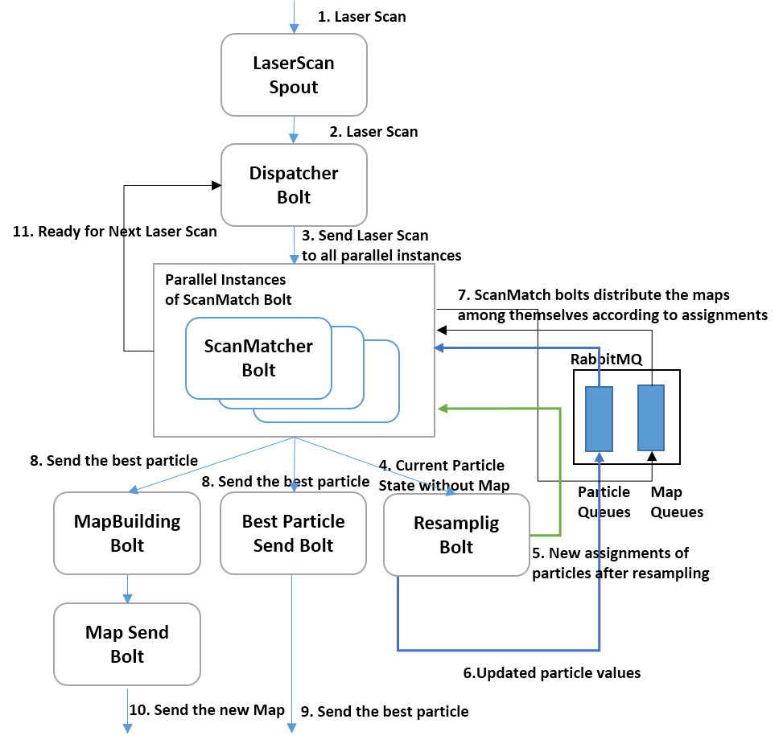
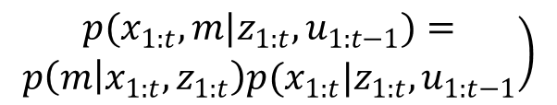
Simultaneous Localization & Mapping (SLAM)
Streaming Workflow
Application
Build a map given the distance measurements from robot to objects around it and its pose
Particles are distributed
in parallel tasks
$$\left.\begin{aligned}p(x_{1:t},m|z_{1:t},u_{1:t−1})= \\ p\left(m | x_{1:t}, z_{1:t}\right)p(x_{1:t}|z_{1:t},u_{1:t−1}\end{aligned}\right)$$
Rao-Blackwellized particle filtering based algorithm for SLAM. Distribute the particles across parallel tasks and compute in parallel.
Map building happens periodically

Slide 8
Parallel SLAM Simultaneous Localization and Mapping by Particle Filtering
Speedup

Slide 9
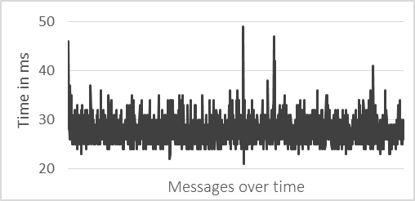
Robot Latency Kafka & RabbitMQ
RabbitMQ versus Kafka
Kinect with
Turtlebot and RabbitMQ

Slide 10
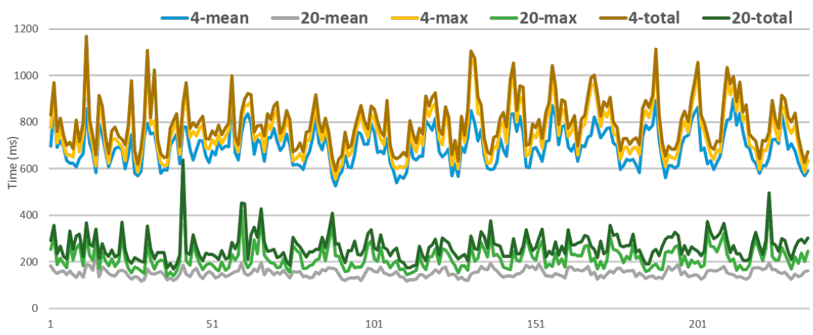
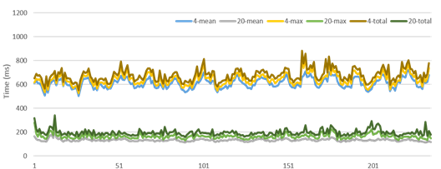
SLAM Latency variations for 4 or 20 way parallelism
Jitter due to Application or System influences such as Network delays, Garbage collection and Scheduling of tasks
No Cut
Fluctuations decrease after Cut on #iterations per swarm member

Slide 11
Fault Tolerance at Message Broker
RabbitMQ supports Queue replication and persistence to disk across nodes for fault tolerance
Can use a cluster of RabbitMQ brokers to achieve high availability and fault tolerance
Kafka stores the messages in disk and supports replication of topics across nodes for fault tolerance. Kafka's storage first approach may increase reliability but can introduce increased latency
Multiple Kafka brokers can be used to achieve high availability and fault tolerance

Slide 12
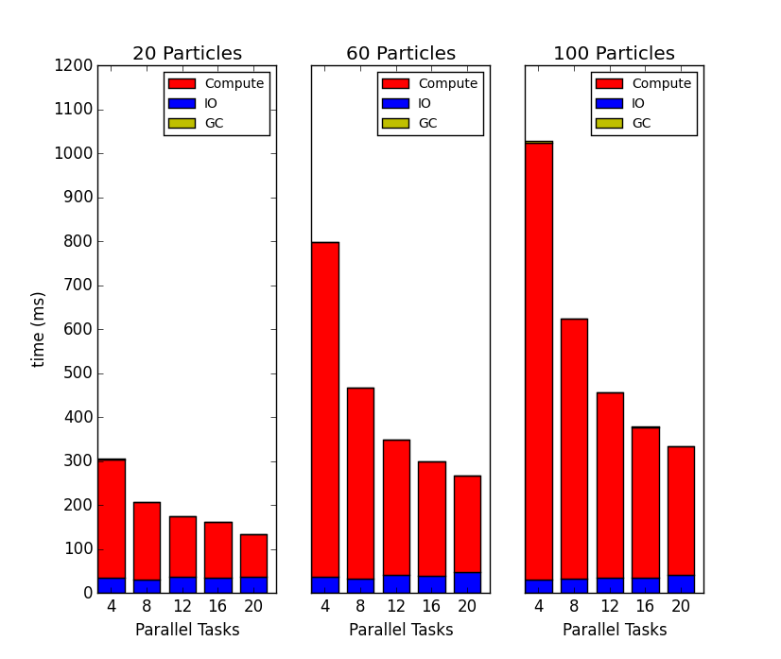
Parallel Overheads SLAM Simultaneous Localization and Mapping: I/O and Garbage Collection

Slide 13
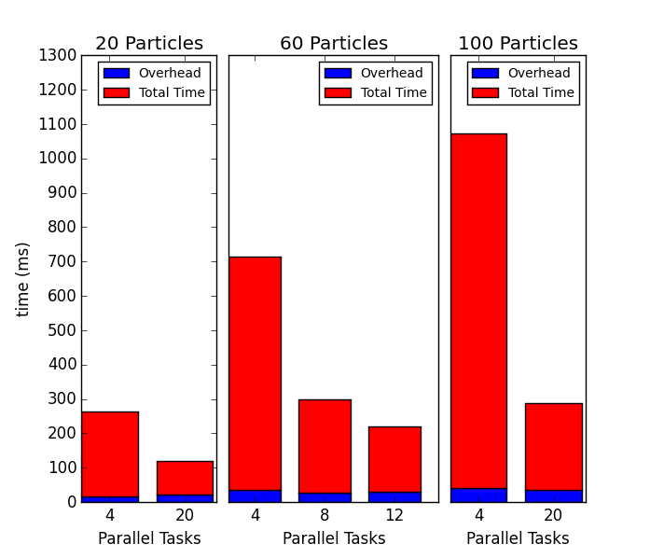
Parallel Overheads SLAM Simultaneous Localization and Mapping: Load Imbalance Overhead

Slide 14
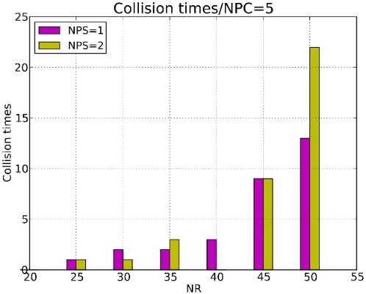
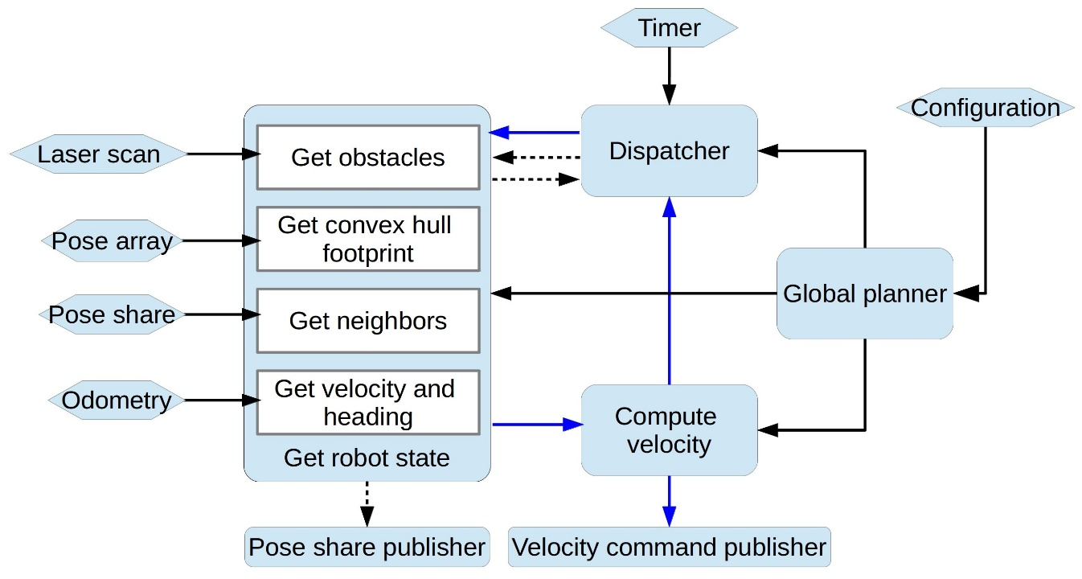
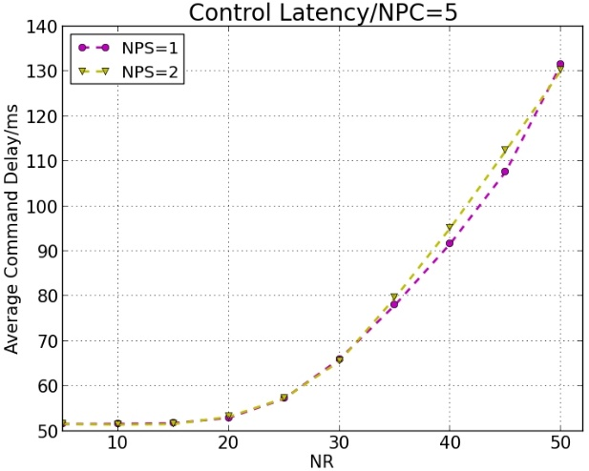
Multi-Robot Collision Avoidance
Second parallel Storm application
Velocity Obstacles (VOs) along with other constrains such as acceleration and max velocity limits,
Non-Holonomic constraints, for differential robots, and localization uncertainty.
NPC NPS measure parallelism
# Collisions versus number of robots
Streaming Workflow
Information from robots
Control Latency
Runs in parallel

Slide 15
Lessons from using Storm
We successfully parallelized Storm as core software of two robot planning applications
We needed to replace Kafka by RabbitMQ to improve performance
  Kafka had large variations in response time
We reduced Garbage Collection overheads
We see that we need to generalize Storm’s
  Map-Dataflow Streaming architecture to
  Map-Dataflow/Collective Streaming architecture
Now we use HPC-ABDS to improve Storm communication performance

Slide 16
Bringing Optimal Communications to Storm
Both process based and thread based
parallelism is used
Node-1
Node-2
Node-1
Node-2
B-1
W-2
W-4
W-6
B-1
W-2
W-4
W-6
W-1
W-3
W-5
W-7
W-1
W-3
W-5
W-7
Worker
Worker
Worker
Worker
Worker
Worker
Worker
Worker
Worker and Task distribution of Storm
A worker hosts multiple tasks. B-1 is a task of component B and W-1 is a task of W
Communication links are between workers
These are multiplexed among the tasks

Slide 17
Memory Mapped File based Communication
Inter process communications using shared memory for a single node
Multiple writer single reader design
A memory mapped file is created for each worker of a node
Create the file under /dev/shm
Writer breaks the message in to packets and puts them to file
Reader reads the packets and assemble the message
When a file becomes full move to another file
PS all of this “well known” BUT not deployed

Slide 18
Optimized Broadcast Algorithms
Binary tree
  Workers arranged in a binary tree
Flat tree
  Broadcast from the origin to 1 worker in each node sequentially. This worker broadcast to other workers in the node sequentially
Bidirectional Rings
  Workers arranged in a line
  Starts two broadcasts from the origin and these traverse half of the line
All well known and we have used similar ideas of basic HPC-ABDS to improve MPI for machine learning (using Java)

Slide 19
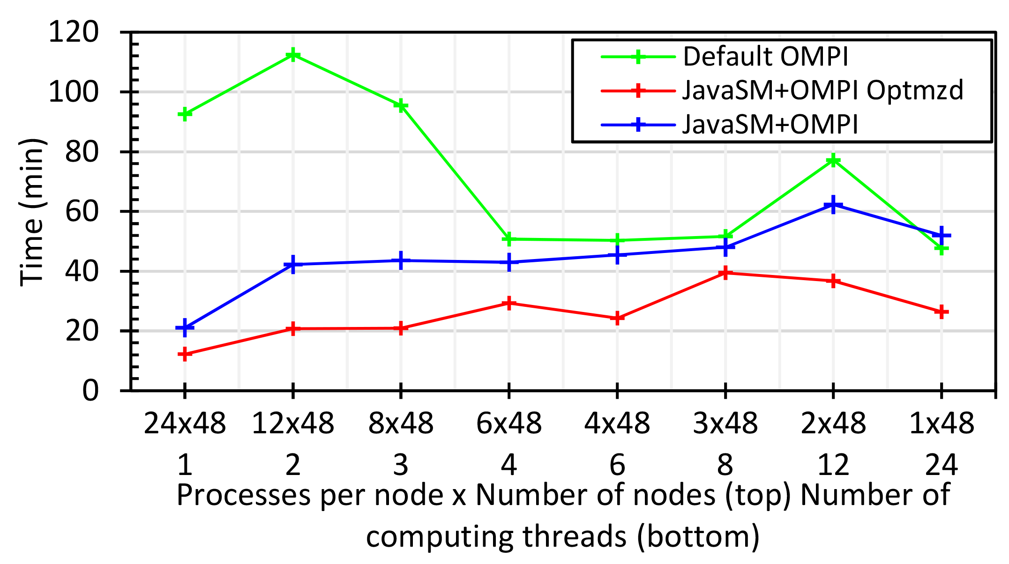
Java MPI performs better than Threads I
128 24 core Haswell nodes with Java Machine Learning
Default MPI much worse than threads
Optimized MPI using shared memory node-based messaging is much better than threads

Slide 20
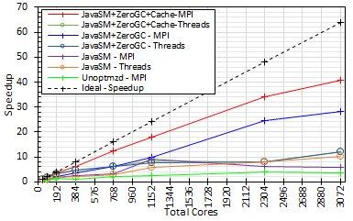
Java MPI performs better than Threads II
128 24 core Haswell nodes
200K Dataset Speedup

Slide 21
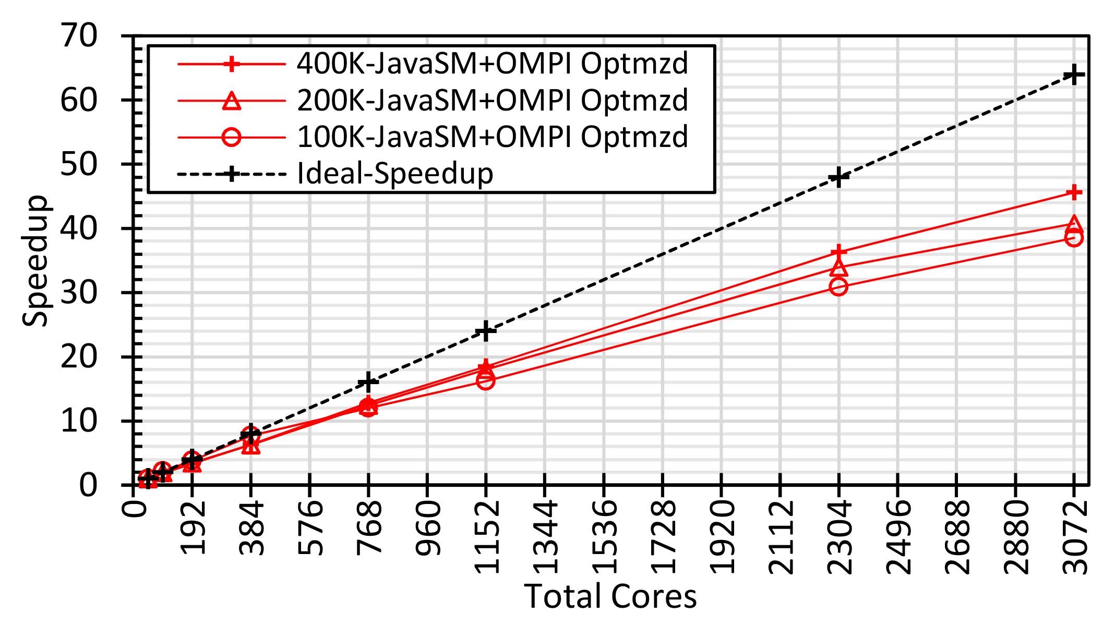
Speedups show classic parallel computing structure with 48 node single core as “sequential”
State of art dimension reduction routine
Speedups improve as problem size increases
48 nodes, 1 core to 128 nodes 24 cores is potential speedup of 64

Slide 22
Experimental Configuration
W-1
RabbitMQ
R-1
B-1
W-5
G-1
RabbitMQ
W-n
Client
11 Node cluster
  1 Node – Nimbus & ZooKeeper
  1 Node – RabbitMQ
  1 Node – Client
  8 Nodes – Supervisors with 4 workers each
  Client sends messages with the current timestamp, the topology returns a response with the same time stamp. Latency = current time - timestamp

Slide 23
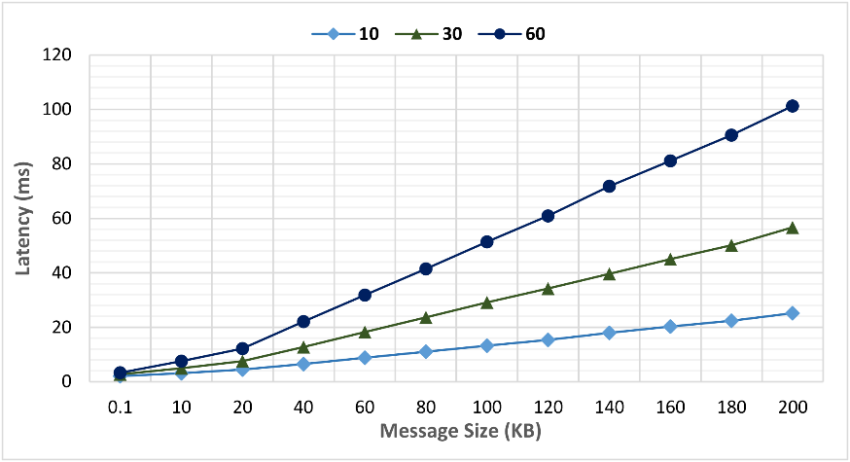
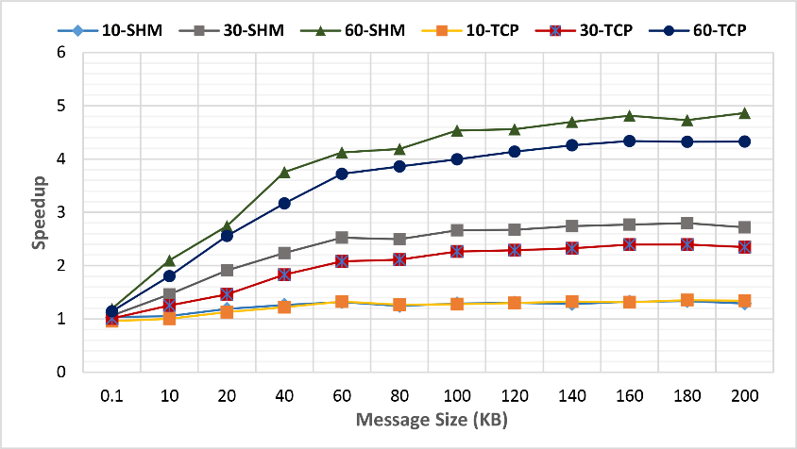
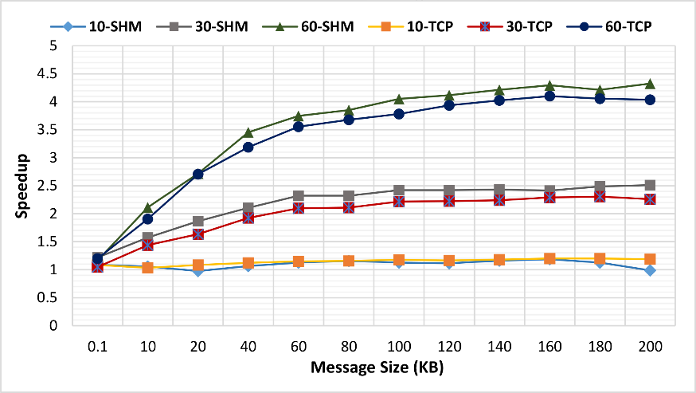
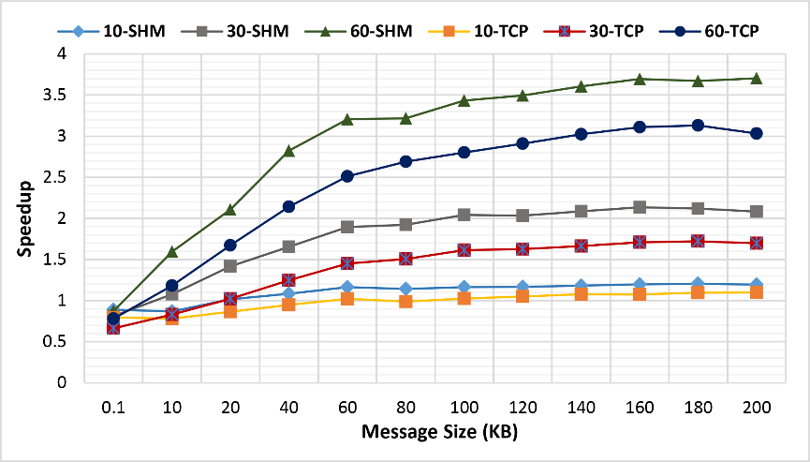
Original and new Storm Broadcast Algorithms
Speedup of latency with both TCP based and Shared Memory based communications for different algorithms and sizes
Binary Tree
Original
Bidirectional
Ring
Flat Tree

Slide 24
Future Work
Memory mapped communications require continuous polling by a thread. If this tread does the processing of the message, the polling overhead can be reduced.
Scheduling of tasks should take the communications in to account
The current processing model has multiple threads processing a message at different stages. Reduce the number of threads to achieve predictable performance
Improve the packet structure to reduce the overhead
Compare with related Java MPI technology
Add additional collectives to those supported by Storm

Slide 25
Conclusions on initial HPC-ABDS use in Apache Storm
Apache Storm worked well with performance enhancements
For Binary tree performed the best
Algorithms reduces the network traffic
Shared memory communications reduce the latency further
Memory mapped file communications improve performance

Slide 26
Thank You
References
  Our software https://github.com/iotcloud
  Apache Storm http://storm.apache.org/
  We will donate software to Storm
  SLAM paper http://dsc.soic.indiana.edu/publications/SLAM_In_the_cloud.pdf
  Collision Avoidance paper http://goo.gl/xdB8LZ

Slide 27
Spare SLAM Slides

Slide 28
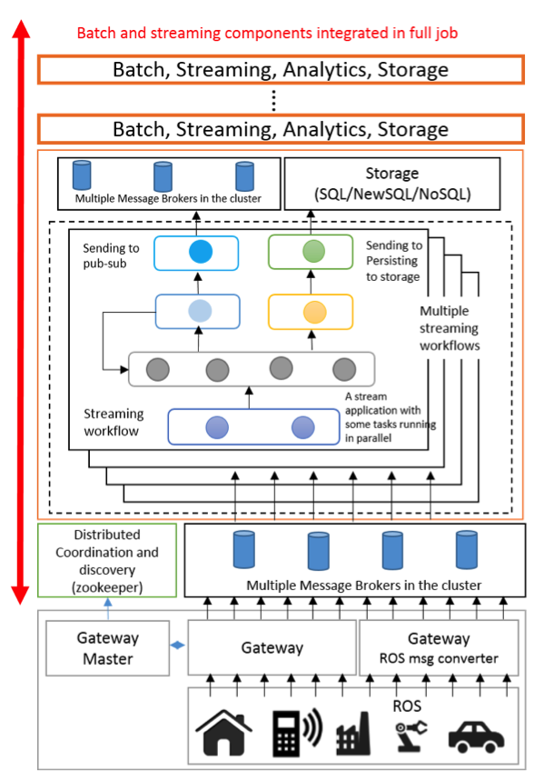
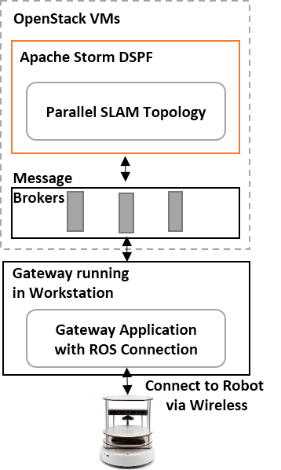
IoTCloud uses Zookeeper, Storm, Hbase, RabbitMQ for robot cloud control
Focus on high performance (parallel) control functions
Guaranteed real time response
Parallel
simultaneous localization and mapping
(SLAM) in the cloud

Slide 29
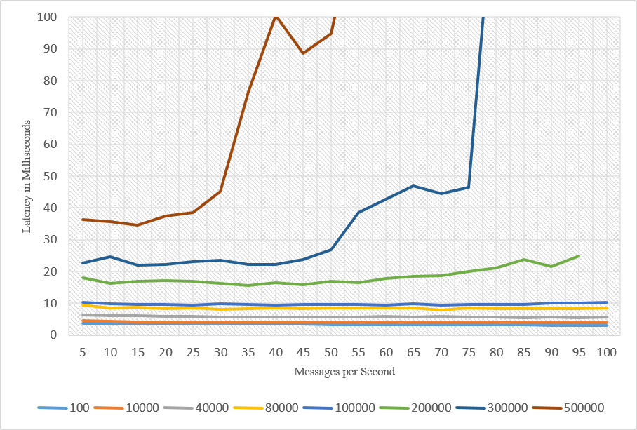
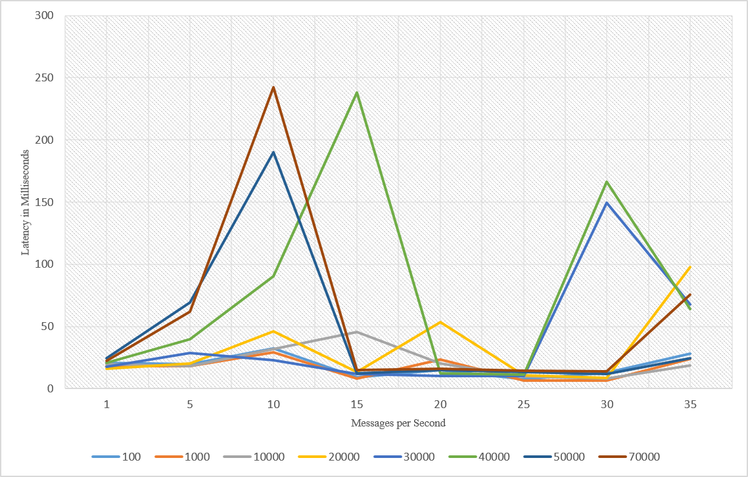
Latency with Kafka
Note change in scales for latency and message size
Latency with RabbitMQ
Different Message sizes in bytes

Slide 30
Robot Latency Kafka & RabbitMQ
RabbitMQ versus Kafka
Kinect with
Turtlebot and RabbitMQ

Slide 31
Parallel SLAM Simultaneous Localization and Mapping by Particle Filtering

Slide 32
Spare High Performance Storm Slides

Slide 33
Memory Mapped Communication
Read packet by packet sequentially
Write
Reader
Writer 01
Obtain the write location atomically and increment
write | Packet 1 | Packet 2 | Packet 3
Writer 02
Write
Shared File
Use a new file when the file size is reached
Reader deletes the files after it reads them fully
Fields
ID | No of Packets | Packet No | Dest Task | Content Length | Source Task | Stream Length | Stream | Content
16 | 4 | 4 | 4 | 4 | 4 | 4
Bytes
Packet Structure

Slide 34
Default Broadcast
Node-1
Node-2
B-1
W-2
W-4
W-6
W-1
W-3
W-5
W-7
Worker
Worker
Worker
Worker
B-1 wants to broadcast a message to W, it sends 6 messages through 3 TCP communication channels and send 1 message to W-1 via shared memory

Slide 35
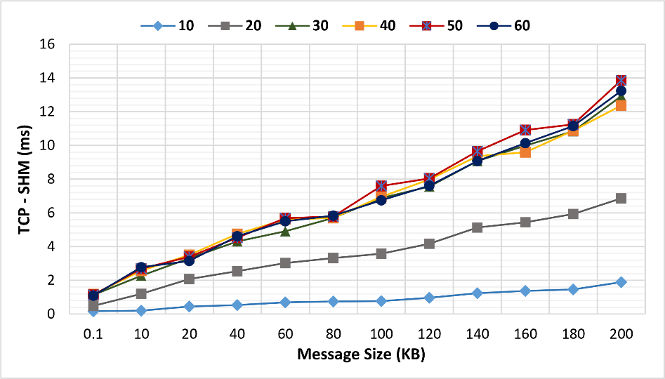
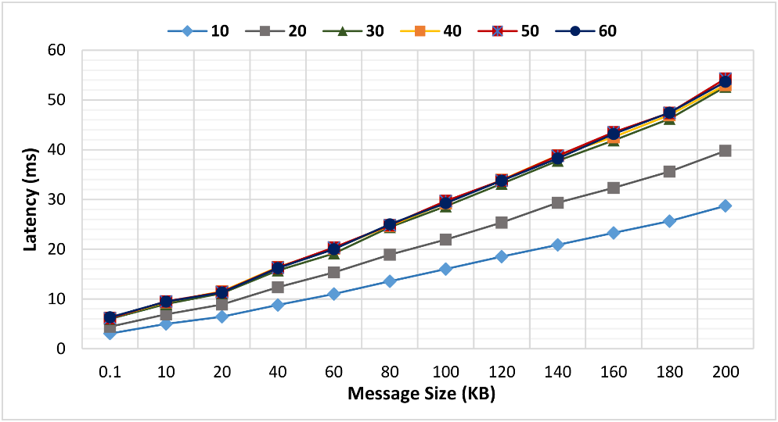
Memory Mapped Communication
A topology with pipeline going through all the workers
No significant difference
because we are using all
the workers in the cluster beyond 30 workers capacity
Non Optimized Time

Slide 36
Spare Parallel Tweet Clustering with Storm Slides

Slide 37
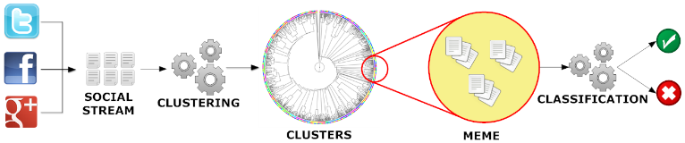
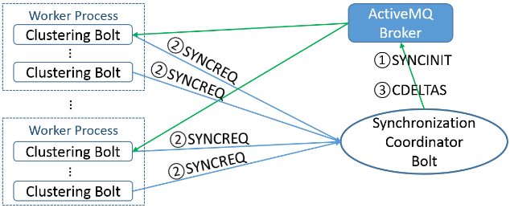
Parallel Tweet Clustering with Storm
Judy Qiu, Emilio Ferrara and Xiaoming Gao
Storm Bolts coordinated by ActiveMQ to synchronize parallel cluster center updates – add loops to Storm
2 million streaming tweets processed in 40 minutes; 35,000 clusters
Sequential
Parallel – eventually 10,000 bolts

Slide 38
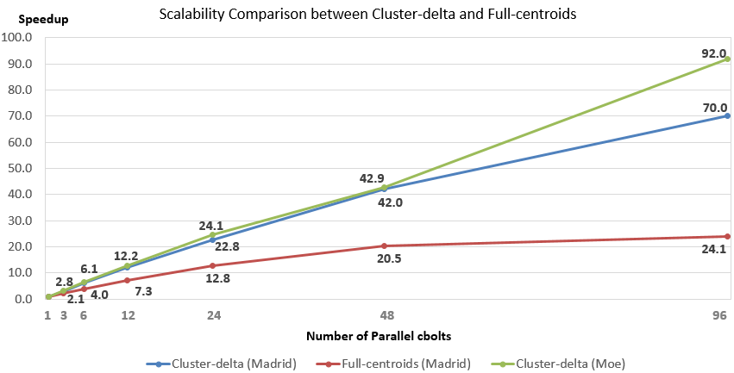
Parallel Tweet Clustering with Storm
Speedup on up to 96 bolts on two clusters Moe and Madrid
Red curve is old algorithm;
green and blue new algorithm
Full Twitter – 1000 way parallelism
Full Everything – 10,000 way parallelism

